Slide 1

Service Models
Choose the service you need.

Slide 2

A Simple Analogy
Say, you just moved to a city and you are looking for a place to live.

Slide 3

What is your choice ?
Built a new house ?
Buy an empty house ?
Live in a hotel ?

Slide 4
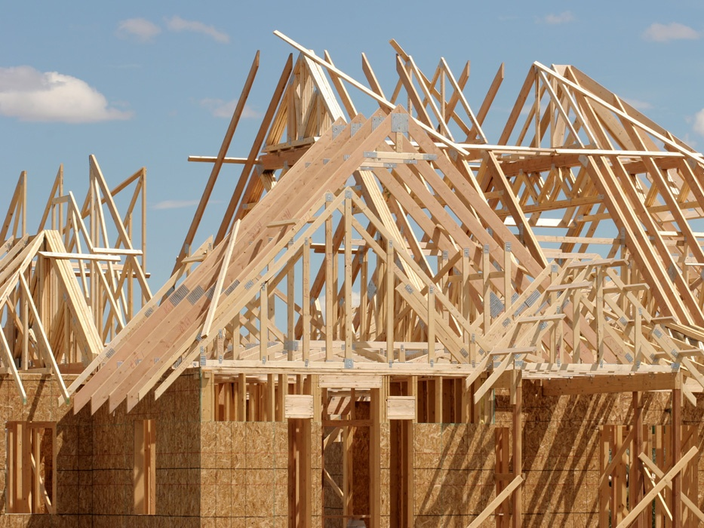
Let’s built a new house !!
You can fully control everything your like your new house to have. But that is a hard work …

Slide 5

If you buy an empty house ?
You can customize some part of your house. But never change the original architecture.

Slide 6

How about live in a hotel ?
Live in a hotel will be a good idea if the only thing you care is enjoy your life!! There is nothing you can do with the house except living in it.

Slide 7
Let’s translate to Cloud Computing !!

Slide 8
Service Models Overview
What if you want to have an IT department ?
Similar to build a new house in previous analogy
You can rent some virtualized infrastructure and build up your own IT system among those resources, which may be fully controlled.
Technical speaking, use the Infrastructure as a Service (IaaS) solution.
Similar to buy an empty house in previous analogy
You can directly develop your IT system through one cloud platform, and do not care about any lower level resource management.
Technical speaking, use the Platform as a Service (PaaS) solution.
Similar to live in a hotel in previous analogy
You can directly use some existed IT system solutions, which were provided by some cloud application service provider, without knowing any detail technique about how these service was achieved.
Technical speaking, use the Software as a Service (SaaS) solution.

Slide 9
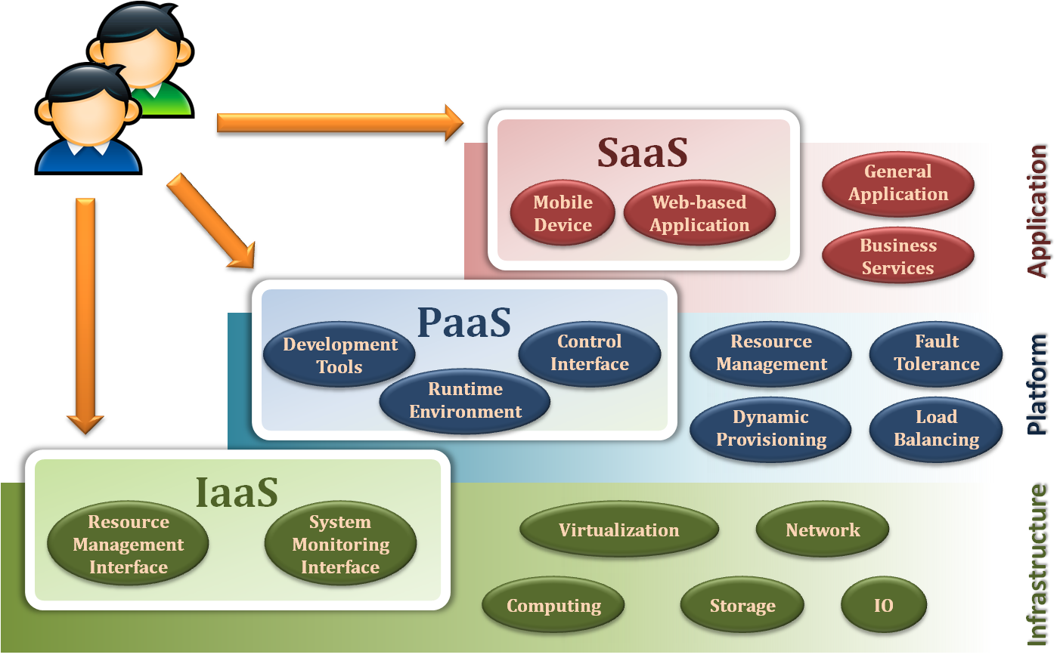
Service Model Overview

Slide 10
Service Models
Infrastructure as a Service
Platform as a Service
Software as a Service

Slide 11
Infrastructure as a Service
Infrastructure as a Service - IaaS
The capability provided to the consumer is to provision processing, storage, networks, and other fundamental computing resources where the consumer is able to deploy and run arbitrary software, which can include operating systems and applications.
The consumer does not manage or control the underlying cloud infrastructure but has control over operating systems, storage, deployed applications, and possibly limited control of select networking components .
Examples :
Amazon EC2
Eucalyputs
OpenNebula
… etc

Slide 12
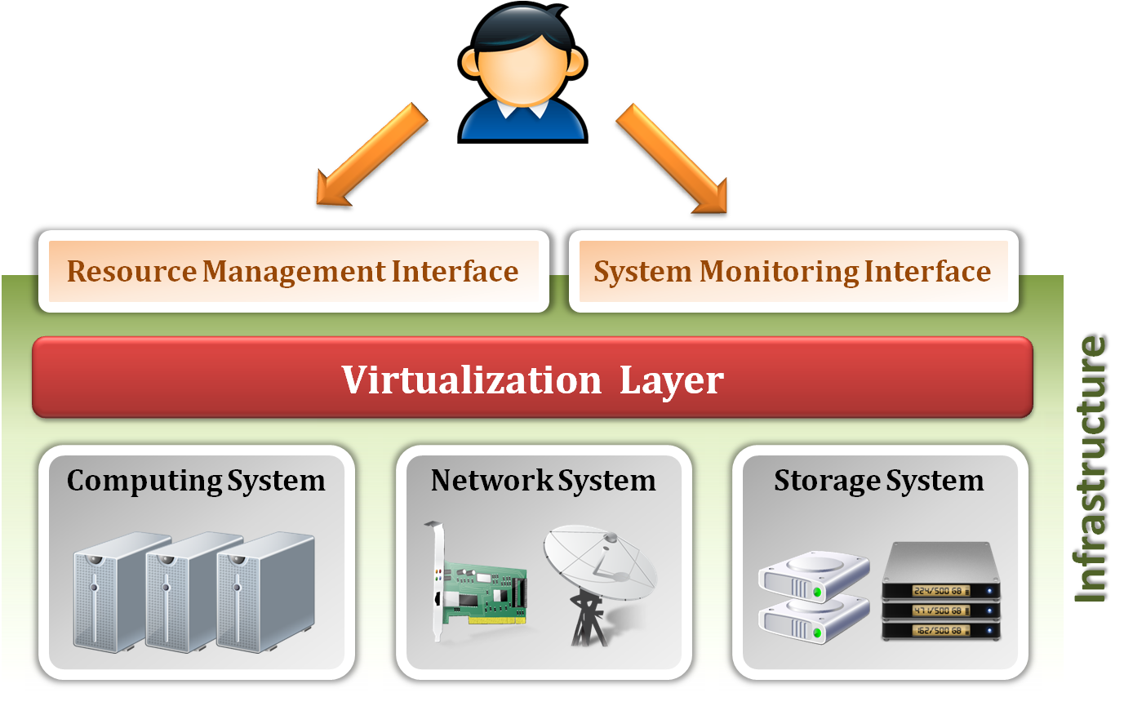
Infrastructure as a Service
System architecture :

Slide 13
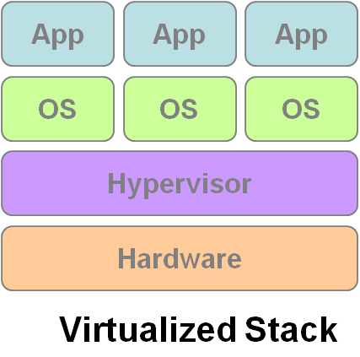
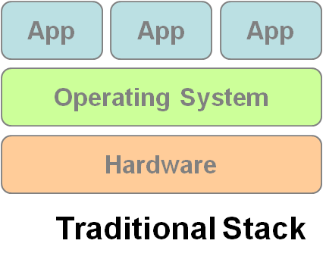
Infrastructure as a Service
Enabling technique - Virtualization
Virtualization is an abstraction of logical resources away from underlying physical resources.
Virtualization technique shift OS onto hypervisor.
Multiple OS share the physical hardware and provide different services.
Improve utilization, availability, security and convenience.
VM1
VM2
VM3

Slide 14
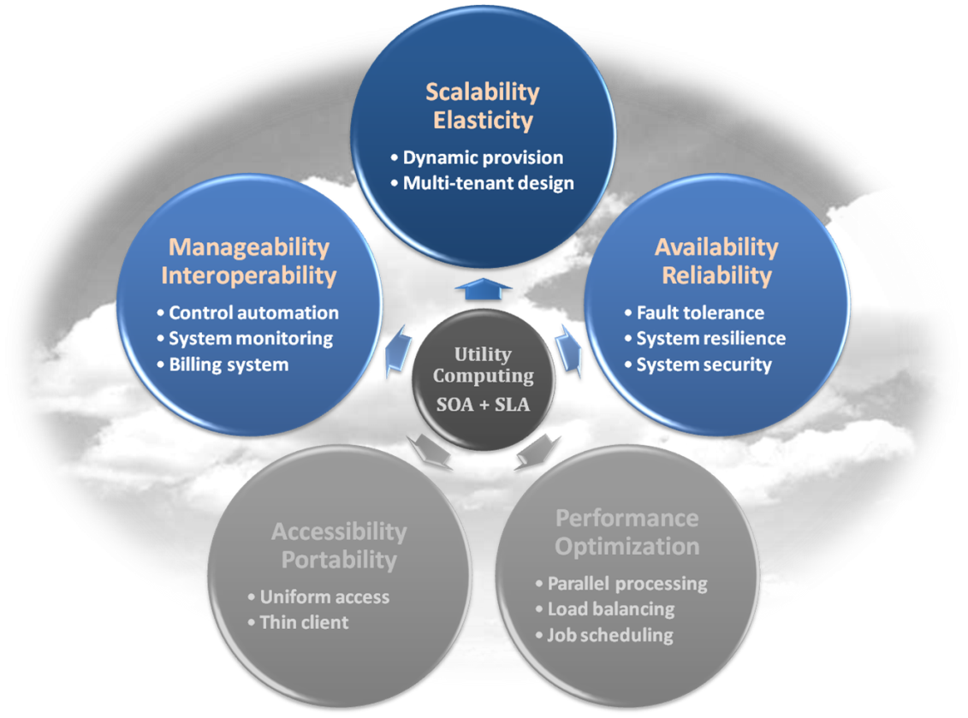
Infrastructure as a Service
Properties supported by virtualization technique :
Manageability and Interoperability
Availability and Reliability
Scalability and Elasticity

Slide 15
Infrastructure as a Service
Provide service –Resource Management Interface
Several types of virtualized resource :
Virtual Machine – As an IaaS provider, we should be able to provide the basic virtual machine operations, such as creation, suspension, resumption and termination, …etc.
Virtual Storage – As an IaaS provider, we should be able to provide the basic virtual storage operations, such as space allocation, space release, data writing and data reading, …etc.
Virtual Network – As an IaaS provider, we should be able to provide the basic virtual network operations, such as IP address allocation, domain name register, connection establishment and bandwidth provision, …etc.

Slide 16
Infrastructure as a Service
Provide service – System Monitoring Interface
Several types of monitoring metrics :
Virtual Machine – As an IaaS provider, we should be able to monitor some system states of each virtual machine, such as CPU loading, memory utilization, IO loading and internal network loading, …etc.
Virtual Storage – As an IaaS provider, we should be able to monitor some storage states of each virtual storage, such as virtual space utilization, data duplication and storage device access bandwidth, …etc.
Virtual Network – As an IaaS provider, we should be able to monitor some network states of each virtual network, such as virtual network bandwidth, network connectivity and network load balancing, …etc.

Slide 17
IaaS - Summary
IaaS is the deployment platform that abstract the infrastructure.
IaaS enabling technique
Virtualization
Server Virtualization
Storage Virtualization
Network Virtualization
IaaS provided services
Resource Management Interface
System Monitoring Interface

Slide 18
Service Models
Infrastructure as a Service
Platform as a Service
Software as a Service

Slide 19
Platform as a Service
Platform as a Service - PaaS
The capability provided to the consumer is to deploy onto the cloud infrastructure consumer-created or acquired applications created using programming languages and tools supported by the provider.
The consumer does not manage or control the underlying cloud infrastructure including network, servers, operating systems, or storage, but has control over the deployed applications and possibly application hosting environment configurations.
Examples :
Microsoft Windows Azure
Google App Engine
Hadoop
… etc

Slide 20
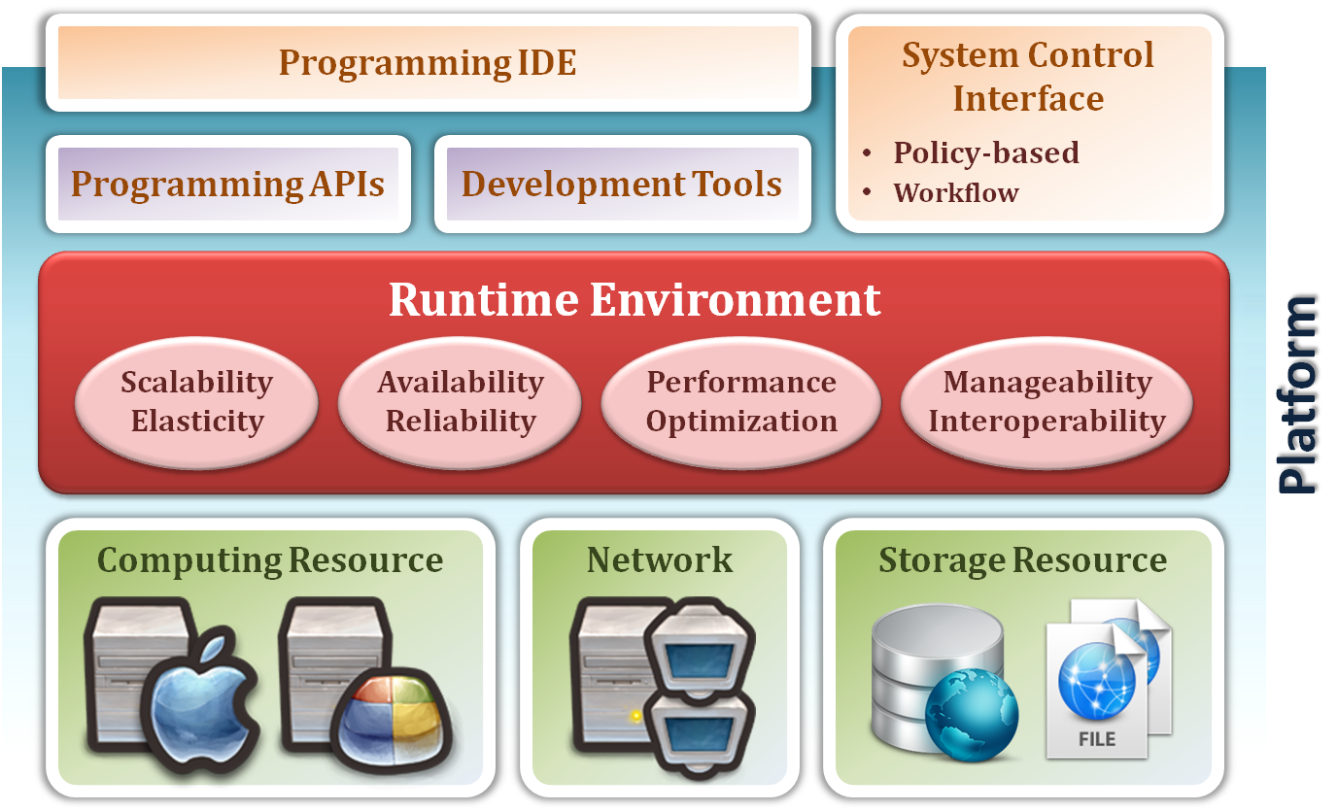
Platform as a Service
System architecture :

Slide 21
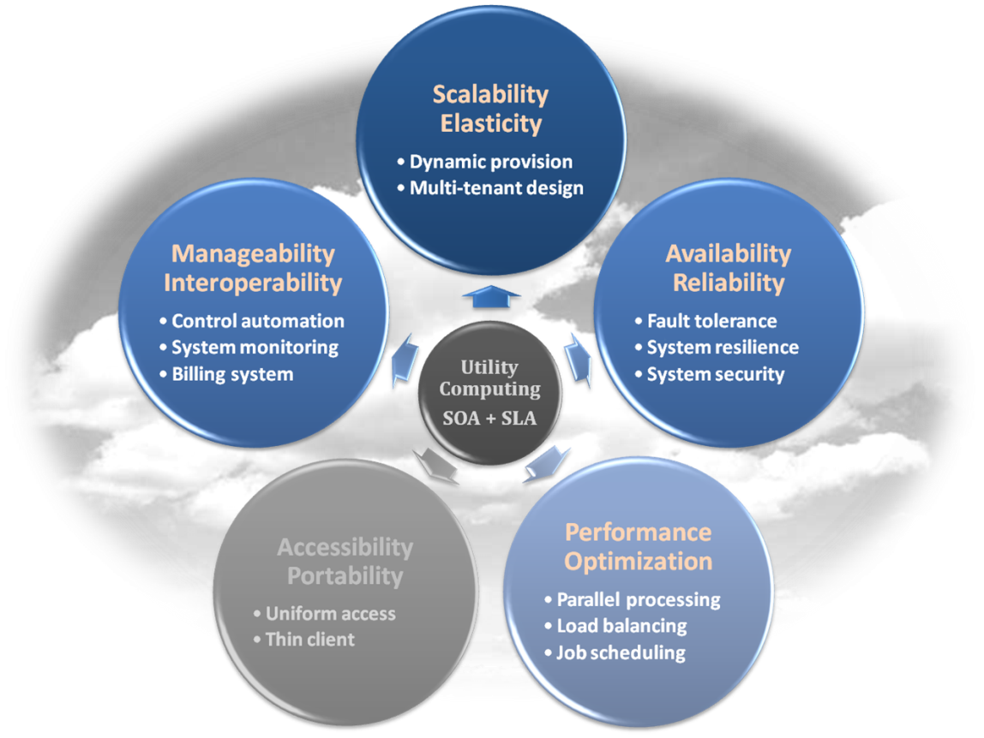
Platform as a Service
Enabling technique – Runtime Environment Design
Runtime environment refers to collection of software services available. Usually implemented by a collection of program libraries.
Common properties in Runtime Environment :
Manageability and Interoperability
Performance and Optimization
Availability and Reliability
Scalability and Elasticity

Slide 22
Platform as a Service
Provide service – Programming IDE
Users make use of programming IDE to develop their service among PaaS.
This IDE should integrate the full functionalities which supported from the underling runtime environment.
This IDE should also provide some development tools, such as profiler, debugger and testing environment.
The programming APIs supported from runtime environment may be various between different cloud providers, but there are still some common operating functions.
Computation, storage and communication resource operation

Slide 23
Platform as a Service
Provide service – System Control Interface
Police-Based Control
Typically described as a principle or rule to guide decisions and achieve rational outcome(s)
Make the decision according to some requirements
Workflow Control
Describe the flow of installation and configuration of resources
Workflow processing daemon delivers speedy and efficient construction and management of cloud resources

Slide 24
PaaS - Summary
PaaS is the development platform that abstract the infrastructure, OS, and middleware to drive developer productivity.
PaaS enabling technique
Runtime Environment
PaaS provide services
Programming IDE
Programming APIs
Development tools
System Control Interface
Policy based approach
Workflow based approach

Slide 25
Service Models
Infrastructure as a Service
Platform as a Service
Software as a Service

Slide 26
Software as a Service
Software as a Service - SaaS
The capability provided to the consumer is to use the provider’s applications running on a cloud infrastructure. The applications are accessible from various client devices through a thin client interface such as a web browser (e.g., web-based email).
The consumer does not manage or control the underlying cloud infrastructure including network, servers, operating systems, storage, or even individual application capabilities, with the possible exception of limited user-specific application configuration settings.
Examples :
Google Apps (e.g., Gmail, Google Docs, Google sites, …etc)
SalesForce.com
EyeOS
… etc

Slide 27
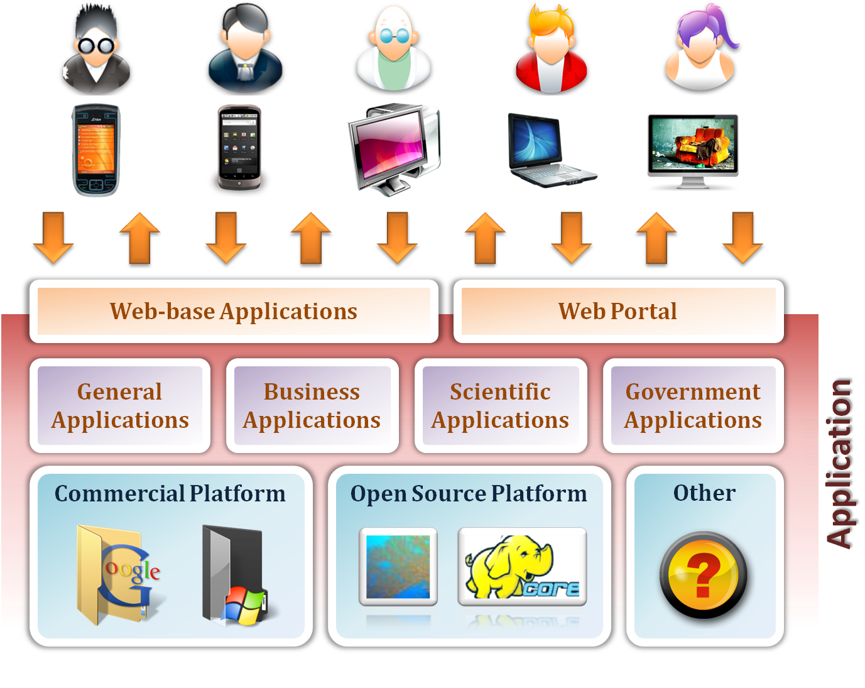
Software as a Service

Slide 28
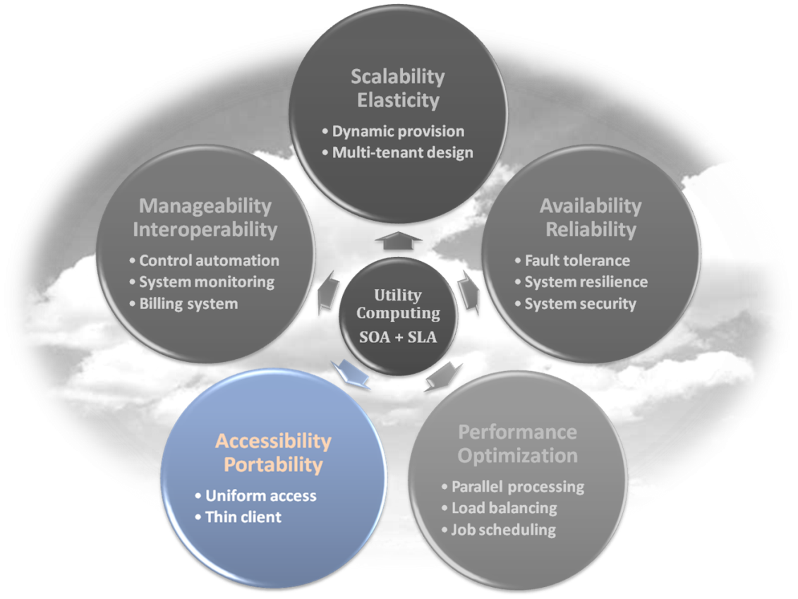
Software as a Service
Enabling Technique – Web Service
Web 2.0 is the trend of using the full potential of the web
Viewing the Internet as a computing platform
Running interactive applications through a web browser
Leveraging interconnectivity and mobility of devices
Enhanced effectiveness with greater human participation
Properties provided by Internet :
Accessibility and Portability

Slide 29
Software as a Service
Provide service – Web-based Applications
Conventional applications should translate their access interface onto web-based platform.
Applications in different domains
General Applications – Applications which are designed for general propose, such as office suit, multimedia and instant message, …etc.
Business Applications – Application which are designed for business propose, such as ERP, CRM and market trading system, …etc.
Scientific Applications – Application which are designed for scientific propose, such as aerospace simulation and biochemistry simulation, …etc.
Government Applications – Applications which are designed for government propose, such as national medical system and public transportation system service, …etc.

Slide 30
Software as a Service
Provide service – Web Portal
Apart from the standard search engine feature, web portals offer other services such as e-mail, news, stock prices, information, databases and entertainment.
Portals provide a way for enterprises to provide a consistent look and feel with access control and procedures for multiple applications and databases, which otherwise would have been different entities altogether.
Some examples :
iGoogle
MSNBC
Netvibes
Yahoo!

Slide 31
SaaS - Summary
SaaS is the finished applications that you rent and customize.
SaaS enabling technique
Web Service
SaaS provide services
Web-based Applications
General applications
Business applications
Scientific applications
Government applications
Web Portal

Slide 32

Deployment models
How to deploy a cloud system ?

Slide 33
Deployment Model
There are four primary cloud deployment models :
Public Cloud
Private Cloud
Community Cloud
Hybrid Cloud
Each can exhibit the previously discussed characteristics; their differences lie primarily in the scope and access of published cloud services, as they are made available to service consumers.

Slide 34
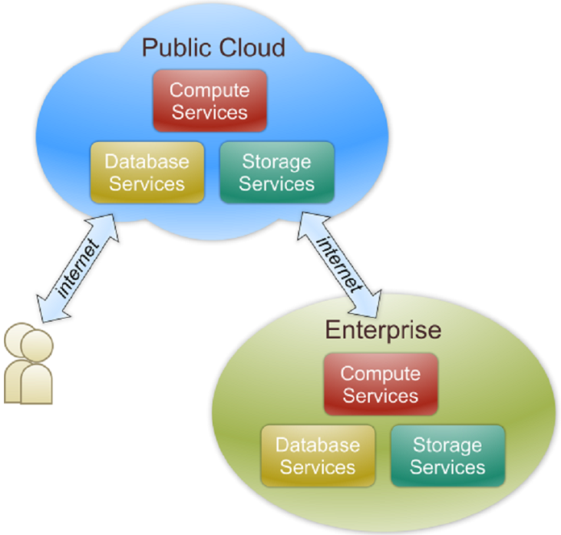
Public Cloud
Public cloud definition
The cloud infrastructure is made available to the general public or a large industry group and is owned by an organization selling cloud services.
Also known as external cloud or multi-tenant cloud, this model essentially represents a cloud environment that is openly accessible.
Basic characteristics :
Homogeneous infrastructure
Common policies
Shared resources and multi-tenant
Leased or rented infrastructure
Economies of scale

Slide 35
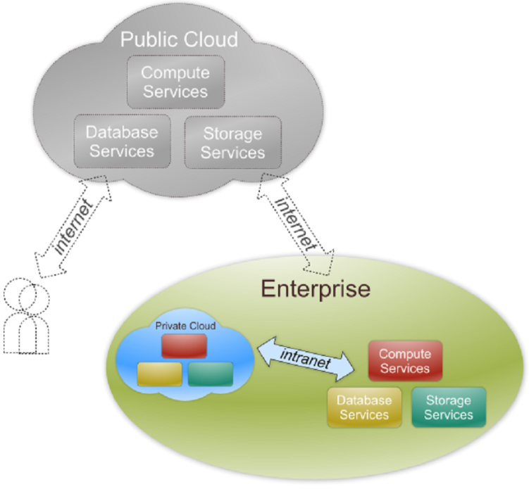
Private Cloud
Private cloud definition
The cloud infrastructure is operated solely for an organization. It may be managed by the organization or a third party and may exist on premise or off premise.
Also referred to as internal cloud or on-premise cloud, a private cloud intentionally limits access to its resources to service consumers that belong to the same organization that owns the cloud.
Basic characteristics :
Heterogeneous infrastructure
Customized and tailored policies
Dedicated resources
In-house infrastructure
End-to-end control

Slide 36
Public vs. Private
Comparison :
 | Public Cloud | Private Cloud
Infrastructure | Homogeneous | Heterogeneous
Policy Model | Common defined | Customized & Tailored
Resource Model | Shared & Multi-tenant | Dedicated
Cost Model | Operational expenditure | Capital expenditure
Economy Model | Large economy of scale | End-to-end control

Slide 37
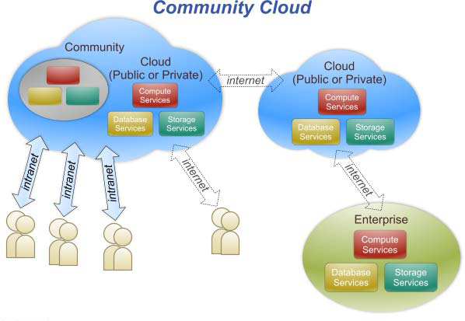
Community Cloud
Community cloud definition
The cloud infrastructure is shared by several organizations and supports a specific community that has shared concerns (e.g., mission, security requirements, policy, and compliance considerations).

Slide 38
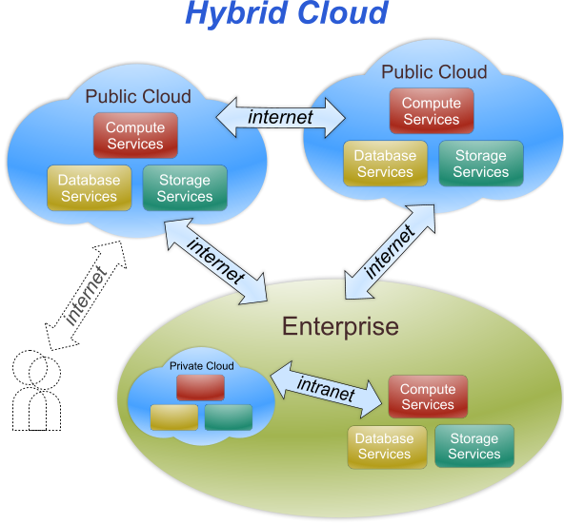
Hybrid Cloud
Hybrid cloud definition
The cloud infrastructure is a composition of two or more clouds (private, community, or public) that remain unique entities but are bound together by standardized or proprietary technology that enables data and application portability (e.g., cloud bursting for load-balancing between clouds).

Slide 39
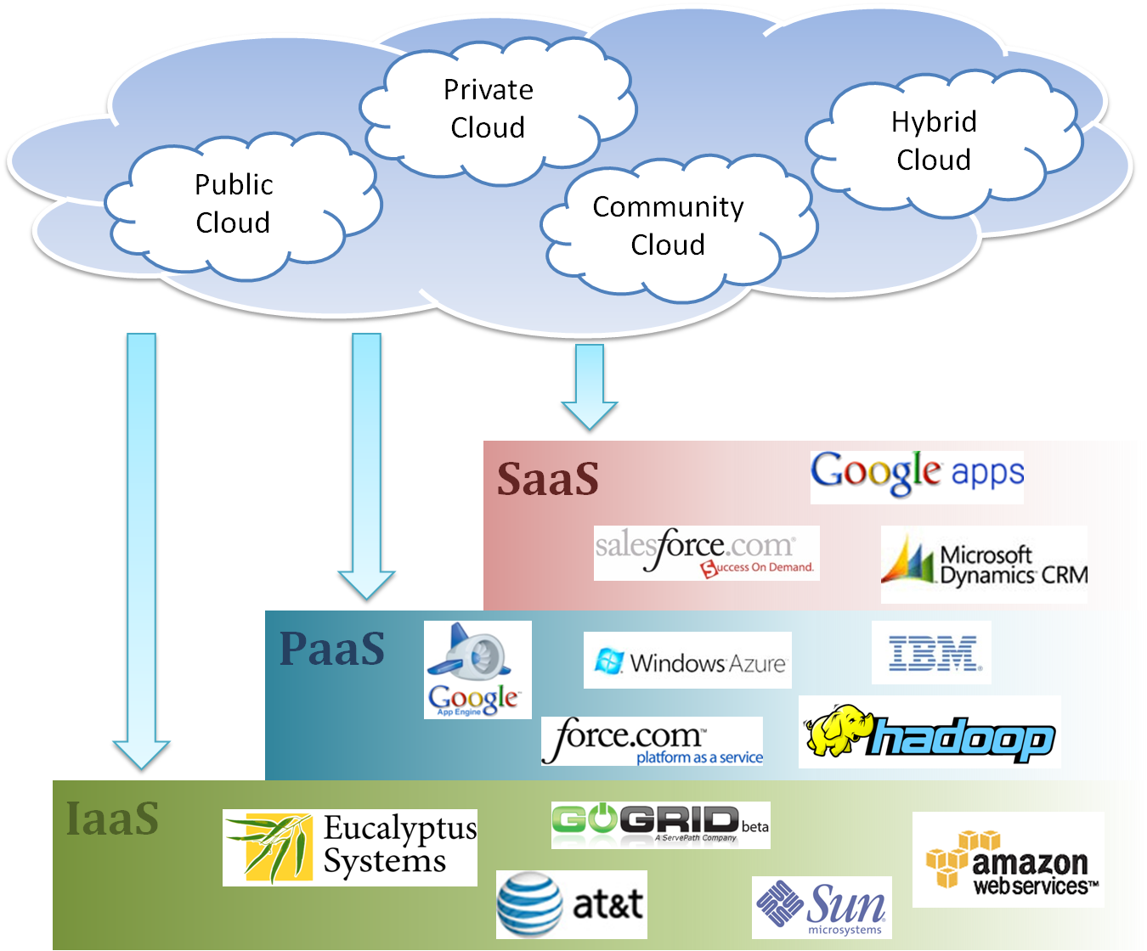
Cloud Ecosystem

Slide 40
Summary
What is cloud computing in your mind
Clear or Cloudy?
Cloud computing is a new paradigm shift of computing
Cloud computing can provide high quality of properties and characteristics based on essentially central ideas
Service models and deployment models provide services that can be used to
Rent fundamental computing resources
Deploy and develop customer-created applications on clouds
Access provider’s applications over network (wired or wireless)

Slide 41
Architectural Layers of Cloud Computing
In the cloud computing stack, there are three basic layers
that together create cloud environment. They are:
Infrastructure as a Service(IaaS)
Platform as a Service (PaaS)
Software as a Service (SaaS)
SaaS
PaaS
IaaS

Slide 42
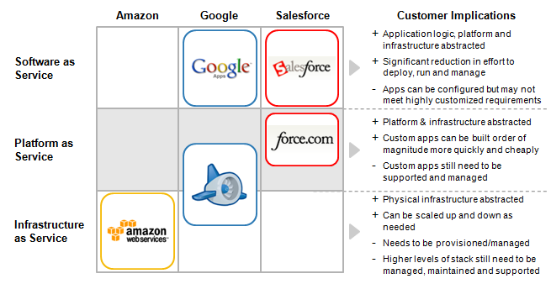
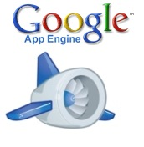
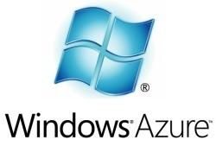
Service Delivery Model Examples
Amazon
Google
Microsoft
Salesforce
SaaS
PaaS
IaaS
Products and companies shown for illustrative purposes only and should not be construed as an endorsement

Slide 43
Framework of cloud computing
Application
Services and built in functionality
Developments tools
Platform
Basic middleware
(database services , application server )
Virtualized resources
Virtualized images
Infrastructure
Compute
Networking
Image Metadata
Storage
Image
Software kernel (OS. VM Manager)
Hardware

Slide 44
Virtual infrastructure management and Cloud Computing
For building the cloud environment a variety of requirements must be met to provide a uniform and homogeneous view of the virtualized resources.
Virtual Infrastructure Management is the key component to build the cloud environment which does the dynamic orchestration of virtual machines on a pool of physical resources.

Slide 45
Virtual infrastructure management and Cloud Computing
Virtual infrastructure management provide primitives to schedule and manage VMs across multiple physical hosts.
Cloud management provide remote and secure interface for creating controlling and monitoring virtualized resources on IaaS.

Slide 46
View of Cloud Deployment
Cloud Application
Client
Infrastructure
Application
Virtualized Application
SaaS
Service
PaaS
Platform
IaaS
Storage
Infrastructure

Slide 47
Software as a Service
It is a Deployment/Delivery model
Hosted and managed by vendor
Delivered across the internet
It is a Business Model : usage-based pricing(vs. perpetual license model of on –premise software).Examples:
Per user per month
Per transaction
Per GB of storage per month

Slide 48
Software as a Service
Architectural
Multi-tenancy
Scalability
Security
Performance
Functional
Provisioning
Billing
Metering
Monitoring

Slide 49
MULTI-TENANCY
Multi-tenancy is an architectural pattern
A single instance of the software is run on the service provider’s infrastructure
Multiple tenants access the same instance.
In contrast to the multi-user model, multi-tenancy requires customizing the single instance according to the multi-faceted requirements of many tenants.

Slide 50
MULTI-TENANCY
A Multi-tenants application lets customers (tenants) share the same hardware resources, by offering them one shared application and database instance ,while allowing them to configure the application to fit there needs as if it runs on dedicated environment.
These definition focus on what we believe to be the key aspects of multi tenancy:
The ability of the application to share hardware resources.
The offering of a high degree of configurability of the software.
The architectural approach in which the tenants make use of a single application and database instance.

Slide 51
Multi-tenants Deployment Modes for Application Server
Fully isolated Application server Each tenant accesses an application server running on a dedicated servers.
Virtualized Application Server Each tenant accesses a dedicated application running on a separate virtual machine.
Shared Virtual Server Each tenant accesses a dedicated application server running on a shared virtual machine.
Shared Application Server The tenant shared the application server and access application resources through separate session or threads.
Application Server
Tenant A
Tenant B
Application server
Application server
Virtual machine
Tenant A
Virtual machine
Tenant B
Application server
Tenant A
Virtual machine
Tenant B
Session thread
Tenant A
Application Server
Tenant B
Session Thread

Slide 52
Multi-tenants Deployment Modes in Data Centers
Fully isolated data center The tenants do not share any data center resources
Virtualized servers The tenants share the same host but access different databases running on separate virtual machines
Shared Server The tenants share the same server (Hostname or IP) but access different databases
Shared Database The tenants share the same server and database (shared or different ports) but access different schema(tables)
Shared Schema The tenants share the same server, database and schema (tables). The irrespective data is segregated by key and rows.
Tenant A
Tenant B
Virtual
Machine
Database
Tenant A
Virtual
Machine
Database
Tenant B
Tenant A
Tenant B
Tenant A
Tenant B
Tenant A
Tenant B

Slide 53
Conceptual framework of Software as a Service
Presentation
Menu and Navigation
User Controls
Display and Rendering
Reporting
Security
Application Engine
Operation
Identity and federation
Monitoring and Altering
User Profile
Workflow
Authentication and Single Sign on
Notification and Subscription
Execution Handling
Backup and Restore
Authorization and Role-based Access Control
Metadata Execution Engine
Orchestration
Provisioning
Configuration and Customization
Entitlement
Metadata Services
Performance and Availability
Encryption
Data Synchronization
Messaging
Metering and Indicators
Regularity Controls
Infrastructure
Database
Storage
Computer
Networking and Communications

Slide 54
Migrating to Cloud Environment
The Software can be redeployed in cloud environment as Software as a Service (SaaS). The main sections of the software can be mapped to the SaaS architecture.

Slide 55
Payroll Processing in Cloud Computing
Many State Government departments are utilizing standardized set up of payroll packages which are deployed at user locations and it is amounting huge investment on procurement of hardware and software and maintenance for various locations of the organization.

Slide 56
Payroll Software Installed at more than 300 locations
User
Software Module
Standalone Loaded on PC

Slide 57
Drawbacks
Drawbacks :
Software Maintenance problems.
Individual Hardware is required.
Often Data Loss occurs.

Slide 58
Migrating the payroll package, to cloud environment can be worked out without changing business logic.

Slide 59
IN CLOUD
User-1
Software
Module
Single Instance
Multi-tenancy
User-3
User-1

Slide 60
Architectural Overview for Multi-tenancy
Client
HTTP
Request
Authentication
Ticket Server
Authentication Module
Create Ticket()
Session Ticket
Tenant Token
Tenant Auth
Data
+ Create Ticket()
Configuration
Single-tenant business logic
Layout Component
Configuration Component
Tenant Config
Data
Query
Data
File I/O Component
Workflow Component
Database
Query Adjuster
Load Balancer
Record Initializer
Database Pool
Data
Data
Data

Slide 61
Provisioning for new tenants
For Separate server model new machine is to be installed.
For separate database model create a database start it on a server.
For separate schema and shared schema models
scripts / stored procedure could create new schema in one of the existing databases.

Slide 62
Background of the Application
The existing application, which is implemented in state government departments, is having the following main sections:
Data admin
Master data entry
Month process
Token no. entry
Reports
Back up to system
The existing package is deployed in the user premises and found difficult in regular software maintenance and overhead costs for the infrastructure requirements.

Slide 63
The application is ideally suited to deploy in cloud environment with following features:
The application can be taken up as a single instance and multi-tenant model
Configurability option in the software is required to be provided.
Configurability in SaaS enables the flexibility to access the software by many tenants with the option of configuring each tenant for their application needs.
The software will have configurability for the following :
User interface.
Workflow.
Data.
Access control.

Slide 64
SaaS Applications
User requirements / Use cases | Type of environment in cloud | Impact
Payroll processing | IaaS (VM) Cloud storage and SaaS | 1. Processing time will be reduced. 2. Hardware requirements will be reduced. 3. Number of users can be increased with scalability. 4. Maintenance cost will be reduced.
Project Management | PaaS and Cloud storage | 1. Processing time can be reduced. 2. Project execution time and cost can be reduced. 3. Efficient way of utilization of skill sets and manpower can be attained.
e-Governance & Office automation | IaaS Cloud storage SaaS | 1. Hardware cost can be reduced. 2. CPU processing time can be reduced. 3. Accountability can be maintained. 4. Maintainance cost can be reduced. 5. Reduces energy consumption.
e-Learning | Cloud storage IaaS PaaS SaaS | 1. Hardware cost can be reduced. 2. CPU processing time can be reduced. 3. Accountability can be maintained. 4. Maintainance cost can be reduced.

Slide 65
SOA and Cloud Computing
In cloud environment we adopt the bundling of resources into layers of
Saas
Paas
Iaas
And further add a layer for business process management with the concept of service oriented architecture(SOA).
SOA is a base for further building of cloud environment for composite application with work flow concepts.

Slide 66

Thank You

