Slide 1
Divide & Conquer Algorithm
- Dr. Varsha R.Dange

Slide 2
Contents:-
Divide and conquer
General strategy of divide and conquer
examples binary search,
quick sort-best case, worst case and average case time complexities,
merge sort and analysis,
finding majority element and analysis,
finding simultaneous maximum and minimum,
selection problem

Slide 3
Divide and Conquer Algorithm
A divide and conquer algorithm is a strategy of solving a large problem by
breaking the problem into smaller sub-problems
solving the sub-problems, and
combining them to get the desired output.
To use the divide and conquer algorithm, recursion is used.

Slide 4
How Divide and Conquer Algorithms Work?
Here are the steps involved:
Divide: Divide the given problem into sub-problems using recursion.
Conquer: Solve the smaller sub-problems recursively. If the sub problem is small enough, then solve it directly.
Combine: Combine the solutions of the sub-problems that are part of the recursive process to solve the actual problem.

Slide 5
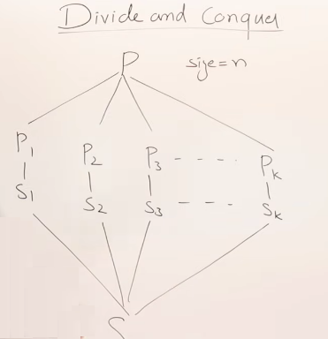
Here after diving a problem into sub-problem then sub-problems remains same as main problem

Slide 6
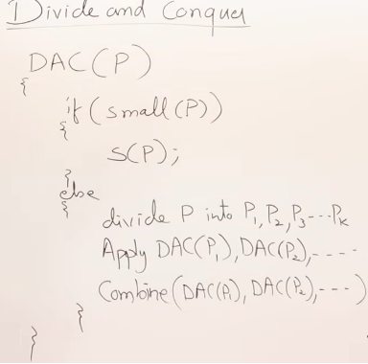
General method for divide & conquer strategy

Slide 7
The following computer algorithms are based on divide-and-conquer programming approach −
Max-Min Problem
Merge Sort Algorithm
Quick Sort Algorithm
Binary Search Algorithm
Strassen's Matrix Multiplication
Karatsuba Algorithm
Closest pair (points)

Slide 8

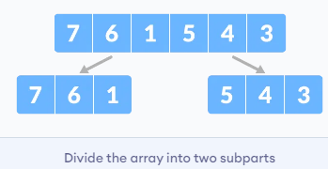
Divide and Conquer Algorithms Example
we will sort an array using the divide and conquer approach
Divide the array into two halves.

Slide 9
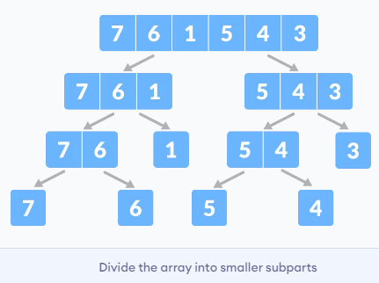
Divide and Conquer Algorithms Example
Again, divide each subpart recursively into two halves until you get individual elements.

Slide 10
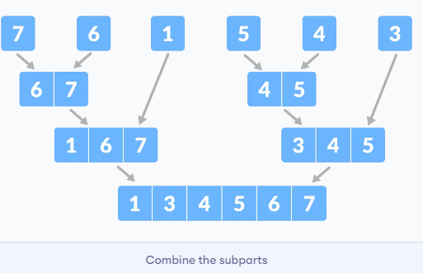
Divide and Conquer Algorithms Example
3. Now, combine the individual elements in a sorted manner. Here conquer and combine steps go side by side.

Slide 11
Binary Search
Binary search is an efficient algorithm used to find a specific element in a sorted array or list.
It operates by repeatedly dividing the search interval in half until the target value is found or the interval is empty.
In this approach, the element is always searched in the middle of a portion of an array.

Slide 12
How Binary Search Works:
Initialization: Start with two pointers, low and high, representing the bounds of the search interval.
Initially, low is set to the first index (0), and high is set to the last index (n-1) of the array.
Iteration: While low is less than or equal to high:
Calculate the middle index: mid = (low + high) / 2.
Compare the middle element (arr[mid]) with the target value:
If arr[mid] equals the target, the search is successful, and the index mid is returned.
If arr[mid] is less than the target, adjust the low pointer to mid + 1 to search the right half.
If arr[mid] is greater than the target, adjust the high pointer to mid - 1 to search the left half.

Slide 13
How Binary Search Works:
Termination: If low exceeds high, the target is not present in the array, and the search returns -1 or indicates failure.(means element to be search is not present in arr)

Slide 14
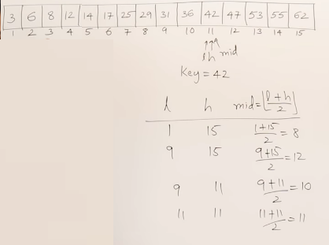

Slide 15
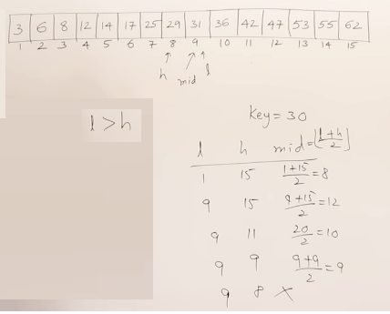

Slide 16
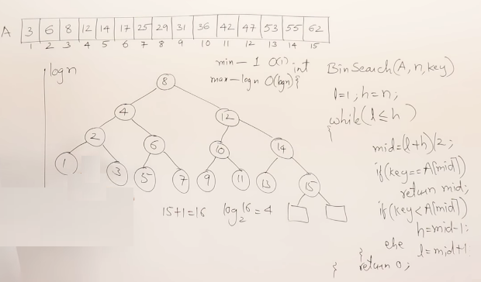

Slide 17

Analysis:
Input: an array A of size n, already sorted in the ascending or descending order. k
Output: analyze to search an element item in the sorted array of size n.
Logic: Let T (n) = number of comparisons of an item with n elements in a sorted array.
Set BEG = 1 and END = n . Find mid =
Compare the search item with the mid item.
Case 1: item = A[mid], then LOC = mid, but it the best case and T (n) = 1
Case 2: item ≠A [mid], then we will split the array into two equal parts of size . And again find the midpoint of the half-sorted array and compare with search element.
Repeat the same process until a search element is found.
T (n) = T(n/2)+1...... (Equation 1)
{Time to compare the search element with mid element, then with half of the selected half part of array}

Slide 18
// Recursive function for binary search
binarySearch(int arr[], int low, int high, int target) {
if (low <= high) {
int mid = low + (high - low) / 2;
If (arr[mid] == key)
return mid;
// If key is smaller than mid, search the left subarray
if (key < arr[mid] )
binarySearch(arr, low, mid - 1, key);
// If key is larger than mid, search the right subarray
binarySearch(arr, mid + 1, high, key);
}
//key is not present in the array
return -1;
}

Slide 19
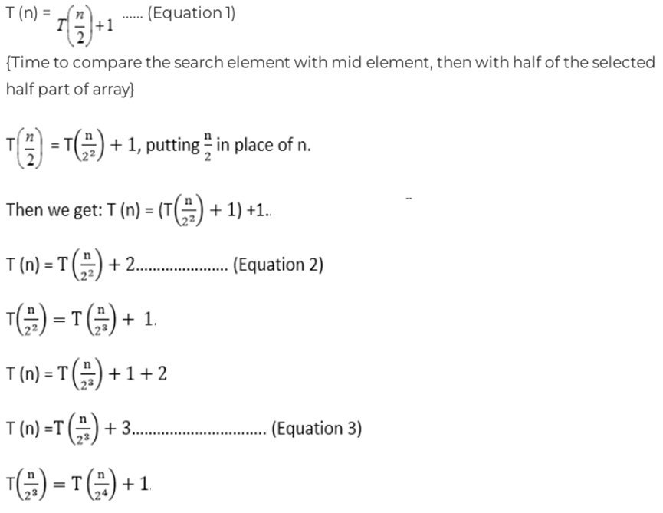

Slide 20
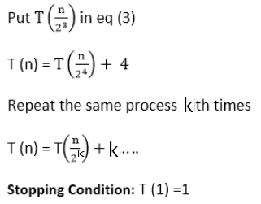

Slide 21

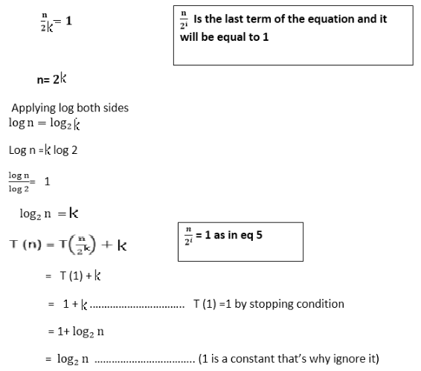


Slide 22
Time Complexity Analysis:
Worst-Case Scenario: In the worst case, the target element is not present in the array, or it is located at the first or last position. The while loop will continue halving the search space until the interval is reduced to a single element. The number of iterations required is proportional to the logarithm (base 2) of the number of elements, denoted as log₂(n). Therefore, the worst-case time complexity is O(log n).
Best-Case Scenario: In the best case, the target element is located at the middle of the array during the first comparison. In this situation, the while loop executes only once, resulting in a time complexity of O(1).
Average-Case Scenario: On average, the target element could be located at any position within the array. Due to the halving nature of the search space, the average number of iterations still scales logarithmically with the number of elements, leading to an average-case time complexity of O(log n).

Slide 23
Merge Sort
The Merge Sort algorithm is a divide-and-conquer algorithm that sorts an array by first breaking it down into smaller arrays, and then building the array back together the correct way so that it is sorted.
Divide: The algorithm starts with breaking up the array into smaller and smaller pieces until one such sub-array only consists of one element.
Conquer: The algorithm merges the small pieces of the array back together by putting the lowest values first, resulting in a sorted array.
The breaking down and building up of the array to sort the array is done recursively.

Slide 24
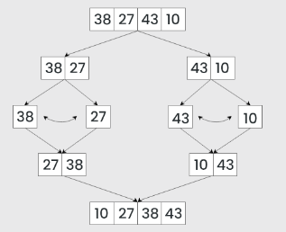
Let’s look at the working of above example:
Divide:
[38, 27, 43, 10] is divided into [38, 27 ] and [43, 10] .
[38, 27] is divided into [38] and [27] .
[43, 10] is divided into [43] and [10] .
Conquer:
[38] is already sorted.
[27] is already sorted.
[43] is already sorted.
[10] is already sorted.
Merge:
Merge [38] and [27] to get [27, 38] .
Merge [43] and [10] to get [10,43] .
Merge [27, 38] and [10,43] to get the final sorted list [10, 27, 38, 43]
Therefore, the sorted list is [10, 27, 38, 43] .

Slide 25
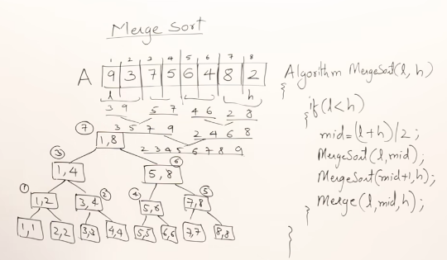

Slide 26
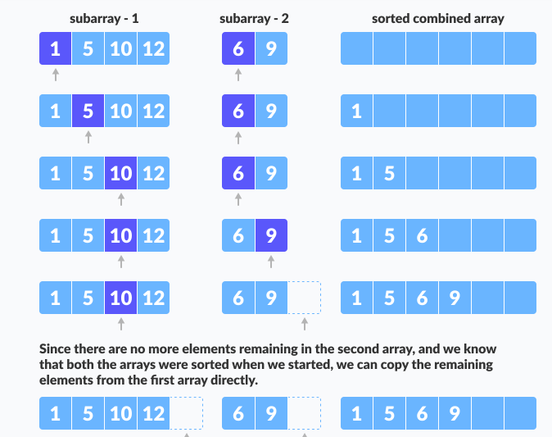
Merge operation

Slide 27
Mergersort
void mergeSort(int arr[], int left, int right)
{ if (left < right)
{
int mid = left + (right - left) / 2;
mergeSort(arr, left, mid);
mergeSort(arr, mid + 1, right);
merge(arr, left, mid, right);
} }

Slide 28
merge function
The merge function works as follows:
Create copies of the subarrays L <- A[p..q] and M <- A[q+1..r].
Create three pointers i, j and k
i maintains current index of L, starting at 1
j maintains current index of M, starting at 1
k maintains the current index of A[p..q], starting at p.
Until we reach the end of either L or M, pick the larger among the elements from L and M and place them in the correct position at A[p..q]
When we run out of elements in either L or M, pick up the remaining elements and put in A[p..q]

Slide 29
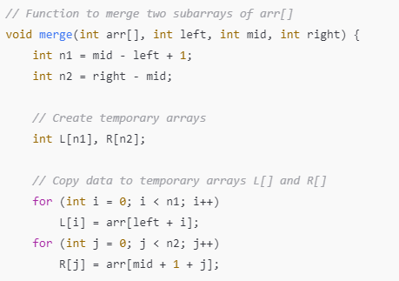
Merge

Slide 30
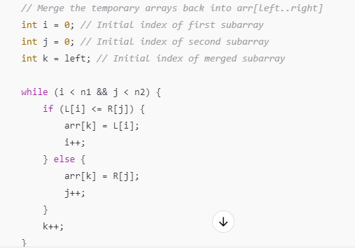
Merge

Slide 31
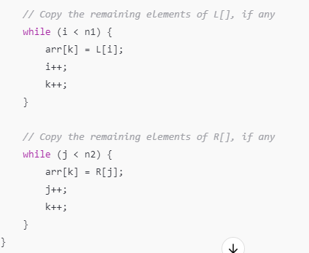
Merge

Slide 32
Time Complexity analysis
Best, Worst, and Average Case Complexity
Best Case (O(n log n)): Even if the array is already sorted, Merge Sort still recursively divides and merges the array.
Worst Case (O(n log n)): Even for a reverse-sorted array, Merge Sort performs the same number of comparisons and merging operations.
Average Case (O(n log n)): Since the number of comparisons and merges does not change significantly for different inputs, the average-case complexity remains O(n log n).

Slide 33
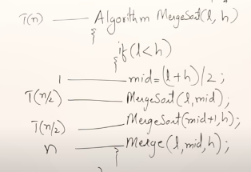
Recurrence Relation for Time Complexity
T(n)=2T(n/2)+O(n)
there are log n levels and each level requires O(n) merging work, the overall time complexity is:
O(nlog⁡n)

Slide 34
finding majority element and analysis
Naïve Method /Brute force –good solution
Sorted Approach-better solution
Divide and Conquer Approach-better solution
using Boyer-Moore Voting Algorithm –optimal solution

Slide 35
find the majority element using Naïve approach

Slide 36
finding majority element and analysis
// find the majority element using the Naïve approach
int findMajorityElement(int arr[], int n) {
for (int i = 0; i < n; i++)
{
int count = 0;
// Count occurrences of arr[i]
for (int j = 0; j < n; j++)
{
if (arr[j] == arr[i]) {
count++;
}
}
// Check if it's the majority element
if (count > n / 2) {
return arr[i];
}
}
return -1; // No majority element found
}
O(N²) time complexity & O(1) space complexity.

Slide 37
find the majority element using sorting approach

Slide 38
finding majority element and analysis
// find the majority element using sorting
int findMajorityElement(int arr[], int n) {
// Step 1: Sort the array
qsort(arr, n, sizeof(int), compare);
// Step 2: Candidate is the middle element
int candidate = arr[n / 2];
// Step 3: Count occurrences of candidate
int count = 0;
for (int i = 0; i < n; i++) {
if (arr[i] == candidate) {
count++; } }
// Step 4: Verify majority condition
if (count > n / 2) {
return candidate;
}
return -1; // No majority element
}
O(N log N) time complexity & O(1) space complexity.

Slide 39
find the majority element using Divide and Conquer Approach

Slide 40
Divide and Conquer Approach for Finding Majority Element
Algorithm
Divide: Split the array into two halves.
Conquer: Recursively find the majority element in both halves.
Combine:
If both halves return the same element, it is the majority.
Otherwise, count occurrences of both candidates in the entire range and return the one that appears more than N/2 times.

Slide 41
Divide and Conquer Approach for Finding Majority Element
// Function to find the majority element using Divide and Conquer
int findMajorityElementDC(int arr[], int left, int right) {
// Base case: If only one element, return it
if (left == right) {
return arr[left];
}
// Step 1: Divide - Find the middle index
int mid = left + (right - left) / 2;
// Step 2: Conquer - Recursively find majority elements in left and right halves
int leftMajor = findMajorityElementDC(arr, left, mid);
int rightMajor = findMajorityElementDC(arr, mid + 1, right);
// Step 3: Combine - If both halves return the same majority element
if (leftMajor == rightMajor) {
return leftMajor;
}

Slide 42
Divide and Conquer Approach for Finding Majority Element
// Otherwise, count occurrences in the full range
int leftCount = countOccurrences(arr, left, right, leftMajor);
int rightCount = countOccurrences(arr, left, right, rightMajor);
// Return the one that appears more than N/2 times
int size = right - left + 1;
if (leftCount > size / 2) {
return leftMajor;
}
if (rightCount > size / 2) {
return rightMajor;
}
return -1; // No majority element found
}

Slide 43
Divide and Conquer Approach for Finding Majority Element
// Function to count occurrences of an element in the given range
int countOccurrences(int arr[], int left, int right, int candidate) {
int count = 0;
for (int i = left; i <= right; i++) {
if (arr[i] == candidate) {
count++;
}
}
return count;
}
O(N log N) time complexity & Space Complexity: O(log N) (for recursion stack)

Slide 44
Example: Consider the array: [3, 3, 4, 2, 4, 4, 2, 4, 4]
Step 1: Divide the Array
We start with the full array: arr[] = {3, 3, 4, 2, 4, 4, 2, 4, 4}.
Divide the array into two halves:
Left half: {3, 3, 4, 2 ,4}
Right half: { 4, 2, 4, 4}

Slide 45
Divide and Conquer Approach for Finding Majority Element
step 2: Recursively Divide Each Half
Left Half: {3, 3, 4, 2,4}
Divide again into two halves:
Left half: {3, 3,4}
Right half: {2,4}
For {3, 3,4},recursively divide into:
{3} → Majority element is 3.
{3} → Majority element is 3.
{4} → Majority element is 4.

Slide 46
Divide and Conquer Approach for Finding Majority Element
Now combine:
leftMajor = 3, rightMajor = 3.
Count occurrences of both in {3, 3}:
3 occurs 2 time
the majority element is 3
Now combine:
leftMajor = 3, rightMajor = 4
Count occurrences of both in {3, 3,4}:
3 occurs 2 time, 4 occurs 1 time.
the majority element is 3

Slide 47
Divide and Conquer Approach for Finding Majority Element
Same for Right Half: { 4, 2, 4, 4}
4 is the majority element in this half.
Step 3: Combine Left and Right Halves
Now we combine results for the entire array:
Left Major from {3, 3, 4, 2,4}: 3
Right Major from { 4, 2, 4, 4}: 4
Count occurrences of 3 and 4 in the entire array {3, 3, 4, 2, 4, 4, 2, 4, 4}:
3 occurs 2 times.
4 occurs 5 times.
Since 4 appears more than 9/2 = 4.5 times, 4 is the majority element.

Slide 48
find the majority element using Boyer-Moore Voting Algorithm

Slide 49
finding majority element and analysis
// find the majority element using Boyer-Moore Voting Algorithm
int findMajorityElement(int arr[], int n) {
int candidate = -1, count = 0;
// Phase 1: Find a candidate
for (int i = 0; i < n; i++) {
if (count == 0) {
candidate = arr[i];
count = 1;
} else if (arr[i] == candidate) {
count++;
} else {
count--; }}}
// Phase 2: Verify the candidate
count = 0;
for (int i = 0; i < n; i++) {
if (arr[i] == candidate) {
count++;
} }
// Check if the candidate is a majority element
if (count > n / 2) {
return candidate;
}
return -1; // No majority element found
O(N) time complexity & O(1) space complexity

Slide 50
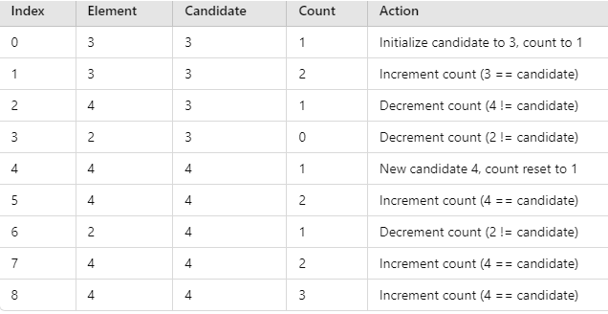
Example: Consider the array: [3, 3, 4, 2, 4, 4, 2, 4, 4]
First Pass
After the first pass, the potential majority candidate is 4.

Slide 51
Example: Consider the array: [3, 3, 4, 2, 4, 4, 2, 4, 4]
Second Pass:
Count the occurrences of 4 in the array:
4 appears 5 times.
Array length n is 9; thus, n/2 is 4.5.
Since 5 > 4.5, 4 is confirmed as the majority element.
Conclusion:
The Boyer–Moore Majority Vote Algorithm efficiently identifies the majority element by first selecting a candidate and then verifying its majority status. This two-pass approach ensures both time and space efficiency.

Slide 52
finding simultaneous maximum and minimum

Slide 53
finding simultaneous maximum and minimum
Approach: Divide and Conquer
Divide:
Split the array into two halves.
Conquer:
Recursively find the maximum and minimum in each half.
Combine:
Compare the results from both halves to get the final maximum and minimum.
Time Complexity
Best/Average/
Worst Case: O(n)(linear time).
Uses 3n/2 -2 comparisons

Slide 54
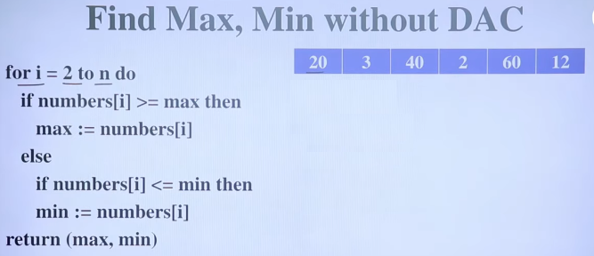
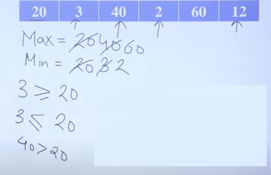

Slide 55
In linear approach consider that 1 2 3 4
Max = 1 2 3 4
Min= 1
Now consider 4 3 2 1
Max =4
Min= 4 3 2 1
Here for best case it will take (n-1) comparisons and worst case it will take 2(n-1) comparisons

Slide 56
Using DAC
In DAC approach, we will divide the problem into sub-problems and find the max and min of each group, now max of each group will compare with the only max of another group and min with only min.
Algorithm
Base Case: If there is only one element, both min and max are the same.
Base Case: If there are two elements, compare them directly.
Recursive Case:
Divide the array into two halves.
Recursively find min-max in both halves.
Merge the results.

Slide 57
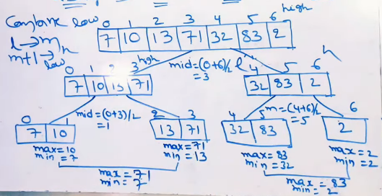

Example

Slide 58
Algorithm
// Function to find min and max using Divide and Conquer
findMinMaxDAC(int arr[], int low, int high) {
// Base case: Only one element
if (low == high) {
min = arr[low];
max = arr[low];
}

Slide 59
Continued…
// Base case: Two elements
if (high == low + 1) {
if (arr[low] < arr[high]) {
min = arr[low];
max = arr[high];
else {
min = arr[high];
max = arr[low];
}

Slide 60
Continued…
// Divide: Find middle index
mid = (low + high) / 2
//Recursively find min & max in left &right subarrays
left = findMinMax(arr, low, mid);
right = findMinMax(arr, mid + 1, high);
// Combine: Merge results
min = (left.min < right.min) ? left.min : right.min;
max = (left.max > right.max) ? left.max : right.max;

Slide 61
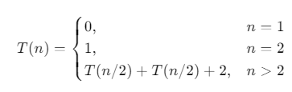
Continued…
// Divide: Find middle index
mid = (low + high) / 2
//Recursively find min & max in left &right subarrays
left = findMinMax(arr, low, mid);
right=findMinMax(arr, mid+1, high);
// Combine: Merge results
// Find minimum
if (left.min < right.min) {
min = left.min;
} else {
min = right.min;
}
// Find maximum
if (left.max > right.max) {
max = left.max;
} else {
max = right.max;
}
Recurrence Relation =

Slide 62
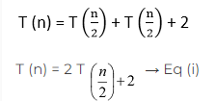
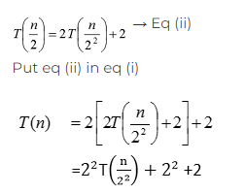
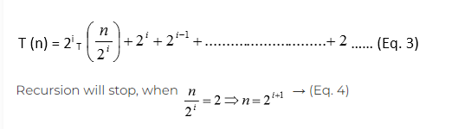

Slide 63
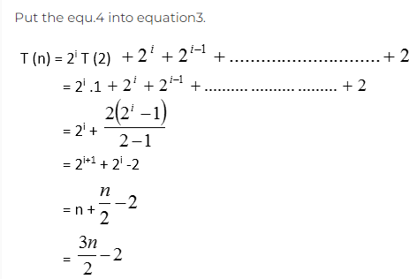

Slide 64


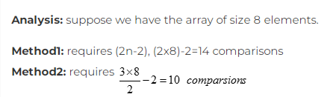

Number of comparisons requires applying the divide and conquering algorithm on n elements =
Ans: 748

Slide 65
Selection problem

Slide 66
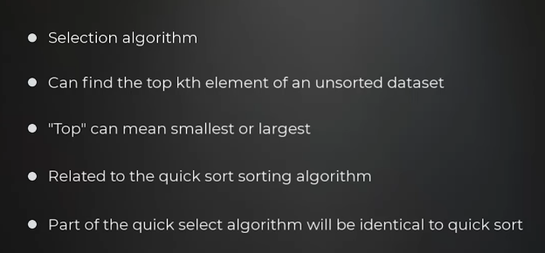
Selection Problem
The general problem of finding the k-th smallest or k-th largest element in an unsorted array using the Divide and Conquer (DAC) approach. Different ways to solve it:
Sorting + Picking k-th element → O(nlogn)
QuickSelect Algorithm → O(n)

Slide 67
Selection Problem applications
The Selection Problem has several real-world applications across different domains. Here are some key applications:
1. Order Statistics in Data Analysis
Finding the Median: The median is the n/2th smallest element. This is crucial in statistics for robust data summarization.
Percentiles & Quartiles: The k-th smallest element helps in calculating percentiles (e.g., 25th, 50th, 75th percentile).
Example: In large datasets (like salaries, exam scores, or stock prices), median and percentiles help in meaningful comparisons.
2. Competitive Programming & Algorithm Design
Used in QuickSelect Algorithm, an efficient way to find the k-th smallest/largest element in O(n) average time.
Used in Median of Medians Algorithm to guarantee worst-case O(n) selection.
3. Database Query Optimization
Top-k Queries: Databases often retrieve only the top-k largest or smallest elements instead of sorting the entire dataset.
Example: Finding the top 10 highest-grossing movies without sorting all movies.

Slide 68
Selection Problem applications
4. Machine Learning & Data Science
Feature Selection: Selecting the most important k features from a dataset.
Example: In a machine learning model, choosing the top-k most significant attributes to improve accuracy.
Outlier Detection: Finding extreme values in data, like the top 5 highest temperatures recorded.
5. Operating Systems & Memory Management
Process Scheduling: Selecting the k-th highest priority process in priority-based scheduling.
Memory Allocation: Finding the k-th largest memory block available in best-fit or worst-fit allocation.
6. Network Security & Intrusion Detection
Detecting Top-k Anomalous Activities: Identifying the k most suspicious IP addresses or users based on anomaly scores.
Traffic Analysis: Finding the top-k busiest network connections for optimization and security monitoring.

Slide 69
Selection Problem applications
7. Stock Market & Financial Analysis
Top-k Performing Stocks: Finding the top 5 stocks based on highest returns in a given period.
Risk Assessment: Selecting k worst-performing stocks to minimize risk in portfolio management.
8. Image & Signal Processing
Filtering & Edge Detection: Selecting the median pixel intensity for noise reduction.
Top-k Pixel Selection: Finding the k-th most prominent colors in an image for compression.
9. Artificial Intelligence & Search Engines
Top-k Document Retrieval: Search engines like Google use selection algorithms to return the top-k most relevant results.
Recommendation Systems: Suggesting the top-k most popular movies, books, or songs.

Slide 70
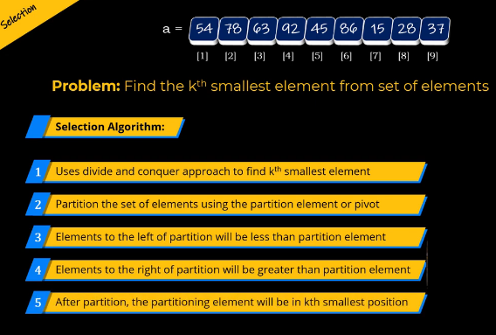

Slide 71


Slide 72
Algorithm:
Divide:
Choose a pivot element (e.g., last, first, or median-of-medians).
Partition the array into two subarrays:
Left subarray with elements less than the pivot.
Right subarray with elements greater than the pivot.
The pivot is now in its correct position.
Conquer:
If pivot index = k, return the pivot.
If k is smaller, recursively search in the left subarray.
If k is larger, recursively search in the right subarray with adjusted k.
Combine:
The result is found in one of the recursive calls.
Its time complexity is O(n) in best case in worst it is O(n²)

Slide 73
partition(int arr[], low, high) {
pivot = arr[high];
i = (low );
for (j = low; j <= high - 1; j++) {
if (arr[j] < pivot) {
swap(&arr[i], &arr[j]);
i++;
}
}
swap(&arr[i], &arr[high]);
return (i );
}

Slide 74
// QuickSelect to find k-th smallest element
quickSelect(arr[], low, high, k) {
while (low <= high) {
pivotIndex = partition(arr, low, high);
if (pivotIndex == k)
return arr[pivotIndex]; // Found k-th smallest
else if (k < pivotIndex )
high = pivotIndex - 1; // Search in left subarray
quickSelect(arr, low, high, k)
else
low = pivotIndex + 1; // Search in right subarray
quickSelect(arr, low, high, k)
}
return -1; // Error case
}

Slide 75
54 78 63 92 45 86 15 28 37 k=3
7 10 4 3 20 15 k=3
54 78 63 92 45 86 15 28 37 k=3
After partition 15 28 37 92 45 86 54 78 63 pivotindex=k
7 10 4 3 20 15 k=3
After partition 7 10 4 3 15 20 pivotindex!=k
Again partition p=3 3 10 4 7 15 20 pivotindex!=k
Again partition p=7 3 4 7 10 15 20 pivotindex=k

