Slide 1
Unit 3 Greedy strategy
- Dr. Varsha R.Dange

Slide 2
Contents
General approach,
fractional knapsack problem using greedy method,
Job scheduling/sequencing using greedy approach examples,
Huffman coding,
minimum spanning tree-Kruskal’s and Prim’s algorithm

Slide 3
Greedy Approach
The greedy method is one of the strategies like Divide and conquer used to solve the problems.
This method is used for solving optimization problems.
An optimization problem is a problem that demands either maximum or minimum results
The greedy approach/technique, is an algorithmic strategy used in optimization problems
The Greedy Method is a problem-solving technique where we build the solution step by step, choosing the option that looks best at the current moment (locally optimal choice), hoping it will lead to the overall best solution (globally optimal).

Slide 4
Characteristics of Greedy method
Greedy Choice Property – A locally optimal choice at each step leads to a globally optimal solution.
Optimal Substructure – An optimal solution of the problem contains optimal solutions to its sub-problems.
1. Local Optimal Choice
At each step, pick the choice that seems best right now.
Example: always take the largest coin first while making change.
2. Irrevocable Decisions
Once you make a choice, you don’t go back to change it later.
No backtracking.
3. Feasible Solution
Each choice should keep the solution valid (must satisfy problem constraints).
Example: when scheduling jobs, pick only jobs that can fit into the timeline.
4. Optimal Substructure Property
The global solution can be formed by combining solutions to smaller subproblems.
Example: shortest path in a graph → shortest path from A to C via B is built from shortest path A→B and B→C.
5. Greedy-Choice Property
There exists a way to reach an optimal solution by making greedy choices at each step.
If this property doesn’t hold, greedy method may fail.

Slide 5
Characteristics of Greedy method
1. Local Optimal Choice
At each step, pick the choice that seems best right now.
Example: always take the largest coin first while making change.
2. Irreversible Decisions
Once you make a choice, you don’t go back to change it later.
No backtracking.
3. Feasible Solution
Each choice should keep the solution valid (must satisfy problem constraints / rules).
Example: when scheduling jobs, pick only jobs that can fit into the timeline.

Slide 6
Characteristics of Greedy method
4. . Optimal Substructure Property
The global solution can be formed by combining solutions to smaller subproblems.
Example: shortest path in a graph → shortest path from A to C via B is built from shortest path A→B and B→C.
5. Greedy-Choice Property
There exists a way to reach an optimal solution by making greedy choices at each step.

Slide 7
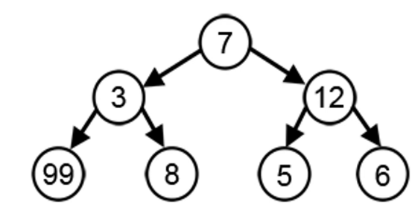

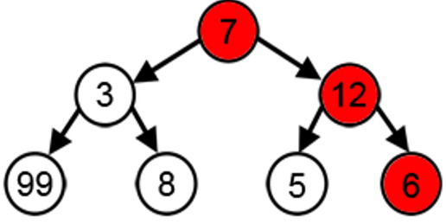
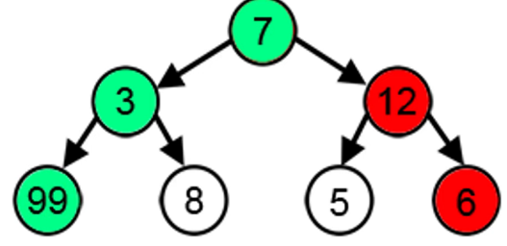

Will greedy always give optimal solution-no
Here we have to find largest path

Slide 8
Will greedy always give optimal solution
The greedy algorithm is not always the optimal solution for every optimization problem, as shown in the example below.
the greedy approach to make change for the amount 20 with the coin denominations [18, 1, 10],
the algorithm starts by selecting the largest coin value that is less than or equal to the target amount. In this case, the largest coin is 18,
so the algorithm selects one 18 coin. After subtracting 18 from 20, the remaining amount is 2.
At this point, the greedy algorithm chooses the next largest coin less than or equal to 2, which is 1.
It then selects two 1 coins to make up the remaining amount. So, the greedy approach results in using one 18 coin and two 1 coins.
Although it uses three coins, a better solution would have been to use two 10 coins, resulting in a total of only two coins (10 + 10 = 20).

Slide 9
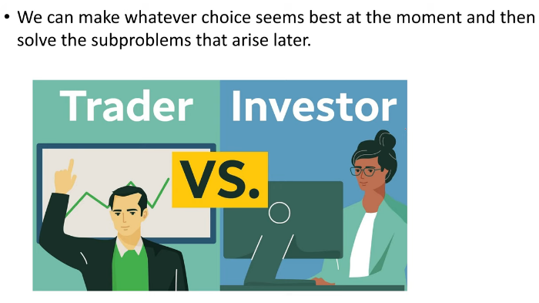
Example
Problem: A trader wants to maximize profit by buying and selling stocks.
Trader, buy at the lowest price seen so far and sell at the highest price seen later.

Slide 10
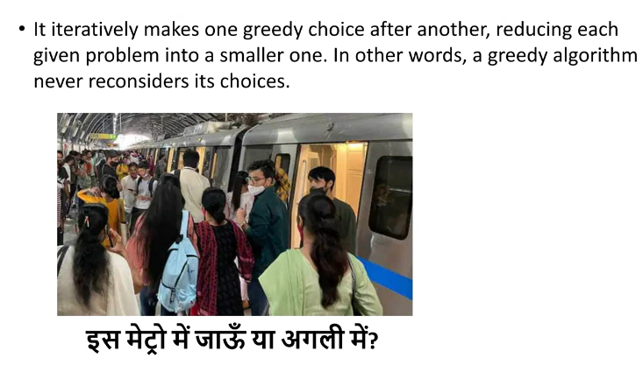
Example

Slide 11
The Greedy Algorithm works well in problems where: ✅ Making the best choice locally leads to the best global solution. ✅ There are sorting or priority-based conditions (e.g., selecting the highest, lowest, or shortest). ✅ The decisions are final (once taken, they are not changed later).

Slide 12
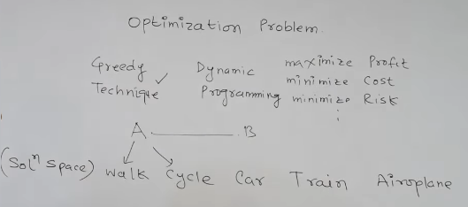



Feasible-optimal ?
Suppose there is a problem 'P'. I want to travel from A to B shown as below : P : A → B
constraint - 6hr and min cost
Constraint
Train is the optimal sol which take 6 hrs n min cost
Feasible solutions

Slide 13
Feasible-optimal ?
If we say that we have to cover the journey at the minimum cost.
This means that we have to travel this distance as minimum as possible, so this problem is known as a minimization problem.
Till now, we have two feasible solutions, i.e., one by train and another one by air.
Since travelling by train will lead to the minimum cost so it is an optimal solution.
An optimal solution is also the feasible solution, but providing the best result so that solution is the optimal solution with the minimum cost.
There would be only one optimal solution.

Slide 14
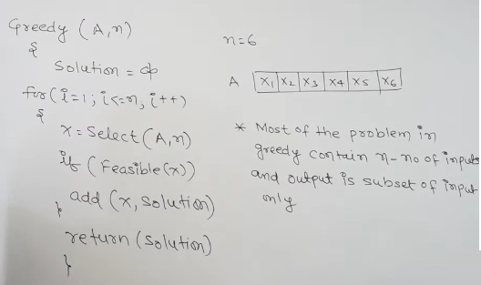
General approach

Slide 15
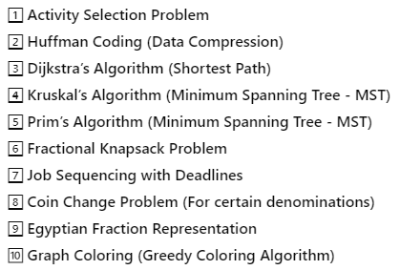
Example of Greedy method

Slide 16
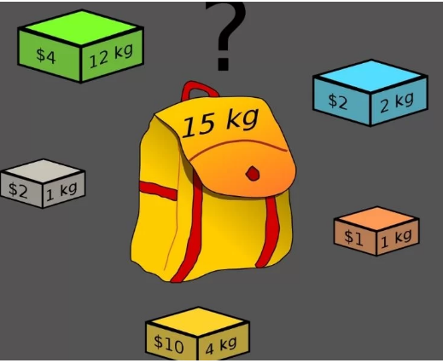
fractional knapsack problem using greedy method
Problem Statement: The weight of N items and their corresponding profits are given.
We have to put these items in a knapsack of weight W such that the total profit obtained is maximized.
Fill in the knapsack with a subset of items such that the selected weight is less than or equal to the capacity of the knapsack and the profit of items is maximum.
we can take fractions of items.

Slide 17
fractional knapsack problem using greedy method
There are basically three approaches to solve the problem:
The first approach is to select the item based on the maximum profit.
The second approach is to select the item based on the minimum weight.
The third approach is to calculate the ratio of profit/weight.
Among these we have to choose optimal one i.e last one.

Slide 18
Example
Object | 1 | 2 | 3
Profit | 25 | 24 | 15
Weight | 18 | 15 | 10
M=20 maximum weight
1. We will greedy about profit ,so we choose that object which gives max profit
Here fraction Xi = remaining bag
capacity/total weight :--2/15
Object | 1 | 2 | 3
Profit | 25 | 24 | 15
Weight | 18 | 15 | 10
Xi | 1 | 2/15 | 0
BAG
2/15 (obj2)
2
20
18 (obj1)
18

Slide 19
Calculate profit = ∑ Xi*profit
= 1*25 + (2/15)*24 + 0*15
= 25 + 48/15 = 25+3.2=28.2
2) we will greedy about min weight
Object | 1 | 2 | 3
Profit | 25 | 24 | 15
Weight | 18 | 15 | 10
Xi | 0 | 10/15 | 1
Calculate fraction profit = Xi * profit
15 + (10/15)*24
= 15+16 =31
BAG
10
10/15 (obj 2)
20
10
10 (obj3)

Slide 20
3. We greedy about item : calculate the ratio of profit/weight.
BAG
Object | 1 | 2 | 3
Profit | 25 | 24 | 15
Weight | 18 | 15 | 10
P/W | 1.4 | 1.6 | 1.5
Xi | 0 | 1 | 5/15
5
5/10 (obj3)
20
15 (obj2)
15
Calculate fraction profit = Xi * profit
= 24 + (5/10) * 15
= 24 + 7.5
= 31.5

Slide 21
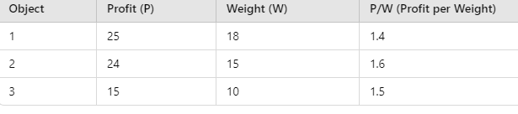
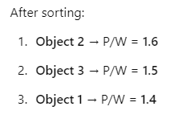
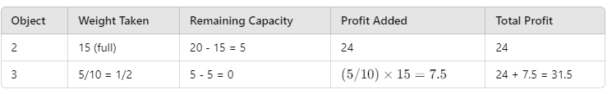

Slide 22
Greedy Approach
Calculate profit-to-Weight Ratio: Compute p/w for each item.
Sort Items: Sort items in decreasing order of p/w.
Pick Items Greedily:
Add the highest p/w item fully if possible.
If not, take the fraction that fits in the remaining weight , remainingweight / totalweight
Continue Until Knapsack is Full.

Slide 23
Algorithm
Greedy Knapsack Algorithm:
1. GreedyFractionalKnapsack(items, n, capacity):
// Each item has: value[i], weight[i]
// Step 1: Compute value/weight ratio for each item
for i = 1 to n: ---Time : O(n)
Compute P[i] / W[i]
// Step 2: Sort items in descending order of ratio
sort items by ratio[i] in decreasing order --O(nlogn)
totalProfit = 0 // maximum profit
remainingCapacity = capacity

Slide 24

Algorithm
// Step 3: Pick items one by one
for i = 1 to n: ----- O(n)
if weight[i] <= remainingCapacity:
// Take the whole item
totalProfit = totalProfit + Profit[i]
remainingCapacity = remainingCapacity - weight[i]
else:
// Take fraction of the item
fraction = remainingCapacity / weight[i]
totalProfit = totalProfit + (value[i] * fraction)
remainingCapacity = 0
break // knapsack is full
return totalProfit
Adding up the dominant terms:
O(n)+O(nlogn)+O(n) = O(nlogn)
Final Time Complexity: O(nlog⁡n)

Slide 25
Example
Objects: 1 2 3 4 5 6 7
Profit (P): 10 5 15 7 6 18 3
Weight(w): 2 3 5 7 1 4 1
M (Weight of the knapsack): 15
n (no of items): 7

Slide 26
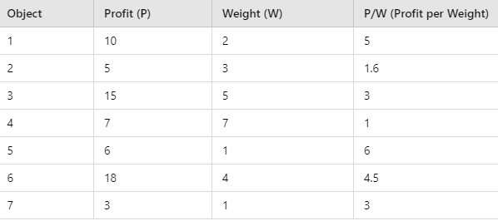
Step 1: Calculate P/W and Sort in Non-Increasing Order

Slide 27
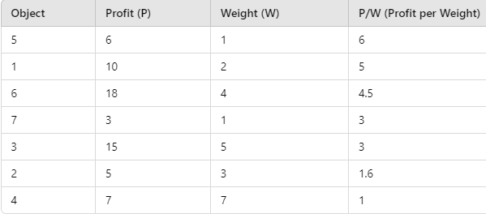
After sorting based on P/W ratio:

Slide 28
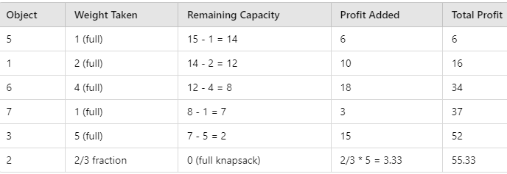
Step 2: Greedy Selection
Knapsack Capacity = 15

Slide 29
Huffman Coding

Slide 30
Huffman Coding
Huffman Coding is a greedy algorithm used for lossless data compression.
It is used to reduce the number of bits needed to store or transmit data.
It was first developed by David Huffman.
Data can be encoded efficiently using Huffman Codes.

Slide 31
Huffman Coding
It is a widely used and beneficial technique for compressing data , in which there are frequently occurring characters.
It assigns variable-length codes to input characters based on their frequency,
It assigns shorter codes to more frequent characters and longer codes to less frequent characters.

Slide 32
Suppose we have 15 characters in a data file.
Normal Storage: 8 bits per character (ASCII) - 8 x 15 =120 bits are required to send this string.
Char | ASCII | Binary
A | 65 | 01000001
B | 66 | 01000010
C | 67 | 01000011
D | 68 | 01000100

Slide 33
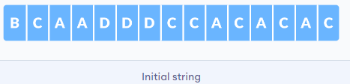
But we want to compress the file and save it compactly.
We can use----
Fixed length coding
Variable length coding

Slide 34
(i) Fixed length Code: Each letter represented by an equal number of bits. With a fixed length code, 2 bits per character:
A---- 00
B ---- 01
C ---- 10
D ---- 11
1. Data Encoding:
With 4 characters (A, B, C, D), a fixed-length code requires 2 bits –2*4=8
For 15 characters, the encoded data uses: 15 characters × 2 bits = 30 bits
For character : 4*8=32 bits
Total = 8+ 30+32=70bits
Problem: If one character occurs very often (say `a` occurs 50% of the time), we are still wasting 3 bits every time.

Slide 35
ii) Huffman coding (variable length Code ):
Count frequency of characters.
Build a binary tree where low-frequency characters are deeper and high-frequency characters are closer to the root.
Assign `0` to left edge and `1` to right edge.
Traverse tree to generate variable-length codes
Once the data is encoded, it has to be decoded. Decoding is done using the same tree.

Slide 36
Huffman coding follows Greedy approach:
The greedy method works by making the locally optimal choice at each step, with the hope of reaching the global optimum.
In Huffman coding:
At every step, we pick the two smallest frequency nodes (locally optimal choice).
Combine them into a new node whose frequency is the sum.
Repeat until only one tree remains (global optimum).
This greedy choice ensures that characters with higher frequency get shorter codes.

Slide 37
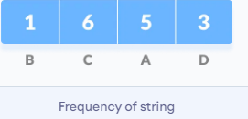
Steps for Huffman coding---
Count frequency of characters.

Slide 38
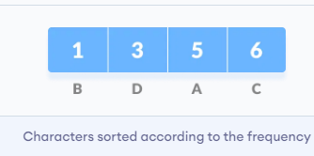
2. Insert the characters and their frequencies in in a priority queue Q(min-heap), which keeps them ordered automatically
3. Construct the Huffman Tree
Make each unique character as a leaf node.

Slide 39

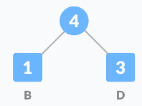
4. Create a new node `z` with frequency = sum of those two.
Set the value of the z as the sum of the above two minimum frequencies.
(EXTRACT-MIN twice(get 2 smallest),create a new node and insert back)
Getting the sum of the least numbers

Slide 40
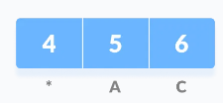
5. Remove these two minimum frequencies from Q and add the sum into the list of frequencies (* denote the internal nodes in the figure).
6.Insert node z into the tree.

Slide 41

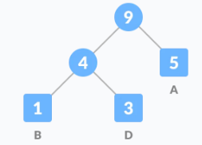
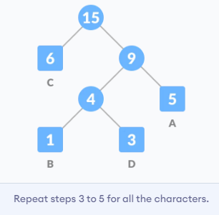

7. Repeat steps 3 to 5 for all the characters

Slide 42
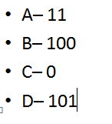
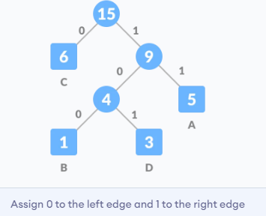
8. For each non-leaf node, assign 0 to the left edge and 1 to the right edge.

Slide 43

Encode each char as
A– 11
B– 100
C– 0
D– 101

Slide 44
For sending the above string over a network, we need to send:
1. The compressed message bits (encoded string).
2. The codebook (mapping of characters to Huffman codes), so the receiver can decode.
Here We do not need to send frequencies.
The total size is given by the table below:

Slide 45
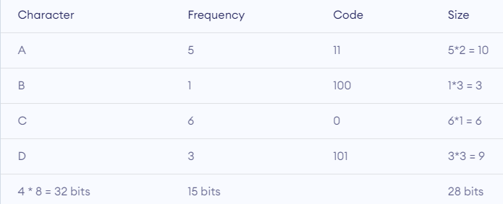
4 characters need to be identified → assume 8 bits each → `4 × 8 = 32 bits`.
Codes themselves (to tell receiver how many bits/code) → 9 bits (as per given).
So, codebook size = 32 + 9 = 41 bits.

Slide 46
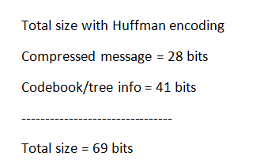
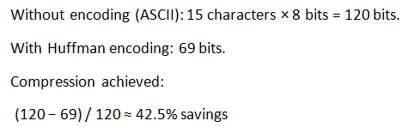
% Savings = (Savings ÷ Original size) × 100
= (51 ÷ 120) × 100
≈ 42.5 %

Slide 47
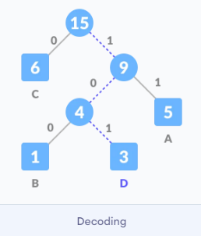
Decoding the code
For decoding the code, we can take the code and traverse through the tree to find the character.
Let 101 is to be decoded, we can traverse from the root as in the figure below.

Slide 48
Huffman Coding Algorithm
Huffman_Coding(characters, frequencies):
Input:
characters[] → array of characters
frequencies[] → array of corresponding frequencies
Output:
Huffman tree and codes for characters
1. Create a priority queue Q (min-heap) of nodes
2. For each character c in characters:
create a node n with frequency = freq(c)
insert n into Q

Slide 49
Huffman Coding Algorithm
3. while size(Q) > 1:
left = extract_min(Q) // least frequency node
right = extract_min(Q) // second least frequency node
create a new node parent
parent.freq = left.freq + right.freq
parent.left = left
parent.right = right
insert parent into Q

Slide 50
Huffman Coding Algorithm
4. root = extract_min(Q) // final node is the root of Huffman tree
5. Traverse the Huffman tree:
assign '0' to left edge, '1' to right edge
store the code for each character
6. return codes for all characters

Slide 51
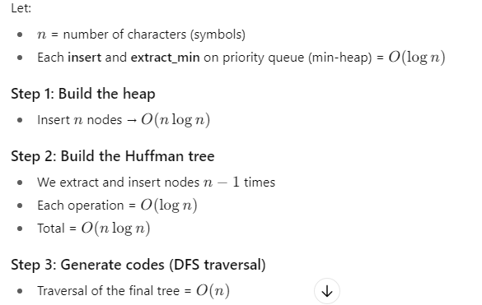


Huffman Coding complexity analysis

Slide 52
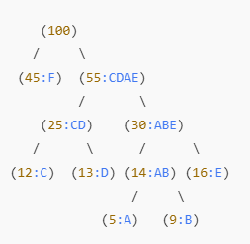
Example
Char | Frequency
A | 5
B | 9
C | 12
D | 13
E | 16
F | 45
Encoded String for "ABCD“
A -> 1100
B -> 1101
C -> 100
D -> 101
Encoded Output: 11001101100101

Slide 53




the Huffman Code Prefix-Free
Huffman codes are always prefix-free by design.
Prefix-free means: no code is the starting part of another code.
This property ensures that an encoded message can be uniquely decoded without ambiguity.
This ensures that the encoded message is uniquely decodable.

Slide 54
the Huffman Code Prefix-Free
Justification---
In Huffman coding, every symbol is stored at a leaf node of the tree.
When we assign codes by moving left (0) or right (1), we only stop at the leaves.
Since all symbols are at leaves, no symbol’s code can ever be the beginning of another’s code.

Slide 55
Job scheduling/sequencing using greedy approach

Slide 56
Job Sequencing Problem
The Job Sequencing Problem is a classic optimization problem in Greedy Algorithm
where we aim to schedule a set of jobs in such a way that we maximize the total profit
while ensuring that each job is completed within its deadline.

Slide 57
Problem Statement
Given N jobs, where each job has:
Job ID – Unique identifier for each job.
Deadline – The latest time by which the job must be completed.
Profit – The profit earned if the job is completed within its deadline.
Each job takes exactly 1 unit of time to complete.
The objective is to schedule the jobs in a way that maximizes the total profit.

Slide 58
Constraints
Each job takes exactly 1 unit of time to complete.
Each job has a fixed deadline, meaning it must be completed before or on its deadline.
Each job has a profit, which is earned only if the job is completed on time.
Jobs cannot be preempted, meaning once a job starts, it must complete before another job can begin.
A single job can be scheduled per time slot.
Uni-processor is there for job execution .

Slide 59
Algorithm
Input:
An array of N jobs, each with a Job ID, Deadline, and Profit.
Output:
The sequence of scheduled jobs.
The maximum profit obtained.
Steps:
Sort all jobs in descending order of profit.
Find the maximum deadline among all jobs.
Create an array of time slots (size = maximum deadline).
Selects the jobs with highest profits and place it in the latest available slot before its deadline
If a free slot is found, schedule the job.
If no slot is available, skip the job.
Compute the total profit from the scheduled jobs.

Slide 60
Examples
Consider the following tasks with their deadlines and profits. Schedule the tasks in such a way that they produce maximum profit after being executed −
S. No. | 1 | 2 | 3 | 4 | 5
Jobs | J1 | J2 | J3 | J4 | J5
Deadlines | 2 | 2 | 1 | 3 | 4
Profits | 20 | 60 | 40 | 100 | 80

Slide 61
Step 1 : Arrange the jobs in descending order of their profits.
Step2 : Find the maximum deadline value, dm, from the deadlines given.
max deadline = 4
we create a time slot array of size 4.
S. No. | 1 | 2 | 3 | 4 | 5
Jobs | J4 | J5 | J2 | J3 | J1
Deadlines | 3 | 4 | 2 | 1 | 2
Profits | 100 | 80 | 60 | 40 | 20

Slide 62
Step 3: Schedule Jobs
Choose the job with highest profit, J4.
Deadline 3
Total Profit = 100.
S. No. | 1 | 2 | 3 | 4 | 5
Jobs | J4 | J5 | J2 | J3 | J1
Deadlines | 3 | 4 | 2 | 1 | 2
Profits | 100 | 80 | 60 | 40 | 20
0
1
2
3
4
J3 | J2 | J4 | J5
Job consider | Slot assign | Solution | Profit
J4 | [2,3] →slot3 | J4 | 100
J5 | [3,4]→slot4 | J4,J5 | 100+80=180
J2 | [1,2]→ slot2 | J2,J4,J5 | 180+60=240
J3 | [0,1]→slot1 | J3, J2,J4,J5 | 240+40=280
J1 | Rejected
Final Job Order: J3 → J2 → J4 → J5
Total Profit: 40 + 60 + 100 + 80 = 280

Slide 63
Example 2
S. No. | 1 | 2 | 3 | 4 | 5
Jobs | J1 | J2 | J3 | J4 | J5
Deadlines | 2 | 2 | 1 | 3 | 3
Profits | 20 | 15 | 10 | 5 | 1
After sorting : Max Deadline =3
S. No. | 1 | 2 | 3 | 4 | 5
Jobs | J1 | J2 | J3 | J4 | J5
Deadlines | 2 | 2 | 1 | 3 | 3
Profits | 20 | 15 | 10 | 5 | 1

Slide 64
S. No. | 1 | 2 | 3 | 4 | 5
Jobs | J1 | J2 | J3 | J4 | J5
Deadlines | 2 | 2 | 1 | 3 | 3
Profits | 20 | 15 | 10 | 5 | 1
0
1
2
3
J2 | J1 | J4
Job consider | Slot assigned | Solution | Profit
J1 | [1,2] | J1 | 20
J2 | [0,1] | J2,J1 | 20+15 =35
J3 | Rejected
J4 | [2,3] | J3,J2,J1 | 35+5=40
J5 | Rejected
Total Profit =40 and Job sequence - J3,J2,J1

Slide 65
Example 3
Jobs | J1 | J2 | J3 | J4 | J5 | J6 | J7
Deadlines | 3 | 4 | 4 | 2 | 3 | 1 | 2
Profits | 35 | 30 | 25 | 20 | 15 | 12 | 5
After sorting : Max Deadline =4
Jobs | J1 | J2 | J3 | J4 | J5 | J6 | J7
Deadlines | 3 | 4 | 4 | 2 | 3 | 1 | 2
Profits | 35 | 30 | 25 | 20 | 15 | 12 | 5

Slide 66
Jobs | J1 | J2 | J3 | J4 | J5 | J6 | J7
Deadlines | 3 | 4 | 4 | 2 | 3 | 1 | 2
Profits | 35 | 30 | 25 | 20 | 15 | 12 | 5
0
1
2
3
4
J4 | J3 | J1 | J2
Job consider | Slot assigned | Solution | Profit
J1 | [2,3] | J1 | 35
J2 | [3,4] | J1,J2 | 35+30=65
J3 | [1,2] | J3,J1,J2 | 65+25=90
J4 | [0,1] | J4, J3,J1,J2 | 90+20=110
J5 | Rejected
J6 | Rejected
J7 | Rejected
Total Profit =110 and Job sequence - J4, J3,J1,J2

Slide 67
Time Complexity
Step 1: Sort Jobs by Profit in Descending Order-Time Complexity: O(N log N)
Step 2: Find Maximum Deadline-Time Complexity: O(N)
Step 3: Create an Array for Time Slots-Time Complexity: O(N)
Step 4: Place Jobs in Latest Available Slot Before Deadline- Slots-Time Complexity: O(N²)
Final Time Complexity: O(N²) in worst case in Best case O(N logN)

Slide 68
Program for worst case scenario:
import java.util.Arrays;
class Job {
int id, profit, deadline;
Job(int id, int profit, int deadline) {
this.id = id;
this.profit = profit;
this.deadline = deadline;
}}
public class JobSequencingWorstCase {
// Function to sort jobs by profit in descending order
static void sortJobsByProfit(Job[] jobs) {
Arrays.sort(jobs, (a, b) -> b.profit - a.profit); }
// Function to find the maximum deadline among all jobs
static int getMaxDeadline(Job[] jobs) { int maxDeadline = 0;
for (Job job : jobs)
maxDeadline = Math.max(maxDeadline, job.deadline);
return maxDeadline;
}
// Function to perform Job Sequencing (Worst Case)
static void jobSequencing(Job[] jobs, int n) {
// Step 1: Sort jobs by profit (Descending)
sortJobsByProfit(jobs);
// Step 2: Find max deadline
int maxDeadline = getMaxDeadline(jobs);
int[] slots = new int[maxDeadline]; // Slot array
Arrays.fill(slots, -1); // Initialize slots as empty
int totalProfit = 0;
int[] jobSlot = new int[n]; // Store allocated slot for each job

Slide 69
// Step 3: Assign jobs (Worst Case - Scan all slots)
for (int i = 0; i < n; i++) {
for (int j = jobs[i].deadline - 1; j >= 0; j--)
{ // Scan from deadline down
if (slots[j] == -1) { // If slot is empty
slots[j] = jobs[i].id;
totalProfit += jobs[i].profit;
jobSlot[jobs[i].id - 1] = j + 1;
// Store allocated slot (1-based index)
break;
}} }
// Output scheduled jobs with allocated slots
System.out.println("Job ID | Allocated Slot");
for (int i = 0; i < n; i++) {
if (jobSlot[i] != 0)
System.out.println("J" + (i + 1) + " | Slot " + jobSlot[i]);
}
System.out.println("Maximum Profit: " + totalProfit);
}
// Driver Code (Worst Case Scenario)
public static void main(String[] args) {
int n = 7; // Number of jobs (Increase N for testing worst case)
// Worst case: All jobs have the same large deadline (N)
Job[] jobs = {
new Job(1, 50, 7),
new Job(2, 40, 7),
new Job(3, 30, 7),
new Job(4, 20, 7),
new Job(5, 10, 7),
new Job(6, 5, 7),
new Job(7, 1, 7)
};
jobSequencing(jobs, n);
}}

Slide 70
output
Job ID | Allocated Slot
J1 | Slot 7
J2 | Slot 6
J3 | Slot 5
J4 | Slot 4
J5 | Slot 3
J6 | Slot 2
J7 | Slot 1
Maximum Profit: 156

Slide 71
minimum spanning tree-Kruskal’s and Prim’s algorithm

Slide 72
Minimum Spanning Tree (MST) Using Greedy Approach
Minimum Spanning Tree (MST) is a subset of edges in a connected, weighted, and undirected graph that:
Connects all vertices without forming cycles.
Has minimum total edge weight among all spanning trees.
Why is it called Greedy Algorithm?
It is called greedy because it chooses the optimal solution present at the moment and not the optimal solution as a whole.

Slide 73
How to find cost of Minimum Spanning Tree?
The cost of a spanning tree is the sum of the weights of its edges.
A Minimum Spanning Tree (MST) is the spanning tree with the lowest cost among all possible spanning trees.
There can be multiple MSTs for a graph.
All vertices are connected without cycles.
For n vertices, the MST has n-1 edges.

Slide 74
Algorithms to Find MST:
Prim’s Algorithm – Greedy approach, builds MST one edge at a time.
Kruskal’s Algorithm – Sorts edges by weight and picks the smallest while avoiding cycles.
Applications of MST:
Network Design (Internet, roads, electrical circuits).
Clustering in Machine Learning.
Approximation Algorithms for NP-Hard Problems.
MST helps in efficiently connecting nodes with minimum cost.

Slide 75
Prim’s Algorithm

Slide 76
Prim’s Algorithm
What is Prim’s Algorithm?
Prim’s Algorithm is a Greedy Algorithm used to find the Minimum Spanning Tree (MST) of a connected, weighted, undirected graph.
How Prim’s Algorithm Works?
Start with any vertex as the initial MST.
Select the smallest edge that connects a new vertex to the MST.
Repeat until all vertices are included in the MST.

Slide 77
Prim’s Algorithm
Properties of Prim’s Algorithm
Always maintains a connected MST while adding edges.
Uses Priority Queue (Min Heap) for efficiency.
Why Prim’s is a Greedy Algorithm?
At each step, it chooses the smallest edge that expands the MST.
The local optimal choice leads to a globally optimal MST.
Prim’s Algorithm is used for network design, clustering, and efficient connectivity.

Slide 78
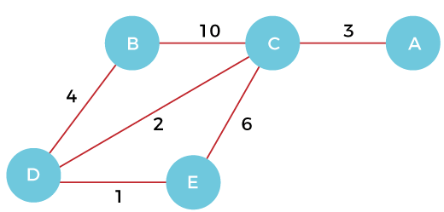
Example of prim's algorithm

Slide 79

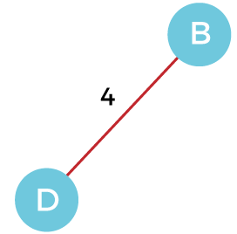
Step 1 - First, we have to choose a vertex from the above graph. Let's choose B.
Step 2 - Now, we have to choose and add the shortest edge from vertex B.
There are two edges from vertex B that are B to C with weight 10 and edge B to D with weight 4.
Among the edges, the edge BD has the minimum weight. So, add it to the MST.

Slide 80
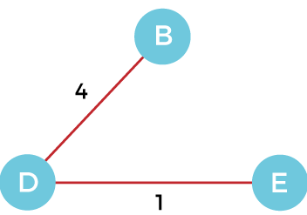
Step 3 - Now, again, choose the edge with the minimum weight among all the other edges.
In this case, the edges DE and CD are such edges.
Add them to MST and explore the adjacent of C, i.e., E and A.
So, select the edge DE and add it to the MST.

Slide 81
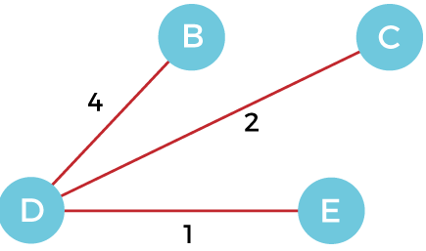
Step 4 - Now, select the edge CD, and add it to the MST.

Slide 82
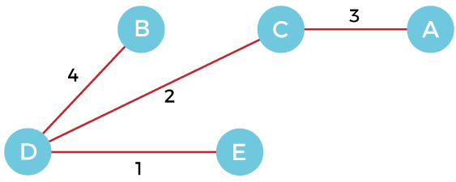
Step 5 - Now, choose the edge CA. Here, we cannot select the edge CE as it would create a cycle to the graph. So, choose the edge CA and add it to the MST
So, the graph produced in step 5 is the minimum spanning tree of the given graph. The cost of the MST is given below -
Cost of MST = 4 + 2 + 1 + 3 = 10 units.

Slide 83
Prim’s Algorithm
A = ∅; //A stores the edges of the MST (initially empty).
U = {1}; //U starts with a single vertex (let’s say vertex 1).
while (U ≠ V) //Loop Until All Vertices are in U
let (u, v) be the least weighted edge such that //Find the smallest edge (u, v) where
v ∈ V - U and u ∈ U; //u is in U (already in MST). And v is in V - U (not yet in MST).
A = A ∪ {(u, v)} //Add the edge (u, v) to MST (A).
U = U ∪ {v} //add vertex v to U (mark v as included in MST).
//Repeat Until U Contains All Vertices (U = V)

Slide 84
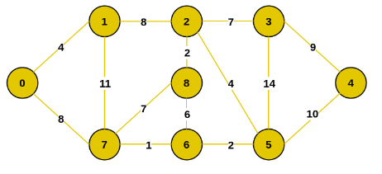
Example 2

Slide 85
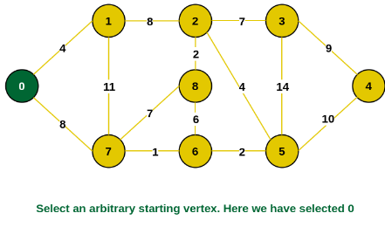
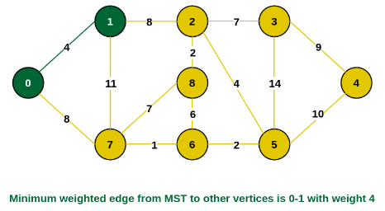

Slide 86
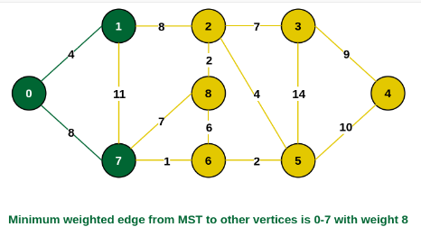
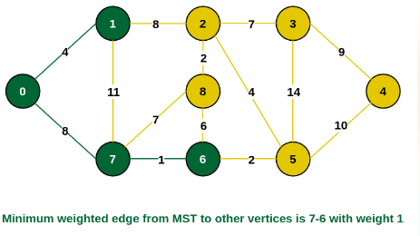

Slide 87
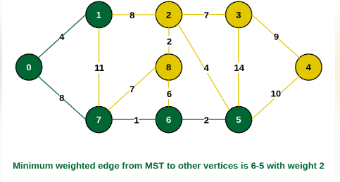
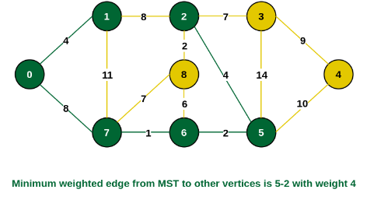

Slide 88
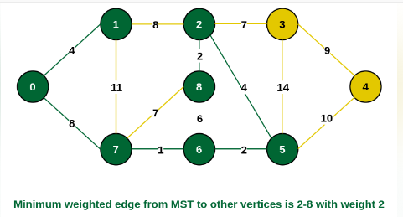
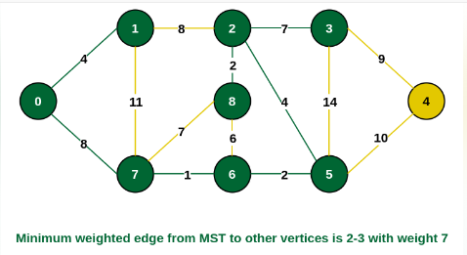

Slide 89
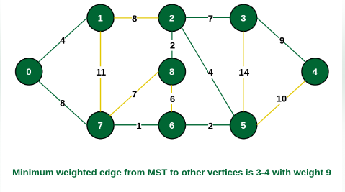
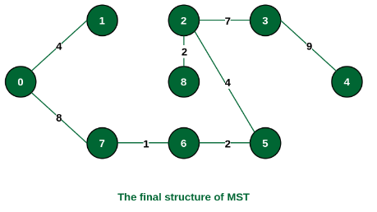
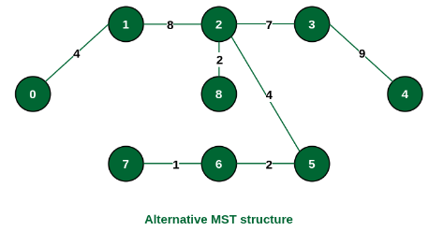

Slide 90
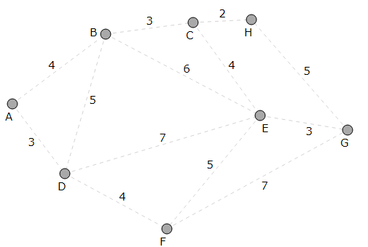

Slide 91
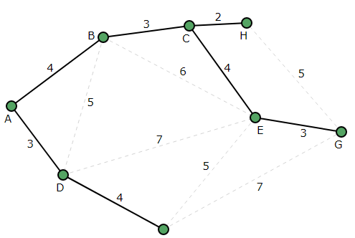

Slide 92
Time complexity of Prim’s algorithm
The time complexity of Prim’s algorithm depends on the data structures used for the priority queue (min-heap) and adjacency representation.
Best and Worst Case Time Complexity
1. Using an Adjacency Matrix + Simple Min Selection (O(V²))
Each vertex is checked for the minimum edge, leading to O(V²) complexity.
Best Case: O(V²)
Worst Case: O(V²)

Slide 93
Complexity O(E log V) for Prim’s Algorithm Using a Min-Heap and Adjacency List
Extract-Min Operation (O(log V))
The algorithm picks the minimum-weight edge V times from a priority queue (min-heap).
Each extraction takes O(log V).
Total contribution: O(V log V).
2. Edge Relaxation(short distance found) (O(log V) per edge update)
Every vertex is connected through E edges in total.
Each edge update in the priority queue (decrease-key operation) takes O(log V).
3. Total contribution: O(E log V).
Final Complexity: O(V log V + E log V) = O(E log V) (since E ≥ V in a connected graph).

Slide 94
Kruskal's Algorithm

Slide 95
Kruskal's algorithm
Kruskal's algorithm is a minimum spanning tree algorithm that takes a graph as input and finds the subset of the edges of that graph which
form a tree that includes every vertex
has the minimum sum of weights among all the trees that can be formed from the graph

Slide 96
How Kruskal's algorithm works
It falls under a class of algorithms called greedy algorithms that find the local optimum in the hopes of finding a global optimum.
We start from the edges with the lowest weight and keep adding edges until we reach our goal.

Slide 97
How Kruskal's algorithm works
The steps for implementing Kruskal's algorithm are as follows:
Sort all the edges from low weight to high
Take the edge with the lowest weight and add it to the spanning tree. If adding the edge created a cycle, then reject this edge.
Keep adding edges until we reach all vertices.

Slide 98
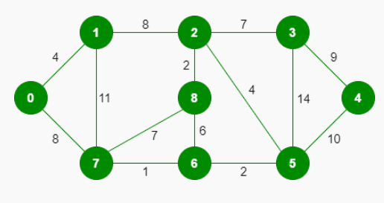

Slide 99







Slide 100



