Slide 1
Unit 4 Dynamic programming
-Dr. Varsha R.Dange

Slide 2
Contents
General strategy,
Fibonacci sequence example dynamic and recursive with comparison.
Travelling salesman problem by dynamic programming. And
0-1 knapsack problem using dynamic programming.

Slide 3
General strategy
Dynamic Programming (DP) is an optimization technique used in algorithm design to solve complex problems by breaking them down into simpler sub-problems and saves the result for future purposes so that we do not need to compute the result again.
DP is widely used to improve the efficiency of recursive solutions by avoiding redundant calculations.
It is particularly useful for problems that have overlapping sub-problems and optimal substructure.

Slide 4
General strategy
Dynamic Programming (DP) Follows “principle of optimality”
It means :
It will take decision at each stage to find optimal solution.

Slide 5
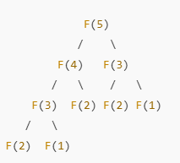
Overlapping Subproblems
A problem has overlapping sub-
problems if it solves the same smaller
problems multiple times.
Example: Fibonacci Numbers
The Fibonacci sequence is:
F(n)=F(n−1)+F(n−2)
Let’s compute F(5)using recursion:
2.Optimal Substructure → The best solution is built from the best solutions of subproblems.

Slide 6
Dynamic programming approach is similar to divide and conquer in breaking down the problem into smaller and yet smaller possible sub-problems.
But unlike divide and conquer, these sub-problems are not solved independently.
Rather, results of these smaller sub-problems are remembered (Memoization) and used for similar or overlapping sub-problems.

Slide 7
Applications of Dynamic Programming
0-1 Knapsack Problem
Travelling Salesman Problem (Dynamic Approach)
Longest Common Subsequence Algorithm
Floyd Warshall Algorithm
Matrix Chain Multiplication

Slide 8
How does the dynamic programming approach work?
The following are the steps that the dynamic programming follows:
It breaks down the complex problem into simpler subproblems.
It finds the optimal solution to these sub-problems.
It stores the results of subproblems . The process of storing the results of subproblems is known as memoization.
It reuses them so that same sub-problem is calculated not more than once.
Finally, calculate the result of the complex problem.
In the case of dynamic programming, the space complexity would be increased as we are storing the intermediate results, but the time complexity would be decreased.

Slide 9
Approaches of dynamic programming
There are two approaches to dynamic programming:
Top-down approach
Bottom-up approach

Slide 10
Top-down approach
The top-down approach follows the memorization technique
while bottom-up approach follows the tabulation method.
Advantages
It is very easy to understand and implement.
It solves the subproblems only when it is required.
It is easy to debug.
Disadvantages
It uses the recursion technique that occupies more memory in the call stack.
Sometimes when the recursion is too deep, the stack overflow condition will occur.
It occupies more memory that degrades the overall performance.

Slide 11
Bottom-Up approach
The bottom-up approach is also one of the techniques which can be used to implement the dynamic programming.
It uses the tabulation technique to implement the dynamic programming approach.
It solves the same kind of problems but it removes the recursion.
If we remove the recursion, there is no stack overflow issue and no overhead of the recursive functions.
In this tabulation technique, we solve the problems and store the results in a matrix.

Slide 12
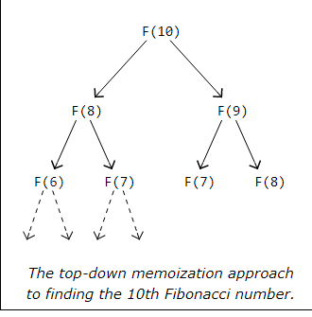
Why is it called "Top-Down"?
We start from the main problem and break it into smaller subproblems.
If a subproblem has been solved before, we reuse the stored result (memoization).
This follows a recursive approach.

Slide 13
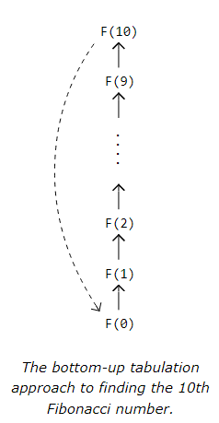
Why is it called "Bottom-Up"?
We start solving the smallest subproblems first and build up to the final solution.
Uses iteration instead of recursion.
Stores all results in a table (array dp[]) to avoid re-computation.

Slide 14
Fibonacci sequence using DP

Slide 15
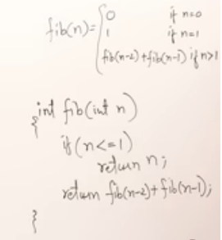
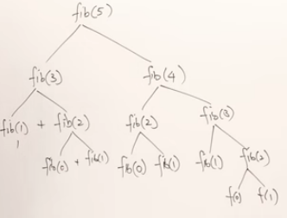
0,1,1,2,3,5,8,13…. Now we want to find out nth term for eg. Fib(5) ,total 15 calls done

Slide 16
Now recurrence relation T(n)=2T(n-1)+1
Ans=O(2^n)
So can we minimize it ? YES using DP

Slide 17
Memoization Method
Here we take Global Array, initially empty so -1 used i.e not known
Now trace the tree
-1 | -1 | -1 | -1 | -1 | -1
0
1
2
3
4
5

Slide 18
Fib5, -1 ,we don’t know it value ,so call the function Fib3 -1 ,Fib4=-1 ,Fib1 now in code it is given base case as it return n. for Fib1 =1 ,store in array.
Fib2,unknown,Fib0=0….use the stored value for calculations.
0 | 1 | 1 | 2 | 3 | 5
0
1
2
3
4
5

Slide 19
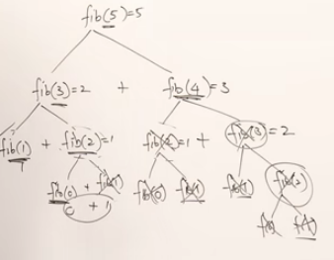
By storing the result ,we have minimize the repeated calls . Here we have done 6 calls ,i.e n+1 calls. So Time complexity reduced to O(n) i.e. exponential to linear.

Slide 20
Memoization follows top down approach ,here we have started with Fib(5) then goes down .
But it is now commonly used.
Tabulation method is common

Slide 21
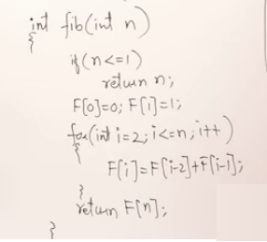
Tabulation Method
0 | 1
Consider this code :
0
1
2
3
4
5
0 | 1 | 1
0
1
2
3
4
5
i
0 | 1 | 1 | 2
0
1
2
3
4
5
i

Slide 22
Tabulation Method
0 | 1 | 1 | 2 | 3
Consider this code :
0
1
2
3
4
5
i
0 | 1 | 1 | 2 | 3 | 5
0
1
2
3
4
5
i
It uses bottom up approach ,we started with base condition

Slide 23
0-1 Knapsack problem using dynamic programming

Slide 24
0-1 Knapsack problem
Unlike in fractional knapsack, the items are always stored fully without using the fractional part of them.
Its either the item is added to the knapsack or not. Its not divisible .
that is why, this method is known as the 0-1 Knapsack problem.
Aim for this is to maximize the total value of items placed in a knapsack of limited capacity.

Slide 25
Problem Statement
Given:
N items/objects, each with a weight (w[i]) and a value/profit (p[i]).
A knapsack with a maximum weight capacity of M.
Find the maximum value/profit that can be obtained by selecting some items, ensuring that their total weight does not exceed M.
Each item can be either included (1) or not included (0)

Slide 26
Dynamic Programming Approach
In this we take decision at every stage that items include or not, represented as 1or 0.
W=8 n=4
P={1,2,5,6}
w={2,3,4,5}
If we apply brute force here then we can find possible combinations like
{0,0,0,0}
{0,0,0,1}
{0,1,0,1}
{1,0,1,0} like wise ,n choose which one will give max profit. It will required 2^n solutions .So using DP we can min it.

Slide 27
Tabulation
mtd:
M=8 n=4
P={1,2,5,6}
w={2,3,4,5}
The DP table V[i][w] is a 2D array where:
i represents items (0 to n).
w represents knapsack capacity (0 to W).
V[i][w] stores the maximum profit we can get by considering the first i items and a knapsack of capacity w.
W
0 | 1 | 2 | 3 | 4 | 5 | 6 | 7 | 8
Pi | wi
1 | 2
2 | 3
5 | 4
6 | 5
0
1
2
3
4

Slide 28
M=8 n=4 Here we can use formula to solve
P={1,2,5,6}
w={2,3,4,5}
Initially we are not filling any obj in bag, so no profit
w
0 | 1 | 2 | 3 | 4 | 5 | 6 | 7 | 8
Pi | wi
1 | 2
2 | 3
5 | 4
6 | 5
0
1
2
3
4
0 | 0 | 0 | 0 | 0 | 0 | 0 | 0 | 0
0
0
0
0

Slide 29
Now we consider 1st object & ignore other obj .Similarly goes to 2nd obj consider & 1st is also be considered and ignored remaining ,means
If we at i^{th} row means we consider all the objects also
w
0 | 1 | 2 | 3 | 4 | 5 | 6 | 7 | 8
Pi | wi
1 | 2
2 | 3
5 | 4
6 | 5
0
1
2
3
4
0 | 0 | 0 | 0 | 0 | 0 | 0 | 0 | 0
0
0
0
0

Slide 30
Now first weight 2, it can be filled if capacity is 2 ,so profit will be one .Write it in table ,1 will be as previous i.e 0. and remaining row values will be 1 because at this stage we are having only one obj to fill
w
0 | 1 | 2 | 3 | 4 | 5 | 6 | 7 | 8
Pi | wi
1 | 2
2 | 3
5 | 4
6 | 5
0
1
2
3
4
0 | 0 | 0 | 0 | 0 | 0 | 0 | 0 | 0
0 | 0 | 1 | 1 | 1 | 1 | 1 | 1 | 1
0
0
0

Slide 31
Consider 2nd obj ,it can be filled when M=3 so profit =2 ,write it in table and previous values will be same 0,1
now we have consider 1st also .
So w=5 and M=5 p=3 so from 5 to 8 al values will be 3 .
At 4 ,we can from upper value 1 or its previous 2 ,whichever is max ,so 2
w
0 | 1 | 2 | 3 | 4 | 5 | 6 | 7 | 8
Pi | wi
1 | 2
2 | 3
5 | 4
6 | 5
0
1
2
3
4
0 | 0 | 0 | 0 | 0 | 0 | 0 | 0 | 0
0 | 0 | 1 | 1 | 1 | 1 | 1 | 1 | 1
0 | 0 | 1 | 2 | 2 | 3 | 3 | 3 | 3
0
0

Slide 32
3rd obj ,this obj can fill in the bag if capacity is 4,so profit is 5 .
Now we consider 1 n 2nd obj as well.check for combination
If we take 1st n 3rd obj the weight =6 ,p=6
If we take 2nd n 3rd obj the weight =7 ,p=7
w
0 | 1 | 2 | 3 | 4 | 5 | 6 | 7 | 8
Pi | wi
1 | 2
2 | 3
5 | 4
6 | 5
0
1
2
3
4
0 | 0 | 0 | 0 | 0 | 0 | 0 | 0 | 0
0 | 0 | 1 | 1 | 1 | 1 | 1 | 1 | 1
0 | 0 | 1 | 2 | 2 | 3 | 3 | 3 | 3
0 | 0 | 1 | 2 | 5 | 5 | 6 | 7 | 7
0

Slide 33
Now Formula :if we call table as V then
V[i,w] =max V[i-1,w],
V[i-1,w-w[i]]+p[i]
i=row no,w=column no.
w
0 | 1 | 2 | 3 | 4 | 5 | 6 | 7 | 8
Pi | wi
1 | 2
2 | 3
5 | 4
6 | 5
0
1
2
3
4
0 | 0 | 0 | 0 | 0 | 0 | 0 | 0 | 0
0 | 0 | 1 | 1 | 1 | 1 | 1 | 1 | 1
0 | 0 | 1 | 2 | 2 | 3 | 3 | 3 | 3
0 | 0 | 1 | 2 | 5 | 5 | 6 | 7 | 7
0

Slide 34
V[i,w] =max{V[i-1,w],V[i-1,w-w[i]]+p[i]}
Now 4th obj,
V[4,1]=max{V[3,1],V[3,1-5]+6} it become V[3,-4],this value is undefined so we take V[3,1]as max
upto 5th weight we get –ve no. so fill as it is.
w
0 | 1 | 2 | 3 | 4 | 5 | 6 | 7 | 8
Pi | wi
1 | 2
2 | 3
5 | 4
6 | 5
0
1
2
3
4
0 | 0 | 0 | 0 | 0 | 0 | 0 | 0 | 0
0 | 0 | 1 | 1 | 1 | 1 | 1 | 1 | 1
0 | 0 | 1 | 2 | 2 | 3 | 3 | 3 | 3
0 | 0 | 1 | 2 | 5 | 5 | 6 | 7 | 7
0 | 0 | 1 | 2 | 5

Slide 35
V[i,w] =max{V[i-1,w],V[i-1,w-w[i]]+p[i]}
V[4,5]=max{V[3,5],V[3,5-5]+6}= max{V[3,7],V[3,0]+6}
max{ 5,0+6=6}=6
w
0 | 1 | 2 | 3 | 4 | 5 | 6 | 7 | 8
Pi | wi
1 | 2
2 | 3
5 | 4
6 | 5
0
1
2
3
4
0 | 0 | 0 | 0 | 0 | 0 | 0 | 0 | 0
0 | 0 | 1 | 1 | 1 | 1 | 1 | 1 | 1
0 | 0 | 1 | 2 | 2 | 3 | 3 | 3 | 3
0 | 0 | 1 | 2 | 5 | 5 | 6 | 7 | 7
0 | 0 | 1 | 2 | 5 | 6

Slide 36
V[i,w] =max{V[i-1,w],V[i-1,w-w[i]]+p[i]}
V[4,6]=max{V[3,6],V[3,6-5]+6}= max{V[3,7],V[3,1]+6}
max{ 6,0+6=6}=6
w
0 | 1 | 2 | 3 | 4 | 5 | 6 | 7 | 8
Pi | wi
1 | 2
2 | 3
5 | 4
6 | 5
0
1
2
3
4
0 | 0 | 0 | 0 | 0 | 0 | 0 | 0 | 0
0 | 0 | 1 | 1 | 1 | 1 | 1 | 1 | 1
0 | 0 | 1 | 2 | 2 | 3 | 3 | 3 | 3
0 | 0 | 1 | 2 | 5 | 5 | 6 | 7 | 7
0 | 0 | 1 | 2 | 5 | 6 | 6

Slide 37
V[i,w] =max{V[i-1,w],V[i-1,w-w[i]]+p[i]}
V[4,7]=max{V[3,7],V[3,7-5]+6}= max{V[3,7],V[3,2]+6}
max{ 7,1+6=7}=7
w
0 | 1 | 2 | 3 | 4 | 5 | 6 | 7 | 8
Pi | wi
1 | 2
2 | 3
5 | 4
6 | 5
0
1
2
3
4
0 | 0 | 0 | 0 | 0 | 0 | 0 | 0 | 0
0 | 0 | 1 | 1 | 1 | 1 | 1 | 1 | 1
0 | 0 | 1 | 2 | 2 | 3 | 3 | 3 | 3
0 | 0 | 1 | 2 | 5 | 5 | 6 | 7 | 7
0 | 0 | 1 | 2 | 5 | 6 | 6 | 7

Slide 38
V[i,w] =max{V[i-1,w],V[i-1,w-w[i]]+p[i]}
V[4,8]=max{V[3,8],V[3,8-5]+6}=max{V[3,8],V[3,3]+6}
max{ 7,2+6=8}=8 final answer is 8 so sequence of weight ={0,1,0,1) it 2 and 4th obj
w
0 | 1 | 2 | 3 | 4 | 5 | 6 | 7 | 8
Pi | wi
1 | 2
2 | 3
5 | 4
6 | 5
0
1
2
3
4
0 | 0 | 0 | 0 | 0 | 0 | 0 | 0 | 0
0 | 0 | 1 | 1 | 1 | 1 | 1 | 1 | 1
0 | 0 | 1 | 2 | 2 | 3 | 3 | 3 | 3
0 | 0 | 1 | 2 | 5 | 5 | 6 | 7 | 7
0 | 0 | 1 | 2 | 5 | 6 | 6 | 7 | 8

Slide 39
Step-by-Step Process to Find Selected Items
Start from the last cell
v[n][W], where n is the number of items and W is the total knapsack capacity.
Compare the value from the previous row:
If v[i][w]≠v[i−1][w], it means item was included.
If v[i][w]=v[i−1][w], the item was not included.
If an item was not included:
Move to the previous row:
i = i−1
If an item was included:
Subtract its weight from the remaining capacity:
w = w−w[i−1]
Move to the previous row:
i = i−1
Repeat until i=0 or remaining capacity w=0.

Slide 40
Find Selected Items
The maximum value obtained is 8 (from v[4][8]).
to find selected items:
v[4][8]=8 and v[3][8]=7 i.e 8 ≠ 7 so Item 4 (wi=5, Pi=6) is included.
Remaining weight: 8−5=3. now
v[3][3]=2 and v[2][3]=2, so Item 2 (wi=3, Pi=2) is included.
Remaining weight: 3−3=0.
Stop (since W=0).
Final Answer
Maximum Value: 8
Selected Items: Item 4 (w=5, P=6) Item 2 (w=3, P=2)

Slide 41
Time complexity analysis
The 0/1 Knapsack problem using Dynamic Programming (DP) has a time complexity of O(nW), where:
n is the number of items.
W is the total capacity of the knapsack.
We use a 2D DP table of size (n+1)×(W+1), where:
Rows represent items (from 0 to n).
Columns represent capacities (from 0 to W).
Nested Loop Execution
The outer loop runs for each item O(n).
The inner loop runs for each weight capacity O(W).
Since each cell in the table is filled once using a constant-time operation O(1),
the total time complexity is:
O(n×W)
Unlike the exponential time complexity O(2^n) of the recursive approach, the DP approach significantly improves efficiency.

Slide 42
If the item is not included → take previous value V[i-1, w]
If the item is included → take V[i-1, w - weight[i]] + p [i]

Slide 43
// Function to solve 0/1 Knapsack problem using 2D DP table
int knapsack(int W, int weight[], int value[], int n) {
int V[n + 1][W + 1]; // DP table
// Initialize the table
for (int i = 0; i <= n; i++) {
for (int w = 0; w <= W; w++) {
if (i == 0 || w == 0) { // Base case: No items or 0 capacity
V[i][w] = 0;
} else if (weight[i - 1] <= w) { // checking If item can fit (index i-1,
because indexing starts from 0)
if (V[i - 1][w] > p[i - 1] + V[i - 1][w - weight[i - 1]]) {
V[i][w] = V[i - 1][w]; // Do not include the item
} else {
V[i][w] = p[i - 1] + V[i - 1][w - weight[i - 1]]; // Include the item
}} else {
V[i][w] = V[i - 1][w]; // Item cannot be included
} } } return V[n][W]; // Maximum value for the full knapsack }

Slide 44
We check whether the current item (index i-1, because indexing starts from 0) can fit in the knapsack with the given capacity w.
If weight[i-1] ≤ w, we have two choices:
Exclude the item → Take the value from the previous row: V[i-1][w]
Include the item → Add its value to the best solution without this item: p[i-1] + V[i-1][w - weight[i-1]].

Slide 45
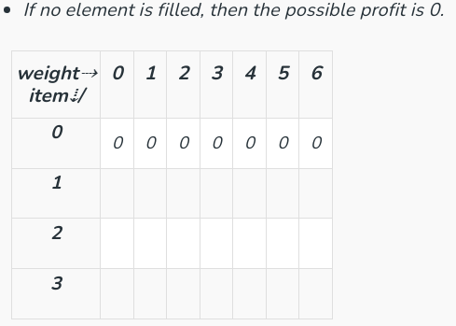
weight[] = {1, 2, 3}, profit[] = {10, 15, 40}, Capacity = 6

Slide 46
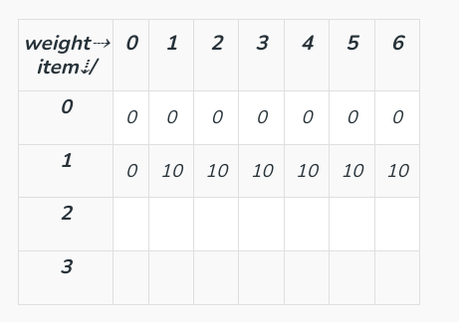
weight[] = {1, 2, 3}, profit[] = {10, 15, 40}, Capacity = 6

Slide 47
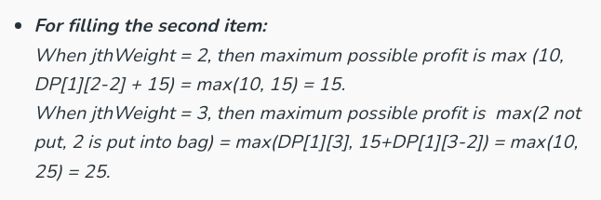
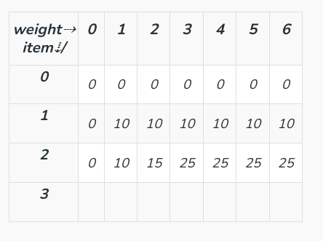

Slide 48
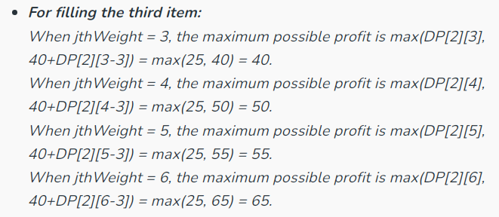
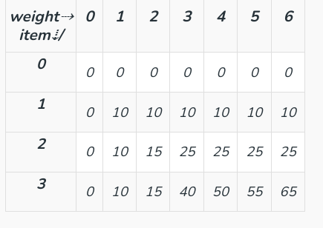

Slide 49
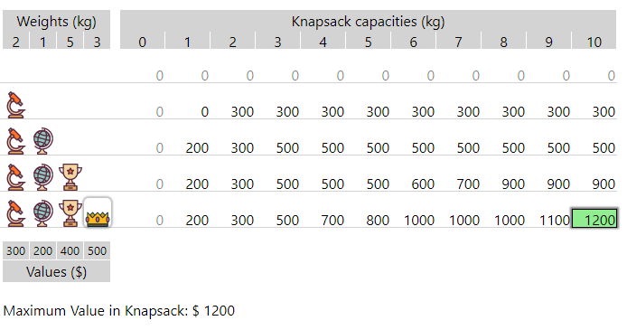

Slide 50
Traveling Salesman Problem using Dynamic Programming

Slide 51
Traveling Salesman Problem (TSP)
The Traveling Salesman Problem (TSP) is a famous optimization problem where a salesman must visit N cities exactly once and return to the starting city while minimizing the total travel cost (distance or time).

Slide 52
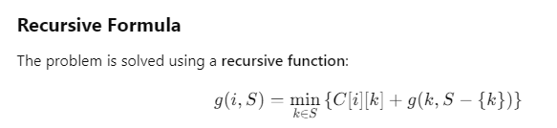
g(i,S)- min. cost of visiting cities in s and ending at city 1.
S-set of cities to visit
i-starting city
c[i,k] – cost of travelling from city i to k city
S-{k}-subset of S excluding k city

Slide 53
Time complexity = O(n² * 2^n)
Time complexity= no. of unique subproblems * time taken by each unique subproblem

