Slide 1
Unit 5 Backtracking
- by: Dr. Varsha R.Dange

Slide 2
Backtracking
Backtracking is like trying different paths, and when you hit a dead end, you backtrack to the last choice and try a different route.
Backtracking is a problem-solving algorithmic technique that involves finding a solution incrementally by trying different options and undoing them if they lead to a dead end.

Slide 3
It is commonly used in situations where you need to explore multiple possibilities to solve a problem,
like searching for a path in a maze or solving puzzles like Sudoku.
When a dead end is reached, the algorithm backtracks to the previous decision point and explores a different path until a solution is found or all possibilities have been exhausted.

Slide 4
Types of Backtracking Problems
Problems associated with backtracking can be categorized into 3 categories:
Decision Problems
These problems require determining whether a solution exist(yes/no)
Example: Checking if a Hamiltonian cycle exists in a graph.
2. Optimization Problems
These problems involve finding the best solution from multiple possible solutions. Example: The Traveling Salesman Problem (TSP)—finding the shortest route covering all cities.
3. Constraint Satisfaction Problems (CSPs)
Problems where a solution must satisfy a given set of constraints. Example: Sudoku, n-Queens, Graph Coloring.

Slide 5
Generally constraint satisfaction problem can be solved using backtracking
Backtracking problems involve two types of constraints:
1. Explicit Constraints
These define the properties of a valid solution.
If an explicit constraint is violated, backtracking occurs immediately.
Examples-
in n-Queens, no two queens should be in the same row, column, or diagonal.
In Graph Coloring, adjacent nodes must not have the same color.

Slide 6
Implicit Constraints
These define the rules for selecting the next possible solution step.
They dynamically evolve as the solution is built.
Examples:
In Sudoku, a number can be placed in a cell only if it is not present in the same row, column, or box.
In Word Search, the next selected letter must if it form a valid word.

Slide 7
Working of Backtracking Algorithm
Choose a possible solution component.
Verify if it satisfies constraints.
If it satisfies, proceed to the next step.
If it violates, backtrack and try another option.
Repeat until a complete solution is found.

Slide 8
Backtracking Algorithm Structure (Pseudocode)
Backtrack(solution):
if solution is complete:
process the solution
return
for each possible choice:
if choice is valid:
make the choice
Backtrack(solution) // Recursive call
undo the choice (backtrack) // Remove last step if needed

Slide 9
Detailed Explanation of the Steps
Base Case:
If the solution is complete, process it and return.
Recursive Case:
Loop through all possible choices at the current step.
Check if a choice is valid (i.e., satisfies constraints).
If valid, include the choice and move to the next step.
If no valid solution is found, backtrack by undoing the last choice.

Slide 10
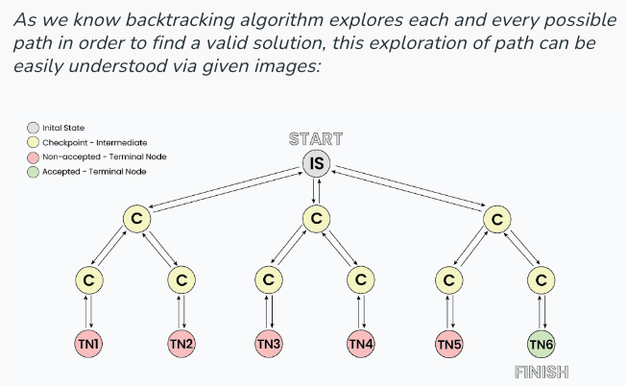
How does Backtracking works?

Slide 11
graph coloring problem with examples

Slide 12
Graph coloring problem
Graph coloring refers to the problem of coloring vertices of a graph in such a way that no two adjacent vertices have the same color.
This is also called the vertex coloring problem.
If coloring is done using at most m colors, it is called m-coloring.

Slide 13
graph coloring problem
Graph coloring problem is both, a decision problem as well as an optimization problem.
A decision problem is stated as, “With given M colors and graph G, whether a such color scheme is possible or not?”.
The optimization problem is stated as, “Given M colors and graph G, find the minimum number of colors required for graph coloring.”

Slide 14
Applications of Graph Coloring
Map Coloring -
Ensures that no two adjacent regions (countries, states, districts) share the same color.
Used in geographical maps to differentiate neighboring areas.
Task Scheduling -
Assigns resources (e.g., CPU, workers, classrooms) to tasks while avoiding conflicts.
Example: Parallel processing where dependent tasks get different colors to avoid execution conflicts.

Slide 15
Applications of Graph Coloring
Time Table Scheduling-
Allocates different time slots for classes/exams ensuring no two overlapping events occur at the same time.
Assignment Problems -
Assigns workers to tasks, ensuring that no worker is assigned two conflicting tasks.
Example: Assigning interviewers to candidates in a recruitment process.

Slide 16
Applications of Graph Coloring
Conflict Resolution -
Used in networks, databases, and traffic systems to prevent conflicts.
Example: Deadlock prevention in operating systems by ensuring non-conflicting resource allocation.
Sudoku Puzzle Solving -
Each cell in a Sudoku grid represents a node in a graph.
Each number represents a different color.

Slide 17
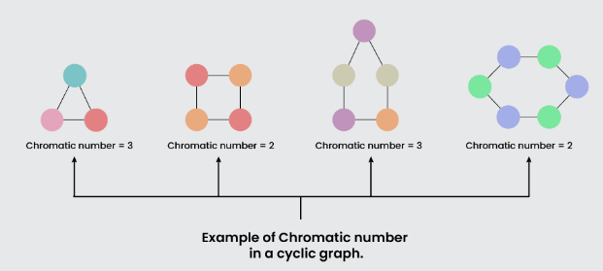
Chromatic Number:
The minimum number of colors needed to color a graph is called its chromatic number.
For example, the following can be colored a minimum of 2 colors.

