Slide 1
DESIGN AND ANALYSIS OF ALGORITHMS
-Dr. Varsha R.Dange

Slide 2
Course Prerequisites: Basic programming Skills, Data structures, Discrete Structures.
Course Objectives:
1. To understand asymptotic notations and apply suitable mathematical techniques to find asymptotic time and space complexities of algorithms.
2. To provide students with foundations to deal with a variety of computational problems using different design strategies.
3. To select appropriate algorithm design strategies to solve real world problems.
4. To understand notions of NP-hardness and NP-completeness and their relationship with the intractability of decision problems.
5. To understand randomized, approximation algorithms for given computational problems.

Slide 3
Course Outcomes
The student will be able –
1. To formulate computational problems mathematically.
2. To apply appropriate algorithmic paradigm to design efficient algorithms for computational problems.
3. To apply suitable mathematical techniques to analyze asymptotic complexity of the algorithm for a complex computational problem.
4. To understand the significance of NP--completeness of some decision problems and its relationship with intractability of the decision problems.
5. To understand significance of randomness, approximability in computation and design randomized and approximation algorithms for suitable problems.
6. To incorporate appropriate data structures, algorithmic paradigms to craft innovative scientific solutions for complex computing problems.

Slide 4
Unit 1
Basic introduction to time and space complexity analysis: Algorithm definition, insertion sort running time calculation, Notations Theta, big O, big Omega, little o notations with examples. Space complexity definition and examples like matrix multiplication, bubble sort, factorial computation recursive and iterative version. Recurrence relations and finding time complexity using substitution method, recursion tree and master theorem. Proof of correctness of algorithms

Slide 5
Algorithm
An algorithm is any well-defined computational
procedure that takes some value, or set of values, as
input and produces some value, or set of values, as
output.
An algorithm is thus a sequence of computational steps that transform the input into the output.

Slide 6
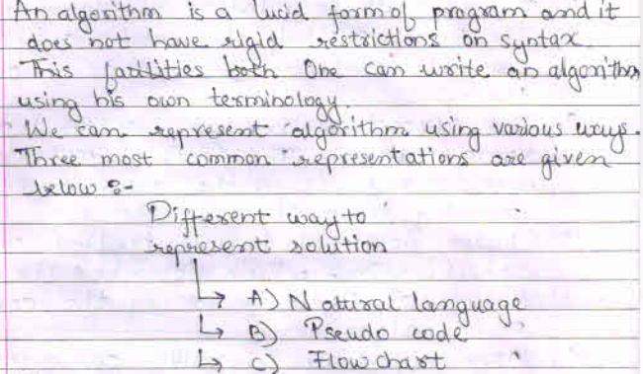
Algorithm

Slide 7
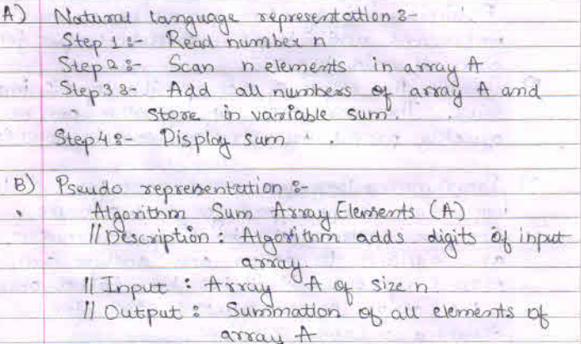
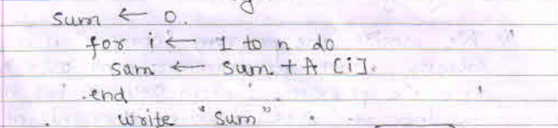
Ways of writing Algorithm

Slide 8
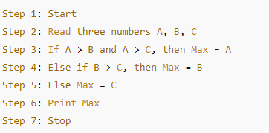
Ways of writing Algorithm
Natural Language (Plain English)
Simple, human-readable steps.
Good for explaining the logic informally.
Example: Problem: Find the maximum of three numbers.

Slide 9
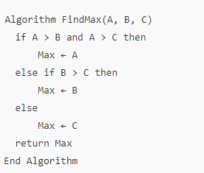
Ways of writing Algorithm
2. Pseudocode
Structured like programming code but language-independent.
Preferred in DAA for clarity and analysis.
Example:

Slide 10
Ways of writing Algorithm
3. Flowchart
Visual representation using symbols (ovals, diamonds, rectangles).
Useful for understanding flow and logic.
Best for beginners or simple processes.

Slide 11
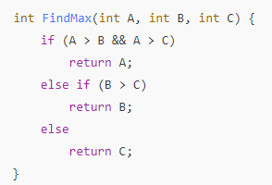
Ways of writing Algorithm
4. Programming Language
Writing the actual implementation in C, Python, Java, etc.
Useful for running and testing.
Example in C:

Slide 12
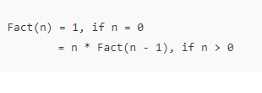
Ways of writing Algorithm
5. Mathematical/Recursive Notation
Used for recursive algorithms and mathematical problems.
Example: Factorial

Slide 13
Analysis of Algorithms
Analysis of algorithms is the process of evaluating an algorithm's efficiency in terms of:
Time (how fast it runs)
Space (how much memory it uses)
It helps you decide which algorithm is best suited for a given problem, especially when there are multiple alternatives.

Slide 14
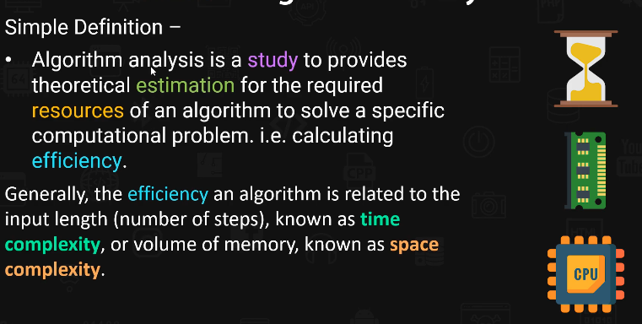
Analysis of Algorithms

Slide 15
Analysis of Algorithms
This ensures that our program works well, especially when dealing with large amounts of data or solving complex problems.
Real-Time Example
Imagine you're planning a road trip, and you have two routes to choose from:
Route A is a highway with minimal traffic, but it's longer.
Route B is shorter but has heavy traffic.
Similarly, in programming:
Route A might be like an algorithm that's slower but uses less memory.
Example: A recursive algorithm using fewer variables (e.g., recursive Fibonacci with no array)
Slower because it recalculates values
Uses little memory

Slide 16
Analysis of Algorithms
Route B might be faster but uses more memory.
frequent braking, acceleration, and idling in traffic.
Requires more fuel because of the stop-and-go.
Example:
A dynamic programming version of Fibonacci using memoization or a table
Faster due to reuse of computed values
Uses extra memory to store results

Slide 17
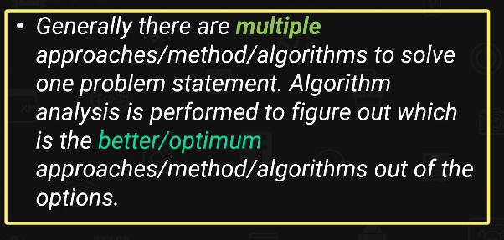

Need of Analysis of Algorithms

Slide 18
What is the need for Complexity Analysis?
Complexity Analysis determines the amount of time and space resources required to execute it.
It is used for comparing different algorithms on different input sizes.
Complexity helps to determine the difficulty of a problem.
measured by how much time and space (memory) it takes to solve a particular problem

Slide 19
Orders of growth (time complexities) (classes of Time function)
f(n)=2n+3
f(n) =500n+700
f(n) = n/200+6
O(n)
order of growth means the efficiency of an algorithm
Order of Growth | Description | Example | Explanation
Constant | O(1) | Indexing an item in a list | Time does not depend on input size.
Logarithmic | O(log N) | Repeatedly halving a number | Time grows with the logarithm of input size.
Linear | O(n) | Summing a list | Time grows proportionally to input size.
Quadratic | O(n^2) | Summing each pair of numbers in a list | Time grows quadratically with input size.
Cubic | O(n^3) | Matrix Multiplication | Cubic growth. Examples include triple nested loops.
Exponential | O(2^n) | Visiting each node in a binary tree | Time doubles with each additional input size.

Slide 20

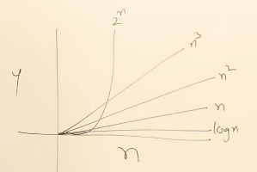
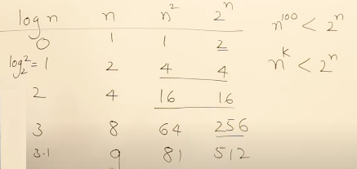
Orders of growth (time complexities) (classes of Time function)
The sequence of growth rates (from slowest to fastest) is as follows

Slide 21
f(n)=2
f(n) =5
f(n) = 6000
n is size of input
O(1)
Constant Growth (1):
the number of operations Independent of n. Always the slowest growth.
Logarithmic Growth (log ⁡n):
the number of operations grows very slowly, even for large n. For example: log⁡10=1, log⁡100=2 (base 10). (Ex. binary search)
Square Root Growth (√n):
Faster than logarithmic but slower than linear. For example: For n = 100 √n = 10
Linear Growth (n):
the number of operations grows directly proportionally to n. For example: n=100 , algo performs about 100 steps/operations.

Slide 22
Linearithmic Growth (nlog⁡n ):
Combines linear and logarithmic terms. Common in efficient sorting algorithms like merge sort.
Polynomial Growth (n²,n³):
n² grows faster than nlog⁡n and n³ grows faster than n². Examples include nested loops (e.g., bubble sort). Cubic growth. Examples include triple nested loops.
Exponential Growth (2^{n}):
the number of operations grows much faster than any polynomial growth. For example: For n=10, 2^{n} = 1024. Exponential growth. Examples include recursive algorithms like solving the traveling salesman problem.
Super-Exponential Growth (n^{n}):
The fastest growth rate. For n=5 , n^{n}=3125

Slide 23
Asymptotic Notations in Complexity Analysis:
Algorithm A is asymptotically faster than Algorithm B
We mean:
For small inputs, B might be faster.
But for large inputs, A will eventually be better or more efficient.

Slide 24
Asymptotic Notations in Complexity Analysis:
Asymptotic Notation is a way to describe the efficiency of an algorithm (time or space)
Asymptotic Notations are mathematical tools used to describe how fast an algorithm work when the input size (n) becomes very large. (n→ ∞).
asymptotic notations are used to evaluate the performance of an algorithm, in its best cases and worst cases scenario.
Is a method of defining the mathematical boundaries of its run-time performance .
There are mainly three asymptotic notations:
Big-Oh Notation (O-notation)
Big-Omega Notation (Ω-notation)
Theta Notation (Θ-notation)
Small /little Oh (o)
Small /little omega ω

Slide 25
Big-O notation
Big O notation is a mathematical notation used to describe the upper bound or worst-case scenario of an algorithm's runtime complexity in terms of the input size.
Describes the maximum time an algorithm takes.
It tells : “The algorithm will not take more time than this, even in the worst case.”
Example: If an algorithm runs in at most 5n + 3 steps, we say it is O(n).

Slide 26
Big-O notation
In Big O notation, "order" refers to the growth rate of a function as its input size increases.
It helps measure how the time (or space) complexity of an algorithm scales with the size of the input.
Big-O notation ignores constants and lower-order terms to focus on the dominant factor that affects growth.

Slide 27
algorithm grows” /growth rate
It means: How the time (or memory) taken by the algorithm increases when the input size (n) becomes bigger.
Algorithm grows” means: How quickly the time or space increases when the input gets bigger
In other words:
When the input gets larger, does your algorithm:
Take a little more time?
Take a lot more time?
Take crazy long time?

Slide 28
algorithm grows” /growth rate
Ex-
You’re cooking:
For 2 people, it takes 20 minutes.
For 4 people, it takes 40 minutes.
For 8 people, it takes 80 minutes.
Here, time increases as the number of people increases → so your cooking "grows" linearly.

Slide 29
algorithm grows” /growth rate
Growth Rate = "How Fast" the Time Increases
For n², the algorithm grows faster
For n, it grows slower
Input size (n) | Steps for f(n) = n | Steps for f(n) = n²
1 | 1 | 1
10 | 10 | 100
100 | 100 | 10,000

Slide 30
f(n)
f(n) is the actual number of steps (or time or memory) your algorithm takes when the input size is n.
Real-Life Analogy:
Imagine you’re folding clothes:
1 shirt → takes 1 minute
5 shirts → takes 5 minutes
100 shirts → takes 100 minutes
That’s f(n) = n (because time grows as the number of shirts n grows)
Ex.
for (int i = 0; i < n; i++) { print(i); }
This loop runs n times. So, f(n) = n (Number of steps = n)

Slide 31
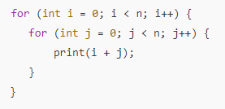
This loop runs n × n = n² times
So, f(n) = n²

Slide 32
g(n) is a standard function used to compare with the actual work your algorithm does.
g(n) is a known function used to describe how fast an algorithm grows
f(n) = what your algorithm actually does
g(n) = a reference growth pattern like:
1 → constant time
log n → logarithmic time
n → linear time
n² → quadratic time
2ⁿ → exponential time
You use g(n) to describe the speed class of your algorithm.
Why do we need g(n)?
Because we want to group and compare algorithms easily.
Instead of saying:
“My algorithm takes 3n² + 5n + 7 steps,” We say: “It grows like n² → That’s g(n)

Slide 33
Common g(n) functions (growth patterns):
g(n) | Called... | Growth Speed | Example Task
1 | Constant | Fastest | Return first element in array
log n | Logarithmic | Very fast | Binary search
n | Linear | Normal speed | Loop over all items
n log n | Linearithmic | Faster than quadratic | Merge sort
n² | Quadratic | Slow | Nested loops
2ⁿ | Exponential | Very slow | All combinations of n items

Slide 34

Big-O notation
Big-O gives an upper bound on how much time or space an algorithm can take as the input size n increases.
Big-O tells us the worst-case time“ It answers the question: “How bad can it get?”
It tells you:
The maximum number of steps your algorithm may take For very large input. Ex-
this loop runs n times So, f(n) = n
We write: f(n) = O(n) → meaning: “This algorithm will take at most n steps”

Slide 35
Big-O notation
For ex- Grocery Checkout
You’re at a supermarket:
If there are n people in line, and the cashier takes 1 minute per person
You wait up to n minutes
So:
Your waiting time = f(n)
Compare with g(n) = n
Then: f(n) = O(n) → time is at most n minutes
Even if sometimes it’s faster (e.g., some people leave), Big-O still describes the worst you might face.

Slide 36
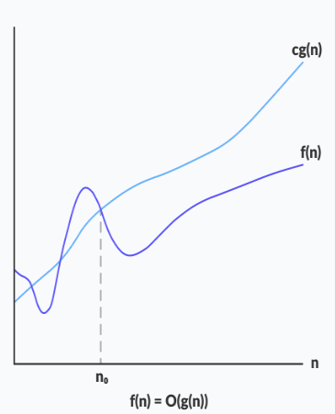
Big-O notation
Mathematical representation (definition):
Given two functions f(n) and g(n),
we say that f(n) is Asymptotically equal to O(g(n))
f(n) = O(g(n)) iff there exist constants c > 0 and n₀ >= 1 such that:
f(n) <= c*g(n) for all n >= n₀.
In simpler terms, here g(n) is an upper bound for function f(n),as g(n) grows faster than f(n) , for all n >= n₀ where c and n₀ are constants.
g(n) is TIGHT upper bound of f(n)

Slide 37
Big-O notation
Example :
If an algorithm runs in f(n) = 3n + 5, then:
It is O(n) because for large enough n, the constant and lower-order terms don’t matter.
i.e., 3n + 5 ≤ 4n for all n ≥ 1
Or we can take
3n + 5 ≤ 4n² for all n ≥ 1

Slide 38
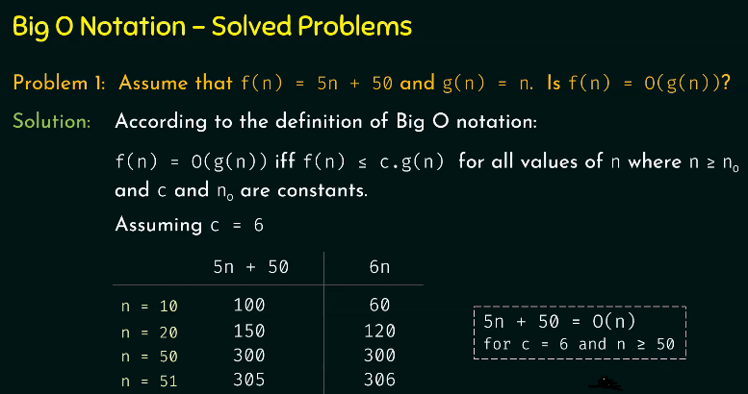
Problem 1

Slide 39
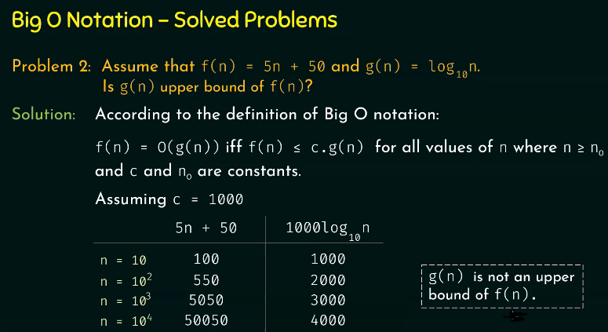

Problem 2
This grows logarithmically with n, which is much slower than linear growth for large n

Slide 40
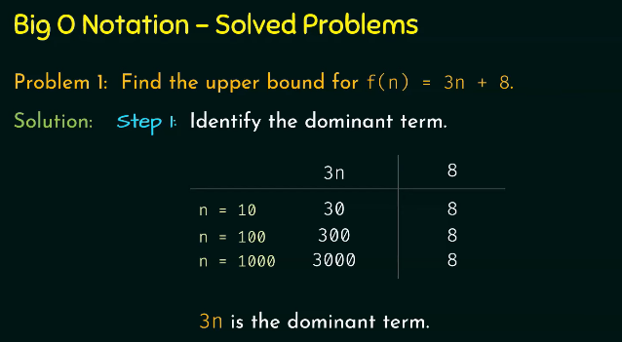
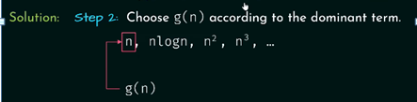
Problem 3

Slide 41
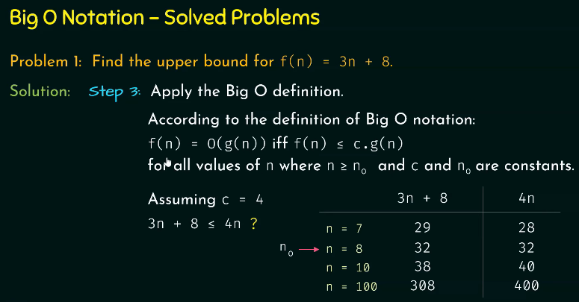

Problem 3 continued………………..

Slide 42
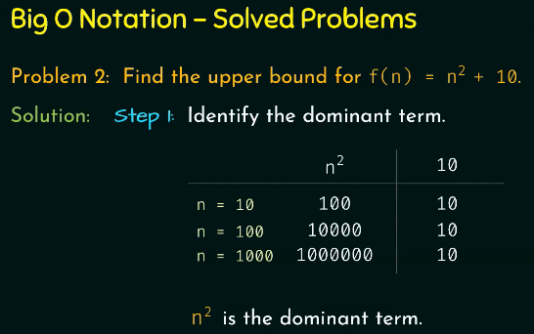
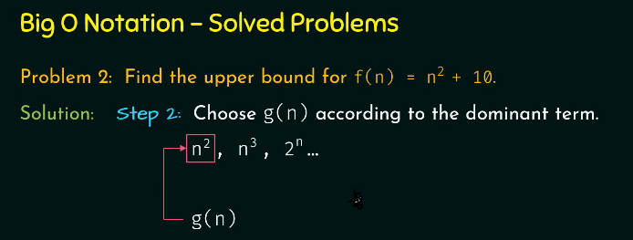
Problem 4

Slide 43
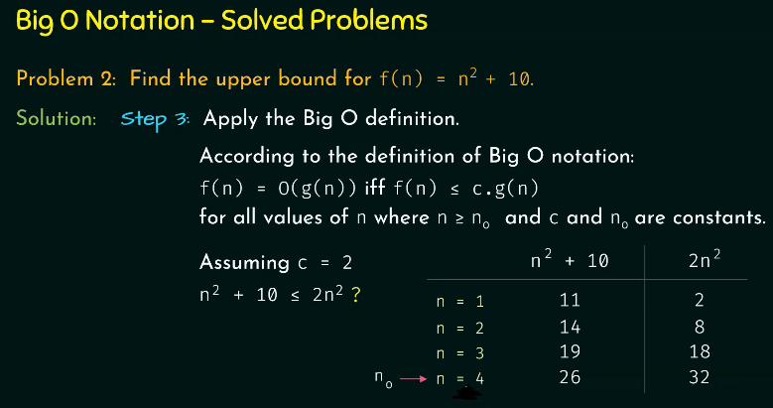
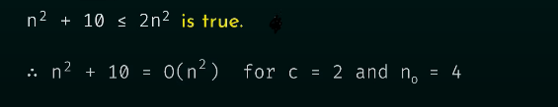
Problem 4 continued……………..

Slide 44
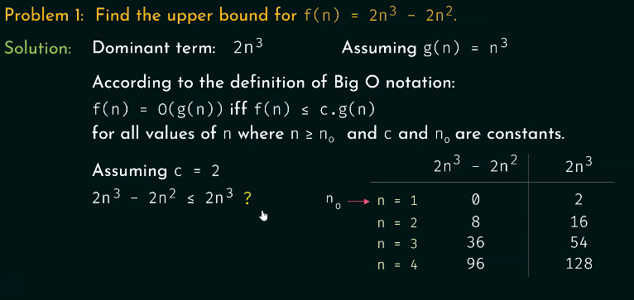
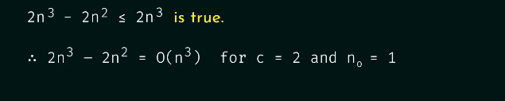
Problem 5

Slide 45
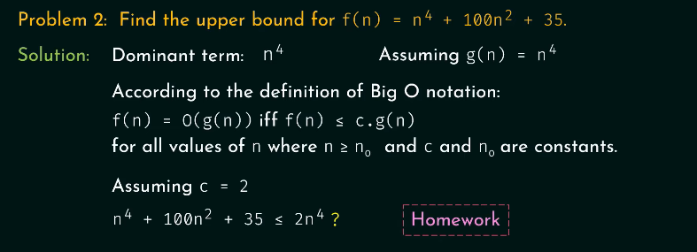
Problem 6
n0=12

Slide 46
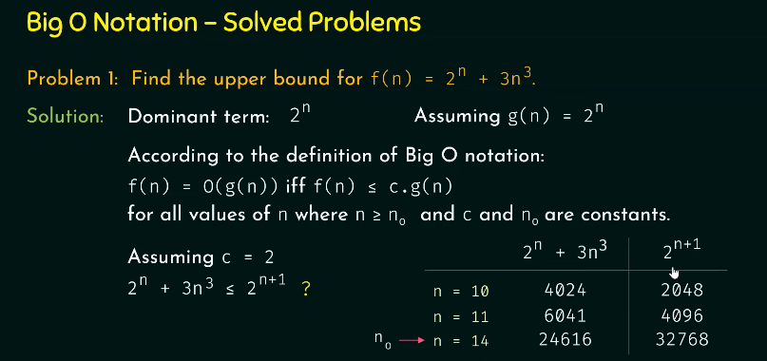

Problem 7

Slide 47
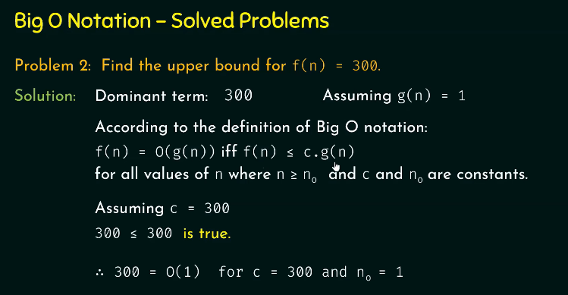
Problem 8

Slide 48
Big-Omega (Ω)?
Big-Omega (Ω) gives a lower bound on the time or space your algorithm will take.
It tells you: “At least this much time will be needed.” It shows best case.
Example Laundry
You are folding clothes:
Each shirt takes at least 1 minute
If there are n shirts, it will take at least n minutes
So:
Time = Ω(n) Even if you are super fast or multitask, you cannot do it in less than n minutes.

Slide 49
Big-Omega (Ω)?
Example:
Let’s say you are searching in an unsorted list:
Best case: the item is at the first position → Ω(1)
Worst case: item is at the end → O(n)
So you can say:
The time to search is Ω(1) and O(n)

Slide 50
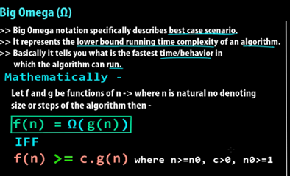
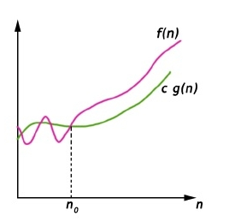
Big Omega
we use Big-Omega Ω when we want to represent the minimum time the algorithm will take.

Slide 51
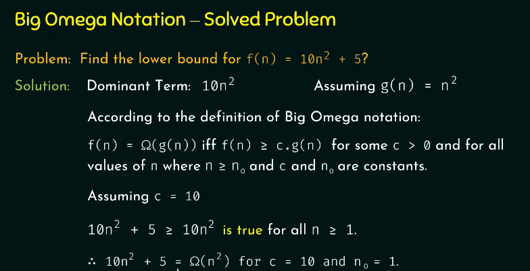
Problem 1

Slide 52
Theta (Θ)
Theta (Θ) notation gives a tight bound on the time or space your algorithm takes.
Your algorithm takes at least and at most that much time — so it grows exactly at that rate.
Ex: If an algorithm takes exactly n steps (not more, not less), we say: f(n) = Θ(n)
This for loop runs exactly n times in all cases:
Best case → n times
Worst case → n times
So, Time complexity = Θ(n)

Slide 53
Theta (Θ)
Example: Bus Travel Time
Imagine a bus that always travels at a fixed speed of 60 km/h.
If you want to calculate how long it will take to travel a distance of n kilometers:
Time taken = (n / 60) hours
This means: The time to travel grows exactly in proportion to the distance.
For every extra km, the time increases by exactly the same amount.
It's a tight bound — not more, not less.
No traffic (no best/worst case)
shortcuts (no random speedups)
Time always grows linearly with distance

Slide 54
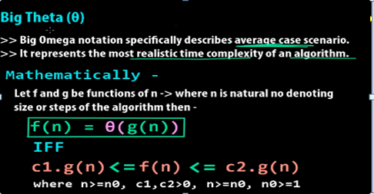
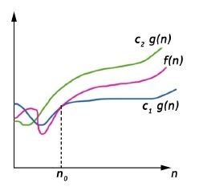
Big Theta Notation
We use Big-Theta (Θ) to show the exact time an algorithm takes.
t means the algorithm takes at least and at most that much time — it's the tight bound.

Slide 55
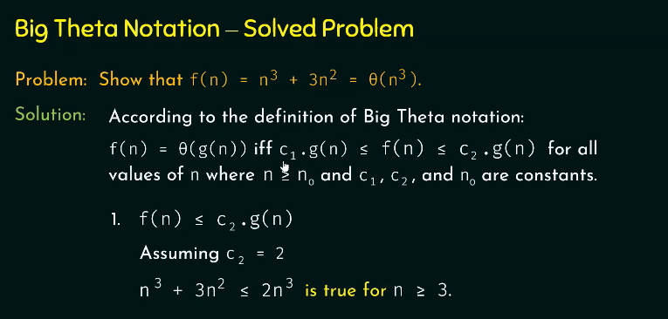
Problem 1

Slide 56
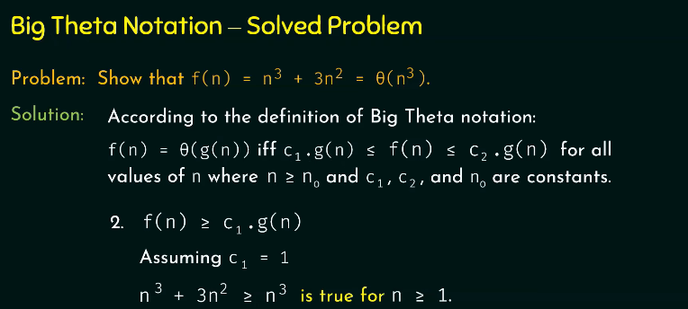

Problem 1 continued………..

Slide 57

Little o Notation
Little o notation is used to describe an upper bound that cannot be tight. In other words, loose upper bound of f(n).
The growth of function f(n) is strictly less than g(n).It means
f(n) grows slower than g(n) as n becomes very large.
f(n) will never catch up to g(n), no matter how big n gets.

Slide 58
Example Slow Walker vs Fast Runner
Imagine:
f(n) is the time a slow walker takes to finish a race as the distance increases.
g(n) is the time a fast runner takes.
Now suppose:
As the race gets longer and longer (distance = n), the walker becomes much slower compared to the runner.
Even though both need more time as distance grows, the walker's time grows much more slowly — it never catches up with the runner.

Slide 59
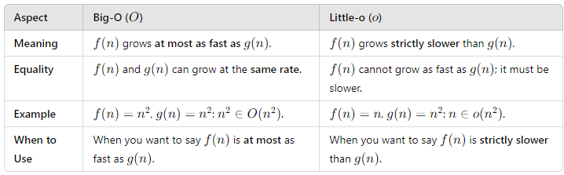
Difference Between Big O (O) and Little o(o)

Slide 60
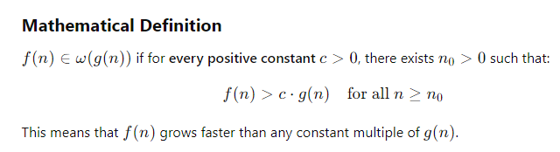
Little omega (ω)Notation
Little omega (ω) notation describes the strict lower bound of a function's growth rate.
The function f(n) grows strictly faster than g(n) as n becomes very large as n→∞.
f(n) is always more than g(n) after a point.
g(n) is a loose lower bound of f(n) — but not tight.

Slide 61
Little omega (ω)Notation
Real-Life Example
Imagine:
f(n) = speed of a car
g(n) = speed of a cycle
As time (n) goes on, the car always becomes faster than the cycle — and keeps increasing the gap.
So, Car speed = ω(Cycle speed) The car always overtakes and grows faster.

Slide 62
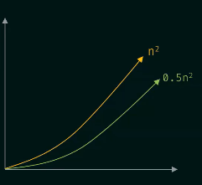
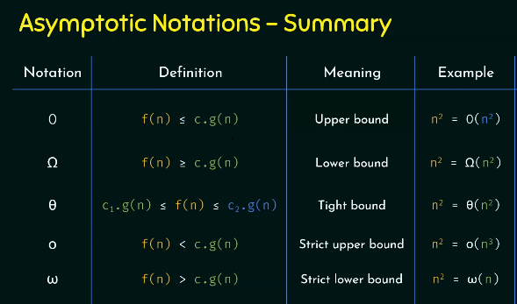
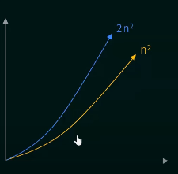
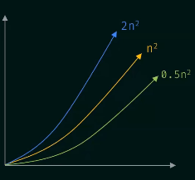
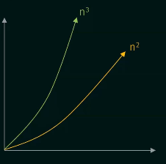
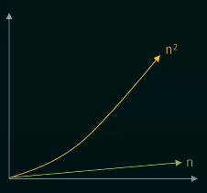

Slide 63
S.No. | Big O | Big Omega (Ω) | Big Theta (Θ)
1. | It is like (<=) rate of growth of an algorithm is less than or equal to a specific value. | It is like (>=) rate of growth is greater than or equal to a specified value. | It is like (==) meaning the rate of growth is equal to a specified value.
2. | The upper bound of algorithm is represented by Big O notation. Only the above function is bounded by Big O. Asymptotic upper bound is given by Big O notation. | The algorithm’s lower bound is represented by Omega notation. The asymptotic lower bound is given by Omega notation. | The bounding of function from above and below is represented by theta notation. The exact asymptotic behavior is done by this theta notation.
3. | Big O – Upper Bound | Big Omega (Ω) – Lower Bound | Big Theta (Θ) – Tight Bound
4. | It is define as upper bound and upper bound on an algorithm is the most amount of time required ( the worst case performance). | It is define as lower bound and lower bound on an algorithm is the least amount of time required ( the most efficient way possible, in other words best case). | It is define as tightest bound and tightest bound is the best of all the worst case times that the algorithm can take.
5. | Mathematically: Big Oh is 0 <= f(n) <= Cg(n) for all n >= n0 | Mathematically: Big Omega is 0 <= Cg(n) <= f(n) for all n >= n0 | Mathematically – Big Theta is 0 <= C2g(n) <= f(n) <= C1g(n) for n >= n0

Slide 64
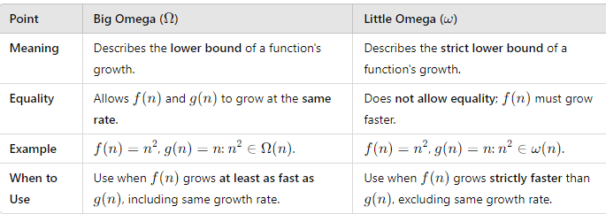
Difference Between Big Omega (Ω) and Little Omega (ω)

Slide 65
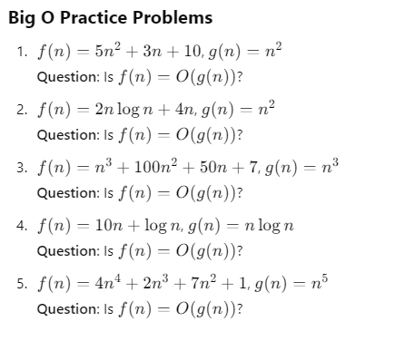

Slide 66
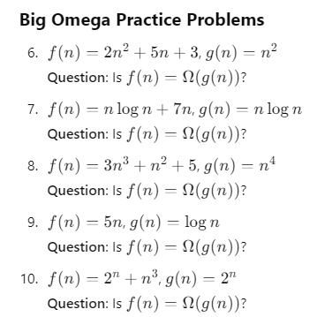

Slide 67
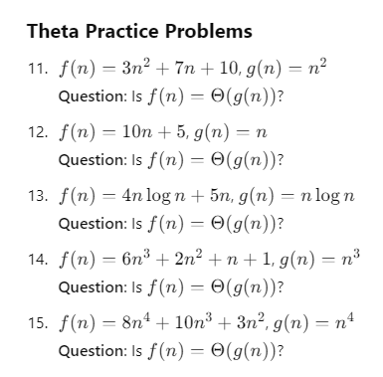

Slide 68
Types of analysis of algo - Best case, average case, and worst-case
When we study algorithms, we want to know how fast they run and how much memory they use. This helps us understand how efficient an algorithm is.
Time and Space Complexity:
Time complexity = How long the algorithm takes to run
Space complexity = How much memory it uses
Worst Case:
It shows the maximum time an algorithm might take to finish.
We assume the most difficult input for the algorithm.
It helps us know the upper bound (maximum limit) of time.
For linear search, the worst case occurs when x is present at the last location. So Time complexity (Worst case) = O(n)

Slide 69
Types of analysis of algo - Best case, average case, and worst-case
Worst-case analysis is used in critical systems where failure is not an option and performance must be guaranteed, no matter how extreme the situation is.
Banking Transactions: In banking systems, even if there's heavy traffic or the database is overloaded, the system must process transactions without delays. Worst-case analysis ensures the system remains fast and reliable under such conditions.
Emergency Services: In emergency response systems the system must work quickly even if there’s a high volume of calls or complex data. Worst-case analysis ensures the system can handle the worst possible situation without failure.
Flight Control Systems: In aviation, the flight control system must always respond quickly, even during extreme conditions like turbulence or system overload. Worst-case analysis helps ensure safety and efficiency under all scenarios.

Slide 70
Types of analysis of algo - Best case, average case, and worst-case
Best Case:
It shows the minimum time an algorithm can take to finish.
This happens when the input is most favorable.
We use it to find the lower bound (smallest limit) of the time.
For linear search, the best case occurs when x is present at the first location. So Time complexity (Best case) = Ω(1) (constant time)

Slide 71
Real-Time Example of Best-Case Use:
Sorting Small Lists: In situations where a small list of items is already sorted (e.g., sorting a list of 5 names in alphabetical order), best-case analysis shows the algorithm's fastest performance.
Search Engine Cache: When a user searches for a popular query that is already cached in the system, the search engine can retrieve results almost instantly. Best-case analysis helps optimize performance for these types of quick, common searches.
Autofill Suggestions: In applications like Google search or address forms, if the user types something that matches the stored data exactly (e.g., previously entered addresses), best-case analysis ensures the autofill feature works as fast as possible.

Slide 72
Types of analysis of algo - Best case, average case, and worst-case
Average Case Analysis
It tells us the expected time an algorithm takes for typical (random) input.
It lies between best and worst case.
We assume all inputs are equally likely.

Slide 73
Types of analysis of algo - Best case, average case, and worst-case
Why Is Average-Case Hard to Use?
We Don’t Know the Inputs: To calculate the average, we need to know how often different types of inputs happen. This is hard to figure out.
imagine you run a shop. You want to know the average number of customers per day. But:
Some days are very busy (festivals),
Some are slow (rainy days),
And you don’t always know why.
So, finding the "average" is not easy unless you track everything carefully.

Slide 74
Types of analysis of algo - Best case, average case, and worst-case
Why Is Average-Case Hard to Use?
Complicated Math: To find the average case, you have to consider every possible input and how likely it is — that can take a lot of time and complex math.
example: Suppose you're guessing how long it takes people to find a book in a messy library:
Some find it right away,
Some take a long time,
You’d have to calculate every case and their probability — it's tricky!

Slide 75
Average Case Analysis:
Average-case can be applied in situations where inputs follow typical, predictable patterns, like web searches or social media.
Web Search Engines: In search engines, most search queries are typical, and data is usually organized in a way that allows fast retrieval. Average-case analysis helps optimize performance for the most common, normal searches.
Social Media Feeds: On platforms like Facebook or Instagram, users' activities are usually random, but they follow general patterns like liking posts or commenting. Average-case helps ensure a smooth user experience for typical activity.

Slide 76
Why We Need Best case, average case, and worst-case
Decision Making: Developers must select the best algorithm for a given problem based on time, memory, and input size.
Scalability: Helps us know if the algorithm will still work well for large input.s (worst-case analysis is especially important here).
Reliability: Worst-case analysis shows how the algorithm behaves even in the toughest situations.
Optimization: By knowing how fast or slow an algorithm is, we can identify inefficiencies, enabling developers to choose or design better alternatives.

Slide 77
Real-Time Example: Searching in an Unsorted Array
Let's analyze the time complexity of searching for an element in an unsorted array of size n.
Algorithm
Linear Search: Start at the first element and check each element until the target is found or the end of the array is reached.
Cases
Best Case: The target element is the first element in the array. Time Complexity: O(1) (constant time).
Average Case: The target element is somewhere in the middle of the array on average. Time Complexity: O(n/2) (simplified as O(n) because constants are ignored in asymptotic analysis).
Worst Case: The target element is the last element, or it is not present in the array. Time Complexity: O(n)

Slide 78
How to measure complexity?
The complexity of an algorithm can be measured as:
Time complexity
Space complexity

Slide 79
Time complexity
Time complexity is defined in terms of how many times it takes to run a given algorithm, based on the length of the input.
How is Time complexity computed?
To estimate the time complexity, we need to consider the cost of each fundamental instruction and the number of times the instruction is executed.

Slide 80
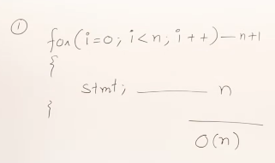
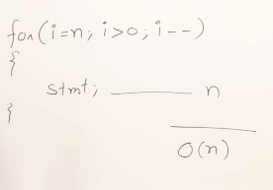
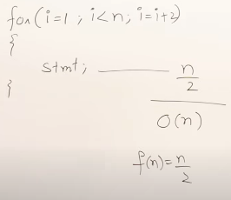
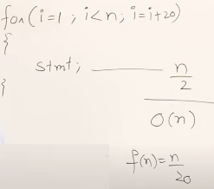
Ascending or descending don’t matter
Here we can skip n+1
Ignore the constants

Slide 81



Slide 82






After the first iteration: p=0
After the second iteration: p=0+1=1
After the third iteration: p=1+2=3
And so on.
The value of p grows as the sum of consecutive integers.
The sum of the first k integers is k(k+1)/2
Loop will stop at p > n
So,
And

Slide 83



i = 1 is the initialization step where i starts at 1. The loop runs as long as i<n
i = i * 2.This means that at each iteration, i is multiplied by 2 (doubles each time).i.e.
Then, i=1 i=2, i=4, i=8, i=16 etc.
Each time, i grows exponentially.
After k iterations, i becomes 2^{k}.
The loop stops when i>=n, solve it
Taking the logarithm (base 2) of both sides:
The time complexity of the given loop is O(log n).

Slide 84





Slide 85



Slide 86


Slide 87


With for loop ,we can write the same logic

Slide 88


using for loop ,we can write the same logic
O(log n)

Slide 89



For 6and 3 , It will executed one time only
For 5 ,5 it will not executed
For 16,2 it will executed nearly 7 ,i.e. 16/2 means n/2

Slide 90

For conditional statements ,the condition will decide the no. of times loop will execute
Here ,If condition is true , so it execute one stmt, it takes O(1)
If condition false ,then it is for O(n) times

Slide 91

it is for O(n) times

Slide 92
Time and Space Complexity of Insertion Sort
Insertion sort is a simple sorting algorithm that works similarly to the way you sort playing cards in your hands.
Key Operations in Insertion Sort:
Comparisons: Comparing the current element with sorted elements to find its correct position.
Shifts: Moving sorted elements to make room for the current element.
The array is virtually split into a sorted and an unsorted part.
Values from the unsorted part are picked and placed in the correct position in the sorted part.
Start with the second element in the array (since the first element is already "sorted").
Take the current element (let's call it the key) and compare it with the elements before it.
If the key is smaller than its predecessor (the element before it), move the larger element one step to the right.
Continue comparing the key with earlier elements and shifting larger elements to the right until you find the correct position for the key.
Place the key in its correct position.
Repeat this process for all elements in the array until the array is fully sorted.

Slide 93
Time and Space Complexity of Insertion Sort
Example:
Let's sort the array [5, 3, 8, 6] using this method:
Start with the second element,(key) 3.
Compare it with 5.
Since 3 is smaller than 5, shift 5 to the right.
Place 3 in its correct position: [3, 5, 8, 6].
Move to the third element, 8.
Compare it with 5.
Since 8 is larger, it remains in its position: [3, 5, 8, 6].
Move to the fourth element, 6.
Compare it with 8.
Since 6 is smaller, shift 8 to the right.
Compare 6 with 5.
Since 6 is larger than 5, place 6 after 5: [3, 5, 6, 8].
Now the array is sorted in ascending order: [3, 5, 6, 8].

Slide 94
Insertion Sort Algorithm
InsertionSort(arr):
for i = 1 to length(arr) - 1:
key = arr[i]
j = i - 1
while j >= 0 and arr[j] > key:
arr[j + 1] = arr[j] # Shift element to the right
j = j - 1
arr[j + 1] = key # Insert key into correct position

Slide 95
5 4 10 1 6 2
Step 5: Fifth Iteration (i=5)
Key: 2
Initial j=4 (starts from i−1)
Compare 2 with arr[j]=10a:
2<10, so shift 10 one position to the right.
j=3.
Compare 2 with arr[j]=6:
2<6, so shift 6 one position to the right.
j=2.
Compare 2 with arr[j]=5:
2<5, so shift 5 one position to the right.
j=1.
Compare 2 with arr[j]=4:
2<4, so shift 4 one position to the right.
j=0.
Compare 2 with arr[j]=1:
2>1, so stop shifting.
j=0 (inner loop exits).
Insert 2 at position j+1=1
Array after Step 5: 1,2,4,5,6,10
Step 3: Third Iteration (i=3)
Key: 1
Initial j=2 (starts from i−1)
Compare 1 with arr[j]=10:
1<10, so shift 10 one position to the right.
j=1
Compare 1 with arr[j]=5:
1<5, so shift 5 one position to the right.
j=0.
Compare 1 with arr[j]=4:
1<4, so shift 4 one position to the right.
j=−1 (end of while loop).
Insert 1 at position j+1=0
array after Step 3: 1,4,5,10,6,2
Step 1: First Iteration (i=1) Key: 4
Initial j=0(starts from i−1
Compare 4 with arr[j]=5:
4<5, so shift 5 one position to the right.
j becomes −1 (end of while loop).
Insert 4 at position j+1=0.
Array after Step 1: 4,5,10,1,6,2
Step 2: Second Iteration (i=2)
Key: 10
Initial j=1 (starts from i−1)
Compare 10with arr[j]=5:
10>5, so no shifting is needed.
j remains 1 (inner loop does not execute).
Array after Step 2: 4,5,10,1,6,2
Step 4: Fourth Iteration (i=4)
Key: 6
Initial j=3 (starts from i−1)
Compare 6 with arr[j]=10:
6<10, so shift 10 one position to the right.
j=2.
Compare 6 with arr[j]=5:
6>5, so stop shifting.
j=2 (inner loop exits).
Insert 6 at position j+1=3. Array after Step 4: 1,4,5,6,10,2
Output: 1,2,4,5,6,10

Slide 96

Time Complexity of Insertion Sort:
Best Case: O(n)
Scenario: The array is already sorted.
Explanation:
The algorithm performs n−1 comparisons and n shifts (1 shift per element, including placing it back in the same spot).
Therefore, the total number of operations is proportional to the size of the array, i.e., O(n).
Best Case Analysis:
Input: Array is already sorted.
Inner Loop Execution: 0 times for each i.
Total Frequency:
Outer loop: (n−1) times.
Inner loop: 0 times.
Overall time complexity: O(n).
n−1 comparisons for [ 1 2 3 4 5 ] means sorted array

Slide 97
Worst Case Analysis
Input: Array is in reverse order.
Inner Loop Execution: For each i, the inner loop executes i times.
Total Frequency:
Outer loop: (n−1)times.
Inner loop: 1+2+⋯+(n−1)=n(n−1)/2​
Overall time complexity: O(n²).

Slide 98




6 5 4 3 2 1

Slide 99

Avg case:
The average case happens when the input array is in a random order.
This requires analyzing the expected number of comparisons and shifts for all possible permutations of the array.
At each index i, the algorithm compares the key with up to i elements from the sorted portion.
For a random permutation, on average, the key is inserted somewhere in the middle of the sorted portion, leading to i/2 comparisons.
This gives us O(n²) total comparisons in the average case.
space complexity of the Insertion Sort algorithm constant space requirement: O(1)

Slide 100
MCQ
For the functions, n^{k} and c^{n}, what is the asymptotic relationship between these functions?
Assume that k >=1 and c > 1 are constants.
Choose all answers that apply:
n^{k} is O(c^{n})
n^{k} is ῼ(c^{n})
n^{k} is θ(c^{n})
Answer : (1)

Slide 101
Bubble Sort Algorithm
Bubble Sort is a simple comparison-based sorting algorithm.
It repeatedly steps through the list, compares adjacent elements, and swaps them if they are in the wrong order.
This process continues until the list is sorted.

Slide 102
Bubble Sort Algorithm
procedure BUBBLE_SORT(array, n)
// Outer loop for passes
for (i = 0; i < n - 1; i++) do
swapped ← FALSE // Initialize the swapped flag
// Inner loop for comparisons
for (j = 0; j < n - i - 1; j++) do
if (array[j] > array[j + 1]) then
// Swap array[j] and array[j + 1]
temp ← array[j]
array[j] ← array[j + 1]
array[j + 1] ← temp
swapped ← TRUE // Mark that a swap occurred
end if
end for
// If no swaps occurred, array is sorted
if (swapped = FALSE) then
break
end if
end for
end procedure

Slide 103
Dry Run Example
Input: [4,3,2,1], n=4
Pass 1:
Compare and swap: [4,3,2,1]→[3,4,2,1]→[3,2,4,1]→[3,2,1,4]
Swapped = TRUE.
Pass 2:
Compare and swap: [3,2,1,4]→[2,3,1,4]→[2,1,3,4]
Swapped = TRUE.
Pass 3:
Compare and swap: [2,1,3,4]→[1,2,3,4]
Swapped = TRUE.
Pass 4:
No swaps occur; the array is sorted. Exit early.

Slide 104
1. Best Case Analysis
Scenario:
The input array is already sorted.
Example: [1,2,3,4,5]
Step-by-Step Explanation:
Pass 1:
Compare 1 and 2: No swap.
Compare 2 and 3: No swap.
Compare 3 and 4: No swap.
Compare 4 and 5: No swap.
No swaps occurred; the algorithm terminates early.
Number of Comparisons:
n−1 comparisons in the first pass.
Early termination after one pass.
Time Complexity:
Best Case: O(n) (single pass)

Slide 105
2. Average Case Analysis
Scenario:
The input array is in random order.
Example: [4,3,5,1,2]
Step-by-Step Explanation:
Pass 1:
Compare 4 and 3: Swap → [3,4,5,1,2]
Compare 4 and 5: No swap.
Compare 5 and 1: Swap → [3,4,1,5,2].
Compare 5 and 2: Swap → [3,4,1,2,5]
Pass 2:
Compare 3 and 4: No swap.
Compare 4 and 1: Swap → [3,1,4,2,5]
Compare 4 and 2: Swap → [3,1,2,4,5]
Pass 3:
Compare 3 and 1: Swap → [1,3,2,4,5]
Compare 3 and 2: Swap → [1,2,3,4,5]
Pass 4:
Compare 1 and 2: No swap.
Array is sorted; algorithm terminates.
Number of Comparisons and Swaps:
Comparisons: Roughly n(n−1)/2.
Swaps: Fewer than the worst case but significant.
Time Complexity:
Average Case: O(n²)

Slide 106


3. Worst Case Analysis
Scenario:
The input array is sorted in reverse order.
Example: [5,4,3,2,1]
Step-by-Step Explanation:
Pass 1:
Compare 5 and 4: Swap → [4,5,3,2,1].
Compare 5 and 3: Swap → [4,3,5,2,1]
Compare 5 and 2: Swap → [4,3,2,5,1].
Compare 5 and 1: Swap → [4,3,2,1,5]
Pass 2:
Compare 4 and 3: Swap → [3,4,2,1,5][
Compare 4 and 2: Swap → [3,2,4,1,5]
Compare 4and 1: Swap → [3,2,1,4,5]
Pass 3:
Compare 3 and 2: Swap → [2,3,1,4,5]
Compare 3 and 1: Swap → [2,1,3,4,5]
Pass 4:
Compare 2 and 1: Swap → [1,2,3,4,5]
Pass 5:
No swaps; array is sorted.
Number of Comparisons and Swaps:
Comparisons: n(n−1)/2 (maximum possible swaps).
Time Complexity:
Worst Case: O(n^2)

Slide 107


Slide 108
Recurrence Relation
When we write code that calls itself (recursion), we use recurrence to find how much time it takes.
A recurrence relation shows how the solution to a big problem depends on the solutions to smaller versions of the same problem.
A recurrence relation is a mathematical equation that defines a sequence or a function using its own previous values.
Used to analyze time complexity of recursive algorithms
2. Methods to Solve Recurrence Relations
a) Substitution Method : Guess the solution and prove it using mathematical induction.
b) Recursion Tree Method :Represent the recurrence as a tree to analyze the work at each level.
c) Master Theorem :A shortcut to solve recurrences in the standard form
T(n) = aT(n/b) + f(n)

Slide 109

Recurrence Relation

Slide 110


Slide 111


Slide 112

Factorial recurrence relation

Slide 113

recurrence relation

Slide 114

Recurrence Relation

Slide 115

Recurrence Relation
Recurrence relation:
1 If n = 0
T(n)=
T(n-1) If n > 0

Slide 116



Recurrence Relation
Recurrence relation:
1 If n = 0
T(n)=
T(n-1) +n If n > 0

Slide 117

Recurrence Relation
Recurrence relation:
0 If n <0
T(n)=
1 If n =1
T(n-1) +T(n-2) If n > 1

Slide 118


Recurrence Tree

Slide 119

Solve recurrence relation –problem1
T(n)=T(n−1)+1 This means:
To compute T(n), we first need to compute T(n−1), Then add 1 to it.
In recurrence relations, we replace (n) with (n−1), (n−2), etc., to simplify or solve the recurrence step-by-step.
This method is called recursion tree expansion or iterative method or back substitution method.
It is a technique used to solve recurrence relations by repeatedly substituting the recurrence into itself until we reach the base case.
This helps us find the time complexity of a recursive algorithm

Slide 120



Solve recurrence relation –problem1

Slide 121


Solve recurrence relation –problem2

Slide 122

Solve recurrence relation –problem2

Slide 123






Solve recurrence relation –problem3

Slide 124


Solve recurrence relation –problem3

Slide 125

summery

Slide 126



Solve recurrence relation –problem 4

Slide 127


Solve recurrence relation –problem 4

Slide 128

Solve recurrence relation –problem 4
According to GP -A Geometric Progression (GP),(mathematical term) is a sequence of numbers where each term after the first is found by multiplying the previous term by a fixed, non-zero number called the common ratio(r).
common ratio(r

Slide 129



recurrence relation for diving function
If any algo is taking any i/p then it can decrease it as n-1 ,diving as n/2 and root function as √n.

Slide 130




recurrence relation for diving function- example1

Slide 131



recurrence relation for diving function- example2

Slide 132



recurrence relation for diving function- example2

Slide 133



recurrence relation for diving function- example3

Slide 134





recurrence relation for diving function- example3

Slide 135


recurrence relation for diving function- example3

Slide 136




Problem 3
Replace n, k and n/2^{k}

Slide 137
Master’s Theorem for Decreasing Functions
Master’s theorem can only be applied on decreasing and dividing recurring functions. If the relation is not decreasing or dividing, master’s theorem must not be applied.
General form:-- T(n) = aT(n-b) + f(n) where, a > 0 and b > 0,and f(n)=O(n^{k} ) where k>=0 , f(n) is asymptotically positive
Here,
n − size of the problem
a − number of sub-problems in the recursion
n-b − size of the sub problems based on the assumption that all sub-problems are of the same size.
f(n) − represents the cost of work done outside the recursion -> Θ(n^{k}), where k >= 0

Slide 138

Master’s Theorem for Decreasing Functions
If the recurrence relation is in the above given form, then there are three cases in the master theorem to determine the asymptotic notations −
if a = 1, T(n) = O (n^{k+1}) or O (n* f(n))
if a > 1, T(n) = O (a^{n/b} * n^{k}) or
O (a^{n/b} * f(n))
if a < 1, T(n) = O (n^{k}) or O (f(n))

Slide 139



Master’s Theorem for Dividing Functions
General form:--- T(n) = aT(n/b) + f(n) where, a >= 1 and b > 1,
f(n)= Θ(n^{k} log^{p} n) --- log n whole to the power p
If the recurrence relation is in the above given form,
We find out 2 values
1. log_{b} a
2. k
then there are three cases in the master theorem to determine the asymptotic notations

Slide 140

Example
Example 1
Consider a recurrence relation given as T(n) = 8T(n/2) + n²

Slide 141

Practice problems

Slide 142

Practice problems

Slide 143

Practice problems

Slide 144

Practice problems

Slide 145

Practice problems

