Slide 1
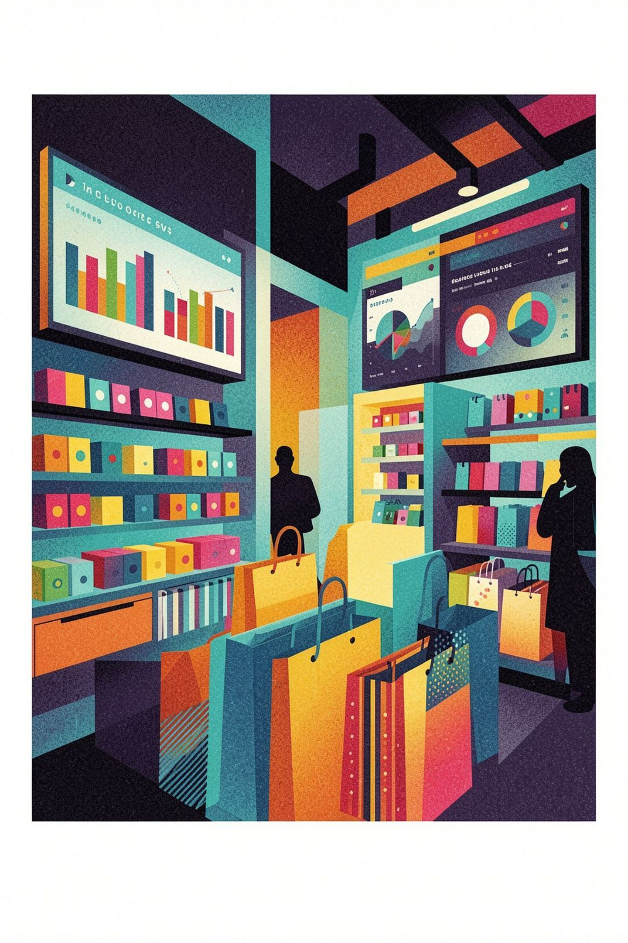

Customer Shopping Behavior Analysis
A deep dive into 3,900 purchases — uncovering spending patterns, customer segments, and strategic opportunities.

Slide 2


Project Overview
This project analyzes customer shopping behavior using transactional data from 3,900 purchases across various product categories. The goal is to uncover insights into spending patterns, customer segments, product preferences, and subscription behavior to guide strategic business decisions.

Slide 3
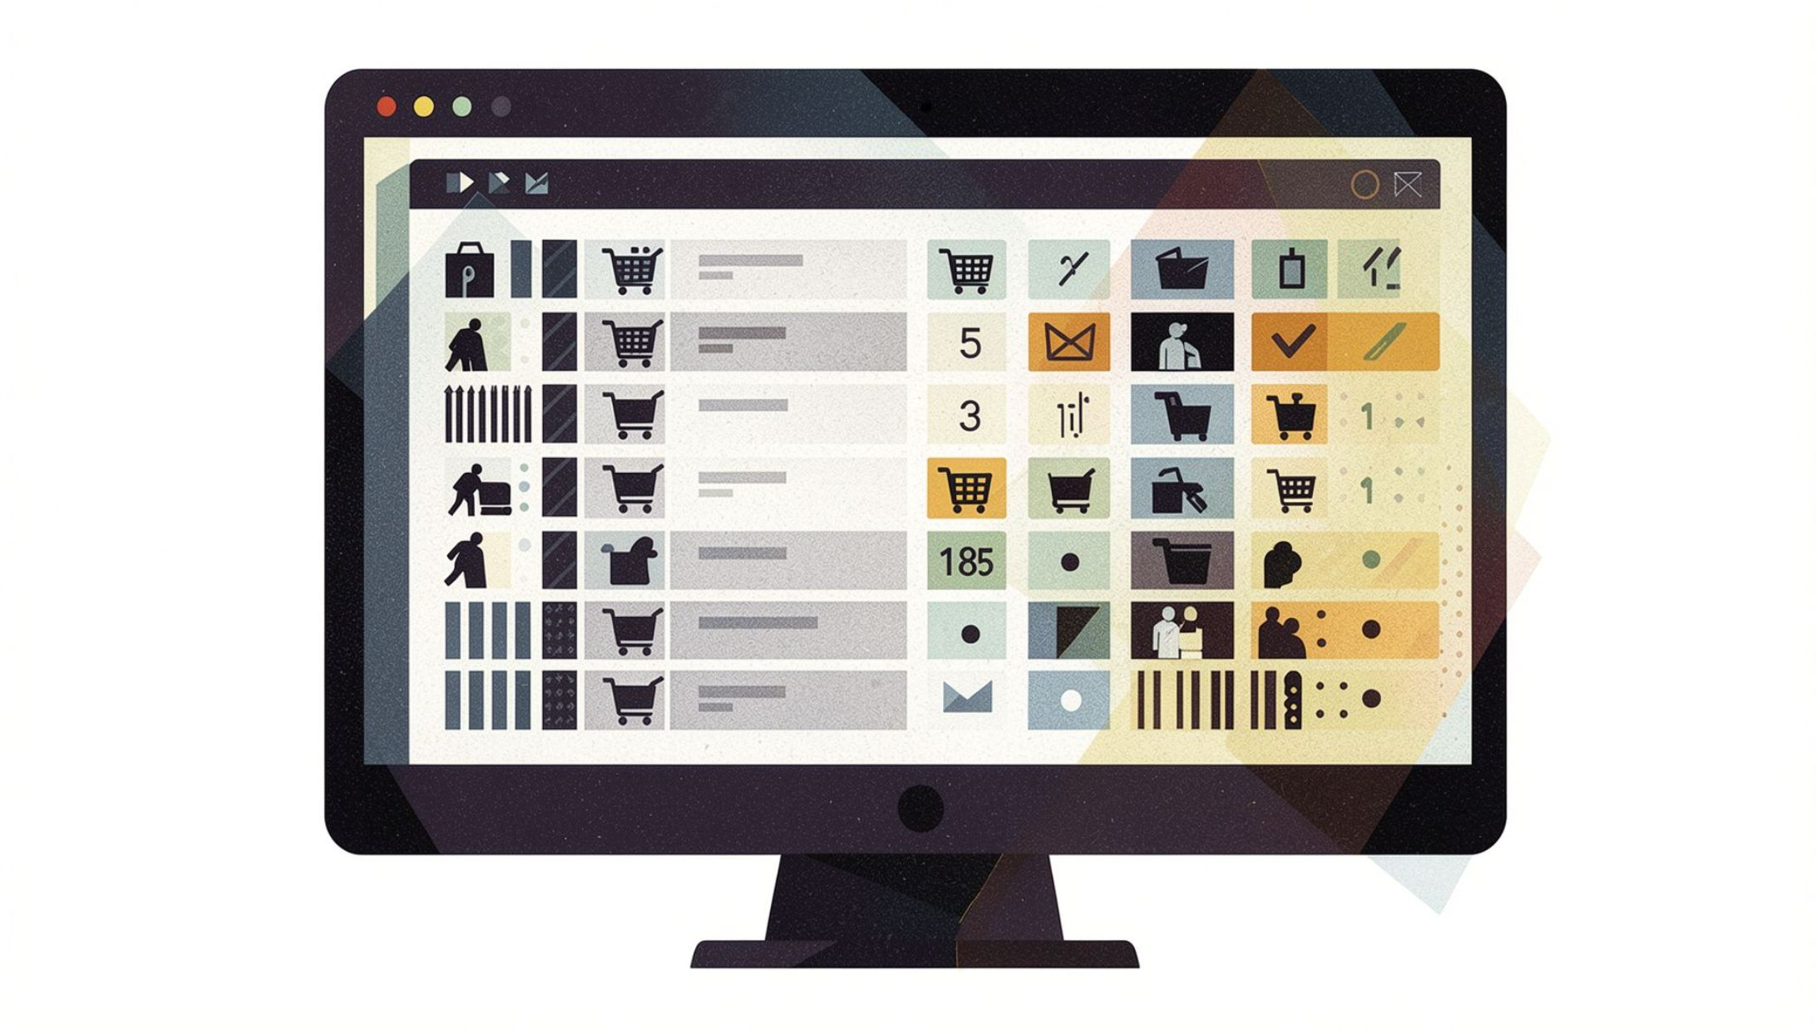
Dataset Summary
Scale
3,900 purchases with 18 features per record
Key Features
Age, Gender, Location, Subscription Status, Item Purchased, Category, Purchase Amount, Season, Size, Color, Discount Applied, Promo Code Used, Previous Purchases, Frequency of Purchases, Review Rating, Shipping Type
Missing Data
37 values in the Review Rating column — handled during cleaning

Slide 4
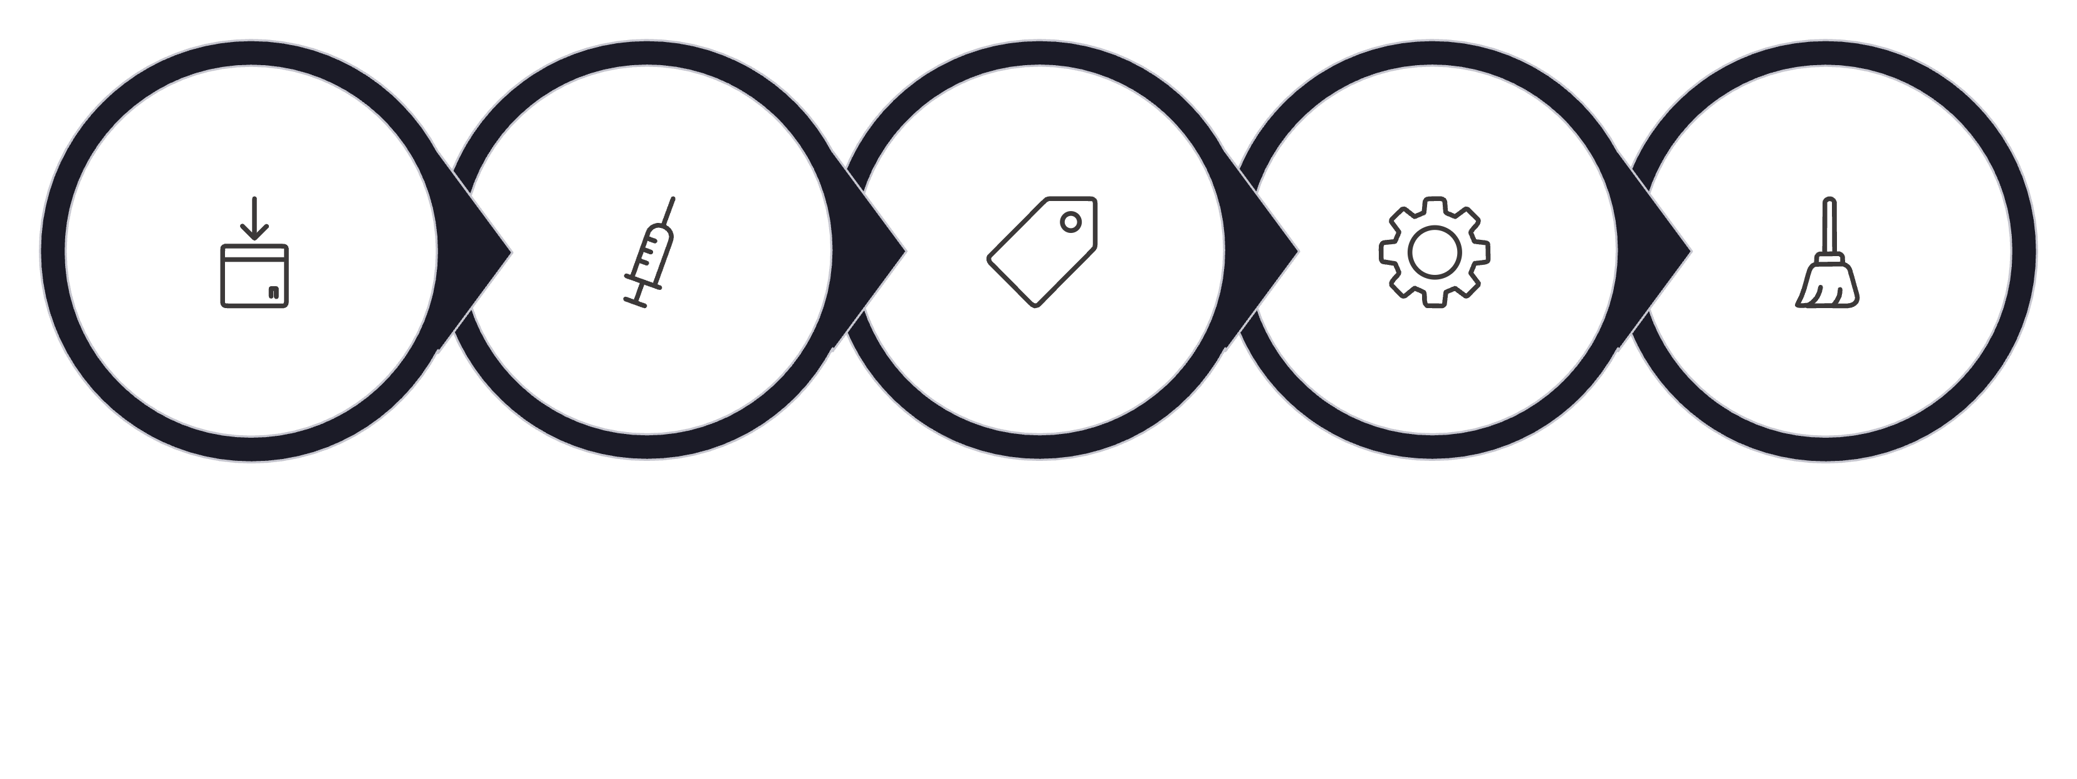

Data Preparation & Cleaning
Import
Impute
Rename
Engineer
Deduplicate
Missing Review Rating values were imputed using median rating by product category. New features included age_group (binned ages) and purchase_frequency_days. After verifying redundancy between discount_applied and promo_code_used, the latter was dropped. The cleaned DataFrame was then loaded into PostgreSQL for SQL analysis.

Slide 5
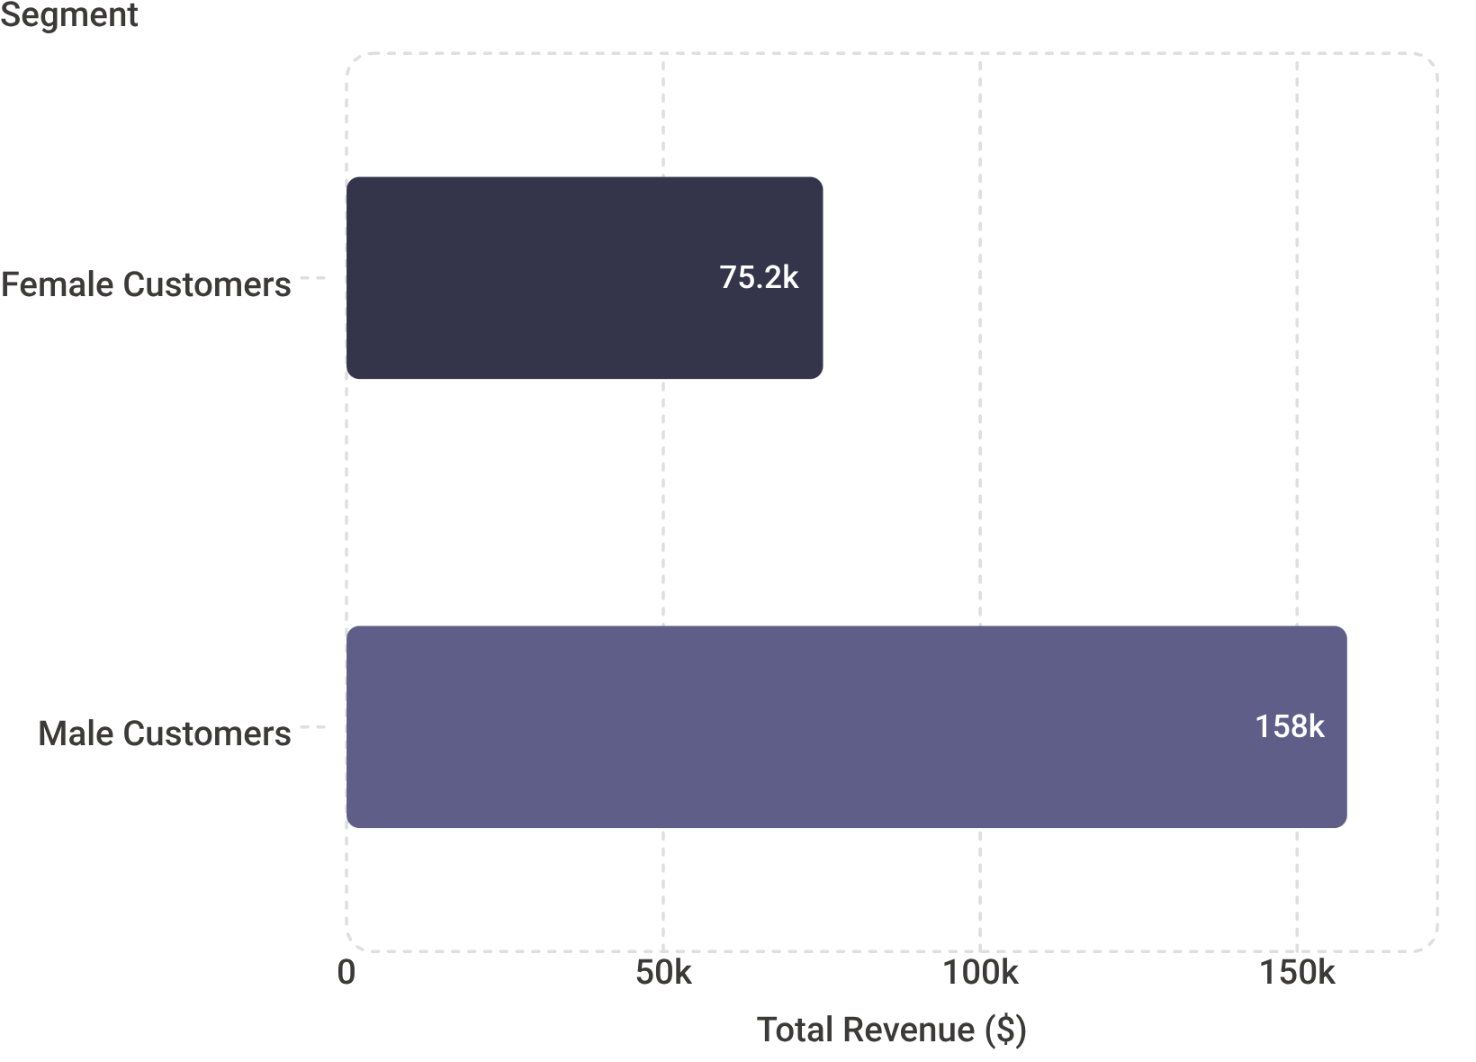

Revenue by Gender
Key Insight
Male customers generate $157,890 in total revenue compared to $75,191 from female customers.
Male customers generate 2.1x more revenue than female customers — a significant gap that warrants targeted strategy for both segments.

Slide 6

High-Spending Discount Users
839
$97
Discount Users
Top Spender
Customers who used discounts yet spent above the average purchase amount of $59.76
Customer 9 — highest individual spend among discount users
$90
Runner-Up
Customers 4 and 20 — tied for second highest spend with discounts applied
This indicates strong demand elasticity — discounts drive volume without sacrificing high-value purchases.

Slide 7
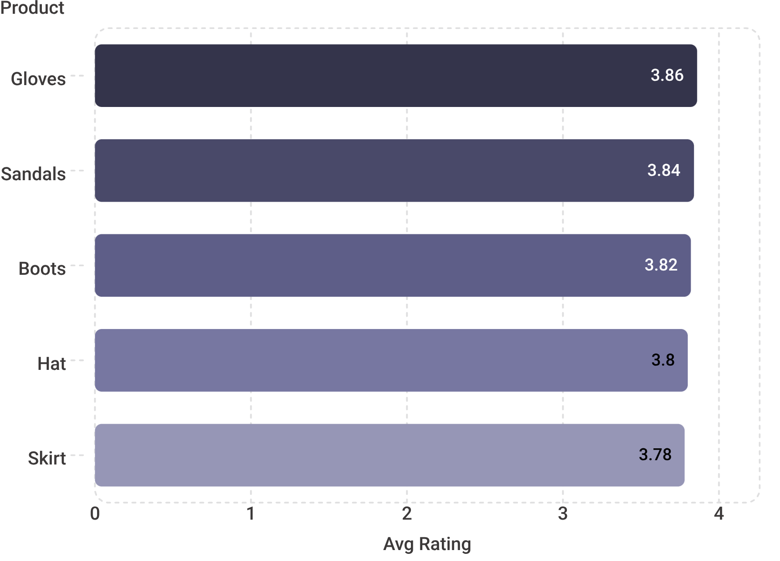


Top 5 Products by Rating
Customer Favorites
Ratings are tightly clustered between 3.78 and 3.86, suggesting consistent satisfaction across top-performing products. Accessories and footwear dominate the top tier.
Gloves — 3.86 avg rating
Sandals — 3.84 avg rating
Boots — 3.82 avg rating
Hat — 3.80 avg rating
Skirt — 3.78 avg rating

Slide 8


Shipping Type Comparison
Standard Shipping
$58.46 average purchase amount
Express Shipping
$60.48 average purchase amount
Express shipping users spend 3.5% more per transaction than standard shipping users. Customers who opt for faster delivery demonstrate higher purchase intent and willingness to spend.

Slide 9
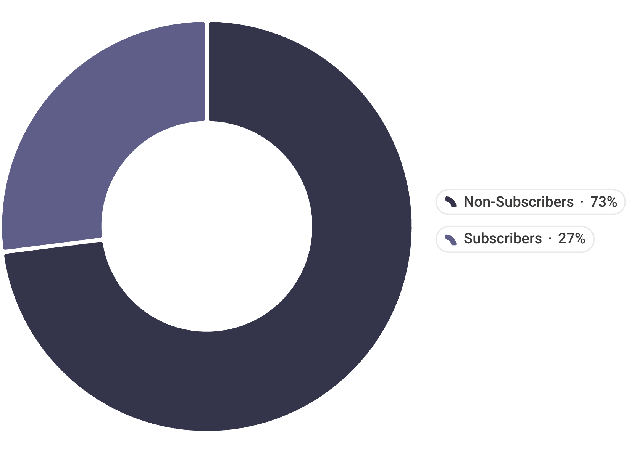
Subscribers vs. Non-Subscribers
Revenue Breakdown
Segment
Customers
Avg Spend
Total Revenue
Subscribers
1,053
$59.49
$62,645
Non-Subscribers
2,847
$59.87
$170,436
Non-subscribers represent 73% of the customer base and drive 73% of total revenue — a near-perfect proportional split that signals untapped subscription conversion potential.

Slide 10
Discount-Dependent Products
Products with Highest Discount Rates
These five products show the highest proportion of purchases made with a discount applied — signaling potential over-reliance on promotional pricing.
50%
49%
49%
48%
Hat
Sneakers
Coat
Sweater
47%
Pants

Slide 11
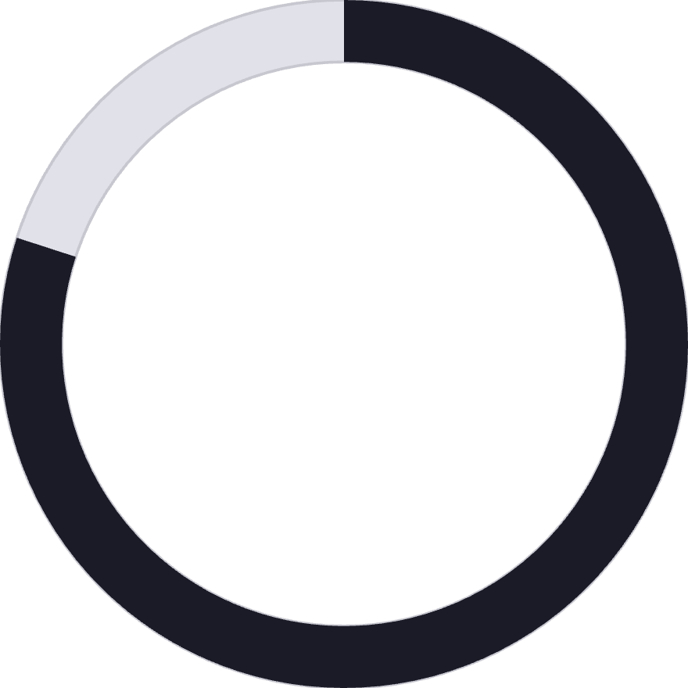
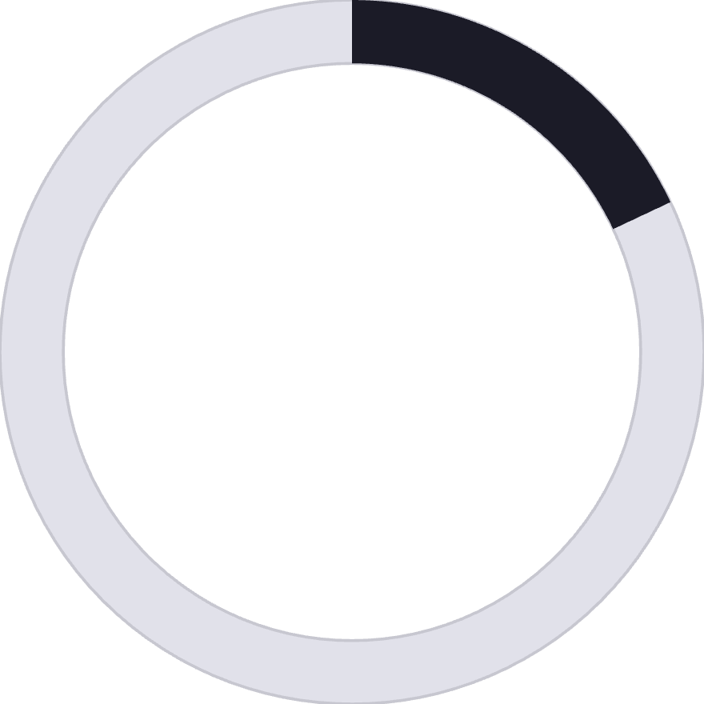



Customer Segmentation
80%
18%
2%
Loyal
Returning
New
3,116 customers — the backbone of the business
701 customers — showing repeat engagement
83 customers — early-stage acquisition
The majority of the customer base consists of loyal repeat buyers, representing a strong foundation for retention-focused strategies. Growing the New and Returning segments presents the clearest path to incremental revenue growth.

Slide 12



Strategic Recommendation
Boost Subscriptions
Promote exclusive benefits for subscribers
Loyalty Programs
Reward repeat buyers to increase retention
Targeted Marketing
Focus on high-revenue segments and express users
Product Positioning
Highlight top-rated products in campaigns

