Slide 1
What You Saw is Not What You Get: Domain Adaptation Using Asymmetric Kernel Transforms
Brian Kulis, Kate Saenko, and Trevor Darrell
UC Berkeley EECS and ICSI
-By Team : INVINCIBLES
Samrudha Ganesh Kelkar, Shreyank Jyoti, Umesh Sharnagat
2018900072, 2018900069, 2018900082

Slide 2
Problem
“What you saw” during training is often not “what you get” during deployment: the distribution and even the type and dimensionality of features can change from one dataset to the next.
Visual domain adaptation problem.
We need a model that is not restricted to symmetric transformations, nor to features of the same type and dimensionality, making it applicable to a significantly wider set of adaptation scenarios than previous methods.

Slide 3
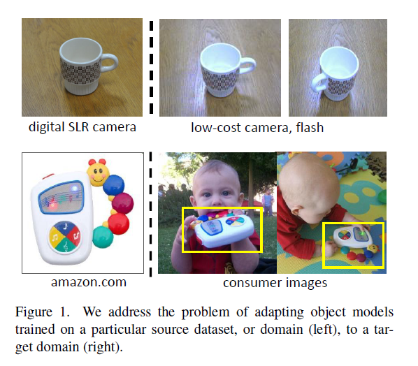
Problem
Each image dataset corresponds to a particular “visual domain” with its own peculiarities.

Slide 4
Challenges
[19] learns a metric to compare two cross-domain data points that satisfies a set of given cross-domain (dis)similarity constraints.
Because the Mahalanobis distance is used for learning, the algorithm essentially treats both the source and target domains as part of a single data set.
This approach is insufficient when
the dimensionalities of the domains are different
It restricts the type of transformations that can be learned.
[19]Saenko, K., Kulis, B., Fritz, M., & Darrell, T. (2010, September). Adapting visual category models to new domains. In European conference on computer vision (pp. 213-226). Springer, Berlin, Heidelberg.

Slide 5
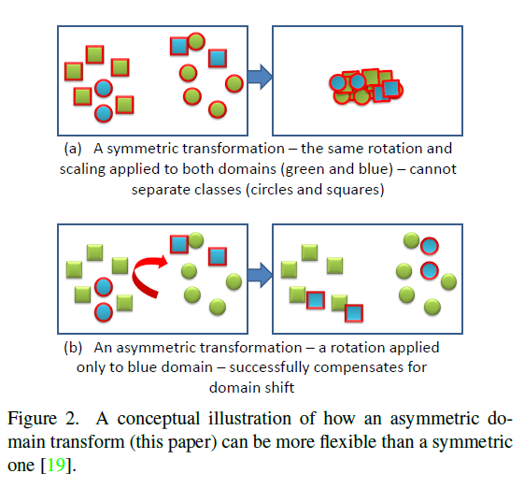
Motivation
Asymmetric indefinite transformations are more flexible for a variety of adaptation tasks.

Slide 6

Asymmetric Transforms
ARC-t
where X is the matrix of all the points in A, Y is the matrix of all points in B, r is a matrix regularizer, and the c_{i} are the loss functions over the constraints, assumed to be expressed as a function of the matrix X^{T} W Y . Thus, the optimization aims to minimize a matrix regularizer r plus a set of constraints that are a function of the learned inner products x^{T} W y.

Slide 7

Experimental Setup
We consider two scenarios in our experiments.
all categories are present at training
We assume that we have many labeled examples for each category in the source domain, and a few labeled examples for each category in the target domain. We form the following class-based constraints for each pair of training points (x; y), where x € A and y € B:
if x and y are from the same category, we construct the constraint
and if x and y are in different categories, we construct the constraint
(Here l and u are lower and upper bound parameters)

Slide 8
Kernalization
Define K_{A} = X^{T}X and K_{B} = Y^{T}Y
Instead of solving for W directly, we can equivalently
solve for L, and then implicitly construct W via
W =XK_{A}^{-1/2} LK_{B}^{-1/2}Y^{T}

Slide 9
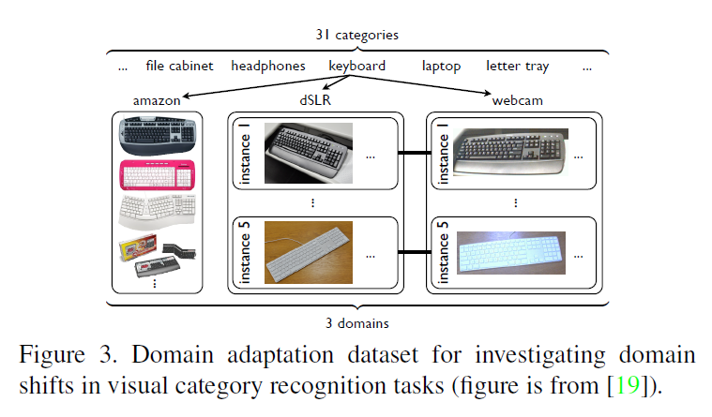
Dataset

Slide 10
Dataset Contents:
Office Dataset: Contains 3 domains Amazon, Webcam, and Dslr. Each contain images from amazon.com, or office environment images taken with varying lighting and pose changes using a webcam or a dslr camera, respectively. Contains 31 categories in each domain. SURF BoW histogram features, vector quantized to 800 dimension (unless indicated as 600).
Images
Surf Features
Surf Features with object Ids
Decaf features
Dataset link:
https://people.eecs.berkeley.edu/~jhoffman/domainadapt/#datasets_code

Slide 11
Observations and results
Experiment 1: Impact of Asymmetric Transformation.
Test | Description | Accuracy
Without Transformations | KNN trained on domain A and tested directly on domain B | 20.24
With Transformation | KNN trained on domain A and tested with transformation of domain B | 63.78

Slide 12
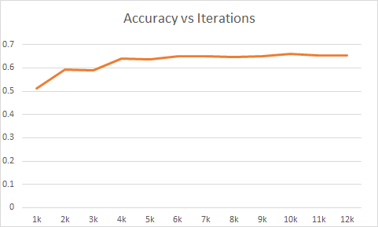
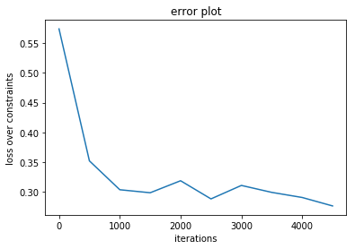
Observations and results
Experiment 2: Accuracy vs Optimization iterations

Slide 13
Observations and results
Experiment 3: Accuracy across categories
Class Name | Number of image samples | Correctly identified Images | Accuracy (in %)
trash_can | 15 | 14 | 93.3333333
back_pack | 12 | 11 | 91.6666667
mobile_phone | 31 | 26 | 83.8709677
calculator | 12 | 10 | 83.3333333
tape_dispenser | 22 | 18 | 81.8181818
scissors | 18 | 14 | 77.7777778
desk_chair | 13 | 10 | 76.9230769
stapler | 21 | 16 | 76.1904762
file_cabinet | 15 | 9 | 60
mouse | 12 | 7 | 58.3333333
paper_notebook | 10 | 5 | 50
bike | 21 | 9 | 42.8571429
monitor | 22 | 9 | 40.9090909
keyboard | 10 | 4 | 40
phone | 13 | 5 | 38.4615385
bottle | 16 | 5 | 31.25
bike_helmet | 24 | 7 | 29.1666667
headphones | 13 | 3 | 23.0769231
ruler | 7 | 1 | 14.2857143
printer | 15 | 2 | 13.3333333
ring_binder | 10 | 1 | 10
pen | 10 | 1 | 10
bookcase | 12 | 1 | 8.33333333
letter_tray | 16 | 1 | 6.25
Mean Accuracy |  |  | 49.5147266

Slide 14
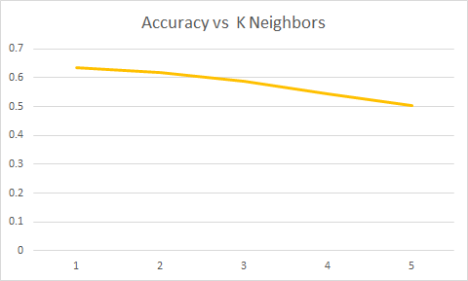
Observations and results
Experiment 4: Impact of K nearest neighbours

Slide 15
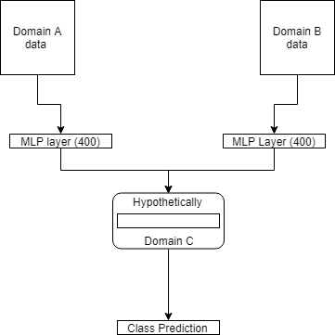
Observations and results
Experiment 5: Transfer Learning
We trained a neural network with an intuition to transform each domain to a new space where they show the maximum similarity in terms of similar classes.

Slide 16
Observations and results
Experiment 5: Transfer Learning (Domain A is Amazon, Domain B is DSLR)
Training Data | Testing Data | Approach | Accuracy(in %)
Domain A | Domain A | Neural Network | 50.43%
Domain B | Domain B | Neural Network | 73.27%
Domain A | Domain B | Direct prediction on NN | 13.23%
Domain A | Domain B | After transfer learning | 22.17%

Slide 17
Thanks!

