Slide 1
ITSP – 2014
TEAM PRAKTAAN
GESTURE CONTROLLED REMOTE
                ANKIT PATIL
                SUKHADA BAKARE
                SHUBHAM PATIL
                MENTORED BY: SAMRUDH KELKAR

Slide 2
Purpose of the project
To make a gesture controlled remote we will be using accelerometer sensors to learn and get input from hand gestures, replacing the conventional remote.

Slide 3
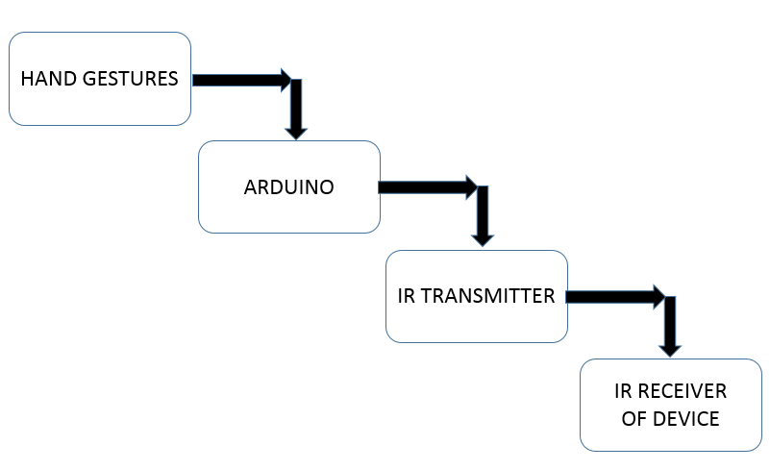
BLOCK DIAGRAM

Slide 4
COMPONENTS
Arduino-UNO
ADXL 345 Accelerometer
IR Receiver - TSOP 1738
IR Transmitter Led
Switches, LEDs and resistors

Slide 5
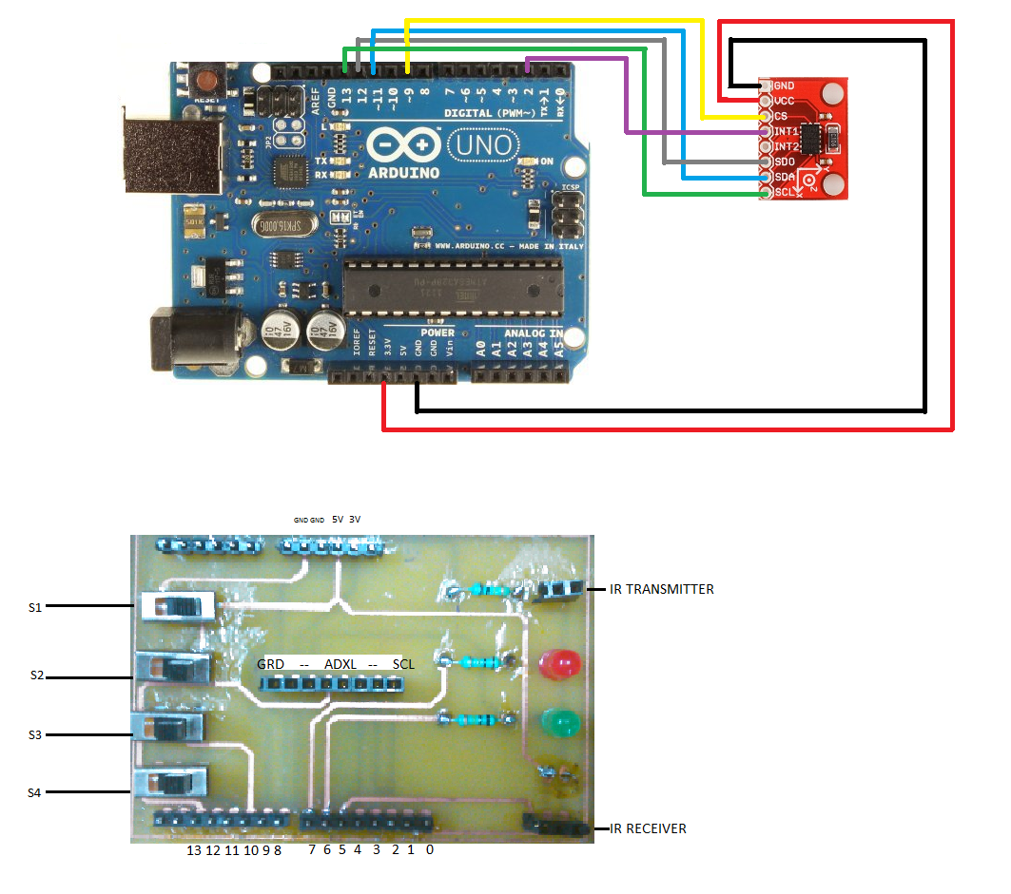
CIRCUIT DIAGRAM

Slide 6
Input from the hand gestures using accelerometer
The 3-axis accelerometer records acceleration values in X,Y and Z direction measured by the virtue of hand movements.
We analysed the data using python script and converting it into Excel format. Depicted graphical representation of data from different users.
For instance, we tried hand up, down, rotation. And for the hand up gesture we got the following graph.
As seen in the graph, we can see change in acceleration values distinctly in two regions. We use this as a gesture condition.Such a graph is obtained only from accelerometer sensor. If a gryoscope sensor is also used one can get even more precise movements.

Slide 7
UP HAND GESTURE GRAPHICAL DATA

Slide 8
CONVERTING TO IR SIGNALS
The ADXL I2C protocol is used to record the acceleration values.
Using library built in Arduino UNO environment, we recorded and stored the IR signals.
A TSOP sensor is used to receive signals which are then transmitted to the device receiver using IR transmitter LED.

