Slide 1
Newton’s Playground
By Samrudh Shenoy and Samarth Shah

Slide 2
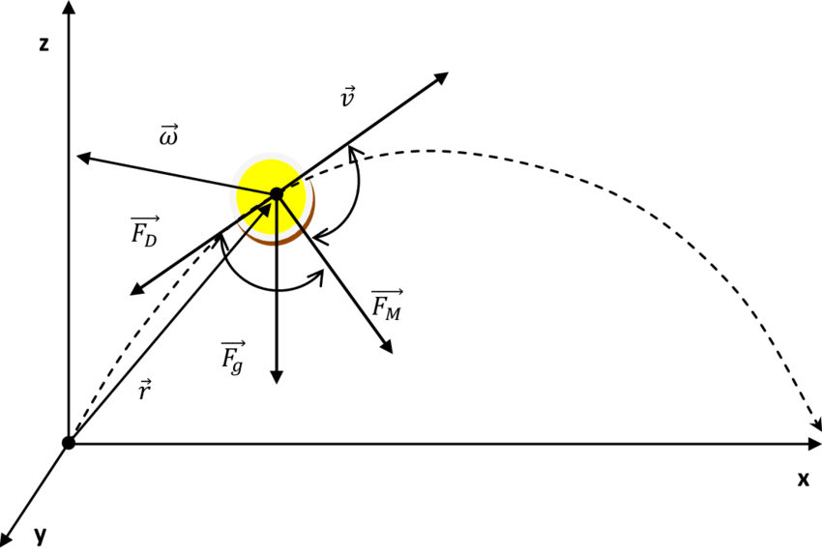
Introduction
Kinematics Physics simulator similar to the simulators on PHET
Used to test different experiments and learn how forces like gravity affect the movement of objects

Slide 3
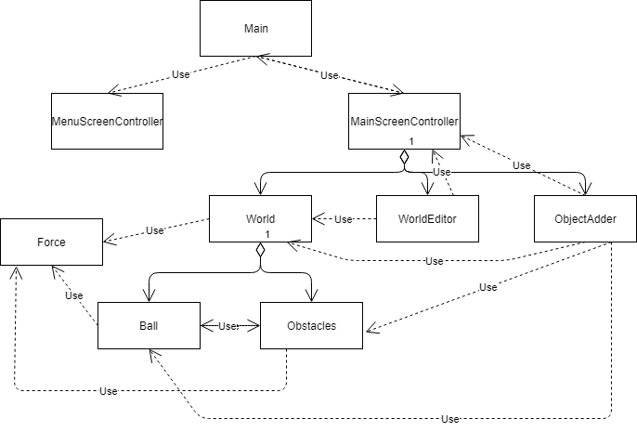
Code Overview

Slide 4
Code Overview
JavaFX Code split up into Model, View, Controller
Model: classes related to the objects like the ball and the world
View: FXML files used to make the UI
Controller: classes used to control the UI and put data from the model into the UI

Slide 5
Major Issues
Collisions
We were at first checking if the ball was hitting a line instead of a line segment, so the ball would bounce randomly
Bounces
We needed help doing the math to make the bounces realistic with angles other than horizontal and vertical
Phasing
The ball would go through the obstacles because the velocity was so high it would pass through it before the collision was detected
Others:
Interactable UI, File Loading and Saving

Slide 6
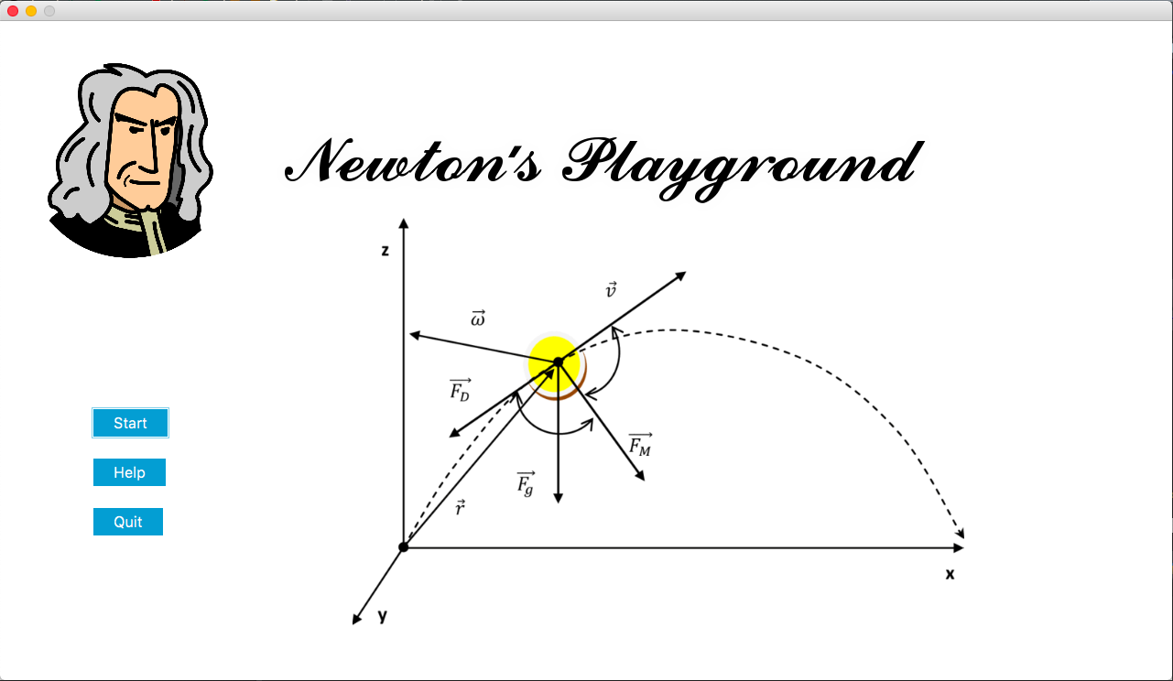

Slide 7
Main Screen Options
Help
Brings up a window with a complete help menu and detailed instructions
Quit
Quits the program

Slide 8
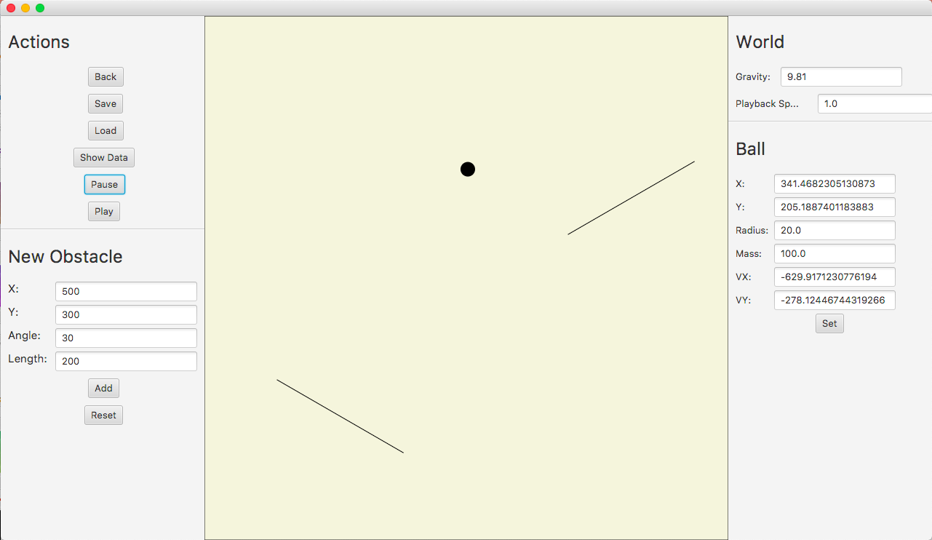
}
{
Ball
Settings
Options
{
}
Ball Values
Obstacle Addition
Obstacles

Slide 9
What’s Next for Newton’s Playground
3D User Interface and Object POV
Different Obstacles and Objects
Networked (LAN) Live Experiments

Slide 10
Thank You!!

