Slide 1
CareerCraft AI
Autonomous Multi-Agent Career Intelligence & Strategic Dashboard
Mareddy Samruth Reddy
Artificial Intelligence & Data Science

Slide 2
The Problem Statement
Current ATS and Career Platforms suffer from:
• Static 'Yes/No' filters without growth logic.
• Identifying gaps without providing roadmaps.
• Lack of context-awareness (Live market trends).
• No long-term persistence or memory of progress.

Slide 3
The Proposed Solution
A Multi-Agent Autonomous Strategy Layer:
• 7 Specialized Agents collaborating via LangGraph.
• RAG-Grounded advice using internal knowledge bases.
• Real-time industry alignment via Web Search Tools.
• Dynamic 12-week roadmaps with live resource links.

Slide 4
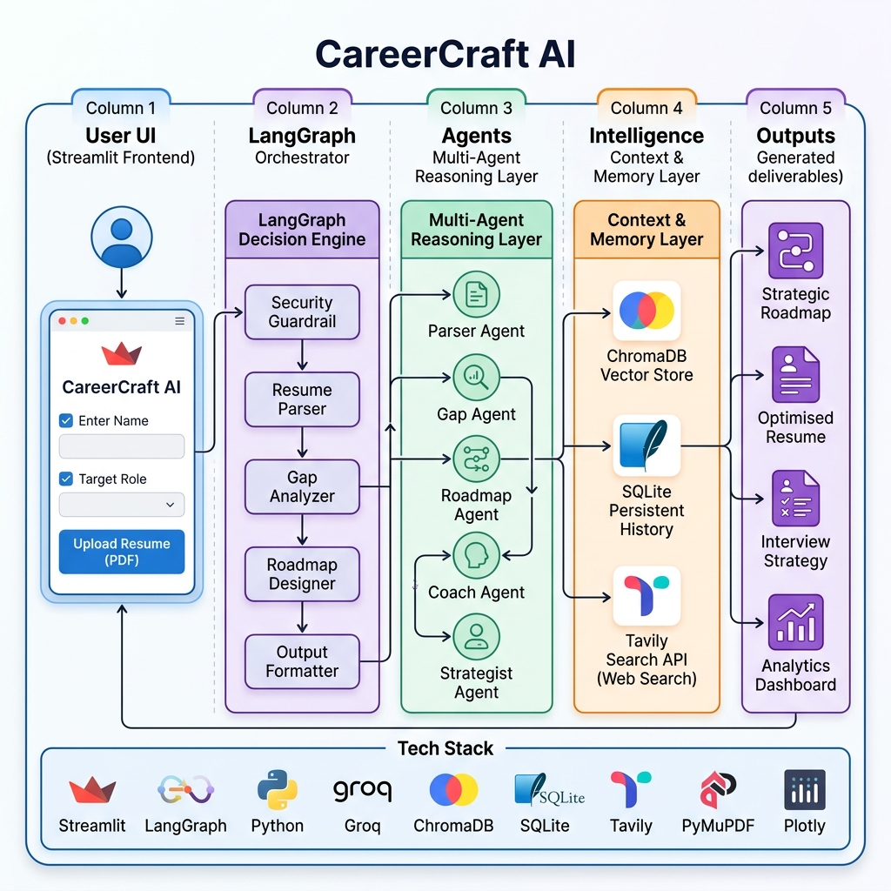
System Architecture

Slide 5
Challenges & Solutions
• State Management: Used LangGraph's StateGraph for robust handoffs.
• Hallucinations: Implemented Security Guardrail nodes for validation.
• Rate Limits: Optimized context with aggressive compression.

Slide 6
Future Scope
• Mobile Application Deployment (Android/iOS).
• Real-time Skill Verification (GitHub/LinkedIn API).
• Enterprise HR Integration for internal mobility.
• Voice-based Mock Interview Simulations.

Slide 7
Conclusion
Project Impact & Success:
• 95%+ Entity Extraction Accuracy.
• 100% Data Persistence and Reasoning Traceability.
• Bridging the gap between static matching and strategic coaching.

