Slide 1


Artificial Intelligence Project
A* Combined with Hamiltonian Cycle for the SnAIke
El Haloui Sami Kuy Yannick Orban Maxime
27st May of 2023

Slide 2
Table des matières
Introduction
Generating the Hamiltonian Cycle
A* search to perturb the cycle
Implementation
Conclusion

Slide 3


Introduction
Problem : No AI Snake complete the grid within a reasonable time Solution : Perturbated Hamiltonian Cycle
1. Introduction

Slide 4
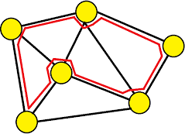
Hamiltonian Cycle
NP complete problem to solve
Faster methods possible for certain type of graphs
2. Generating the Hamiltonian Cycle

Slide 5
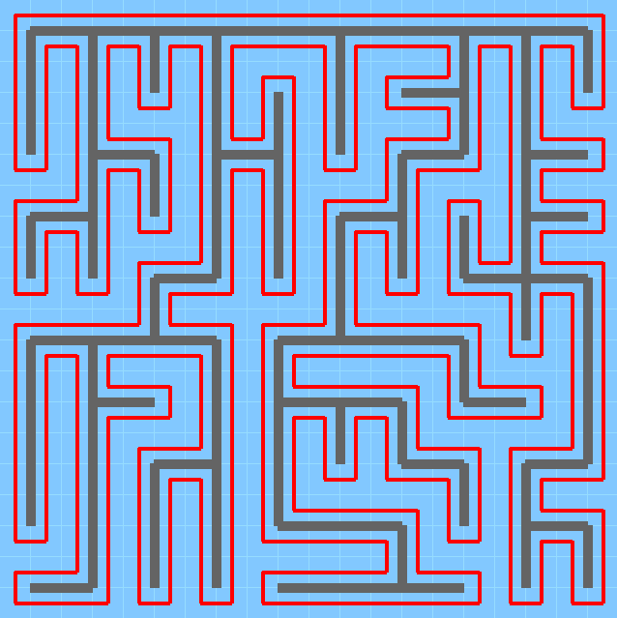
Prim’s Algorithm
Used for grids with even sides
Generate a maze then always turn left
2. Generating the Hamiltonian Cycle

Slide 6
A* search to perturb the cycle
Heuristic same as classic A* : g = Depth or Cost
h = Manhanttan distance between the apple and the node f = g + h
In the original A*, the snake doesn’t take in account that the body moves along his head
But it has to follow the hamiltonian cycle and can take legal shortcuts (shown in the demo)
3. A* search to perturb the cycle

Slide 7
Implementation limitations
In the game’s implementation, the snake can’t follow closely his own tail. (if an apple spawns right between his head and tail, it dies)
The game does not support grids that are not square-shaped. (X must be equal to Y)
4. Implementation

Slide 8
Results
Snake that can finish the game for lots of configurations
Some limitations :
Grid with obstacles without valid Hamiltonian Cycle but with a smaller Hamiltonian Cycle possible (missing some squares). In this case our snake dies instantly
Only small grids can support the search of a Hamiltonian Cycle with obstacles. The search becomes quickly very long
5. Conclusion

