Slide 1
Ethics in a Computing Culture
Chapter 5
Trust, Safety, and Reliability

Slide 2
Objectives
Why does software fail?
What are the consequences of software failure?
How can we help prevent software failures from occurring in the future?

Slide 3
Causes of Computer Failure
A computer might fail to meet expectations by:
Hardware errors (malfunction) The hardware might malfunction, causing erroneous results.
Software errors (bugs) mistakes in either the programming or the design of the software.
Being programmed to solve the wrong problem (programmers fail to deliver client expectations)
Misuse (a computer is provided erroneous data), involves attempting to use a computer for the wrong purpose or using one incorrectly for the right purpose.
Communication failure (human misunderstands a computer prompt)
Malice (hackers) - often the product of a full-blown vendetta, for-profit crime, terrorism, or warfare.

Slide 4
Causes of Computer Failure (continued)
Suppose a word processor marks a sentence as a fragment, but the sentence is grammatically correct. What type of error is this likely to be?
Suppose an ATM gives someone less cash than was charged to his or her account. What type of error is this likely to be?

Slide 5
History's Worst Software Bugs
http://www.wired.com/software/coolapps/news/2005/11/69355?currentPage=all

Slide 6
Ariane 5 Flight 501
The "software bug" was actually down to carelessness. For the Ariane 4 rocket, they had carefully calculated that the maximum horizontal velocity would never overflow a 16 bit integer. The Ariane 5's horizontal velocity could be over five times higher, and thus could overflow a 16 bit integer, but the engineers neglected to check this and reused this part of the software.
Video link to launch and investigation of rocket explosion
http://www.youtube.com/watch?v=3bujoNtjgTU

Slide 7
Case: Ariane 5 Flight 501
Ariane 5 Flight 501 was an unmanned test flight sponsored by the European Space
consisted of a cluster of four rockets, came to an end when the rockets self-destructed due to a computer error.
“arithmetic overflow” error that could have been prevented if the program developers had not decided to gain efficiency by gambling that such an error would not occur.
floating point numbers were represented as sixty-four bits and integers were represented as either sixteen bits or thirty-two bits
a 64-bit floating point number, which was converted to a 16-bit integer, proved too large to fit into 16 bits.
bug did not cause a loss of life, but it did result in a loss of $3.5 million
was included on Wired magazine’s 2005 list of the ten worst bugs in history

Slide 8
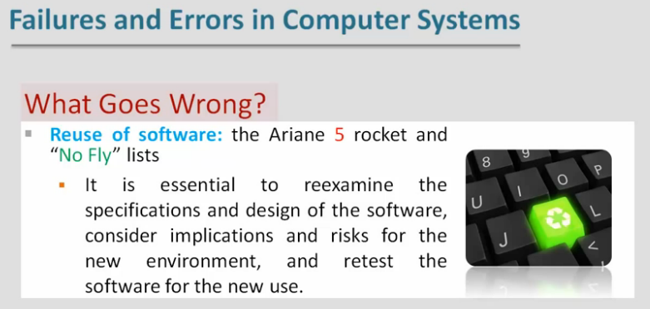

Slide 9
Case: Ariane 5 Flight 501
Suppose we knew the identity of the people who made the decision to omit the code necessary to handle the arithmetic overflow error, which caused the rockets during the Ariane 5 flight to self-destruct.
Would you hold those people responsible for the accident?
Suppose lives had been lost due to the Ariane 5 disaster.
Should anyone be considered guilty of criminal negligence?
Notes:
June 4, 1996 -- Ariane 5 Flight 501. Working code for the Ariane 4 rocket is reused in the Ariane 5, but the Ariane 5's faster engines trigger a bug in an arithmetic routine inside the rocket's flight computer. The error is in the code that converts a 64-bit floating-point number to a 16-bit signed integer. The faster engines cause the 64-bit numbers to be larger in the Ariane 5 than in the Ariane 4, triggering an overflow condition that results in the flight computer crashing.
First Flight 501's backup computer crashes, followed 0.05 seconds later by a crash of the primary computer. As a result of these crashed computers, the rocket's primary processor overpowers the rocket's engines and causes the rocket to disintegrate 40 seconds after launch.

Slide 10
Case: Pentium Floating Point Divide
In October, 1994, Professor Thomas Nicely, a professor of mathematics at Lynchburg College in Virginia, notified Intel Corporation about an apparent flaw in the Intel P5 Pentium chip.
The flaw had to do with floating point division.
division of one floating point number by another floating point number sometimes produced invalid results.
the erroneous values were significant only for those calculations requiring high precision and were quite rare (approximately once in every nine billion floating point divide operations)
the total number of such operations that were done every day by PCs was enormous, so that the number of faulty values was also very large.

Slide 11
Case: Pentium Floating Point Divide
Intel indicated they had been aware of the problem for several months, but had not announced it to the general public.
A report on CNN turned the bug into real news.
Intel argued that the bug was not very important and affected very few users. Offered to replace chips only for those users who could demonstrate a need for high precision.
Public outrage ensued. Believed Intel had an obligation to deliver a product that behaved as it was supposed to.
cost to Intel for the floating point divide bug has been estimated at approximately one-half billion dollars
loss of trust by the public is difficult to measure in dollars, but there can be no doubt that Intel’s image was tarnished

Slide 12
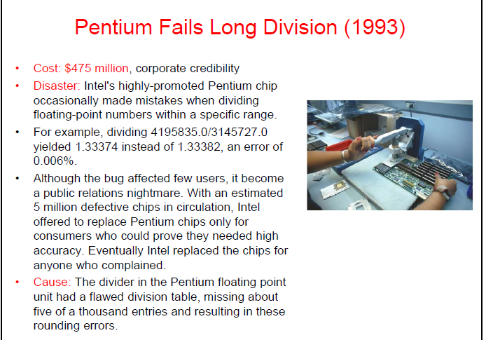

Slide 13
Case: Pentium Floating Point Divide
Did Intel have a moral obligation to replace the defective Pentium 5 chips, even for those users who had no need for high precision?
When employees of Intel first discovered the bug, did they have an ethical responsibility to make the problem public?

Slide 14
Case: Pentium Floating Point Divide (continued)
Suppose a bank was relying on computers that had the Intel Pentium 5 chip to perform extensive computations relating to investments. Suppose further that the error in the chip caused the bank to lose a significant amount of money.
Does Intel have a moral obligation to compensate the bank for its loss? This is not a question of Intel’s legal liability.

Slide 15
Denver Baggage Claim System
News Report on Denver airport baggage claim system
From Notable Software Failures
http://www.youtube.com/watch?v=xx8f4x6C_KY

Slide 16
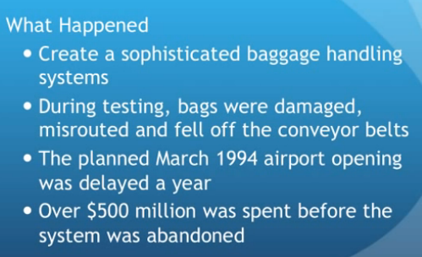
Denver Baggage Claim System

Slide 17
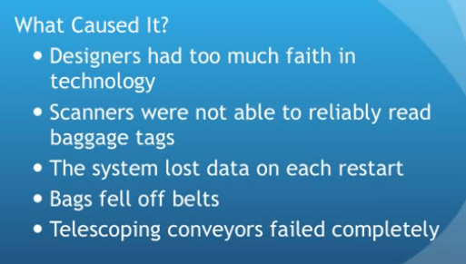
Denver Baggage Claim System

Slide 18
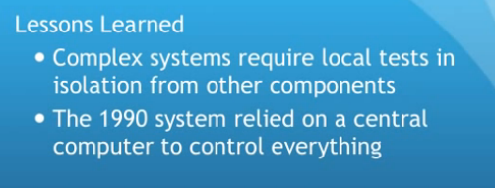
Denver Baggage Claim System
MSNBC Denver airport baggabe
http://www.youtube.com/watch?v=xx8f4x6C_KY

Slide 19
Case: Why Software Fails
Form included only a single blank labeled “Name.”
made it difficult to identify each chemist’s last name because of the variety of ways people had chosen to write their names in the blank, i.e., Wayne Thomas MD
Hired a programming student, and asked her to write a program that would identify the last name of each registrant.
programmer needs a logical plan that defines the steps necessary to determine the solution to the problem the program is supposed to solve.
The specific sequence of steps constitutes an algorithm which is a mathematically precise description of a procedure.
program, when it is finished, is a kind of translation of the algorithm into a programming language.
A software error could arise because of a faulty algorithm (a certainty in this case, since there is no infallible algorithm for the problem) or because of a faulty representation of the algorithm in the chosen programming language.

Slide 20
Case: Why Software Fails
The consequences of the faulty program in the chemist conference scenario were not especially costly, but caused a few participants (approx. 300 of a supposed 6,000 chemists) to be inconvenienced. Is this number sufficient enough for either the conference organizers or the programmer to have any ethical responsibility?
Assuming the conference organizers had a limited budget, was the organizers’ decision to hire a student to do the programming a moral one?

Slide 21
Bugs and Public Safety
Safety-critical software: software that may affect someone’s safety if it fails to work properly
usually includes software that could potentially harm the environment, as that would presumably indirectly harm humans
Examples: air traffic control software, software that controls processes within a nuclear power plant, software associated with braking systems of automobiles, or patient monitoring software in an intensive care unit.
most agree no way to be absolutely certain that a nontrivial computing system will function correctly.
many disagree about how best to maximize software reliability.

Slide 22
Bugs and Public Safety
test a program would be to test every possible execution and make sure that no matter what the input, the program will work correctly.
number of different possible instruction sequences executed by a moderately sized program is huge, making it impossible to test all possible sequences
Possible to roughly calculate the number of executions required to exhaustively test a program.
Decision point: a place in computer code where the next instruction executed depends on input data
one hundred decision points could result in over 10³⁰ different executions of instruction sequences. If a computer required one picosecond to execute each sequence (a speed that is actually much faster than current computers’ capabilities), the time required to execute all those sequences would exceed ten billion years.

Slide 23
Bugs and Public Safety
Control programs: programs that control some sort of machinery
Control programs are particularly difficult to test because they are commonly multiprocess programs with real-time constraints
Real time: a program must do something within a specific amount of time
Multi-process: programs that execute at the same time as one or more other programs
must coordinate with each other so that they do not get in each other’s way.

Slide 24
Bugs and Public Safety (continued)
Software engineering has made many advances that have improved our ability to produce reliable programs.
Better education and training of software engineers, programmers, and analysts
More sophisticated testing procedures
Better maintenance
Refocusing the software development process on the prevention of bugs rather than the detection and correction of bugs
single most important component of reliable software is the quality of the people who create it.
Despite the intractability of exhaustive testing, testing is still one of the most important ways in which we attempt to ensure software reliability BUT it can never be foolproof.

Slide 25
Software Maintenance
Maintenance of programs is another area where real progress has been made.
Sometimes programs need to be updated because of new developments in the application environment.
Sometimes, despite developers’ best efforts, software fails.
High-quality software requires a high-quality maintenance system for reporting, documenting, and correcting problems when they happen.

Slide 26
The Software Development Process
Major tasks of software development are as follows:
Requirements—Literally what is required of the software. For large projects, specialists called “requirements engineers” interview clients to determine exactly what the system needs to do to best serve the clients
Specifications and Design—Once the requirements of a system are established, designers develop the particular set of component program modules, or subprograms of the software system.
Implementation—Programmers then use the design to create code in an appropriate programming language. The program is considered a correct program when it matches the specification.
Proving a program correct means that the program matches a specification. A correctness proof for a program does not prove that the specification itself is correct.
The specifications are based on requirements, which are derived largely through human communication.

Slide 27
Communication
One of the ways in which the overall software process has improved is to concentrate on human communication.
Communication is frequently cited as the most important aspect of software development.
Many executives of software production companies, as well as several famous computer scientists, have asserted that the most important skill needed by a software developer is the ability to communicate.
Brooks’s Law: “Adding people to a late project makes it later.”
Adding new people adds new lines of communication, which increase the chances of miscommunication or missed communication

Slide 28
Bugs and Public Safety (continued)
Many executives of software production companies, as well as several famous computer scientists, have asserted that the most important skill needed by a software developer is the ability to communicate.
Defend or refute that assertion.
Would more extensive testing of the software have prevented the Ariane flight failure?
Explain your reasoning.

Slide 29
Case: Therac-25
A machine designed for cancer treatments, known as a medical linear accelerator.
One of a series of such machines marketed by Atomic Energy of Canada Limited (AECL).
“25” designation referred to its power, which was substantially greater than its predecessors
Unlike earlier versions, it relied much more heavily on the machine’s software for control and hence for safety.
Video explain some technicalities:
Therac 25 - Software Testing – Udacity
An Investigation of the Therac-25 Accidents
http://courses.cs.vt.edu/professionalism/Therac_25/Therac_1.html

Slide 30
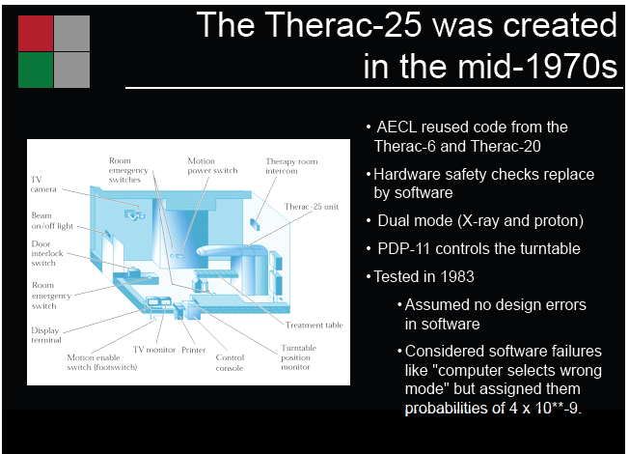

Slide 31
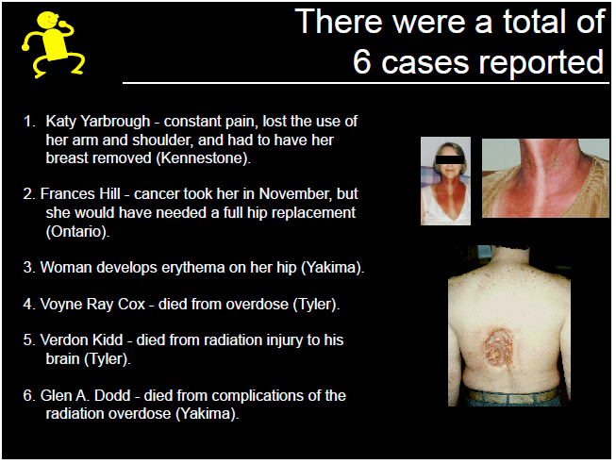

Slide 32
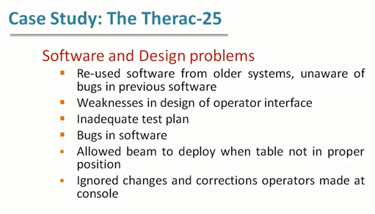

Slide 33
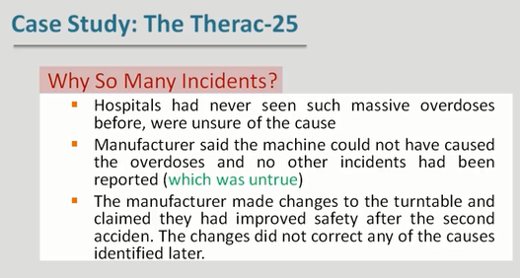

Slide 34
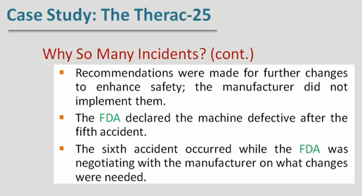

Slide 35
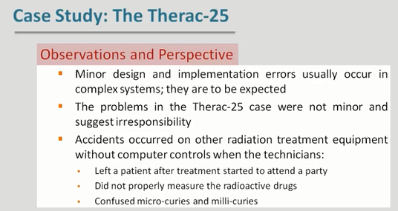

Slide 36
Case: Therac-25
Therac-25: machine designed for cancer treatments
radiation overdose occurred at the Kennestone Oncology Center in Marietta, Georgia in 1985
Less than 2 months later, a woman received a severe radiation burn to her hip from a Therac-25 machine
Six serious accidents involving the Therac-25. All six accidents seriously harmed patients, and three patients actually died directly because of the Therac-25.
Notes:
Ask students if they agree with Birsch’s assessment.

Slide 37
Case: Therac-25
Both inside and outside of AECL, people had such trust in the Therac-25 machine and its software that they discounted their own powers of observation.
The medical staff at Kennestone were unable to accept the idea that the patient had suffered more than a minor radiation burn.
BUT one of Kennestone’s medical physicists did call AECL to inquire if it were possible for the Therac-25 to operate in a way that would cause aradiation overdose.
AECL assured him that it was not, in fact, possible.
Details of the accident were not reported to AECL or to the FDA because the physicians in charge didn’t even agree that an accident had occurred

Slide 38
Accountability and Moral Responsibility
Douglas Birsch: applied ethicist who argues that both the programmer who designed Therac’s software and the company’s quality assurance officer bear significant moral responsibility for the accidents
A quality assurance officer is the person responsible for the policies, personnel, and budget required to monitor and enforce a company’s quality standards.
Without more information about the accidents, Birsch explained, it is not possible to assess the exact degree of moral responsibility.
He doesn’t argue that the programmer and the quality assurance officer bear legal responsibility; a matter for the courts to decide.

Slide 39
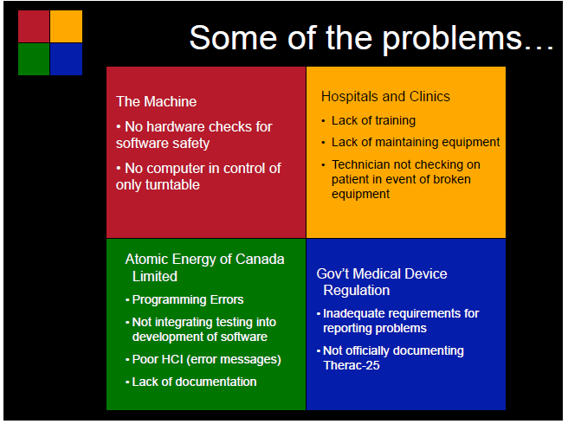

Slide 40
Birsch’s criteria
For a person to bear moral responsibility:
“(1) The person’s actions must have caused the harm, or been a significant causal factor.
(2) The person must have intended or willed the harm, or it must be a result of his or her negligence, carelessness or recklessness.
(3) The person must be able to have known, or must know the consequences of the action, or must have deliberately remained ignorant of them.”

Slide 41
Programmer’s Moral Responsibility
The programmer, as the person who wrote the software, made or at least allowed the software errors that directly caused the radiation overdoses.
The programmer, as the software expert, knew (or at least, ought to have known) that such a complex program could have bugs that were unlikely to be detected by testing. He should have notified management of that fact.
The programmer knew the machine was potentially lethal and understood the possible consequences of a software failure.

Slide 42
Mitigating circumstances: Context of the time
The program was entirely developed by one person, working alone. Today this would be considered extremely poor programming practice.
2The software contained elementary errors, indicating that the programmer lacked formal training. Today, software used to control such potentially dangerous equipment would not be developed by amateurs.
The programmer worked in an assembly language–a very low level language that is very similar to machine language. Using assembly language was a decision that was dependent upon the time the software was developed.
The Therac-20 software was reused almost intact in the Therac-25 because it appeared to be error free. It wasn’t but hardware safeguards removed on Therac-25

Slide 43
Thinking It Through
Did anyone involved in the Therac-25 accidents behave in an immoral (unethical) way? Explain your reasoning.
What software do you encounter in your life that could be hazardous to you if it were to malfunction?

Slide 44
Case: A&P’s Cash Register Scandal
In 1974, a scandal occurred in New York City at the A&P Supermarket at 220 East 46th Street. Inspectors from the New York City Department of Consumer Affairs alleged that the cash registers in the markets systematically overcharged customers when the number of items purchased and the total bill for the purchases was larger than a specified amount
The A&P cash register scandal:
only possible because people trusted a computer to do arithmetic correctly

Slide 45
Case: A&P’s Cash Register Scandal
Manager and two part-time checkers were fired.
The allegations were that the manager had programmed the registers so that if the amount of a purchase was greater than a certain amount, the total would be increased by an additional percentage.
The manager, at least in his public statements, insisted he knew nothing of such a scheme, and that he had no awareness of the registers overcharging anyone

Slide 46
Thinking it Through
Is it morally permissible to accept a computer’s calculations without actually checking it?

Slide 47
Case: A&P’s Cash Register Scandal (continued)
Suppose you had a long grocery bill. You add up the prices of the individual items by hand, and your answer is considerably more than the total on the bill you paid. Adding them again, you get the same answer.
Would you assume that you added incorrectly, or that the computer did?

Slide 48
Malware
Malware: short for “malicious software”
Worm—A program that makes copies of itself and propagates those copies through a network to infect other computers.
Virus—Malware that is similar to a worm, but which resides in another program. That program must execute in order for the virus to propagate itself.
Spyware—A computer program secretly installed for the purpose of collecting information about the computer’s user or users.
Trojan horse—A piece of software that masquerades as an innocent, and perhaps useful, program, but that is actually designed for a malicious purpose.
Rootkit—A program that embeds itself into a computer’s operating system and acquires special privileges that would normally be available to the operating system.

Slide 49
Hackers
people who write and deploy malware are commonly called hackers and the activity of doing it is called hacking
Two connotations now:
simply people who were good at problem solving via programming.
most people today use “hacker” to describe someone who uses computer knowledge for unethical purposes.
older meaning seems to be fading fast
An attack that exploits a previously unidentified vulnerability is known as a day zero attack or a zero day attack. Zero day attacks are commonly the most dangerous and unexpected
ethical debates concerning particular uses of malware do arise.

Slide 50
Ethical Hacking
“white hat hackers;”
their goal is to seek out vulnerabilities so they can be removed before a malicious intruder discovers them and launches an attack.
raises some ethical and legal issues:
Hiring a team of hackers is always a risk, because it’s possible that, despite the team’s supposedly legitimate intentions, some or all members of the team may actually have illegitimate goals.
Sometimes even legitimate hacking necessarily violates the law. Former ‘”white hat hacker” testing system he worked on, arrested for hacking. networks today cross state boundaries and even national boundaries, making the legal issues murky at best.
The education and training of ethical hackers is controversial.

Slide 51
Hacking – Other kinds
Phishing scam attempts to fool or frighten a person into revealing key information.
simply human trickery.
For example, a respectable looking person might show up at the reception area of a corporation with a flash drive that he claims to have found in the parking lot
Physical attacks may involve breaking and entering or may be associated with some sort of listening device or camera.

Slide 52
Thinking it through
Another group of hackers, who consider themselves ethical, write worms or viruses that perform some kind of beneficial task. For example, such a hacker may write a worm that will seek out a particular vulnerability in an operating system, fix the problem, and then destroy itself. Are these hackers really acting in an ethical manner? Explain

Slide 53
Case: Stuxnet Worm
Stuxnet: a computer worm that has significantly set back the Iranian nuclear development program
extremely sophisticated software, speculated to have been created by the CIA and the Israeli governmant
Its sophistication is manifest in various ways:
The worm attacked three different operating systems, including Windows.
four (an unprecedented number) instances of a zero day attack for Windows systems.
exploited other previously identified, vulnerabilities, and included a Windows rootkit.
very large worm, consisting of over 500,000 bytes of programming
very specific in its target. unleash its attack only on Siemens Supervisory Control And Data Acquisition (SCADA) systems, which were used in the centrifuges in Iran’s nuclear program.
several variants to explicitly attack five different sites in Iran.

Slide 54
Thinking It Through
Can the people who wrote the Stuxnet worm be considered ethical hackers?
An instance of “cyber warfare” ?
Suppose the Stuxnet worm, instead of just destroying centrifuges, had caused some other sort of damage that had taken human lives. Would that affect whether the people who created and deployed the worm were ethical hackers? Explain

Slide 55
PUBLIC TRUST ISSUES
Problems and expenses associated with implementing safety-critical software.
election technology example examines software that, while not safety-critical, is of great societal importance.
how computers can actually entice us into overuse.

Slide 56
Nuclear Shutdown System
Darlington Nuclear Generating Station: the first Canadian nuclear station to use computers to run the emergency shutdown systems for its reactors
written by nuclear engineers who knew how to program, that is, written by experts in the domain of the application for which the program was intended
Ontario Hydro, owner the nuclear plant, had battle to convince the Atomic Energy Control Board (AECB), Canada’s federal regulatory agency for nuclear power plants, that the programs were reliable. The process required more time that the original programming effort and was very costly.
Notes:
Ask students if it is better to have experts on a particular technology write safety-critical programs or to have software engineers write them? Why?

Slide 57
Parnas’ Evaluation of Nuclear Shutdown System
David L. Parnas, a leading software engineer, asked to evaluate the programs.
“Shut off the pumps if the water level remains above one hundred meters for more than four seconds.”
Parnas pointed out that it becomes difficult to interpret in a situation in which the water level varies during a four second span.
“Shut off the pumps if the minimum water level over the past four seconds was above one hundred meters.”
That interpretation would be very different in practice if the water was moving in large waves, as might happen, for example, in an earthquake.

Slide 58
Thinking it Through
The shutdown programs were written by nuclear engineers who knew how to program. Hence, they were experts in the domain of the application for which the program was intended. In general, is it better to have experts on a particular technology write safety-critical programs or to have software engineers write them? Explain your reasoning.

Slide 59
Elections and Voting Technology
Counting votes obviously is not a safety-critical task, but equally as obvious, it is one of enormous importance
Unlike most safety-critical systems, there is a clear danger of the system being attacked by people who either wish to disrupt the election or to determine the winner.

Slide 60
Case: The 2000 Presidential Election
Extremely close one between then-VP Al Gore and George W. Bush.
Because of the way presidents are elected in the U.S., the winner of the election came down to whoever would be the winner of the popular vote in the state of Florida.
Al Gore conceded to George W. Bush in a televised speech. George W. Bush had won the election in Florida, and hence the nation, by 537 votes.
Technology played a significant role in both the reporting of the results by the news media and in some of the problems with counting the vote.

Slide 61
Case: The 2000 Presidential Election
news media uses statistical models and exit polls to predict the result of an election. until the election of 2000, the media was almost always right when they declared a winner.
problems with the punch card technology used in Florida and its apparent failure to correctly record all of the votes cast.
discrepancy between exit polls and the actual reported count was particularly large. One reason was that many ballots were declared invalid.
If the voter does not punch the card firmly, the chad may not detach fully and the card reader cannot record a vote for that ballot

Slide 62
Case: The 2000 Presidential Election
No clear consensus as to what constituted a reasonable way to do that.
Example When should a punch count? One example: if a chad was detached at three of the four corners, it seems reasonable that the voter had intended to punch out that chad.
December 12, when the U.S. Supreme court ruled that the manual recounts ordered by the Florida Supreme Court violated the equal protection clause of the United States Constitution because the standard was too vague and would lead to inconsistent counts in different districts. The following day, Al Gore conceded the election.

Slide 63
Case: Hacking The Diebold Voting Machine
Help America Vote Act of 2002. provided funding for states to modernize their voting systems and eliminate punch card and lever systems.
necessarily have to have very robust security measures as well as rigorous audit procedures so as to guarantee a correct vote count.
Not only must the systems be secure, the voting public needs to believe they are secure in order to have confidence in the process.

Slide 64
Diebold AccuVote-TS & successor, the Diebold AccuVote-TSx
by September of 2006 were the most widely used electronic voting machine in the United States.
A number of computer scientists had expressed alarm at the rapid proliferation of computerized voting machines, claiming that they were not sufficiently secure.
Princeton group’s research showed that someone who was alone with the machine for only two or three minutes could install malware on the machines. Made video to show how it cold be done: http://citp.princeton.edu/voting
.

Slide 65
The Opponents of Microsoft PowerPoint
Anti-PowerPoint Political Party (APPP) is attempting to get a referendum on the ballot to ban PowerPoint and possibly other presentation software.
Claim:PowerPoint costs Swiss citizens about two and one half billion dollars each year in wasted time, arguing that 85% of the people who attend PowerPoint presentations are bored and get nothing out of them.
Edward Tufte, noted statistician, artist, graphic designer, and computer scientist, believes that the cultural effect of PowerPoint presentations weaken both verbal and spatial reasoning. Only use hierarchical bullet point Knowledge representation

Slide 66
PPT Related to Space Shuttle Columbia Disaster
board’s report also included a highly critical comment concerning the way important critical information was communicated at NASA:
As information gets passed up an organization hierarchy, from people who do analysis to midlevel managers to high-level leadership, key explanations and supporting information is filtered out.
The Board views the endemic use of PowerPoint briefing slides instead of technical papers as an illustration of the problematic methods of technical communication at NASA
PowerPoint issue is an exemplar of a great many of the ways in which we come to rely on computers.
People easily become dependent on technology, from presentation software and word processors to spell checkers and e-mail programs.

Slide 67
Thinking it Through
Suppose your school were to ask students to vote on a school policy to ban the use of PowerPoint or similar presentation software in the classroom. Would you vote for it? Explain your reasoning.

