Slide 1
CSE 262 Technology, Ethics, and Global Society Dr. Valerie Cross

Slide 2
Chapter 2 Computing Professions and Professional Ethics
Objectives
Intro Cases
FIGHTING INJUSTICE
REFUSING TO DO A FAVOR FOR A FRIEND
PROFESSIONS AND CODES
ETHICAL STANDARDS
PROFESSIONALISM AND THE LAW
CASE: GOING INTO BUSINESS
MULTICULTURAL PERSPECTIVE

Slide 3
Objectives
explore these various meanings of the words “professional” and “profession,” particularly as they pertain to computing and the computing professions.
the standards that distinguish occupations from professions, particularly occupations associated with computing.
examine the impact of professional standards on those within the profession and the members of the general public who are affected by those standards.
Couple of scenarios first to get discussion going

Slide 4
Case Summary: Fighting Injustice, i.e., Reading another’s email
Rachael was a senior computer science major who worked part-time for IT services at her university.
Professor Paige was having a bad semester. She had never been the most popular teacher in the CS dept, but this semester was a target of ZTBT which had a Web site with videos making fun of Prof. Paige, particularly her clumsiness.
Rachael had Professor Paige for classes and found her to be a competent teacher with a genuine interest in her students. She had seen the videos of Prof. Paige.
Rachel was working on Prof. Paige’s computer to install new software and Prof. Paige had to run to class and asked Rachel to log her out of the email program.
Rachel noticed a subject “So sorry about your diagnosis”

Slide 5
Case Summary: Fighting Injustice, i.e., Reading another’s email
Rachel opened and read the email to learn that Prof. Paige has MS. She then began to think that the videos were not so funny anymore.
She posted to the ZTBT site about Prof. Paige’s MS and asked that Prof. Paige be left alone. But others wanted to know how she found out. She revealed that she had read Prof. Paige’s email.
Her supervisor learned of this behavior and promptly fired her.

Slide 6
Case: Fighting Injustice
Were Rachael’s actions moral? Explain.
Were Rachael’s actions ethical? Explain.
Was Ms. McFarland justified in firing Rachael? Explain.
Suppose Rachael had not been in Professor Paige’s office because of her job with IT services. Suppose she had simply been a student who was in the office for a conference when Professor Paige was temporarily called away for some reason. Would that change either of your first two answers? Explain.
Did Professor Paige behave ethically when she asked Rachael to log her off rather than doing it herself? Explain

Slide 7
Case: Fighting Injustice, i.e., Reading another’s email
Employee violated the privacy policy of IT services explained and emphasized when CS senior student took the job.
Student signed documents signifying willingness to follow the policy.
Violated a trust that people on the IT staff rely on to do their jobs properly.
Violated the ethical standards of the job and of chosen profession.
Behaved unprofessionally

Slide 8
Case: Refusing to do a favor for a friend i.e., letting friend use account to submit work
Michael, snowed in, couldn’t submit work and would receive severe late penalty
Only friend could get a hold of was Greg, software engineer at consulting company
Favor: Have friend Greg log in as Michael on university computer and submit his work for him
Greg saw it as clear violation of the university’s Code of Student Conduct as well as, in his estimation, a violation of the Software Engineering Code of Ethics since he would be misrepresenting his identity using his company’s computer system..

Slide 9
Case: Refusing to do a favor for a friend i.e., letting friend use account to submit work
Did Greg do the right thing? Explain.
Because Greg is no longer a student, does the university’s Code of Student Conduct apply to him? Explain.
Because you have not read the Software Engineering Code of Ethics, you do not know whether Greg is correct in claiming that using a work computer to submit a friend’s school assignment would violate it. If you were going to write a code of ethics for software engineers, what would you write about situations like this? Explain.

Slide 10
Ethics
Ethics - a set of morally permissible standards of a group that each member of the group (at his/her rational best) wants every other member to follow even if their doing so would mean that he/she must do the same.
Questions to be answered
What do we mean by a set of standards?
What group are we talking about?

Slide 11
Why We Care about Professional Standards of Computing
The privacy, safety, and well-being of the general public affected by computers and the software that runs on computers
Examples:
Therac-25
technical support representative posting pictures on Web
Toyota recalled over 100,000 Prius hybrid automobiles – braking problems
Computer professionals
Power of system administrator,
database administrators
safety of the passengers because of the computer hardware and software used by that vehicle

Slide 12
Thinking it Through
List 3 situations in which a computer professional, either directly or indirectly, could strongly affect your life.

Slide 13
Profession? Definition of Bayles
According to Bayles , the consensus view is that any profession:
requires extensive training
involves significant intellectual effort
provides an important service to society
Bayles then identifies three other features common to most professions:
certification or licensing
organization of members
autonomy in one’s work

Slide 14
Thinking It Through
In the United States you do not need a license to be a software engineer unless you practice in Texas.
Provide a plausible rationale for Texas’s requirement.
Provide a plausible rationale for the lack of that requirement in other states.

Slide 15
Update some on certification exams
So far 10 states have indicated they will offer the test: Alabama, Delaware, Florida, Michigan, Missouri, New Mexico, New York, North Carolina, Texas, and Virginia.
http://theinstitute.ieee.org/career-and-education/career-guidance/licensing-software-engineers-is-in-the-works
National Council of Examiners for Engineering and Surveying
http://ncees.org/about-ncees/news/ncees-introduces-pe-exam-for-software-engineering/

Slide 16
The Good Works Project
At Harvard Graduate School of Education
how young people deal with ethical problems in their professions
One can define “profession” narrowly, including only those careers—such as law or medicine—that require specific training and licensing.
The definition used here is much broader. It encompasses any career in which the worker is awarded a degree of autonomy in return for services to the public that are performed at a high level.
Within the power of the individual worker to behave like a professional, should she or he choose to do so

Slide 17
Thinking It Through
Is the weather person on the local television station a professional according to either Bayles or the Good Works Project?
Explain.

Slide 18
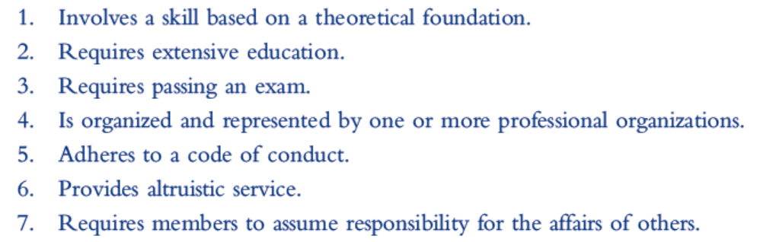
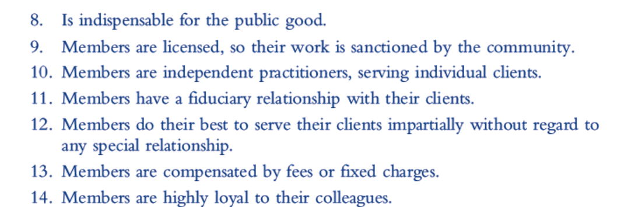
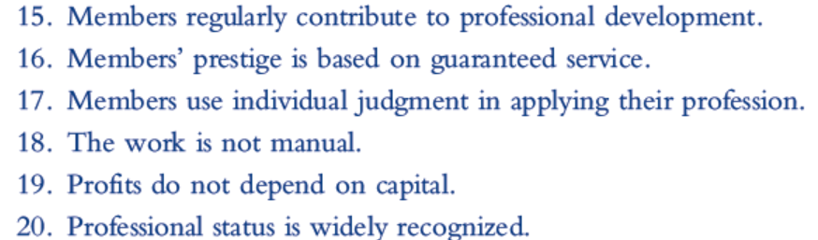
Kultgen’s Wheel of Attributes of Professions
twenty attributes compiled by sociologist Geoffrey Millerson from twenty-one scholars of sociology as necessary for a vocation to be considered a profession.

Slide 19
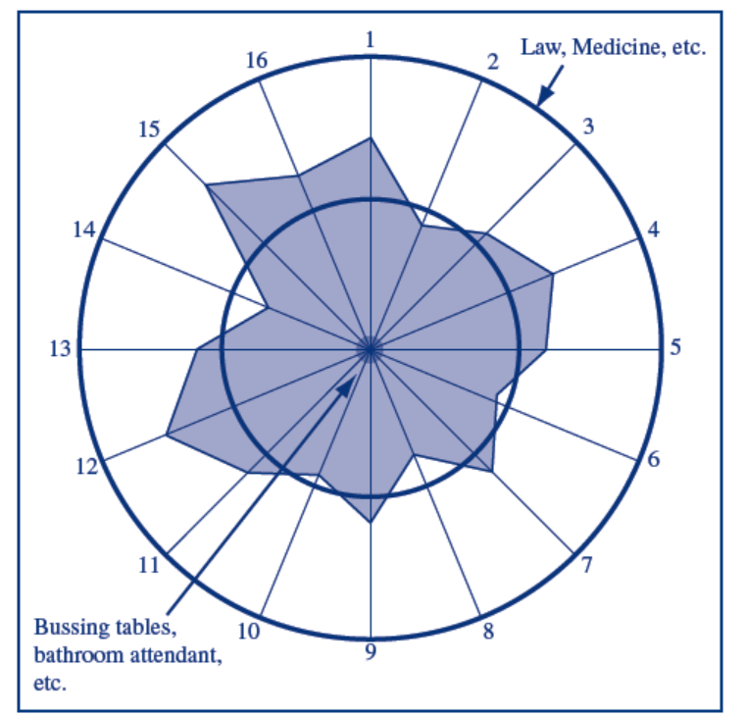
Kultgen’s Wheel of Attributes of Professions
Numbers map to 1st
16 attributes and spoke
Represents how much
Occupation has the
Atttribute.
Gray area represents
A fictitious occupation
inner circle represents the
dividing line between
professional occupations and
nonprofessional ones
(arbitrary no scale)

Slide 20
Thinking It Through
Choose an occupation other than law or medicine that you think of as a profession. Which of Kultgen’s twenty attributes does it have?
Using Kultgen’s wheel, make the argument that software engineering is—or is not—a profession. (Just answer according to what you currently know about the software engineering occupation.)

Slide 21
A Moral Basis for Professions
A profession is a number of individuals in the same occupation voluntarily organized to earn a living by openly serving a certain moral ideal in a morally permissible way beyond what law, market, and morality would otherwise require. (Davis, Ch. 1)
A moral ideal is a state of affairs that, though not morally required, everyone (that is, every rational person at his/her rational best) wants everyone else to approach, all else being equal. Moreover, everyone wants that so much that they are willing to reward, assist, or at least praise such conduct if that is the price for others to do the same

Slide 22
Code of Ethics Linked to Profession
impossible to satisfy the definition of profession without (something like) a code of ethics,
impossible to teach “professionalism” without teaching the code (at least implicitly),
impossible to understand professions without understanding them as bound by such a code.
No code of ethics, then no professions.
only (more or less) honest occupations, trade associations, and the like. There are no professions

Slide 23
Profession First
a professional puts profession first. That is, when a conflict arises between the professional’s code and the policy of an employer or perhaps even the law, the professional’s code must take precedence.
a code of ethics, if accepted by all the members of a profession, can be important independent of an enforcement mechanism.
Can you think of any examples?

Slide 24
Thinking It Through
Does teaching qualify as a profession under any or all of the definitions discussed so far? If so, which definitions, and what attributes of teaching makes it qualify as a profession? If not, what parts of the definitions does teaching not meet?

Slide 25
ETHICAL STANDARDS for Computing Professionals
Association for Computing Machinery (ACM) has adopted a code of ethics
Joint effort by the ACM and the Institute of Electrical and Electronic Engineers (IEEE) produced the ACM/IEEE Software Code of Ethics and Professional Practice,
Still no complete agreement as to what the standards should be.

Slide 26
Trick Question Example
Client privilege question on “bribing”
Lawyer, cannot report information
Engineer, bound to report information
Professional ethical standards vary by profession and may require diametrically opposed actions
the law does not allow physician or lawyer to testify against your client
Reporter depends on state whether must reveal sources but in federal court required to.

Slide 27
Thinking it Through
Lawyers are required to keep the confidence of their clients. Give the strongest argument you can as to how such a rule
could be morally permissible.
cannot be morally permissible.

Slide 28
Specifying the Standard
Ethical standards, according to Davis’s model, may take the form of rules, principles, or ideals
Rules tell us certain things we must do (obligations) and certain things we must not do (prohibitions).
from ACM Code of Ethics “As an ACM member, I will honor property rights, including copyrights and patents.”
(from the ACM/IEEE Software Engineering Code of Ethics and Professional Practice“…those managing software engineers shall, as appropriate, not punish anyone for expressing ethical concerns about a project

Slide 29
Specifying the Standard
Principles are truths that are to be consistently maintained unless there is a compelling reason to do otherwise.
The ACM/IEEE Software Engineering Code of Ethics and Professional Practice specifies eight principles. Two example principles
PUBLIC—Software engineers shall act consistently with the public interest.
2. CLIENT AND EMPLOYER—Software engineers shall act in a manner that is in the best interests of their client and employer consistent with the public interest.

Slide 30
Specifying the Standard
Ideals are goals that are inherently good to achieve. However, failure to achieve them is not necessarily wrong. Sometimes an ideal actually cannot be fully achieved, but even then it is good to strive to achieve it.
Example: a standard for computer professionals included in a code adopted by three Swedish trade unions: “Computer professionals develop systems that use technology in such a way as to satisfy the interests of the user.”

Slide 31
Following the Standards
The ACM Code of Ethics contains 24 rules.
The ACM/IEEE Software Engineering Code of Ethics and Professional Practice contains 80 rules divided into eight categories.
Neither code assigns priorities to its rules so following them consistently may be difficult.
Often, one can count on one’s intuition being consistent with the code. Sometimes, however, one’s intuition is not sufficient, and the professional must work hard to account for all of the factors relevant to the decision.

Slide 32
CASE: Revealing the Location of a Body
Famous case involved a lawyer whose client, a convicted and executed murderer, had told the lawyer where the body of one of his victims was buried. Despite pleas from the victim’s family, the lawyer refused to divulge the information to the family on the basis of attorney/client privilege. She continued to refuse to divulge the information even after a waiver was granted from the Ethics Board.

Slide 33
Thinking It Through
Let us assume that the lawyer who refused to reveal the site of her client’s victim was intending to do the right thing. Make the strongest case you can that her decision was
moral.
immoral

Slide 34
CASE: A Better Way, i.e. Algorithm
Characters:
New software developer right out of college
Boss, been with company 20 years
Scenario
First assignment for developer and he determines after testing software that results meet minimal requirements but not preferred requirements for precision.
He wants to develop new software library which he believes would not take long to fix the problem
Boss says “NO, no time or budget for auxiliary project and simply wants to document as “current technology makes higher degrees of precision impractical.

Slide 35
CASE: A Better Way, i.e. Algorithm
What points/considerations should be kept in mind on this scenario?

Slide 36
CASE: A Better Way, i.e. Algorithm
Some applicable clauses from the ACM/IEEE Software Engineering Code of Ethics and Professional Practice
CLAUSE 3:01 “Strive for high quality, acceptable cost, and a reasonable schedule, ensuring significant tradeoffs are clear to and accepted by the employer and the client, and are available for consideration by the user and the public.”
CLAUSE 3:05 “Ensure an appropriate method is used for any project on which they work or propose to work.”
CLAUSE 3:11 “Ensure adequate documentation, including significant problems discovered and solutions adopted, for any project on which they work.”
CLAUSE 4:01 “Temper all technical judgments by the need to support and maintain human values.”

Slide 37
Thinking it Through
Does the ACM/IEEE Software Engineering Code of Ethics and Professional Practice
require/allow/prohibit
developer to/to/from appeal(ing) to higher authorities regarding his desire to use the new programs? Explain.

Slide 38
Importance of Codes
ACM Code of Ethics and ACM/IEEE Software Engineering Code of Ethics and Professional Practice
Not basis of profession ( by M. Davis definition)
do not define a moral ideal that is openly and voluntarily followed by those of the would-be profession.
In U.S. most computer professionals are not familiar with the particular rules of either code. And some of those who are familiar with the codes do not accept them fully
no particular reason to accept the ACM Code as the appropriate one for setting standards for all computing professionals

Slide 39
Example from ACM Code of Ethics
.As with most codes for relatively young disciplines, some problems:
ACM Code includes moral imperative, “Avoid harm to others.”
“harm” is defined as “injury or negative consequences, such as undesirable loss of information, loss of property, property damage, or unwanted environmental impacts.”
Programmer working on target identification for armed robots or a security specialist working on cyber war strategies would seem to violate this moral imperative since explicitly in the business of trying to cause injury or an undesirable (to the enemy) loss of information.
What do YOU think?

Slide 40
Thinking it Through
Consider the general moral imperative “Respect the privacy of others.” Here, also, there are potential situations where the requirement becomes problematic. Identify such a situation and explain why it is problematic.

Slide 41
Becoming a Professional
Lawyers/physicians - a specific event marks one’s entry into the profession
computing professionals - no single event signals entry into the profession.
a computer professional’s formal obligations most commonly come in the form of codes of conduct dictated by his/her employer.
no generally recognized credentials, and no rites of passage, that establish them as professionals

Slide 42
CASE: Pornography on a University Computer
Systems Manager discovered Dean’s hard disk filled with pornography .wmv files when working on problem of poor performance on workstation.
Options for systems manager:
Confront the dean and demand that he delete the files.
Report the matter to the provost.
Transfer the files to the server to improve performance of the workstation and say nothing to anyone

Slide 43
Thinking it Through
What should systems manager do? Explain
If the files had been vacation videos of the dean and his family, should systems manager’s decision be any different?
Systems manager looked at the dean’s files without his permission. If that became known, should he face consequences? In particular, if he confronted the dean and he fired him for looking at his files, would he be justified?

Slide 44
PROFESSIONALISM AND THE LAW
most professions, any enforcement mechanisms are associated with and enforced by the relevant professional organization
Some professions, such as law, medicine, civil engineering and accounting, require a government license
early-1990s, in Texas tried to create standards for licensing software engineers.
both the IEEE and the ACM were involved in defining a suitable body of knowledge and developing exams to test one’s mastery of that body of knowledge.
ACM ultimately withdrew from the effort,
ACM’s position is that software engineering as a discipline is too immature for its body of knowledge to be defined with precision.

Slide 45
Becoming a Professional
three components to establishing one’s credentials for a profession:
education
Experience
examination
Today’s computing professionals are not required to be qualified under any of those three components.
most computing professionals are employed by a company or a government agency, both of which enforce their own standards

Slide 46
Thinking it Through
Not all software engineers work on products that affect public safety. Moreover, not all software development is done by people who are software engineers. Should there be some type of legal regulation on any type of software other than the regulations that already exist? Explain.

Slide 47
CASE: GOING INTO BUSINESS
bright young man has talent with problem shooting computer troubles.
Gains reputation and makes a business of it
Uses his business clients to gain inside information
Sometimes uses information to his advantage
careful not to gossip or to reveal to anyone what he learned
never considered what he was doing as wrong but considered himself an honest businessman who remained discreet about his clients’ business

Slide 48
Thinking It Through
Were his actions (reading his customers’ files) moral from an act utilitarian viewpoint? Explain
He did not believe his acquisition of his clients’ information to be morally wrong. Make the strongest case you can that his position is
VALID.
NOT VALID

Slide 49
MULTICULTURAL PERSPECTIVE: THE NEW ZEALAND COMPUTER SOCIETY’S CODE OF PROFESSIONAL CONDUCT
Many countries have adopted or adapted the ACM/IEEE Software Engineering Code of Ethics and Professional Practice.
Others have created their own codes from scratch, to better reflect the cultural context and values of their country.
Code of Professional Conduct used by the New Zealand Computer Society (NZCS).
Some Tenets: Non-Discriminatory, Zeal, Community, Skills, Continuous Development, Outcomes and Consequences, Potential or Real Conflicts of Interest, Competence

Slide 50
Summary
Best-known codes for software engineers and computer scientists in the United States.
ACM/IEEE Software Engineering Code of Ethics and Professional Practice
ACM Code of Ethics are
neither speaks for an entire profession.
Computer professionals not licensed by law, except for software engineers in Texas.
ACM’s policy explicitly opposes the licensing of software engineers.
Computing societies in most technologically advanced countries have adopted codes of ethics.
The New Zealand Computer Society’s Code of Professional Conduct

Slide 51
Summary
Good Works Project has the least restrictive definition of “professional”,
the only requirement is a degree of autonomy and a high level of service to the public. The definition
Kultgen and his wheel of attribute includes the most attributes.
Michael Davis relates most directly to our interest in the ethical responsibilities of professionals.
requires that a profession’s members voluntarily serve a particular moral ideal, in a morally permissible way, beyond what the law, the market, and morality would otherwise require.

Slide 52
Links to
ACM Code of Ethics and Professional Conduct
http://www.acm.org/about/code-of-ethics
Software Engineering Code of Ethics and Professional Practice
http://www.acm.org/about/se-code
NZCS Code of Professional Conduct
http://www.nzcs.org.nz/about/ethics

