Slide 1
Ethics in a Computing Culture
Chapter 3
Privacy

Slide 2
Objectives
What is privacy?
How is personal privacy interpreted, and how is it protected by law?
How is technology adding or removing security?

Slide 3
Today’s Technology
Can you think of some examples of today’s technology that cause information to become public?

Slide 4
Ways Information Becomes Public
Rewards or loyalty programs
Body scanners
Digital video recorders
Automobile “black boxes”
Enhanced 911 service
RFIDs
Implanted chips
Cookies
Spyware

Slide 5
What sorts of things do you think are private?

Slide 6
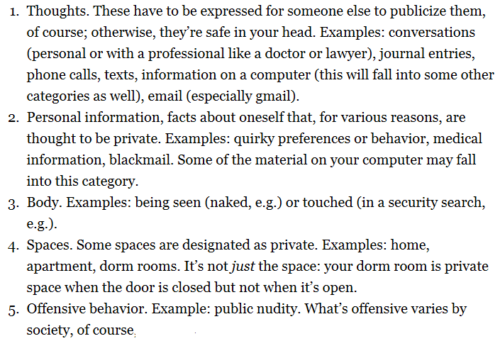
What sorts of things do you think are private?

Slide 7
Links to get you thinking
This video clip was screened in the opening of the 32nd International Conference of Data Protection and Privacy Commissioners "Privacy: Generations", held in Jerusalem, Israel 27-29 October 2010. http://www.youtube.com/watch?v=hsnr_4ccceY
Google http://www.youtube.com/watch?v=IRkQPj6KbP8
Jan 27, 2014 Data Privacy Day
https://www.staysafeonline.org/data-privacy-day/about
Microsoft Studies Online Privacy Attitudes, Privacy Policy Accountability
http://www.privatewifi.com/microsoft-studies-online-privacy-attitudes-privacy-policy-accountability/
Is privacy dead? http://www.youtube.com/watch?v=IRkQPj6KbP8

Slide 8
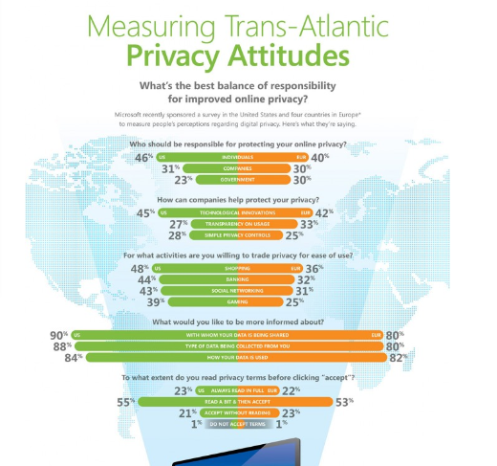

Slide 9
What is Privacy
Recognizing and dealing with privacy problems raised by computer systems is complicated by the lack of agreement about how to describe our right to privacy.
Dictionaries generally give three definitions of privacy:
1) seclusion (which means being set apart or out of view);
2) secrecy or concealment; and
http://www.youtube.com/watch?v=L_65-G1NVrU
http://www.youtube.com/watch?v=4fv4nWOUGOE
3) freedom from intrusion.
http://www.youtube.com/watch?v=w6eufn3NSt0
Definitions conflict with each other, complicating our attempts to agree about privacy issues.

Slide 10
Right to Publicity
http://www.youtube.com/watch?v=qqjE7-gLWZc
http://www.youtube.com/watch?v=533QumQ78LQ
Public figures have their “brand” protected.

Slide 11
What Privacy Rights do we Have?
Published on Jul 4, 2012 In 1890 Louis Brandeis and Samuel Warren wrote a Harvard Law Review article titled "The Right to Privacy." As initially envisioned by Brandeis and Warren, the right of privacy was the "right to be let alone."
http://www.youtube.com/watch?v=iA6SlGNB-cc

Slide 12
Case: Security Class
Security Class assignment:
students are required to intercept e-mails and IMs from the university’s network and post them to the class blog.
When you write email using a school email account, do you consider the exchanged content to be private? Why or why not?
Is the situation different with company account instead of a school account?

Slide 13
Case: Michael’s Essay
Assignment: Argue for something you are actually against
paper advocated strongly that the United States ought to provide financial and logistical support to terrorist groups active in nondemocratic countries as a method for spreading democracy.
Michael’s paper became public through a series of actions performed by other people:
Professor Hernandez uploaded his paper to Plagiarism Preventer without his knowledge.
Plagiarism Preventer allowed Professor Bobson to download the paper.
Professor Bobson posted the paper on the Internet.
Various blogs and social media sites drew attention to the paper.
Traditional media outlets publicized the controversy widely on TV and in newspapers.
Upset people called Michael at home to harass and threaten him.
When considering the outcome of Michael’s essay submittal,
which of the actions led to a violation of Michael’s privacy?
Which of the actions were unethical, but did not violate Michael’s privacy?
What if Michael’s personal information had not been included in the paper? What if only his name, but not his grade, was included?

Slide 14
Case: Michael’s Essay (cont.)
Is it unethical for
professors to use Plagiarism Preventer without student consent?
Plagiarism Preventer to give the full text of students’ works to third parties?
Justify your answers using one of the ethical theories from Chapter 1.

Slide 15
Privacy?
“privacy” as secrecy, then the media did not violate Michael’s privacy because Michael’s paper was already publicly available on Professor Bobson’s blog.
“privacy” as freedom from intrusion, then the reporters did not violate Michael’s privacy because they did not have any direct interactions with him.
Many feel that the media should not widely publicize information that makes an innocent person look bad.

Slide 16
Theories and Conceptions of Privacy
“right to be let alone”: a conception of privacy that focuses on the grievance felt by the harmed party and on actions that directly make them feel harassed, embarrassed, or exposed
right to privacy as the “right to be free from intrusion.”
Popularized by Louis Brandeis (who would go on to be a justice of the Supreme Court of the United States) and Samuel Warren in a famous article in the Harvard Law Review, published in 1890.
Recent inventions and business methods call attention to the next step which must be taken for the protection of the person, and for securing to the individual… the right “to be let alone.” Instantaneous photographs and newspaper enterprise have invaded the sacred precincts of private and domestic life; and numerous mechanical devices threaten to make good the prediction that “what is whispered in the closet shall be proclaimed from the house-tops.”
Notes:
Ask students if a bystander videotapes a police officer writing a traffic ticket, is the officer’s right to be let alone violated?

Slide 17
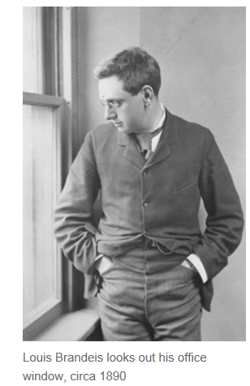
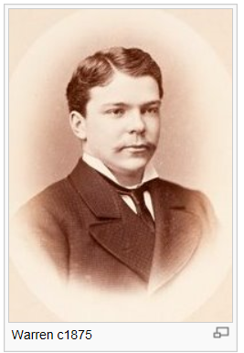
1890 point
Disagreement about whether or not a right to privacy could exist.
A right is a liberty or entitlement owed to a person simply because he or she is a person.
In the United States, for example, the government acknowledges a person’s rights to free speech, to free practice of religion,
opponents of the right to privacy claimed that there was no such right, and that intellectual property rights and contract law were sufficient to protect people from so-called privacy violations. Warren and Brandeis sought to debunk these ideas.
http://www.brandeis.edu/now/2013/july/privacy.html
Samuel Warren 1875, graduated Harvard Law School

Slide 18
Brandeis and Warren
They conclude that a “right to be let alone” already existed and was recognized by the courts, even though it was not explicitly written in the law.
They wrote, “a man’s house is his castle, impregnable, often even to [officers of the law.]”
They recommended that a person whose privacy is breached should be allowed to sue, except in circumstances where the privacy breach is necessary for public safety or for the functioning of a court of law.

Slide 19
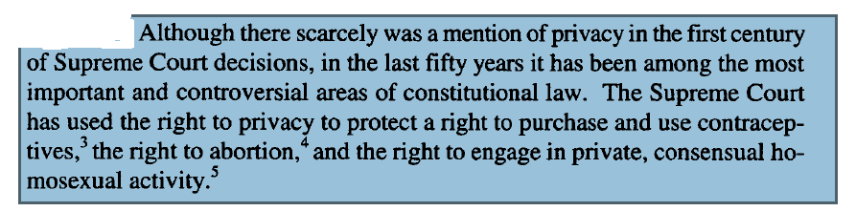
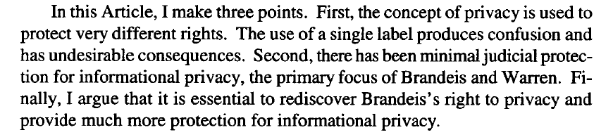
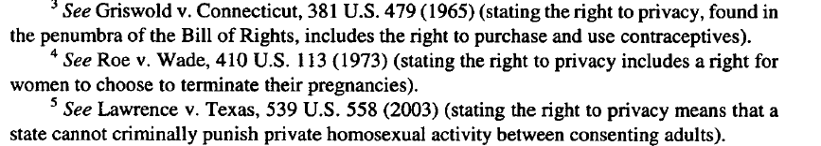
Rediscovering Brandeis’s Right to Privacy by Erwin Chemerinsky http://scholarship.law.duke.edu/cgi/viewcontent.cgi?article=2494&context=faculty_scholarship

Slide 20
“right to be let alone
Michael’s Essay: Which of the parties in the case are guilty of privacy violations under this definition?

Slide 21
Breach of trust vs Privacy
breaches of trust, but this is not a privacy problem according to the definition of Warren and Brandeis.
They would argue that these are exactly the types of situations that could be handled by contract law. Hernandez broke her trust with Michael.
This may have violated an implicit contract with Michael to keep his work confidential.
Bobson did not have a relationship with Michael, but he did break his trust with Plagiarism Preventer by publicly posting the materials it provided.
The parties that most clearly violated Michael’s right to be let alone are Professor Bobson and the harassing callers.

Slide 22
Thinking It Through
When anthropologists and sociologists talk about private life, they typically mean the life of the family and the home, as opposed to public life, which concerns work outside the home and events in the public square. Should the “right to be let alone” apply only to private life, or should it extend to places like the office and public beaches as well? Explain your answer.
Some police officers object to being videotaped while they are going about their jobs (for example, writing traffic tickets). If a bystander videotapes a police officer writing a traffic ticket, does this violate the police officer’s right to be let alone? Why or why not?

Slide 23
Privacy as Concealment
Judge Posner “I think privacy is greatly overrated, because privacy basically means concealment.”
““Still, a good deal of privacy just facilitates the personal counterpart of the false advertising of goods and services, and by doing so, reduces the well-being of society as a whole,” Posner says.”
argues there is no fundamental right to privacy and that people are interested in privacy only to conceal their own wrongdoing or prevent embarrassment

Slide 24
Posner’s Argument
Judge Posner argues that, in the future, modern notions of privacy will be obsolete. His argument has three main parts:
Pre-modern peoples (living in small villages or tribal cultures) had no real ability to conceal anything about themselves, and therefore no privacy. It is perfectly natural for people to live with little or no privacy.
Contemporary people are willing to give up their private information, and become transparent, in return for very small financial incentives or improvements in convenience. This proves that we do not value individual privacy.
Concealment is most useful to criminals, and least useful to honest people.
Therefore, privacy is mostly a social harm that reduces safety, not a social good.
Another supporting “I have nothing to hide” argument says that people are not concerned about privacy because they do not have anything they wish to conceal.

Slide 25
Judge Richard Posner: Privacy
Published on Apr 23, 2012
Judge Posner believes that as a social good, privacy is overrated because it means people are able to conceal things.
http://www.youtube.com/watch?v=kQu0et1jXfs

Slide 26
Privacy as Concealment
Michael’s Essay Case
How would restricting information until others understand the context benefit someone in Michael’s situation?
Does Posner’s opinion fall in line with the application of delaying access to private information like Michael’s paper?

Slide 27
Solove’s Taxonomy of Privacy Problems
top-down: starting with a single clear definition, and then discovering that not all privacy problems are covered by the definition
bottom-up: starting with a list of the common kinds of privacy problems and building a definition up
Notes:
How are top-down and bottom-up applied in Solove’s taxonomy of privacy?

Slide 28
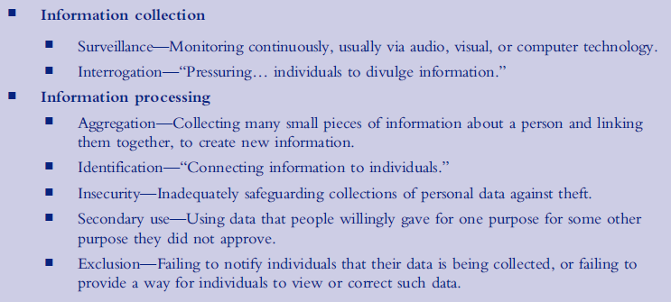
Solove’s Taxonomy of Privacy Problems
(continued)

Slide 29
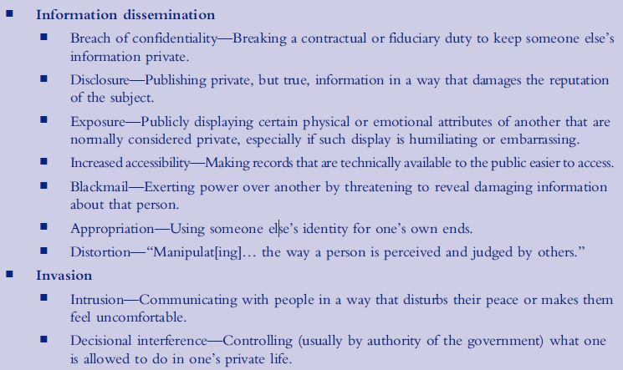
Solove’s Taxonomy of Privacy Problems
(continued)

Slide 30
Aggregation
Aggregation—Collecting many small pieces of information about a person and linking them together, to create new information.
Solove says, “When analyzed, aggregated information can reveal new facts about a person that she did not expect would be known about her when the original, isolated data was collected.”

Slide 31
Solove’s Taxonomy of Privacy Problems
(continued)
PleaseRobMe: a Web site that allowed users to find houses where the owners were away from home
Aggregated social networking status updates (such as Twitter, Foursquare, Flickr, and Facebook) and home address information
The information PleaseRobMe gathered was already freely available on the Internet
Notes:
Ask students to debate whether a Web site like PleaseRobMe is morally wrong or in the right.

Slide 32
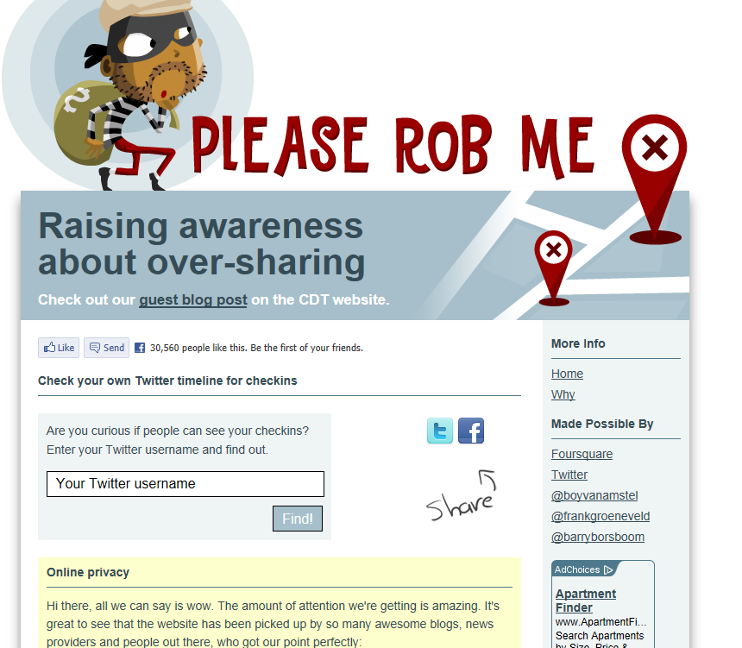

Slide 33
Increased Accessibility
Increased accessibility—Making records that are technically available to the public easier to access.
Example: Civil Rights Act of 1964.
The Civil Rights Act of 1964 a landmark piece of legislation in the United States that outlawed major forms of discrimination against racial, ethnic, national and religious minorities, and women.
Illegal to reject job applicants based solely on their arrest records. Not a major issue in past since even though arrest records have always been public information, few employers would take the time to search every local newspaper for the past ten years
Now combination of online arrest records, online court records, and Internet search engines makes it very easy to violate the law, and violations are very difficult to catch.

Slide 34
Exposure vs Disclosure
BOTH revealing truthful private information
Disclosure—Publishing private, but true, information in a way that damages the reputation of the subject.
Exposure—Publicly displaying certain physical or emotional attributes of another that are normally considered private, especially if such display is humiliating or embarrassing.

Slide 35
Thinking It Through
Some Americans refuse to fill out census forms on the grounds that it is a privacy violation. Under which of Solove’s categories does this fall?
What type of privacy problems are present in Professor Hernandez’s actions?
Consider Plagiarism Preventer’s decision to allow Professor Bobson access to the full text of Michael’s paper. Which item in Solove’s hierarchy is most applicable to this action?

Slide 36
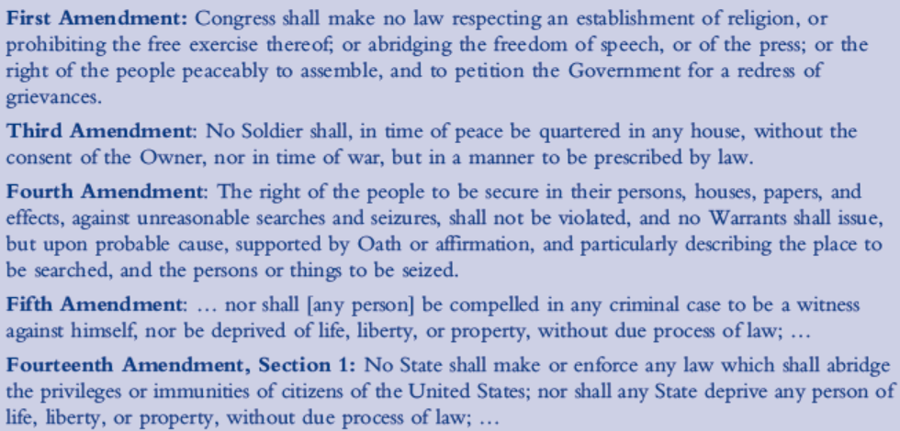
“RIGHT TO PRIVACY” ?
Constitution is the first place we should look.
U.S. Constitution does not explicitly describe a broad right to privacy.
Various amendments to the constitution define certain narrow areas of privacy.

Slide 37
Piecemeal Approach to Privacy
Many different laws, with each law designed to protect the privacy of one particular kind of data, or one particular medium of communication. Examples:
Contents of first class mail – Title 18, U.S. Code, section 1702
Contents of a student’s academic records – Family Educational Rights and Privacy Act (Title 20, U.S. Code, section 1232g)
Bank records – Title 12, U.S. Code, section 3403
Many laws dealing with specific privacy issues, BUT NO law that defines or protects privacy in general.
One of the liberties the Fourteenth Amendment addresses is Warren and Brandeis’s “right to be let alone.”
1969 Supreme Court case of Stanley v. Georgia.

Slide 38
Thinking It Through
Cellular phone companies can locate you very accurately as long as your phone is turned on and has a signal. This location information is often used by law enforcement to solve crimes. Under the Fourth Amendment, should it be legal for law enforcement to get this information without a warrant? In other words, should cell phone location fall under the category of things (“persons, houses, papers, and effects”) protected by the Fourth Amendment? Explain your reasoning.

Slide 39
Privacy in Practice and in the Law
Some experts argue against the idea of “a reasonable expectation of privacy”
Claim it introduces subjectivity into decisions
Private depends on context ― did a person think he or she had privacy at the time?
Is this dependence on context a strength or a weakness when used to interpret the Fourth Amendment?
In 1967, the Supreme Court indeed upheld expectation of privacy in Katz v. United States.
Without a warrant, the FBI had recorded phone conversations of Mr. Katz, who was using a public telephone booth, and they argued that because the phone booth was in a public place, Katz did not have a reasonable expectation of privacy.
the Supreme Court disagreed.

Slide 40
Multicultural Perspectives
Libel: publishing or broadcasting false statements about another person, usually with the intent of harming the other person’s reputation
Most legal systems recognize libel as a crime
In the United States, for a statement to be libel, it usually must be “(a) a statement of fact; (b) that is false; (c) and defamatory; … (g) that causes actual injury…
In Spain, person guilty of libel for “the disclosure of facts relating to private life, which affect a person’s reputation and good name.”

Slide 41
Thinking It Through
Imagine that a writer from Country A posts an article on a server residing in Country B, about someone who resides in Country C. The article is readable only by people in Country D (readers from other countries trying to access the article receive an error message).
If countries A, B, C, and D have very different libel laws, which country’s laws ought to apply, and why?

Slide 42
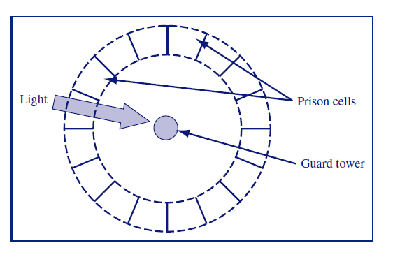
Interdisciplinary Topic: Panopticism
Michel Foucault: Essay “Panopticism,” (1979) explores the influence of persistent surveillance on society, comparing modern society to the modern prison
Bentham’s Panopticon prison design – metaphor for the role of surveillance
In modern society
a prison design proposed by the English philosopher Jeremy Bentham (1748-1832)

Slide 43
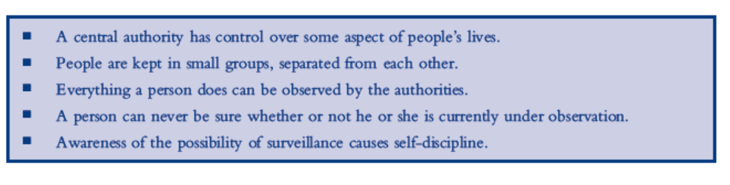
Panopticism Key Ideas

Slide 44
Thinking It Through
Besides crime, what are some other beneficial aspects of surveillance in a modern society?
Judge Posner argues that before modern times, people had very little privacy because an entire family would live together in a single room.
Is this situation of constant observation by other family members an example of panoptic structure?
Be sure to refer to the “key ideas” of panoptic structures in your argument.

Slide 45
Thinking it Through
In what ways can social networking be liberating?
Name a way the features of social networking can be oppressive. Ultimately, are social networking services likely to be liberating or oppressive to a society?

Slide 46
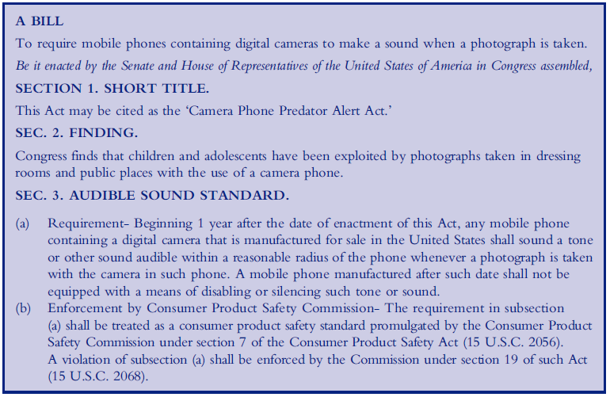
Case: Camera Phone Predator Alert Act
Notes:
Does it make sense that this bill singles out camera phones, instead of addressing all digital cameras and video-recording devices? Would the enacted law make it illegal to own a camera phone that takes pictures silently?

Slide 47
Case: The Texas Infant DNA Database
Imagine you were a state health official who would make a decision about whether or not to pass on DNA sequences to the US military. Explain why you would or would not support the action.
Would your opinion change if the group responsible for compiling the database was a for-profit organization instead of the US military? Would it be better or worse?
Would you be more comfortable if the DNA were not released to the US military until 18 years after it was collected?

Slide 48
Case: Lower Merion School District
At the heart of the problem is a piece of software called LANrev, which has a Theft Track feature intended to help school administrators track down missing laptops.
So far, the legal fees in the case have reached one million U.S. dollars. The school had issued 2,300 laptops to its students.
Use an act utilitarian argument to evaluate whether or not the LMSD should have installed the remote Theft Track software on student laptops.
Compare the costs of the lawsuit to the costs of laptop thefts, and consider the probability of being sued versus the probability of a laptop being stolen.

