Slide 1
Ethics in a Computing Culture
Chapter 4
Intellectual and Intangible Property

Slide 2
Objectives
What is intellectual property?
What are the new types of intangible property that are born from the computing age?
What are the issues that arise as we adapt our copyright laws to these new forms of intangible and intellectual property?

Slide 3
U.S. Constitution
(Article I, Section 8). States that the Congress has the right to “promote the progress of Science and useful Arts, by securing for limited Times to Authors and Inventors the exclusive Right to their respective Writings and Discoveries”
This passage in the Constitution recognizes that
creativity and invention are essential to improving the quality of human life,
people are more likely to engage in such activities if they can make a living doing so.

Slide 4
Intellectual Property
“intellectual” property - the products of creativity and invention
Distinguish them from tangible property such as a house
Several types of intellectual property, focus on ones most affected by computing and the Internet,
Look at new types of intangible property that arise due to computing, but do not seem to be creative in nature.
Background on current intellectual property law and the philosophical basis for these laws.

Slide 5
Copyright: Forever Less One
Somewhat Critical of Restrictions of Copyright law
http://www.youtube.com/watch?v=tk862BbjWx4#aid=P933RyCzfkg

Slide 6
“Piracy”
Refers to the intentional illegal copying of copyrighted material.
Use “piracy” instead of “theft” to emphasize that there are morally significant differences between copying intangible property and stealing physical objects

Slide 7
Case: Sony BMG Antipiracy Rootkit
In 2005, in an effort to stop music piracy,
Sony BMG started using a copyright protection scheme on its CDs.
When the music CD was inserted in a CD player, it worked normally,
When it was inserted in a computer, the user was asked whether to install “Enhanced CD” content, which might contain photographs, music-playing software (similar to iTunes), or other materials.
The installation program also used a rootkit to change the computer’s operating system.
A rootkit is a piece of software that allows an unauthorized user to override security and get administrator access to a computer; it gets its name because the main administrator account on many computer systems is called the “root” account.

Slide 8
Case: Sony BMG Antipiracy Rootkit
If the user chose “Agree” when playing the CD on a computer, the “Enhanced Content” :
used a rootkit to get administrator access to the computer, even if the person playing the CD did not have administrator privileges.
modified the operating system to place limits on how the CD’s contents could be copied or used. 1) limited the number of times the user could convert the CD to MP3 files and the number of copies of the CD the user could “burn”;
prevented people from using the CD with nonapproved music-playing programs or devices.
used a technology called cloaking to make it hard to tell whether or not the user’s computer had the software installed.

Slide 9
Case: Sony BMG Antipiracy Rootkit
Sony BMG concerned about people converting its CDs into MP3 music files and posting them on the Internet for people to download illegally.
Other companies addressed this problem by
making CDs that could not be played in a computer at all. When the CD was inserted in a computer, the computer simply ejected the CD.
did not use any antipiracy technology.
Sony BMG in a way took a compromise approach
knew that many users wanted to use their computers as home stereos and to listen to their music on MP3 players,
opted to go with a copy protection scheme that limited casual piracy while allowing users some flexibility

Slide 10
Security Expert Opinion on Sony BMG Approach
In a commentary in Wired, security expert Bruce Schneier
expressed concern that antivirus and antispyware companies originally chose not to detect or remove the rootkit.
noted that the Symantec Corporation, publisher of numerous widely used security programs, explained its lack of action by saying that the “rootkit was designed to hide a legitimate application.”
Schneier rejected this claim, saying that “the only thing that makes this rootkit legitimate is that a multinational corporation put it on your computer, not a criminal organization.”

Slide 11
Case: Sony BMG Antipiracy Rootkit
Do you agree with security expert Bruce Schneier’s opinion? “The only thing that makes [the rootkit that Sony BMG included on their CDs to prevent piracy] legitimate is that a multinational corporation put it on your computer, not a criminal organization.”
Should it be illegal for someone to convert the CDs they purchased into MP3 files, then use them in their personal music players?

Slide 12
Case: Sony BMG Antipiracy Rootkit (continued)
Should it be okay for antivirus companies to distinguish between rootkits from major corporations and rootkits from criminals? Would allowing the former but denying the latter be fair?
Is it ethical for one to remove the rootkit that Sony BMG installed on your computer without their permission? Furthermore, would it be ethical to break the DRM lock on a Kindle book?

Slide 13
Case: Virtual Investment Fraud
Investment fraud schemes are common in massive multiplayer online games such as Second Life or EVE Online.
games almost always have some form of virtual currency, and players are often looking for ways to earn a quick (virtual) buck.
In 2006, a character named “Cally” in the popular game EVE Online started the EVE Intergalactic Bank.
Cally would take deposits of the game’s currency (the Interstellar Kredit, or ISK) and pay interest on these deposits.
claimed that he was reinvesting the money, but in actuality he was pocketing most of the money.
Reported (though widely disputed) that when Cally’s scheme started to fall apart, he walked away with 790 billion ISK.
many Web sites allow players to exchange ISK for U.S. dollars and vice versa.
At the time Cally’s bank failed, the 790 billion ISK that he had allegedly stolen was worth about 170,000 U.S. dollars.

Slide 14
Case: Virtual Investment Fraud
Cally bragged about his scam, admitting it openly, but he was not punished. Why not?
EVE Online is a computer game about piracy and commerce in outerspace. Players are encouraged to steal each other’s cargo, attack each other, or extort money by threatening to attack.
As a commentator reported in the blog Ten Ton Hammer, CCP hf. (thecompany behind EVE) decided that what Cally did was within the rules of the game.
Although creating fake investments is wrong in real life, it is perfectly acceptable within the EVE Online game.

Slide 15
Case: Virtual Investment Fraud
Defend or refute the claim that “fraud is fraud, regardless of whether or not it occurs in a virtual world; if something stolen can be easily converted into real currency, then it is a real fraud and should be punished.”
Assume that we live in a society (such as the US) that has a personal income tax. Should Interstellar Kredit (ISK) in Eve Online should be subject to income tax, or should only U.S. dollars earned by selling ISKs be subject to income tax?

Slide 16
Jefferson’s Idea on Ideas
In a letter he wrote in 1813, Thomas Jefferson pointed out the difficulty of owning one’s ideas.
“If nature has made any one thing less susceptible than all others of exclusive property, it is the action of the thinking power called an idea, which an individual may exclusively possess as long as he keeps it to himself; but the moment it is divulged, it forces itself into the possession of everyone, and the receiver cannot dispossess himself of it.”

Slide 17
Chapter 4 Focus
Intellectual property law is very complicated
Cannot hope to give a full summary of it here.
Focus on three key types of intellectual property protections that directly affect computing:
copyright,
patent,
trademark

Slide 18
Intellectual Property Law in the United States
Key questions when considering intellectual property protection
What type of thing can be protected?
patents protect inventions, not artworks.
What rights are reserved for the creator of the work?
one cannot publish a photograph without the photographer’s permission.
What rights are reserved for the public?
a book critic has the right to use short quotes from a book in her criticism,
How does one obtain the protection for a work?
How long does it last?

Slide 19
Copyright (Title 17, U.S. Code section 102).
Copyright: the main mechanism for protecting creative works such as art, music, and writing in the US
protects “original works of authorship fixed in any tangible medium of expression” in the areas of literature, music, drama, pantomime, graphic art, sculpture, motion pictures, sound recordings, and architecture
Does NOT protect ideas, facts, or common knowledge
Does NOT protect creative works until they appear in a tangible fixed form
Example: dance choreography; in order to protect their work, dance choreographers often make video recordings of a dance during a rehearsal.
Notes:
Point out that choreographers often videotape their dances in order to give them a “tangible fixed form.”

Slide 20
Copyright (continued)
Author: term used for all creators (including artists, choreographers, architects, etc.) in the US
Author’s works are automatically protected by copyright as soon as they take on a tangible form
Under U.S. law, the default length of a copyright is the lifetime of the author plus 70 years after the author’s death

Slide 21
Copyright (continued)
US copyright gives authors four main rights:
reproduce the copyrighted work
prepare derivative works based upon the copyrighted work
distribute copies of the copyrighted work to the public by sale or other transfer of ownership, or by rental, lease, or lending
perform or display the copyrighted work publicly.
The author, and only the author, has the right to use the copyrighted work in these ways, although she can sell her copyright to others or authorize others to exercise these rights on her behalf.
two main rights reserved for the public that deserve special attention: fair use and the doctrine of first sale.

Slide 22
Fair Use
According to US Code, the fair use of a copyrighted work…for purposes such as criticism, comment, news reporting, teaching (including multiple copies for classroom use), scholarship, or research, is not an infringement of copyright.
Understanding fair use has become very important because
computer technologies make reusing copyrighted material much easier than it used to be.
Example: the results of a Google image search include copyrighted images, which many people might think they can use in their documents.
Bloggers borrow extensively from material copyrighted by the Associated Press.
many journalists copy material from Wikipedia.
Before using copyrighted content without permission, one should consider whether or not it is a fair use.

Slide 23
Fair Use (continued)
Law specifies four factors that should be considered when a court or other arbitrator evaluates if something is fair use:
the purpose and character of the use, including whether such use is of a commercial nature or is for nonprofit educational purposes
the nature of the copyrighted work
Pubished vs unpublished
Fiction vs nonfiction
the amount and substantiality of the portion used in relation to the copyrighted work as a whole
the effect of the use upon the potential market for or value of the copyrighted work

Slide 24
Fair Use (continued)
Imagine that an instructor in a college course on computer ethics wants to provide students with Bruce Schneier’s Wired article. Rather than direct students to the Web site where it is posted, she makes copies and hands them out in class. Is this fair use?

Slide 25
Fair Use (continued)
Imagine that an instructor in a college course on computer ethics is using a textbook other than this one but wants to provide this chapter to students as a supplement. The instructor makes a PDF copy of the chapter (not the whole book) and posts it on a public Web site. Is this fair use?
What if the instructor decides to place the PDF on a password-protected site rather than a public one, so only her students can access the article? Is this more likely to be considered fair use?

Slide 26
Doctrine of First Sale
Doctrine of first sale: states authors are not entitled to a second royalty
copyright law (Title 17, U.S. Code section 109) says “the owner of a particular copy…lawfully made under this title…is entitled, without the authority of the copyright owner, to sell or otherwise dispose of the possession of that copy.”
workable since it was first created in 1908.
As consumers shift from physical books to e-books, and from CDs to MP3s, first sale may no longer make sense.

Slide 27
Eroding Fair Use and First Sale
Digital rights management (DRM): a collection of technologies that work together to ensure that copyrighted content can be only viewed by the person who purchased it
In a DRM system, the copyrighted material is encrypted. This means that it cannot be read, and looks like gibberish, unless you have a special numerical key to unlock it.
Hackers are often able to decrypt the material and produce a version that is usable on any device.
Digital Millennium Copyright Act (DMCA): law passed by US Congress in 1998 to deal with modern copyright issues
Anticircumvention clause: “No person shall circumvent a technological measure that effectively controls access to a work protected under this title.”

Slide 28
Thinking It Through
The doctrine of first sale has a big effect on college students. Many students prefer to buy a used copy of a textbook, rather than spending more to get a new copy. On the other hand, if the used textbook were only 1% cheaper than the new one, we suspect that most students would probably choose the new one. How big does the price difference have to be for you to prefer the used book? Explain your reasoning.
Can you think of any criticisms for the DMCA?

Slide 29
Comparing Plagiarism vs. Copyright Violation
How are these two different?
Can you have plagiarism without copyright violation?
Can you have copyright variations without plagiarism?

Slide 30
Sharing versus Selling
In 1994 a MIT student David LaMacchia charged with criminal copyright infringement for allegedly running a computer bulletin board (similar to a private Web site) that illegally provided copyrighted software (such as Microsoft Excel and SimCity 2000) for download.
Case thrown out since the law said that copyright infringement was criminal only if the infringer acted “for [the] purpose of commercial advantage or private financial gain” (Title 17, U.S. Code, section 506).
In 1997 the U.S. Congress passed the No Electronic Theft Act (or NET Act). Amended U.S. copyright law so that the definition of the term “financial gain” includes receiving copyrighted works for free (Title 17, U.S. Code, section 101

Slide 31
Thinking it Through
NET Act also made it a criminal offense to share copyrighted works with a total value of more than $1,000 within any 180-day period. Penalties include up to five years in prison and a fine of up to $250,000, even if the copyright holder cannot show any financial harm from the infringement.
Imagine that you routinely swap music albums or movies with friends. Are you likely to accidentally cross the “$1,000 within any 180-day period” threshold? In other words, are people who are acting in a morally permissible way likely to accidentally commit the crime of sharing too much? Explain your reasoning.

Slide 32
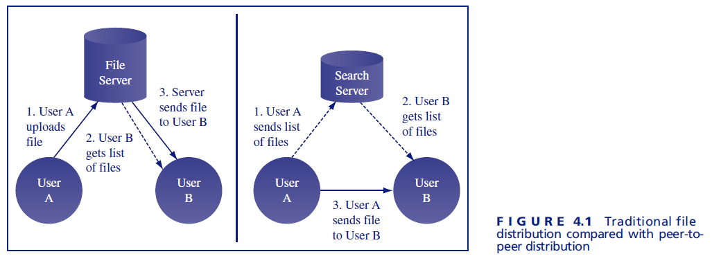
Peer to Peer Sharing and Searching
In a traditional file-sharing system users upload computer files to a central
server so that other users can download them. A user can easily see what files are contained on the server, select whichever ones she wants, and download them.
Napster software program enabled users of a peer-to-peer file sharing service to search for files to download, allowed users to find which files were shared by other users.
It did not download, upload, or store copyrighted files, but the company’s software allowed users to swap copyrighted files with each other

Slide 33
Peer to Peer Sharing and Searching (continued)
Various courts found that Napster committed contributory infringement and vicarious infringement.
Napster clearly knew what its users were doing, and the company allowed people to continue because it benefited the company financially; thus, the courts shut down the Napster service.
Contributory infringement: occurs when an infringement committed by another person would not have happened without your help
Vicarious infringement: involves an infringement that occurs in an area under your supervision, and when you should have been policing and preventing such acts
Was Napster’s business model morally permissible?
How is this different from search engines like Google?

Slide 34
BitTorrent
The BitTorrent technology is used
by software and movie pirates to share files, but it is also used by large software companies.
by companies that need to deliver one large file to millions of users.
Example: a large file (such as a video game or DVD movie) is broken into thousands of small pieces.
The company uploads the pieces to a few thousand users (a process known as seeding the file), and then those users pass it out to everyone else.
Once your computer obtains a piece of the file, it rebroadcasts that piece to other users who are also looking for it.
BitTorrent is beneficial for large corporations that need to distribute large software updates to their users.

Slide 35
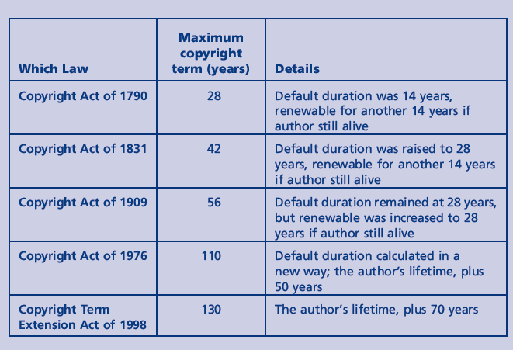
Changing Copyright Durations or terms
note that the figure addresses only copyrights held by individuals; different rules apply to copyrights held by corporations.

Slide 36
Downside to Long copyright terms
Why should they expire at all?
One argument is that it
is often difficult to track down the current owner of a copyright many years after the creation of the work.
Because copyrights can be sold or traded, it is hard to know whether anyone owns the right once the original author has died.
A copyrighted work that is still within its copyright term, but no longer has a copyright owner, is called an orphaned work.

Slide 37
Copyright (continued)
Should it be legal to print a T-shirt with the Mona Lisa on it without paying a royalty?
Should it be legal to print a T-shirt with Disney’s Phineas and Ferb on it without paying a royalty?
Should it be legal to trademark a color?

Slide 38
Patent Law
Invention: any new and useful process, machine, [article of] manufacture, or composition of matter, or any new and useful improvement thereof
Distinct from an artistic or creative work
Protected by patents

Slide 39
Patent Law (continued)
United States Patent and Trademark Office (USPTO): verify inventions are patentable and meet two criteria:
Novelty: An invention is novel only if it has not previously been invented by someone else
Nonobviousness: A solution to a problem that is obvious to another specialist in the appropriate area cannot be patented
no widely accepted definition of, or test for, obviousness, which is why many court cases to invalidate patents focus on challenging the obviousness of the invention.
Once a patent is issued, it typically lasts twenty years from the date the application was filed.
once an invention is patented, no one can “make,use, offer to sell, or sell” the invention without the patent holder’s permission.

Slide 40
Trademark
Trademark: a legally registered word, phrase, symbol, or other item that identifies a particular product, service, or corporation
to register a trademark, you must already be using it to represent a product or service, and and your mark must not be easily confused with a competing product’s trademark
trademark lasts ten years but can be renewed indefinitely
“Trademark” and “brand” are sometimes used synonymously, although “brand” is also used to describe the product’s identity as a whole, whereas a trademark is one specific element of that identity
to receive a trademark, must already be using the mark to represent a product or service, and your mark must not be easily confused with a competing product’s trademark

Slide 41
Trademark Examples
T-Mobile holds a trademark for the color magenta when used to promote wireless telecommunication products and services
Tivo holds a trademark on the “six pops” sound that Tivo video recorders make when fast-forwarding.
Motorola holds a trade on the “chirp” sound its phones make
Coca-Cola holds a trademark on “bottles, jars, or flasks with bulging, protruding or rounded sides”

Slide 42
Trademark (continued)
Trade dress: involves the look and feel of a product or its packaging
The Nintendo Wii has a recognizable design and trade dress. Immediately after its release, a variety of companies started releasing knock-off game systems that looked like the Wii and had a similar price.
Should Nintendo be able to stop these companies from selling game systems that looked similar to the Nintendo Wii?

Slide 43
Trade secrets
Example: most Internet search companies keep their search algorithms secret, so that their competitors cannot steal them. Such secrets are called trade secrets. Intellectual property laws are not needed to protect trade secrets.
If you have invented a better mousetrap, anyone who buys one will be able to look at it and figure out your design. Intellectual property laws are necessary so that inventors can charge money for their inventions even after the public knows about them, and artists can charge money for their work even after it has been publicly displayed.

Slide 44
Virtual Goods
Intellectual property is not the only type of valuable intangible good. The rise of the Internet, particularly the sale of online games, digital books, and music, has given rise to a whole new class of intangible property: virtual goods
Virtual goods: items that rely on some online system for their existence
Must be rivalrous, nontangible, and not services
Is it reasonable to spend real money on virtual items?
Notes:
Point out that many Web sites allow game players to trade their virtual currency for real currency--is there any real difference between them?

Slide 45
VG Examples
World of Warcraft, players invest hundreds of hours to obtain weapons and armor that exist only in the game.
The ISK, currency is a virtual currency.
In the online world Second Life, it is possible to purchase or rent virtual land with real money. Many people make a real-life living by purchasing land in Second Life, then subletting it to renters
Habbo Hotel, an online game, users can purchase items to decorate rooms in a hotel. Although these items have no function other than decoration, some of them sell for hundreds, even thousands, of U.S. dollars.
Counting real money transactions (RMTs), virtual goods purchased with real money, the world market fogr virtual oods has been estimated at between $2 billion and $10 billion per year.

Slide 46
Protecting Virtual Goods
For most virtual goods, there is no way to make a backup copy or transfer it to another system.
Only the hosting company is capable of preventing the loss of a virtual good.
In a dispute between a consumer and a hosting company, the consumer currently has very little recourse.

Slide 47
Case: Bragg v. Linden Lab
This case is about virtual property maintained on a virtual world on the Internet.
Plaintiff, March Bragg, Esq., claims an ownership interest in such virtual property.
Bragg contends that Defendants, the operators of the virtual world, unlawfully confiscated his virtual property and denied him access to their virtual world.
Ultimately at issue in this case are the novel questions of what rights and obligations grow out of the relationship between the owner and creator of a virtual world and its resident-customers.
While the property and the world where it is found are “virtual,” the dispute is real

Slide 48
Case: Bragg v. Linden Lab
The dispute ultimately at issue in this case arose on April 30, 2006, when Bragg acquired a parcel of virtual land named “Taessot” for $300.
Linden sent Bragg an email advising him that Taessot had been improperly purchased through an “exploit.”
Linden took Taesot [sic] away. It then froze Bragg’s account, effectively confiscating all of the virtual property and currency that he maintained on his account with Second Life
According to Bragg, the virtual goods and virtual currency confiscated by Linden Lab were worth between $4000 and $6000 in real U.S. dollars.

Slide 49
Case: Bragg v. Linden Lab
Terms of service (TOS): a set of terms and conditoins you must agree to in order to join a virtual world
Imagine a situation in which you rented an apartment and your renter’s contract contained wording similar to Clause 2.6 of the Second Life ToS—that is, the landlord can evict you at any time for any reason or for no reason.
Would this contract be morally permissible?

Slide 50
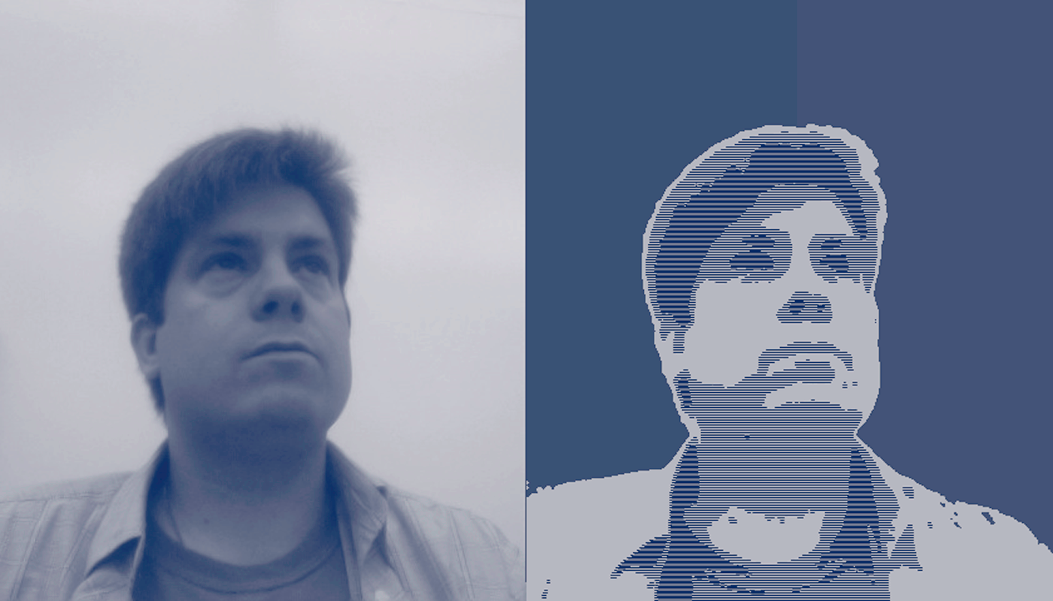
Case: Fairey’s Hope
Fairey’s “Hope” poster is clearly based on a 2006 photograph of President Obama taken by freelance photographer Mannie Garcia Posterized Image example:
F I G U R E 4.4 Posterized portrait in the style of Shepard Fairey
(Brinkman and Sanders, Ethics in a Computing Culture, Sengage)

Slide 51
Case: Fairey’s Hope
Three parties involved in a dispute about the interpretation of copyright law with regard to this photograph. Their positions were as follows:
The Associated Press believed it held the copyright to the photograph and should therefore have been credited by Mr. Fairey and received monetary compensation for the photograph’s use.
Mr. Garcia believed he held the copyright to the photograph. He claimed he never signed anything assigning the copyright to the Associated Press.
Mr. Fairey believed that his use of the photograph, regardless of who held the copyright, was a fair use and hence not a copyright violation.

Slide 52
Case: PlaysForSure
PlaysForSure, a digital media standard created by Microsoft
When you use a file for the first time (and, in some systems, every time you access the file), your device must contact a key server, which is a computer on the Internet that provides the key to unlock the file to authorized users.
On April 22, 2008, Microsoft informed MSN Music Store customers that it would be turning off the key servers on August 31, 2008.
After that date, it would not be possible to reauthorize a music file.
While music files would continue to play on the owner’s current computer, they would not be usable if the owners 1) upgraded or reinstalled their operating system, or 2) got new computers
Microsoft quickly reversed its decision, announcing that the MSN Music Store key servers would continue to operate at least until the end of 2011

Slide 53
Case: PlaysForSure
Some have suggested that Microsoft should distribute an “unlocker” program that permanently removes the encryption from PlaysForSure music files.
Why is this is not a decision that Microsoft can make on its own?

Slide 54
Case: DeCSS
DeCSS: a program that removes the copy protection from DVDs, allows them to be copied
DMCA prohibits circumventing the DRM on a copyright work. The law also makes it a crime to traffic in (buy and sell or otherwise distribute) circumvention devices, which are tools that are intended to help in this process.
Eric Corley: went to prison for “trafficking in circumvention devices” for sharing DeCSS through his Web site
Internet activists came up with innovative ways to spread the DeCSS program without directly placing it on the Web, including selling the code on T-shirts, embedding it into paintings, or using it as the lyrics for a song
Notes:
Ask students if the Internet activists should have also gone to prison, or were they protected by the First Amendment right to freedom of speech? If they were protected, why wasn’t Corley?

Slide 55
Case: DeCSS (continued)
One argument against Corley’s conviction was that the DRM that DeCSS was designed to counteract is too simple to count as a true DRM system
Is the ease of circumventing a DRM system relevant in deciding whether or not circumventing the DRM system was morally permissible?

Slide 56
INTELLECTUAL PROPERTY PROTECTION FOR SOFTWARE
The source code of a computer program (see Figure 4.5) is a creative work of authorship and is copyrighted
look and feel of a game as a whole can be copyrighted
Atari’s copyright for Pac-Man case is interesting because, in many situations, trademark law is used to protect “look and feel,” not copyright.
Blue Nile, an online jewelry store, sued Ice.com, another online jewelry store, for allegedly copying its look and feel. Although no decision has been reached in the case, Justice Lasnik has left open the possibility that trade dress law
(discussed earlier in Section 4.3.3) might protect the look and feel of Blue Nile.

Slide 57
Patents for software
reasonable to patent a piece of software if it was a genuine invention, but experts cannot agree which pieces of software are genuine inventions, or even on whether or not a piece of software can even be an invention
Examples:
So if most people designing an online shopping site would hit on the idea of 1-Click shopping, then 1-Click shopping is an obvious idea, hence not patentable.
Argument: U.S. Patent Office is not competent to decide whether the idea behind a piece of software is nonobvious, and that it therefore regularly awards software patents for things that are not truly inventions

Slide 58
Patents for Algorithms
One of the major controversies surrounding software patents has to do with the question of whether or not a patent can be used to protect an algorithm.
Example: Google’s main method for estimating the importance of a Web page, the PageRank algorithm, is patented.
PageRank might be viewed as a basic mathematical fact; the mathematical formulas that define PageRank are relatively simple to write down and can be found on Wikipedia.
On the other hand, they were not simple to discover

Slide 59
The Creative Commons
In many societies there are a great many resources that are not owned by any one person—fish in a public stream, grass on public land, a picnic table in a public park, etc. These resources, which are held jointly by everyone, are sometimes called the commons.
Free Culture, Harvard Law Professor Lawrence Lessig
argues that, historically, most creative work has been in the commons rather than privately owned.
Computers in general, and the Internet in particular, have changed all this. Mechanical reproduction and Internet distribution of intellectual property has pushed intellectual property owners into a corner, where they feel they must fight tooth and nail to hold on to their livelihoods.
As a result, according to Lessig, current copyright law allows very little material to enter the creative commons.

Slide 60
Creative Commons
Lessig, along with renowned computer scientist Hal Abelson and others, founded an organization called Creative Commons.
Creative Commons devoted to helping people release their creative work into the creative commons.
Creative Commons came up with a variety of copyright-compatible licenses and symbols that can be used to indicate that you have licensed your work for reuse by others.
Some Creative Commons licenses allow items to be reused for commercial purposes, while others do not.
It is possible to believe that true piracy is wrong and harmful to creativity and yet also believe that the current copyright regime goes too far and is harmful to creativity.

Slide 61
Multicultural - Region Coding for Video Discs
to prevent DVD sales from cannibalizing theater ticket sales, movie studios may choose to use a technology called region-coding. Any company that makes a DVD or Blu-Ray player is obligated to include region-coding technology, which prevents the user from playing videodiscs from other parts of the world
Critics of region-coding focus on a practice called price discrimination, which is the practice of charging different people different prices for the same thing (usually richer people pay more, and poorer people pay less).
DVD on Amazon’s Chinese site might cost 20 yuan, or about $2.95. The same DVD, in English, costs over $20 on Amazon’s U.S. site.

Slide 62
Multicultural Perspectives
Should region-based price discrimination be prohibited?
Why do you think region-based price discrimination is legal?
Which specific copyright enables the copyright holder to charge different people different amounts of money?

Slide 63
BitTorrent, The Pirate Bay, and the Pirate Party
The sites that provide search functionality for Bit-Torrent are called index sites, and the authorities have repeatedly shut them down.
An index site provides a service very similar to the service Napster provided; it allows you to find out which files are available for download
most popular index site The Pirate Bay based in Sweden.
allows users to search for torrents (which are the keys used to locate files),
also allows users to find other users with whom to swap file pieces.
Pirate Bay repeatedly shut down by Swedish authorities, but each time it has simply re-located to a new Internet service provider (ISP), and re-opened

Slide 64
Pirate Party
This party focuses on three main issues:
1) privacy protection,
2) copyright reform, and
3) the reduction or elimination of patents and other private monopolies.
The Piratpartiet’s statement of principles includes the following: “The copyright will encourage the creation, development and dissemination of culture… We claim that widespread and systematic abuses of today’s copyright actively oppose these purposes by limiting both the creation of culture and cultural access.”
Pirate Bay (one of the 100 most popular sites on the Internet) makes it an important target for intellectual property holders.

Slide 65
Multicultural Perspectives (continued)
Is it possible that violating copyright might be immoral in one country (i.e., the United States) but moral in another country (i.e., Sweden)?
For those who said “yes,” is this position an example of cultural relativism?
For those who said “no,” is it morally acceptable for one country to have strong copyright protection while another does not?

Slide 66
Intellectual Property Protection Through Intentional Errors
One famous compiler of mathematical tables, L.J. Comrie,
He was aware of some errors in the book, and suggests (perhaps tongue-in-cheek, perhaps not) that these errors were left in intentionally, so that he could prove any plagiarism.
Plagiarism identification schemes of this type still exist today, in the form of digital watermarking of images.
Digital watermarking means embedding small errors into a digital image so that someone viewing the image cannot see the errors with the naked eye, but a special computer program can use the errors to identify the source of the image.

Slide 67
Plagiarism, the Web, and Writing
Helene Hegemann’s first novel, written when she was just seventeen had several passages that were plagiarized from other books.
Still Hegemann was selected as a finalist for the “best novel” prize at the Leipzig Book Fair, an award worth $20,000
Although Ms. Hegemann has apologized for not being more open about her sources, she has also defended herself as the representative of a different generation, one that freely mixes and matches from the whirring flood of information across new and old media, to create something new. “There’s no such thing as originality anyway, just authenticity,” said Ms. Hegemann in a statement released by her publisher after the scandal broke
Argument is that if the new work created by mixing is original and authentic overall, it does not matter if some of the sentences are taken from elsewhere.

Slide 68
Interdisciplinary Topics
Assuming that Comrie was serious about using the errors in his book to catch plagiarists, would Immanuel Kant have viewed Comrie’s decision to leave known errors in his table of logarithms as moral or immoral?
Which do you find to be more acceptable:
to “borrow” sentences without attribution when writing a novel for publication
to do so when writing an assignment for school

Slide 69
Philosophical Foundations of Intangible Property Law
Which ethical theories support the legal protection of intellectual or virtual property?
Intellectual Property: The Consequentialist Argument
Intangible Property: The Deontological Argument

Slide 70
Intellectual Property: The Consequentialist Argument
U.S. Constitution says that the Congress has the right to“promote the Progress of Science and useful Arts, by securing for limited Times to Authors and Inventors the exclusive Right to their respective Writings and Discoveries” (Article I, Section 8).
Inherently consequentialist argument.
seems to imply that one would not normally, all things being equal, give authors and creators a monopoly on their ideas.
also recognizes that we, as a society, need authors and inventors. And so to encourage more people to create and invent, the founders decided to allow limited time monopolies on ideas.
not based on the rights of the authors, or on notions of justice or caring, but just on the idea that such monopolies will increase the overall happiness of our nation.

Slide 71
The Consequentialist Argument
an increasing number of examples that seem to contradict it.
authors of open source products willingly give up most of their intellectual property rights.
Wikipedia Thousands of editors, from all walks of life, have contributed articles or edits to Wikipedia.
extremely valuable projects, like Linux and Wikipedia, that have been created for free, we need to re-examine that intellectual property laws are necessary to ensure progress in technology, the arts, and scholarship

Slide 72
Intangible Property: The Deontological Argument
Deontological theorists (such as Kant) focus on the rights and duties of individuals, instead of the consequences of actions.
deontological theories inevitably lead us to question the very foundations of the idea of property.
Does a “right to property” exist at all? As we saw with the “right to privacy” in Chapter 3, the question of whether or not a natural right to property exists is not completely settled
John Locke (1632-1704) Ideas in his Second Treatise of Government. are controversial
a natural resource becomes ours if: 1) there is plenty for everyone else, and 2) we transform it into something new through our own labor.
Problem: this does not seem to tell us anything about intellectual property because intellectual property is not rivalrous,
Problem: applying his theory of property to virtual property.

Slide 73
Philosophical Foundations of Intangible Property Law
Imagine that you play an online game and obtain a valuable virtual object that you don’t want. You sell it through an online auction for $10,000 (actual U.S. dollars), but after handing the item over to the purchaser, he puts a stop order on the payment, effectively stealing the item.
Should the police treat this theft the same as the theft of a real $10,000 item, such as a car? Explain your reasoning.

