Slide 1

QRINTO PRINT STUDIO
Admin and Store panel
Comprehensive Platform Guide
Version 1.0 | August 2026

Slide 2
Table of Contents
1
Project Overview
6
Store Portal
2
Important URLs
7
Permission Matrix
3
Login & Access
8
Customer Website
User Roles
9
Resource Center
4
5
Admin Portal
10
1

Slide 3
1
Project Overview
What is Qrinto Print Studio?

Slide 4
What is Qrinto?
Custom Photo Printing & Personalized Product E-Commerce Platform
P
Personalized Products
$
Multi-Payment
Greeting cards, magnets, custom prints with photo customization
PayPal, cash at counter
S
Multi-Store
N
Noritsu 931-bl and Qrinto Resources
Multiple physical store locations with individual management
https://www.noritsu.com/931bl-resource-center.html
Q
QR Kiosk Ordering
C
Multi-Currency
Customers scan store QR code to begin in-store ordering
USD and CAD with automatic conversion by store location

Slide 5
High-Level Customer Workflow
1
2
3
4
5
6
7
8
Scan QR
Select Type
Choose Size
Browse
Customize
Checkout
Confirm
Pickup
Store selected
Product category
Price variant
Templates
Upload photos
Pay or cash
Emails sent
Store pickup
Order Status Lifecycle
Pending
→
Confirmed
→
Processing
→
Printing
→
Shipped/
Delivered
Also: Cancelled | Refunded (from any status)

Slide 6
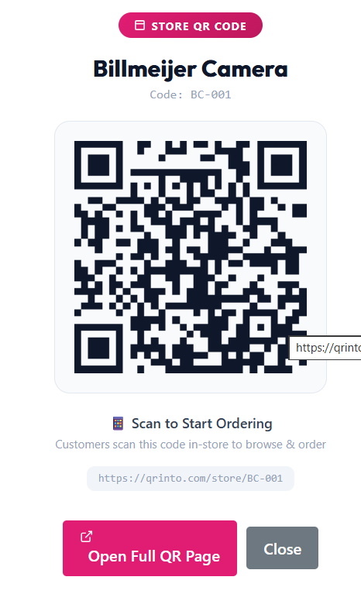
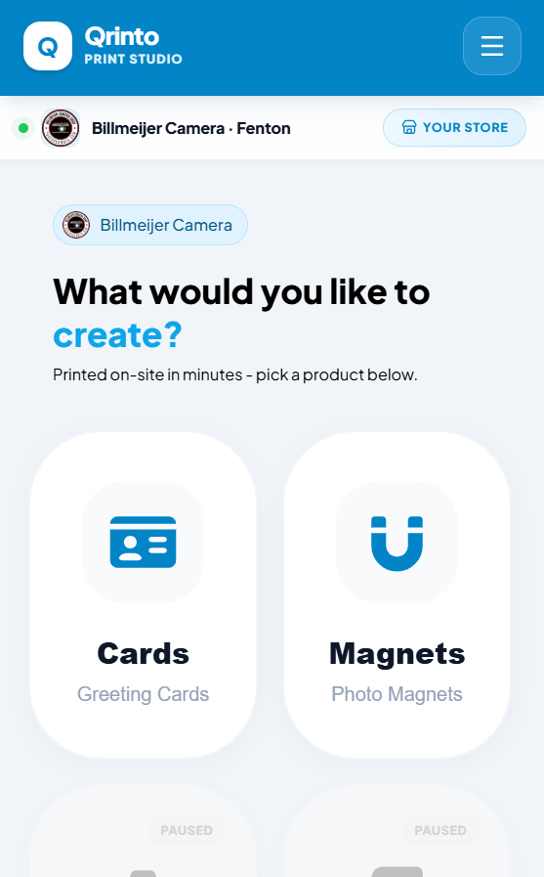
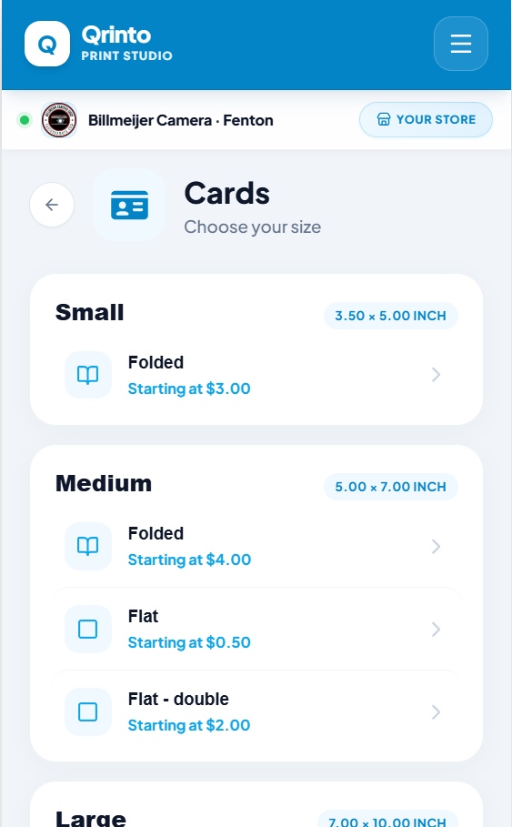
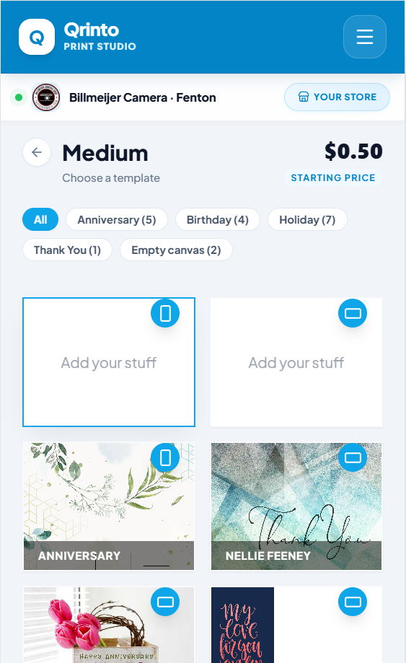
High-Level Customer Workflow
1
2
3
4
Shipped/
Delivered

Slide 7
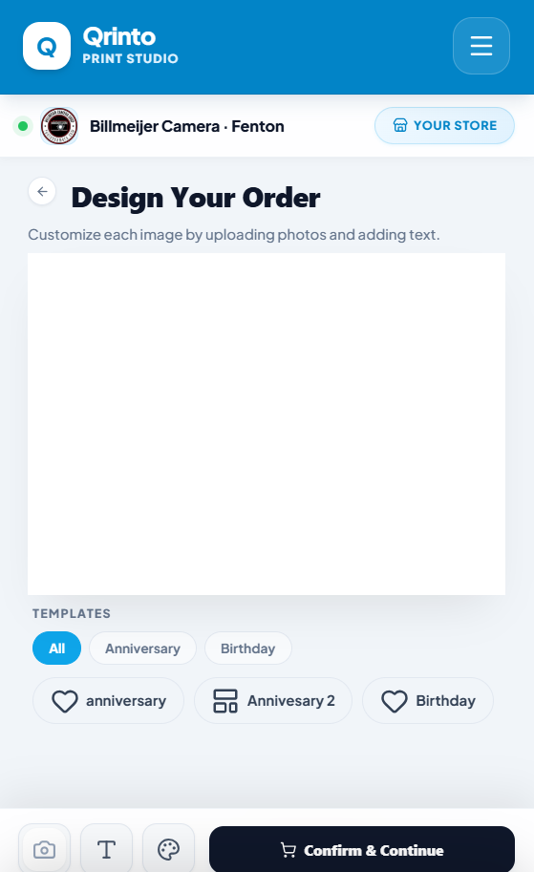
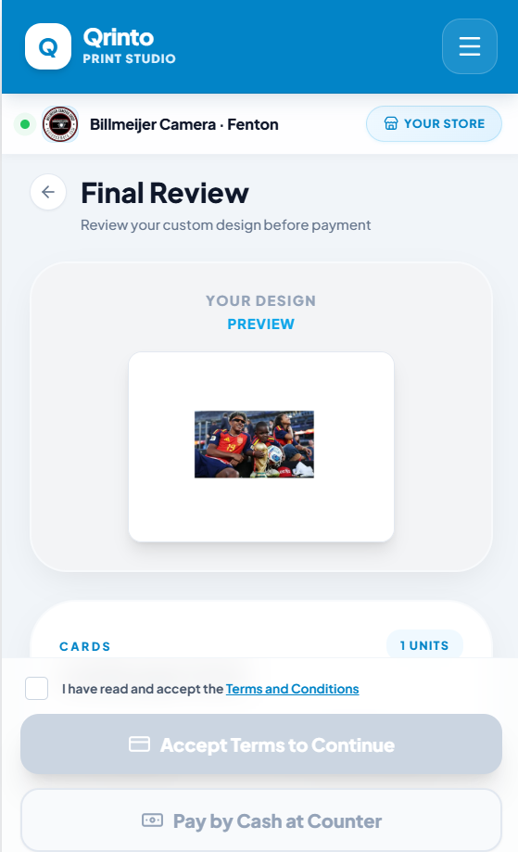
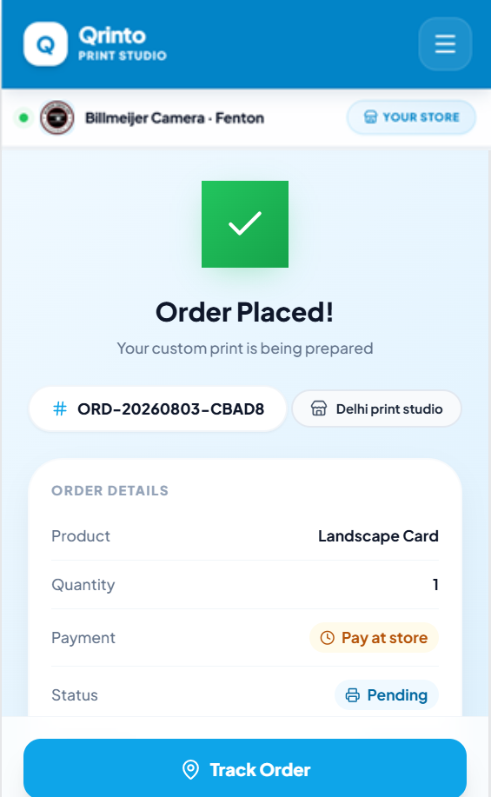
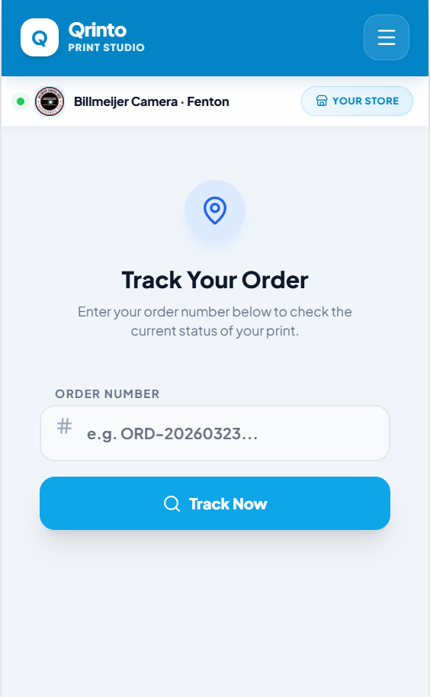
High-Level Customer Workflow
5
6
7
8
Shipped/
Delivered

Slide 8
2
Important URLs
Application, API, and External Service endpoints

Slide 9
Application & Modules URLs
Page
Route
Description
Customer (Mobile)
/
Quick Flow mobile experience
Customer (Desktop)
/pc/
Desktop PC flow
Store Finder
/find-store
Geolocation-based store finder
Admin Panel
/admin
Full admin dashboard
Order Tracking
/track
Track by order number
Custom Print
/custom-print
Direct upload printing
Cart
/cart
Shopping cart
Store QR Entry
/store/{code}
QR scan entry point

Slide 10
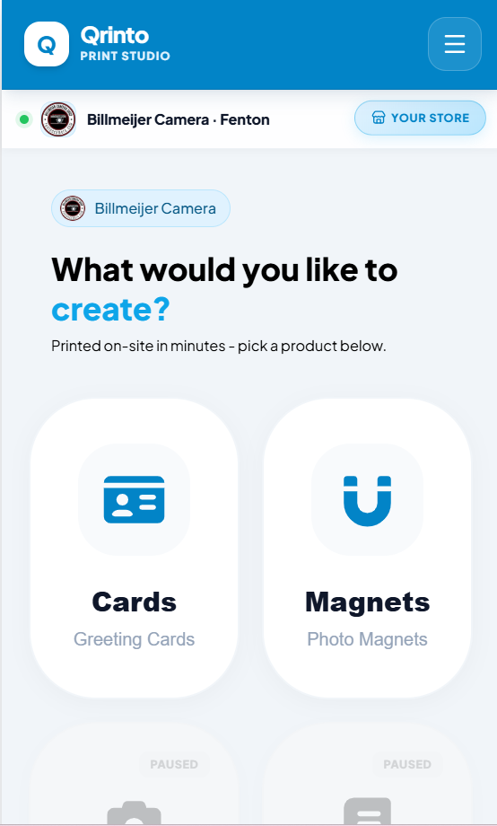
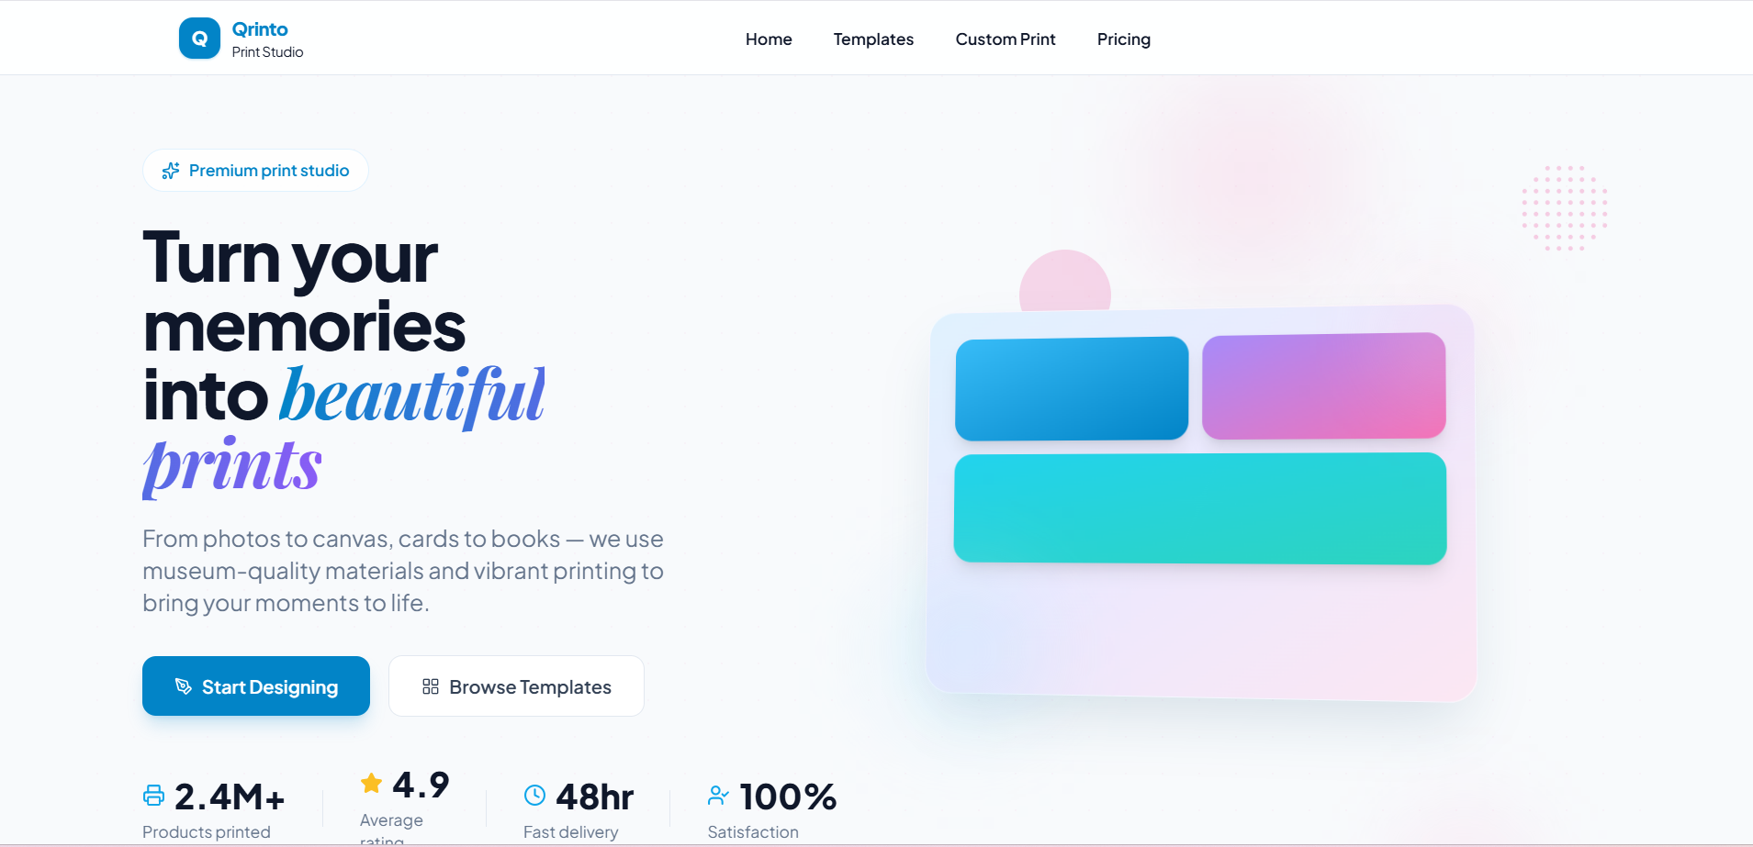
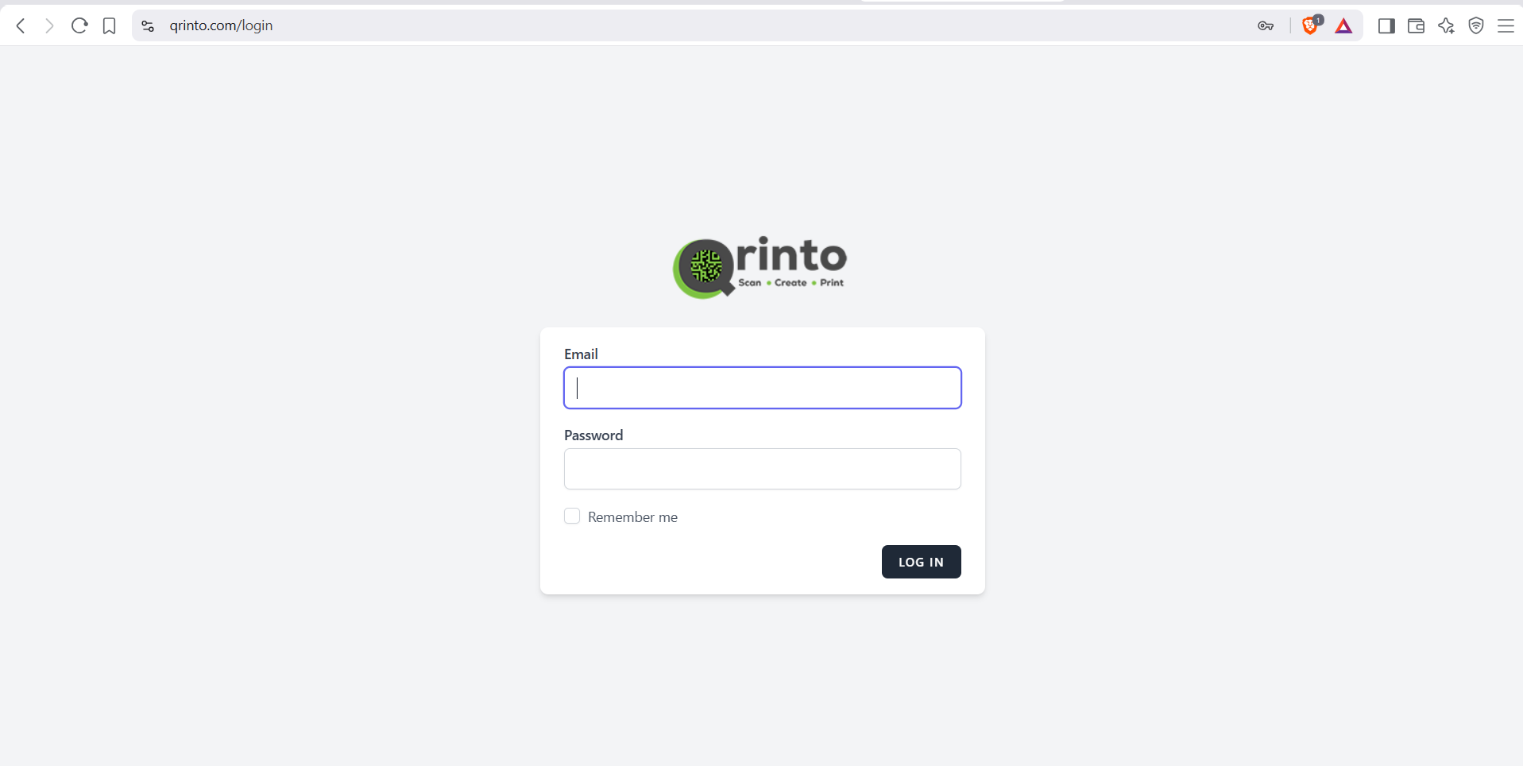
Application & API URLs
Customer (Mobile)
Customer (Desktop)
Admin and Store panel Login
https://qrinto.com/
https://qrinto.com/pc/
https://qrinto.com/login

Slide 11
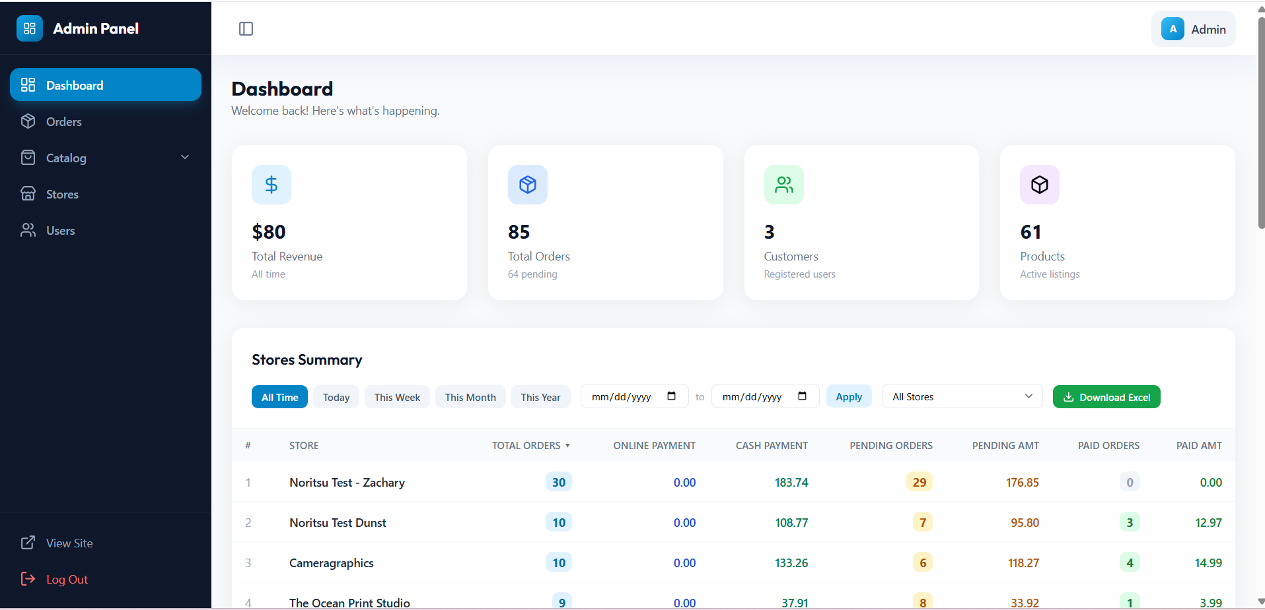
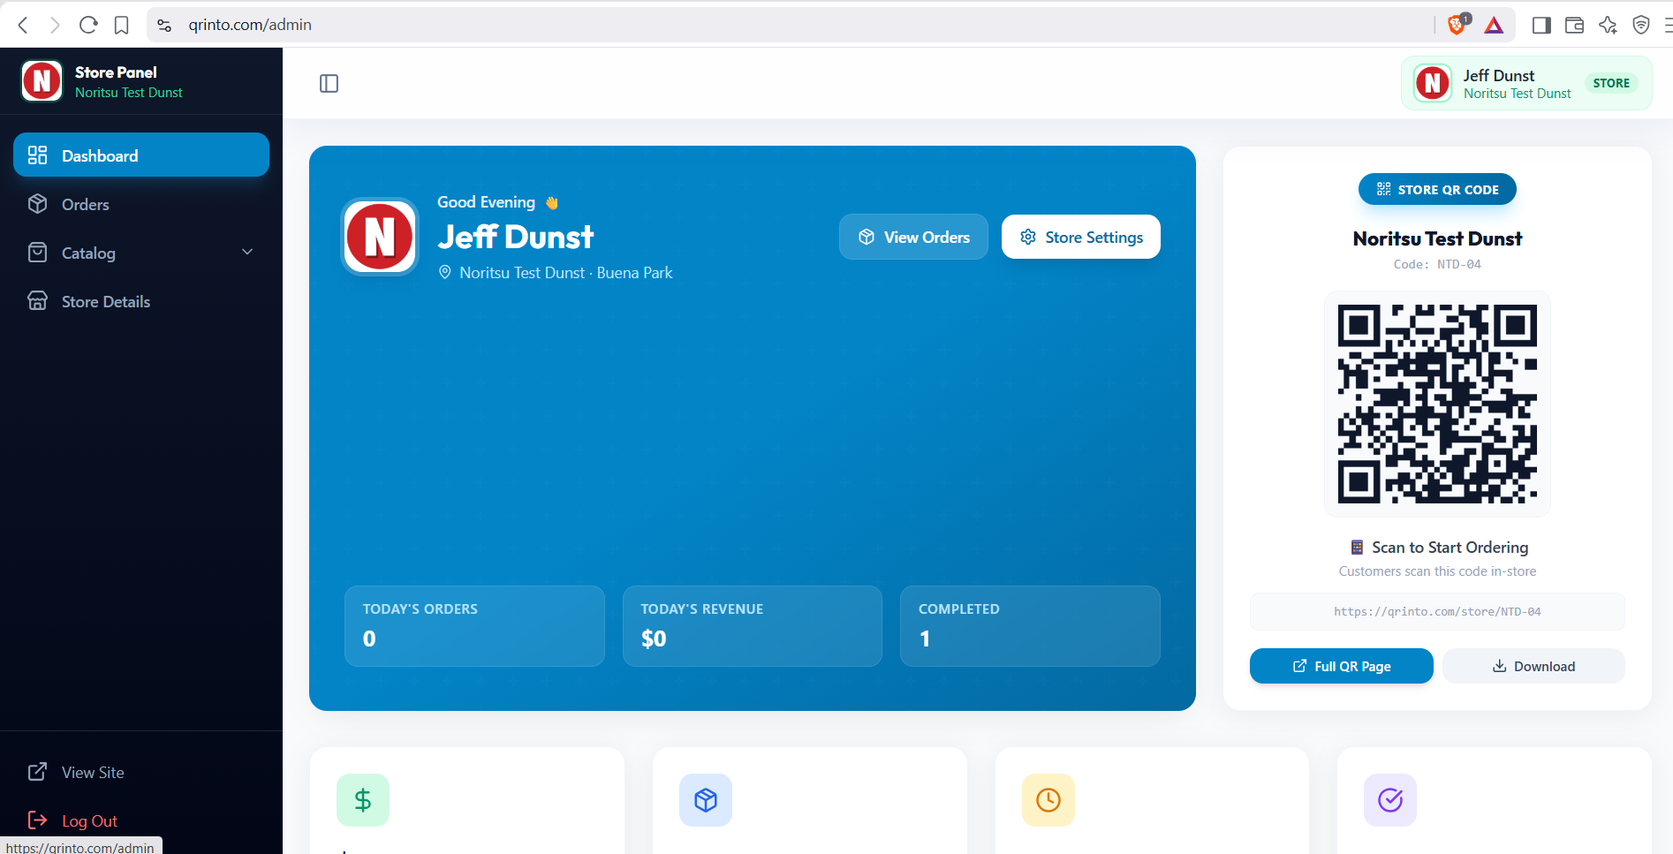
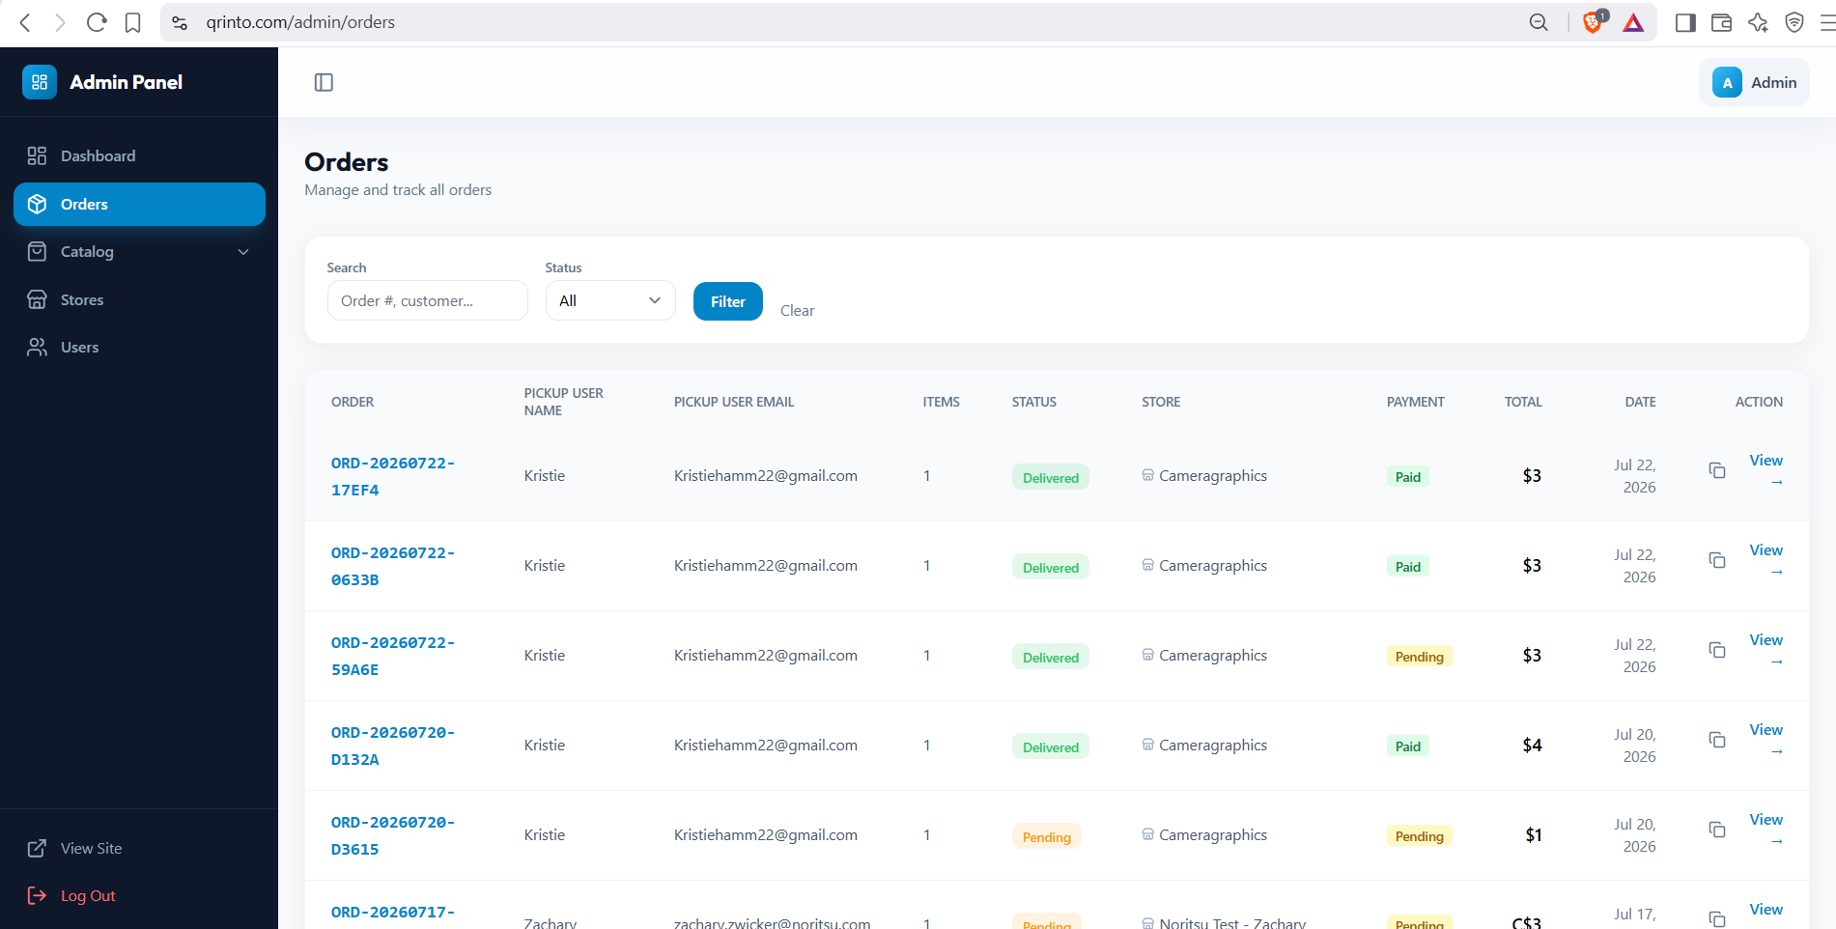
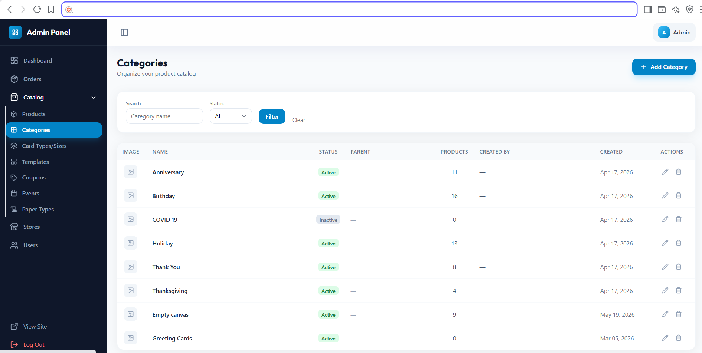
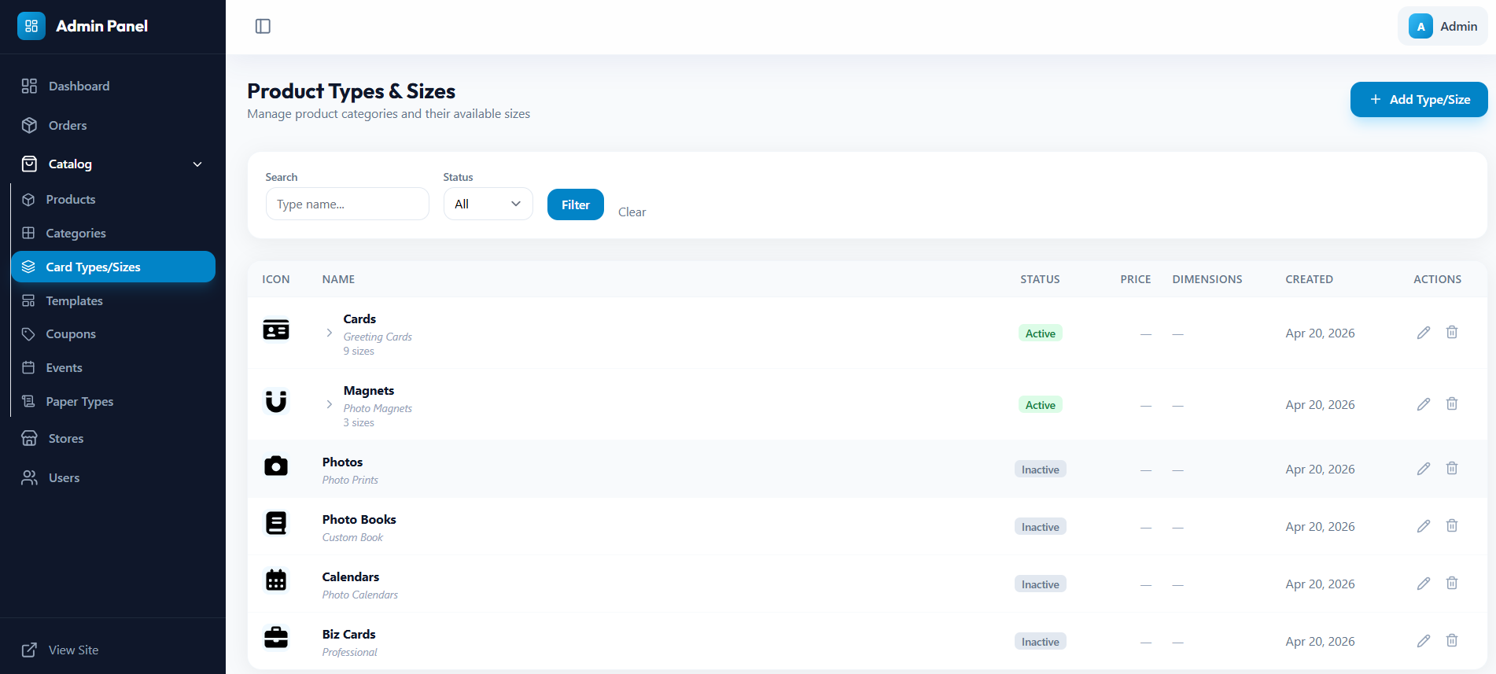
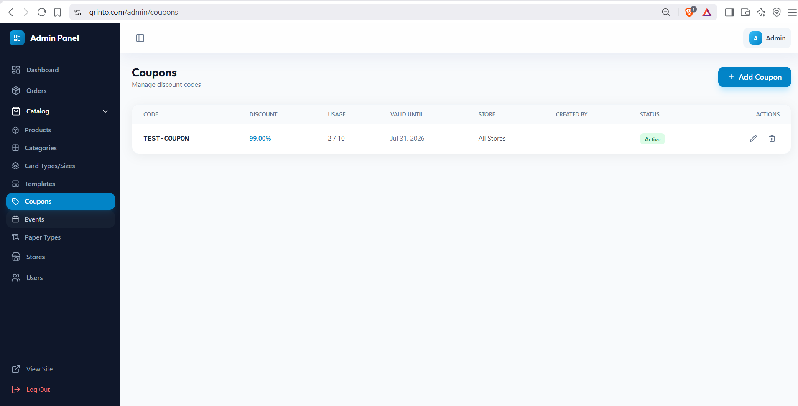
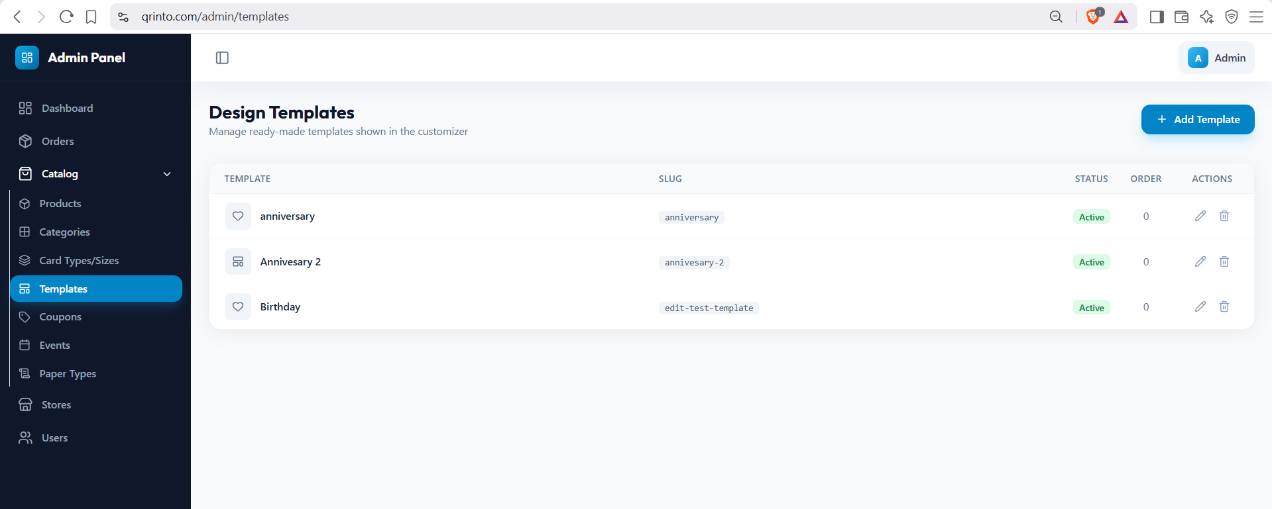
Application & Modules URLs
Admin Panel
Store Admin Panel
Order page
Product Page
https://qrinto.com/admin
https://qrinto.com/admin
https://qrinto.com/admin/orders
https://qrinto.com/admin/products
Categories page
Product Types & Sizes
Design Templates
Coupons page
https://qrinto.com/admin/categories
https://qrinto.com/admin/product-types
https://qrinto.com/admin/templates
https://qrinto.com/admin/coupons
Events page
Paper Types
Store Management
Users Manage
https://qrinto.com/admin/events
https://qrinto.com/admin/paper-types
https://qrinto.com/admin/stores
https://qrinto.com/admin/users

Slide 12
3
Login & Access
Authentication flows and session management

Slide 13
Authentication Flow
Standard Login
https://qrinto.com/login
1. User visits /login
2. Submits email + password
3. Dashboard and access all modules assign
4. Logout
5. Redirect: admin → /admin
customer → /my-account
5. Cart merged, logged in
Note: Registration and Password Reset routes are currently DISABLED (commented out in routes/auth.php). Customers are created via Social Login only. Session driver: database. Store selection stored in session as active_store_id.

Slide 14
4
User Roles
Four system roles with different access levels

Slide 15
User Roles & Access Levels
Admin
A
All modules
Full unrestricted access to all stores, products, orders, users, and settings
Store Admin
S
Own store modules
Manages their assigned store only: orders, products, categories, coupons, events
Staff
F
View only
Store-level read access. Can enter admin panel (canAccessAdmin = true)
Customer
C
Customer portal only
End user: browse products, design custom prints, place and track orders
Role Check Methods (User account base)

Slide 16
5
Admin Portal
Full system access across all stores

Slide 17
Admin Portal: Dashboard & Orders
Dashboard
All Admin Modules
Total revenue across all stores
Products
Paper Types
Order count & status distribution
Full CRUD + masks + options
Store-linked configs
Store summary reports (JSON + CSV export)
Categories
Stores
Tree hierarchy CRUD
CRUD + printer + FTP
Store statistics with entity counts
Product Types
Users
Order Management
Parent-child sizes
List, toggle, view details
View ALL orders across all stores
Coupons
Templates
Filter by status, payment, search
% or fixed, global scope
Design template CRUD
Update order & payment status
Events
Qrinto Sizes
Duplicate orders
Seasonal with categories
Custom print sizes
Generate/view print-ready PDFs
Send print jobs to store printers
Status change triggers customer email

Slide 18
Admin Portal: Catalog Management
Products
Product Types (Hierarchy)
Name, description, prices (USD + CAD), SKU, tags
Greeting Cards
Images: frame, sample, background, overlay
no_of_pages: 1 (flat), 2 (double), 4 (folded)
3.5x5 - $4.99
Mask editor for photo placement zones
5x7 - $6.99
Bulk delete support
7x10 - $8.99
Categories
Coupons
Parent-child tree hierarchy
Percentage or fixed discount
Image, description, SEO metadata
Min order, max discount, usage limits
Cascade-deletes products on removal
Date range (start/expiry)
Can restrict to specific stores

Slide 19
6
Store Portal
Scoped access to own store resources only

Slide 20
Store Portal: Scoped Access
Store Administrators can ONLY access and manage resources belonging to their own store. They cannot view, edit, or delete data from other stores.
Orders
Coupons
View own store orders
Create, edit, delete own
Update status & payment
Scoped by user_id / store_id
Print / duplicate / PDF
Events
Products
Create, edit, delete own
Create, edit, delete own
Link to own store
Mask editor for own products
AI content generation
Store Details
Categories
Update store info & logo
Create, edit, delete own
Configure printer & FTP
Tagged by user_id
Dashboard Details
Paper Type
Customers scan this code in-store
Create, edit, delete own
Limit Stats
Tagged by user_id
Store Admin CANNOT:
Create/delete stores | Manage users | Manage product types | Access other stores' data | Export cross-store reports | Manage global sizes

Slide 21
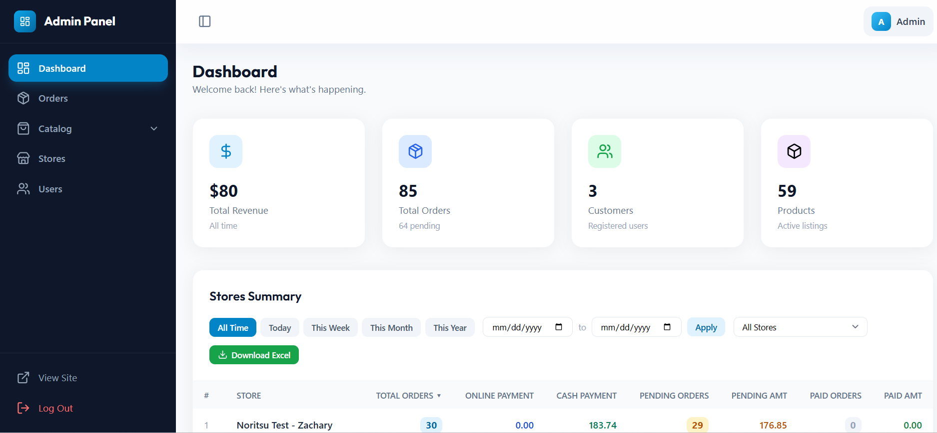
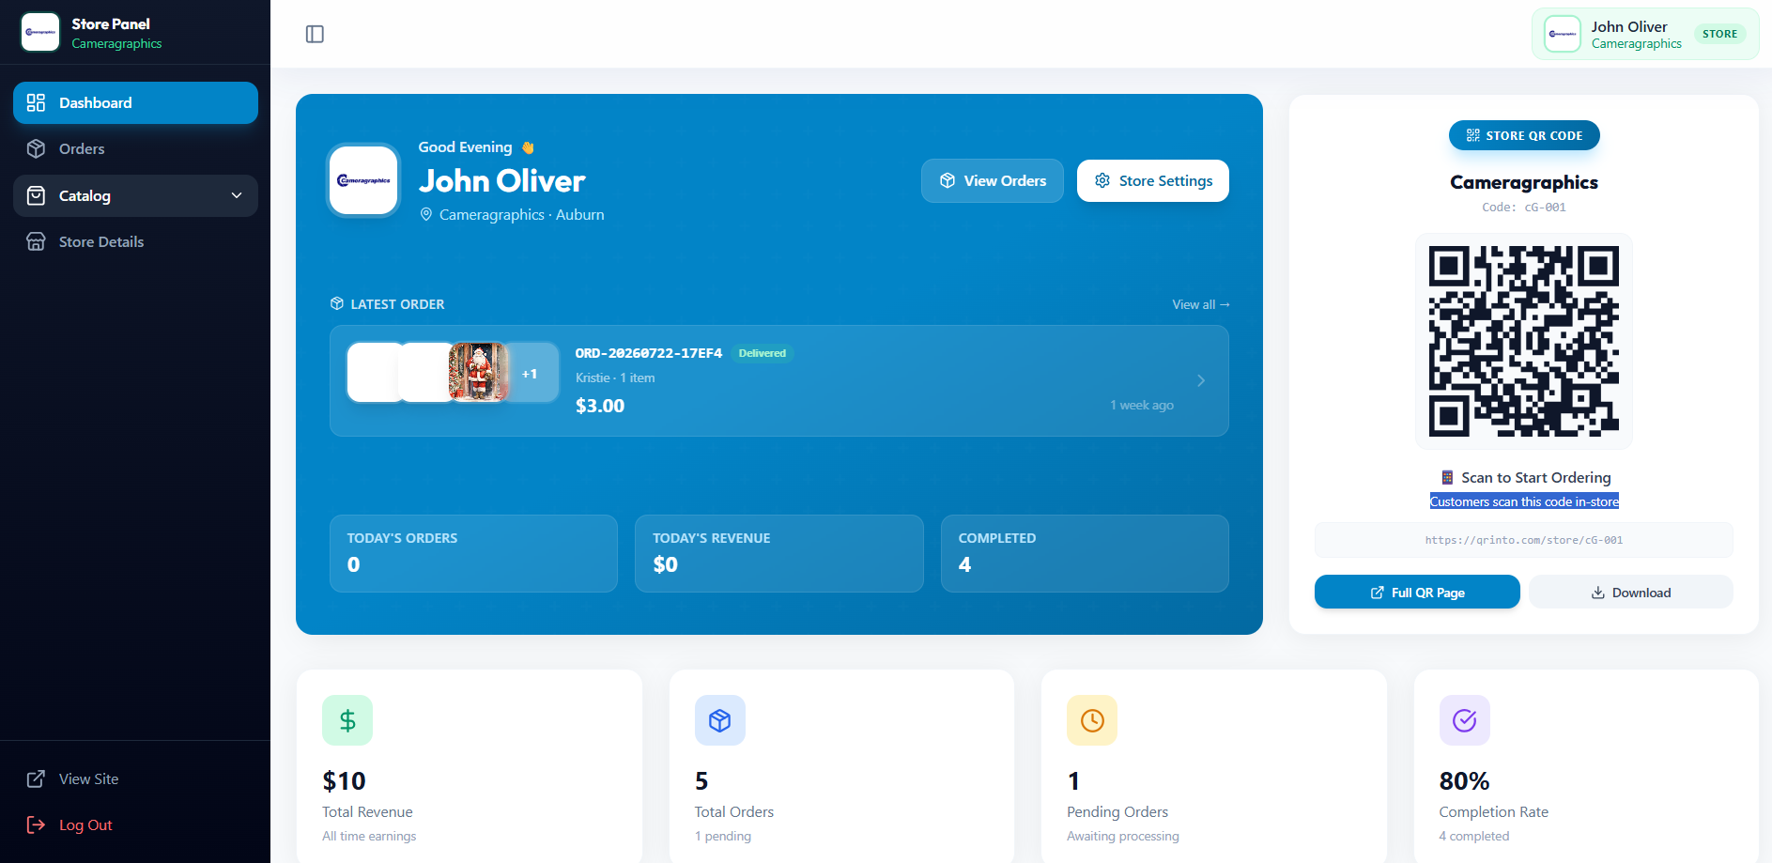
Dashboard : Access
Admin Panel
Store Panel

Slide 22
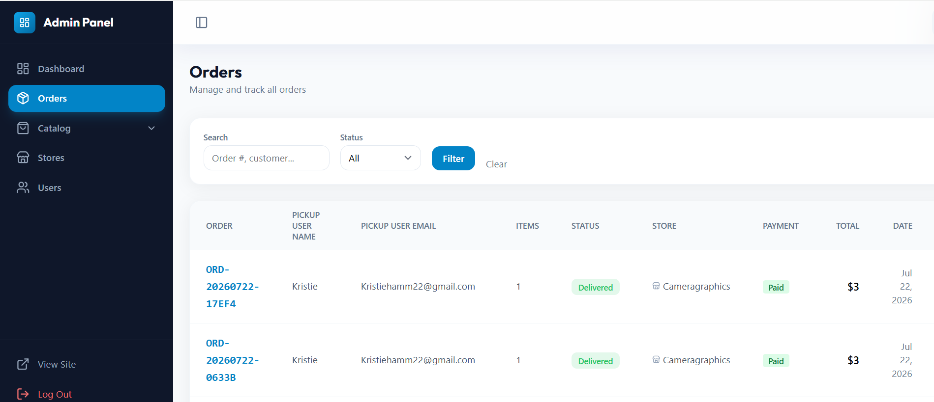
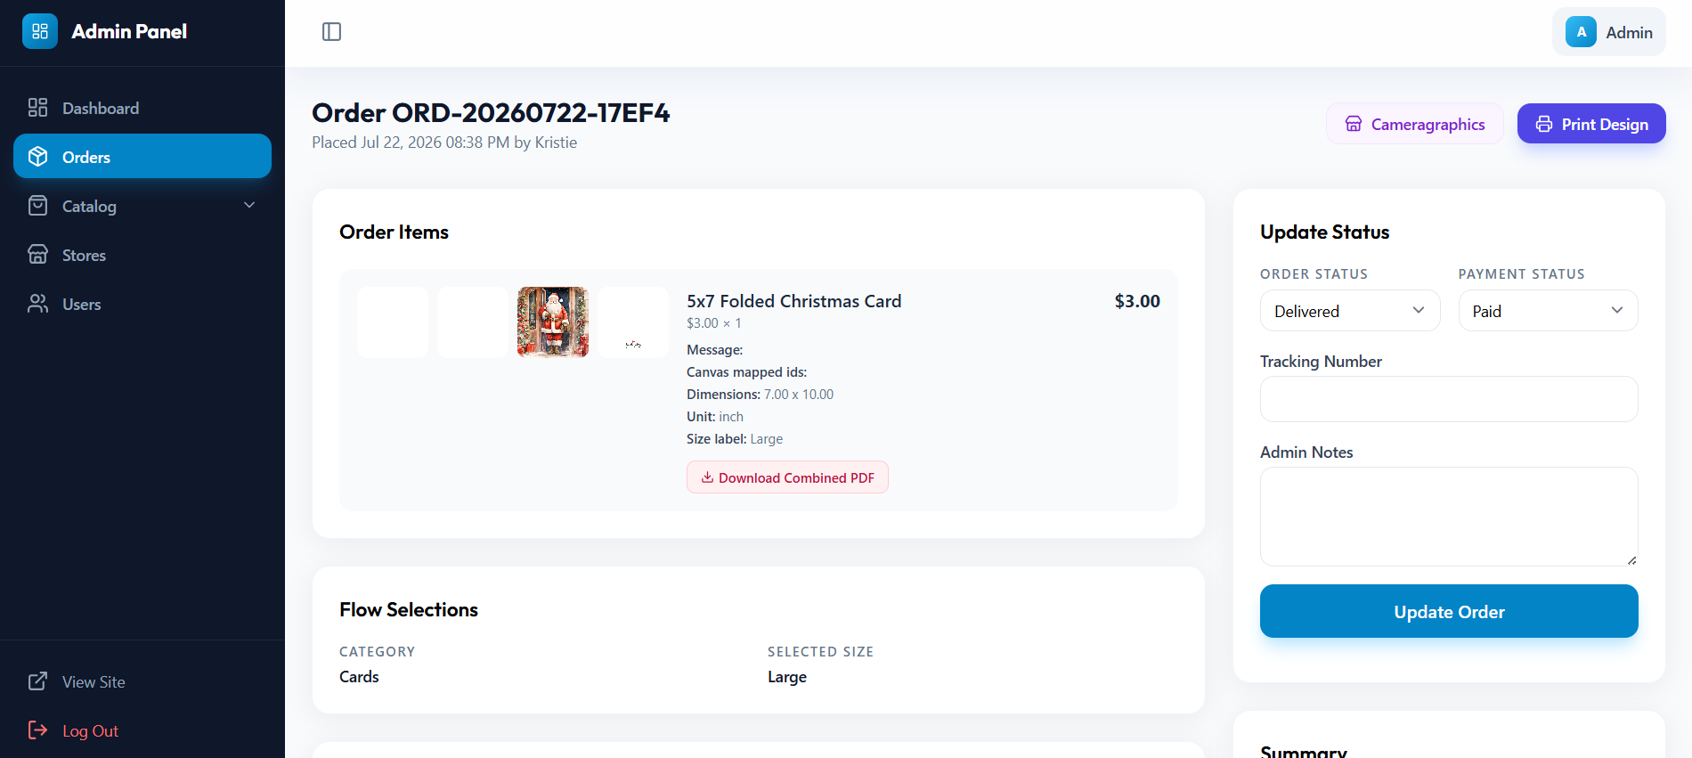
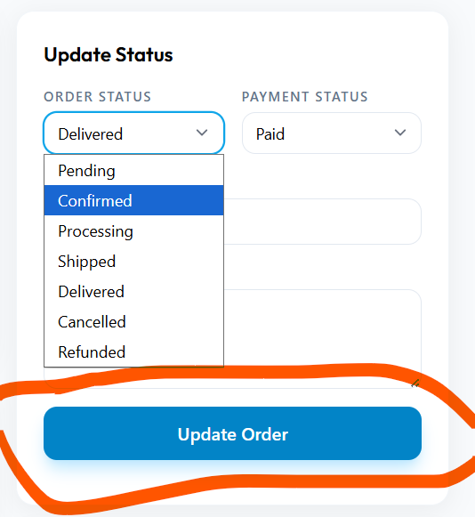
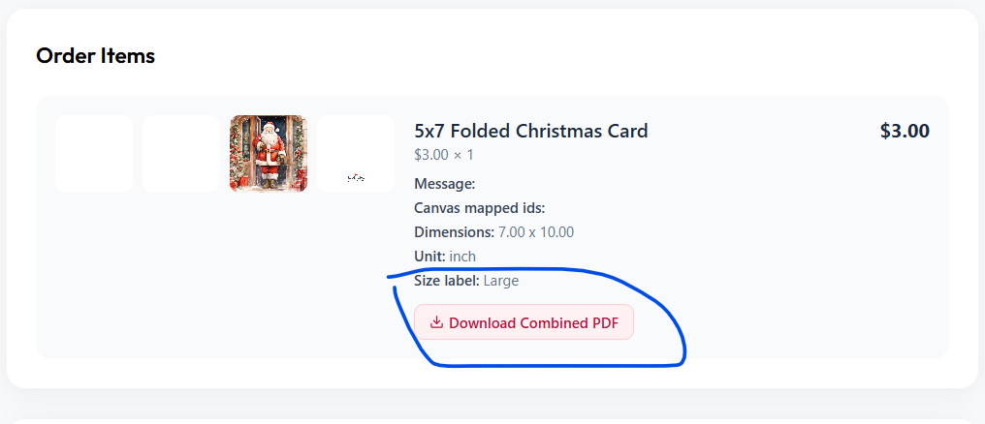
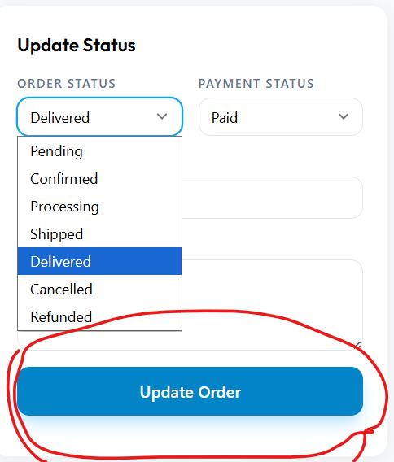
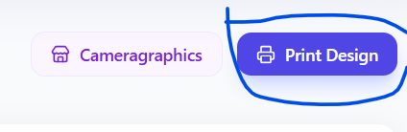
Orders : Access
All Orders
Order Details
Accept Order
Download PDF
Update status
Print Design

Slide 23
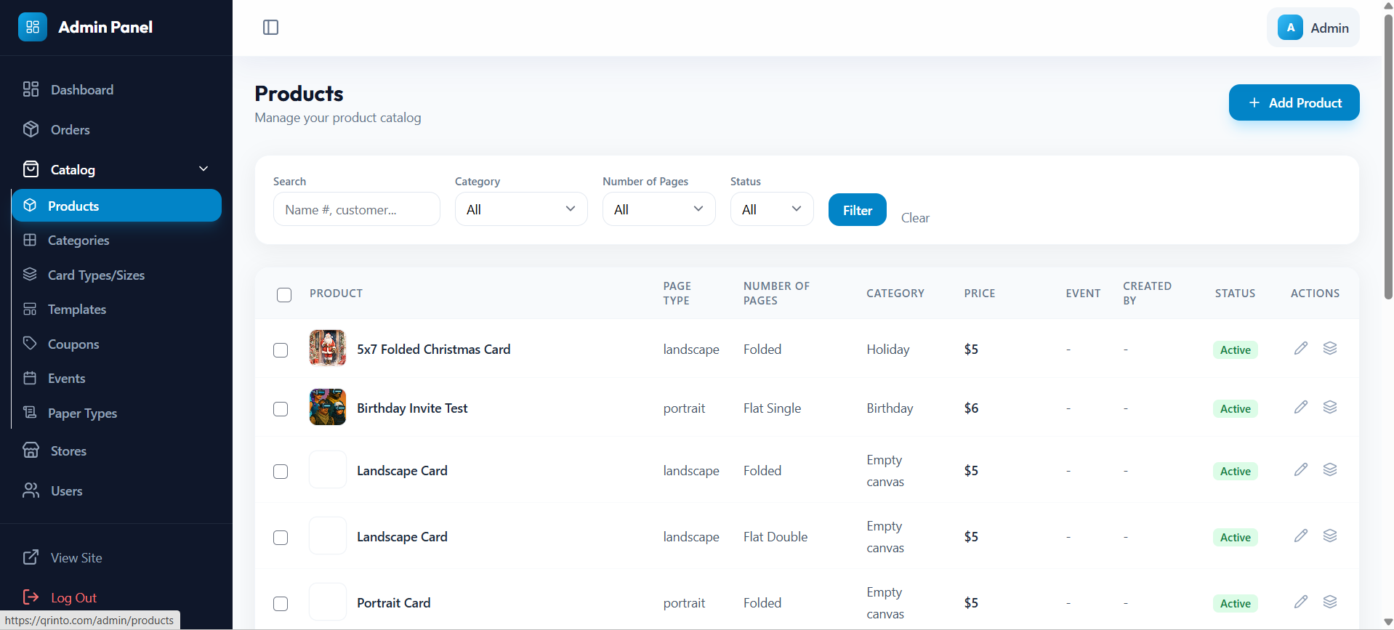
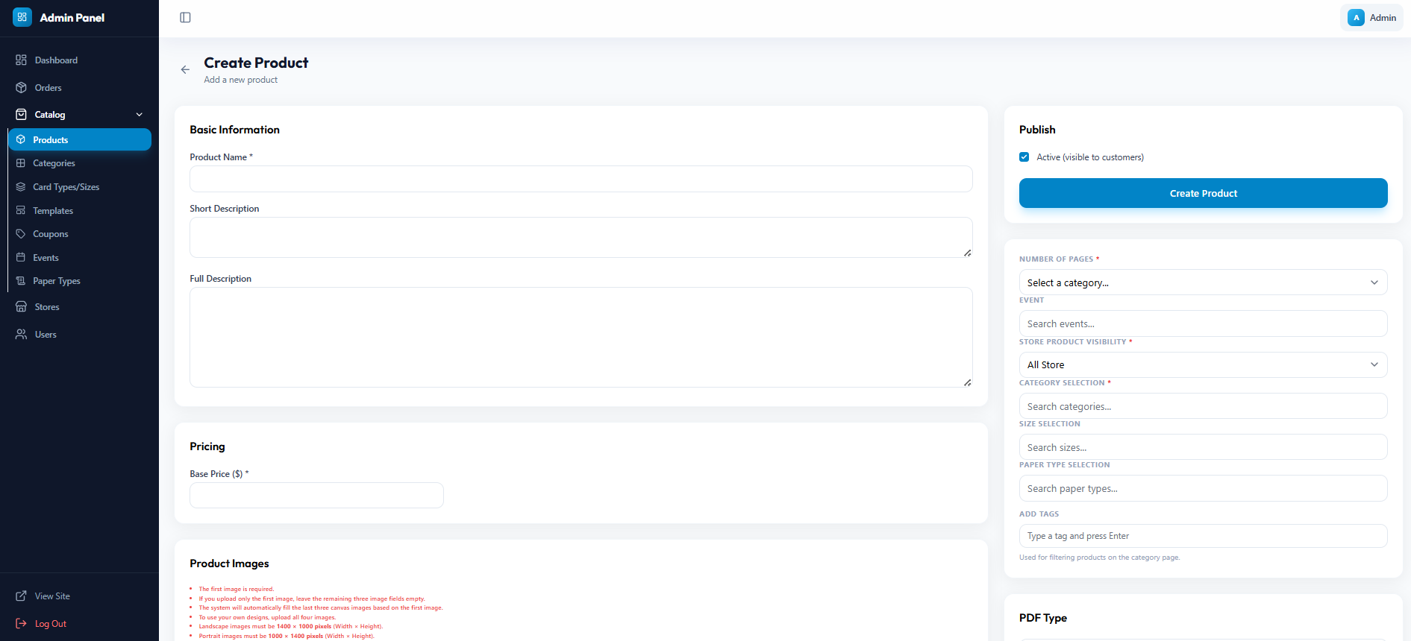
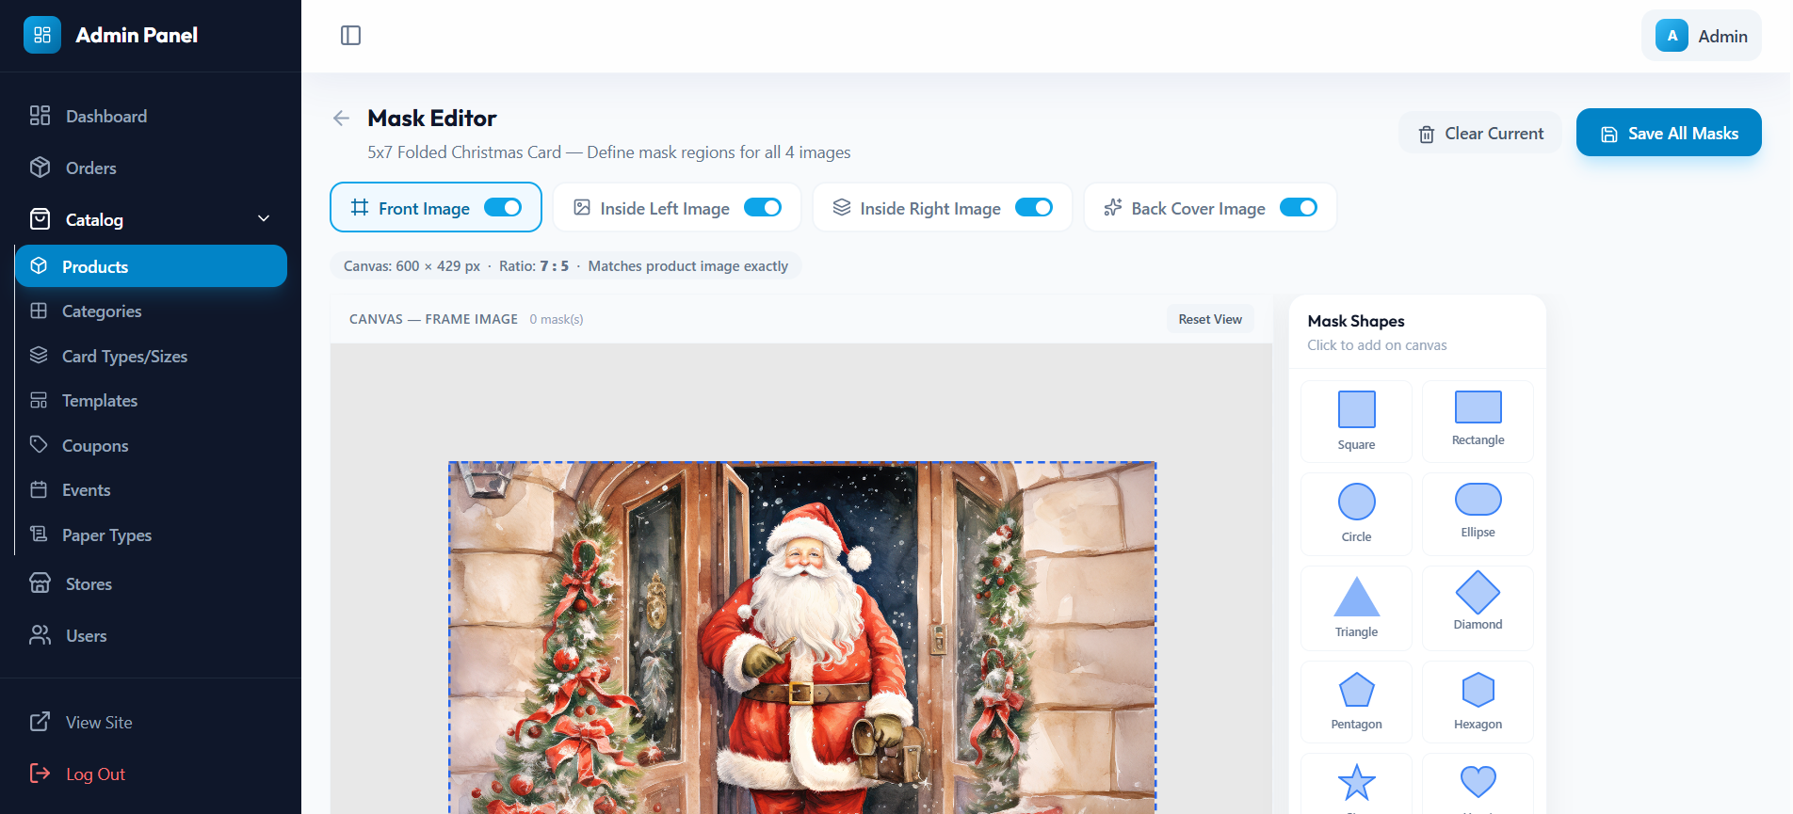
Products : Access
All Products
Create Product
Update Marking Product

Slide 24
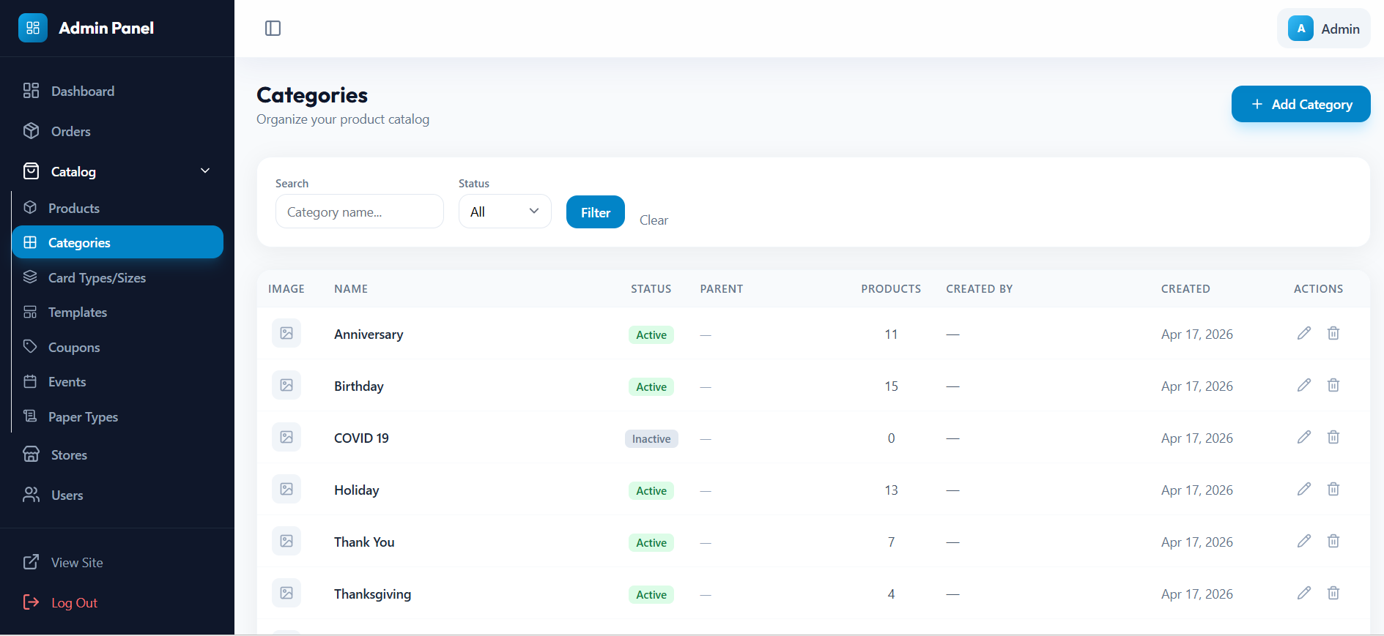
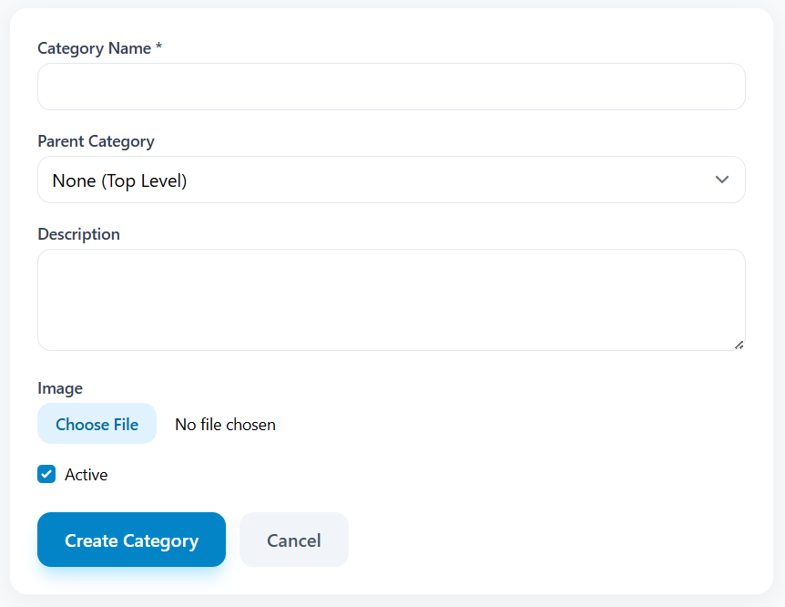
Categories : Access
All Categories
Create Category

Slide 25
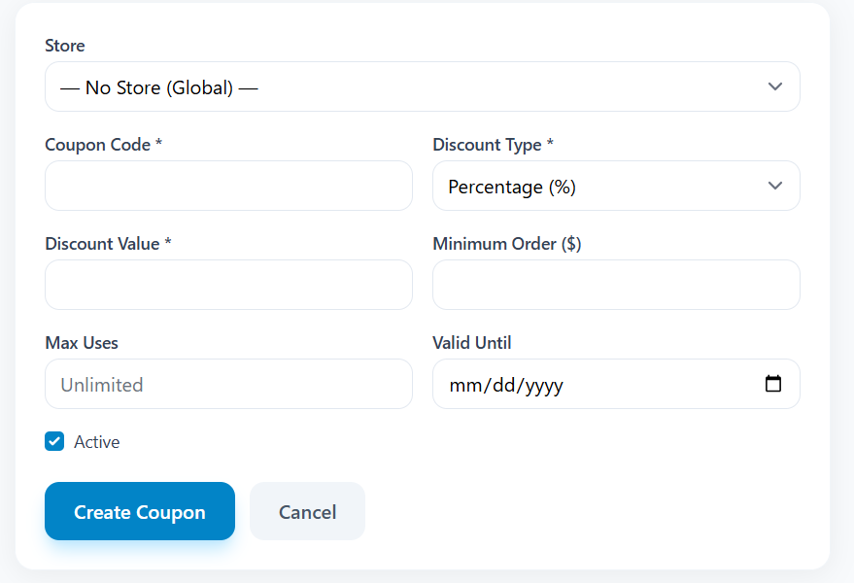
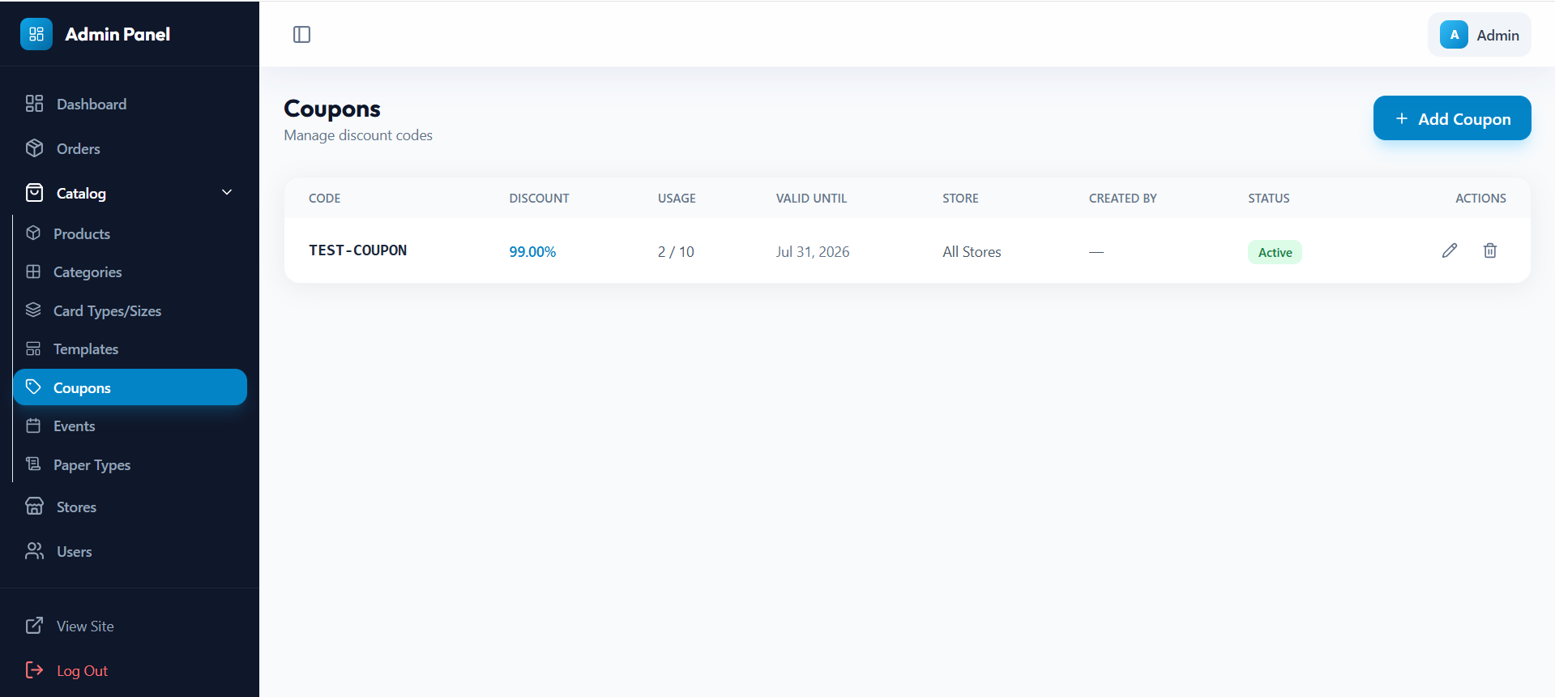
Coupons : Access
All Coupons
Create Coupon

Slide 26
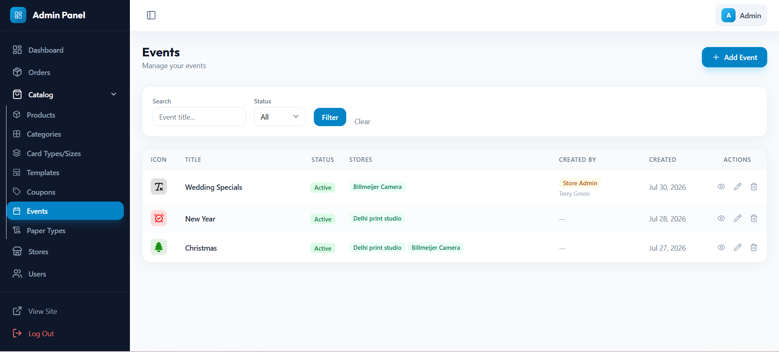
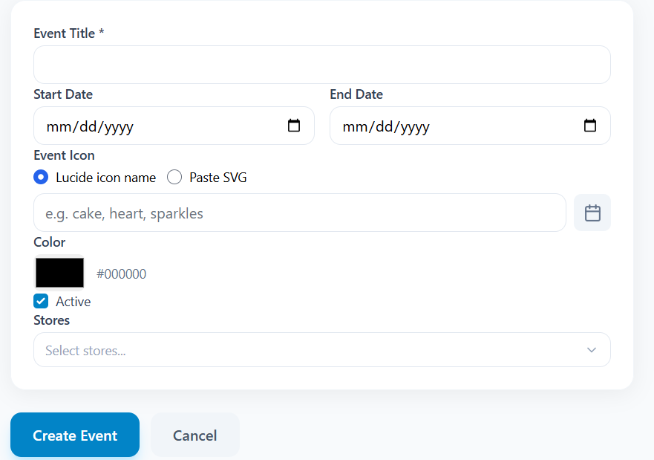
Events : Access
All Events
Create Event

Slide 27
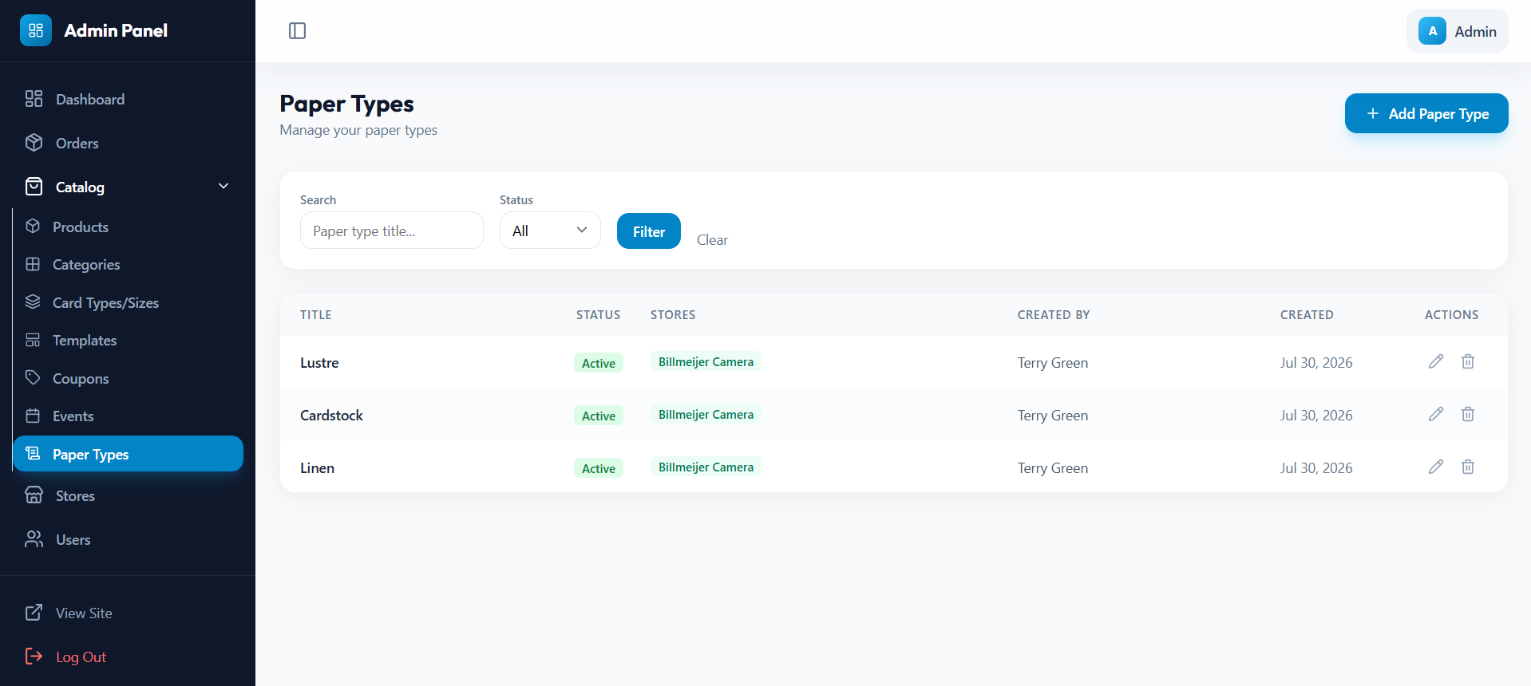
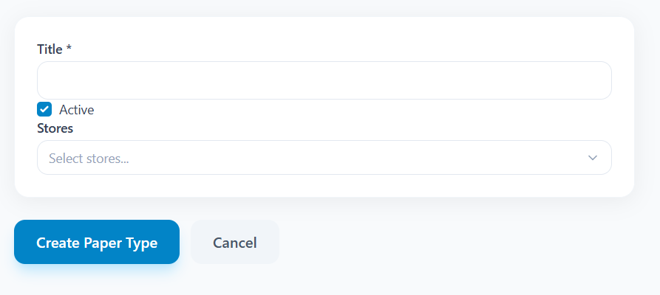
Paper Type : Access
All Paper Types
Create Paper Type

Slide 28
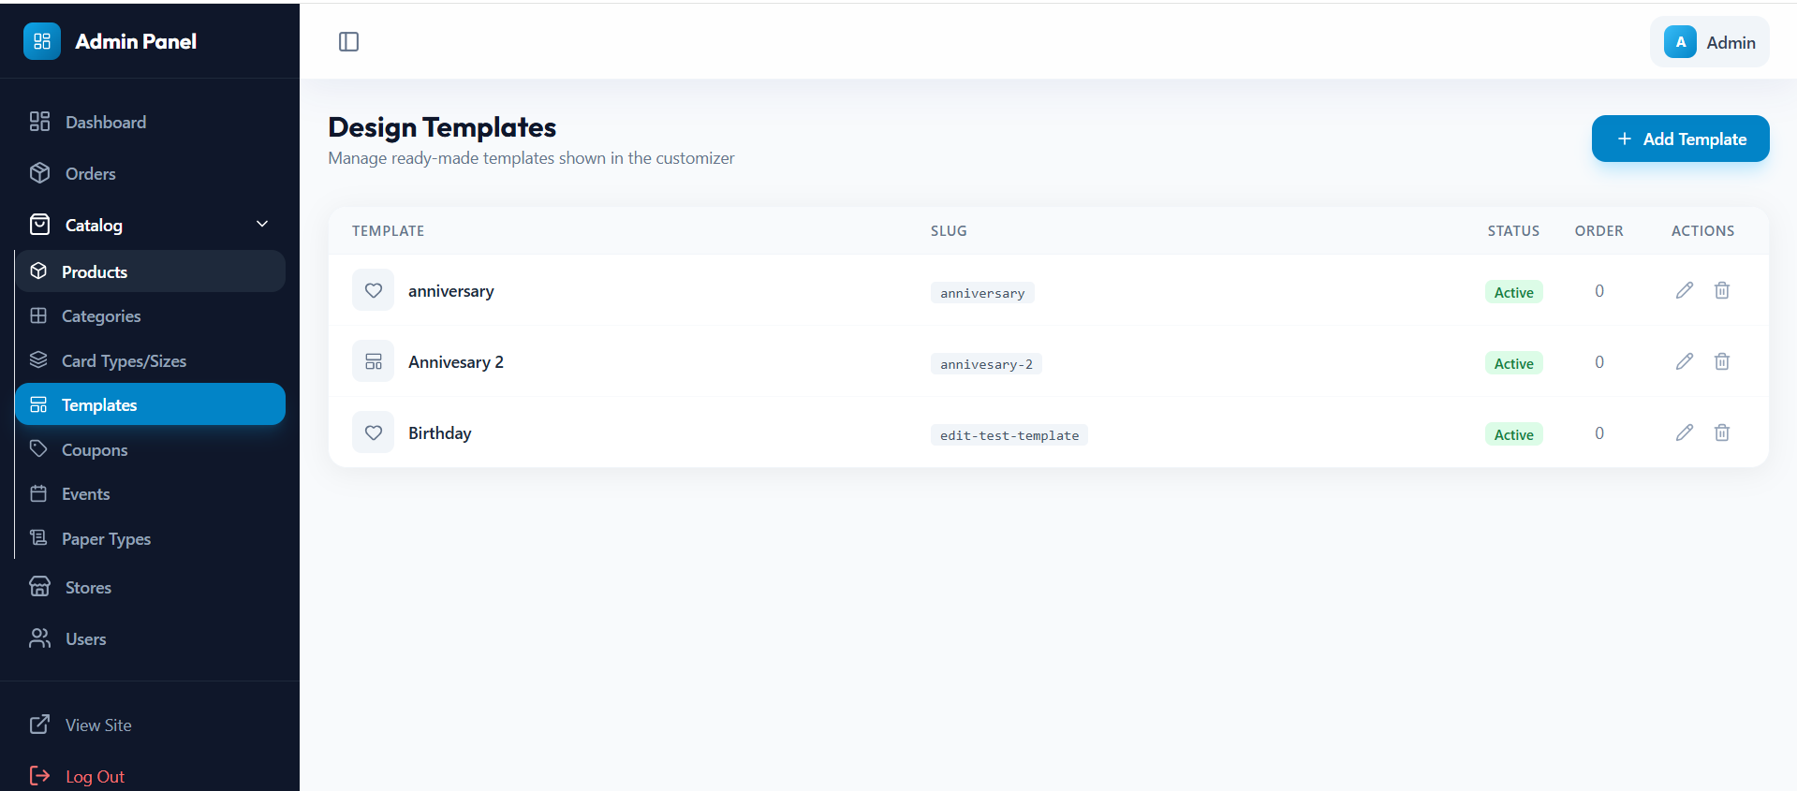
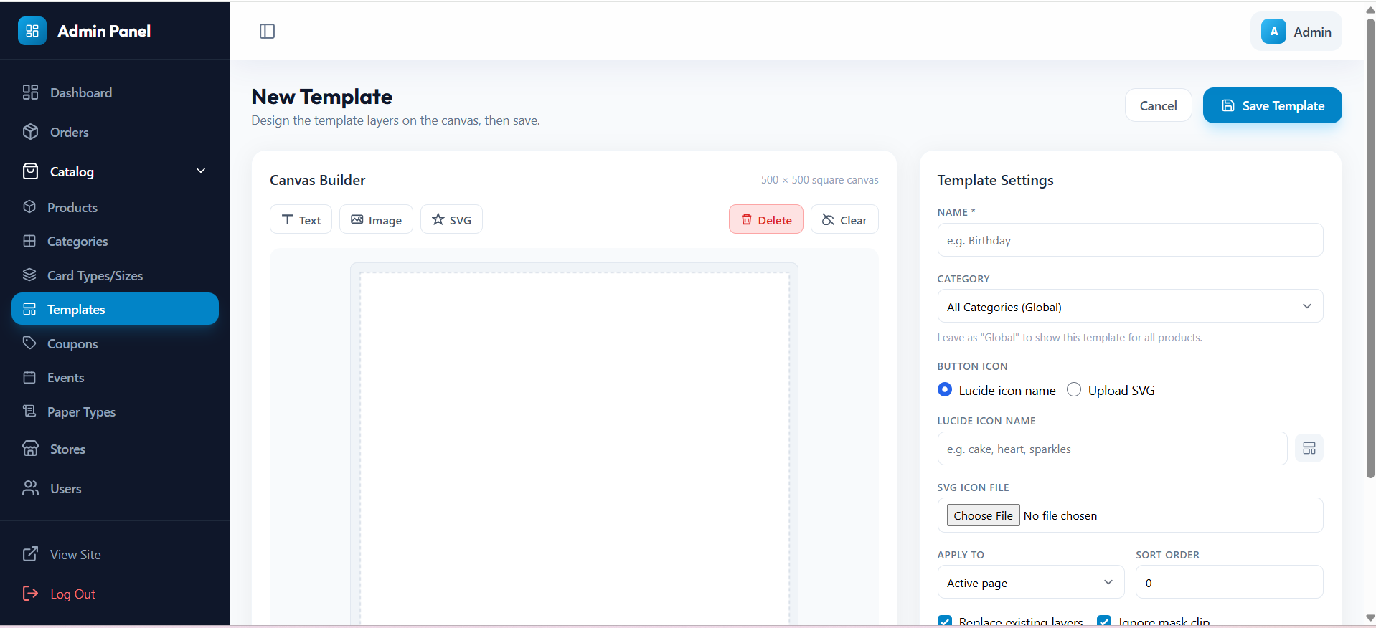
Paper Type : Access
All Design Templates

Slide 29
7
Permission Matrix
Admin vs Store Admin comparison

Slide 30
Permission Matrix: Admin vs Store Admin
Feature
Admin
Store Admin
View all stores
✅
❌
View own store
✅
✅
Create / delete stores
✅
❌
Manage all products
✅
❌
Manage own products
✅
✅
Manage all categories
✅
❌
Manage own categories
✅
✅
Manage all coupons
✅
❌
Manage own coupons
✅
✅
Manage all events
✅
❌
Manage own events
✅
✅
Manage all paper types
✅
❌
Manage own paper types
✅
✅
Manage users
✅
❌
View analytics
✅
Limited
Global settings
✅
❌
Product types CRUD
✅
❌

Slide 31
8
Customer Website
Mobile and desktop customer experience

Slide 32
Customer Website Features
S
Store Finding
C
Shopping Cart
Geolocation (300mi radius), text search via OpenStreetMap, QR code scan
Multi-item cart, guest + auth, quantity adjust, coupon codes, cart merging on login
B
Product Browsing
$
Checkout
Select type → size → browse templates filtered by category and events
Single-item or cart checkout. PayPal, cash at counter. Name, email, phone, instructions
D
Customization
T
Order Tracking
Canvas editor (Fabric.js), mask zones, photo upload, 30 fonts, 3 page modes
Track by order number: status timeline, product details, store pickup info, design preview
Mobile Flow: / (QuickFlowController)
Desktop Flow: /pc/ (QuickFlowPcController)

Slide 33
9
Print System Architecture
QrintoPrintAgent and Noritsu integration

Slide 34
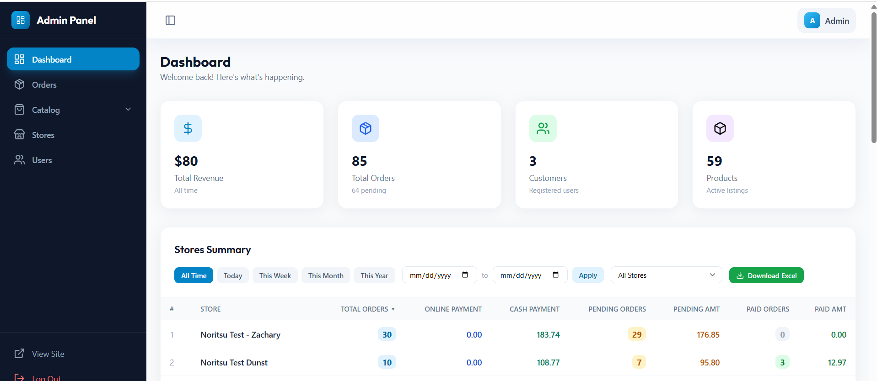

Print System:
Store Admin
Access Order
Email
Downloads
asset file
Sends to
Noritsu 931-BL
delivered
→
→
→
→
→
Store Admin
Access Order

Slide 35
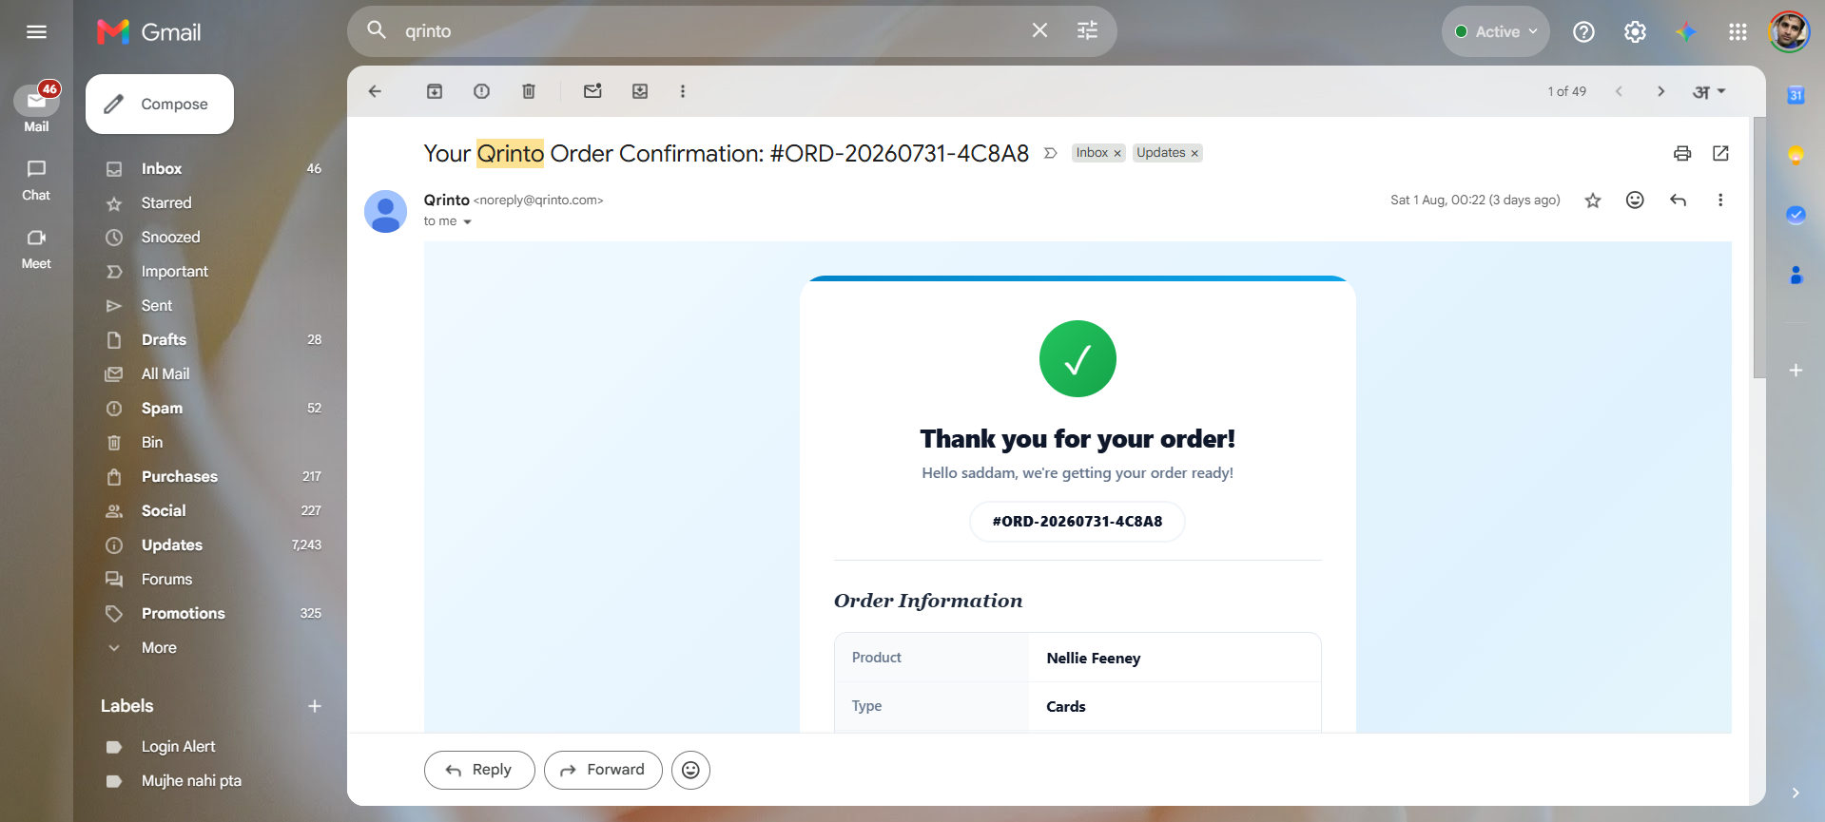
Print System:
Store Admin
Access Order
Email
Downloads
asset file
Sends to
Noritsu 931-BL
delivered
→
→
→
→
→
Email
Download file

Slide 36
Email Notification System
Trigger
Mail Class
Recipient
New order placed
OrderConfirmationMail
Customer
New order placed
AdminOrderAlertMail
Admin
New order placed
StoreOrderAlertMail
Store email
Quick Flow order
QuickFlowOrderMail
Customer + Admin + Store
Status changed
OrderStatusUpdateMail
Customer
Store user created
StoreUserWelcomeMail
New store user
QuickFlowOrderMail attaches the print-ready PDF design to the email. All templates are in resources/views/emails/.

