Slide 1

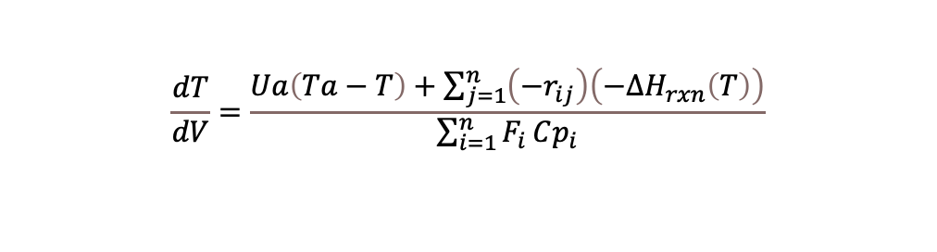





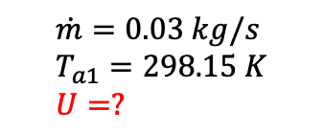

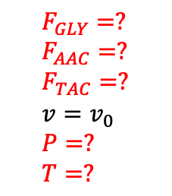
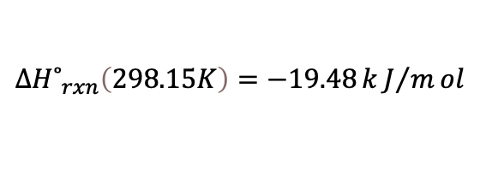

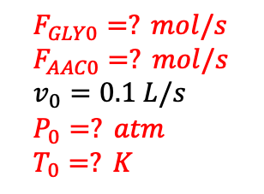


$$GLY + AAC ↔MAC + W$$
$$ΔH˚_{rxn}\left(298.15K\right)=−36.24 kJ/mol$$
$$F_{GLY}=? \\ F_{AAC}=? \\ F_{TAC}=? \\ v=v_{0} \\ P=? \\ T=?$$
$$MAC + AAC ↔DAC + W$$
$$ΔH˚_{rxn}\left(298.15K\right)=−19.48 kJ/mol$$
$$ΔH˚_{rxn}\left(298.15K\right)=−12.41 kJ/mol$$
$$DAC + AAC ↔TAC + W$$
Abreviación | Especie
GLY | Glicerol
AAC | Ácido acetico
MAC | Monoacetín
DAC | Diacetín
TAC | Triacetín
$$n=130 tubos$$
$T_{a2}=322K$
$$\dot{m}=0.03 kg/s \\ T_{a1}=298.15 K \\ U=?$$
$$L=9.75 m$$
$$F_{GLY0}=? mol/s \\ F_{AAC0}=? mol/s \\ v_{0}=0.1 L/s \\ P_{0}=? atm \\ T_{0}=? K$$
$$D=0.0254 m$$
$\frac{dF_{i}}{dV}=r_{i neta}$
$$\frac{dT}{dV}=\frac{Ua\left(Ta−T\right)+\sum_{j=1}^{n}{\left(−r_{ij}\right)\left(−ΔH_{rxn}\left(T\right)\right)}}{\sum_{i=1}^{n}{F_{i}}Cp_{i}}$$

Slide 2




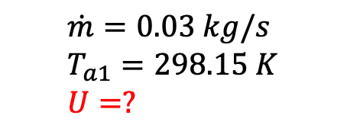
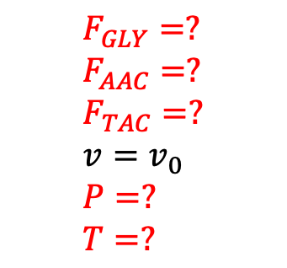
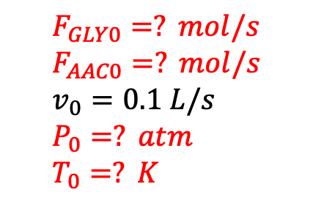
$$F_{GLY}=? \\ F_{AAC}=? \\ F_{TAC}=? \\ v=v_{0} \\ P=? \\ T=?$$
$$n=130 tubos$$
$T_{a2}=322K$
$$\dot{m}=0.03 kg/s \\ T_{a1}=298.15 K \\ U=?$$
$$L=9.75 m$$
$$F_{GLY0}=? mol/s \\ F_{AAC0}=? mol/s \\ v_{0}=0.1 L/s \\ P_{0}=? atm \\ T_{0}=? K$$
$$D=0.0254 m$$

Slide 3
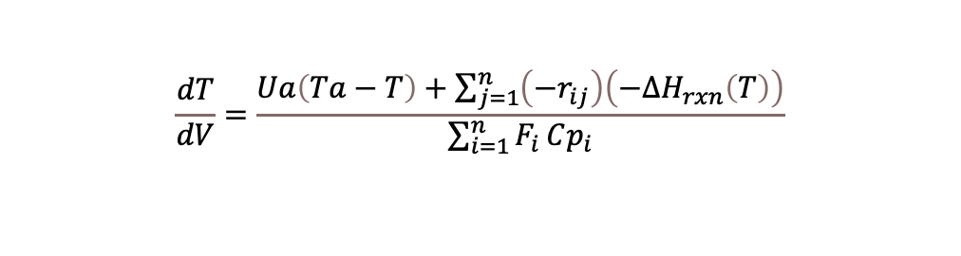
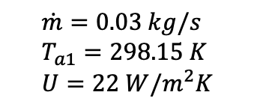
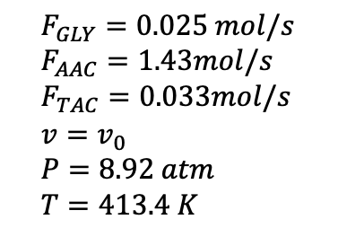
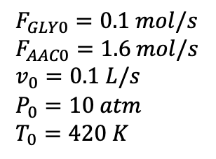
$$GLY + AAC ↔MAC + W$$
$$ΔH˚_{rxn}\left(298.15K\right)=−36.24 kJ/mol$$
$$F_{GLY}=0.025 mol/s \\ F_{AAC}=1.43mol/s \\ F_{TAC}=0.033mol/s \\ v=v_{0} \\ P=8.92 atm \\ T=413.4 K$$
$$MAC + AAC ↔DAC + W$$
$$ΔH˚_{rxn}\left(298.15K\right)=−19.48 kJ/mol$$
$$ΔH˚_{rxn}\left(298.15K\right)=−12.41 kJ/mol$$
$$DAC + AAC ↔TAC + W$$
Abreviación | Especie
GLY | Glicerol
AAC | Ácido acetico
MAC | Monoacetín
DAC | Diacetín
TAC | Triacetín
$$n=130 tubos$$
$T_{a2}=322K$
$$\dot{m}=0.03 kg/s \\ T_{a1}=298.15 K \\ U=22 W/m^{2}K$$
$$L=9.75 m$$
$$F_{GLY0}=0.1 mol/s \\ F_{AAC0}=1.6 mol/s \\ v_{0}=0.1 L/s \\ P_{0}=10 atm \\ T_{0}=420 K$$
$$D=0.0254 m$$
$\frac{dF_{i}}{dV}=r_{i neta}$
$$\frac{dT}{dV}=\frac{Ua\left(Ta−T\right)+\sum_{j=1}^{n}{\left(−r_{ij}\right)\left(−ΔH_{rxn}\left(T\right)\right)}}{\sum_{i=1}^{n}{F_{i}}Cp_{i}}$$

Slide 4
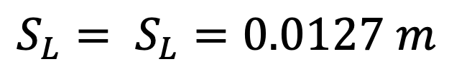


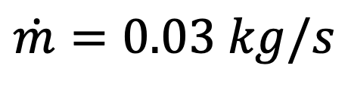
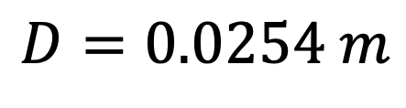
$$S_{L}$$
$$T_{a1}=298.15K$$
$$\dot{m}=0.03 kg/s$$
$${S_{L}= S}_{L}=0.0127 m$$
$$D=0.0254 m$$

Slide 5
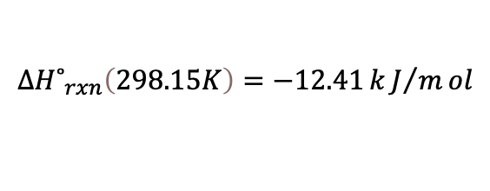
$$ΔH˚_{rxn}\left(298.15K\right)=−36.24 kJ/mol$$
$$ΔH˚_{rxn}\left(298.15K\right)=−19.48 kJ/mol$$
$$ΔH˚_{rxn}\left(298.15K\right)=−12.41 kJ/mol$$

