Slide 1
DMW FINAL PROJECT
SteamSale
Predicting Discount Depth and Value Retention of PC Games on Steam
Data Mining and Warehousing
Asian Institute of Management • Y2 T2

Slide 2
The Problem
Buy-vs-wait advice on Steam is folklore. We want to ground it in data.
Two questions, one dataset.
100,000+
BUYER
Is this discount real, or is it inflated against a fake “regular” price? Will the game drop further if I wait?
games on Steam
INDIE DEVELOPER
Hundreds discounted every weekend at depths from 10% to 95%.
Am I leaving money on the table by joining the next big sale, or is participation actually the only thing that moves my revenue?
SteamSale • DMW Final Project
2

Slide 3
Two Research Questions
Same dataset, two audiences, one project.
PART 1 — Pricing & Value Retention
PART 2 — Sale Effectiveness
Predict current Steam price from game attributes (genre, age, reviews, multiplayer, achievements).
Identify which titles retain value best vs. depreciate aggressively.
Classify each game into a value-retention tier: Premium Hold, Standard, Heavy Discount, Permanent Bargain.
Measure player-count uplift during sale windows vs. pre-sale baseline.
Predict uplift from discount depth, age, sale type, and prior discount history.
Classify sales: High Impact / Moderate Lift / Diminishing Returns / No Effect.
SteamSale • DMW Final Project
3

Slide 4






Data Sources
Five free APIs and one scraper feed one SQLite warehouse. ~5,000 games sampled.
Steam Storefront
Steam Web API
Steam Reviews
Title, prices (PHP), discount %, release date, genres, devs, Metacritic.
Live concurrent player counts, per-call snapshot.
Aggregate counts + score, plus per-review timestamps for velocity.
SteamSpy
IsThereAnyDeal
SteamCharts
Owners bucket, playtime medians, community tags.
Historical price points + sale events. The Part 2 backbone.
Historical CCU time series back to 2012, ~weekly granularity.
SteamSale • DMW Final Project
4

Slide 5
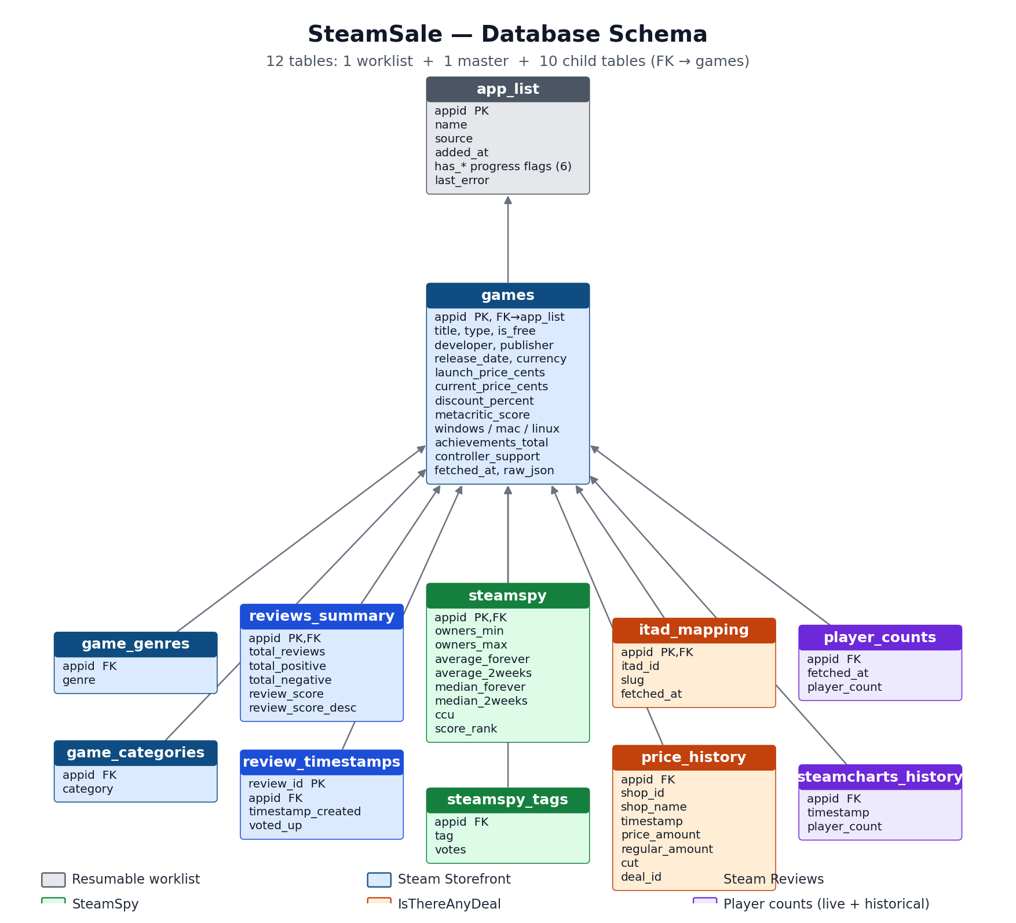
The Data Warehouse
12 tables • resumable pipeline • one SQLite file
Each child table FKs back to games. The worklist (app_list) carries per-stage progress flags so the entire pipeline is resumable — safe to interrupt and restart.
SteamSale • DMW Final Project
5

Slide 6
ML Approach
Two parts, four models, one methodological anchor.
PART 1 — PRICING
PART 2 — SALE EFFECTIVENESS
REGRESSION
REGRESSION
Predict current price (PHP) from age, reviews, genre, dev, ownership, Metacritic. Linear → Random Forest → XGBoost.
Predict player-count uplift % from discount depth, age at sale, sale type, prior discount cadence.
CLASSIFICATION
CLASSIFICATION
Predict retention tier: Premium Hold / Standard / Heavy Discount / Permanent Bargain. Multinomial logistic + tree ensembles.
Predict effectiveness tier: High Impact / Moderate Lift / Diminishing Returns / No Effect.
METHODOLOGY Each game is its own control — sale uplift is measured against the same game's pre-sale baseline (14-day window), not cross-game.
SteamSale • DMW Final Project
6

Slide 7



Expected Outputs
What we plan to deliver by the end of the project.
Models & Artifacts
Visualizations
Business Deliverables
Trained regressors + classifiers (Part 1 and Part 2).
Evaluation reports: RMSE, R², macro-F1, confusion matrices.
SHAP feature-importance plots.
Discount-depth distribution by genre.
Price-decay curves vs. age.
CCU time series with sale events overlaid — the money plot.
"Fair price" recommendation for buyers.
Sale-ROI forecast for indie developers.
Stretch: Chrome extension overlay.
SteamSale • DMW Final Project
7

Slide 8



Why It Matters
Three audiences, one model surface.
BUYERS
INDIE DEVELOPERS
PUBLISHERS
Spot real deals.
Benchmark pricing.
Refine cadence.
Distinguish genuine discounts from inflated baselines. Surface Permanent Bargains.
Compare against similar titles. Forecast uplift before joining seasonal sales.
Identify which sales actually move the needle vs. which are leaving money on the table.
SteamSale • DMW Final Project
8

Slide 9
Methodology Limitations
Honest scope limits — not excuses.
Confounding sale signals
Player-count uplift conflates discount effect with patches, streamer coverage, and seasonality. Within-game baseline mitigates but doesn't eliminate.
Coarse CCU granularity
SteamCharts gives ~weekly per-game CCU, not daily. Fine for 7-day windows; cannot resolve sub-week effects.
Ownership in buckets
SteamSpy estimates are bucketed (e.g. 10M..20M) since Valve restricted profile visibility in 2018.
ITAD coverage gaps
May miss obscure indie titles. Dataset skews toward moderately-popular games where all sources have data.
Survivorship bias
Delisted games drop out. The model only sees titles that survived.
SteamSale • DMW Final Project
9

Slide 10
THE PITCH IN ONE LINE
Part 1 tells you what to buy.
Part 2 tells you when to sell — if you're a developer.
Same dataset. Two audiences. One project.

Slide 11
Questions?
SteamSale • DMW Final Project
Predicting Discount Depth and Value Retention of PC Games on Steam

