Slide 1

Do we know how ChatGPT is used?
Valerio Thrier ,
Samuel Schönenberger,
Iven Welp

Slide 2
Motivation
Why Chat-GPT?
Still relatively new and quickly developing technology
Always in the News
Hype
Growing importance of AI (especially Chat-GPT) in student, as well as everyday life
Chat-GPT as an everyday friend and helper
AI usage under ETH students (sep 2023), Fadoua Balabdaoui, Nora Dittmann-​Domenichini, et. al
Investigating use-cases of and opinion towards AI

Slide 3


Slide 4
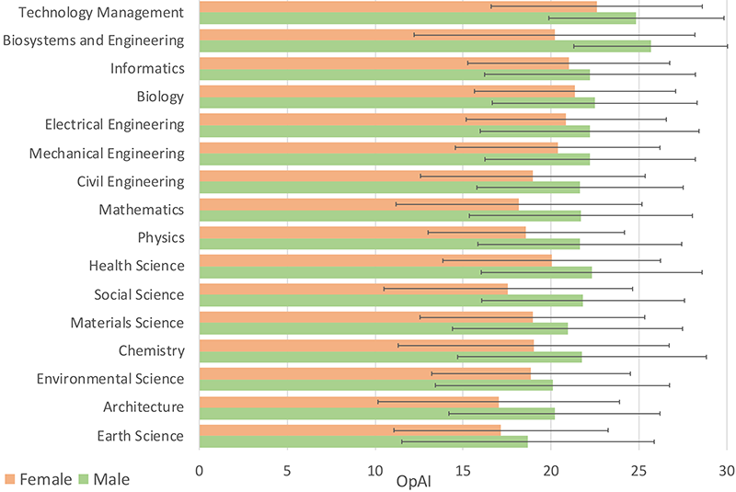
KI usage of (ETH) Students
Survey with 4800 students
Use cases
Writing/correcting/summaries
Coding (reports large impact on coding behaviour)
Overcome language barrier (internationality)
Idea generation, also a first point of attack before googling
Also looked at
Trust
Gender and area of studies discrepancies
Cumulative score of attitudes towards AI by department and gender

Slide 5
Questions And Hypotheses
What are the differences in AI usage between (ETH) students and the general population?
Do social bubbles effect AI usage?
Expectation to general population:
Chat-GPT as google substitute
Entertainment
Writing assistant

Slide 6
Chat-Gpt’s answer About its own usage
Casual Conversation
Information and Assistance (google)
Creative Writing and Storytelling (Idea generation)
Therapeutic Conversations (Mental health support)
Entertainment and Fun (Jokes)
Assistance with Tasks (cooking, planning, …)
Exploring AI Interactions (curiosity)
Accessibility (language barriers, …)

Slide 7
Dataset
Taori, R., Gulrajani, I., et al. (2023). Stanford Alpaca: An Instruction-following LLaMA model.
4 Columns:
Message, Message type (instruction, output, input), Message ID, Conversation ID
Message type:
42% instruction, 42% output, 16% input
51759 Conversations

Slide 8
Dataset Examples
What is the capital of France? | instruction | 0 | 10
The capital city of France is Paris. | output | 1 | 10
Evaluate this sentence for spelling and grammar mistakes | instruction | 0 | 8
There are two spelling errors in the sentence. The corrected sentence should be: "He finished his meal and left the restaurant." | output | 1 | 8
He finnished his meal and left the resturant | input | 2 | 8

Slide 9
Methodological approach
Key-Word search
Manual inspection
Inverse Document Frequency based Analysis
K-means
Multiple approaches for cross-validation

Slide 10
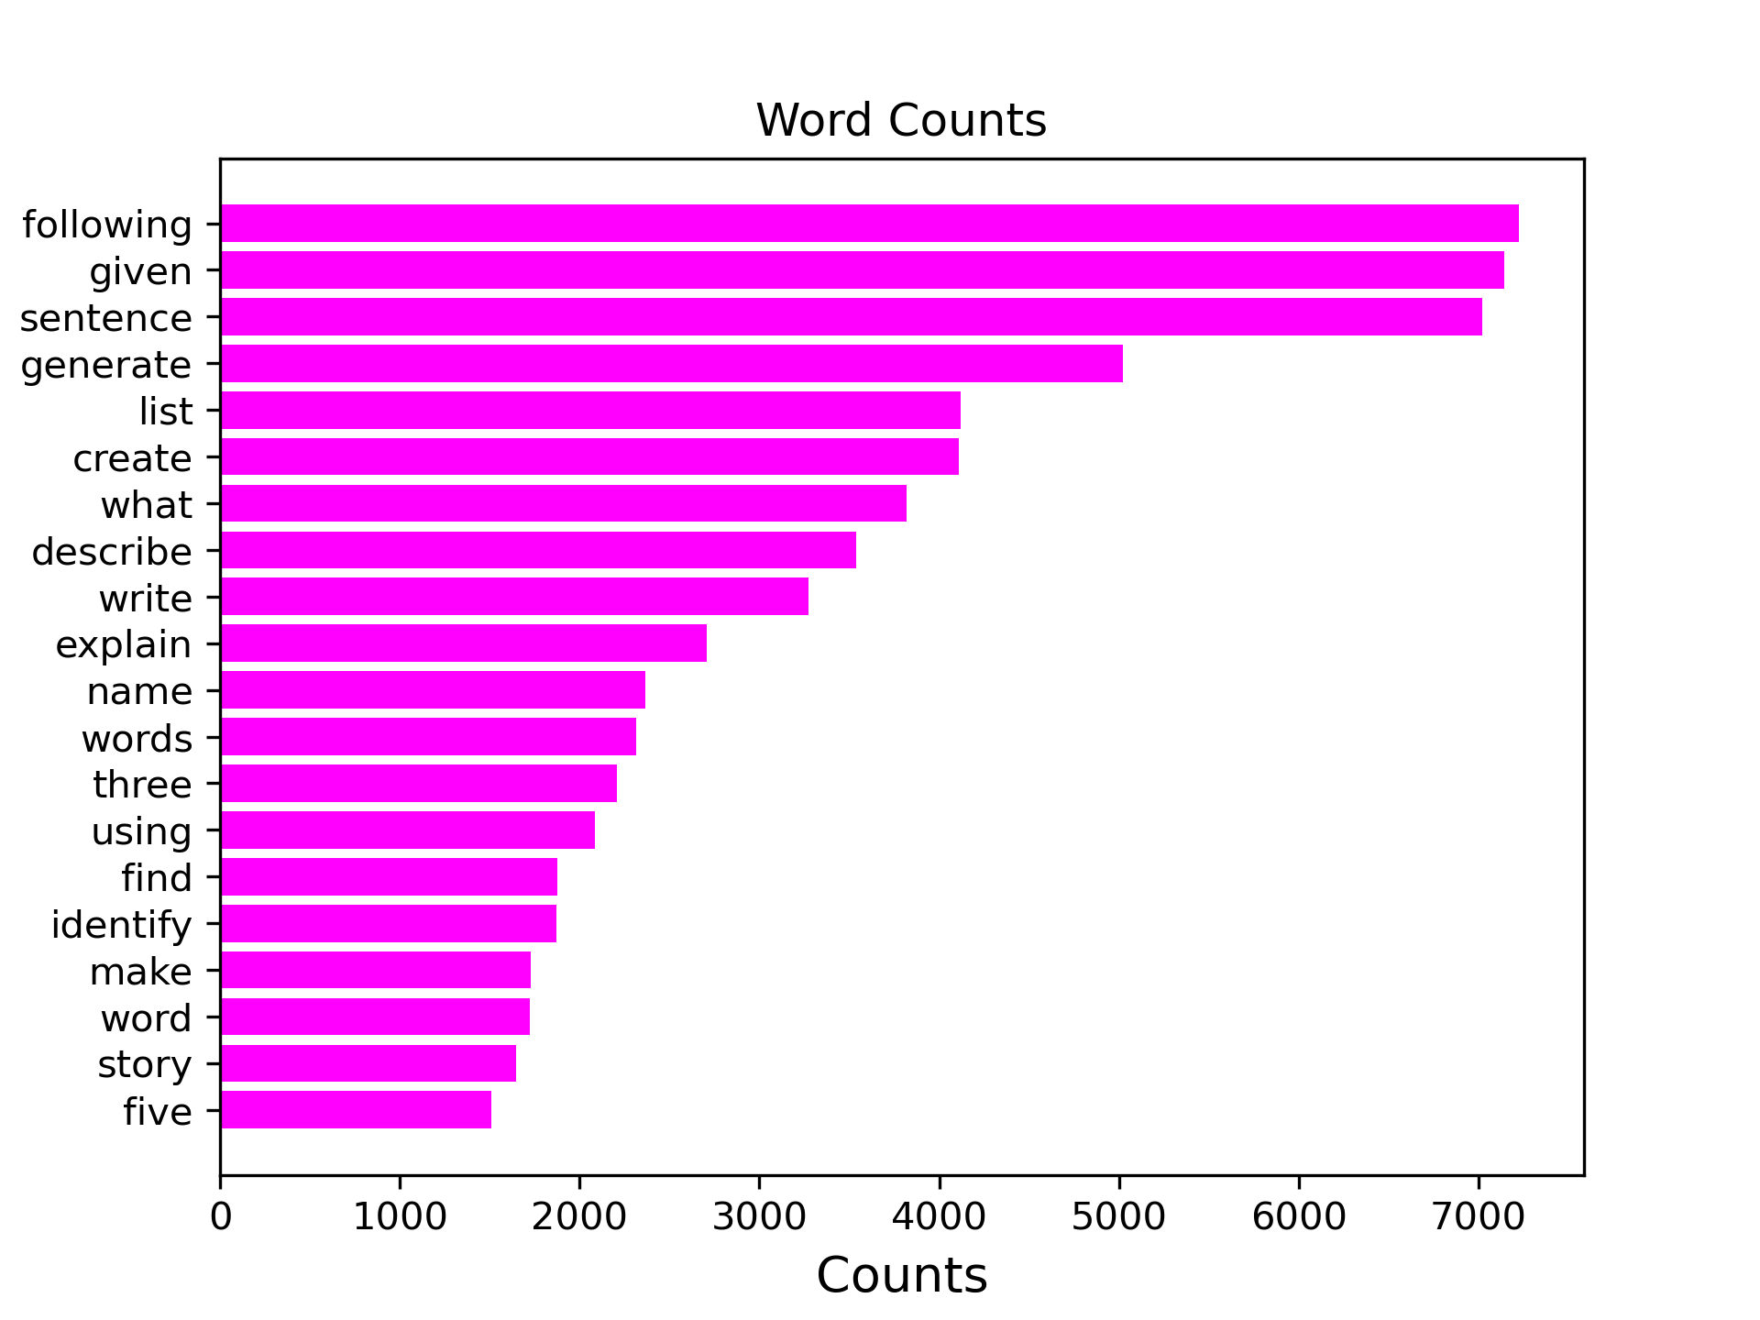
Manual inspection
Sorting by word count
Selecting common words and assigning them to use case-based categories
Problems:
Subject to biases (confirmation)
Rather arbitrary assignment
Shallow (can’t make out connections)

Slide 11
Confirmation Bias
The lazy Googler | The lazy Creator | The lazy Editor | Other | Other
what | create | find | suggest | list
explain | write | identify | classify | describe
why | make | rewrite | give | name
who | word | edit | article | provide
news | story | change |  | example
meaning | text | convert
Table from the consultation presentation

Slide 12


inverse document frequency (idf)
Weighting of word $w_{i}$ based on how frequently it is used across all requests
Formula : ${idf}_{i}=log⁡\left(\frac{|D|}{|\{d:w_{i}∈d\}|}\right)$
E.g. “the” has an idf-value of ~0.43
E.g. “magic” has an idf-value of ~8.52
Words sorted by commonness
4%
Too frequent
Number of requests
Used for further analysis
16%
Number of request containing image $w_{i}$
Too rarely used
80%

Slide 13
Word combination matrix & common pairs
 | best | practices | zoo
best | 415 | 25 | 0
practices | 25 | 40 | 0
zoo | 0 | 0 | 6
Sparse, symmetric matrix
Parsed it to find common pairs (appearing more than 20 times together) like e.g. “best” and “practices”
Excluded words with themselves from common pairs
Created Network from Common Pairs

Slide 14
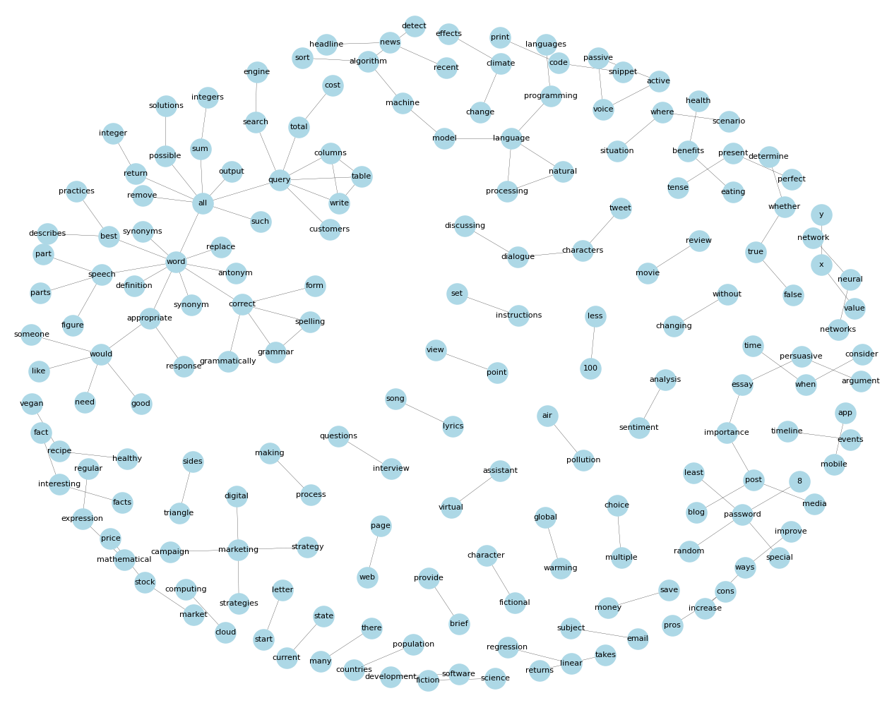
The network

Slide 15
observed Use cases from network
Use Case | Groups
Asking knowledge questions | Fact/interesting/facts, pros/cons, countries/population, recent/news/headlines
Coding questions | Software/development, cloud/computing, snippet/code/print, neural/network/networks, linear/regression, cluster around “model”, returns/takes
Math | X/y/value
Text editing | Active/passive/voice, perfect/present/tense, without/changing
Generating specific content | start/letter, email/subject, fictional/character, Tweet/characters/dialogue/discussing, timeline/events, movie/review, media/blog/post/importance/essay/persuasive/argument

Slide 16
False positive use cases from network
Reason | Group
Words that belong together | Science-fiction, multiple-choice, web-page, view-point, current-state, mobile-app, sentiment-analysis
Sentence structure | Instructions/set, False/true/determine/whether provide-brief, 100/less, Situation/where/scenario/than/angle/sides
Coincidental overlap of uses | Mathematical-expression-regular
Artifacts | All, word, would, there/many, when/consider/time, improve/ways/increase

Slide 17
Specific topics
Financial advice: Stock market (stock/market/price), save/money
Doing the work for the user: marketing/campaign/digital/strategies/strategy, virtual/assistant
Cooking: vegan recipe, healthy recipe, process/making, eating/benefits
SQL: subcluster around “query”
Generating Passwords (password/8/random/special/least)
Ecological questions (global/warming, air/pollution, climate/change/effects)
interview questions → both interviewer and interviewee asked questions
Song lyrics

Slide 18
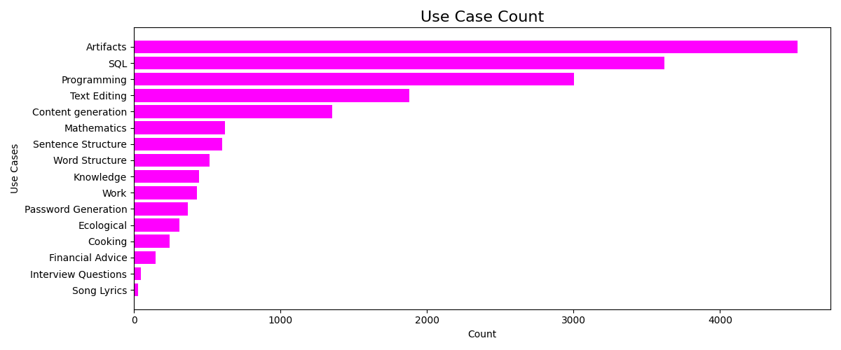

Slide 19
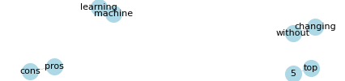
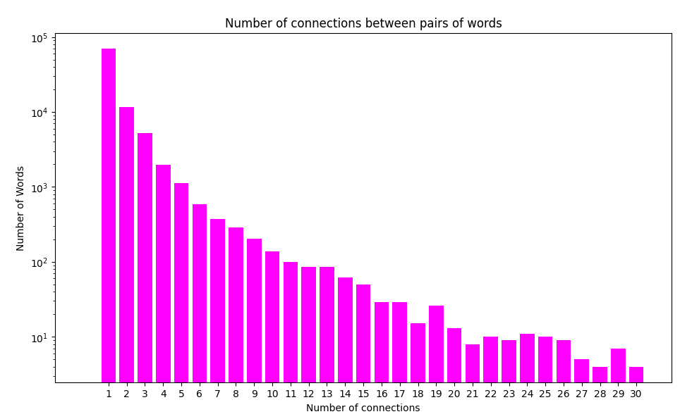
Significance & sensitivity
Network resulting from smaller subset (4000 request)
Significance analysis
Split up dataset into sub-datasets and apply same methods
Resulting networks are much smaller but contain same words
Sensitivity analysis
Thresholds for inclusion of words for analysis
Lower threshold excludes words that would never show up in network → saves computation time
Upper threshold excludes words that would connect completely unrelated topics: “like”, “by”
Including word pairs with fewer connections makes network bigger
includes more artifacts
Makes network harder to analyze for a human
→ 20 is a good threshold for that

Slide 20
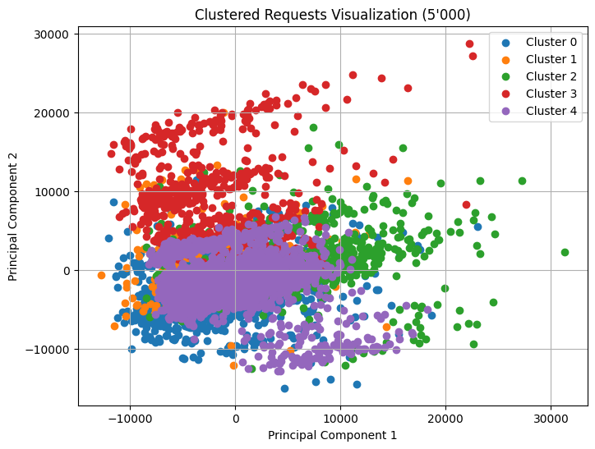
K-MEANS
Each word of a request is represented by a token
All words of a request are pooled
Each point represents one pool/request
PCA for clustering
Divided data into 5 clusters

Slide 21
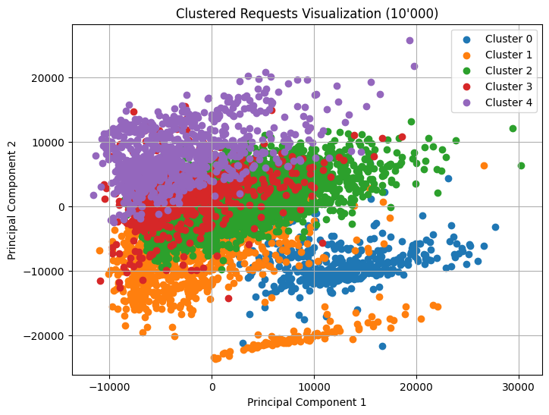
K-MEANS
Cluster 0 | Cluster 1 | Cluster 2 | Cluster 3 | Cluster 4
('given', 4714) | ('given', 647) | ('sentence', 550) | ('create', 645) | ('sentence', 510)
('sentence', 4646) | ('sentence', 543) | ('given', 439) | ('generate', 640) | ('given', 502)
('?', 3362) | ('generate', 527) | ('?', 302) | ('given', 588) | ('?', 395)
('generate', 3119) | ('list', 481) | ('it', 248) | ('sentence', 512) | ('generate', 322)
('list', 2814) | ('?', 462) | ('generate', 241) | ('cat', 463) | ('what', 308)

Slide 22
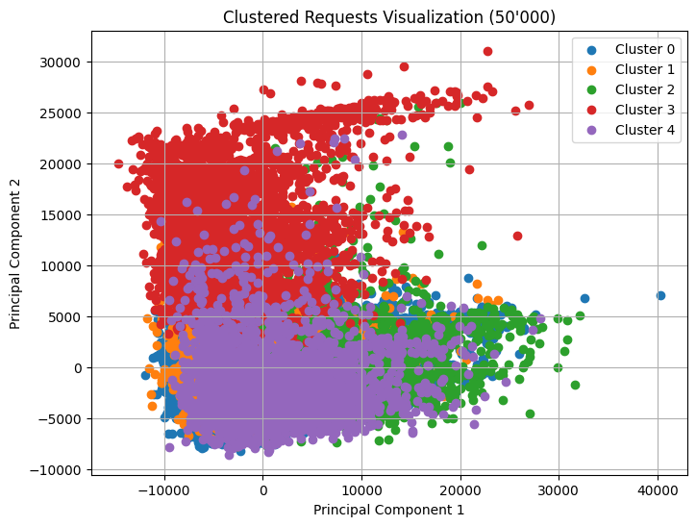
K-means
Cluster 0 | Cluster 1 | Cluster 2 | Cluster 3 | Cluster 4
('printers', 28) | ('introduces', 4) | ('##hs', 6) | ('##rise', 8) | ('##active', 4)
('facing', 25) | ('protective', 3) | ('##leg', 5) | ('ashe', 6) | ('mathematician', 4)
('dye', 25) | ('discoveries', 3) | ('weighs', 5) | ('remembering', 5) | ('sheila', 4)
('bill', 23) | ('sack', 3) | ('ser', 5) | ('thoughtful', 4) | ('pops', 3)
('frequent', 20) | ('bunch', 3) | ('##put', 3) | ('directory', 3) | ('##icles', 3)

Slide 23
Language model
1st step: train a model to understand words
2nd step: make it generate "new" requests
3rd step: train it on requests and our assumed usage-types
4th step: test and execute the model on other requests

Slide 24
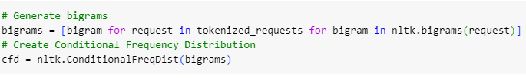
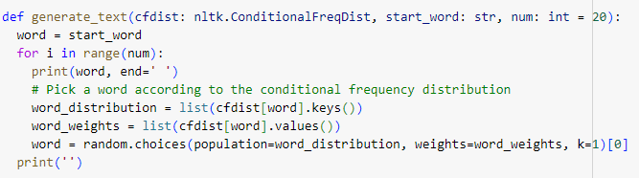
language model
Started with bigrams, we were able to generate probability-based sentences
Which creates a Distribution for each word appearing in our dataset of requests
Notes:
Used as bonus slide for interested people

Slide 25
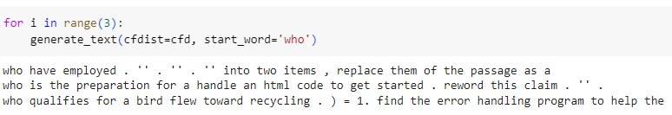
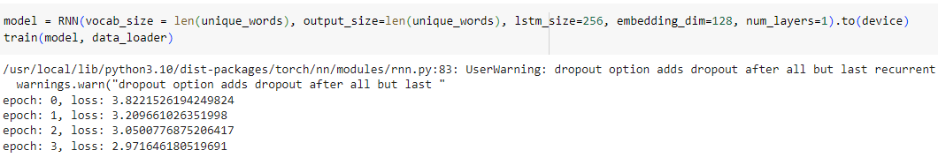
Language model
This isn't very helpful yet
We further used Recurrent Neural Networks (RNN) and Long short-term memory (LSTM) to generate instructions

Slide 26
language model
We have a model which can generate request-like phrases
['can', 'you', 'find', 'local', 'places', 'in', 'the', 'middle', 'of', 'the', 'books', 'generate', 'a', 'detailed', 'description', 'of', 'an', 'ai', 'assistant', '.', 'generate', 'a', 'dialogue', 'between', 'a', 'shopkeeper', 'and', 'an', 'italian', 'cuisine', '.', 'create'] ['can', 'you', 'do', 'to', 'reduce', 'household', 'waste', '.', 'describe', 'the', 'best', 'way', 'to', 'proofread', 'an', 'article', 'and', 'rewrite', 'it', 'such', 'that', 'it', 'is', 'not', 'a', 'while', 'still', 'conveying', 'the', 'unknown', "''", '.'] ['can', 'you', 'give', 'the', 'product', 'what', 'time', 'someone', 'sends', 'an', 'external', 'email', 'to', 'study', 'the', 'project', '.', 'write', 'a', 'description', 'of', 'a', 'computer', 'scientist', 'app', '.', 'name', 'five', 'items', 'that', 'would', 'help']

Slide 27
Summary/Take home messages
Use cases more similar than expected
Unexpected similarity to survey
Results of ETH survey more accurate than expected extrapolated to a wider population
Bubble selectivity hard to answer

Slide 28
Discussion
Limitations:
No information on the sample group
No user ID
Keyword ≠ Topic
Manually selected thresholds
Only taking one AI into account
Chat-GPT4 is not free
Future Work
Using a data set with user information
Gender differences
Specific user types
Refine language model
Combine and tune methods

Slide 29

And a Silly finding to close off
Found a trend for users asking: “Use the following pieces of context to answer the question at the end. If you do not know the answer, just say that you do not know, don’t try to make up an answer.”
User gives no context
Tries to test Chat-GPT’s ability to respond without inventing the context
10/11 times Chat-GPT gives random made-up answer like:
“I'm sorry, I cannot answer that question as the context given does not provide information about the best restaurant in Berlin.”
“The given context does not provide information on the cost of the Seismo S20 powder machine. ”
1/11 times (last response in dataset) Chat-GPT responds with: “I'm sorry, but I don't have enough information to answer that question.”

Slide 30
Declaration of Originality
We, Valerio Thrier, Samuel Schönenberger and Iven Welp, declare that this presentation is entirely our original work, except where otherwise indicated. All sources used in the preparation of this presentation, including but not limited to text, images, graphs, and data, have been properly cited and referenced in accordance with academic standards.
We affirm that:
Any ideas, concepts, or opinions presented in this work are our own and have not been plagiarized from any other source.
Any external sources consulted during the creation of this presentation are duly acknowledged through proper citation.
Any contributions from collaborators or third parties have been appropriately credited.
We understand that academic integrity is of paramount importance, and any form of plagiarism or academic dishonesty is unacceptable. Therefore, we take full responsibility for the originality and authenticity of this work.
Signed,
Valerio Thrier, Samuel Schönenberger, Iven Welp
06.05.2024
Written with help by Chat-GPT
Notes:
Only visible for TAs & Professor

Slide 31
Contributions of Team Members
Valerio Thrier
Idea formation and execution
K-means
Language model testing
Samuel Schönenberger
Idea formation and execution
Data preprocessing
Network analysis based on Inverse Document Frequency based Analysis
Iven Welp
Idea formation and execution
Coordination
Graph- & Layout-design
Notes:
Only visible for TAs & Professor

Slide 32
References
KI Nutzung unter Studierenden (2023), Fadoua Balabdaoui, Nora Dittmann-​Domenichini, et. al.
Taori, R., Gulrajani, I., Zhang, T., Dubois, Y., Li, X., Guestrin, C., Liang, P., & Tatsunori B. Hashimoto. (2023). Stanford Alpaca: An Instruction-following LLaMA model. In GitHub repository. GitHub. https://github.com/tatsu-lab/stanford_alpaca
OpenAI. (2024). ChatGPT (April 8th version) [Large language model].
Margarita Chli, Paul Furgale, Marco Hutter, Martin Rufli, Davide Scaramuzza, Roland Siegwart. “Vocabulary Tree | tf-idf” Perception – Place Recognition Slide 25 , Autonomous Mobile Robots (Spring 2024), ETH Zurich, 9.04.2024.

