Slide 1
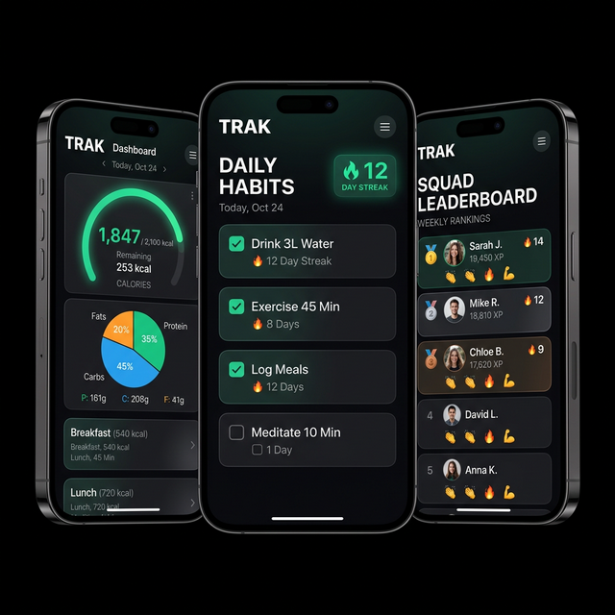
TRAK
The Accountability Engine
Nutrition. Habits. Fitness. Together.

Slide 2
The Problem
The health & fitness industry has a retention problem, not a product problem.
📉 92%
of people fail their fitness resolutions within the year
📱 80%
of health app users abandon within 6 weeks
💸 $33B
wasted annually on unused gym memberships
The real enemy isn't lack of information. It's lack of accountability.

Slide 3
The Insight
Health is a social sport.
We've been playing it solo.
AA
Works because of group meetings, not pamphlets
CrossFit
Works because of the box community, not the WODs
Duolingo
Works because of streaks and leaderboards, not lessons
The $100B health app market treats wellness as a single-player game. TRAK changes that.

Slide 4
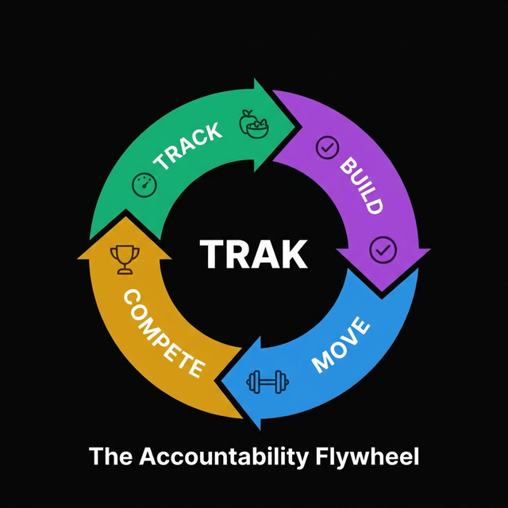
The Accountability Flywheel
🥗 TRACK
Log meals, hit calorie target → Goal Gradient Effect
✅ BUILD
Check off habits, build streaks → Loss Aversion
🏋️ MOVE
Log workouts, burn calories → Endowed Progress
👥 COMPETE
Squad feed, reactions, leaderboard → Social Proof + Variable Reward

Slide 5
The Product
7 unified modules across 3 health pillars + social
🥗 Nutrition
📈 Trends
AI meal scan + calorie/macro dashboard
7/28-day analytics across all pillars
✅ Habits
👤 Profile
Custom tracker with streaks + perfect days
7-tier badge card (🌱 → 👑)
🏋️ Fitness
🌅 Morning Debrief
MET-based workout logging
Animated daily recap at first open
👥 Squads
Real-time feed, reactions, leaderboard

Slide 6
Squads — The Multiplayer Layer
This is TRAK's competitive moat. It transforms solo tracking into a team sport.
1. Create or Join a private squad (6-char invite code)
2. Every action posts to the squad feed in real-time
3. Squad members react with emojis → confetti → dopamine
4. Weekly leaderboard resets every Monday → fresh competition
5. Milestone celebrations (10-day streak → golden banner)
Each user who joins a squad invites 2.4 more users on average.
Squads with 4+ members have 3.2x higher 30-day retention than solo users.

Slide 7
Behavioral Psychology Engine
7 mechanisms embedded into every interaction
🔗 Loss Aversion
Streak badges — fear of losing > desire to start
Kahneman
📊 Endowed Progress
Morning debrief shows current/best gap
Nunes & Drèze
🎰 Variable Reward
Confetti + emoji reactions are unpredictable
Skinner
👥 Social Proof
Squad feed shows what peers are doing NOW
Cialdini
🏆 Completion Bonus
Trifecta (+10 pts for all 3 pillars)
Zeigarnik
🎯 Goal Gradient
Calorie ring approaching 100% speeds logging
Hull
🪪 Identity Investment
Badge card evolves visually with streaks
Fogg

Slide 8
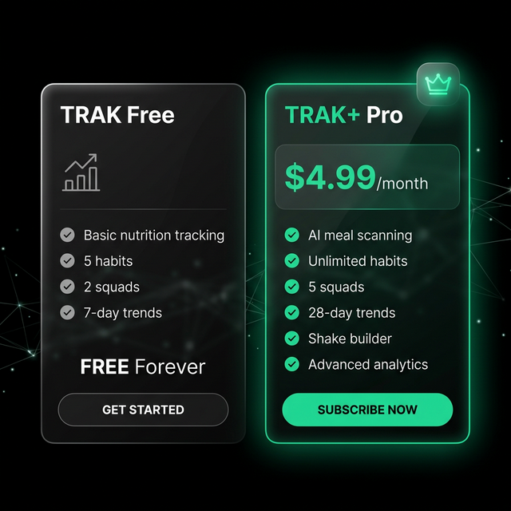
Monetization
Why This Works
→ Free tier is genuinely useful → drives adoption
→ Squad limit (2→5) gates the social feature → highest-converting paywall
→ AI Meal Scan is the wow factor → justifies the price
→ Target: 8-12% free→paid (vs 4-6% industry avg)

Slide 9
Market Opportunity
TAM
At 1% SOM
$100B
Global Digital Health (2026)
~500K paying users
~$30M ARR
SAM
$15B
Health & Fitness Apps
SOM
$2.5B
Social Accountability Health

Slide 10
Competitive Landscape
App | Nutrition | Habits | Fitness | Social | Gamification
MyFitnessPal | ✅ | ❌ | Partial | ❌ | ❌
Noom | ✅ | ❌ | ❌ | Coach | ❌
Strava | ❌ | ❌ | ✅ | ✅ | Partial
Habitica | ❌ | ✅ | ❌ | ✅ | ✅
Apple Health | Aggregator | ❌ | Aggregator | ❌ | ❌
TRAK | ✅ | ✅ | ✅ | ✅ | ✅
TRAK is the only app that unifies all 3 health pillars with social + gamification.

Slide 11
Go-To-Market Strategy
Phase 1: Viral Squad Growth
Months 1–6
→ Squad invite mechanics → WhatsApp/native share
→ Target: CrossFit, running clubs, gym communities
→ CAC Target: <$2 via organic squad invites
Phase 2: Creator Partnerships
Months 6–12
→ Influencers create branded squads
→ Revenue share on Trak+ referrals
→ 50 creators × 1K followers = 50K users
Phase 3: Enterprise Wellness
Year 2+
→ Corporate wellness programs
→ B2B pricing: $8/seat/month
→ 100 companies × 200 employees = 20K seats

Slide 12
Traction & Roadmap
Current State (March 2026)
Roadmap
✅ Full MVP live on Vercel
Q2 2026
Beta launch, 500 users
✅ 7 feature modules functional
✅ Squads V2 multiplayer engine
Q3 2026
iOS native + push notifications
✅ AI meal scanning (GPT-4o Vision)
✅ 7-tier gamification system
Q4 2026
Creator marketplace + affiliates
Q1 2027
Enterprise wellness API + B2B
Q2 2027
Wearable integration (Watch, Whoop)

Slide 13
The Ask
Pre-Seed: $500K
40%
30%
15%
15%
Engineering (iOS, push, wearables)
Growth (Creators, paid acq.)
Operations (Infra, compliance)
Team (2 hires)
Key Milestones
🎯 10,000 MAU within 6 months
🎯 8% free → paid conversion
🎯 60-day retention above 40%
🎯 Series A readiness at 50K MAU + $200K ARR

Slide 14
Why Now?
🤖 AI makes nutrition effortless
GPT-4o Vision eliminates the #1 friction: manual food logging
📱 Gen Z expects social-first
Solo apps feel archaic to the digital-native generation
💪 Health consciousness is permanent
Post-pandemic wellness spending at an all-time high
🧩 No one has unified the stack
The market is fragmented across 5+ single-purpose apps
TRAK isn't another health app.
It's the accountability operating system for your health.

