Slide 1
🏀 Calculate Basketball Scoring Probabilities
Stephen Curry — 2022-23 NBA Regular Season
Statistical Analysis: Binomial Distribution · Conditional Probability · Bayes' Theorem
Author: Sam Sepassi | nd588 Statistics for Data Analysis

Slide 2
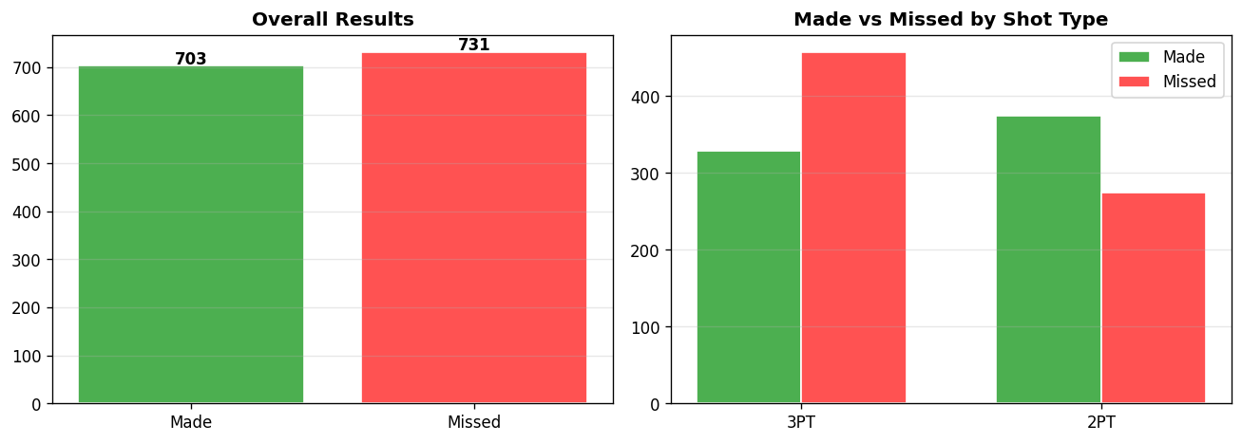
Dataset Overview
Total shots: 1,434 | Made: 703 | Missed: 731 | Overall FG%: 49.0%

Slide 3
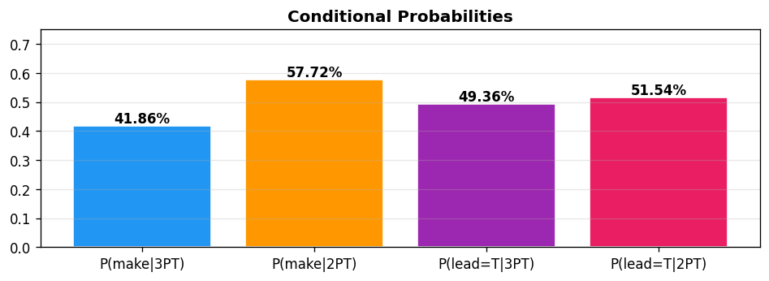
Conditional Probability — Future Outcomes
Section 5A — THREE-POINTERS (shot_type == 3)
P(make | 3PT) = 329/786 = 0.4186 → 41.86%
P(lead=True | 3PT) = 388/786 = 0.4936 → 49.36%
Section 5B — TWO-POINTERS (shot_type == 2)
P(make | 2PT) = 374/648 = 0.5772 → 57.72%
P(lead=True | 2PT) = 334/648 = 0.5154 → 51.54%

Slide 4
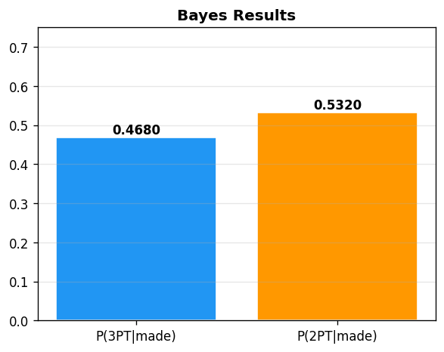
Bayes' Theorem — Past Conditional Probability
P(B|A) = P(A|B) · P(B) / P(A)
P(3PT | made) = P(make|3PT) × P(3PT) / P(make)
= 0.4186 × 0.5481 / 0.4902 = 0.4680 (46.8%)
P(2PT | made) = P(make|2PT) × P(2PT) / P(make)
= 0.5772 × 0.4519 / 0.4902 = 0.5320 (53.2%)
Verification: 0.4680 + 0.5320 = 1.0000 ✓

