Slide 1
A Data-Driven Exploration of Public Tenders
Md Samshad Rahman
samshad@dal.ca
B00968344
Acronym: DDEPT

Slide 2
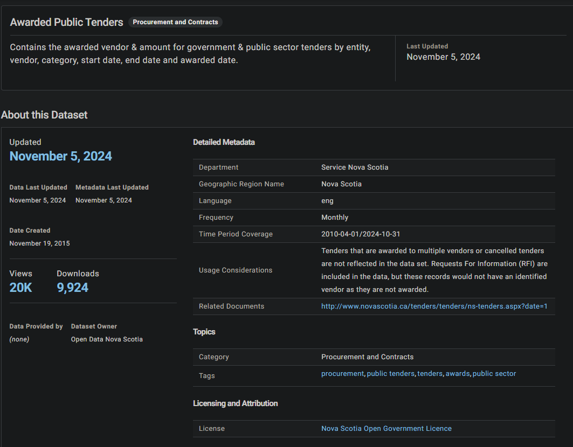
Introduction
URL: https://data.novascotia.ca/Procurement-and-Contracts/Awarded-Public-Tenders/m6ps-8j6u/about_data

Slide 3
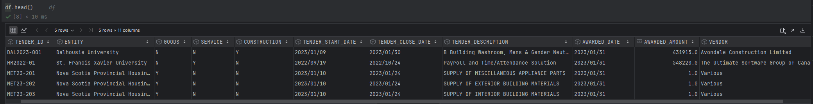
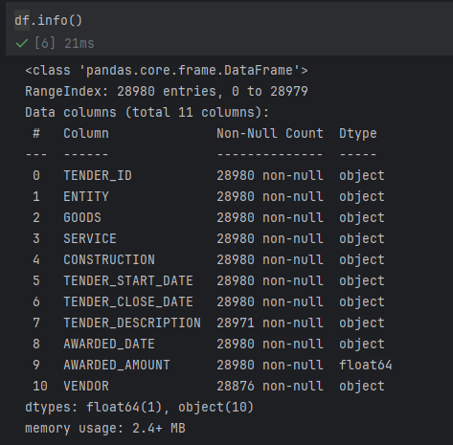
Dataset
Dataset includes more than 29,000 awarded tenders, with fields like tender ID, dates, description, amount, and vendor.

Slide 4
Problem Definition
Understand and interpret procurement trends and vendor patterns in awarded tenders.
Analyze the expenditure trends of an organization or sector across various categories over a year.
Discover insights from tender descriptions using topic modelling and visualization.

Slide 5
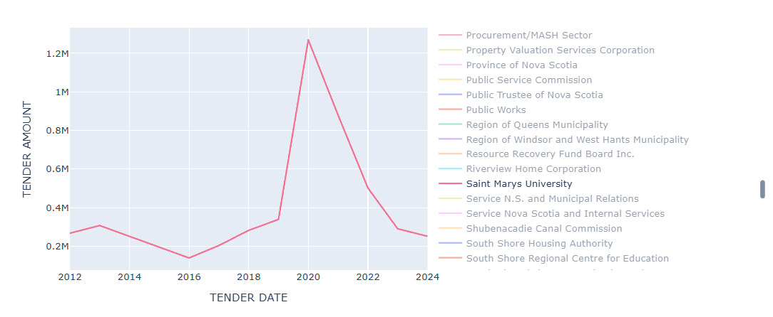
Evolution of Average Yearly Tender Allocation at Saint Mary's University

Slide 6
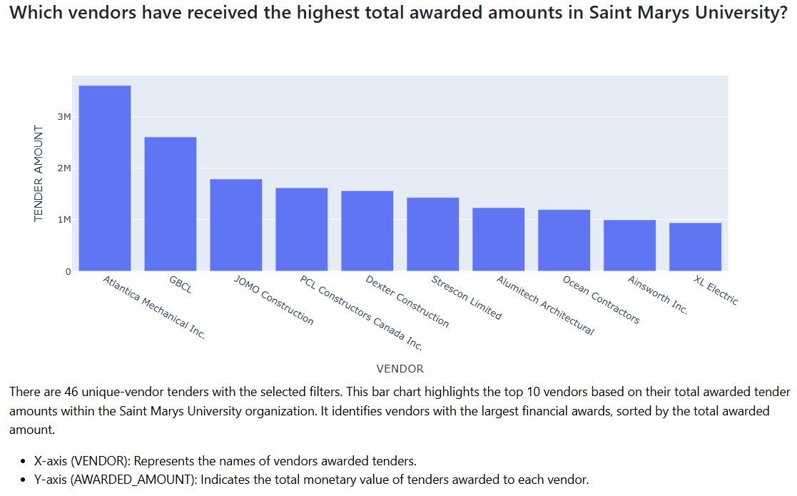
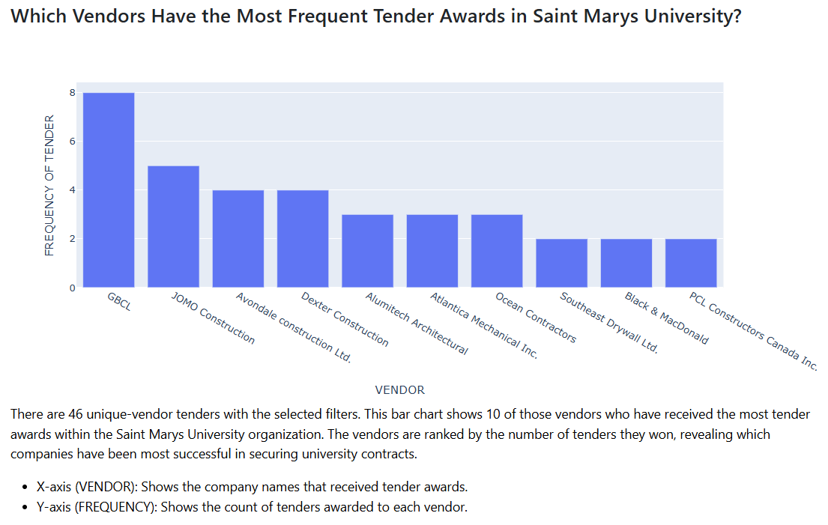

Slide 7
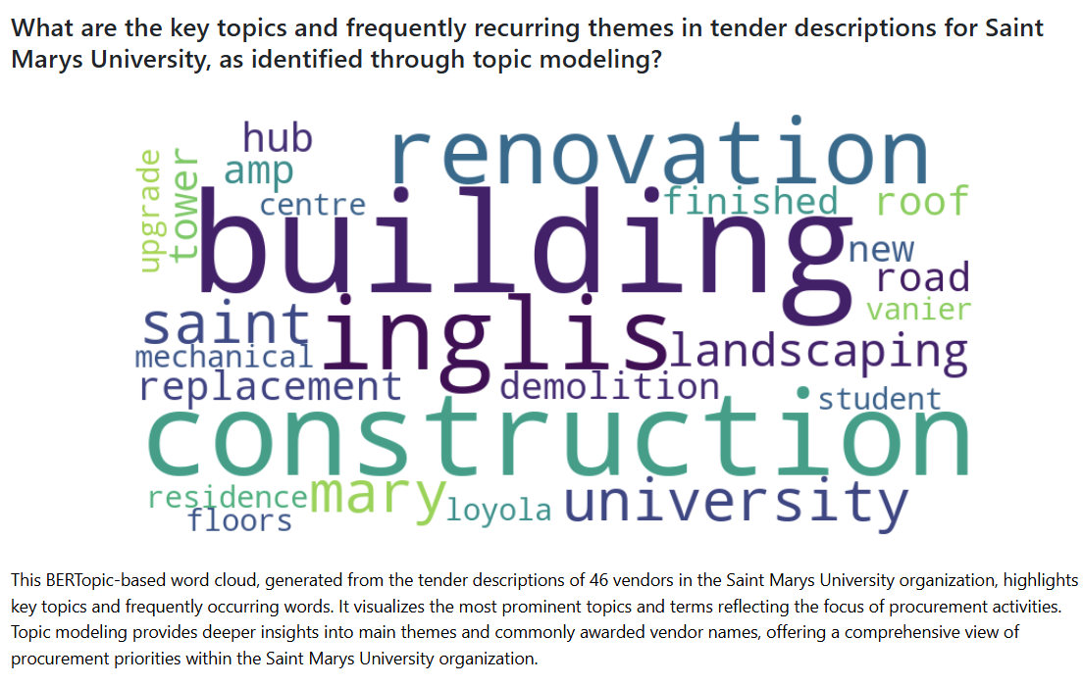

Slide 8
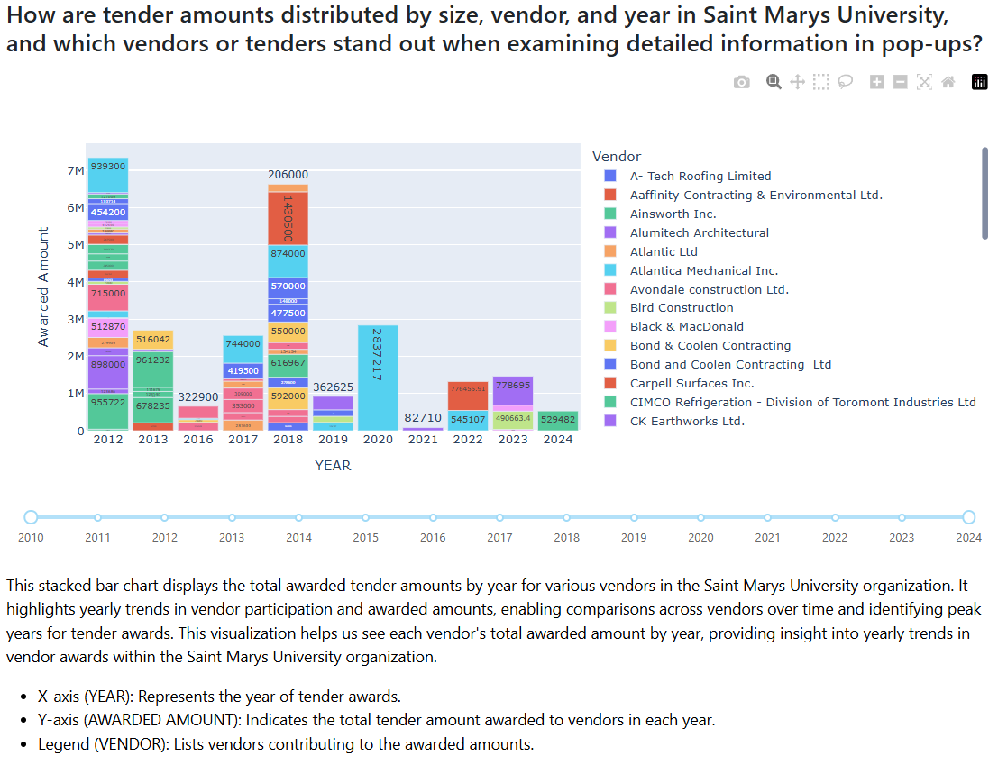

Slide 9
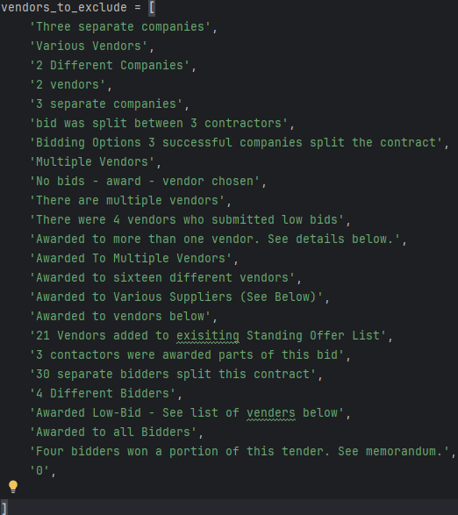
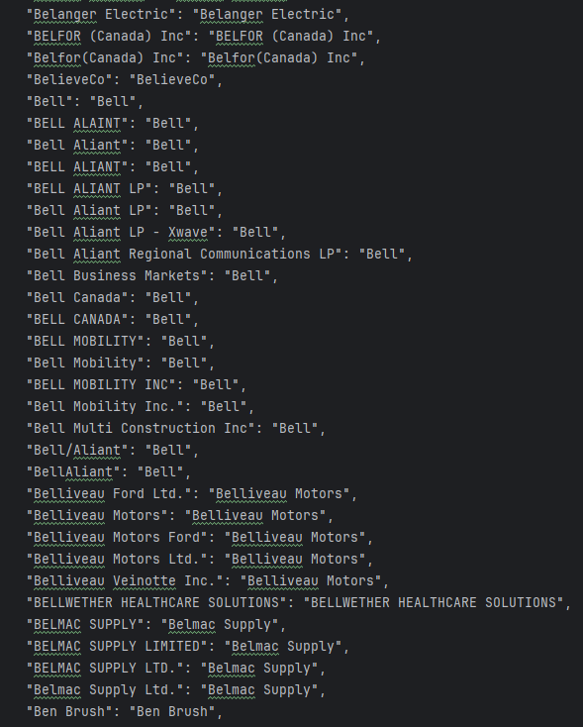
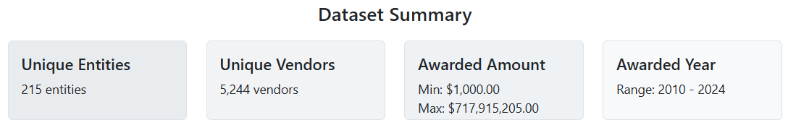
Data Preprocessing
Data Standardization
Eliminating Empty Row
Fixing Datetime Column

Slide 10
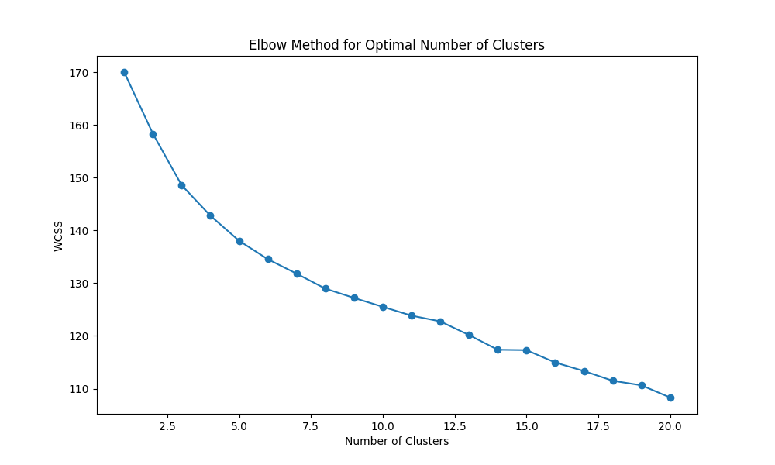
Entity Clustering

Slide 11
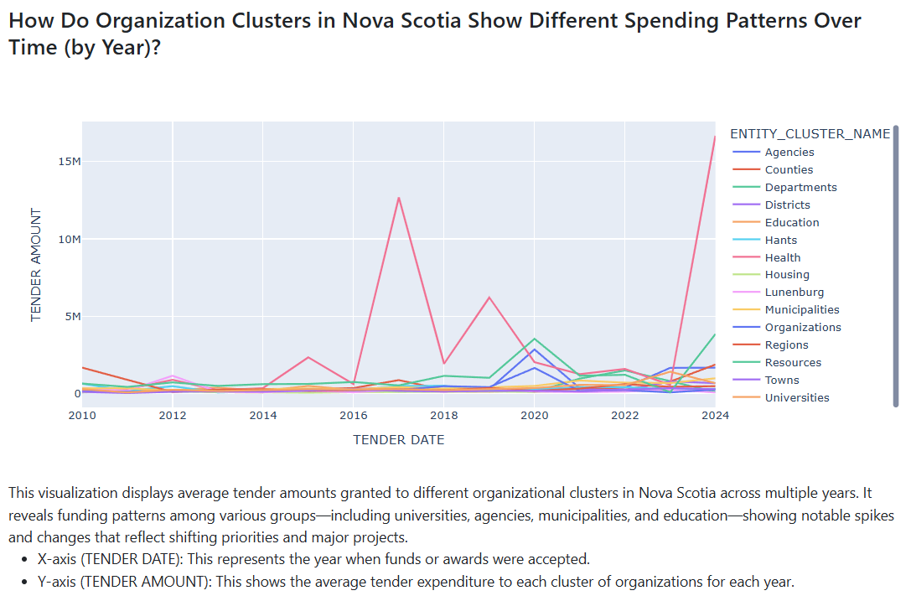

Slide 12
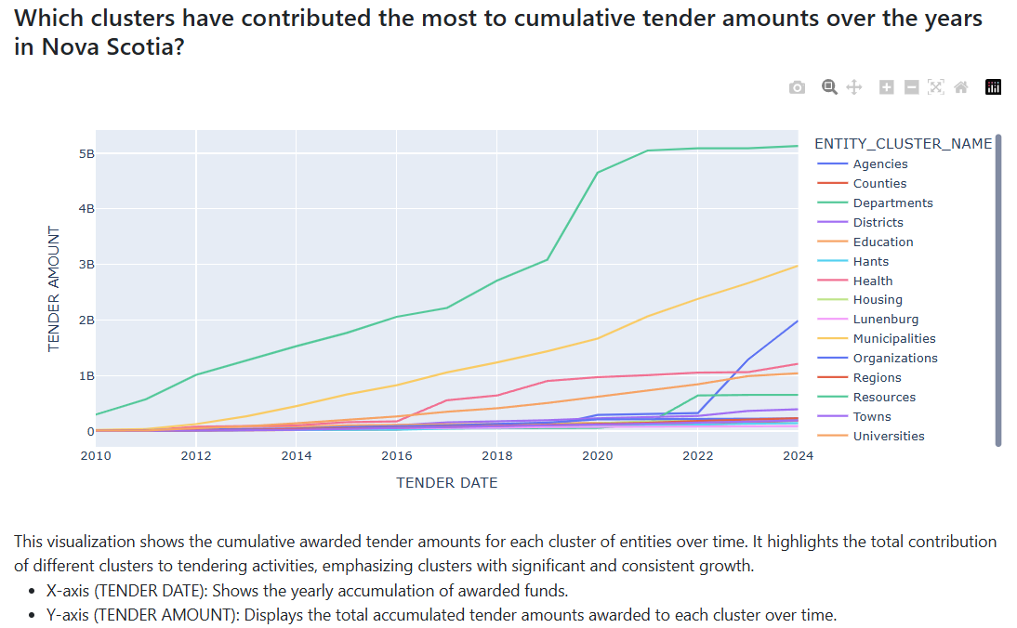

Slide 13
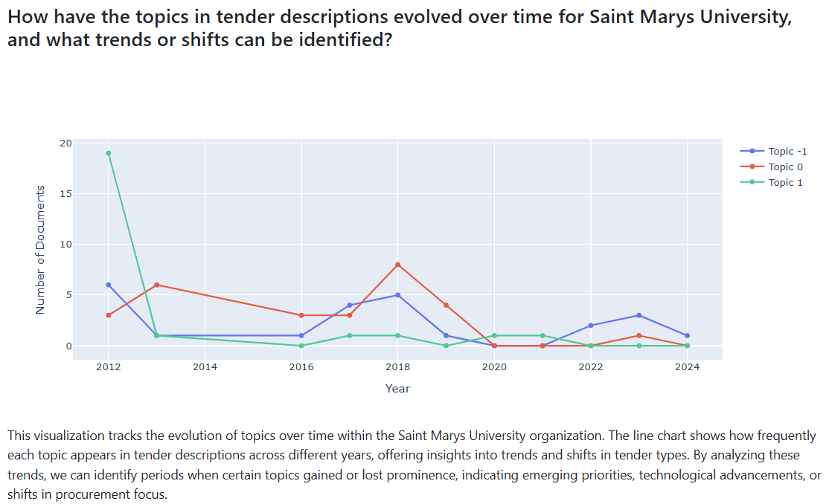
Future Work
Scheduler-Driven Hosting: Ensures the most up-to-date data at all times.
Enhanced User Control: Users can insert instances and manually update clusters.
Integrate LLM: Provides deeper insights from topic models.

Slide 14
Thank you !
Q & A

