Slide 1
A Personalized Digital Intervention for Promoting Mindful Eating Through Real-time Behavioral Analysis and Adaptive Feedback
Mindful Eating System
Md Samshad Rahman
B00968344
samshad@dal.ca

Slide 2
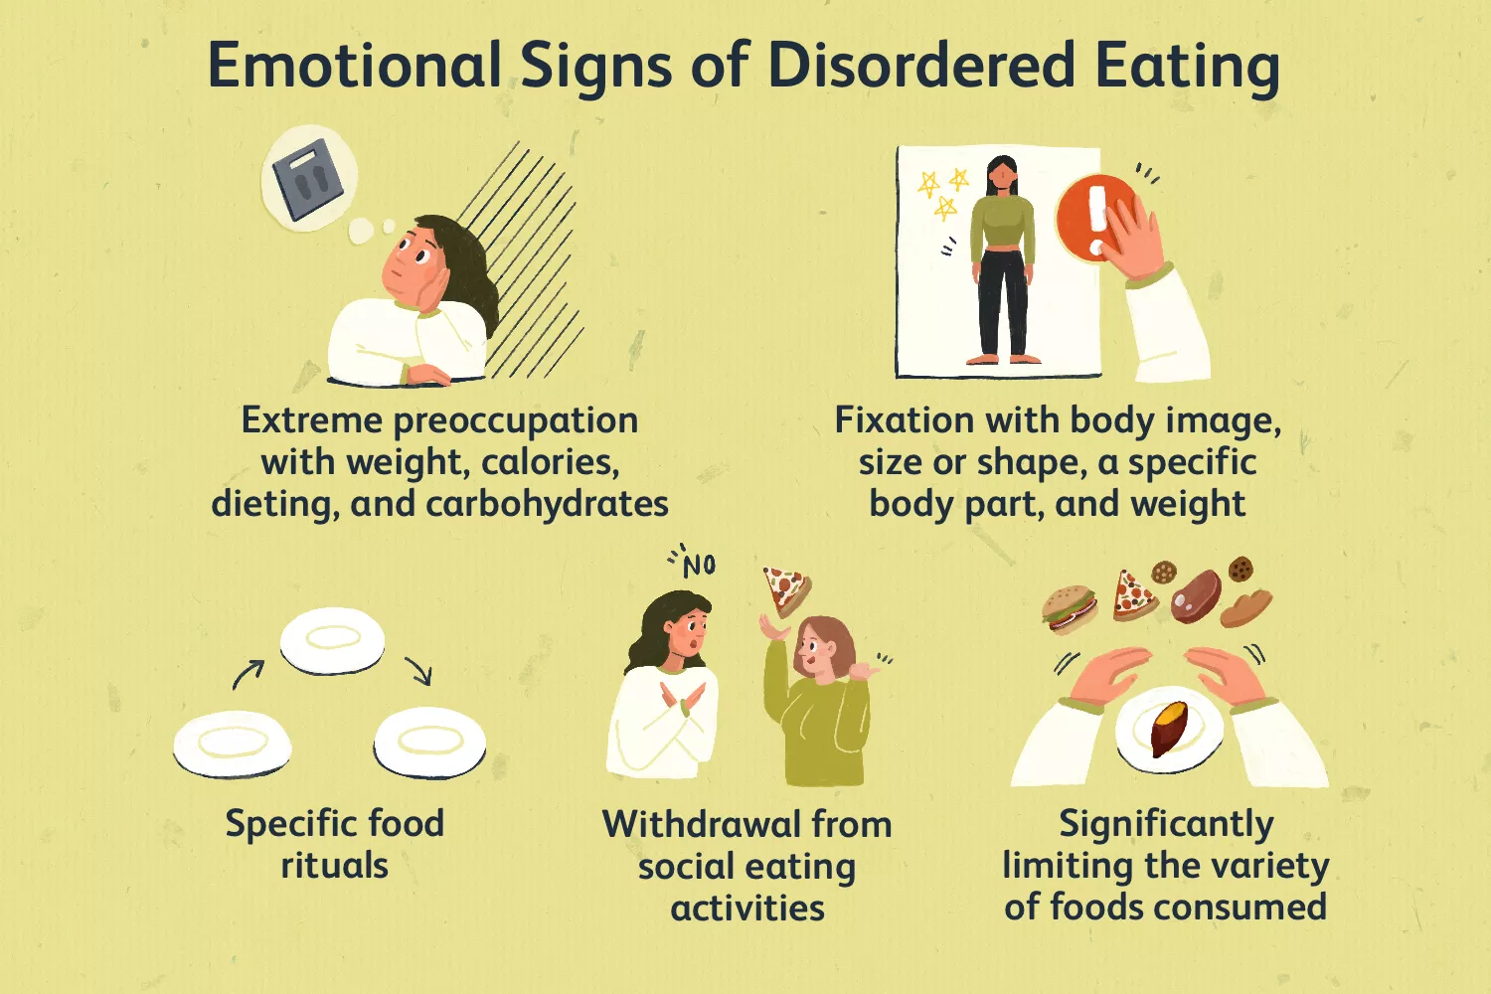
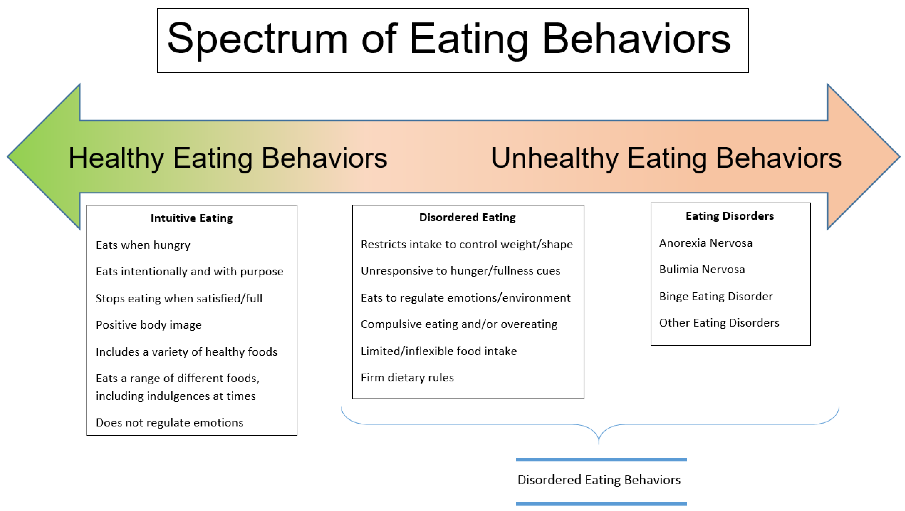
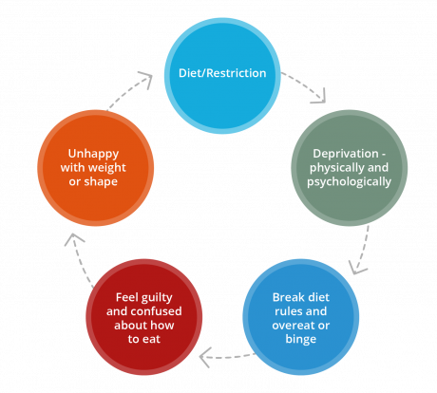
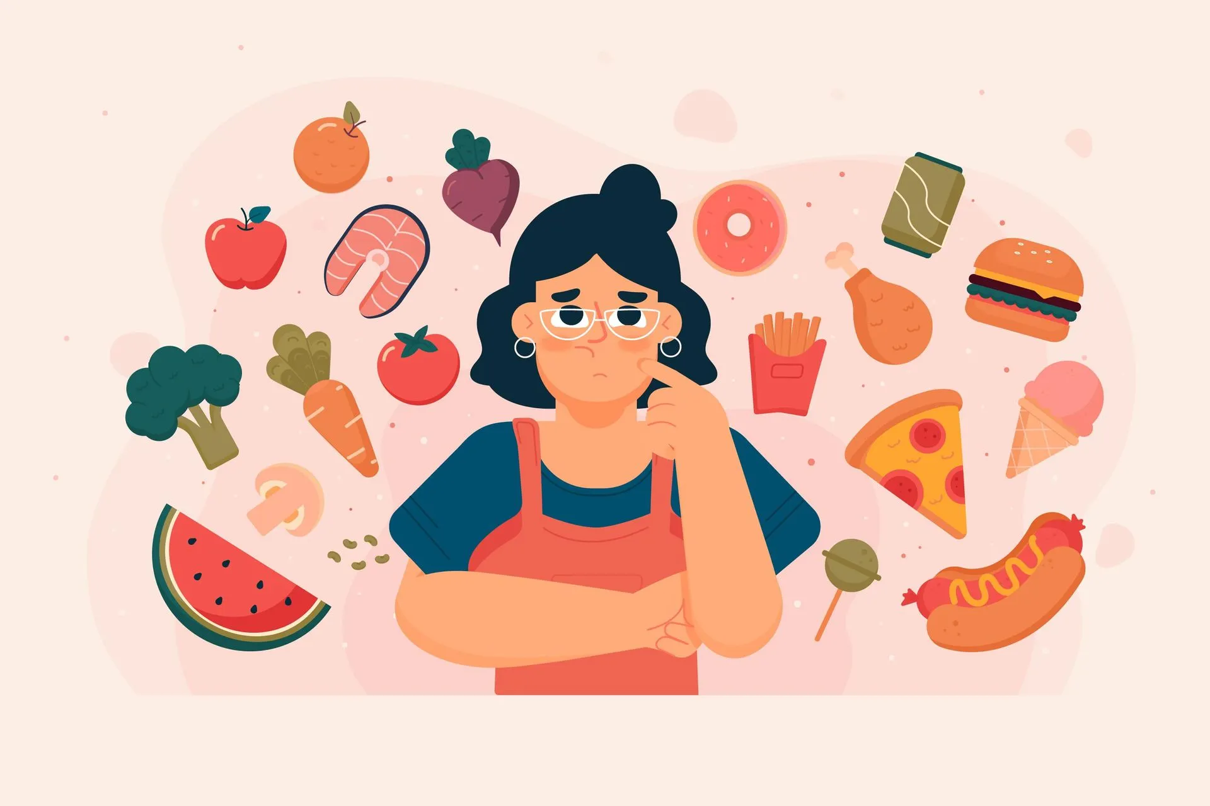
Notes:
https://www.verywellhealth.com/signs-of-disordered-eating-5095720 https://nedc.com.au/eating-disorders/eating-disorders-explained/disordered-eating-and-dieting https://www.mdpi.com/1660-4601/20/17/6638 https://www.thrivehere.com/assessing-your-eating-behaviors-how-to-self-screen-for-signs-of-disordered-eating-and-eating-disorders https://onlinelibrary.wiley.com/doi/10.1111/joim.13699

Slide 3
Big Five Personality Traits
Openness Curious, imaginative, open to new experiences
Conscientiousness Organized, responsible, goal-driven
Extraversion Outgoing, energetic, enjoys social interaction
Agreeableness Compassionate, cooperative, values harmony
Neuroticism Emotionally sensitive, prone to stress or mood swings
Notes:
https://www.ebsco.com/research-starters/social-sciences-and-humanities/big-five-personality-traits#:~:text=The%20Big%20Five%20concept%20is,attitudes%20they%20most%20commonly%20embody.

Slide 4
Key Eating Behaviors Identified
Mindful vs. Distracted Eating
Emotional Eating
Portion Control
Regular vs. Irregular Meals
Balanced Food Choices
Snacking Habits
Social/Environmental Influences
Speed of Eating
Hydration Practices
Fasting/Restrictive Eating Patterns

Slide 5
Data Collection and Model Fine-tuning
Essays dataset: 2467 essays (Source: GitHub - Personality Prediction)
Big Five Traits: Analyzed using Symanto NLP API (Paid)
Mindfulness Tips Dataset: 1500 rows (manual + GPT-4o assisted)
Verified by dietitian and psychologist
Fine-tuned two models:
big5-llama3.2 (Big5 trait prediction)
tips-llama3.2 (Mindfulness tips generation)
Google Colab + Unsloth.ai

Slide 6
Demo

Slide 7
Technology Stack
PostgreSQL: Stores user data, eating behavior history, Big5 traits
FastAPI Backend (Python):
Handles authentication, tip generation, data retrieval
Expo App: React native

Slide 8
Accuracy Achieved
Tested on three separate batches (100 samples each)
Ranked each tip from 1 to 5 (relevance)
Accepted tips with ranks 3 to 5
Final average accuracy: 88%

Slide 9
Future Improvements
Expand questionnaire coverage and get more diverse dataset for big5
More culturally adaptive eating behaviors
Extract food details from uploaded pictures of user
Direct chat with LLM about personalized mindful insights

Slide 10
Thank You!

