Slide 1
Graphical Models I
Uzair Ahmad

Slide 2
Contents
Probability and Distributions
Prior, Joint, Marginal, Conditional
Law of total probabilities
Bayes Rule
The Chain Rule
Notion of Independence
Conditional Independence Diagrams
Directed Graphical Models
Probabilistic Graphical Model
Bayesian Networks

Slide 3
Why Probability ?
Noise
Uncertainty in measurement and modelling
Stochastic real world

Slide 4
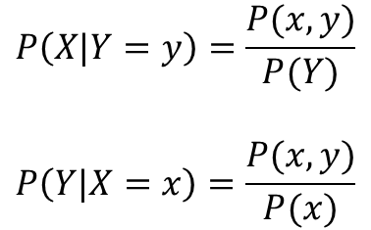
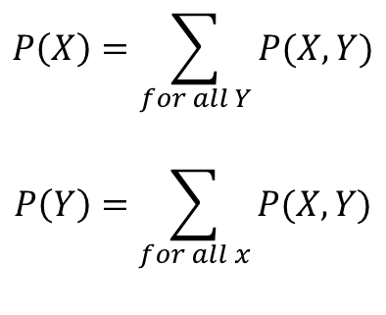
Joint, Marginal and Conditional Probabilities
$$P\left(X\right)=\sum_{for all Y}{P(X,Y)}$$
$$P\left(Y\right)=\sum_{for all x}{P(X,Y)}$$
X
 | -1 | 0 | 1
5 | 0.15 | 0.2 | 0.1 | 0.45
10 | 0.05 | 0.2 | 0.3 | 0.55
 | 0.2 | 0.4 | 0.4 | 1
Y
$$P\left(X|Y=y\right)=\frac{P(x,y)}{P(Y)}$$
$$P\left(Y|X=x\right)=\frac{P(x,y)}{P(x)}$$

Slide 5



Law of Total Probability
Relates marginal probabilities to conditional probabilities
In case of a binary problem
$P\left(A\right)=P\left(B\right)P\left(A | B\right)+P\left(B^{′}\right)P({A|B}^{′})$
A|B
0.6
P(A) = 0.3x0.6 + 0.7x0.5 = 0.53
P(B) = 0.3x0.6 + 0.7x0.5 = 0.53
0.4
B
0.3
A’|B
A|B’
B’
0.7
0.5
0.5
A’|B’

Slide 6
Law of Total Probability
Suppose that two factories supply light bulbs to the market.
Factory X's bulbs work for over 5000 hours in 99% of cases, whereas factory Y's bulbs work for over 5000 hours in 95% of cases.
It is known that factory X supplies 60% of the total bulbs available. What is the chance that a purchased bulb will work for longer than 5000 hours?
A| B_{x}
0.99
0.01
B_{x}
0.6
A’| B_{x}
A| B_{Y}
B_{Y}
0.4
0.95
0.05
A’| B_{Y}
B_{Y}

Slide 7
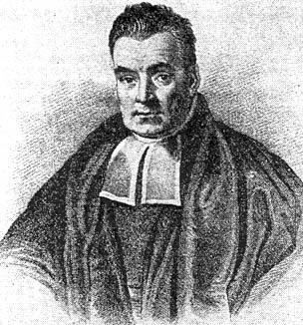
Bayes Formula
Thomas Bayes
1702-1761

Slide 8
Bayesian Classification
P(C_{i}) = relative freq of class C samples (Prior Probability)
P(D|C_{i}) = Conditional Probability
Total Evidence P(D) is constant for all classes
C such that P(C|X) is maximum = C such that P(X|C)·P(C) is maximum

Slide 9
What if Data has more features than just two ?

Slide 10
Object | Outlook | Temp | Humidity | Wind | Play
1 | Sunny | Hot | High | Weak | No
2 | Sunny | Hot | High | Strong | No
3 | Cloudy | Hot | High | Weak | Yes
4 | Rain | Mild | High | Weak | Yes
5 | Rain | Cool | Normal | Weak | Yes
6 | Rain | Cool | Normal | Strong | No
7 | Cloudy | Cool | Normal | Strong | Yes
8 | Sunny | Mild | High | Weak | No
9 | Sunny | Cool | Normal | Weak | Yes
10 | Rain | Mild | Normal | Weak | Yes
11 | Sunny | Mild | Normal | Strong | Yes
12 | Cloudy | Mild | High | Strong | Yes
13 | Cloudy | Hot | Normal | Weak | Yes
14 | Rain | Mild | High | Strong | No

Slide 11
Outlook | P | N
sunny | 2/9 | 3/5
Cloudy | 4/9 | 0
rain | 3/9 | 2/5
Temperature
hot | 2/9 | 2/5
mild | 4/9 | 2/5
cool | 3/9 | 1/5
Humidity
high | 3/9 | 4/5
normal | 6/9 | 1/5
Windy
TRUE | 3/9 | 3/5
FALSE | 6/9 | 2/5

Slide 12
Conditional Probabilities
Prior
P(Play) | 9/14
P(NoPlay) | 5/14
Outlook
P(sunny | P) | 2/9 | P(sunny | N) | 3/5
P(cloudy | P) | 4/9 | P(cloudy | N) | 0
P(rain | P) | 3/9 | P(rain | N) | 2/5
Temperature
P(hot | P) | 2/9 | P(hot | P) | 2/5
P(mild | P) | 4/9 | P(mild | P) | 2/5
P(cool | P) | 3/9 | P(cool | P) | 1/5
Humidity
P(high | P) | 3/9 | P(high | N) | 4/5
P(normal | P) | 6/9 | P(normal | N) | 1/5
Windy
P(TRUE | P) | 3/9 | P(TRUE | P) | 3/5
P(FALSE | P) | 6/9 | P(FALSE | P) | 2/5

Slide 13
Classify Unseen Data
An unseen sample X = <rain, hot, high, false>
P(X|p)·P(P) = P(rain|p)·P(hot|p)·P(high|p)·P(false|p)·P(p) = 3/9 x 2/9 x 3/9 x 6/9 x 9/14 = 0.0105
P(X|n)·P(N) = P(rain|n)·P(hot|n)·P(high|n)·P(false|n)·P(n)
= 2/5 x 2/5 x 4/5 x 2/5 x 5/14 = .018
Sample X will be classified in class N (don’t play)

Slide 14
Bayesian Classification
Naïve assumption: attribute independence P(x₁,…,x_{k}|C) = P(x₁|C)·…·P(x_{k}|C)
If i-th attribute is categorical:
P(x_{i}|C) is estimated as the relative freq of samples having value xi as i-th attribute in class C
If i-th attribute is continuous:
P(x_{i}|C) is estimated thru a Gaussian density function

Slide 15
The Independence Assumption
… makes computation possible
… yields optimal classifiers when satisfied
… but is seldom satisfied in practice, as attributes (variables) are often correlated.

Slide 16
Bayesian networks
Graphical models for reasoning under uncertainty,
The nodes represent variables (discrete or continuous)
Arcs represent direct connections between them.
These direct connections are often causal connections

Slide 17
BNs model the quantitative strength of the connections between variables, allowing probabilistic beliefs about them to be updated automatically as new information becomes available

Slide 18
Syntax
how Bayesian networks are put together
Semantics
how to interpret the information encoded in a network

Slide 19
Bayesian networks
Bayesian network represent a set of random variables X = X1 , ..Xi,...Xn,
A set of directed arcs (or links) connects pairs of nodes, Xi → Xj, representing the direct dependencies between variables.
the strength of the relationship between variables is quantified by conditional probability distributions associated with each node.

Slide 20
The only constraint on the arcs allowed in a BN is that there must not be any directed cycles:
directed acyclic graphs (DAGs)

Slide 21
Graphical Models
Grade
Course Difficulty
Intelligence
SAT
Recommendation Letter
Difficulty
Intelligence
Grade
SAT
Rec Letter

Slide 22
Graphical Models
DAG
Directed Graphical Models
Probabilistic Graphical Models
Bayesian Networks
Formal representation of the probabilistic connections among random variables
Intuitive & Parsimonious (compact)
Difficulty
Intelligence
Grade
SAT
Rec Letter

Slide 23
Graphical Models: Bayesian Network
How to parameterize the BN?
As many nodes as many CPDs
Difficulty
Intelligence
Grade
SAT
Rec Letter

Slide 24
Bayesian Network: CPDs
P(D)
1 | 0.40
0 | 0.60
P(I)
1 | 0.30
0 | 0.70
Difficulty
Intelligence
P(G | I, D)
P(S | I)
I | D | G¹ | G² | G³
0 | 0 | 0.30 | 0.40 | 0.30
0 | 1 | 0.05 | 0.25 | 0.70
1 | 0 | 0.90 | 0.08 | 0.02
1 | 1 | 0.50 | 0.30 | 0.20
Grade
SAT
I | S⁰ | S¹
0 | 0.95 | 0.05
1 | 0.20 | 0.80
P(L | G)
Rec Letter
G | L⁰ | L¹
1 | 0.10 | 0.90
2 | 0.40 | 0.60
3 | 0.99 | 0.01
How BN produces JPD of these 5 variables ?

Slide 25

The Chain Rule
$$P(X_{1},X_{2},X_{3}…X_{n})=\prod_{i}{P\left(X_{i}\right|{Parents(X}_{i}))}$$
$$\text{P}\text{(}\text{A}\text{,}\text{B}\text{,}\text{C}\text{)}$$
$$\text{=}\text{P}\text{(}\text{A}\text{)}\text{P}\text{(}\text{B}\text{│}\text{A}\text{)}\text{P}\text{(}\text{C}\text{│}\text{B}\text{,}\text{A}\text{)}$$
$$\text{=}\text{P}\text{(}\text{A}\text{)}\frac{P(B,A)}{P(A)}\frac{P(A, B,C)}{P(B,A)}$$

Slide 26
Joint Probability Distribution
Possible states of the world captured by n Random Variables
P(X₁, X₂, X₃, … X_{n})
If X₁, X₂, X₃, … X_{n} are binary variables, then 2^{n} possible states
Exploitation of the structure
Space efficiency
Computational savings

Slide 27
Joint Probability Distribution
Intelligence | Difficulty | Grade | P(I, D, G)
0 | 0 | 1 | 0.126
0 | 0 | 2 | 0.168
0 | 0 | 3 | 0.126
0 | 1 | 1 | 0.009
0 | 1 | 2 | 0.045
0 | 1 | 3 | 0.126
1 | 0 | 1 | 0.252
1 | 0 | 2 | 0.0224
1 | 0 | 3 | 0.0056
1 | 1 | 1 | 0.06
1 | 1 | 2 | 0.036
1 | 1 | 3 | 0.024
Possible states → 2x2x3
Degrees of freedom
Independent parameters

Slide 28
Joint Probability Distribution
Conditioning and Elimination
→ Grade 1 → P(I, D, G¹)
Intelligence | Difficulty | Grade | P(I, D, G)
0 | 0 | 1 | 0.126
0 | 0 | 2 | 0.168
0 | 0 | 3 | 0.126
0 | 1 | 1 | 0.009
0 | 1 | 2 | 0.045
0 | 1 | 3 | 0.126
1 | 0 | 1 | 0.252
1 | 0 | 2 | 0.0224
1 | 0 | 3 | 0.0056
1 | 1 | 1 | 0.06
1 | 1 | 2 | 0.036
1 | 1 | 3 | 0.024
I | D | G¹ | P(I, D, G¹)
0 | 0 | 1 | 0.126
0 | 1 | 1 | 0.009
1 | 0 | 1 | 0.252
1 | 1 | 1 | 0.06
Normalization
I | D | G¹ | P(I, D, G¹)
0 | 0 | 1 | 0.126/0.447
0 | 1 | 1 | 0.009/0.447
1 | 0 | 1 | 0.252/0.447
1 | 1 | 1 | 0.06/0.447

Slide 29
Marginal Probability Distribution
Intelligence | Difficulty | Grade | P(I, D, G)
0 | 0 | 1 | 0.126
0 | 0 | 2 | 0.168
0 | 0 | 3 | 0.126
0 | 1 | 1 | 0.009
0 | 1 | 2 | 0.045
0 | 1 | 3 | 0.126
1 | 0 | 1 | 0.252
1 | 0 | 2 | 0.0224
1 | 0 | 3 | 0.0056
1 | 1 | 1 | 0.06
1 | 1 | 2 | 0.036
1 | 1 | 3 | 0.024
I | P(I, D, G)
0 | 0.474
1 | 0.526

Slide 30
A Factor
A Function ɸ defined over a set of variables.
Scope of a factor ɸ → The set of variables
I | D | G | P(I, D, G)
0 | 0 | 1 | 0.126
0 | 0 | 2 | 0.168
0 | 0 | 3 | 0.126
0 | 1 | 1 | 0.009
0 | 1 | 2 | 0.045
0 | 1 | 3 | 0.126
1 | 0 | 1 | 0.252
1 | 0 | 2 | 0.0224
1 | 0 | 3 | 0.0056
1 | 1 | 1 | 0.06
1 | 1 | 2 | 0.036
1 | 1 | 3 | 0.024
Scope P, I, D
Scope I, D
I | D | G¹ | P(I, D, G¹)
0 | 0 | 1 | 0.126
0 | 1 | 1 | 0.009
1 | 0 | 1 | 0.252
1 | 1 | 1 | 0.06
For every combination of the different values of variables the factor gives a real value number (count/prob)

Slide 31
Factors
A function with a scope (arguments)
A Joint Distribution
Characterizing the Distributions of high dimensional spaces
Construct dependencies
Factor operations (products, marginalization, reduction)
Tools to manipulate distributions

Slide 32
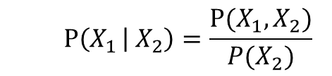
Conditional Probability Distribution (CPD)
P(G | D,I)
I | D | G¹ | G² | G³
0 | 0 | 0.30 | 0.40 | 0.30
0 | 1 | 0.05 | 0.25 | 0.70
1 | 0 | 0.9 | 0.08 | 0.02
1 | 1 | 0.5 | 0.3 | 0.2
Conditional Probability of G given I and D
For every combination of the values of I and D
- Sum is 1
- We have a probability distribution over G
Therefore, CPD is a type of factor
$$P\left(X_{1 } | { X}_{2}\right)=\frac{P(X_{1},X_{2})}{P(X_{2})}$$

Slide 33
Factor Product
a | b | C | ɸ(a,b,c)
1 | 1 | 1 | 0.5x0.5=0.25
1 | 1 | 2 | 0.5x0.7=0.35
1 | 2 | 1 | 0.8x0.1=0.08
1 | 2 | 2 | 0.8x0.2=0.16
2 | 1 | 1 | 0.1x0.5=0.05
2 | 1 | 2 | 0.1x0.7=0.07
2 | 2 | 1
2 | 2 | 2
3 | 1 | 1
3 | 1 | 2
3 | 2 | 1
3 | 2 | 2
a | b | ɸ(a,b)
1 | 1 | 0.5
1 | 2 | 0.8
2 | 1 | 0.1
2 | 2 | 0
3 | 1 | 0.3
3 | 2 | 0.9
b | c | ɸ(b,c)
1 | 1 | 0.5
1 | 2 | 0.7
2 | 1 | 0.1
2 | 2 | 0.2
=
X

Slide 34
Conditioning / Elimination / Reduction
I | D | G | P(I,D,G)
0 | 0 | 1 | 0.126
0 | 0 | 2 | 0.168
0 | 0 | 3 | 0.126
0 | 1 | 1 | 0.009
0 | 1 | 2 | 0.045
0 | 1 | 3 | 0.126
1 | 0 | 1 | 0.252
1 | 0 | 2 | 0.0224
1 | 0 | 3 | 0.0056
1 | 1 | 1 | 0.06
1 | 1 | 2 | 0.036
1 | 1 | 3 | 0.024
Conditioning on I = 1
I | D | G | P(D,G, I¹)
1 | 0 | 1 | 0.252
1 | 0 | 2 | 0.0224
1 | 0 | 3 | 0.0056
1 | 1 | 1 | 0.06
1 | 1 | 2 | 0.036
1 | 1 | 3 | 0.024
D | G | P(D,G | I = 1)
0 | 1 | 0.252/0.4=0.63
0 | 2 | 0.056
0 | 3 | 0.014
1 | 1 | 0.15
1 | 2 | 0.09
1 | 3 | 0.6
→
→
0.4
What is the scope of P(D,G, I¹) factor ?

Slide 35
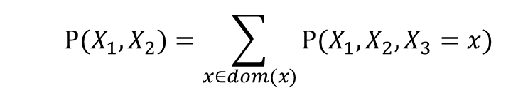
Marginalization
$$P(X_{1},X_{2})=\sum_{x∈dom(x)}{P(X_{1},X_{2},X_{3}=x)}$$
Scope I,D,G
I | D | G | P(I,D,G)
0 | 0 | 1 | 0.126
0 | 0 | 2 | 0.168
0 | 0 | 3 | 0.126
0 | 1 | 1 | 0.009
0 | 1 | 2 | 0.045
0 | 1 | 3 | 0.126
1 | 0 | 1 | 0.252
1 | 0 | 2 | 0.0224
1 | 0 | 3 | 0.0056
1 | 1 | 1 | 0.06
1 | 1 | 2 | 0.036
1 | 1 | 3 | 0.024
I | D | G | P(I,D,G)
0 | 0 | 1 | 0.126
0 | 0 | 2 | 0.168
0 | 0 | 3 | 0.126
0 | 1 | 1 | 0.009
0 | 1 | 2 | 0.045
0 | 1 | 3 | 0.126
1 | 0 | 1 | 0.252
1 | 0 | 2 | 0.0224
1 | 0 | 3 | 0.0056
1 | 1 | 1 | 0.06
1 | 1 | 2 | 0.036
1 | 1 | 3 | 0.024
Scope D,G
D | G | P(a)
0 | 1 | 0.378
0 | 2 | 0.190
0 | 3
1 | 1
1 | 2
1 | 3
+
I | P(a)
0 | 0.6
1 | 0.4
+

Slide 36
Bayesian Network: The Chain Rule
JPD over 5 Variables ? P(D, I, G, S, L)
P(D)
P(I)
Difficulty
Intelligence
P(D, I, G, S, L)=
P(D) P(I) P(G | I, D) P(S | I) P(L | G)
P(G | I, D)
P(S | I)
Grade
SAT
Factors with overlapping scope of 5 variables
The JPD ← Factor Product
Rec Letter
A single row of this JPD looks like what?
P(L | G)

Slide 37
Bayesian Network: The Chain Rule
P(D)
1 | 0.40
0 | 0.60
P(I)
1 | 0.30
0 | 0.70
Difficulty
Intelligence
P(G | I, D)
P(S | I)
I | D | G¹ | G² | G³
0 | 0 | 0.30 | 0.40 | 0.30
0 | 1 | 0.05 | 0.25 | 0.70
1 | 0 | 0.90 | 0.08 | 0.02
1 | 1 | 0.50 | 0.30 | 0.20
Grade
SAT
I | S⁰ | S¹
0 | 0.95 | 0.05
1 | 0.20 | 0.80
P(L | G)
Rec Letter
G | L⁰ | L¹
1 | 0.10 | 0.90
2 | 0.40 | 0.60
3 | 0.99 | 0.01
P(D⁰, I¹, G³, S¹, L¹)=
0.60 x 0.30 x 0.02 x 0.80 x 0.01

Slide 38
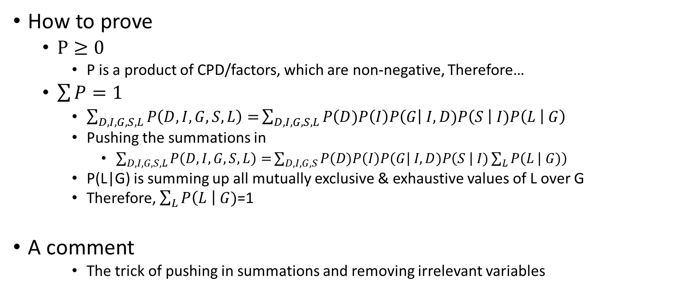
Bayesian Network: JPD Legality
How to prove
$P≥0$
P is a product of CPD/factors, which are non-negative, Therefore…
$\sum{P}=1$
$\sum_{D,I,G,S,L}{P\left(D,I,G,S,L\right)=}\sum_{D,I,G,S,L}{P\left(D)P\left(I\right)P\left(G\right| I,D)P\left(S \right| I)P\left(L \right| G\right)}$
Pushing the summations in
$\sum_{D,I,G,S,L}{P\left(D,I,G,S,L\right)=}\sum_{D,I,G,S}{P\left(D)P\left(I\right)P\left(G\right| I,D)P\left(S \right| I)\sum_{L}{P\left(L \right| G)}\right)}$
P(L|G) is summing up all mutually exclusive & exhaustive values of L over G
Therefore, $\sum_{L}{P\left(L \right| G)}$=1
A comment
The trick of pushing in summations and removing irrelevant variables
G | L⁰ | L¹
1 | 0.10 | 0.90
2 | 0.40 | 0.60
3 | 0.99 | 0.01

Slide 39
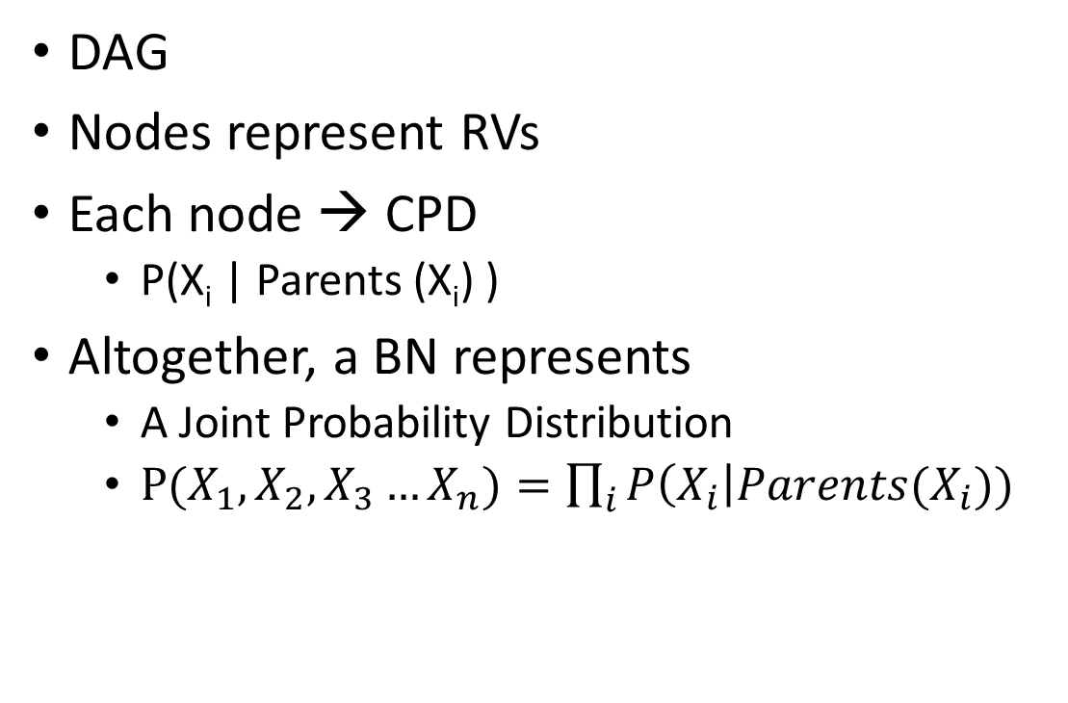
Bayesian Network
DAG
Nodes represent RVs
Each node → CPD
P(X_{i} | Parents (X_{i}) )
Altogether, a BN represents
A Joint Probability Distribution
$P(X_{1},X_{2},X_{3}…X_{n})=\prod_{i}{P\left(X_{i}\right|{Parents(X}_{i}))}$
Difficulty
Intelligence
Grade
SAT
Rec Letter

Slide 40
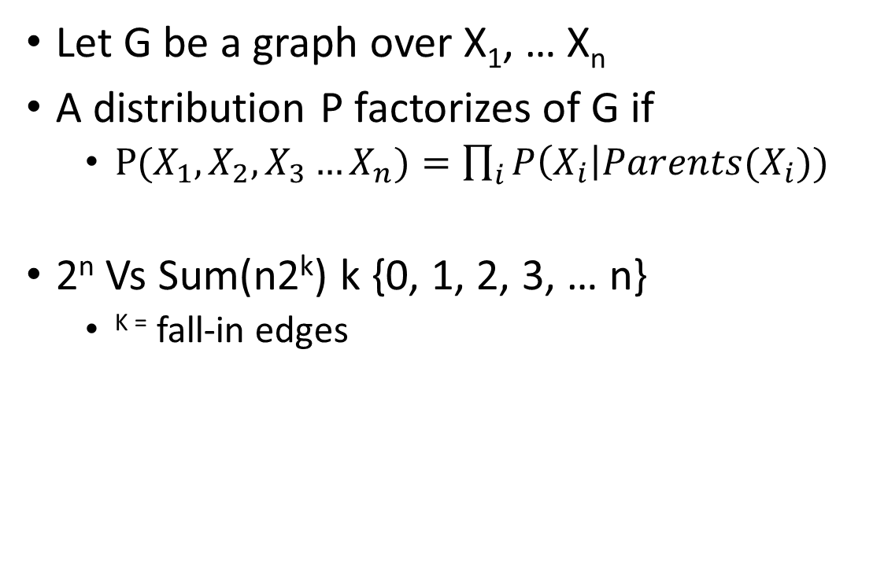
Bayesian Network
Difficulty
Intelligence
Let G be a graph over X₁, … X_{n}
A distribution P factorizes of G if
$P(X_{1},X_{2},X_{3}…X_{n})=\prod_{i}{P\left(X_{i}\right|{Parents(X}_{i}))}$
2^{n} Vs Sum(n2^{k}) k {0, 1, 2, 3, … n}
^{K =} fall-in edges
Grade
SAT
Rec Letter

Slide 41
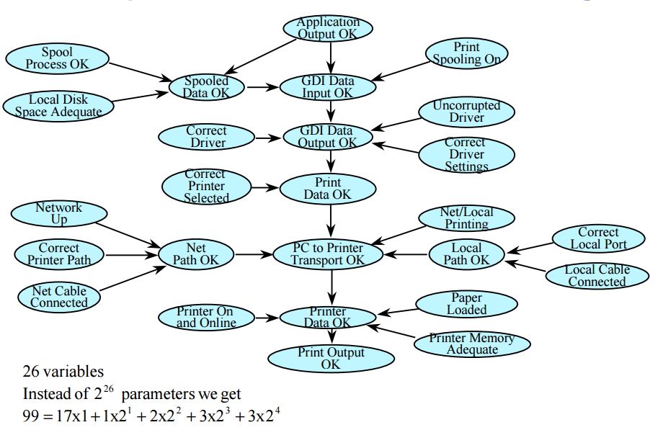
[2]

Slide 42
Bayesian Network: Genetic Inheritance
Clancy
Jackie
Homer
Marge
Selma
Homer
Lisa
Maggie
Genotype
AA, AB, AO, BO, BB, OO
Phenotype
A, B, AB, O

Slide 43
Bayesian Network: Genetic Inheritance
G
Clancy
G
Jackie
B
Jackie
B
Clancy
G
Marge
G
Selma
B
Selma
G
Homer
B
Marge
B
Homer
G
Lisa
G
Maggie
G
Bart
B
Bart
B
Lisa
B
Maggie

Slide 44
Bayesian Network: Reasoning
Causal; Top down
Evidential; Diagnostic, Bottom up
Inter-causal; Side to side
Difficulty
Intelligence
Grade
SAT
Rec Letter

Slide 45
Bayesian Network: Reasoning
P(X1 = 1) = 0.50 , P(X2 = 1) = 0.50
Intercausal → Side to side
Explaining away
Y = 1 means either of the X1 or X2 is 1
Y = 1, X1 = 1
X₁ | X₂ | Y | Prob
0 | 0 | 0 | 0.25
0 | 1 | 1 | 0.25
1 | 0 | 1 | 0.25
1 | 1 | 1 | 0.25
X₁
X₂
Y
P(X1 = 1 | Y = 1) = 0.66 , P(X2 = 1 | Y = 1) = 0.66
X₁ | X₂ | Y | Prob
0 | 1 | 1 | 0.33
1 | 0 | 1 | 0.33
1 | 1 | 1 | 0.33
X₁ | X₂ | Y | Prob
1 | 0 | 1 | 0.50
1 | 1 | 1 | 0.50
Given Y = 1 and X1 = 1
P(X2 = 1 | X1 = 1) = 0.50

Slide 46
Bayesian Network: Reasoning
P(D)
1 | 0.40
0 | 0.60
P(I)
1 | 0.30
0 | 0.70
Difficulty
Intelligence
P(G | I, D)
P(S | I)
I | D | G¹ | G² | G³
0 | 0 | 0.30 | 0.40 | 0.30
0 | 1 | 0.05 | 0.25 | 0.70
1 | 0 | 0.90 | 0.08 | 0.02
1 | 1 | 0.50 | 0.30 | 0.20
Grade
SAT
I | S⁰ | S¹
0 | 0.95 | 0.05
1 | 0.20 | 0.80
P(L | G)
Rec Letter
G | L⁰ | L¹
1 | 0.10 | 0.90
2 | 0.40 | 0.60
3 | 0.99 | 0.01

Slide 47
Bayesian Network: Influence Flow
Influence
Conditioning/Obs on X Changes the belief/CPD of Y
Generally symmetrical
Direct
X → Y :
X ← Y : Y is child of X : Evidential Reasoning
Indirect Influence
X → W → Y : Difficulty → Grade → Letter
Y ← W ← X : Difficulty ← Grade ← Letter
Y ← W → X : Grade ← Intelligence → SAT
Trail of Influence
Influence can flow to more nodes
Active Trails (Without V structure)

Slide 48
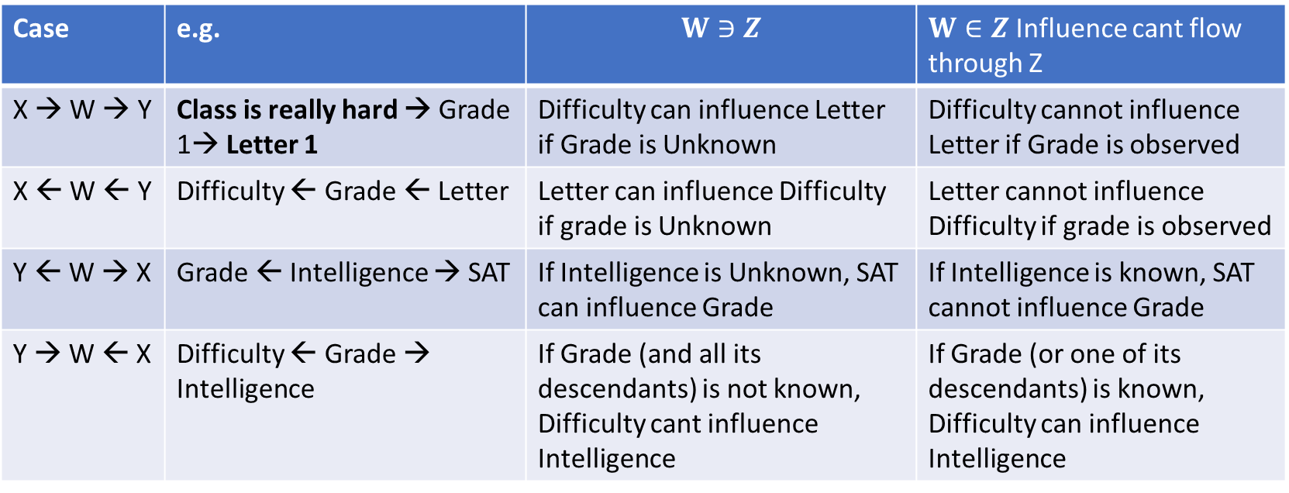
Bayesian Network: Influence Flow
When X can influence Y given information bout Evidence Set Z
Case | e.g. | $$W∋Z$$ | $W∈Z$ Influence cant flow through Z
X → W → Y | Class is really hard → Grade 1→ Letter 1 | Difficulty can influence Letter if Grade is Unknown | Difficulty cannot influence Letter if Grade is observed
X ← W ← Y | Difficulty ← Grade ← Letter | Letter can influence Difficulty if grade is Unknown | Letter cannot influence Difficulty if grade is observed
Y ← W → X | Grade ← Intelligence → SAT | If Intelligence is Unknown, SAT can influence Grade | If Intelligence is known, SAT cannot influence Grade
Y → W ← X | Difficulty ← Grade → Intelligence | If Grade (and all its descendants) is not known, Difficulty cant influence Intelligence | If Grade (or one of its descendants) is known, Difficulty can influence Intelligence

Slide 49
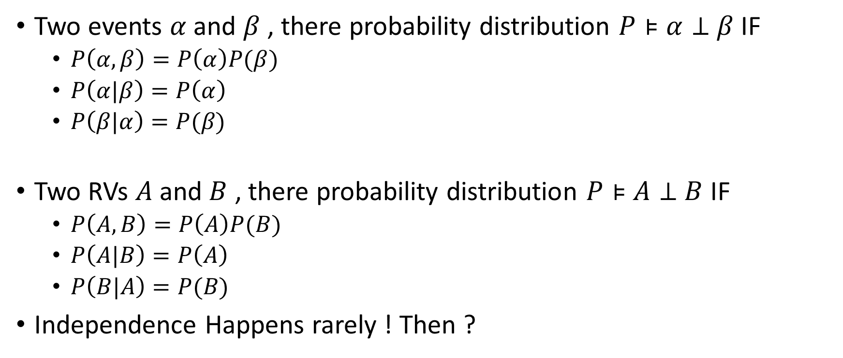
Independencies
Two events $α$and $β$ , there probability distribution $P⊧$ $α⊥$ $β$ IF
$P\left(α,β\right)=P\left(α\right)P(β)$
$P\left(α|β\right)=P\left(α\right)$
$P\left(β|α\right)=P(β\text{)}$
Two RVs $A$and $B$ , there probability distribution $P⊧$ $A⊥$ $B$ IF
$P\left(A,B\right)=P\left(A\right)P(B)$
$P\left(A|B\right)=P\left(A\right)$
$P\left(B|A\right)=P(B\text{)}$
Independence Happens rarely ! Then ?

Slide 50
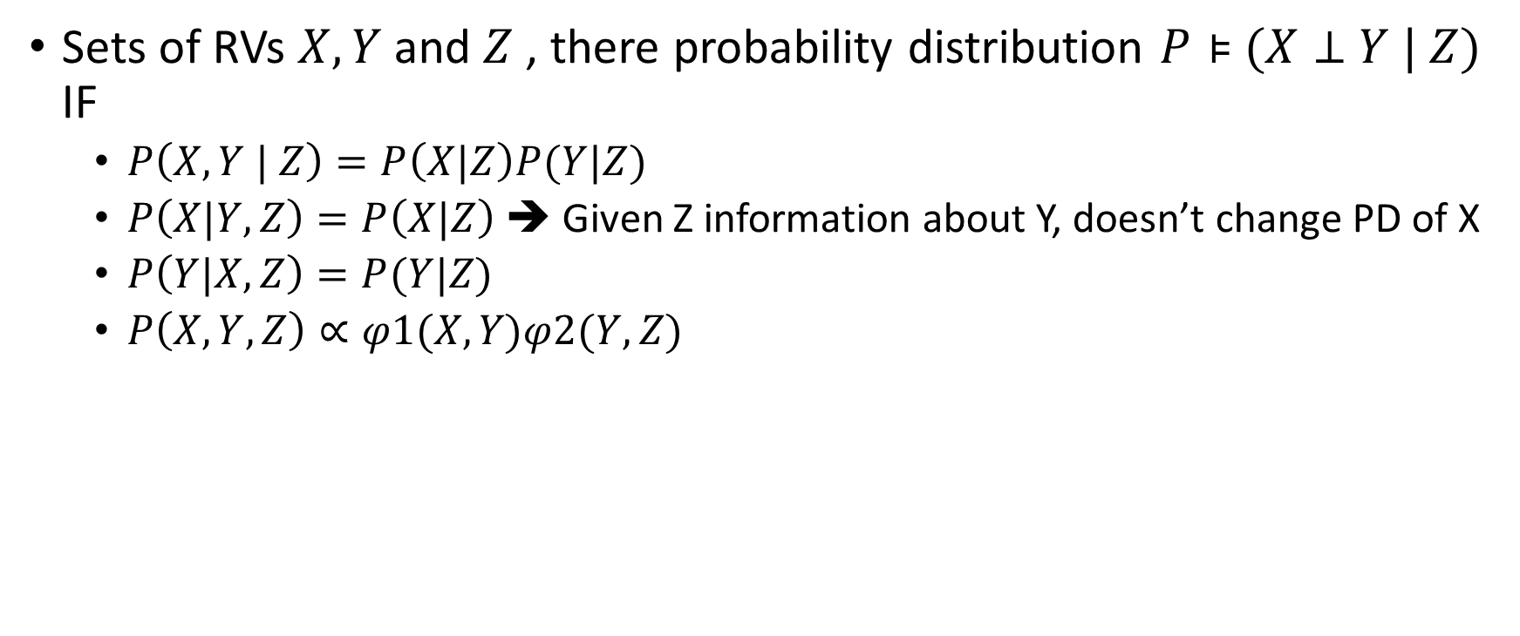
Conditional Independence
Sets of RVs $X, Y$and $Z$ , there probability distribution $P⊧$ $(X⊥$ $Y | Z)$ IF
$P\left(X,Y | Z\right)=P\left(X|Z\right)P(Y|Z)$
$P\left(X|Y, Z\right)=P\left(X|Z\right)$➔ Given Z information about Y, doesn’t change PD of X
$P\left(Y|X,Z\right)=P(Y|Z\text{)}$
$P\left(X,Y,Z\right)∝φ1(X,Y\text{)}φ2(Y,Z\text{)}$

Slide 51
Conditional Independence
Coin
Selection
Flip 1
Flip 2
Flip 1 and Flip 2 are not independent given the information about coin seletion

Slide 52

Conditional Independence
I
I | S | G | P(I,S,G)
0 | 0 | 1 | 0.114
0 | 0 | 2 | 0.1938
0 | 0 | 3 | 0.2622
0 | 1 | 1 | 0.006
0 | 1 | 2 | 0.0102
0 | 1 | 3 | 0.0138
1 | 0 | 1 | 0.252
1 | 0 | 2 | 0.0224
1 | 0 | 3 | 0.0056
1 | 1 | 1 | 0.108
1 | 1 | 2 | 0.0096
1 | 1 | 3 | 0.0024
G
S
S | G | P(S,G | I⁰)
0 | 1 | 0.114/0.6=0.19
0 | 2 | 0.323
0 | 3 | 0.437
1 | 1 | 0.01
1 | 2 | 0.017
1 | 3 | 0.023
S | P(S| I⁰)
0 | 0.95
1 | 0.05
0.6
→
G | P(G| I⁰)
1 | 0.2
2 | 0.34
3 | 0.46
$$P\left(S,G |I^{0}\right)=P\left(S|I^{0}\right)P(G|I^{0})$$

Slide 53

Conditional Independence: Counter Intuition
I | D | G | P(I,D,G)
0 | 0 | 1 | 0.126
0 | 0 | 2 | 0.168
0 | 0 | 3 | 0.126
0 | 1 | 1 | 0.009
0 | 1 | 2 | 0.045
0 | 1 | 3 | 0.126
1 | 0 | 1 | 0.252
1 | 0 | 2 | 0.0224
1 | 0 | 3 | 0.0056
1 | 1 | 1 | 0.06
1 | 1 | 2 | 0.036
1 | 1 | 3 | 0.0024
D
I
G
I | D | P(I,D | G¹)
0 | 0 | 0.126/0.447=0.282
0 | 1 | 0.02
1 | 0 | 0.564
1 | 1 | 0.134
I | P(I| G¹)
0 | 0.302
1 | 0.698
→
0.447
D | P(D| G¹)
0 | 0.846
1 | 0.154
$$P\left(I,D |G^{1}\right)≠P\left(I|G^{1}\right)P(D|G^{1})$$
Conditioning doesn’t always guarantee independence

Slide 54
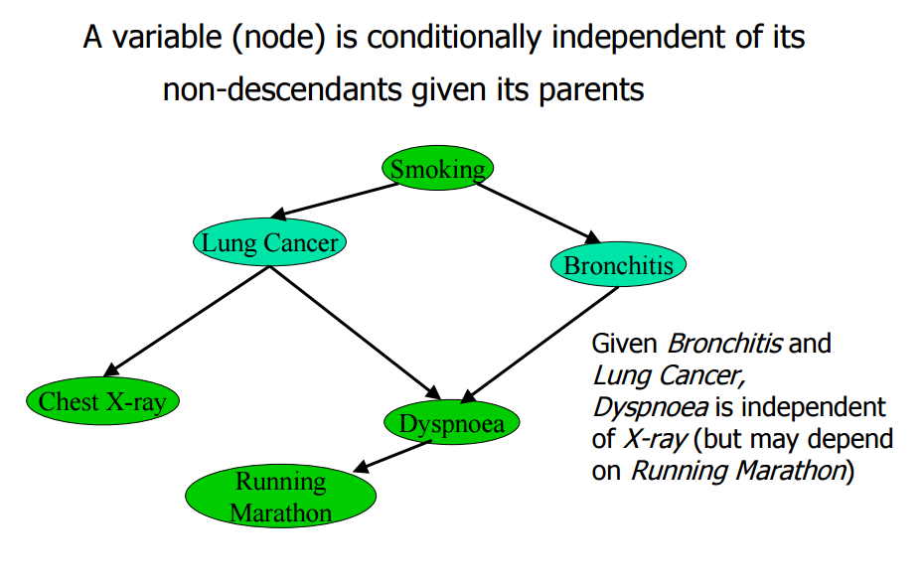
Conditional Independence
[2]

Slide 55
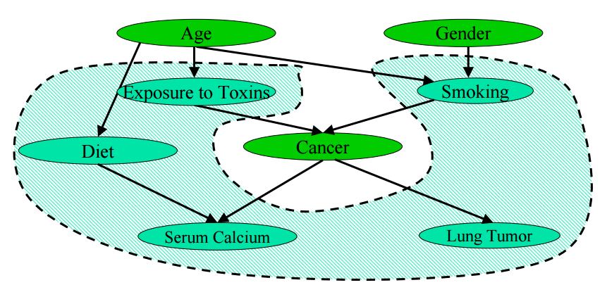
Conditional Independence
A node is Conditionally Independent of All other nodes given its Markov Blanket.
[2]
Markov Blanket: Parents, Children and Spouses (parent of common children)

Slide 56
Summary
Representing a domain and its uncertainty in a Bayesian network
Problem
Nodes & Values
Network Structure
Conditional Probabilities
Instantiation of Nodes
Markov Properties

Slide 57
Problem
A patient has been suffering from shortness of breath (called dyspnea) and visits the doctor, worried that he has lung cancer.
The doctor knows that other diseases, such as tuberculosis and bronchitis, are possible causes, as well as lung cancer.
She also knows that other relevant information includes whether or not the patient is a smoker (increasing the chances of cancer and bronchitis) and what sort of air pollution he has been exposed to.
A positive X-ray would indicate either TB or lung cancer.

Slide 58
Network Structure
P
S
Pollution
Smoking
C
Cancer
X
D
Dyspnea
X- Ray

Slide 59
Network Structure
P
S
Pollution
Smoking
C
Cancer
X
D
Dyspnea
X- Ray

Slide 60
Structure terminology and layout
a family metaphor:
a node is a parent of a child, if there is an arc from the former to the latter.
one node is an ancestor of another if it appears earlier in the chain
a node is a descendant of another node if it comes later in the chain.
Markov blanket
the node’s parents, its children, and its children’s parents.

Slide 61
Conditional probabilities
To quantify the relationships between connected nodes
Done by specifying a conditional probability distribution for each node.
considering discrete variables, this takes the form of a conditional probability table (CPT)

Slide 62
Instantiation
For each node
look at all the possible combinations of values of parent nodes.
Each such combination is called an instantiation of the parent set.
For each distinct instantiation of parent node values, specify the probability that the child will take each of its values.
Root nodes also have an associated CPT (Prior Probabilities)

Slide 63


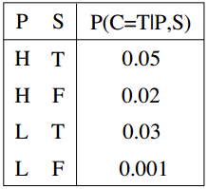
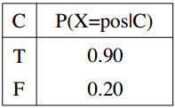
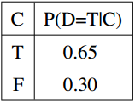
Instantiation
P
S
Pollution
Smoking
C
Cancer
X
D
X- Ray
Dyspnea

Slide 64
The Markov Property
There are no direct dependencies in the system being modeled which are not already explicitly shown via arcs.
In Cancer case, for example, there is no way for smoking to influence dyspnea except by way of causing cancer
there is no hidden “backdoor” from smoking to dyspnea.
Bayesian networks which have this Markov property are also called Independence-maps

Slide 65
Perfect Map
Every arc in a BN happens to correspond to a direct dependence in the system, then the BN is said to be a Dependence-map (or, D-map for short)
A BN which is both an I-map and a D-map is said to be a perfect map.

Slide 66
References & Resources
[1] Daphne Koller Oxford Univ
[2] Vittorio Castelli
[3] "bnlearn“ R Package. Max Min Hill Climbing Algorithms
[4] BN learning using Coronory Data Set
http://hameddaily.blogspot.ca/2015/02/bayesian-network-in-r-introduction.html
[5] Bayesian Networks in R, http://www.bnlearn.com/book-useR/
[6] gRain Package, Graphical Models and Bayesian Networks with R. http://people.math.aau.dk/~sorenh/misc/2014-useR-GMBN/

