Slide 1
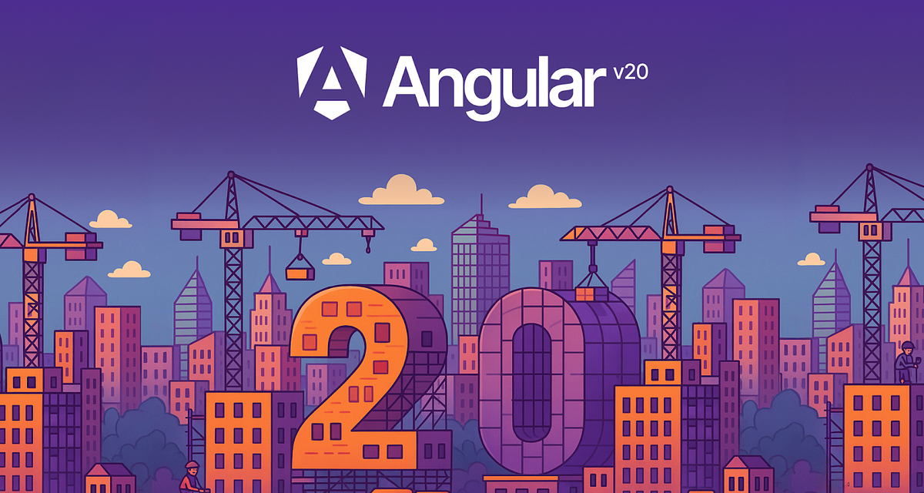

Slide 2
Component Interaction

Slide 3
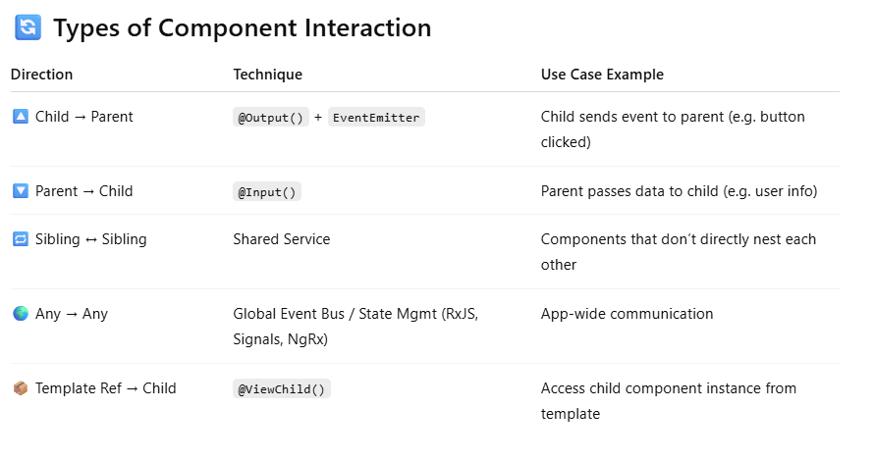
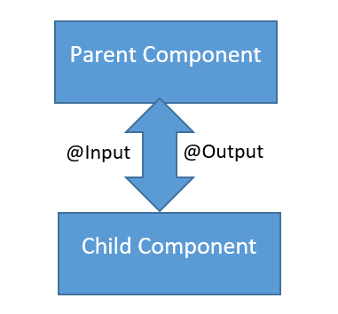
Component Interaction in Angular
In Angular, the app is made up of small components. To work together, these components need to pass data and communicate.

Slide 4
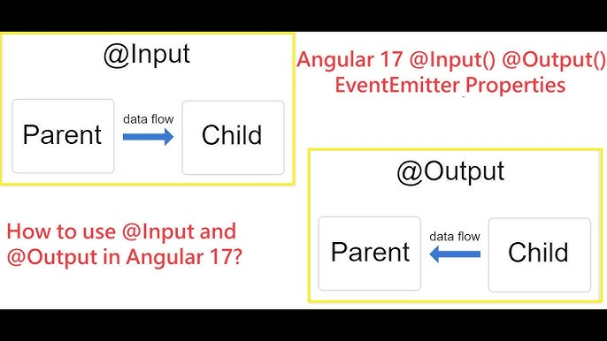

Slide 5
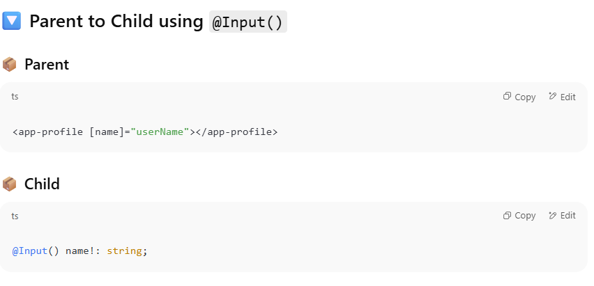
@Input()
Required
Input function

Slide 6
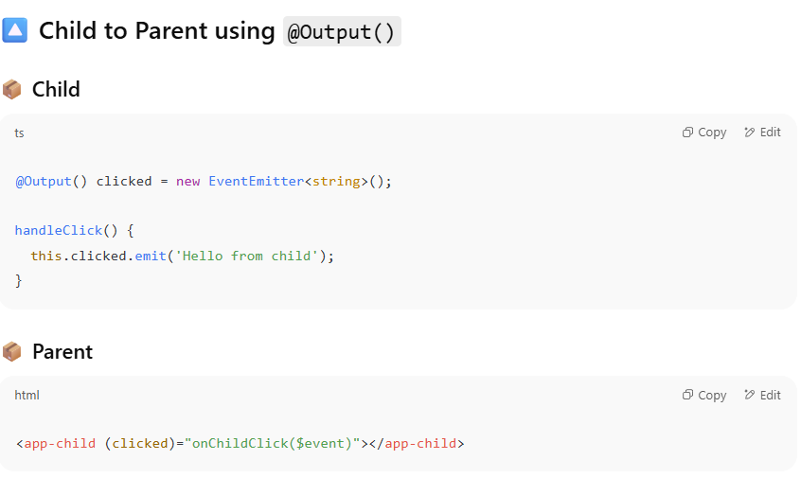
@Output()
output function

Slide 7
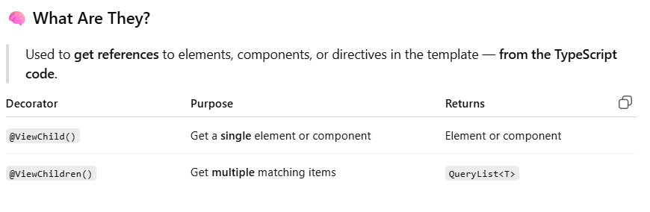
@ViewChild()
# Template Variable
lets a component access a child component, directive, or DOM element from its template.
Think of it as a way to reach into the template and get a reference to something inside it.
@ViewChildren

Slide 8
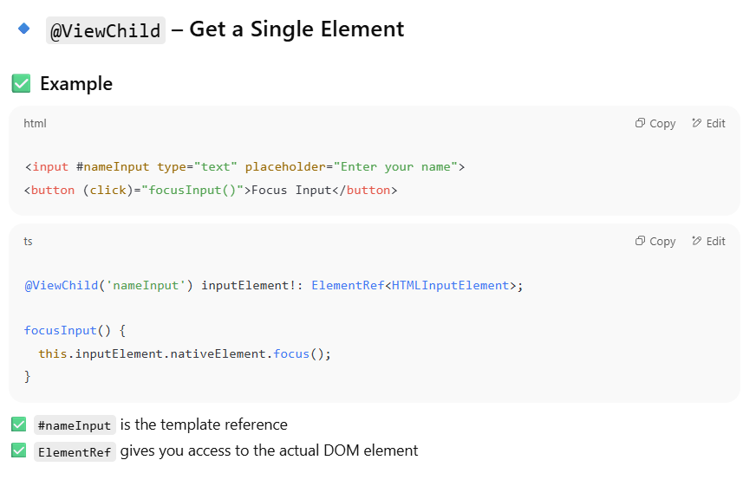
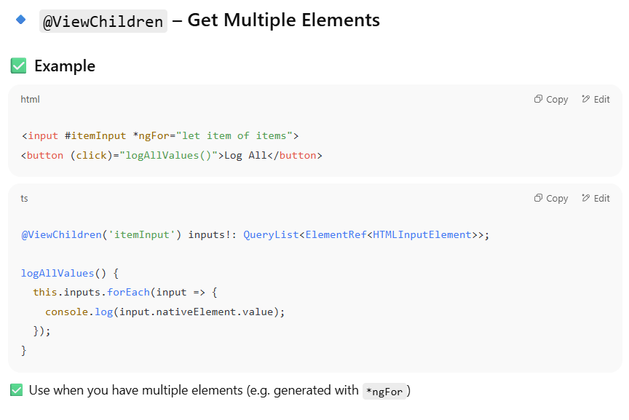

Slide 9
Content Projection

Slide 10
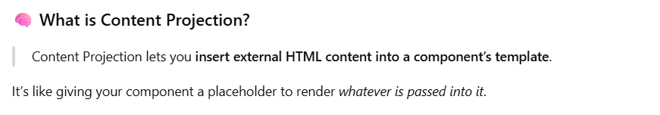
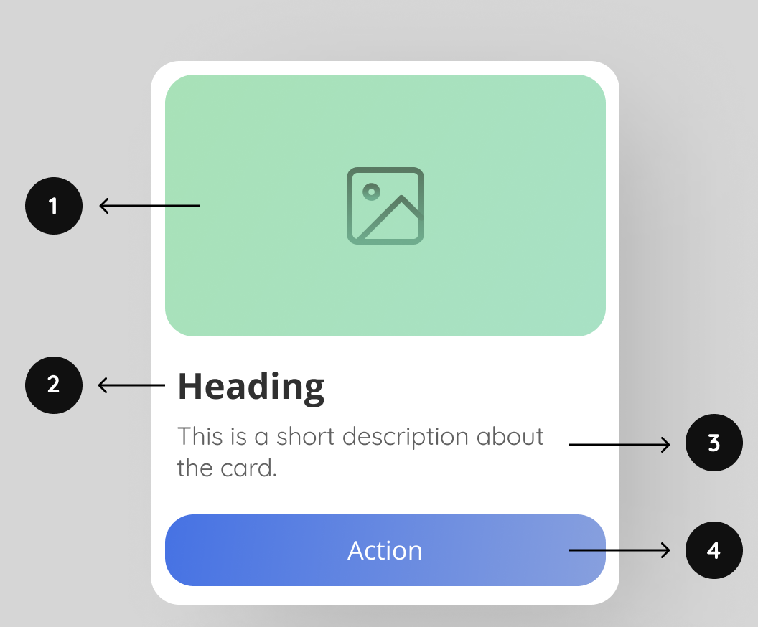
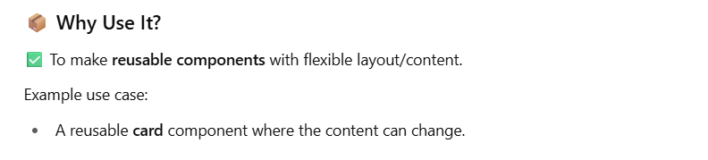
Content Projection in Angular

Slide 11
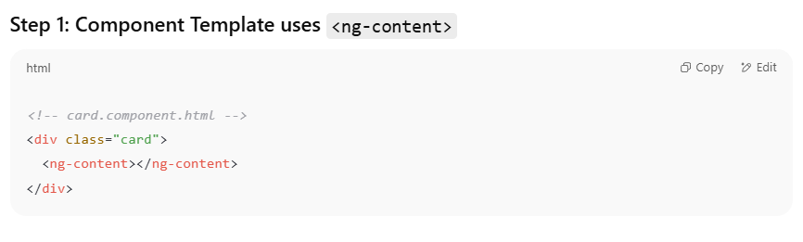
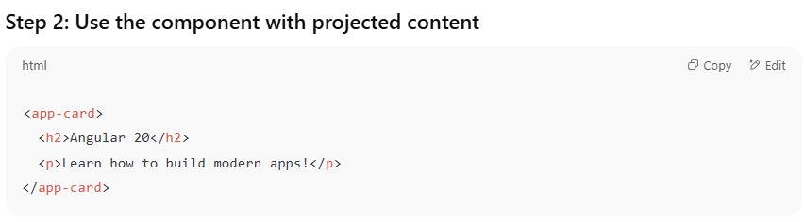
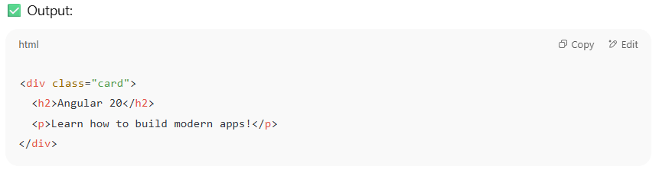
Content Projection in Angular
Card
Photo
………………………
………………………
Button

Slide 12
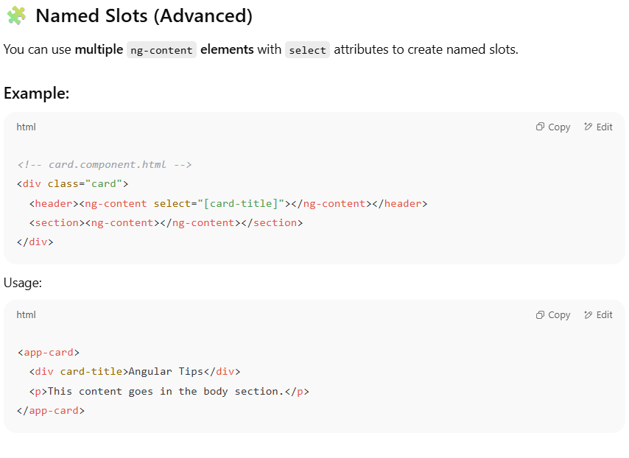
Content Projection in Angular

Slide 13
Service
user
App
Ouput
Input
Services
Child 1
Child 2
Child 1
Child 1
Child 1

Slide 14
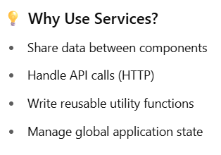
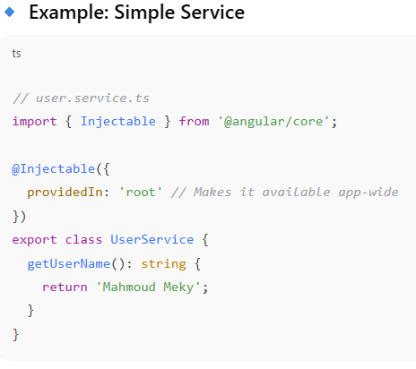
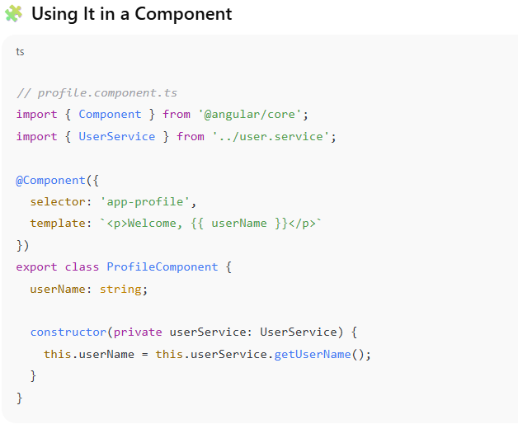
Services
An Angular service is a class that contains business logic, shared data, or reusable functions — and can be injected into components or other services.
It follows the principle of:
"Separation of Concerns" — keep logic out of components.

Slide 15
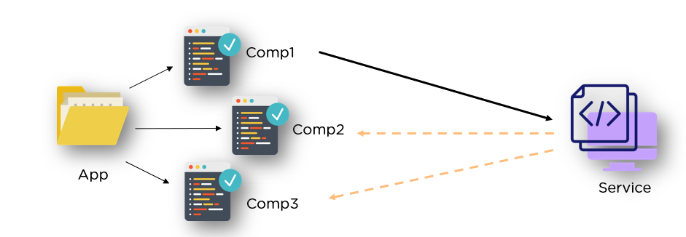
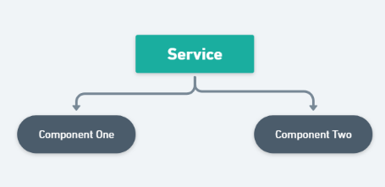
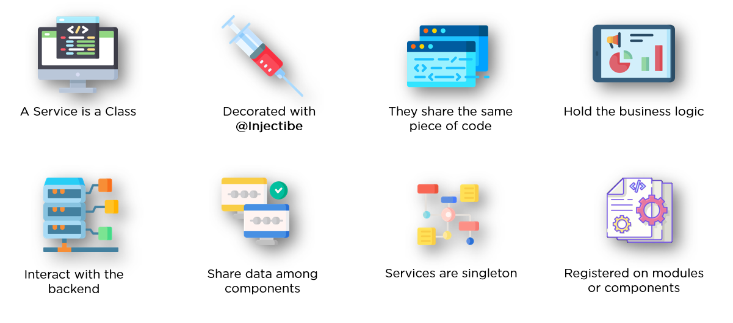
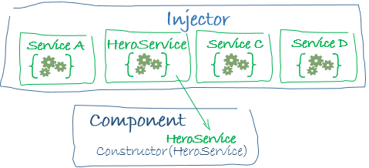
Services
Services in angular are singleton by default.

