Slide 1
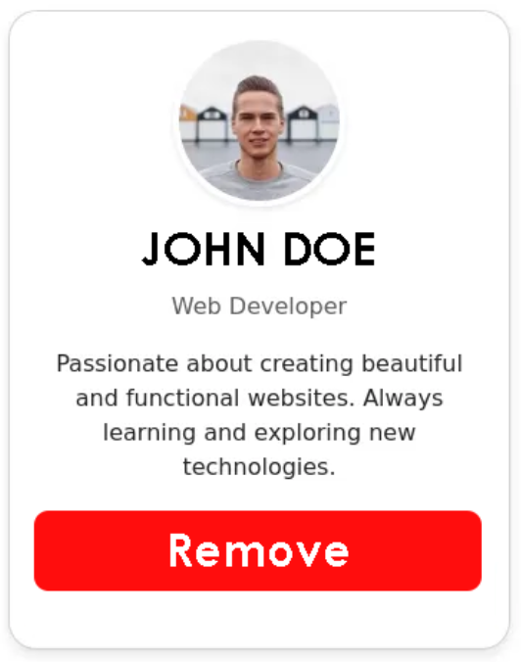
Day 2 : Users List with Parent-Child Communication & Service
Objective: Build a dynamic list of user profile cards, implementing parent-child communication, a shared service, conditional styling, and custom pipes.
Use input to input the all card info.
Use Output to output Remove Action from Remove Button.
List of Users and use flow-control @for to render this list. Min 5 cards.
Create a service to store a list of users.
When Remove button is clicked, it should call removeUser method on the user service., it should remove that specific user from the List of Users and reflect on UI.
Bonus: For Last Card in the list , make outstanding by making its border color red.
Please Don’t Use Chatgbt ..

Slide 2
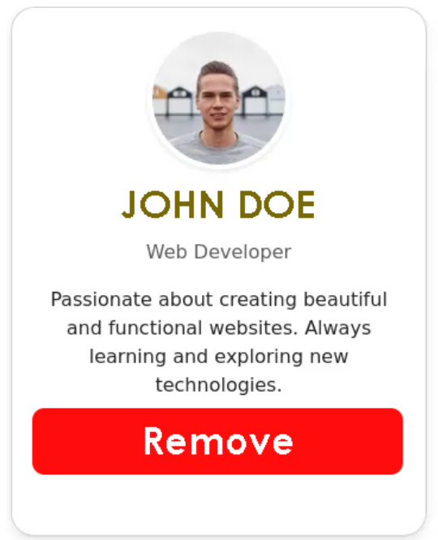
Day 2 : Bonus
S
Search

