Slide 1
Aimes Housing Project
Simarpreet Singh
December 7, 2018

Slide 2
Introduction
The project consists of a database with various features that affect the value of the property prices.
Historical data on the current pricing is available in the data set.

Slide 3
Objectives
The main objective of the project is to develop a model that can provide the use with a estimate of the price taking the features and attributes into consideration.
The model should work with a performance score that best represents the data in a clear and concise manner.

Slide 4
Basic Observation
Average House Value: $181,469
Max House Value: $611,657
Min House Value: $12,789

Slide 5
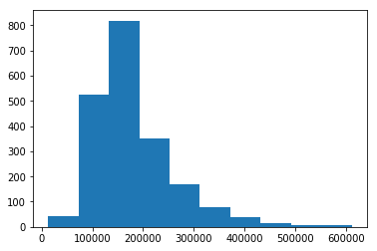
Sale Price Spread

Slide 6
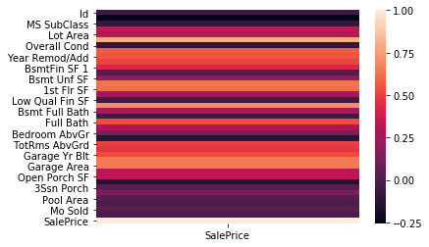
SALE PRICE CORELATION

Slide 7
RELATION
Apart from the Quality, the combined sqft of the houses was the second biggest factor.
Location also played a big role in influencing the price and when location combined with pricing, becomes a heavy weighted influencer.

Slide 8
Recommendations
Calibration of models regularly to reflect real time change.
Better interaction of data and inclusion of outliers in a fashion that reflects proper collection of data.
Optimization can be done through using various modeling techniques and engineering features that can predict prices in a reasonable margin.

