Slide 1
Yelp: Business/Restaurant Recommendation
DAT – DC – 10 Final Project
Sam Sisto
2/22/2016
Notes:
Introduction

Slide 2
The Problem
Can we predict a users business/restaurant preferences based on reviews, past visits, demographics, etc.?
Complexity of this question
Recommendation system
Supervised vs. Unsupervised learning
Spam vs. Ham example
Project shift
Dive into Yelp academic dataset

Slide 3
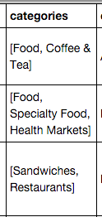
The Data
Yelp academic data set
Top businesses/restaurants from area surrounding 30 large research universities
Three pieces of information: business info, user info and review info
Loading data in
JSON format
Cleaning data
Merging datasets, renaming columns
Getting “funny”, “cool”, “useful” votes from reviews
Categories column

Slide 4

Approach
Script to use user URL’s to get additional information
MVP approach
Use subset of data
Full pass through the data science pipeline

Slide 5
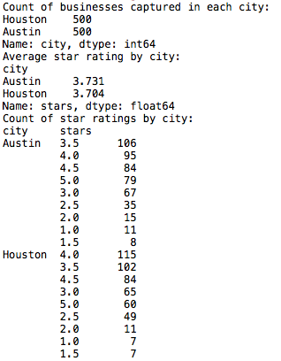
Data Summary & Visualizations

Slide 6
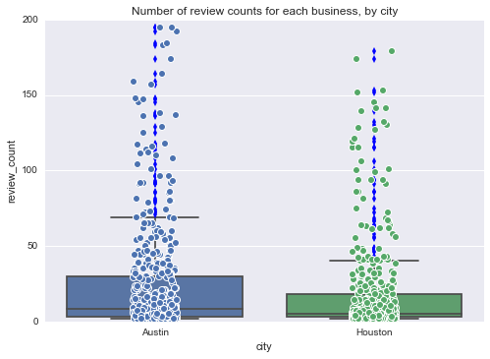
Visualizations (cont.)

Slide 7
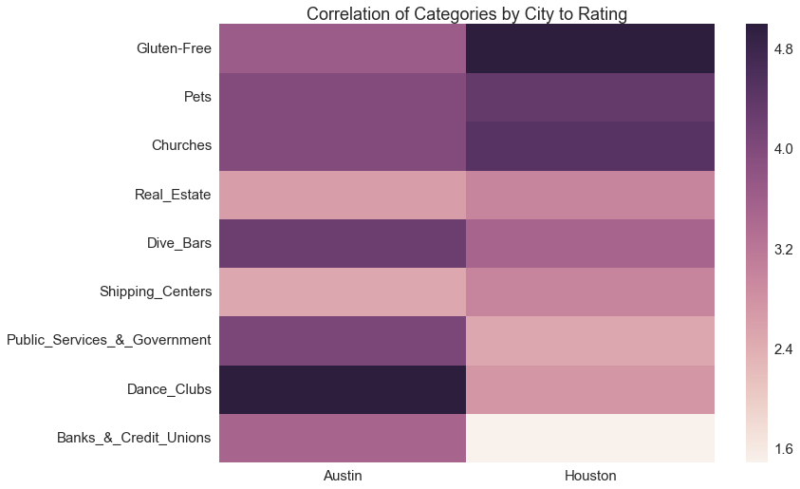
Visualizations (cont.)

Slide 8
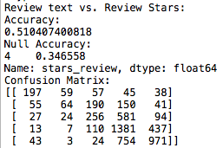
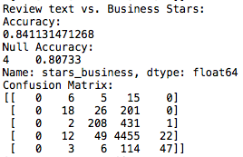
Models
Naïve Bayes
Review text to predict review rating
Review text to predict overall business rating

Slide 9
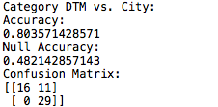
Models (cont.)
Naïve Bayes
Using categories as a document term matrix
Predict city business is located in

Slide 10
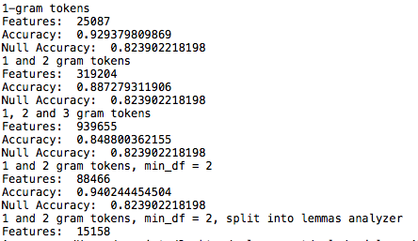
Models (cont.)
Further NLP Analysis
Cycle through different parameters
TextBlob sentiment
LDA
“Topics” are all quite similar

Slide 11
Conclusions
We can do a pretty good job of predicting a reviews rating from text
These are models that could be used as part of a larger, more complex recommendation system
Notes:
No really Earth shattering results

Slide 12
Issues and takeaways
Numerical vs. Textual Data
Visualizations, models, etc.
Getting hung up on collecting data
More time interpreting results

Slide 13
Further work
Primitive recommendation system
Higher sentiment = recommend similar businesses/categories
Incorporate “Check-In” and “Tips” data

Slide 14
Questions?

