Slide 1
Malware Detection
CIA 3 Project Presentation
by
BadriNarayanan S (2348507)
Samson Sabu (2348549)
Department of Computer Science
CHRIST(Deemed to be University), Bengaluru-29

Slide 2
Agenda
Introduction
Types of Malware
Problem Statement
Dataset Description
Data Visualizations
Random Forest Model
Logistic Regression Model
XGBoost Model
CNN Model
LSTM Model

Slide 3

Introduction
Malware, short for "malicious software," refers to any software intentionally designed to cause damage, disruption, or unauthorized access to computer systems, networks, or data, without the consent of the user. Malware encompasses a wide range of malicious programs, including viruses, worms, Trojans, ransomware, spyware, adware, and rootkits.

Slide 4
2) Types of Malware
Viruses: A virus is a malicious program that attaches itself to legitimate programs or files and replicates when executed. Viruses can cause damage to files, software, and the overall system by corrupting or deleting data.
Worms: Worms are self-replicating malware that spread across computer networks, often exploiting vulnerabilities in operating systems or network protocols. Worms can infect multiple devices and cause widespread damage by consuming network bandwidth or exploiting security flaws.

Slide 5
Trojans: Trojans typically trick users into downloading or executing them, allowing attackers to gain unauthorized access to systems, steal sensitive information, or perform other malicious activities.
Rootkits: Rootkits are stealthy malware designed to conceal their presence on a system, often by exploiting vulnerabilities in the operating system or firmware. Rootkits provide attackers with persistent access to compromised systems, allowing them to execute malicious commands or maintain control over the system undetected.

Slide 6
3) Problem Statement
Identifying whether the piece of file or software is legitimate or malware.
Building machine learning and deep learning algorithm to detect malwares, we will be making comparisons with each model.

Slide 7
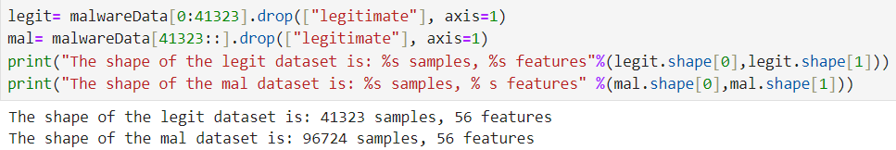
4) Dataset Description
Downloaded a malware dataset, it contains
41,323 binaries (exe ,dll) - legitimate
96,724 malware files from virusshare.com

Slide 8
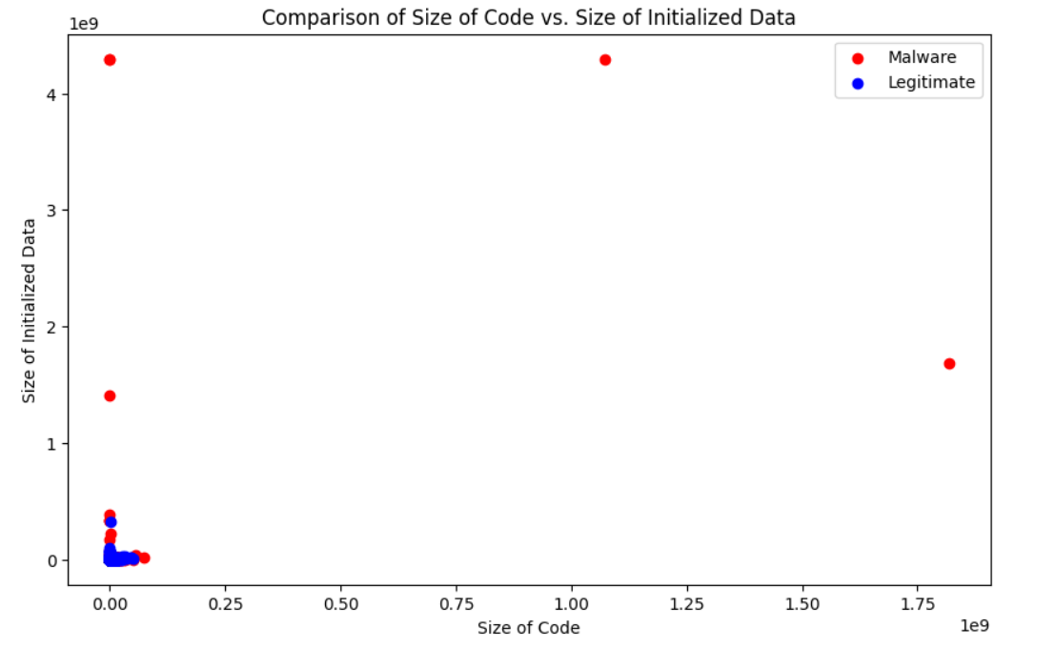
5) Data Visualizations

Slide 9
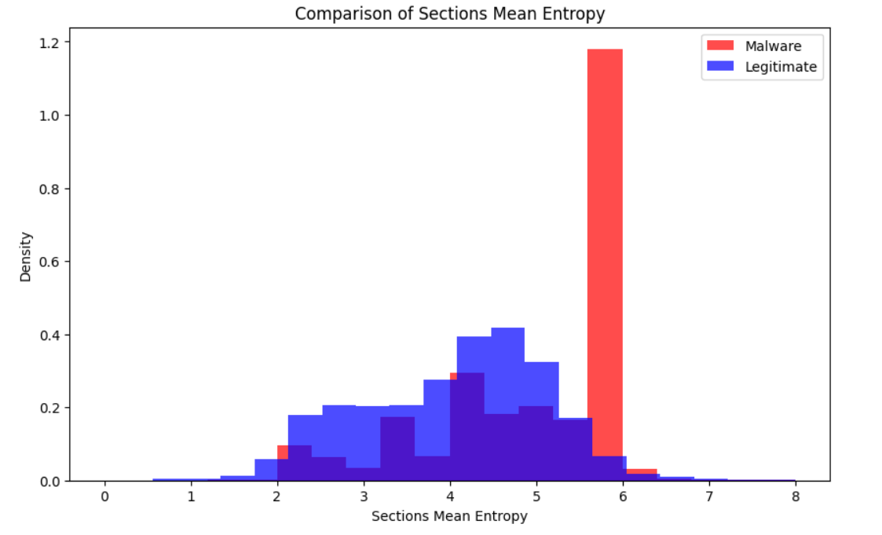
Comparison of Sections Mean Entropy

Slide 10
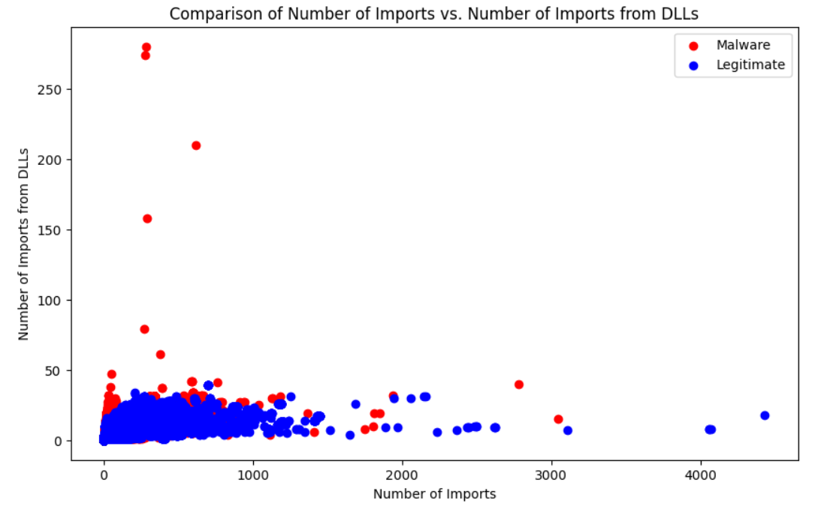
No of imports vs No of imports from DLL

Slide 11
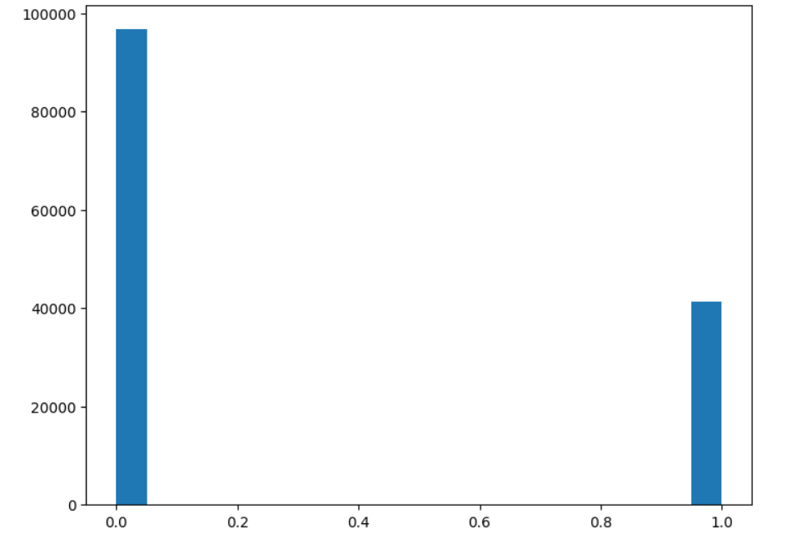
Distribution of Legitimate vs Malware

Slide 12
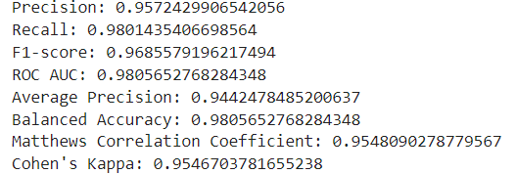
6) Random Forest Model
Inference
Random Forest classifier performs very well on the given dataset, demonstrating high accuracy, precision, recall, and discrimination ability in distinguishing between legitimate and malicious samples.

Slide 13

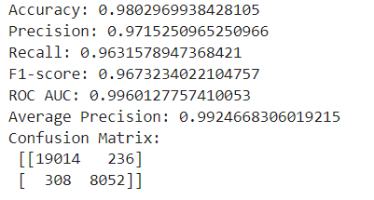
6) Logistic Regression Model
Inference
The model effectively distinguishes between the two classes. Confusion matrix shows a high number of true positives and true negatives, indicating that the model successfully identifies both legitimate and malicious samples with minimal misclassifications.

Slide 14

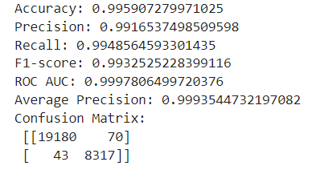
6) XGBoost Model
Inference
The confusion matrix further confirms the model's ability to correctly identify both legitimate and malicious samples with minimal misclassifications. XG Boost model is performing well.

Slide 15
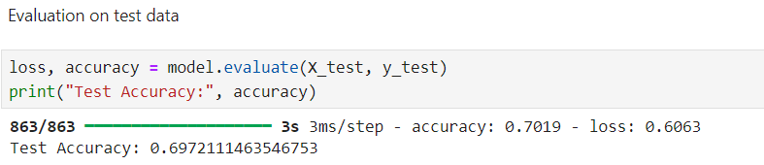
7) CNN Model
Inference
CNN model for malware detection achieved an accuracy of approximately 69.72% on the test set after 10 epochs of training. CNN model achieved some level of learning from the training data, its performance on the test set remains relatively low

Slide 16
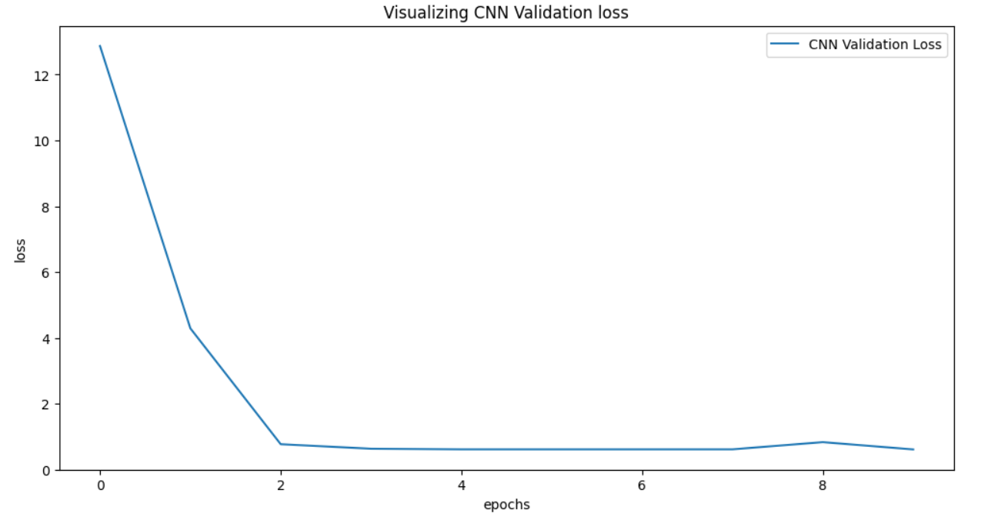
Visualizing CNN Validation loss

Slide 17
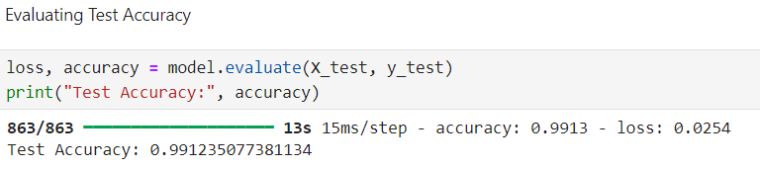
7) LSTM Model
Inference
The loss value steadily decreases during training, indicating that the model effectively minimizes its error on the training and validation data. LSTM model demonstrates excellent performance in malware detection, achieving high accuracy and effectively minimizing loss. When comparing to CNN, LSTM is better for malware detection according to this dataset.

Slide 18
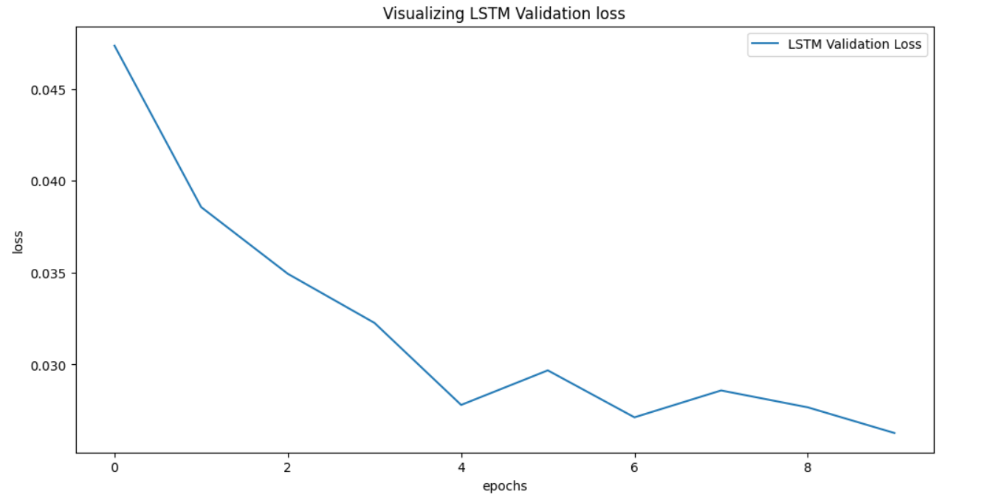
Visualizing LSTM Validation loss

Slide 19


