Slide 1

G2M Case Study
LISUM32 Virtual Internship
14-April-2024

Slide 2
Overview
XYZ is a private firm in US. Due to remarkable growth in the Cab Industry in last few years and multiple key players in the market, it is planning for an investment in Cab industry and as per their Go-to-Market(G2M) strategy they want to understand the market before taking final decision
Objective : To help XYZ is with actionable insights that will help them identify the right company to make their investment.
The data analysis included:
Price/Cost analysis
Date analysis
Coverage analysis
Business growth analysis
Conclusion and Recommendations

Slide 3
Input Data
There are 4 original dataset plus a third party dataset for this project thus:
Cab_Data.csv – this file includes details of transaction for 2 cab companies
Customer_ID.csv – file contains customer’s demographic detail
Transaction_ID.csv – file contains customer's transaction and payment mode
City.csv – file contains list of US cities, their population and number of cab users
Holiday.csv – file contains dates of US holidays

Slide 4
Exploratory Data Analysis
There are 23 features in total
There are 359565 rows.
There are no duplicate records
Time range is from 2016-01-02 to 2018-12-31T
Outliers are present in Price Charged feature
Yellow cab company has higher Users, Price Charged, Cost of trips and profit.
Number of transaction increases few days to weekend and towards end of the year.
Yellow company is dorminant in New York while Pink company - in San Diego
Card mode of payment is more popular
Most clients of the lients are Males
Number of users depend on the economic status of a city

Slide 5
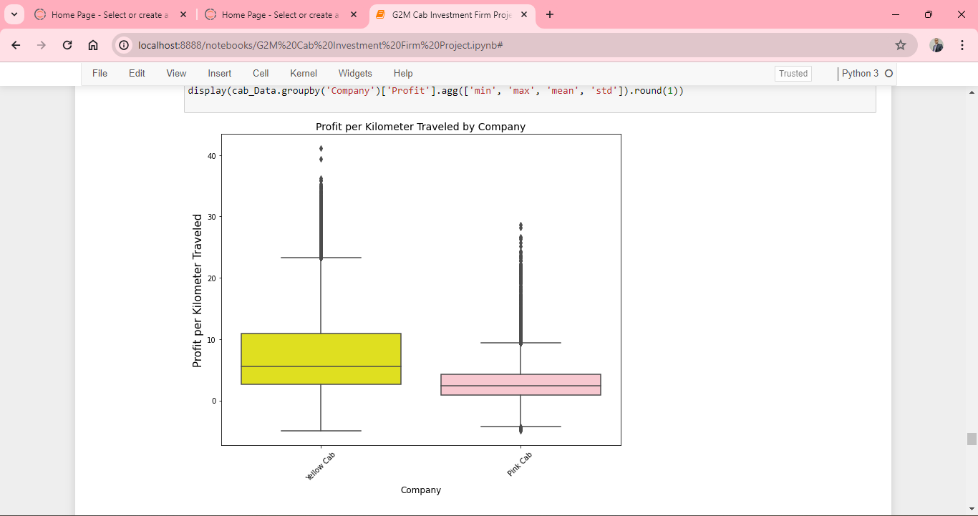
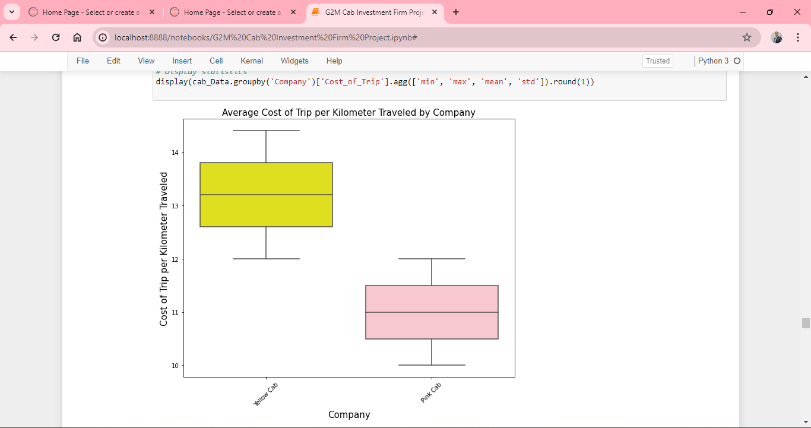
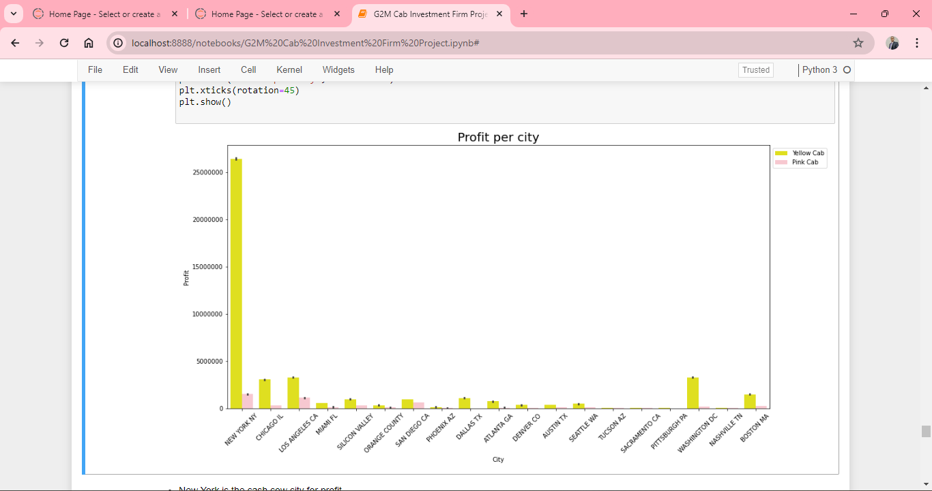
Profit/Cost Analysis
Profit per km of Yellow company is much more than rage cost of trip per km of Yellow company is much more than Pink company
Most of the profit of both companies comes from `New York`

Slide 6
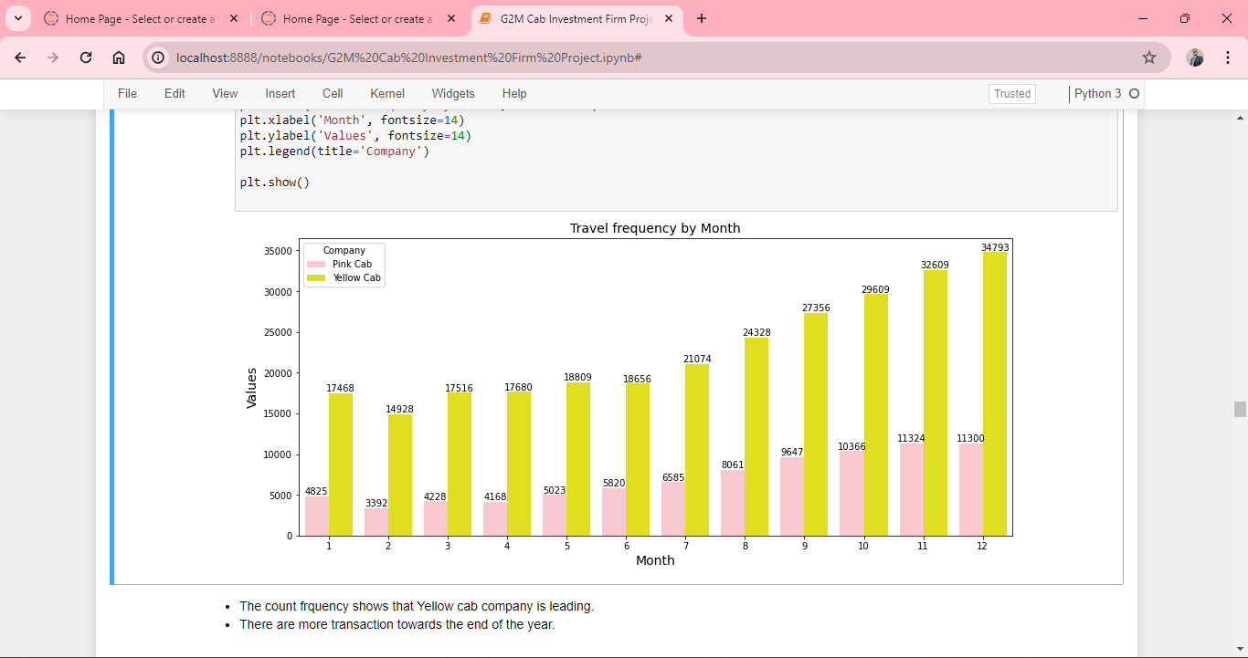
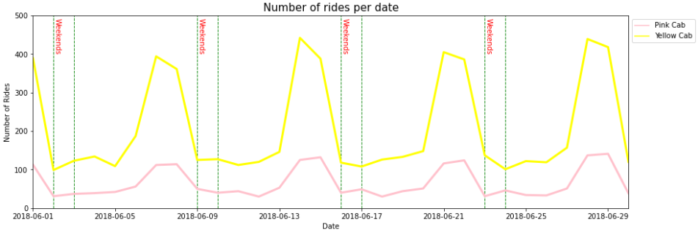
Date Analysis
The count frquency shows that Yellow cab company is leading in terms of transactkion.
There are more transaction towards the end of the year.
There is spike in orders days before the weekends.
Weekdays remain relatively flat

Slide 7
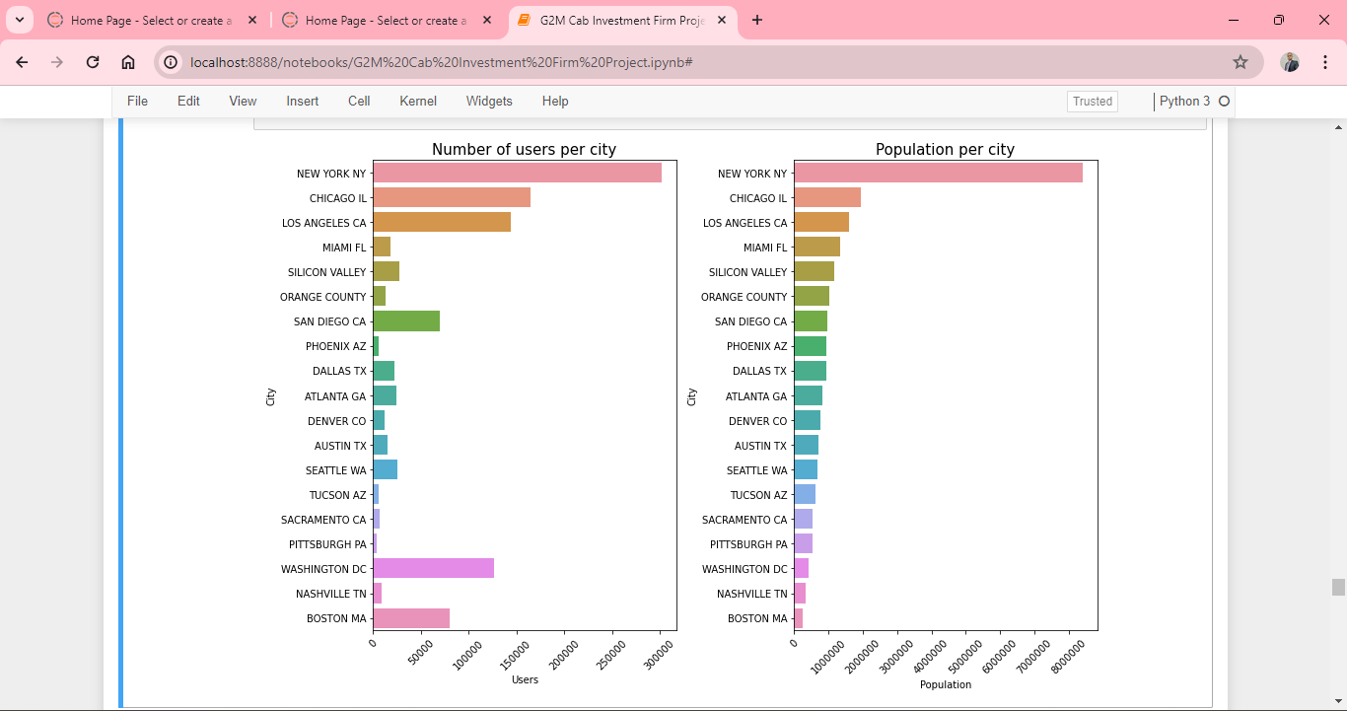
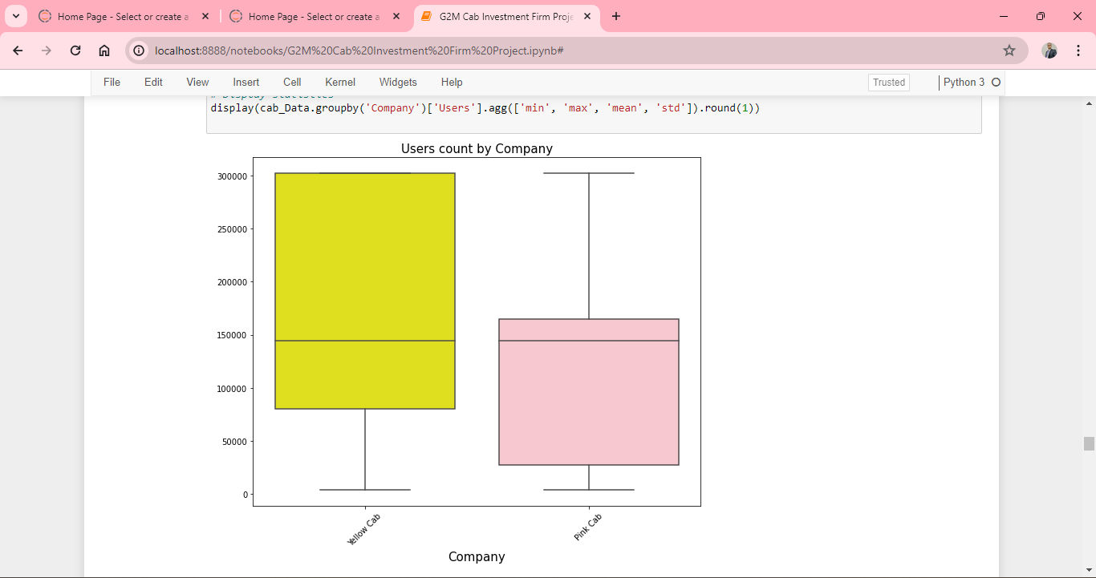
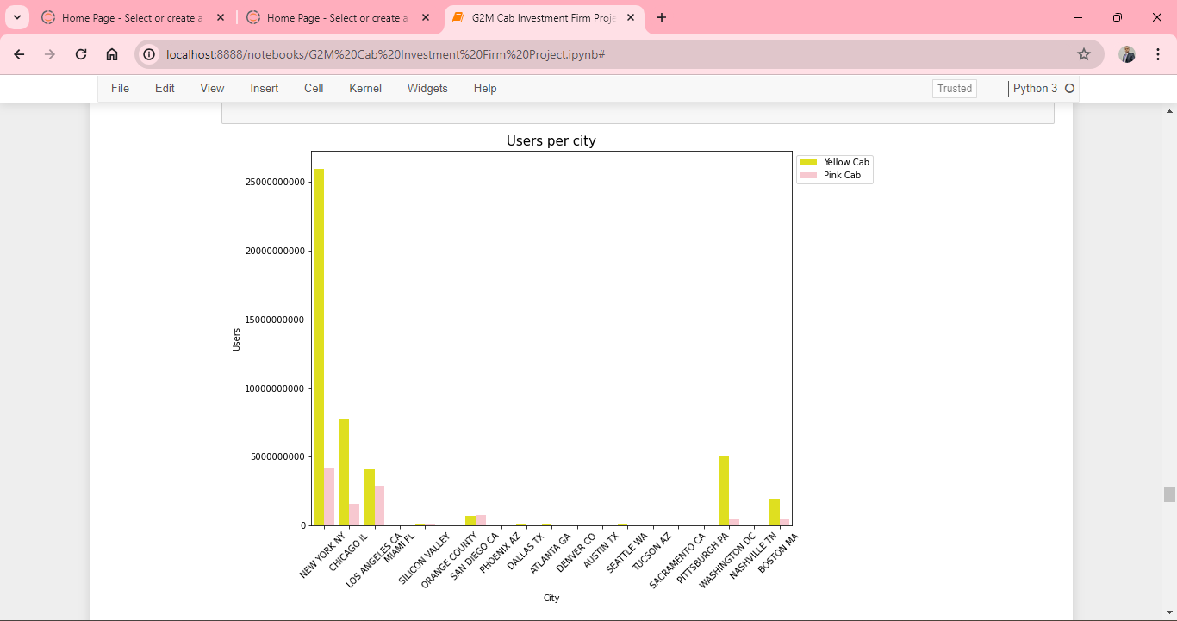
Coverage Analysis
Yellow cab has a higher number of users
New York city has the highest number of users for both company..

Slide 8
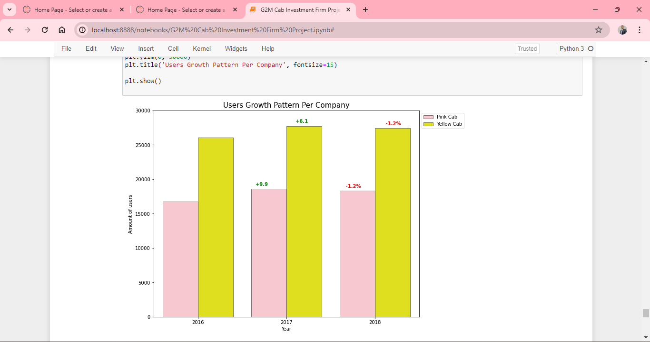
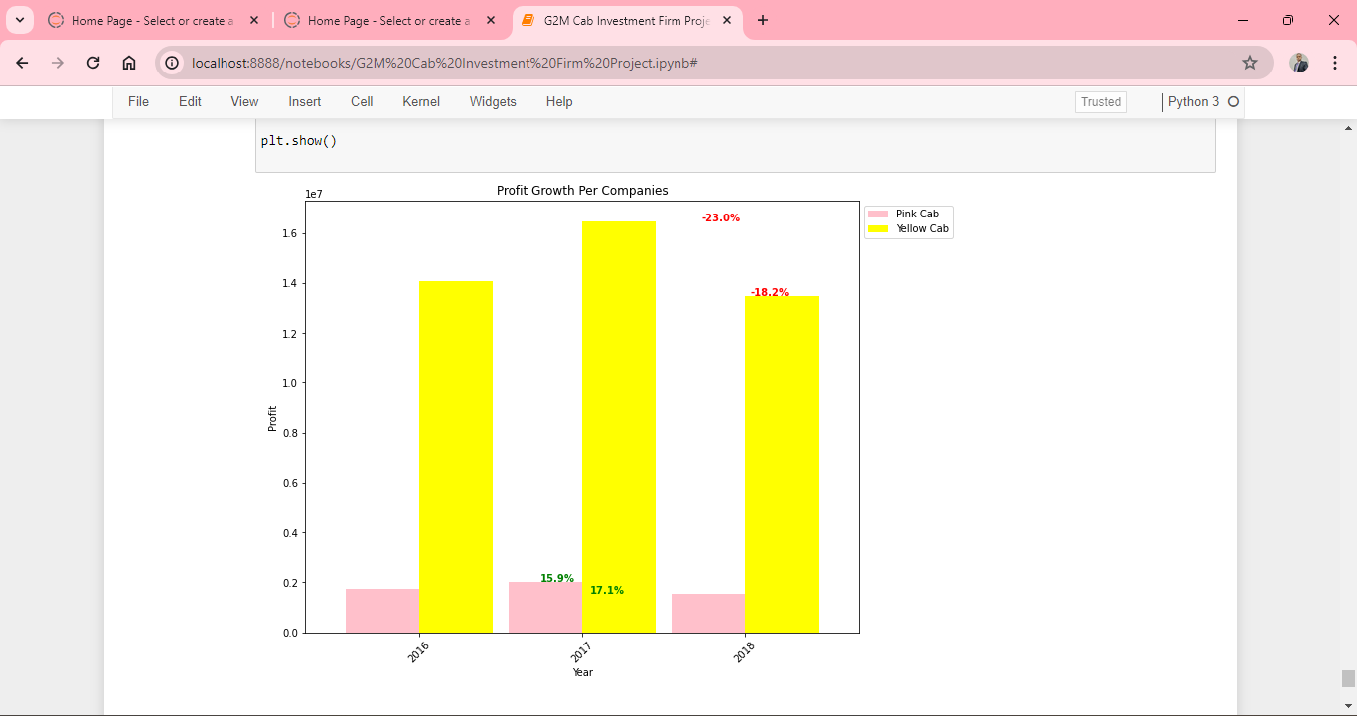
Business Growth Analysis
There is YOY grwoth for both companies in 2016/2017 and a same 1.2 percent decline in 2017/2018.
Pink cab seems to be doing better in terms of attracting new customers.
There is YOY grwoth for both companies in 2016/2017 and a decline in 2017/2018 respectively.

Slide 9
Recommendations
After a thorough analysis of the dataset, we came out with the following insights:
1. There are more Males than Females for both companies.
2. Yellow cab company has more profit than Pink company.
3. New York is the cash cow city for both companies and Yellow company dominates it.
4. Yellow company have higher percentage of users in most cities.
5. There is spike in number of orders in couple of days before the weekends and towards the end of the year.
6. There is also spike in number of order during holidays.
Recommendation:
Based on the insights above, Yellow cab is better company for investment.

Slide 10
Thank You

