Slide 1

G2M Case Study
Virtual Internship
20-March-2023

Slide 2
Overview
XYZ is a private firm in US. Due to remarkable growth in the Cab Industry in last few years and multiple key players in the market, it is planning for an investment in Cab industry and as per their Go-to-Market(G2M) strategy they want to understand the market before taking final decision
Objective : Provide actionable insights to help XYZ firm in identifying the right company for making investment.
The data analysis included:
Exploratory data analysis
Profit analysis
Segmentional analysis
Seasonal analysis
Coverage analysis
Retention analysis
Recommendations for investment

Slide 3
Exploratory Data Analysis
Provided dataset consists of 5 files, each represents different aspects of the customer profile.
Cab_Data.csv – this file includes details of transaction for 2 cab companies
Customer_ID.csv – this is a mapping table that contains a unique identifier which links the customer’s demographic details
Transaction_ID.csv – this is a mapping table that contains transaction to customer mapping and payment mode
City.csv – this file contains list of US cities, their population and number of cab users
Holiday.csv – this file contains dates of US holidays
There are 22 features in total
Timestamps present cover the interval from 2016-01-02 to 2018-12-31

Slide 4
Exploratory Data Analysis
There were 0.13% of duplicates, which were dropped
Outliers are present in Price Charged feature
Price Charged and Cost of trips are higher in general for Yellow company
Distributions of KM Travelled is almost equal for both companies
By the end of year amount of rides increases
People with similar Income are using both companies equally
Yellow cab company have more Users in general
Number of Users doesn’t strictly depends on the population of the city
In all Cities people have similar distribution of Age between 18 and 65 with mean value ~35 years
Yellow company has the most amount of rides in New York, Pink company - in Los Angeles
Payment by card is more popular
Most clients for both companies payment are Males

Slide 5
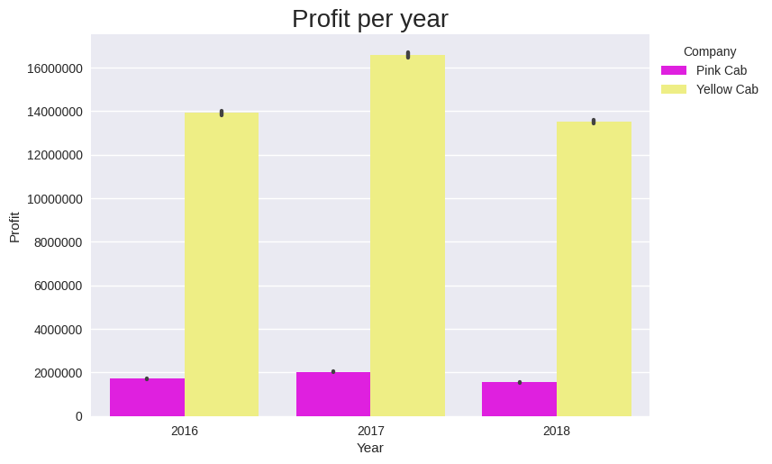
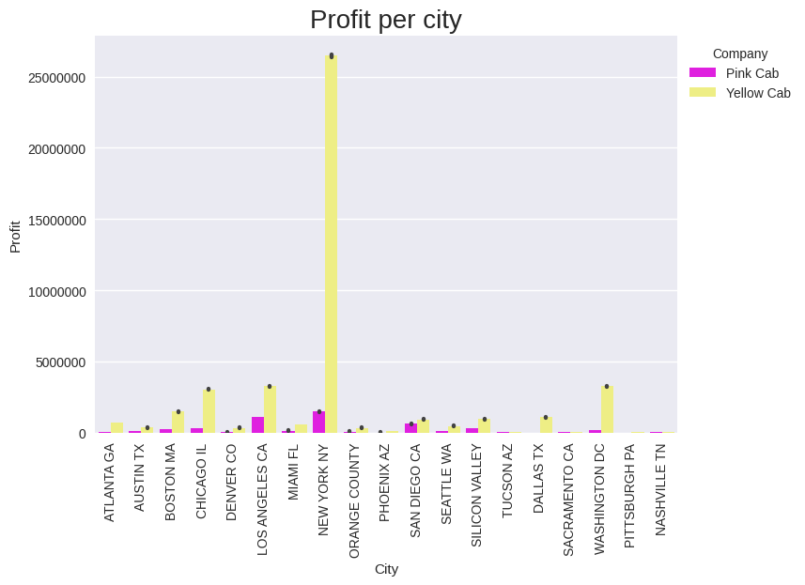
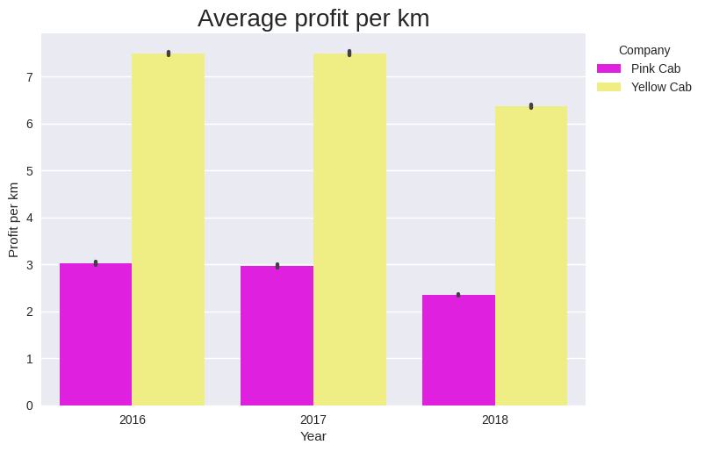
Profit Analysis
Profit of `Yellow` company is ~8 times bigger than profit of `Pink` company
Average profit per km of `Yellow` company is ~2.5 times bigger than of `Pink` company
Most of the profit of `Yellow` and `Pink` companies comes from `New York`
 | Profit | Number of rides | Percent of profitable rides
Pink Cab | 5307328 | 84711 | 86.9
Yellow Cab | 44020373 | 274681 | 95.0

Slide 6
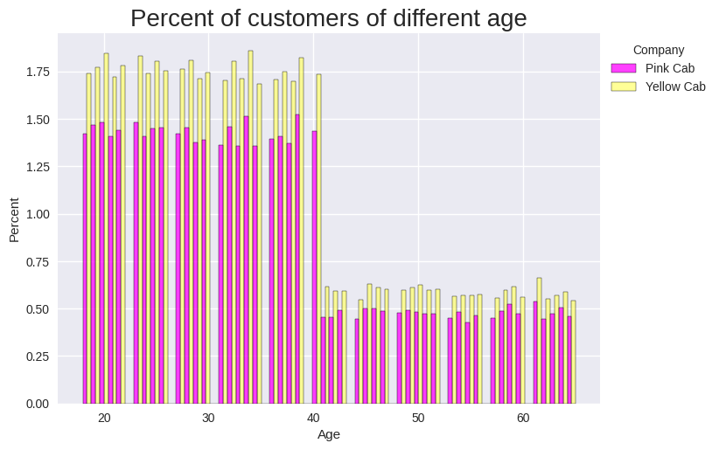
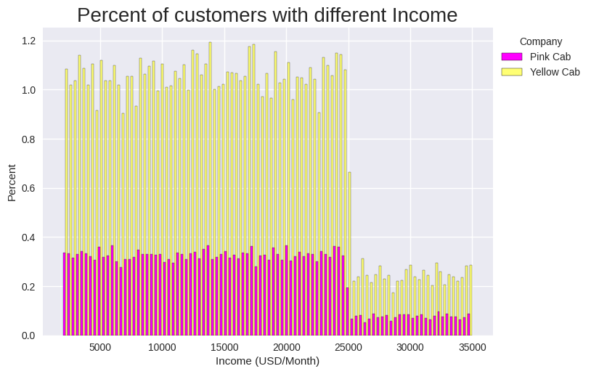
Segmentation Analysis
73% of customers are below age 40 and 27% are older for both companies
91% of customers have income < 25000$ and 9% have more
In both companies percentage of `Males` is ~8% higher than `Females`

Slide 7
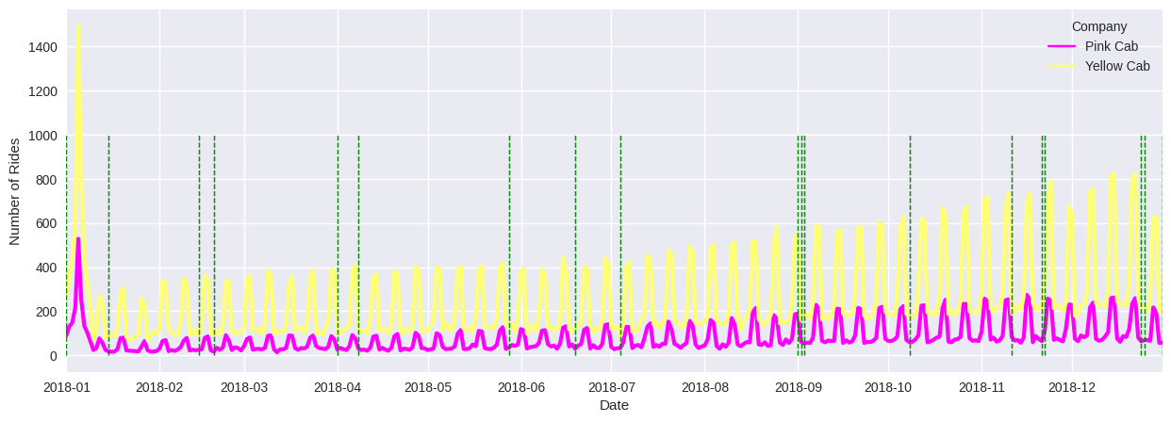
Seasonal Analysis
holidays
There is some year-trend in the data as well as seasonal component
No obvious correlation between `Amount of rides` and `Holidays`, except for the significant rise in the number of rides after New Year in `2017` and `2018`

Slide 8
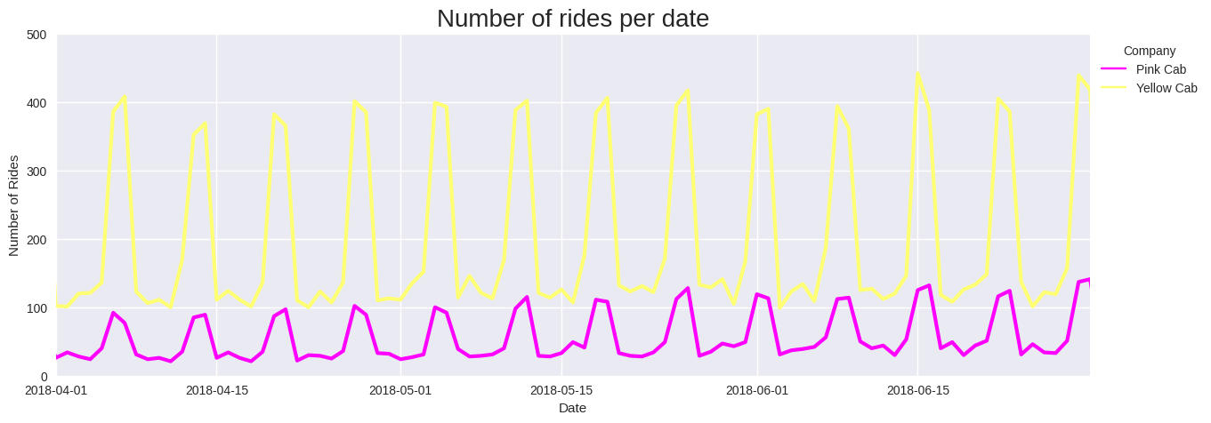
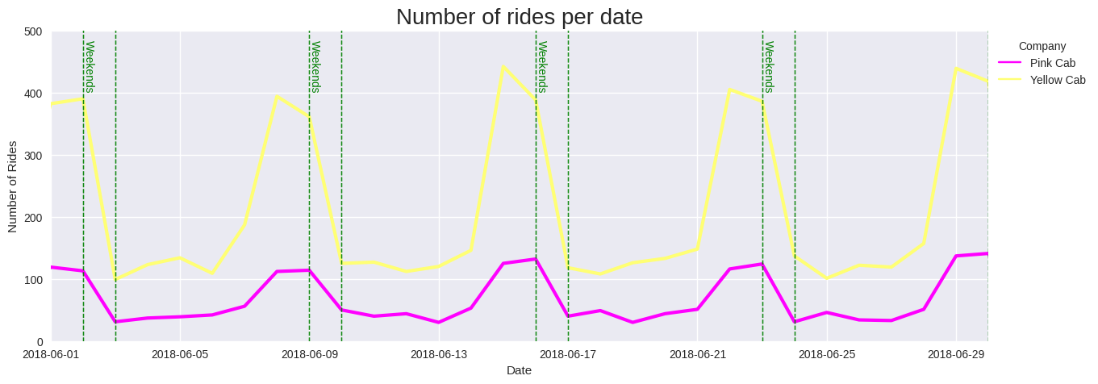
Seasonal Analysis
There is a high amount of orders in couple of days before the weekends, at the start of the week number of orders is the lowest

Slide 9
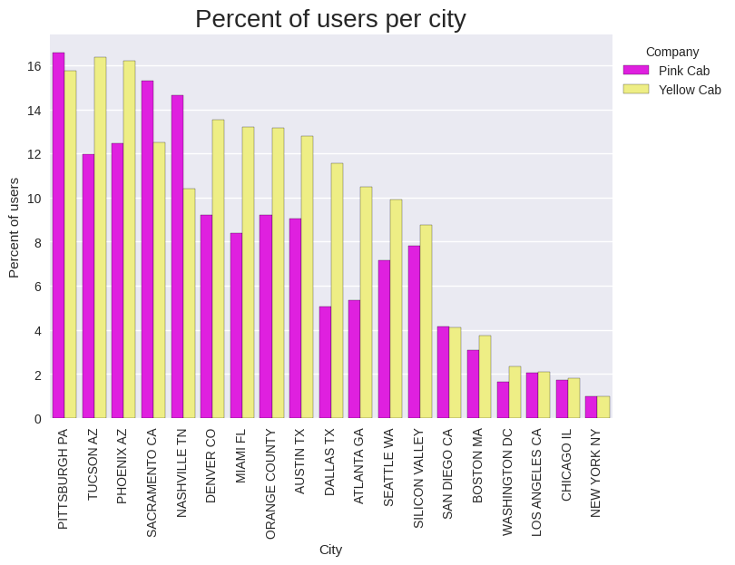
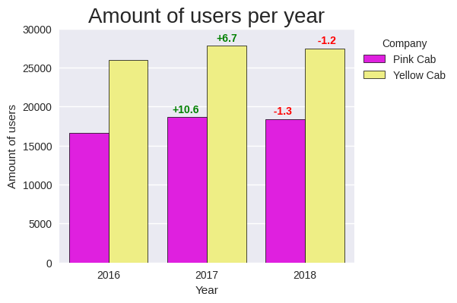
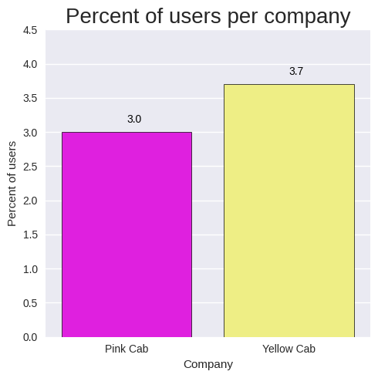
Coverage Analysis
In most cities `Yellow` company have higher percentage of users
In total `Yellow` company have higher percentage of users
Both companies experienced growth in amount of users by +6.7% - for Yellow and +10.6% for Pink in 2016 and reduction by 1.2-1.3% in 2018

Slide 10
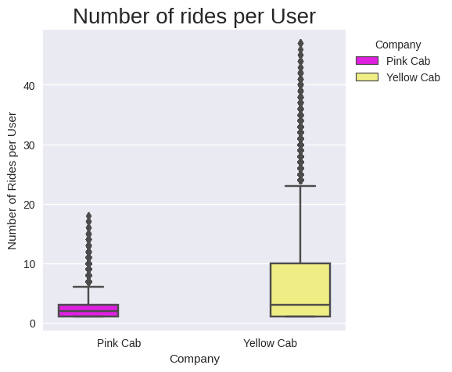
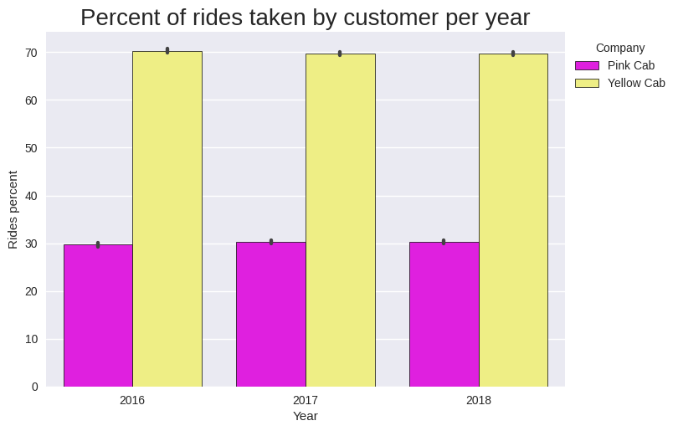
Retention Analysis
In general users in `Yellow` company have more rides per user
In 70% of cases users tends to select Yellow over Pink

Slide 11
Recommendations
According to performed analysis the conclusions are:
1. Profit:
- Profit of Yellow company is ~8 times bigger than profit of Pink company
- Average profit per km of Yellow company is ~2.5 times bigger than of Pink company
- Most of the profit of Yellow and Pink companies comes from New York
- Yellow cab company's rides are 95% profitable, in contrast 87% of Pink company's rides are profitable
2. Customer profile:
- 73% of customers are below age 40 and 27% are older for both companies
- Percentage of Males is ~8% higher than Females for both companies
- 91% of customers have income < 25000 usd and 9% have more
3. Coverage:
- In most cities Yellow company have higher percentage of users
- In total `Yellow` company have higher percentage of users
4. Seasonal dependency:
- Number of orders tends to go higher by the end of the year
- In some years there are extremely high amount of orders during New Years holidays
- Theres is week-wise seasonal component: there is a high amount of orders in couple of days before the weekends, at the start of the week number of orders is the lowest
5. Retention:
- In general users in Yellow company have more rides per user
- In 70% of cases users tends to select Yellow over Pink
Recommendation:
On basis of point above we recommend Yellow cab for investment

Slide 12
Thank You

