Slide 1

TEST FEEDBACK ON THE PRODUCTION ENVIRONMENT

Slide 2
CUSTOMER PORTAL

Slide 3
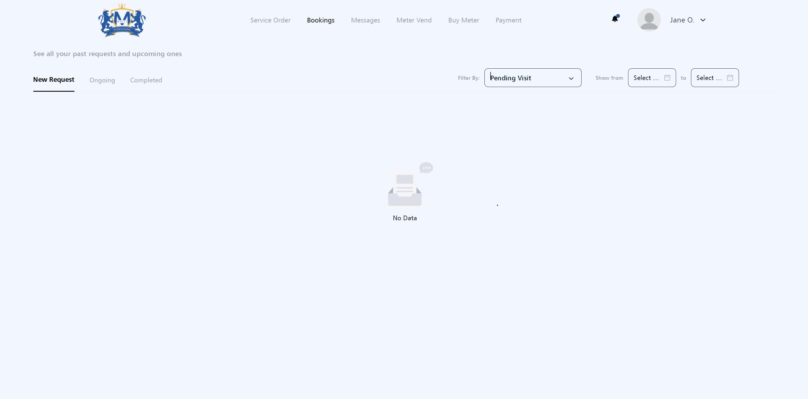
The drop down box its not filtering correctly.

Slide 4
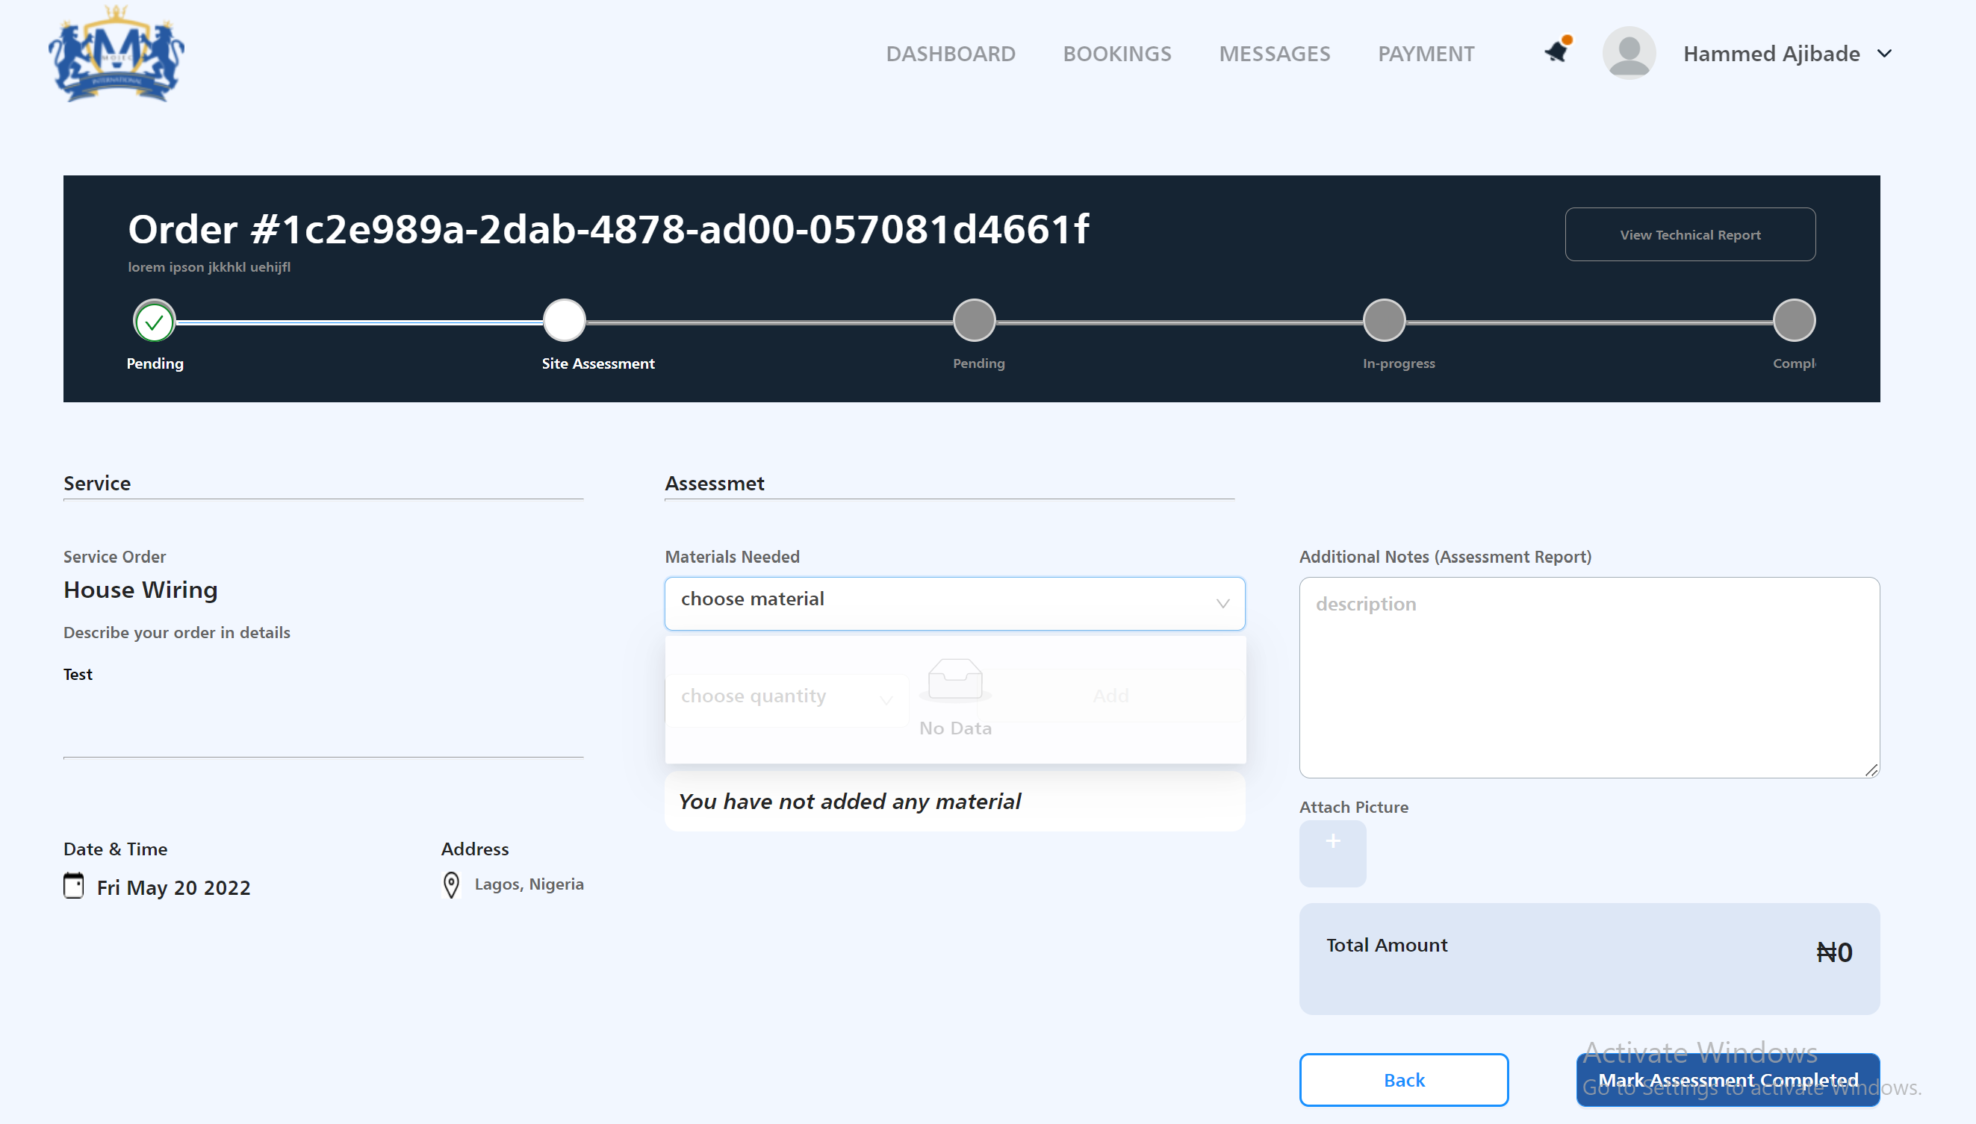
The list of materials needed
to be accessed by technician is empty.

Slide 5
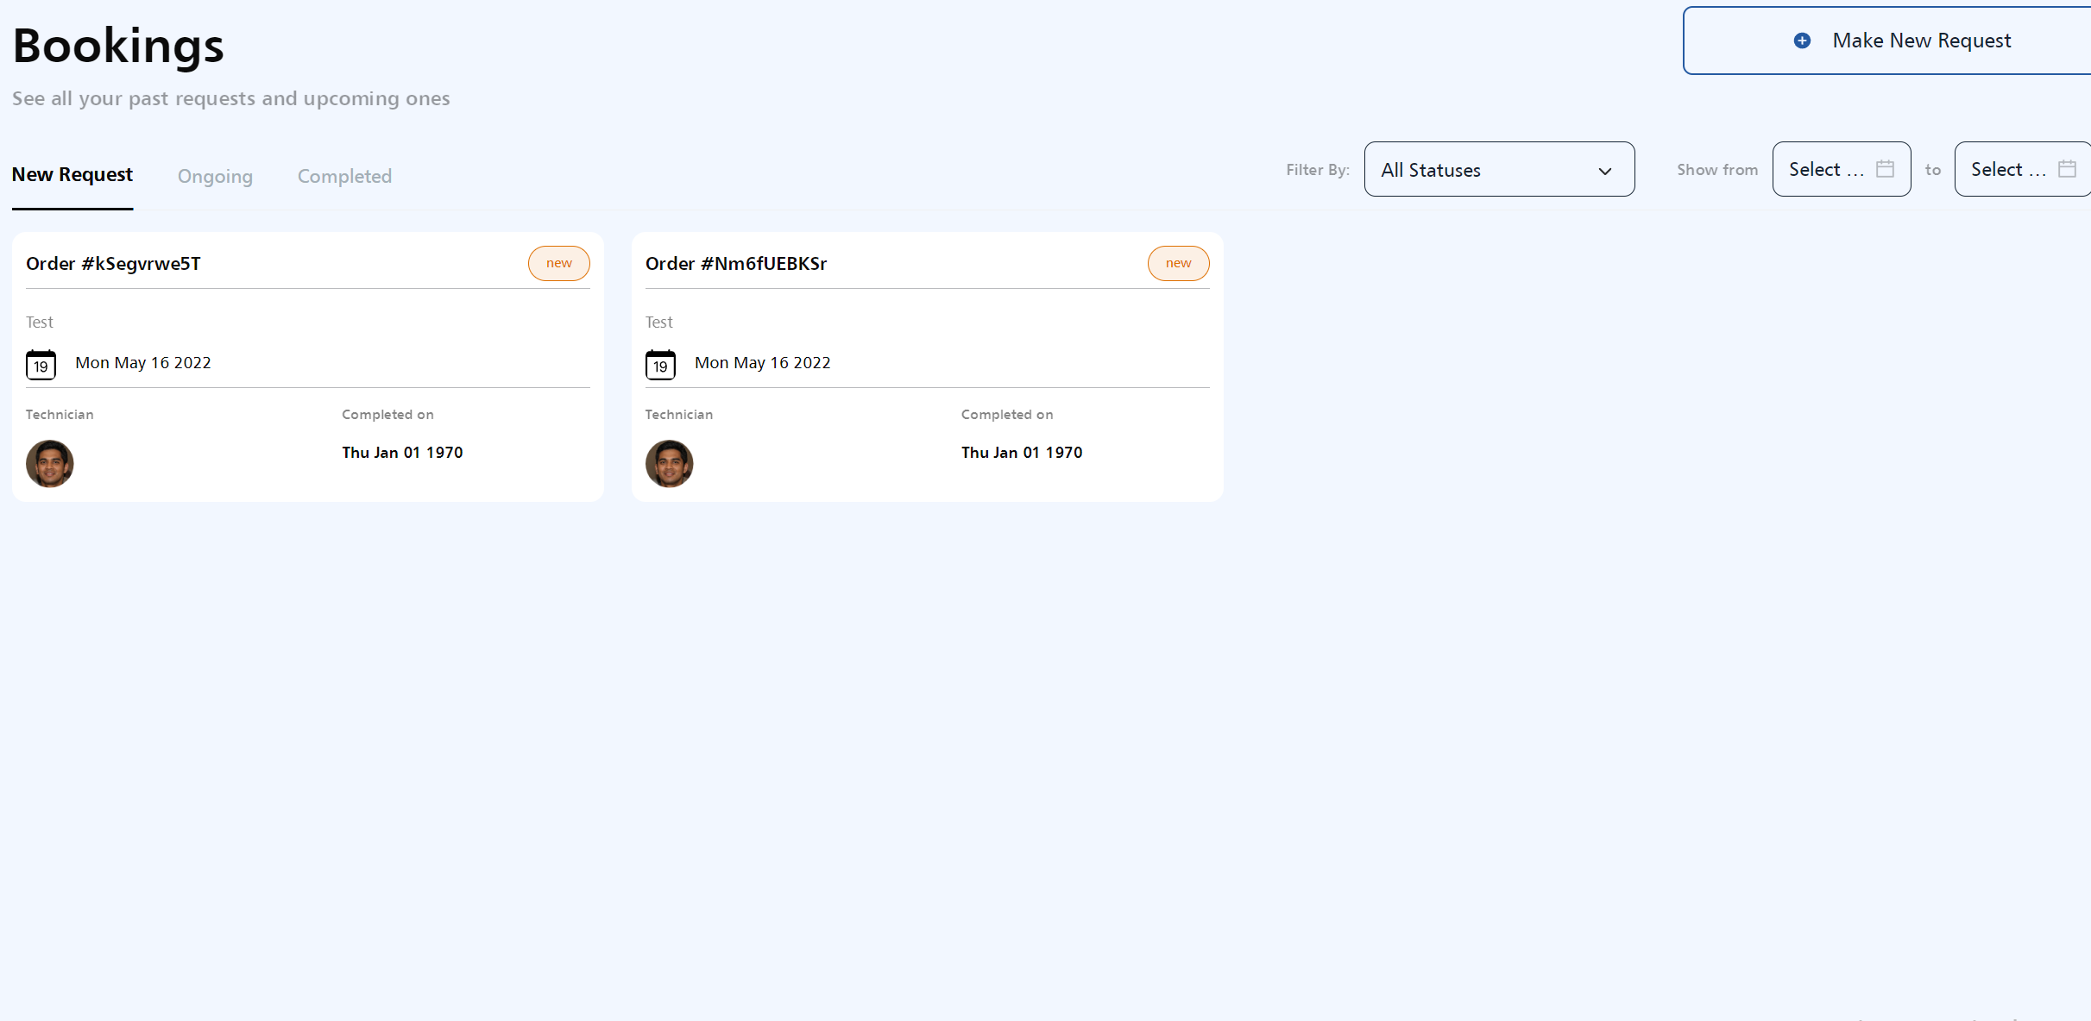
This is not a valid completed date , Validate all the data’s we have around bookings.

Slide 6
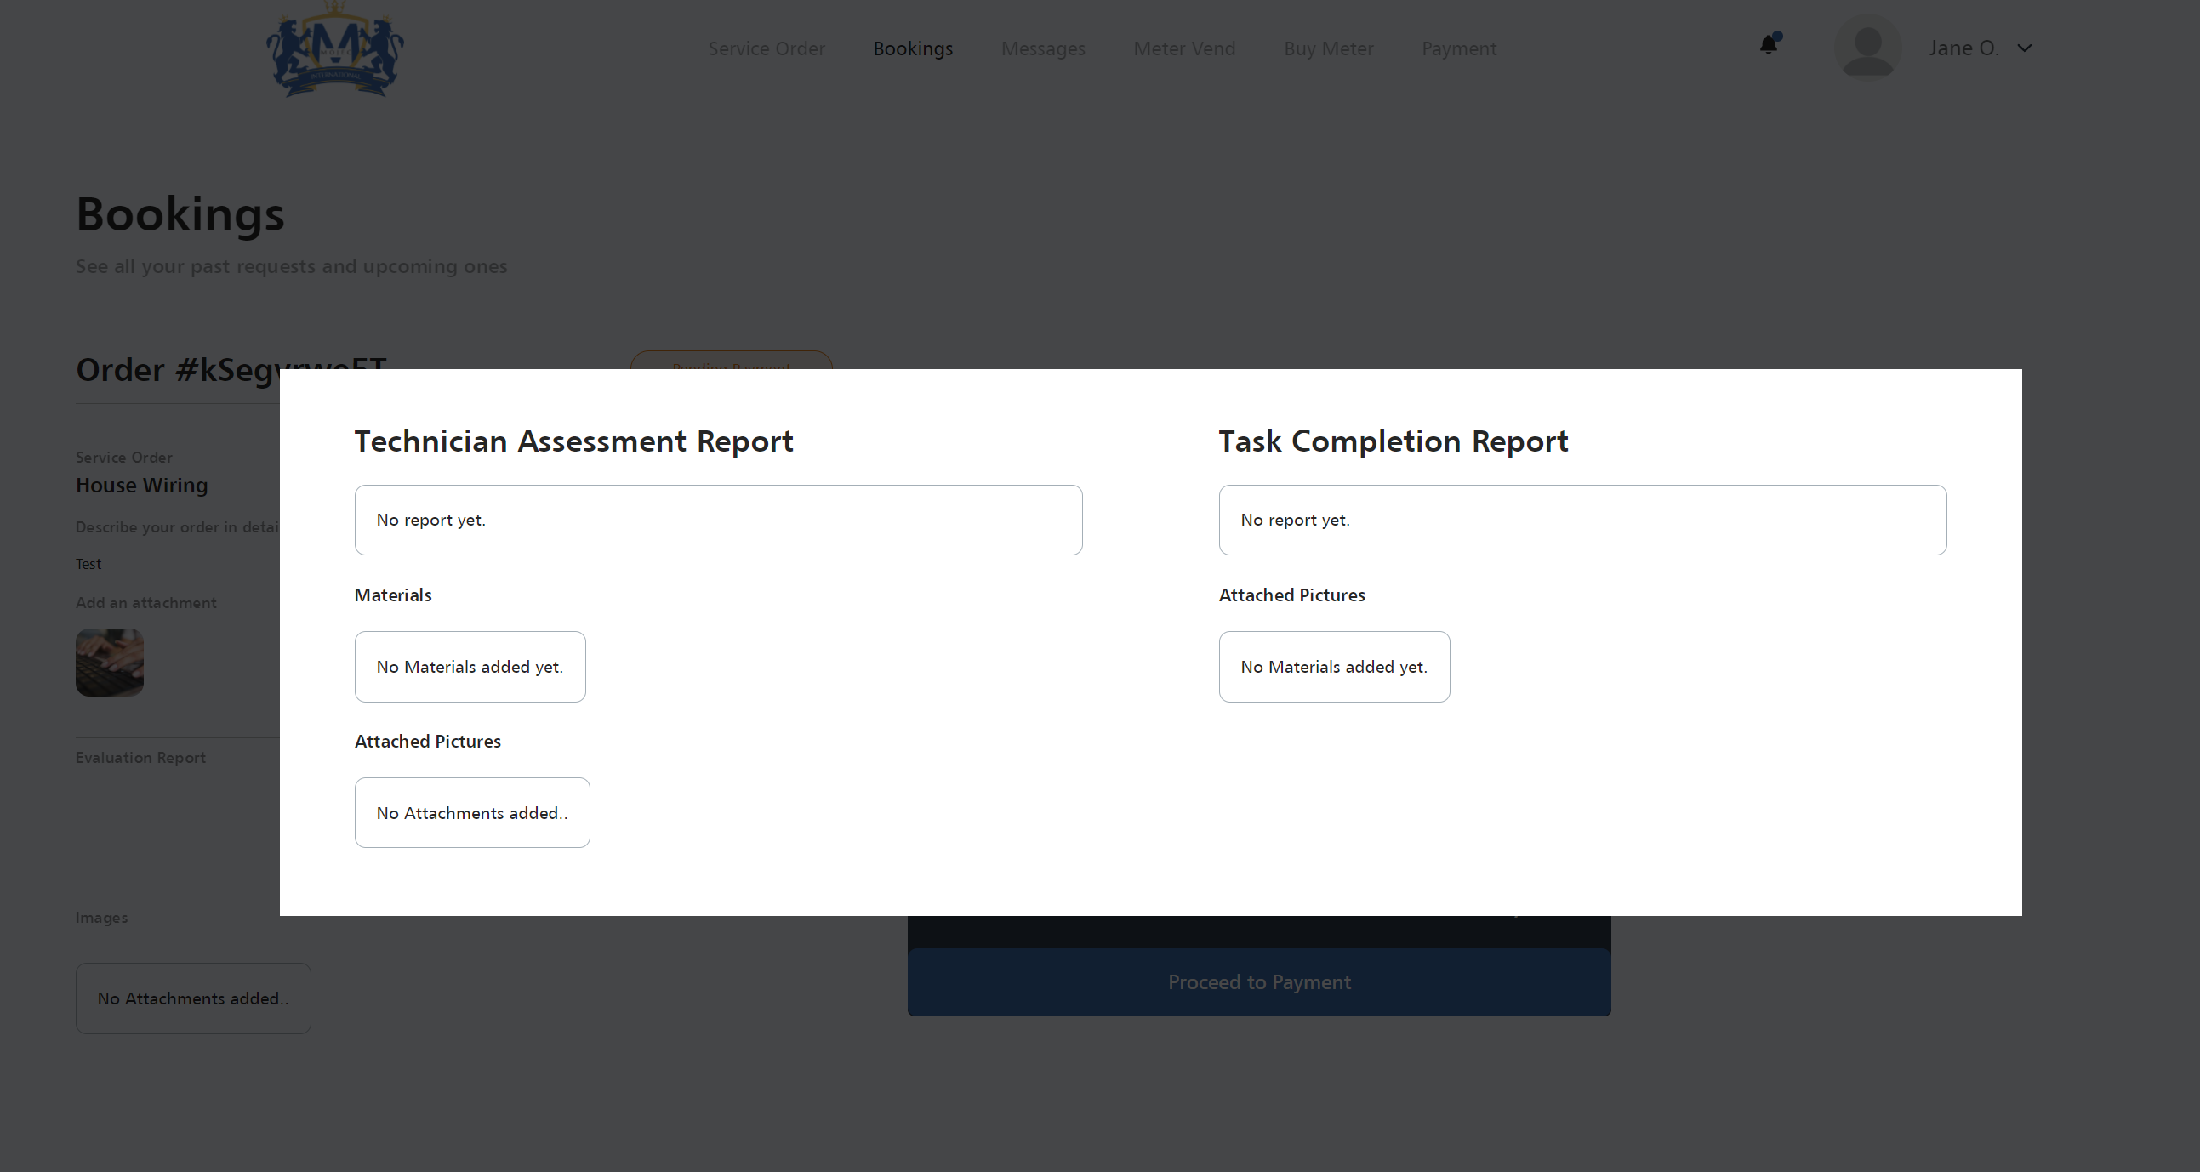
Customer can not view technician details.

Slide 7
ADMIN PORTAL

Slide 8
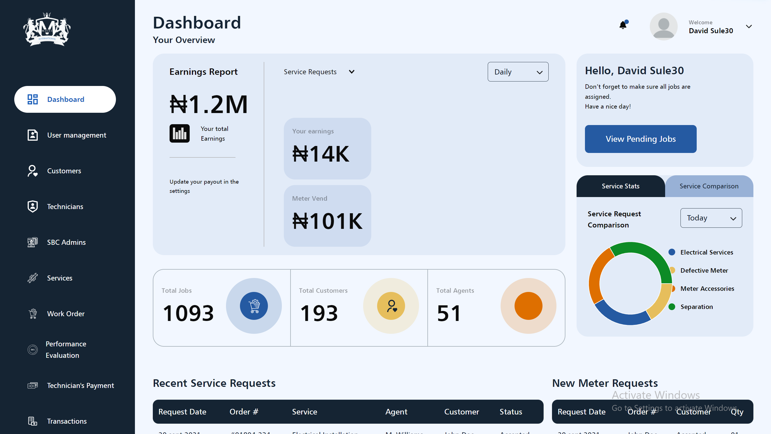
Dashboard data’s are still not validated, we have alot of dummy data’s on the Dashboard.

Slide 9
Admin Portal is very slow
Is giving us bad request Error

Slide 10
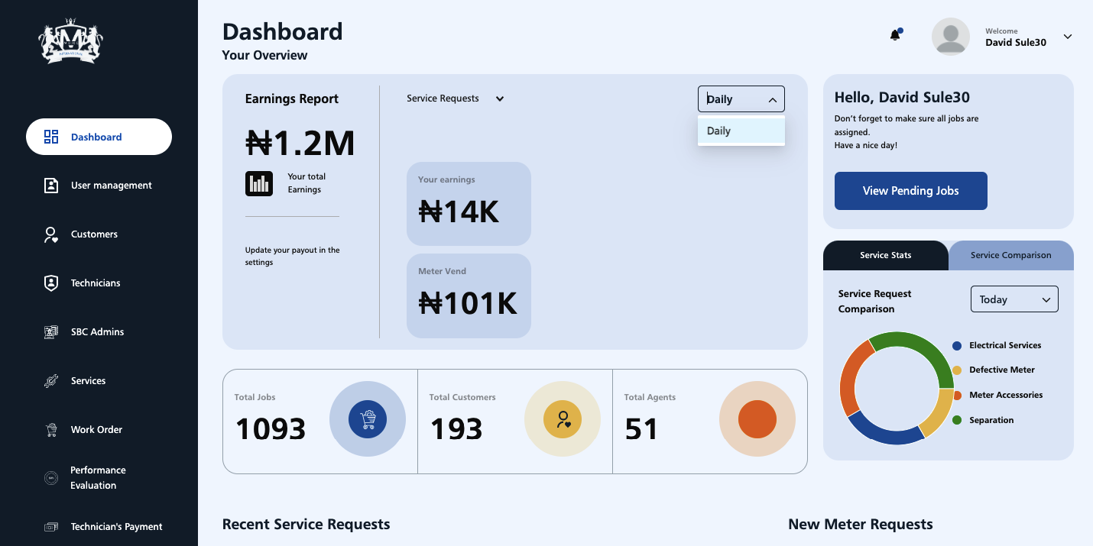
On the “Dashboard”, daily is the only filtering option available.

Slide 11
TECHNICIAN PORTAL

Slide 12


Slide 13
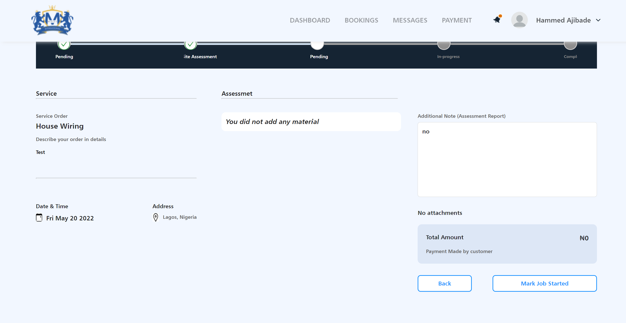
Technician cannot mark Job as Started

