Slide 1

Zend Framework 2
Quick Start

Slide 2

About me
Matthew Weier O'Phinney (@weierophinney)
PHP Developer since 2000
Zend Framework contributor since January 2006; project lead since April 2008
Passionate open source advocate and contributor

Slide 3
ZF2 in a slide
PHP >= 5.3
More Flexibility
  Event and service oriented
More Performant
Open Processes
  No more CLA!
  Git and GitHub
Diverse install methods
  Pyrus, Composer, git submodules

Slide 4

A new core
The ZF1 way:
  Singletons, Registries, Hard-Coded and Soft Dependencies
The ZF2 way:
  Event-Driven Services

Slide 5

New architectural approach
Methodologies used in the development
  Decoupling (ServiceManager, Di)
  Event driven (EventManager)
  Standard classes and SPL extensions (Stdlib)
Take advantage of PHP 5.3
  Namespaces
  Lambda Functions and Closures
  Late Static Binding

Slide 6
Releases
Currently at ZF2.0.0beta4
Goals:
  2.0.0beta5 end of June
  Stable release by end of summer!

Slide 7
Patterns

Slide 8
Decoupling
Contract Oriented Design
Favor composition over inheritance
  Encourage Dependency Injection

Slide 9
Dependency Injection

Slide 10
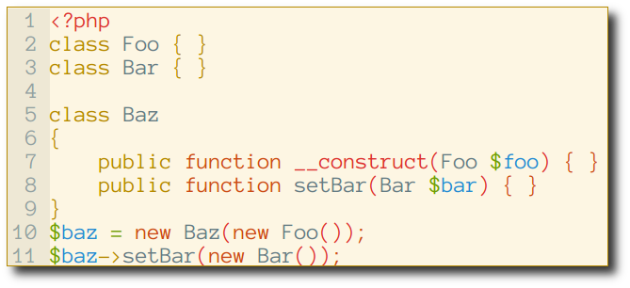
Example

Slide 11
Zend\Di
Supports the 3 different injection patterns:
  Constructor
  Interface
  Setter
Implements a Di Container:
  Manage the dependencies using configuration and annotation
  Provide a compiler to autodiscover classes in a path and create the class definitions, for dependencies

Slide 12
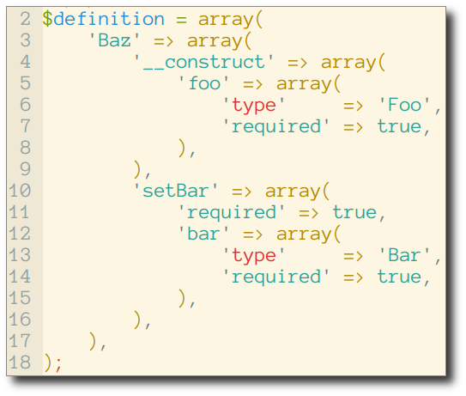
Sample definition

Slide 13
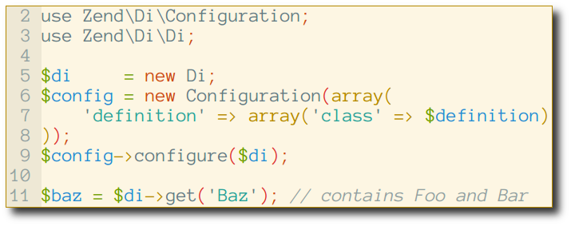
Using the Di container

Slide 14
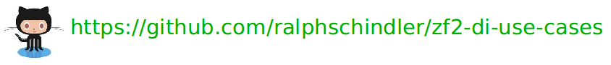
… and more!
Supports annotation-based injections
Supports interface injections
Tons of captured use cases:

Slide 15
… but:
DI container is often slow
DI container is often hard to learn
DI container is often hard to debug

Slide 16
Service Manager

Slide 17
ServiceManager
Very fast – no magic or discovery
Code – don't configure – your injections
Explicit wiring – it's code – makes debugging simpler

Slide 18
Types of Services
Explicit (name => object pairs)
Invokables (name => class to instantiate)
Factories (name => callable returning object)
Aliases (name => some other name)
Abstract Factories (unknown services)
Scoped Containers (limit what can be created)
Shared (or not; you decide)

Slide 19
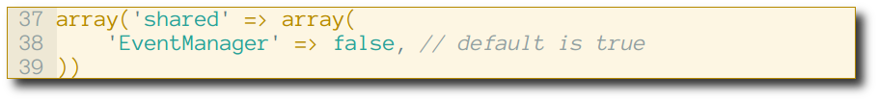
Example: Service

Slide 20
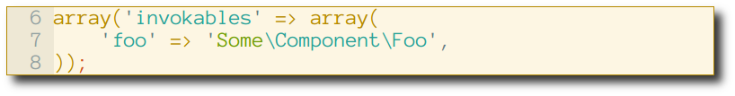
Example: Invokable

Slide 21
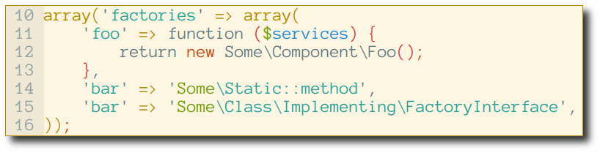
Example: Factories

Slide 22
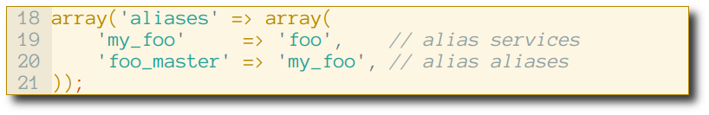
Example: Aliases

Slide 23
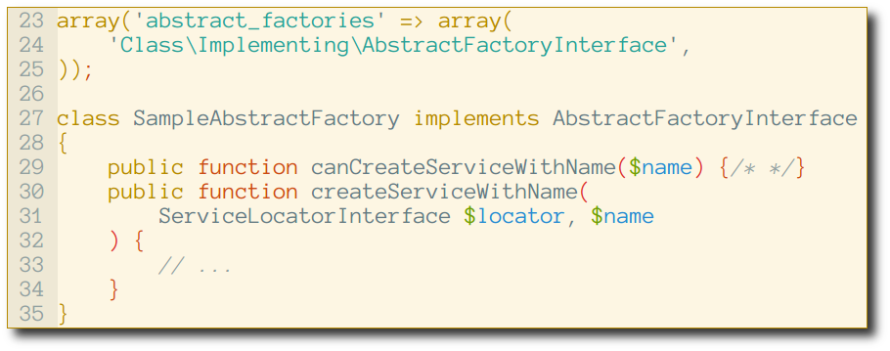
Example: Abstract Factories

Slide 24
Example: (Un)Shared Service

Slide 25
Configure Services Anywhere
Application configuration
Module classes
Module configuration
Local override configuration

Slide 26
Event Manager

Slide 27
EventManager in a Slide
Trigger events
Listen and react to triggered events

Slide 28
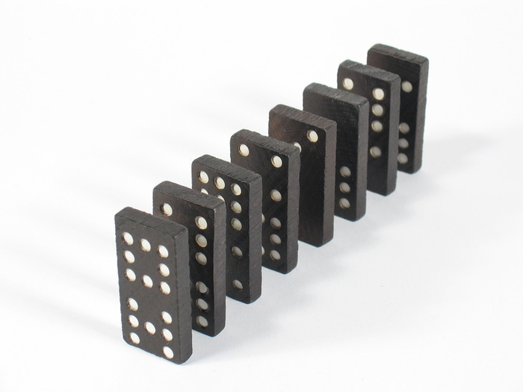
Terminology
An Event Manager is an object that aggregates listeners for one or more named events, and which triggers events.
A Listener is a callback that can react to an event.
An Event is an action.

Slide 29
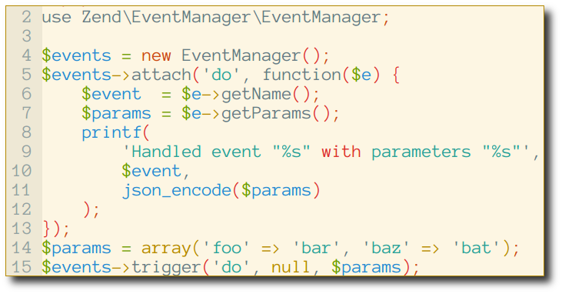
Example

Slide 30
More features
Shared manager, to allow attaching to events when you don't have access to the object.
Wildcard attachment
Short-circuiting (both from within listeners as well as rules-based)
Listener response aggregation

Slide 31
MVC

Slide 32



Event driven architecture
Everything is an event
bootstrap
route
dispatch
Listeners

Slide 33
Three core concepts
Events
Services
Dispatchables (controllers)

Slide 34
Events
Loading modules: loadModules.pre, loadModule, loadModules.post
bootstrap
route
dispatch and dispatch.error
render
finish

Slide 35
Services
Uses ServiceManager to wire default workflow and event listeners
Developers provide additional services and service configuration
Controllers are services

Slide 36
Dispatchables
Receive a request and a response
Return a response
Basically HTTP negotiation

Slide 37
Quick Start:
Zend
Skeleton
Application

Slide 38
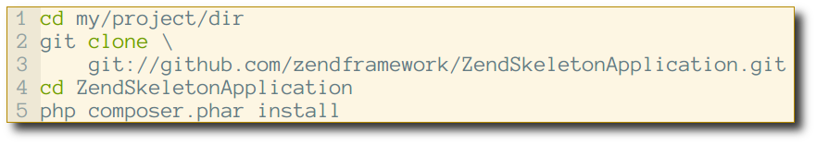
Zend Skeleton Application
A simple, skeleton application using the new MVC layer and the module system
Installation is easy:

Slide 39

Folder's tree
config
data
module
public
vendor

Slide 40
Config folder
config
  autoload
  application.config.php
data
module
public
vendor

Slide 41
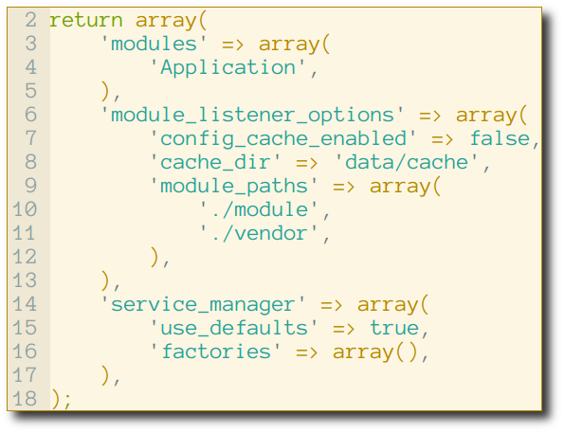
application.config.php

Slide 42
Data folder
config
data
  cache
module
public
vendor

Slide 43
Public folder
public
  images
  js
  css
  .htaccess
  index.php

Slide 44
Vendor folder
config
data
module
public
vendor
  ZendFramework

Slide 45
Module folder
module
  Application
    config
      module.config.php
    src
      Application
        Controller
          IndexController.php
    view
      application
        index
          index.phtml
    Module.php
    autoload_classmap.php
Name of the module

Slide 46
Modules by default
A module is all related code and assets that solve a specific problem.

Slide 47
Modules for ZF2
The basic unit in a ZF2 application
is a Module
Modules inform the MVC about Dispatchables and other code
Modules are “Plug and play” technology
Modules are simple:
  A namespace
  Containing a single classfile: Module.php

Slide 48
Develop Modules
Modules contain all logic related to a discrete application problem.
  Controllers
  Entities
  Plugins
  Etc.
99% of the time, you will write modules

Slide 49
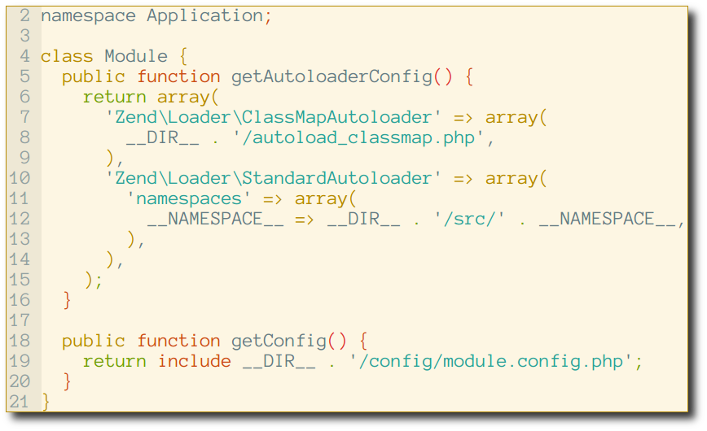
Module.php

Slide 50
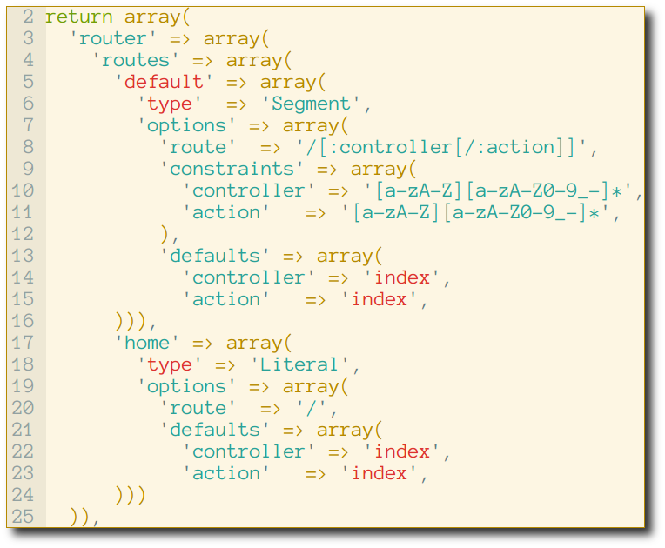
module.config.php – router

Slide 51
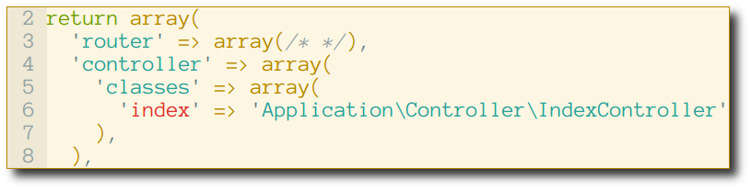
module.config.php – controllers

Slide 52
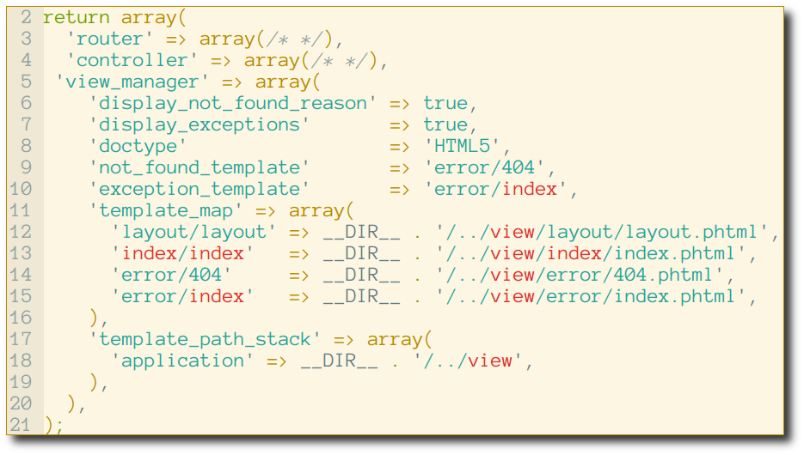
module.config.php – view

Slide 53
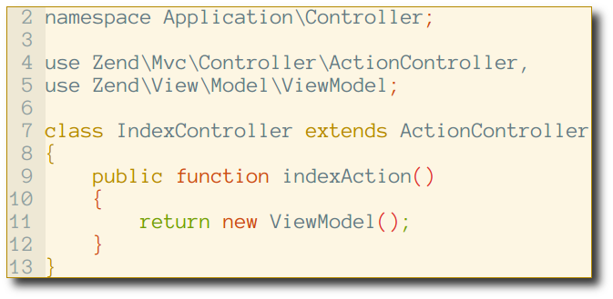
IndexController.php

Slide 54
Packaging
Options

Slide 55
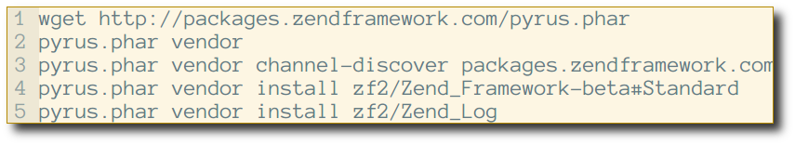
Pyrus
PEAR2 installer and channel server

Slide 56
Composer
New package management and distribution tool
http://packagist.org/
http://getcomposer.org/

Slide 57
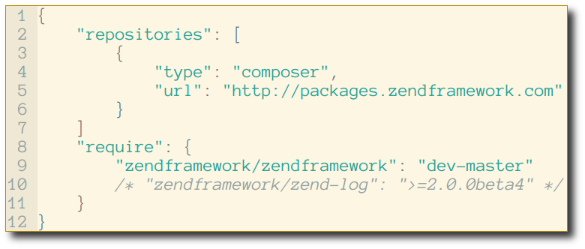
composer.json

Slide 58

Install dependencies

Slide 59
How to contribute

Slide 60


We want you!
How to contribute:
  Write code
  Documentation
  Testing
  Feedbacks/comments
https://github.com/zendframework/zf2

Slide 61
Helping out
http://framework.zend.com/zf2
http://github.com/zendframework
Weekly IRC meetings
#zf2-meeting on Freenode,
18:00 UTC Wednesday
#zftalk.2 on Freenode IRC

Slide 62

Thank you!
Talk feedback:
  https://joind.in/6647
Direct feedback:
  matthew@zend.com
  @weierophinney

