Slide 1

Customer Churn Analysis
Individual Project presented by:
Samson JULES
June 8th , 2020

Slide 2
Problem
Business problem
several rivals that are constantly trying to steal customers
Who are the stakeholders impacted by the problem?
The marketing team
customer service team
Why this problem is important to the organization?
this company has been the market leader for so many years, there are not significant opportunities to grow with new customers.

Slide 3
Methodology
Introduce the methods and data sources used for the analysis. Discuss your choice of variables, methods, and how they will help you address the problem.
The data used in this work comes from the company Telco through Kaggle. This data contains information about customers during the past month. The data includes customer demographics, the services used, the payment method and whether or not the customer is unsubscribed.All this data is very useful to us in that we were able to discover several ideas, statistics etc.. Our job is, on the one hand, to measure the weight of unsubscriptions at the company level, then to identify the percentage and profile of unsubscribed customers, as well as the factors that have contributed most to the unsubscription of these customers. On the other hand, predict the percentage of potential churn.

Slide 4
Regarding the methodology used, we first prepared the data for use, evaluate the churn, measure churn in three categories: - by demographics, - by services, and - by billing information.
In a second step, we looked at which services contributed most or least to unsubscribing or customer churn. Finally, to predict which customers are likely to leave the company if nothing is done and in what quantity.
Statistical calculations have been made to help us find our results.

Slide 5
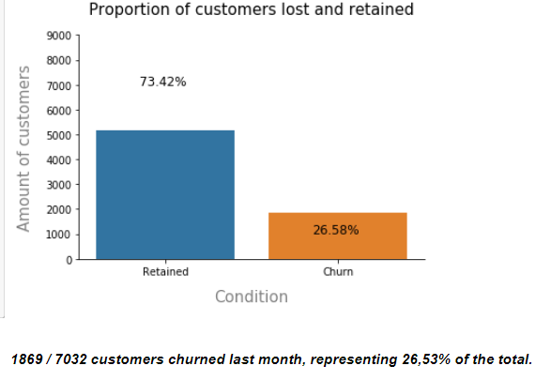
Results
How much is churn affecting the business? How big is churn compared to the existing customer base?

Slide 6
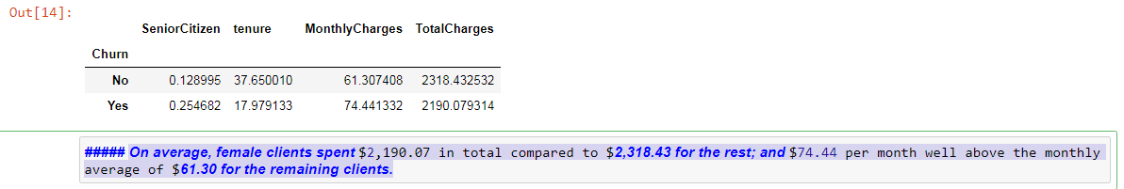
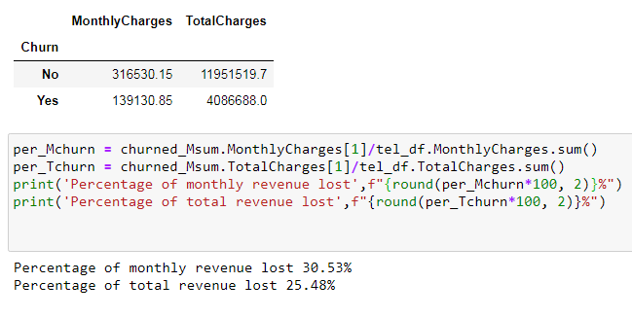

Slide 7
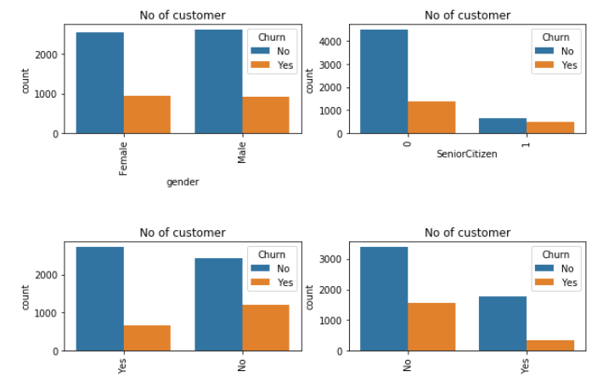
Visualization of customer churn by category

Slide 8
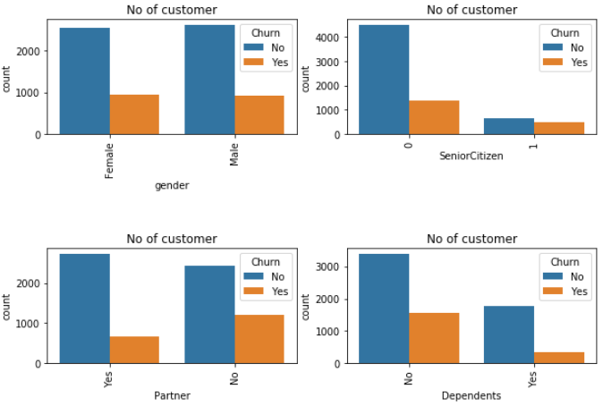
Visualization of average customer churn by category
There are no big difference between male and female who churn
The SeniorCitizen (Yes) are more to leave on average, but less in quantity.
Those who are not partners and are not dependent are more likely to leave the company.

Slide 9
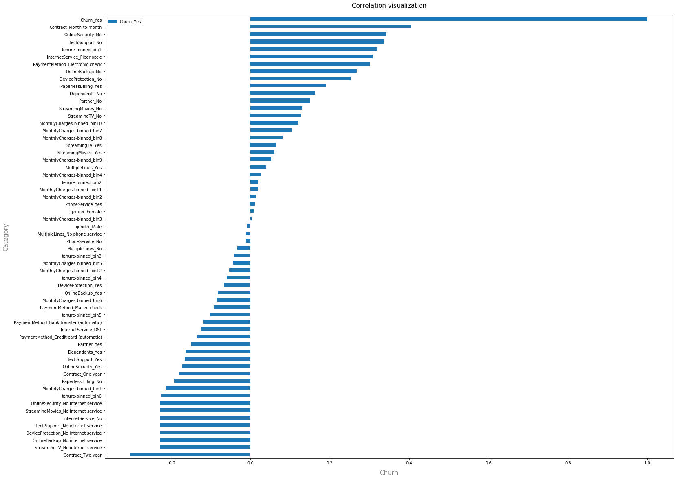

Slide 10
Analysis of correlation visual
Customers who do not use the internet are more loyal to the company.
Those with a month-to-month contract are more likely to leave. This is followed by Online Security_No, Tech Support_No and fiber optic users at the top.
If the older ones tend to stay, the younger ones are the first to leave.

Slide 11
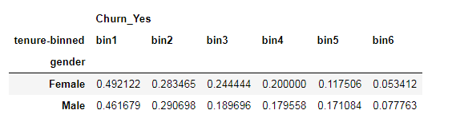
Churn by groups (gender and tenure)
By averaging the sexes in category 1 (with less than a year at the company level) are much more likely to leave it. 49% female and 46% male. However, we can notice that the more years the sexes accumulate, the more they tend to stay there. The last category ([bin6] i.e. with more years are the least inclined to leave.

Slide 12
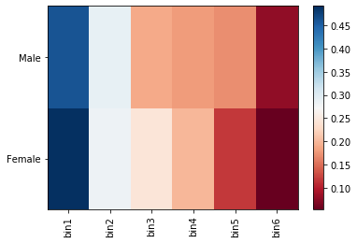
Churn by gender and tenure visual

Slide 13
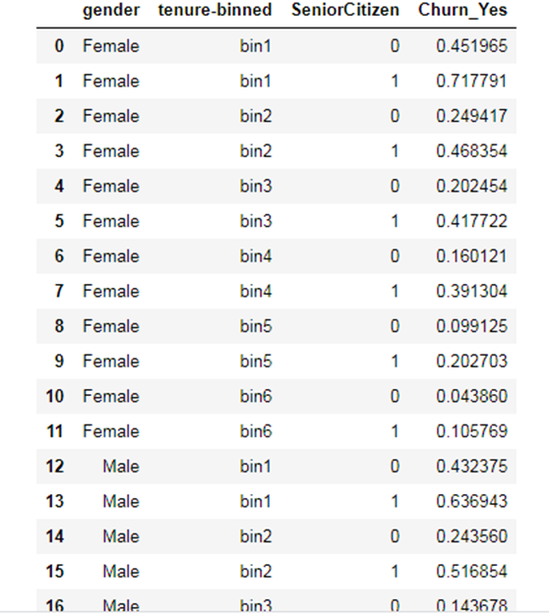
It turns out that in the category of adults who are much more likely to leave the company [bin1], SeniorCitizen(1) Male and Female are more likely to do so on average with 0.7177 (vs. 0.4519) and 0.6369 (vs. 0.4332) respectively.

Slide 14
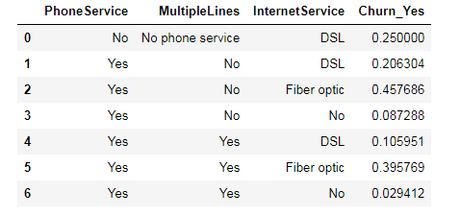
On average, among customers using PhoneService, MultipleLines and InternetService, non-Fiber optic (InternetService) customers are more likely to leave.

Slide 15
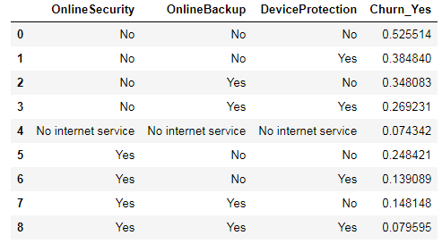
On average, customers who are not subscribers to OnlineSecurity and OnlineBackup are more likely to leave the company. It follows that those who are not subscribers to DeviceProtection also play an important role in their departure.

Slide 16
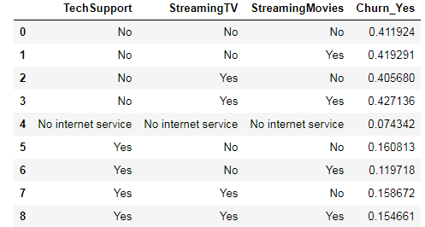
For TechSupport, StreamingTV and StreamingMovies services, customers who are not registered for TechSupport but are registered for StreamingMovies are much more likely to leave.

Slide 17
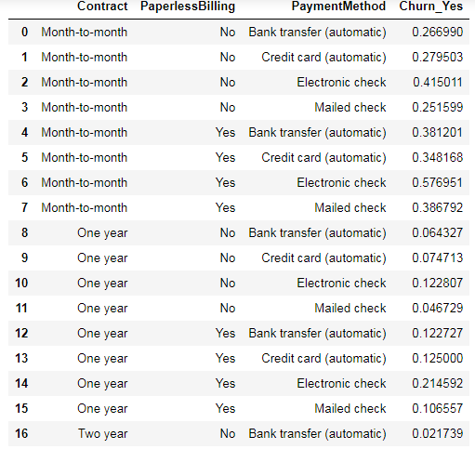
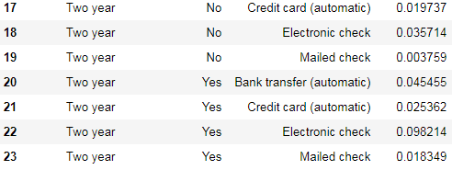
On average, customers with a month-to-month contract, using e-checks as a PaymentMethod and enrolled in PaperlessBilling (Yes) are much more likely to leave (0.576951).
Those with a Two year contract, PaperlessBilling (No), using Mailed check as payment method are the last to leave.

Slide 18
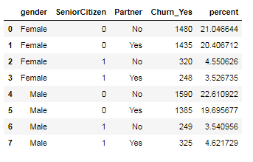
Types of people who churn at higher rates
Young men and young women (married and unmarried) are more likely to leave the company with a percentage of more than 40% by gender.

Slide 19
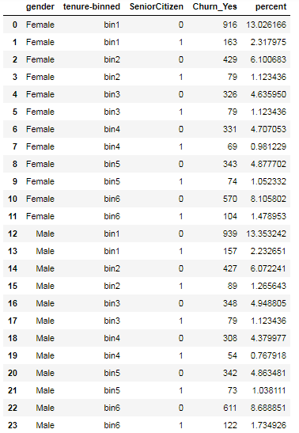
In percentage terms, young women with fewer years as clients and those with much more experience with the company are much more likely to leave than other categories. The same is true for young men. While adults tend to be loyal, over time and in the more experienced categories, they tend to leave.
Groupby Gender, tenure and SeniorCitizen

Slide 20
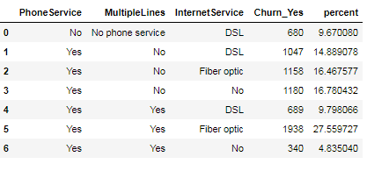
Grouping services (PhoneService, MultipleLines, InternetService)
Fiber optic users have a strong tendency to leave, especially those who use PhoneService and MultipleLines.

Slide 21
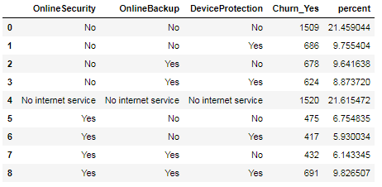
Grouping services (OnlineSecurity, OnlineBackup, DeviceProtection)
The more the customer doesn't use services such as OnlineSecurity, OnlineBackup and DeviceProtection, the more likely they are to leave. Those who don't use any internet service tend to leave the most.

Slide 22
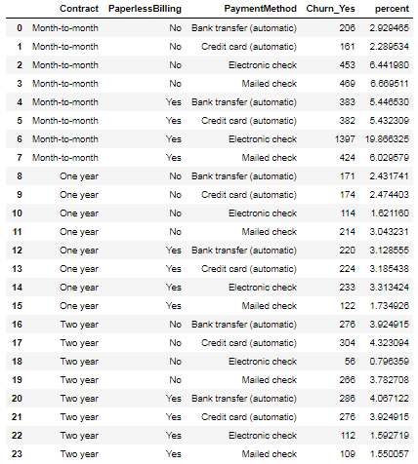
Grouping services (Contract, PaperlessBilling,PaymentMethod)
Customers with a monthly contract using PaperlessBilling are more likely to be loyal to the PaymentMethod used. Those using electronic check are the most likely to leave. The tendency for them to leave decreases as the customer's contract is extended over time.

Slide 23
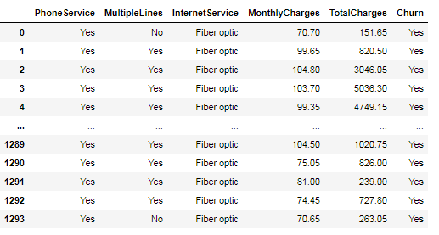
CASE STUDY
The Total Charges for the users of fiber optic (InternetService) who also use PhoneService and MultipleLines are : 2,887,749.4
By increasing sales by 10% in this category, we will have an additional income of : 288,774.94

Slide 24
Discussion & Recommendations
Proposed solution
The company must think of a program better adapted for young people (women and men). Since fiber optic users tend to be more likely to unsubscribe, the company should consider the quality of service offered to this category of users. In addition, the company should consider a special program for people who do not use any Internet service. As regards contracts and payment methods, the company should adapt the service offer to the payment method for those with a monthly contract; and lighten the payment procedure for those who pay by electronic check.

Slide 25
What are strengths of the organization that you have leveraged in your solution?
The company has as much information about its employees as possible.
Its database is well structured
What are weaknesses of the organization that could undermine your solution?
The amount of data available to the company is not very large for a more robust analysis.
What are challenges that you might encounter? How can you mitigate them?
Le delai accorde pour fournir un rapport peut etre tres court. Cependant, nous ferons de notre mieux meme pour un rapport partiel en accelerant advantage notre travail.

Slide 26
References & Appendices
https://github.com/samsonjules/Coursera_Capstone/blob/master/Customer-churn-analysis-week2.ipynb

