Slide 1
A CARIBBEAN RESTAURANT IN MONTREAL
IBM Data Science Professional Certificate
Applied Data Science Capstone
By Samson JULESJuly 4th, 2020

Slide 2
Predicting The location of a new Caribbean restaurant in Montreal is interesting for
Business personnel who wants to invest or open a Caribbean restaurant in Montreal. This analysis will be a comprehensive guide to start or expand restaurants targeting the Caribbean crowd.
Freelancer who loves to have their own restaurant as a side business. This analysis will give an idea, how beneficial it is to open a restaurant and what are the pros and cons of this business.
Haitian or Caribbean crowd who wants to find neighborhoods with lots of option for Caribbean restaurants.
4Business Analyst or Data Scientists, who wish to analyze the neighborhoods of Montreal using Exploratory Data Analysis and other statistical & machine learning techniques to obtain all the necessary data, perform some operations on it and, finally be able to tell a story out of it.

Slide 3
Data acquisition and CLEANING
Data on the reference boroughs, neighbourhoods and cities of Montreal, obtained from http://donnees.ville.montreal.qc.ca/dataset/quartiers
For the geospatial coordinates of the neighbourhoods, we use the geolocator(geocoder). Neighbourhoods are reference neighbourhoods in housing.
Data on Montreal's immigrant population comes from the 2016 Census through http://ville.montreal.qc.ca/portal/page?_pageid=6897,68087755&_dad=portal&_schema=PORTAL
To get location and other information about various venues in Montreal we use Foursquare API.
Cleaned data resulted in 211 unique categories in which Caribbean Restaurant is one of them.

Slide 4
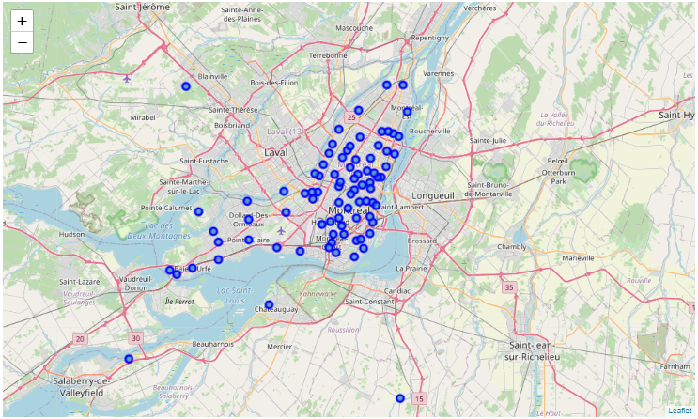
Locate montreal using Geocoder
Montreal and its reference residential neighborhoods in blue

Slide 5
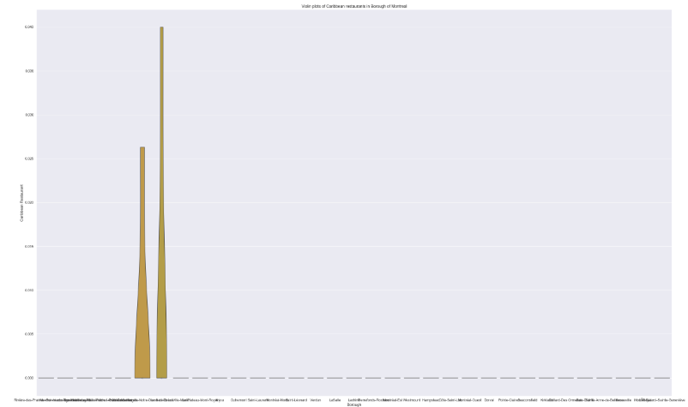
No borough with densely populated Caribbean restaurant
With this plot we can identify the boroughs with densely populated Caribbean restaurants. However, we can notice at first glance that there is not really a high density

Slide 6
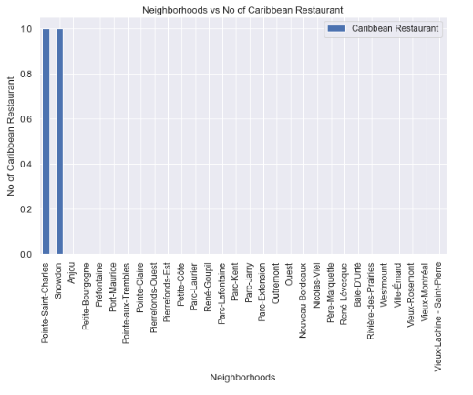
Neighbourhoods or boroughs don’t have more than one restaurant for the most part.
Only 2 boroughs each contain a Caribbean restaurant.

Slide 7
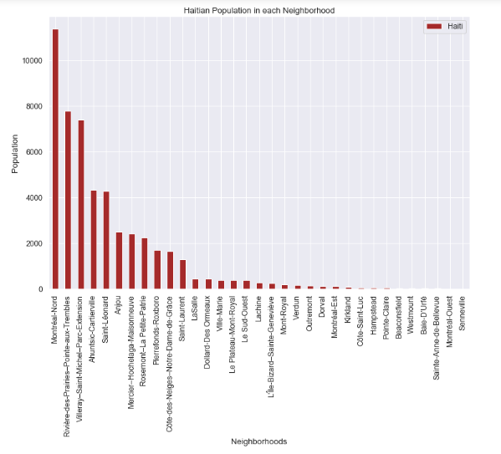
5 boroughs hold more Haitians
Boroughs such as Montréal-Nord, Rivière-des-Prairies-Pointe-aux-Trembles, Villeray-Saint-Michel-Parc-Extension, Ahuntsic-Cartierville and Saint-Léonard are the most populous in terms of the number of Haitian immigrants

Slide 8
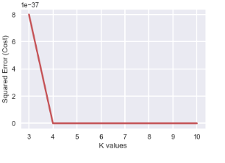
Clustering Neighborhoods of Montreal
After analysing using elbow method using distortion score & Squared error for each K value, looks like K = 4 is the best value

Slide 9
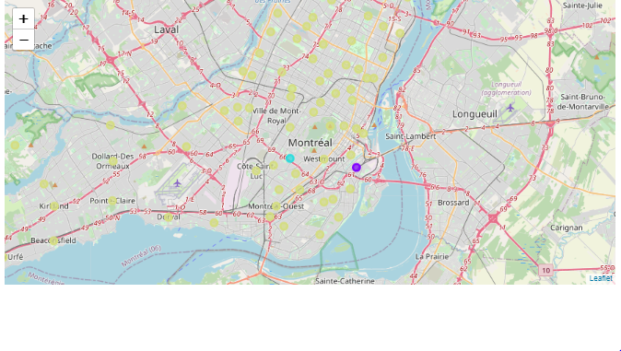
4 clusters with 3 colors
Cluster 0 has no rows meaning no data points or neighborhood was near to this centroid.
Cluster 1 contains the neighborhoods which is more populated with Caribbean restaurants. It is show in purple in the map.
Cluster 2 contains the neighborhoods which is sparsely populated with Caribbean restaurants. It is show in blue in the map.
Cluster 3 contains all the neighborhoods which has least number of Caribbean restaurants. It is shown in yellow color in the map.

Slide 10
Conclusion
Only Côte-des-Neiges-Notre-Dame-de-Grâce and Le Sud-Ouest have one or two Caribbean restaurants.
Boroughs such as Montréal-Nord, Rivière-des-Prairies-Pointe-aux-Trembles, Villeray-Saint-Michel-Parc-Extension, Ahuntsic-Cartierville and Saint-Léonard are the most populous in terms of the number of Haitian immigrants.
Montreal-Nord borough as being the least competitive with the largest community of Haitian immigrants and among the boroughs with the fewest Caribbean restaurants.

