Slide 1
Who is recruiting in Haiti and in what field. A study on 9,000+ jobs published on Jobpaw from 2008 - 2020
Ayiti Analytics Bootcamp – capstone project
By Samson JULES August 12th, 2020

Slide 2





Analyzing 9,000+ job offers online since 2008 is interesting for
Job seekers. This analysis will help them to understand the reality of the job offer
Investors who want to invest in one sector or another. With this work, they will be able to decide whether to invest in the sector where most or least recruitment is taking place;
Students or future students who are or will be preparing to face the job market. They will be able to further refine their knowledge or training. They will thus be better prepared with a good background to face the job market.
Professionals wishing to change careers will have important information and analysis at their disposal to help them decide on their choice.
The public decision-makers who will have studies at their disposal for any adaptation of their employment policy to the reality of the market.

Slide 3

Data acquisition and CLEANING
Our main source for obtaining this data is jobpaw.com, a reference site for job postings. Our acquisition method is based on scraping the information on the website. Our database is built in French. In processing the information obtained, we proceeded as follows:
The initial columns are: Date de publication - Titre du poste - Domaine - Compagnie - Spécialité - Date limite - Ville - Durée;
We are deleting some non-essential columns;
Lines that do not contain a publication date have been removed.
After all we obtain 9491 rows or job posted (and cleaned).

Slide 4
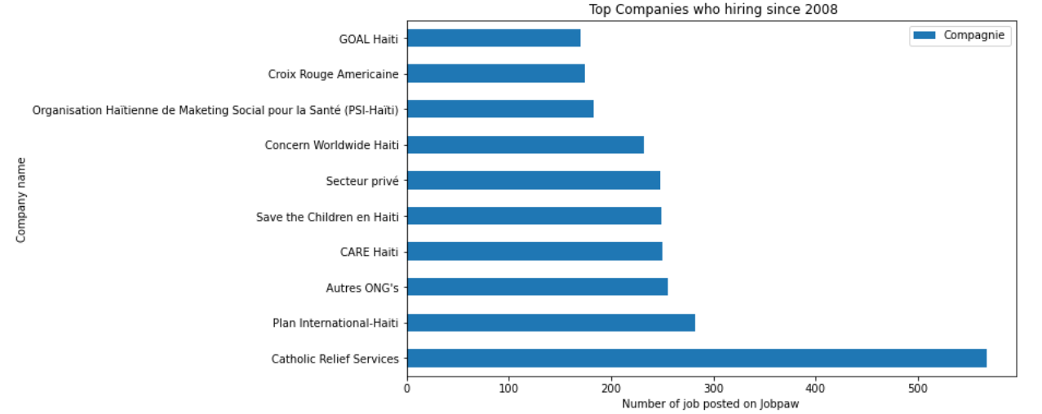
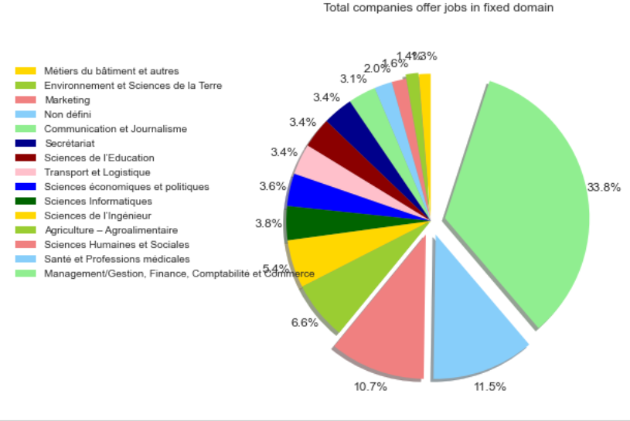
Top companies who recruit in haiti
Catholic Relief Services, Plan International, Care Haiti are among the 15 companies offering more jobs via Jobpaw in Haiti.
Catholic Relief Services, Plan International, Care Haiti are among the 15 companies offering more jobs via Jobpaw in Haiti.

Slide 5
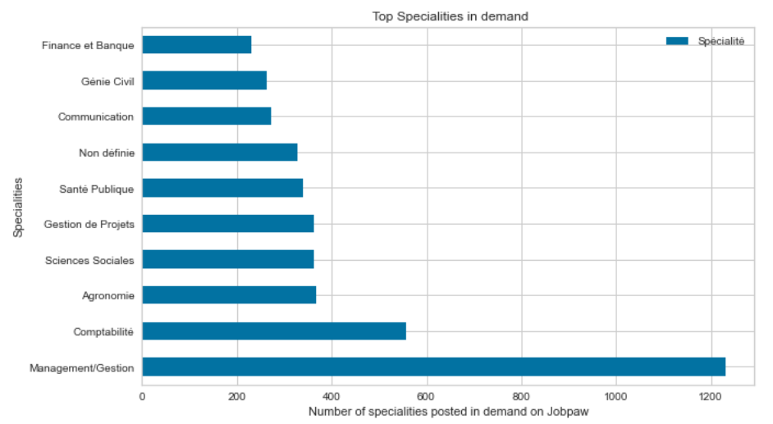
Top specialities in demand since 2008 via Jobpaw
Among the most requested specialities, Mangement/Gestion, Comptabilite (Accounting) and Agronomie are in the top 10.

Slide 6
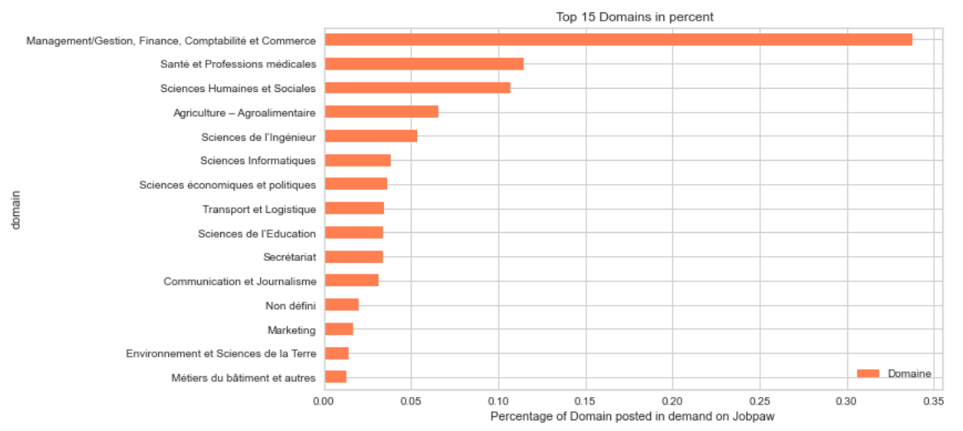
Top 15 domains in percent
Management/Gestion keep the first place higher with more than 33% in total percent.

Slide 7
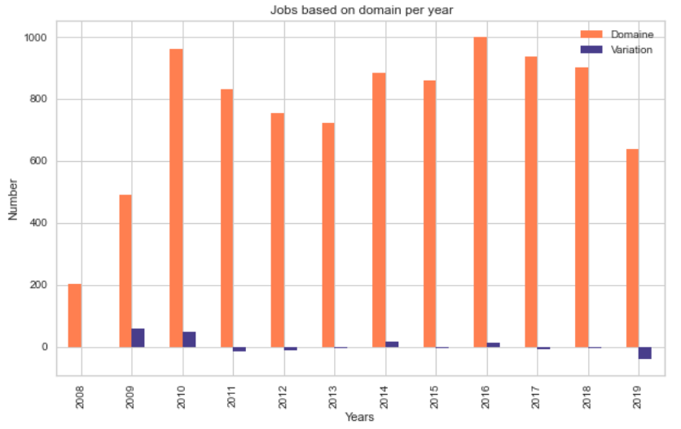
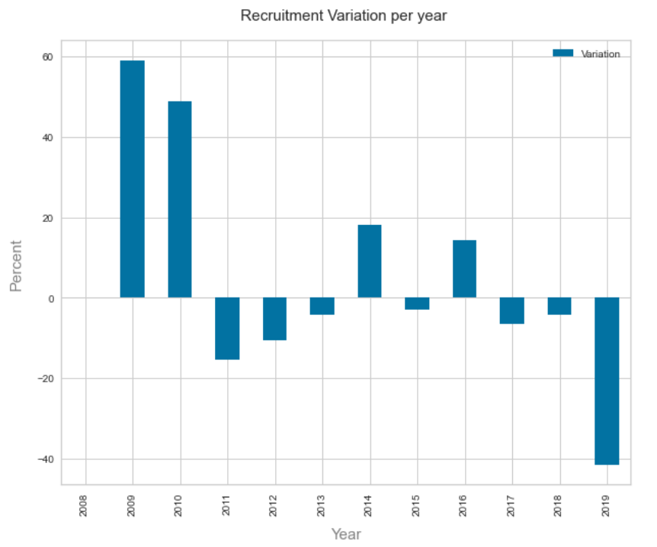
Total Job based on domain per year

Slide 8
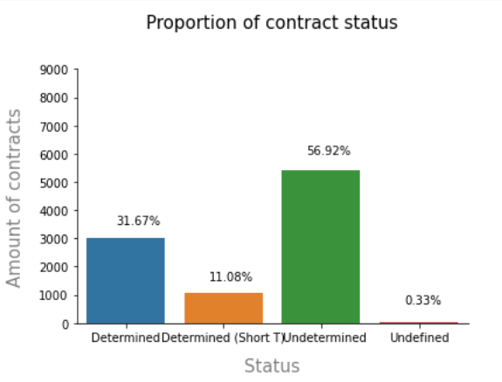
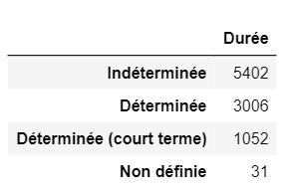
Contracts statuts
Most of the contracts are open-ended contracts (56%).

Slide 9
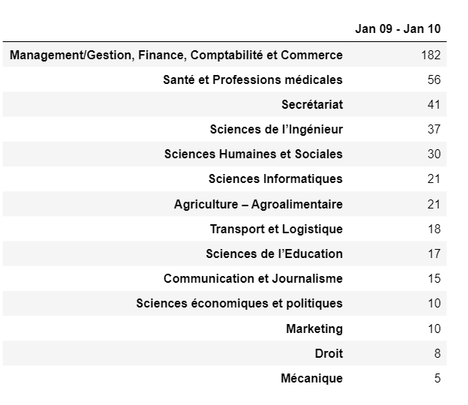
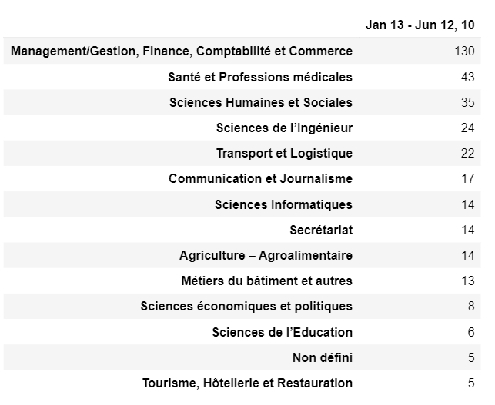
Impact of the 2010 earthquake on employment opportunities
In only 6 months, some domains like Transport et logistique, Sciences humaines et sociales, have a figure almost equal to or exceeding that of the previous year.

Slide 10
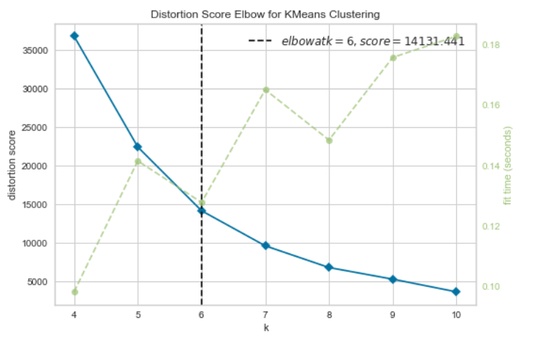
Clustering institutions by total job offers
After analysing using Elbow method using distortion score & Squared error for each K value, looks like K = 6 is the best value.

Slide 11
Job offers by cluster
Cluster 0
Sum | Mean | STD
1260 | 15.1807 | 5.3354
Cluster 3
Sum | Mean | STD
1235 | 42.5862 | 11.0954
Cluster 1
Sum | Mean | STD
407 | 203.5 | 34.6482
Cluster 4
Sum | Mean | STD
1105 | 1.9592 | 1.9686
Cluster 2
Sum | Mean | STD
988 | 109.7777 | 24.9187
Cluster 5
Sum | Mean | STD
407 | 407.0 | nan

Slide 12
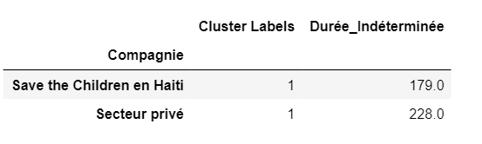
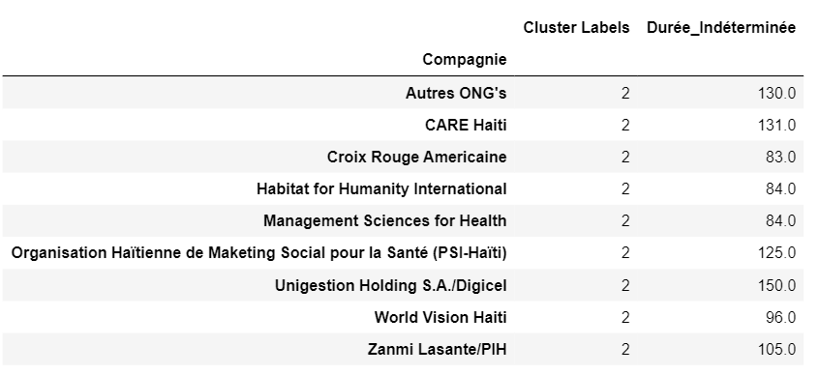
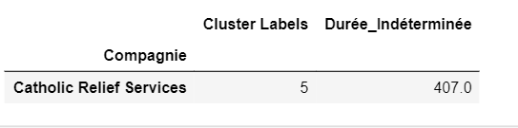
6 clusters with different values
By grouping companies by their frequency of publication and the quantity of fixed-term contracts, we obtain these groups of companies offering a certain quantity of open-ended contracts.

Slide 13




Conclusion
Most job offers are open-ended contracts.
Companies offering more jobs are among those offering more open-ended contracts.
The most popular fields or specialities are dominated by Management
and the health professions.
Catholic Relief Services is the institution offering the most jobs since 2008 through Jobpaw.

Slide 14
Thank You !

Slide 15

Samson JULES
Economist, Data Scientist, Public Manager
Github link: https://github.com/samsonjules/Coursera_Capstone/blob/master/job_analysis.ipynb

