Slide 1
Data Engineer Case Interview
Luah Jun Yang

Slide 2
Section 1: Data Pipelines

Slide 3
Section 1 - Processing Data files on a regular interval
1
Airflow as the scheduling Tool
I selected Airflow as the scheduling tool as I have had prior experience with it. I set a session-based Airflow UI using ngrok via a Google Colab Notebook which is the python Notebook I submitted
2
Data processing and output – Python Operator
I wrote a function to perform the necessary Data processing and output the new CSV files using pandas. The function was then run using 2 task instances of PythonOperator which takes in the dataset1.csv and dataset2.csv as input arguments

Slide 4
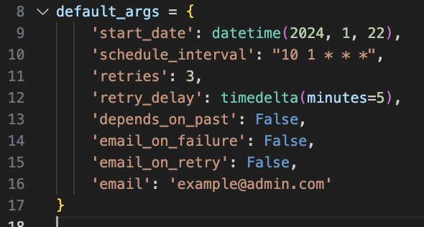
Section 1 =Processing Data files on a regular interval
Cron Schedule set for 0110hrs everyday, as I am expecting the new data file to come in at 1am everyday

Slide 5
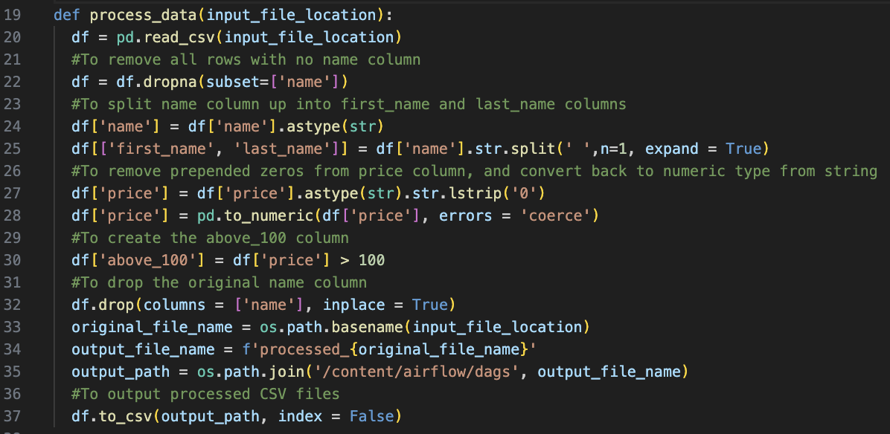
Section 1- Processing Data files on a regular interval
process_data function: - Performs processing steps as specified by comments in Green
- Drops original name column
- Outputs CSV files with new name ‘processed_{original_file_name}.csv’

Slide 6
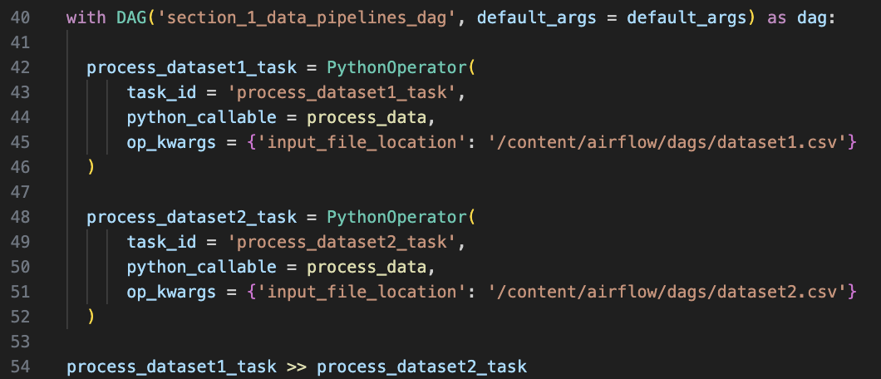
Section 1- Processing Data files on a regular interval
- 2 instances of PythonOperator calling the process_data() function, with the input files being dataset1.csv and dataset2.csv

Slide 7
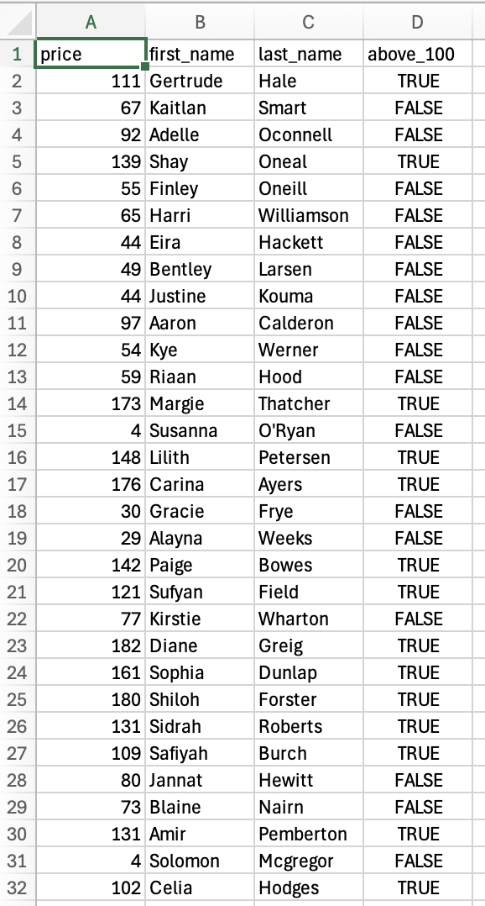
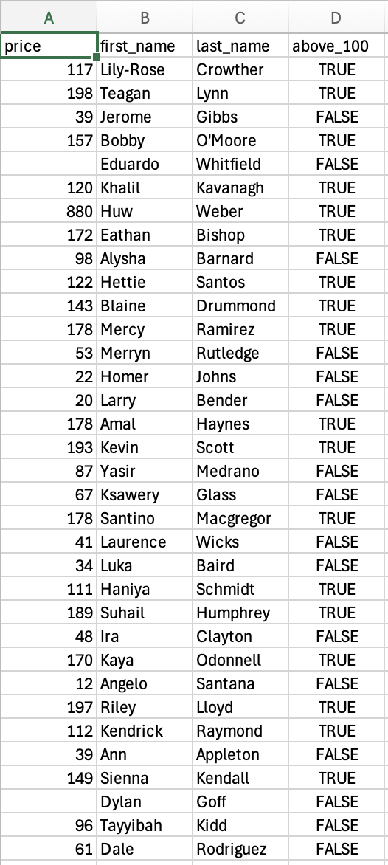
Section 1- Output data files

Slide 8
Section 2: Databases

Slide 9
Section 2 - Database Infrastructure
Deliverables
1
Dockerfile to pull from provided link
2
DDL statements – create_db.sql and ER diagram
3
Queries folder – containing the 2 .sql files for the 2 queries

Slide 10
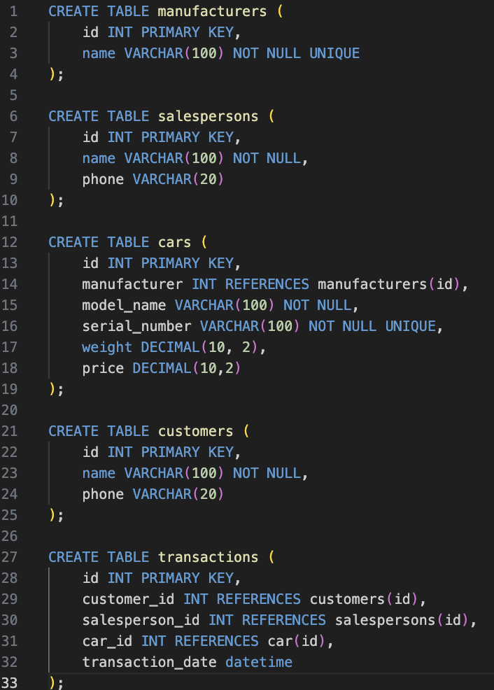
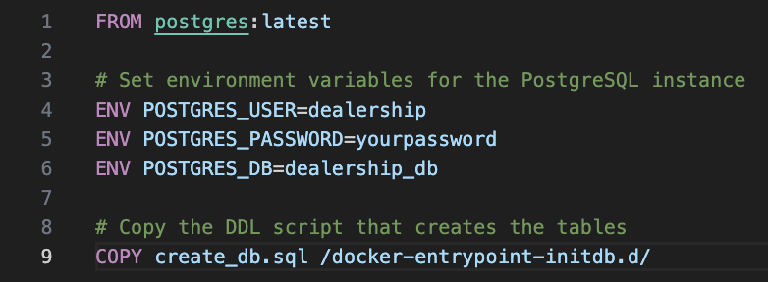
Section 2 - Database Infrastructure
Dockerfile + DDL
Dockerfile:
Pulls the latest postgres image
Sets env variables
Copies the DDL script that will create the tables

Slide 11
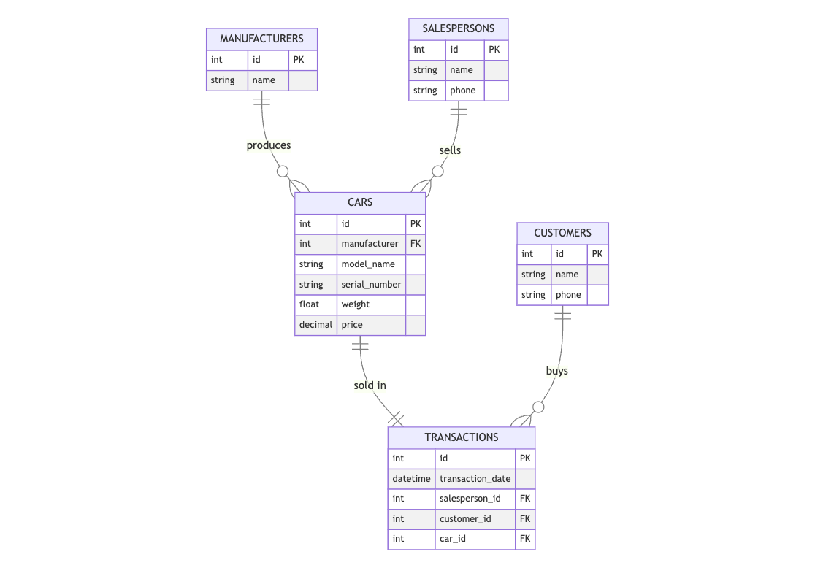
Section 2 - Database Infrastructure
Dockerfile + DDL
DDL statement and ER diagram for the 5 tables to be created:
Manufacturers
Salespersons
Cars
Customers
Transactions

Slide 12
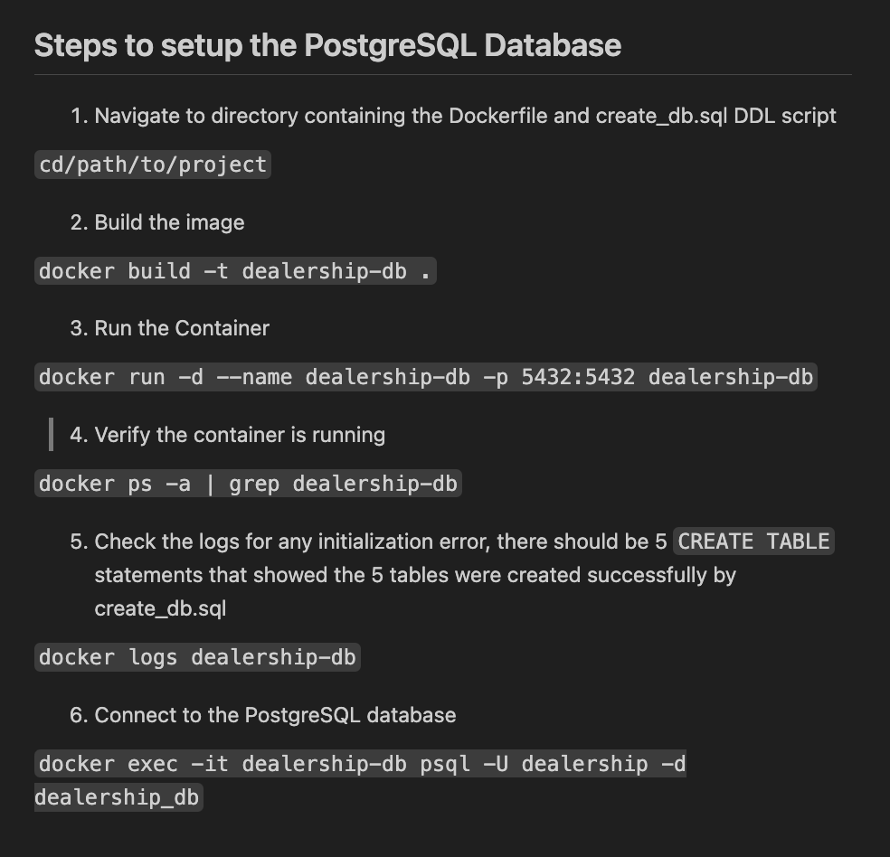
Section 2 - Database Infrastructure
Steps to Run
Step 2:
docker build builds a new Docker image using the Dockerfile in the current directory and –t dealership-db tags the image with the name dealership-db.
Step 3:
docker run creates and starts a new container from the dealership-db image created in the previous step
-d runs the container in detached mode
--name dealership-db names the container dealership-db
-p 5432:5432 maps port 5432 on your machine to port 5432 on the container which is PostgreSQL’s default port

Slide 13
Section 2 - Database Infrastructure
Steps to Run
Step 4:
docker ps –a lists all containers
grep dealership-db filters for containers only containing dealership-db
Step 5:
Displays logs
Step 6:
docker exec –it allocates an interactive terminal
psql –U dealership –d dealership-db runs the PostgreSQL CLI client as the dealership user and connects to the dealership-db database

Slide 14
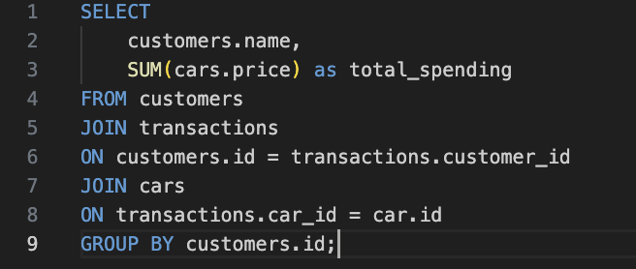
Section 2 - Database Infrastructure
Query 1
Selects customers’ name and SUM() on their price to get their aggregated total spending
Joins customers table with transactions table on customer_id
Joins transactions table on cars table on car_id
Group by customer_id to SUM their total_spending

Slide 15
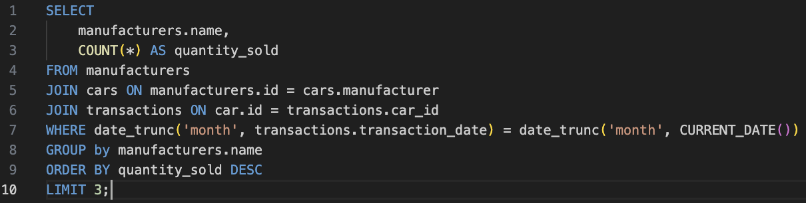
Section 2 - Database Infrastructure
Query 2
Select Manufacturer’s name and COUNT(*) to get the total number of cars sold by each manufacturer
Joins manufacturers table with cars table on manufacturer_id
Joins cars table with transactions table on car_id
Use date_trunc(‘month’) and current_date() to get just the rows of transactions for the current month
Group by manufacturer’s name for the COUNT(*)
Order by quantity_sold DESC and LIMIT 3 to get the top 3 manufacturers in terms of number of cars sold

Slide 16
Section 3: Cloud

Slide 17
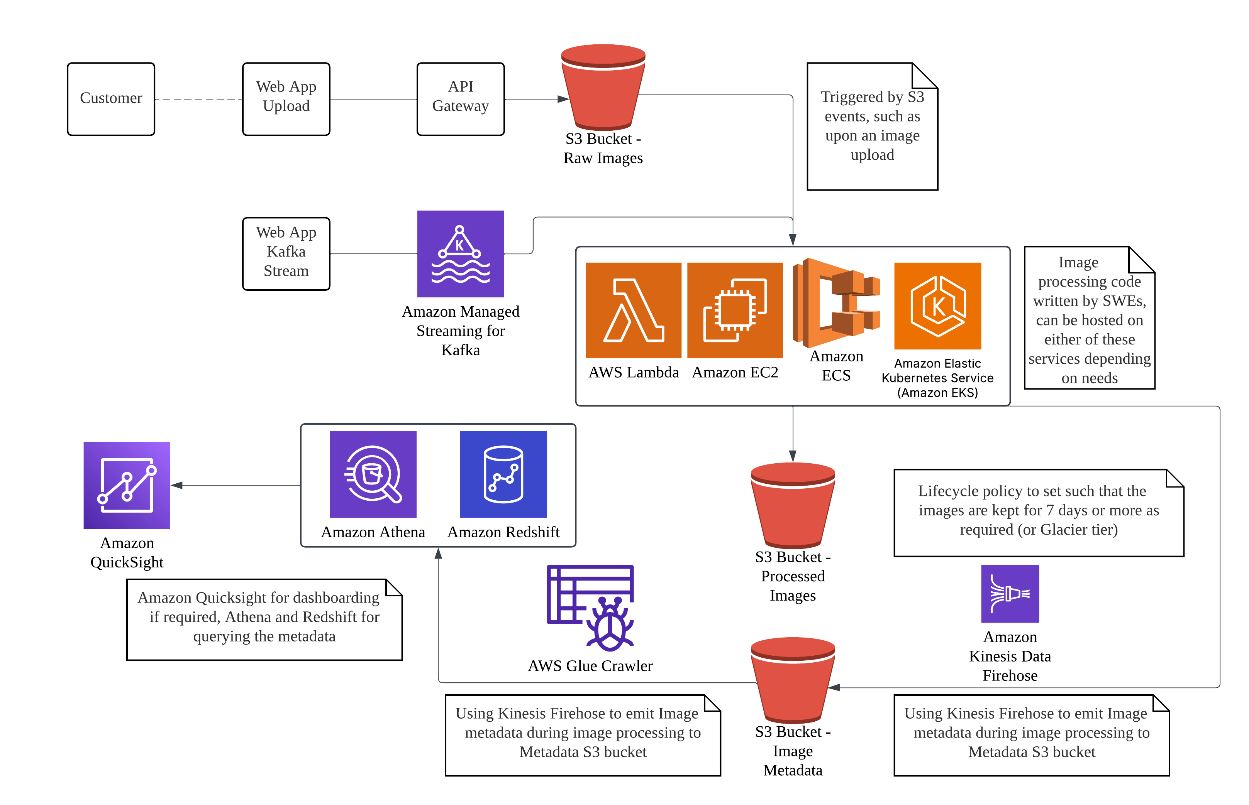
Section 3 – Cloud Infrastructure (AWS)

Slide 18
Section 3 – Cloud Infrastructure (AWS)
Assumptions
The existing image processing code is cloud-ready and can be run in a containerized or serverless state (AWS Lambda, ECS, EKS, EC2 instance)
Web apps are assumed to be integrated with the AWS Ecosystem, which has them working with API Gateway and Amazon MSK
The existing image processing code is able to output the metadata of the images for Kinesis firehose to ingest the data into the metadata S3 bucket
Amazon Quicksight is sufficient as a Business Intelligence solution for the company’s needs

Slide 19
Section 4: Charts and API

Slide 20
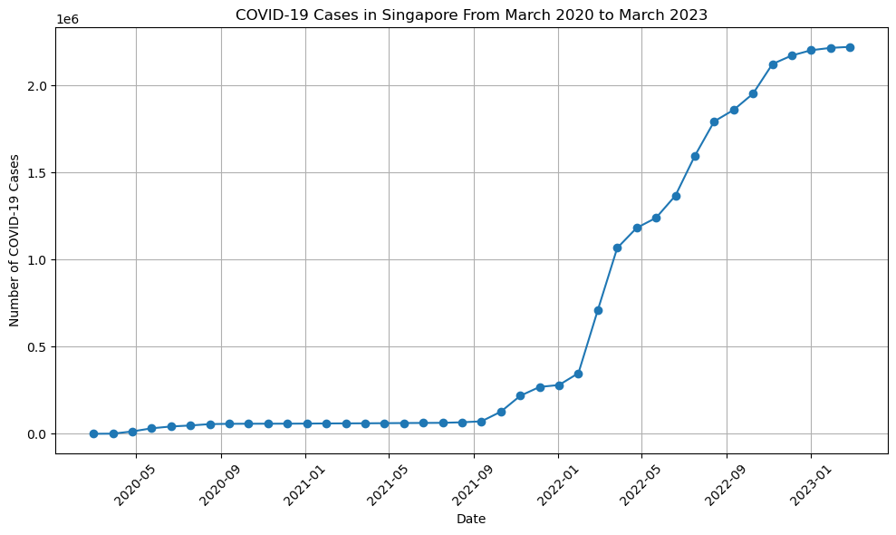
Section 4 – Charts and API

Slide 21
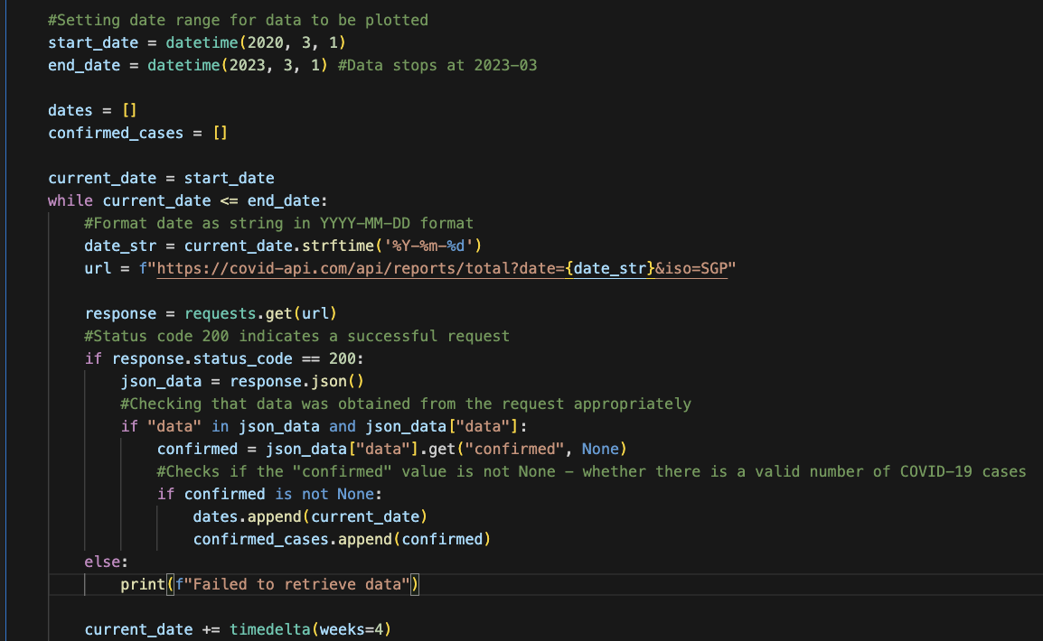
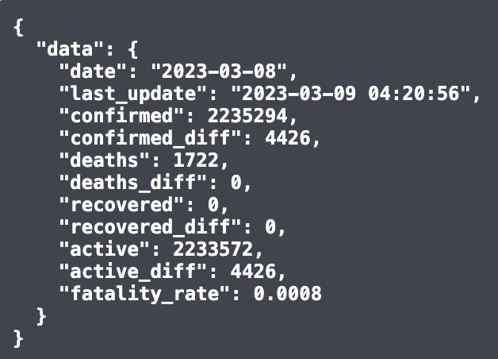
Section 4 – Charts and API
Returned object from the API is of the above format, we are only interested in the ”date” and the “confirmed” fields to allow us to plot the number of COVID-19 cases over time
Using requests.get() to and response.json() to get the json object and checking that the json object is not empty.
The date and confirmed numbers are appended to the dates and confirmed_cases lists which are then subsequently used to plot the chart, iterate through dates from start till end to get number of cases for each month.

Slide 22
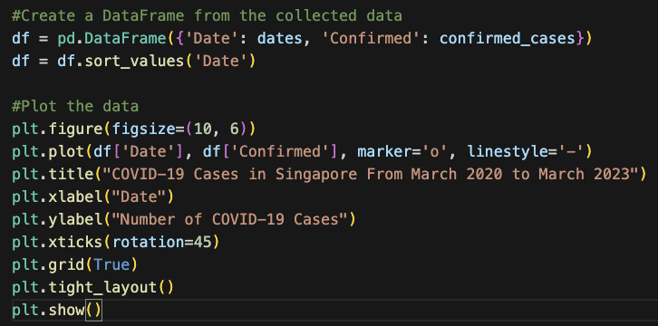
Section 4 – Charts and API
A pandas dataframe is created from the dates and confirmed_cases data obtained from iterating through the dates in the previous code chunk.
Matpotlib is then used to plot the final chart of number of covid cases for each month from March 2020 to March 2023

Slide 23
Section 5: Machine Learning

Slide 24
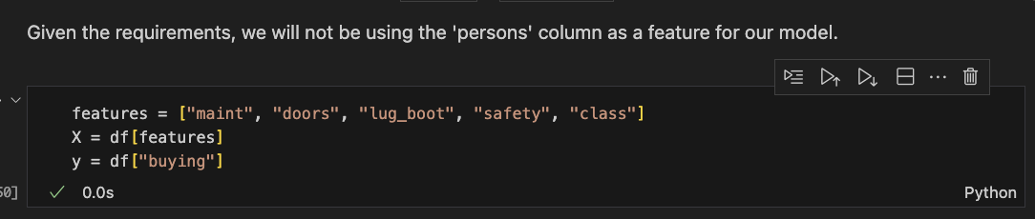
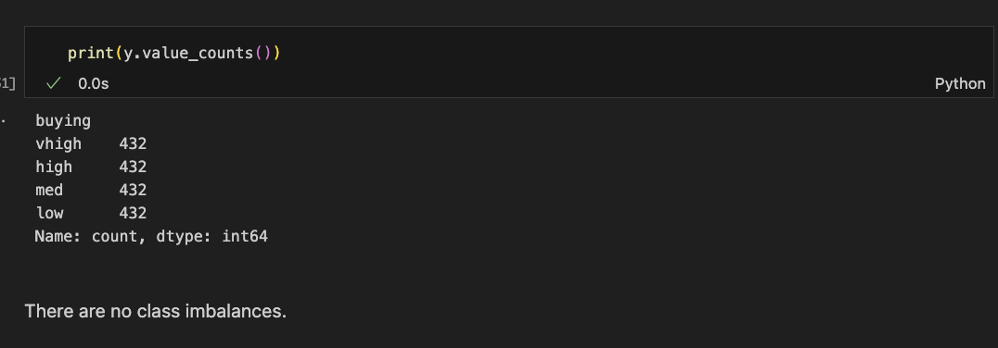
Section 5 – Machine Learning
Using only the Maintenance, Number of doors, Lug boot size, safety, and class value of the car as features for the model.
Checking if there is any class imbalance in the buying price of the car which could lead to poorer performance of the model.

Slide 25
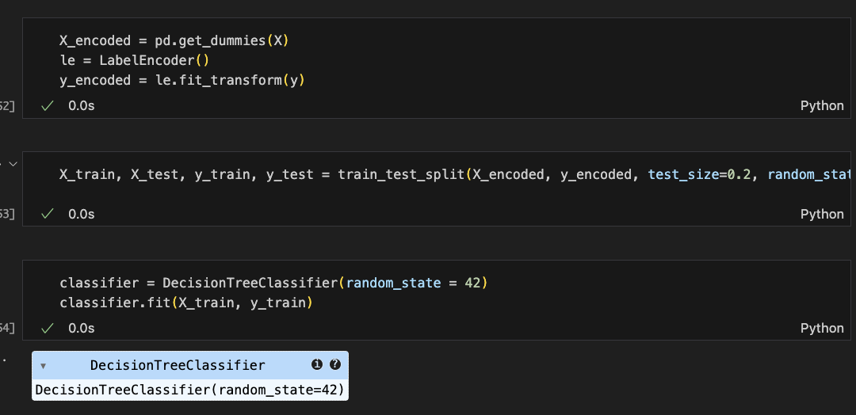
Section 5 – Machine Learning
Using get_dummies() from pandas to one-hot encode the features and LabelEncoder to encode the prediction class (buying price) to numeric values
Use sklearn’s train_test_split to split the data up with a 80/20 split
Fitting the DecisionTreeClassifier from sklearn to the training data

Slide 26
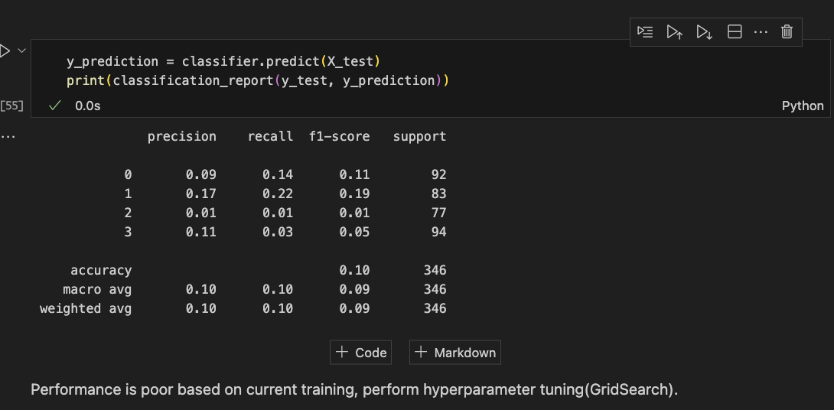
Section 5 – Machine Learning
Given the poor initial performance of the model, I will run hyperparameter tuning, more specifically GridSearch as I aim to improve the performance of the DecisionTreeClassifier

Slide 27
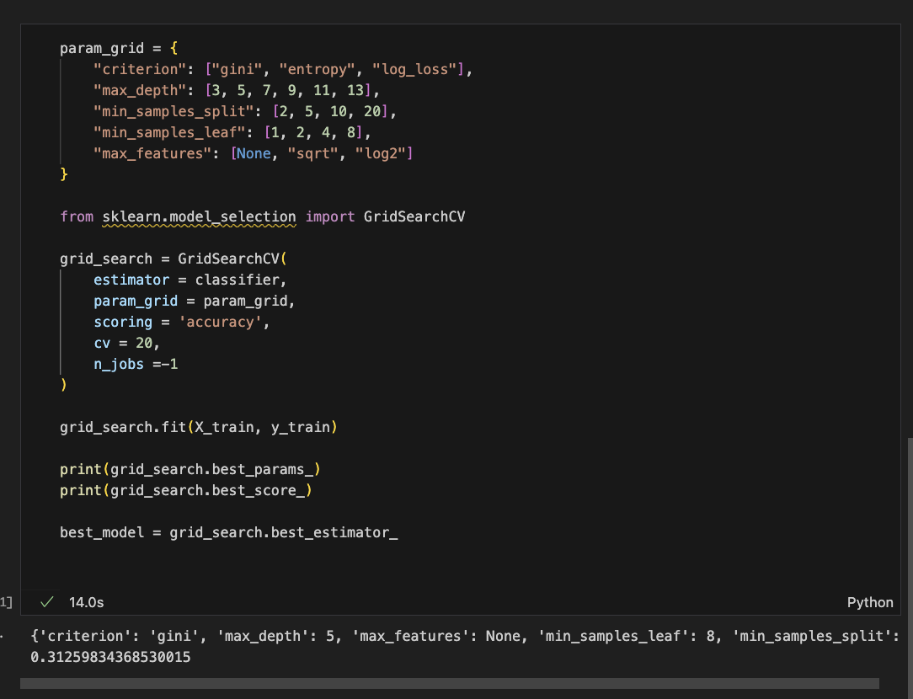
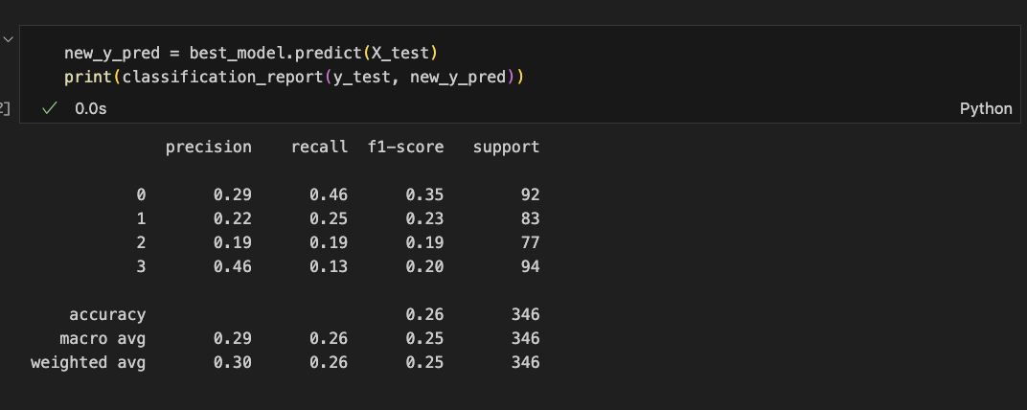
Section 5 – Machine Learning
While the performance is still not ideal, there is an improvement after running GridSearch

Slide 28
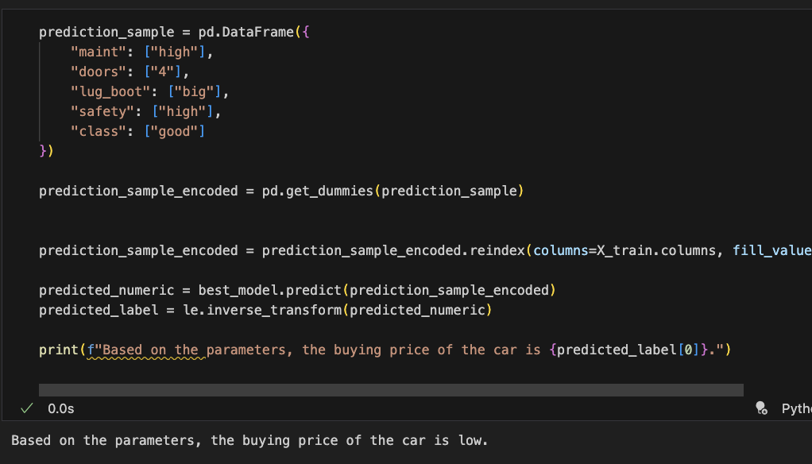
Section 5 – Machine Learning
The final predicted buying price of the car based on the provided parameters is low.

