Slide 1

An Introduction to Modeling and Representation of Clinical Guidelines
Mor Peleg, Ph.D.
Post-doctoral Fellow, SMI, Stanford Medical School, Stanford University, Stanford, CA
Aziz A. Boxwala, M.B.B.S, Ph.D.
Research Scientist, DSG, Harvard Medical School, Brigham & Women’s Hospital, Boston, MA

Slide 2
Outline
Clinical guidelines
  What are clinical guidelines?
  Why should guidelines be computer-based?
  Why is sharing of guidelines important?
Guideline Modeling and representation
  What are guideline-models?
  How do we represent guidelines?
  Why need a standard for a sharable computer-interpretable guideline representation?
Functional requirements for a sharable computer-interpretable guideline representation

Slide 3
Clinical Guideline
The need for guidelines
Development and dissemination
Computer-based guidelines
Sharing of guidelines

Slide 4
The Need For Guidelines
Studies demonstrating huge variability in practices
  Differences among regions
  Differences within communities or institutions
Growing demand for clinical actions based on supporting evidence rather than habit, tradition, or local lore

Slide 5
Need For Guidelines (Cont.)
Quality of care
  medical errors are a significant cause of morbidity and mortality (Institute of Medicine report)
Cost-effectiveness of care
Increase in managed care
  Introduction of rules that have to be followed before resources can be committed

Slide 6
What Are Clinical Guidelines?
A recommended strategy for management of a medical problem in order to
  reduce practice variation
  improve outcomes
  reduce inappropriate use of resources
Methods for development
  based on evidence from scientific studies
  based on consensus among experts

Slide 7
FINDING THE CAUSE OF GYN BLEEDING IN THE POSTMENOPAUSAL WOMAN
A 45-year-old woman reports bleeding nine months after apparent cessation of menstrual function
Has she been taking estrogen orally or topically?
YES
Is the dosage within limits and cyclical?
NO
YES
NO
Rule out trauma or a foreign object as the cause. Check for possible rectal bleeding.
Do a pelvic, Pap smear and swab of lower third of the vagina.
Suspect injudicious estrogen therapy as the cause of bleeding.
Does vaginal smear show midcycle or third week cell changes that occur with phases of the cycle?
Does the smear show a significant percent of cornified epithelial cells?
NO
NO
YES
YES
Suspect estrogenization as the cause
Is atrophy of mucosa apparent
Suspect the patient is still menstruating
NO
YES
Are smear and jet wash or biopsy all negative?
Do a jet wash or endometrial biopsy to screen for hyperplasia, carcinoma, submucous niaroids, polyps or other local disorders
Suspect atrophic vaginitis, an effect of low estrogen production, as the cause
YES
NO
Notes:
Guidelines: usually ~100 pages + some diagrammatic algorithms
I’ve added the pink contour to distinguish actions from decisions

Slide 8
Types of Guidelines
Chronic disease management
  diabetes, asthma, hypertension
Screening guidelines
  cancer screening
  cholesterol screening
Diagnosis
Workup

Slide 9
Types of Guidelines (Cont.)
Risk assessment
  risk for breast cancer, myocardial infarction
Consultations
  Appropriateness determination of diagnostic test
Protocol-based care
  clinical trials
  cancer therapy
  AIDS therapy

Slide 10
Development & Dissemination
Literature Review
Consensus Process
Evidence Evaluation
Guideline Creation,
Review, and Approval
Guideline Publication
(article or monograph)
Assume: Health care will benefit
Guideline Dissemination
Assume: Practitioners will internalize and thereby follow the guideline
Assume: Practitioners will read the guideline

Slide 11
Publication & Dissemination
Conventional publication in journals and textbooks
Mailing of booklets or guideline summaries to clinicians
Compilations of guidelines for reference
Online resources
  Locally supported
  National and international

Slide 12
Problems in Guideline Use
“Cookbook medicine”
  Guidelines, not absolute dogma
Run counter to accepted practices
  Evidence does not always support accepted practices
Not accessible during patient encounter
Not applicable to care setting or to patient

Slide 13
Problems (Cont.)
Vague and non-specific recommendations or decision criteria
  e.g., in patients who are not very ill, the physician might want to think about prescribing drug X
Ambiguous
  Evidence often does not support a single approach
  Range of options often appropriate

Slide 14
Computer-based Guidelines
Provide decision support during the clinical encounter
Can be adapted to clinical setting
Decision criteria and recommendations can be precisely specified

Slide 15
Online Practice Guidelines
Four levels of access to guidelines:
As text documents
As indexed and searchable documents
Interactive guidelines
  Enter patient parameters to traverse guideline
Guideline embedded in EMR System
  automated reminders/alerts
Zielstorff, R. Online Practice Guidelines. JAMIA: 5(3), 1998

Slide 16
National Guideline Clearinghouse
Publishes guidelines on the Internet from many US Institutions
  http://www.guideline.gov
Guidelines published as searchable text
Not useful for clinicians
  Does not provide patient-specific recommendations

Slide 17
Structuring Guidelines
Structured representation of knowledge in a clinical guideline in a form that a computer program can interpret
Programs can utilize the information contained in the guideline for performing actions such as alerts, reminders, and other decision and task support

Slide 18
Vaccine Guideline
Encoding
Decision Logic
get occupation
get age
Health Care Worker
or Age > 65?
yes
otherwise
adult
dose
pediatric
dose
yes
Age < 12?
no
END

Slide 19
Why Structure Guidelines?
Provide automatic decision support
Integrate guidelines into workflow
Ambiguities in guidelines may be reduced
Can be used for quality assurance
  Guideline defines “gold-standard” of care
  Perform retrospective analysis to test if patients treated appropriately
  Reliability studies
Simulation for educational purposes

Slide 20
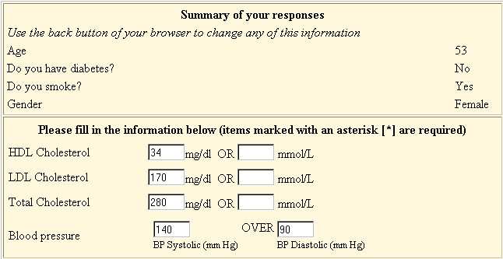
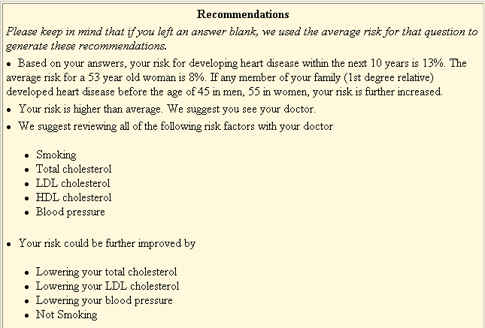
Risk assessment application
Risk for heart disease

Slide 21
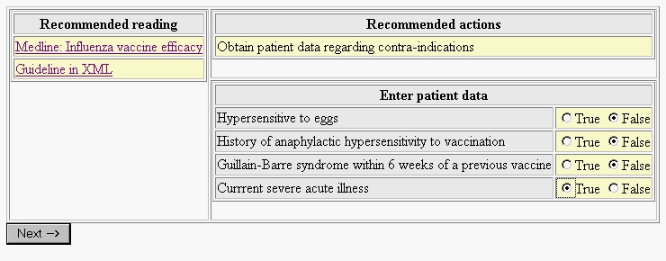
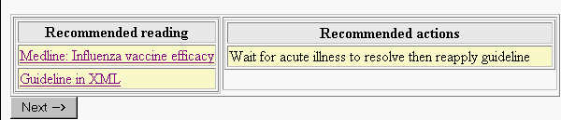
Consultation application
Flu vaccine guideline

Slide 22
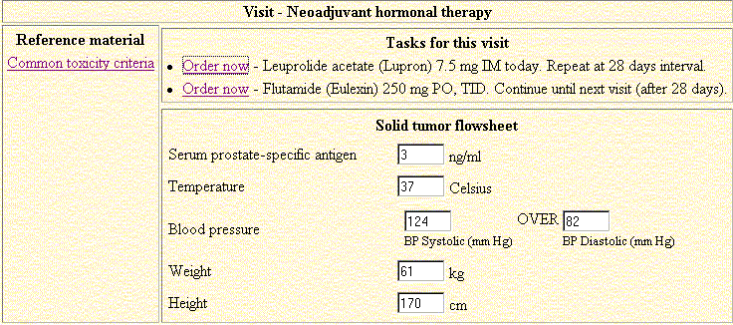
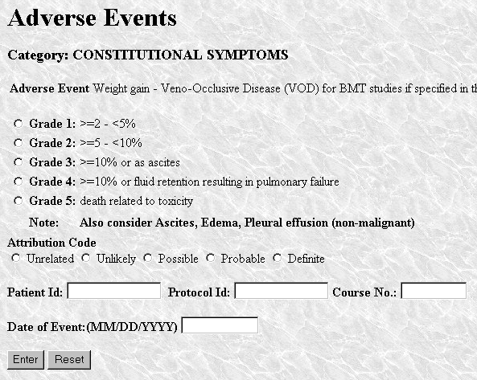
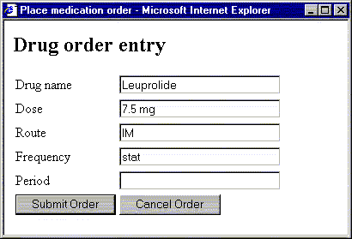
Protocol-based care application
Prostate cancer
protocol

Slide 23
Development & Dissemination
Literature Review
Consensus Process
Evidence Evaluation
Guideline Creation,
Review, and Approval
Guideline Publication
(article or monograph)
Assume: Health care will benefit
Guideline Dissemination
Assume: Practitioners will internalize and thereby follow the guideline
Assume: Practitioners will read the guideline
Notes:
InterMed has two roles in this process:
We want to take out the two assumptions by computerizing the guidelines. When the GLIF-encoded guidelines will be executed, they would be linked to the EPR (DB), so that the patient’s data could be directly queried. Knowing the point at which the patient is on the guideline, and looking at his current medical state, we can deliver the specific appropriate recommendation to the MD, and not have him memorize and internalize the entire guideline.
Right now, the authoring of a guideline is done without the use of tools. The guidelines are created by word processing tools. This way, the guidelines contain many inconsistencies and vague terms that may be avoided by the use of a guideline authoring tool.

Slide 24
Applications of Guidelines
Critical pathways
  acute conditions such as MI
  improved quality and reduced cost
Alerts and reminders
  drug-drug interactions
  vaccination reminders
  abnormal laboratory values
Decision support
Task management

Slide 25
Sharing of Guidelines
Why share guidelines?
  provide consistency in care!
  sharing reduces cost of guideline development

Slide 26
Sharing Computer-based Guidelines
Database of Generic Encoded Guidelines in
Standardized Format
Central Server
to Support
Browsing and
Downloading
of Guidelines
Internet
Process for Submission,
Review, Authoring, and
Encoding of Guidelines
Multi-specialty
Practice
Health System #1
Outpatient Clinic #1
Health System #2
Outpatient Clinic #2

Slide 27
Challenges in Sharing Guidelines
Adaptation of guidelines
  must allow users flexibility in modifying guidelines for
    availability of resources and expertise
    local workflow issues
    practice preferences
Integration with EMR
  Match patient data in EMR to terms in guideline
  Match recommendations in guideline to actions in order entry system

Slide 28
Guideline Sharing
Database of Generic Encoded Guidelines in
Standardized Format
Central Server
to Support
Browsing and
Downloading
of Guidelines
Internet
Process for Submission,
Review, Authoring, and
Encoding of Guidelines
Integration with Local Application
(e.g., EPR, order-entry system,
Other decision-support system)
Local Adaptation of
Encoded Guideline

Slide 29
Guideline Modeling
Model – a simplified abstraction of a system (e.g., guideline) in some domain (e.g., medicine), aimed at understanding and/or explaining aspects of interest
Modeling – the process of generating a model

Slide 30
Representing a Model
A model can be represented using:
  Natural language
    Ambiguous
  Mathematical model (e.g., a formula)
    Can provide for quantitative analysis
  Formal specification languages
    Logics, process algebra (LOTOS), set theory (Z)
    Have formal syntax and semantics
    A formal model can be verified
  Object oriented modeling languages

Slide 31
UML: an Example of an Object Oriented Modeling Language
Unified Modeling Language (Booch, Jacobson, and Rumbaugh.
http://www.rational.com/uml/index.jtmpl
Guideline
name
author
A simplified GLIF model
Of a guideline,
expressed in UML
…
Has parts
Guideline Step
Has specializations
Action Step
Decision Step
Branch Step
Synchronization Step
Patient State Step

Slide 32
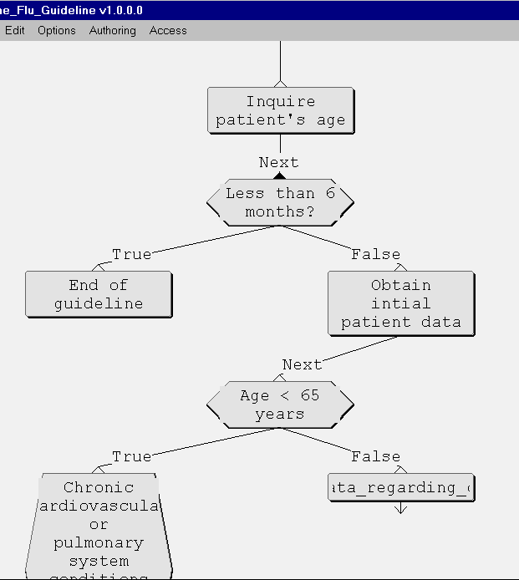
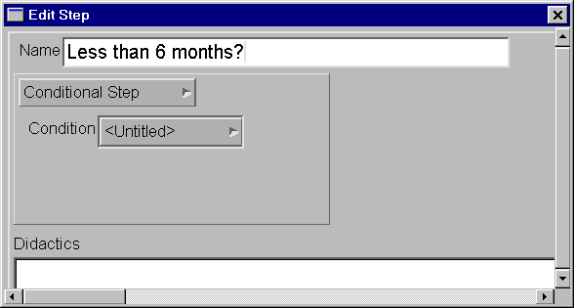
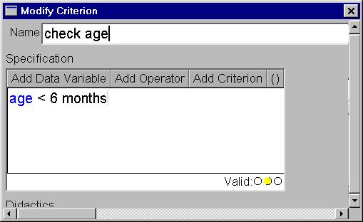
Viewing a Guideline Encoding
DSG Authoring Tool

Slide 33
XML
Developed under the auspices of the World Wide Web Consortium (W3C)
The Extensible Markup Language (XML) is the universal format for structured documents and data on the Web
XML is a method for putting structured data in a text file
XML uses <tags> to markup pieces of data
<Guideline>
<name> Management of Chronic Cough in Immunocompetent Adults </name>
</Guideline>

Slide 34
RDF
RDF is also developed under W3C
The Resource Description Framework (RDF) is an infrastructure that enables the encoding, exchange and reuse of structured metadata
RDF has an explicit model for expressing object semantics (objects, attributes)
RDF uses XML (eXtensible Markup Language) as a common syntax for the exchange and processing of metadata

Slide 35
RDF Schema
The data structure (metadata) definitions of the object model are given by an RDF Schema
<s:Class rdf:about="&a;Guideline">
<s:subClassOf rdf:resource="&a;Guideline_Model_Entity"/>
</s:Class>
<s:Property rdf:about="&a;name">
<s:domain rdf:resource="&a;Guideline_Model_Entity"/>
<s:range rdf:resource="&s;Literal"/
</s:Property>
Guideline_Model_Entity
name: String
Guideline

Slide 36
RDF: an Example of an Encoding Format
RDF can be used as a format to encode instances that conform to the RDF Schema
<a:Guideline rdf:about="&a;Cough_INSTANCE_00068">
<a:name>Management of Chronic Cough in Immunocompetent Adults</a:name>
</a:Guideline>
Notes:
Here the namespace prefix ‘a’ refers to a specific namespace prefix chosen by the author of this RDF expression and defined in an XML namespace declaration such as:
<!ENTITY a 'http://www.rdfschema.org/mynamespace.rdf#'>

Slide 37
XML Schema
Like RDF Schemas, XML Schemas offer facilities for describing the structure and constraining the contents of XML documents
<ElementType name="Guideline" content="eltOnly" model="open">
<AttributeType name="name" dt:type="string" />
</ElementType>

Slide 38
Main Differences Between RDF Schema and XML Schema
RDF has an explicit model for expressing object semantics
RDF Schemas are at a more advanced stage (proposed recommendation) than XML Schemas (Working Draft)
But: XML schemas have more available tools than RDF schemas. The tools include parsers and validators

Slide 39
Models for Guidelines and Medical Decision Rules
Individual decision rules
  Arden Syntax
Multi-step guidelines, modeled as hierarchical sets of nested guideline tasks (steps)
  GLIF
  EON
  PROforma
  ASBRU

Slide 40
Arden Medical Logic Modules
Format for representation and sharing of simple single-step guidelines, or medical decision rules
Most suitable for alerts and reminders
A guideline may be represented by a set of MLMs
Standard published by ANSI
Part of HL7 activity
  Clinical Decision Support & Arden Syntax Technical Committee of HL7, inventor Arden Syntax for Medical Logic Systems, version 2.0. Draft revision. USA. 1999 July 7, 1999
Supported by many commercially-available hospital information systems

Slide 41
Arden MLMs (Cont.)
The syntax is defined in BNF
Each rule is called a medical logic module (MLM)
Event-driven system
Example
  evoke: potassium_storage
  logic: potassium > 5
  action: write pager “Potassium is significantly elevated”
Problem: linking data to EMR

Slide 42
GuideLine Interchange Format
Developed by InterMed, a collaboration of Stanford, Columbia, Harvard, and McGill
  Peleg M, Boxwala AA, et al. “GLIF3: The Evolution of a Guideline Representation Format”. Proceedings AMIA Annual Symposium, 2000

Slide 43
GuideLine Interchange Format (GLIF)
Emphasis on sharing guidelines across different institutions and software applications
  A consensus-based multi-institutional process for developing GLIF (Stanford, Harvard, Columbia)
  An open process – the product is not proprietary
  Supports the use of multiple vocabularies and medical knowledge bases
  Interchange format: RDF

Slide 44
GLIF (Cont.)
Object-oriented representation model for guidelines, based on UML
Flowchart representing temporal sequence of clinical steps
  Action steps: recommendations for clinical actions to be performed
    e.g., Prescribe aspirin
  Decision step: decision criteria for conditional flowchart traversal
    e.g., if patient has pain?

Slide 45
GLIF (Cont.)
  Branch and synchronization steps: concurrent pathways
  Patient state step: indicates patient’s
  Concurrency possible through branch and synchronization steps
  Action and decision steps can be nested
  Steps refer to patient data items (age, cough)
  Expression language: Extended Arden Syntax (supports is-a, and is-unknown)

Slide 46
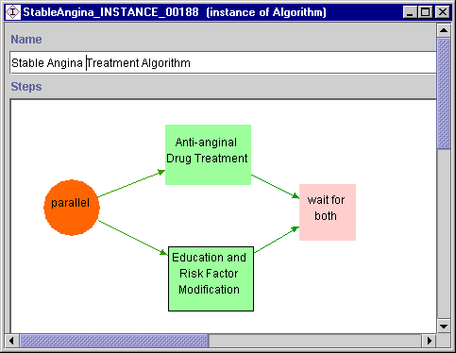
GLIF Example
<action step>
Created by
Protégé
Authoring Tool
<branch step>
<synch step>

Slide 47
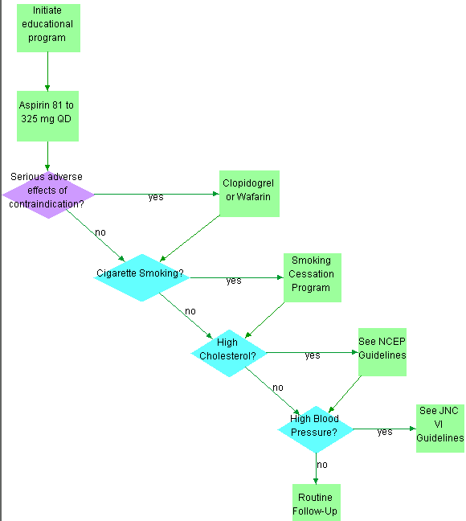
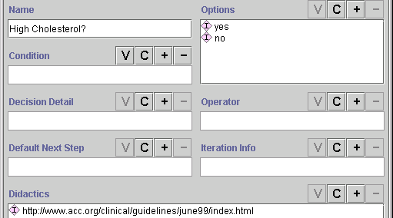
Education and risk
Factor modification
<action step>
<decision step>
LDL_Cholesterol > 160 mg/dL
equals

Slide 48
EON
Developed by Mark Musen, Samson Tu, et al., SMI, Stanford Medical School
  Tu SW, Musen MA. A Flexible Approach to Guideline Modeling. In: AMIA Symp; 1999. p. 420-424.
One of the input sources of GLIF
Allows integration into EPRs
Controlled Terminologies supported
Emphasis on clinical generality, medical expressiveness, operational flexibility, and support for reusability of knowledge bases

Slide 49
EON (Cont.)
Clinical generality
  Different types of guidelines were implemented: breast cancer clinical trial protocol, asthma treatment, JNC-VI hypertension guideline
Medical expressiveness
  3 criteria languages
    A simple object-oriented language
    A temporal query and abstraction language
    First order predicate logic (∀, ∃)

Slide 50
EON (Cont.)
Operational flexibility
  Guideline developers select modeling solutions for guideline tasks from a toolkit
  The tasks are
    Decision-making
    Specification of work to be performed
    Interpretation of data
    Setting goals

Slide 51
EON (Cont.)
Support for reusability of knowledge bases
  Medical domain ontologies, reused by different guidelines
  Guideline components (e.g., common toxicity criteria definitions in cancer protocols)

Slide 52
EON (Cont.)
Abstraction hierarchies
  Classification hierarchy in domain ontologies (e.g., classifying medical terms)
  Action specialization hierarchy
    Drug class (e.g., “steroid”) can be refined to a specific generic drug (beclomethasone) and prescribable item (beclomethasone MDI 100 mcg bd)
  Temporal queries and abstractions

Slide 53
Temporal Queries in EON
EON has a database mediator that combines temporal queries and temporal abstractions
  Temporal query based on formal temporal model
  Temporal abstractions use definitions of abstractions in knowledge base (interval-based abstractions are derived from time-stamped data)
Has the patient experienced any grade-2 leukopenia while taking a course of cyclophosphamide that lasts more than one week?
TEMPORAL SELECT T1.Problem
FROM PROBLEMLIST AS T1,
DRUGS AS T2
WHERE T2.Name=‘cyclophosphamide’
and T1.Name=‘leukopenia’
and T1.Severity=‘grade-2’
WHEN DURATION(T2) > WEEKS(1) AND
AFTER(START(T1), START(T2))

Slide 54
PROforma
Developed by the group of John Fox, Imperial Cancer Research Fund, London, UK
  Fox J, Johns N, and Rahmanzadeh A. Disseminating medical knowledge: the PROforma approach. Artificial Intelligence in Medicine 1998;14:157-181
Emphasis on soundness, safety, and verifiability
  PROforma is a formal specification language

Slide 55
PROforma
Model: An Object-Oriented model as well as logic programming approach
  Guidelines are constraint satisfaction graphs
  Nodes represent “tasks”: clinical actions, decisions, and enquiries, and complex plans, which are constrained by logical and temporal constraints
  Arcs connect tasks within plans. The order of tasks reflect logical, temporal, or other constraints

Slide 56
PROforma (Cont.)
Operational flexibility
  Triggers
  Problem solving
  Argumentation (basis for decision-making)
  Accepting/adopting a decision
  Scheduling
  Data acquisition
Clinical generality
  Different types of guidelines were implemented (e.g., irritable bowl movement, management of acute asthma, breast cancer treatment protocol

Slide 57
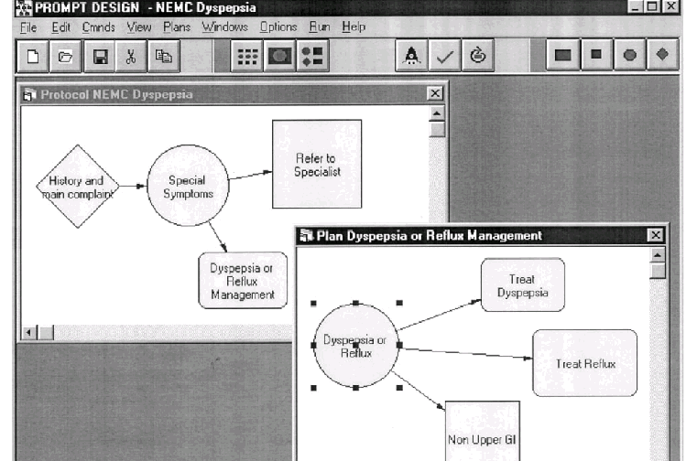
PROforma Example
<decision>
<action>
<enquiry>
<plan>
Management of dyspepsia

Slide 58
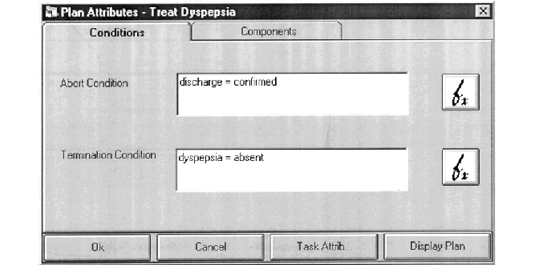
Proforma Example (Cont.)

Slide 59
ASBRU
Developed by Yuval Shahar et al.
  Shahar Y, Miksch S, Johnson P. The Asgaard Project: A Task-Specific Framework for the Application and Critiquing of Time-Oriented Clinical Guidelines. AI in Medicine 1998;14:29-51.
Emphasis on guideline intentions
  e.g., maintain a certain blood pressure

Slide 60
ASBRU (Cont.)
A very expressive language for representing time-oriented actions, conditions, and intentions in a uniform fashion
Guidelines are modeled as plans that can be hierarchically decomposed into (sub)plans or actions
Plans have
  Process and outcome intentions
  Conditions (e.g., setup, abort)
  Prescribed actions

Slide 61
ASBRU (Cont.)
Plans can be executed sequentially, in any order, cyclically, or together
Reasoning under uncertainty possible
  By enabling fuzzy patterns of data interpretations
  Earliest start time
  Latest start time
  Earliest finish time
  Latest finish time
  Minimum duration
  Maximum duration
A treatment plan that starts
24-26 weeks after conception,
ends 32-34 weeks after conception,
and lasts 7-9 weeks
9
7
24
26
32
34

Slide 62
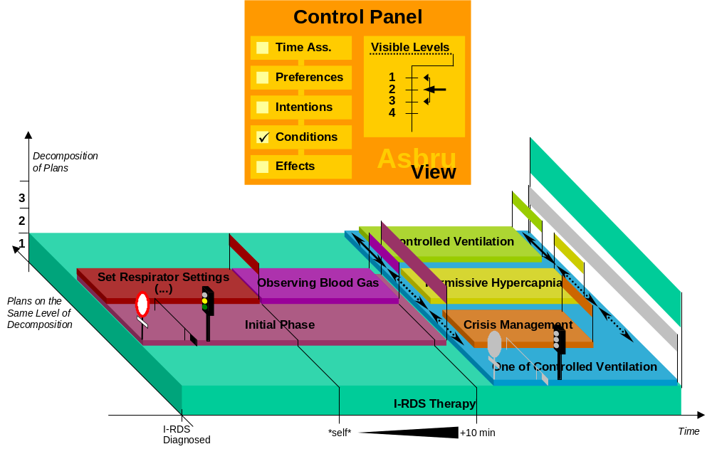
ASBRU Example
Complete condition
Filter precondition
Setup precondition
Abort condition

Slide 63
A Standard Representation of Clinical Guidelines
The standard representation should:
  Be structured
    Can be interpreted and executed by a computer program
  Allow for sharing guidelines
    Promote consistency in care
    Reduce cost of guideline development

Slide 64
A Standard Representation of Clinical Guidelines
The standard representation should:
  Allow for local adaptation
    Local preferences and workflow
    Different resources
  Allow integration with local information system environments trough mapping
    Domain ontology structure into EPR schemas
    Guideline terms to EPR codes
    Guideline actions into EPR procedures

Slide 65
A Standard Representation of Clinical Guidelines
Benefits from a standard
  Sharing of more guidelines
  Concentrating the effort of achieving
    A good representation method
    Good authoring tools and execution applications

Slide 66
Workshop: Towards a Sharable Guideline Representation
The workshop, hosted by InterMEd, was held in March 2000, at Boston
80 attendees from 10 countries
  Government
  Professional specialty organizations
  Insurers
  Health care provider organizations
  Academic medical informatics
  Industry – content, systems, tools providers, consultants, integrators

Slide 67
Purpose of the Meeting
To recognize the need for a standard
To identify the the functional requirements for sharing guidelines
To develop a robust representation model
To identify the collective needs and purposes of different types of guidelines and different applications
To establish a process to foster sharing

Slide 68
Functional Requirements for a Shared Guideline Representation
The proposed requirements encompass the entire life cycle of a computer-interpretable guideline

Slide 69
Life Cycle of a Computer-interpretable Guideline
DEVELOPMENT
USE and ANALYSIS
Authoring
Encoding
Performance
analysis
Reliability studies
Life cycle of a computer-interpretable guideline
Use and
maintenance
Dissemination
Local adaptation and
implementation
IMPLEMENTATION
Testing

Slide 70
Development Requirements

Slide 71
Expressiveness
Important especially during authoring
Ability to express different guidelines and clinical trial protocols
  Clinical trial protocols are different than guidelines
    Define regulations of clinical experiments
    Patient data gathering and analysis is essential
  Clinical trial protocols share with guidelines the tasks that are essential for providing computerized decision support
  The standard should deal with this last task

Slide 72
Expressiveness (Cont.)
There are many types of guidelines
  Elmer Bernstam, Nachman Ash, et al. “Guideline Classification to Assist Modeling, Authoring, Implementation and Retrieval”. AMIA 2000
  Different clinical areas
  Screening, diagnosis, disease management, workup, referral, prevention, and more
  Muliple vs. single encounters
  Settings: in-patient vs. out-patient
  Time-frame: emergency, acute, or chronic
  Computability: algorithmic vs. “guiding”

Slide 73
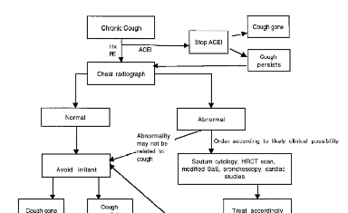
Expressiveness (Cont.)
Ability to express different guideline knowledge components:
  Recommendations
    “In the absence of an abnormal chest radiograph, no additional laboratory test should be ordered until response to cessation of smoking for 4 weeks has been assessed”
  Definitions
    “Chronic Cough:
    lasting 3 weeks or more”
  Algorithms

Slide 74
Expressiveness (Cont.)
“In the absence of an abnormal chest radiograph, no additional laboratory test should be ordered until response to cessation of smoking for 4 weeks has been assessed”
Chronic
cough
Current Cough and
Cough.critical_time.low
< now – 3 weeks
<patient state>
branch
Smoker?
<automatic decision>
<action>
Chest
X-Ray
Lab tests
Can be
ordered
Stop smoking
For 4 weeks
Chest
X-Ray
abnormal?
no
<decision>
Wait
For 2
yes
<synch>

Slide 75
Expressiveness (Cont.)
Ability to express different tasks that are needed for applying a guideline to a specific patient
  Decision making
  Alert sending
  Goal setting
  Specifying work to be performed
  Data interpretation

Slide 76
Expressiveness: Decision Making
Rule in: Latest Chest_X_Ray.
interpretation_cd == normal
Chest
X-Ray
normal?
normal
abnormal
Rule in: Latest Chest_X_Ray.
interpretation_cd == abnormal

Slide 77
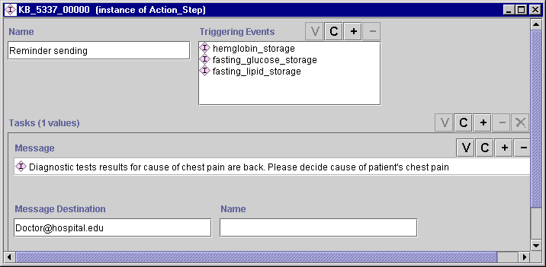
Expressiveness:
Alert/reminder Sending

Slide 78
MLM Format
data:
storage_of_hemoglobin := EVENT {‘1730’};
email_dest := destination {‘email’, ‘name’ = peleg@smi.stanford.edu};
evoke:
storage_of_hemoglobin;
logic:
if is number(last hemoglobin where it occurred within the past 12 hours) …
then conclude true;;;
action:
write: Diagnostic test results for cause of chest pain …” at email_dest;;;

Slide 79
Expressiveness: Goal Setting
Intention example from ASBRU
“In the context of GDM-Type-II, maintain blood glucose state at high level, starting week 24 and ending at delivery
Context: Earliest start time: Time unit:
GDM-Type-II 24 WEEK
Verb: Latest start time: Time unit:
MAINTAIN 24 WEEK
Parameter: Earliest finish time: Time unit:
Blood-glucose DELIVERY WEEK
Abstraction function: Latest finish time: Time unit:
STATE DELIVERY WEEK
Value description:
HIGH

Slide 80
Expressiveness: Specifying
Work to be Performed
Action specification hierarchy
Action Specification
Medically Oriented
Action Specification
Programming Oriented
Action Specification
Subguideline
Action
Get Data
Action
Generate Event
Action
Message
Action
Assignment
Action

Slide 81
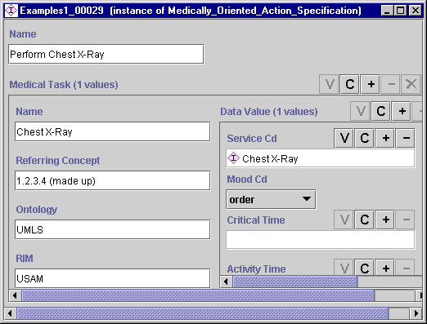
Expressiveness: Specifying
Work to Be Performed

Slide 82
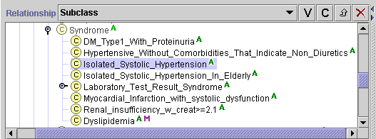
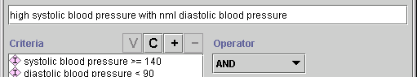
Expressiveness: Data Interpretation
EON example
definition

Slide 83
Human Comprehension
Important especially during authoring and use
  Guideline visualization
  Readability
  Complexity management
  Different guideline views

Slide 84
Guideline Visualization and
Readability
Education and risk
Factor modification
<action step>
<decision step>
LDL_Cholesterol > 160 mg/dL
equals

Slide 85
Complexity Management
Education and risk factor
modification
Nesting
Stable Angina
Treatment

Slide 86
Complexity Management
Samson Tu:
Domain concept = declarative specification of procedure pattern? I wouldn’t say so. Mapping of
declarative specification to a flowchart of GLIF steps
Macro
  A macro allows mapping of a declarative specification to a flowchart of GLIF steps
  Aziz A. Boxwala, et al., “Modeling guidelines using domain-level knowledge representation components” (poster-presentation), AMIA 2000

Slide 87
Macro Example
Screening schedule for colorectal cancer
Name Screening Patient
of test interval group
Fecal occult blood test Every year Asymptomatic, age > 50 years, no other risk factors
Every year Asymptomatic, age > 40 years, family history of colorectal cancer
Flexible sigmoidoscopy Every 5 years Asymptomatic, age > 50 years, no other risk factors
After 1 year, History of colorectal cancer,
3 years, and resected with curative intent
every 5 years

Slide 88
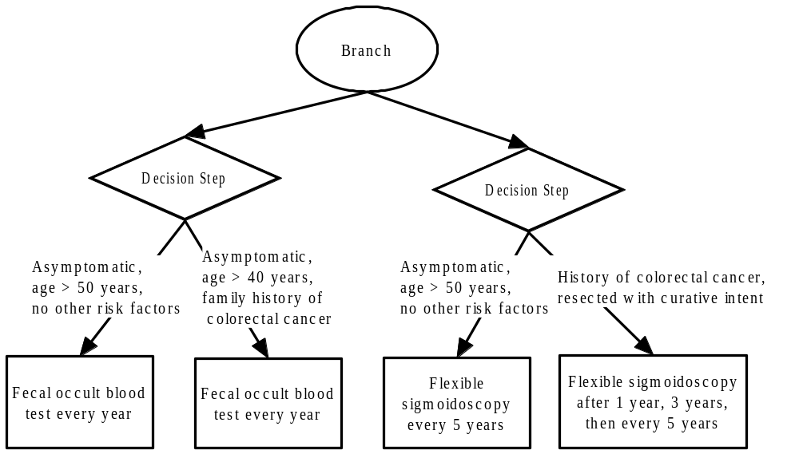
Mapping the Macro Into a GLIF Flowchart
Rule-in:
Rule-in:
Rule-in:
Patient
Group:
Rule-in:
Test &
Screening
Interval:
<action step>

Slide 89
Different Guideline Views
Samson Tu:
Do you really need to talk about this issue? I don’t think we worked out this aspect of the model.
For example, the way we’ve defined views seems to be in conflict with nesting. In the next slide,
for the surgeon, are you suggesting that we don’t use nesting and present details to him/her?
Filters collapse segments of the guideline into a default view of the guideline customized to
  a given user: general practitioner vs. specialist
  Situation: in-patient vs. out-patient clinic
The user can always see more or less details than what is shown to him by default
Mor Peleg:
Is this clearer now?

Slide 90
Different Guideline Views
MD’s view
Surgeon’s view
Breast biopsy
Follow-up
Breast Biopsy
Incisional
Breast
biopsy
Incisional
or
excisional
Follow-up
Excisional
Breast
biopsy

Slide 91
Accessing Patient Data
Representing patient data
  Support for using vocabularies and reference information models
  Important during authoring and encoding
  In GLIF, we have adopted HL7’s Unified Service Action Model (USAM) as an ontology for structuring patient data
Patient Data
Observation
Medication
Procedure

Slide 92
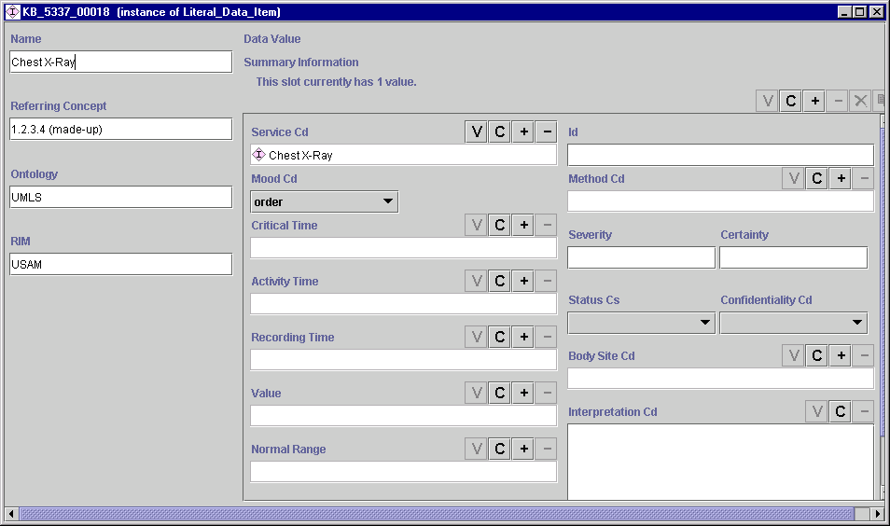
Accessing Patient Data
Observation
Representing patient data
  Important during authoring
Cholesterol
LDL_Cholesterol
360-78-7920
event
serum, 12h fast
(07-18-00, 07-18-00)
high
completed
(07-18-00:21:00)
80 mg/dL
normal
< 130 mg/dL

Slide 93
Accessing Patient Data (Cont.)
Integration with institutional systems
  Important during localization
  mapping of referenced patient data to entries in the EMR
  mapping of recommendations to implementable actions (e.g., through order entry systems)
  Example from EON?

Slide 94
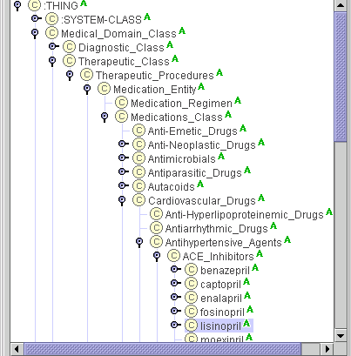
Accessing Patient Data (Cont.)
Samson Tu:
I can describe the process of data mapping that you can use as an example
Support for expressing data abstractions
  Important during authoring and encoding
  The EON example:

Slide 95
Accessing Patient Data (Cont.)
Samson Tu:
These semantic checks has to do with integrity of guideline specification, not data access, it seems to me.
Handling semantic matches and range checks
  Important during encoding and use
  Range check example:
  a patient’s LDL_Cholesterol value of 100 mg/dL is within the normal range (0-130)

Slide 96
Negative Recommendations and Contraindications
Expressing negative recommendations is important during authoring and encoding
Example:“In the absence of an abnormal chest radiograph, no additional laboratory test should be ordered until response to cessation of smoking for 4 weeks has been assessed”
Chronic
cough
branch
Chest
X-Ray
Smoker?
Lab tests
Can be
ordered
Stop smoking
For 4 weeks
Chest
X-Ray
abnormal?
Wait
For 2
no
yes

Slide 97
Negative Recommendations
Samson Tu:
The previous slide and the current one show two different ways of handling negative recommendations:
(1) the previous slide models a negative guideline statement in a positive way, by showing when it’s
appropriate to order further test, (2) the current slide uses “order not to” mood. Is the point of the
two slides to illustrate different ways of handling negative guideline statements?
Cf: Asbru: intentions have attributes of “achieve”, “maintain” or “avoid”
EON, we write warning messages that check for undesirable clinical actions in consultation guideline
Another example: “Based upon the known testing characteristics of four-view sinus radiographs derived from studies … and the lack of such data for sinus CT scans, sinus CT scans are not routinely recommended to evaluate for sinusitis as the cause of cough”
Can be modeled as an action in mood “order not to” instead of order mood
In Asbru, the intention can be “avoid” doing an action
No
Sinus CT

Slide 98
Negative Recommendations (Cont.)
Expressing course of action if negative recommendations are not followed
In GLIF, an action can be associated with a triggering events and with exceptions
  Exception: if an exception happens, then the action is terminated
  Triggering event: the action is triggered by some event

Slide 99
Negative Recommendations (Cont.)
The event of going against a negative recommendation (e.g., ordering Sinus CT) triggers an action that should be taken (e.g., sending a warning to the MD)
Delivering the negative recommendations only when necessary
  Instead of sending a warning ahead of time to every MD, sending the warning only if the non-recommended option was considered by the user

Slide 100
Expressive Decision Model
Representing patient preferences
Representing costs and qualities of services
Enabling different types of decision models

Slide 101
Representing Patient Preferences
Important during authoring, encoding, and use
Alchemist, developed by Gillian Sanders, is a method for automatically creating guidelines form decision models
The idea is to improve guideline applicability, relevance, and acceptance by local clinicians and guideline developers, and thus to promote high-quality and cost-effective health care

Slide 102
Representing Patient Preferences
A decision model systematically represents the following components of clinical decision problems:
  The alternatives
  Uncertain events
  Outcomes
  Preferences

Slide 103
Representing Patient Preferences
Suppose that you can give two different treatments.
  One gives the patient a better chance of staying alive longer but also a higher chance of a poor quality of life
  The other is the opposite
  Knowing the patient’s utilities for the quality of life and life expectancy, the best therapy choice for the patient can be determined

Slide 104
Representing Patient Preferences
How do you calculate patient’s utilities?
Ask them what their indifference probability for the following two options is:
  Live 1 year with probability 100%
  4 years with probability 20%
  Live
  0 years with probability 60%
ask questions for quality of life issues
{

Slide 105
Representing Costs and Qualities Of Services
In Asbru, Utility Preferences bias or constrain the selection of a plan to achieve a certain goal
  Minimize cost
  Maximize quality of service: what is the magnitude of anticipated benefits to following a recommendation

Slide 106
Enabling Different Types of Decision Models
Distinguishing between automatic and non-automatic decisions
High Cholesterol
LDL_Cholesterol > 200 mg/dl

Slide 107
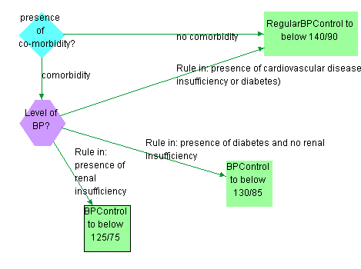
Enabling Different Types of Decision Models
<case>
<action step>
<case step>
<choice>
<choice step>

Slide 108
Enabling Different Types of Decision Models
Incorporating decision models such as
  Decision trees (Alchemist)
  Bayesian networks
  Influence diagrams
  State transition models
Providing sensitivity analysis
  Based on decision models
  Done by Alchemist

Slide 109
Representing Adverse Conditions
Important during authoring, encoding, and use
Treatments can cause adverse reactions. When these occur, the physician may want to change the dose, change the treatment, etc.
In GLIF, this can be represented by exceptions

Slide 110
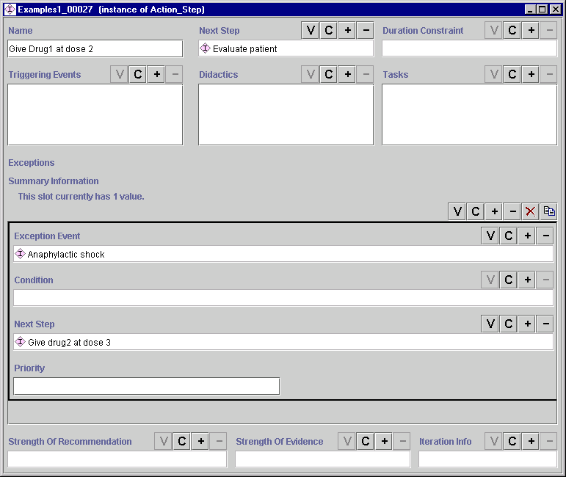
Representing Adverse Conditions

Slide 111
Handling Uncertainties in Data
Instead of a true/false semantics, other possible values are allowed
In EON, these are defined in relationship to eligibility criteria:
  Pass
  Fail
  Not Known
  Presumably Pass
  Presumably Fail

Slide 112
Handling Uncertainties in Data
Providing recommendations despite uncertainties in data
  In Asbru, there are temporal uncertainties:
    Prescribing actions: earliest and latest start and end times, minimum and maximum duration are given, but this gives a range of possibilities

Slide 113
Handling Uncertainties in Data
Temporal abstractions are possible (Resume)
  If two incidents of low hemoglobin are measured on Monday and Friday, we can interpolate that hemoglobin was also low on Wednesday

Slide 114
Linking the Guideline to Support Material
In GLIF, a guidelines, guideline steps, and logical criteria can be linked to support material
  Text material
  Web URL
  Keyword
That serves a purpose, such as evidence, comment, indexing
We are cooperating with Richard Shiffman on incorporating the Guideline Elements Model (GEM) for the purpose of documenting, browsing and selecting guidelines

Slide 115
Presenting Clear Statement of Evidence and Recommendations
GEM
Guideline
Document
Development
Method
Descrip’n
Evidence
Collection
Evid
Time
Period
Method
Evidence
Grading
Descrip’n
Evidence
Combinat’n
Cost
Anal
Spec’n
Harm
Benefit
Quant
Benefit
Harm
Role
Value
Judgmt
Role
Pt
Pref
Qualifying
Statement
Method
Evid
Collect
Number
Source
Docs
Rating
Scheme
Method
Evidence
Combinat’n

Slide 116
Presenting Clear Statement of Evidence and Recommendations
Strength of evidence
  How do the guideline authors evaluate the strength of evidence that supports a recommendation
Strength of Recommendation
  Do the guideline authors want the physician to follow the recommendation in every case, or do they relax the recommendation

Slide 117
Example
Bacterial meningitis
Recommendation: medical emergency
Strength of evidence:
  Low. Studies characterized on medical grounds. Some studies actually show better outcomes with delay of therapy
Problem: better studies cannot be conducted (no volunteers…)

Slide 118
Presenting Clear Statement of Evidence and Recommendations
In GEM, recommendations have the following attributes
  Evidence quality
  Recommendation strength

Slide 119
Constant Parts of Guidelines
Important during authoring and localization
A local implementation of a guideline might change parts of the guideline specification
We need a way to label the parts of a guideline that cannot be changed locally

Slide 120
Implementation Requirements

Slide 121
Guideline Use Cases
Documenting use-cases of guidelines:
  Who uses the guideline
  In what setting/situation
This helps author a guideline while thinking in terms of how the guideline would be used

Slide 122
Reliability and Safety
Ensuring reliability and safety
  Within a guideline
  Among several guidelines that all apply to a certain patient
Verification and validation capabilities
  Syntax checks
  Range checks (e.g., Hb > 2000)
  Semantic Checks (e.g., Age > female)
  Showing that guideline state is reachable
  Simulating the guideline and validating behavior

Slide 123
Reliability and Safety
Ensuring reliability and safety is done through verification and validation
In order to verify a guideline, it needs to be expressed in a formal specification language

Slide 124
Formal Specification Languages
Formal Syntax (an informal definition)
  Defines the alphabet from which allowed words in the languages are formed
  Defines rules by which allowed sentences are formed
  The alphabet may consist of symbols. The syntax can define how to combine the symbols into a graph (e.g., flowchart)
  All of the guideline representations that we mentioned have a formal syntax

Slide 125
Formal Specification Languages
Semantics
  Define the meaning (behavior) of allowed words and sentences in the language
    e.g., when do you exit a guideline step?, what conditions must hold upon exit?
  Formal semantics can be expressed using:
    logics, set theory (Z), process algebra (LOTOS), etc

Slide 126
Formal Specification Languages
The semantics of many knowledge representation languages are not formally defined, but are represented in natural language
PROforma has a formal semantics, based on logic

Slide 127
Reliability and Safety (Cont.)
It will be useful for the guideline representation language to allow documentation of test cases that were run in order to validate the guideline specification

Slide 128
Ease Of Sharing Actual Specifications
Easy to transport specifications among collaborators
  Text format
  XML/RDF
Standard representations should not contain proprietary, application-dependent details
  e.g., devoid of visualization details

Slide 129
Coupling Guidelines to Workflow
Quaglini S, Dazzi L, Gatti L, Stefanelli M, Fassino C, Tondini C. Supporting tools for guideline development and dissemination Artif Intell Med. 1998 Sep-Oct;14(1-2):119-37

Slide 130
Guideline Use Requirements

Slide 131
Support Different Usage Modes
Important during localization and use
Interactive vs. batch
  Batch mode is appropriate for retrospective evaluation
  Interactive mode used within patient encounter to assist doctor in managing patients
The same guideline encoding can be displayed to the user in different ways

Slide 132
Multiple User Interfaces
The following slides contain examples of different guideline user interfaces, taken from the PRESTIGE project

Slide 133
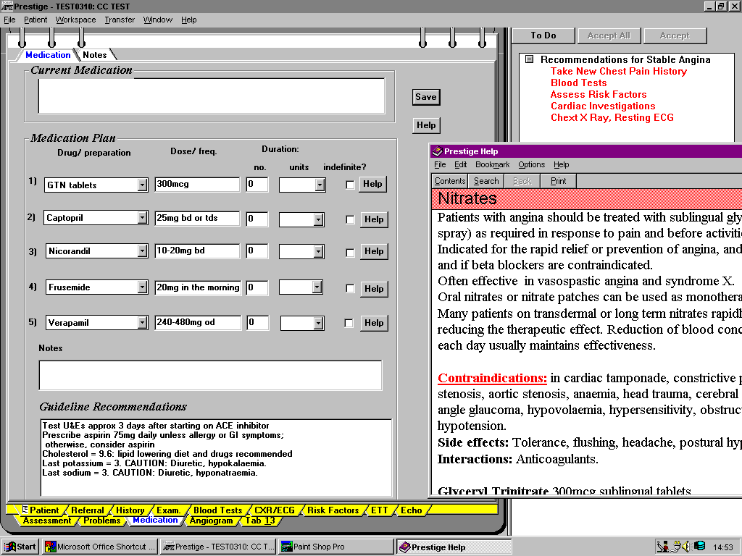

Slide 134
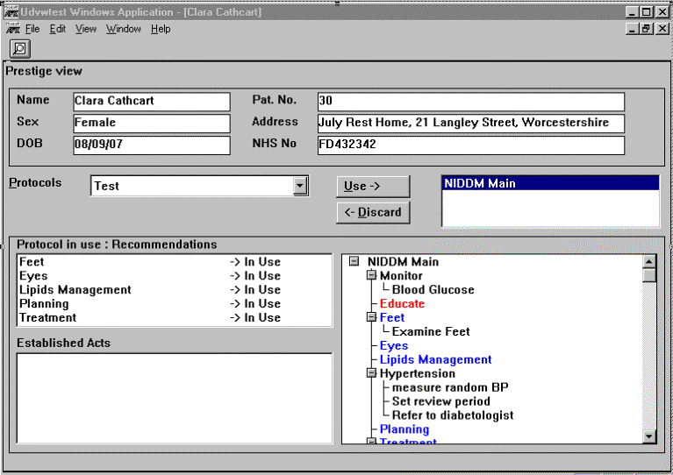

Slide 135
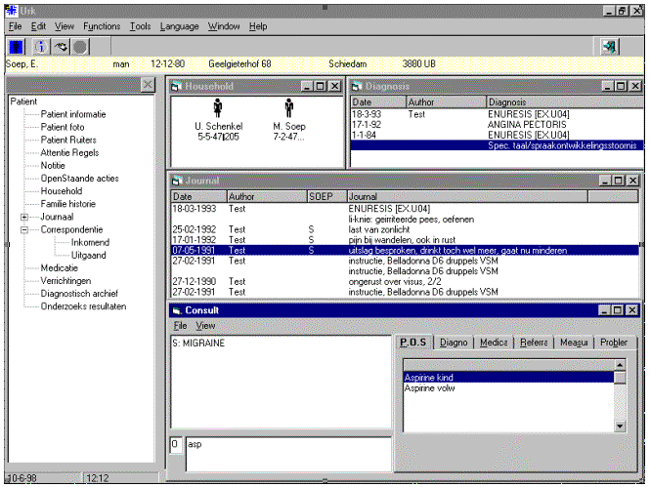

Slide 136
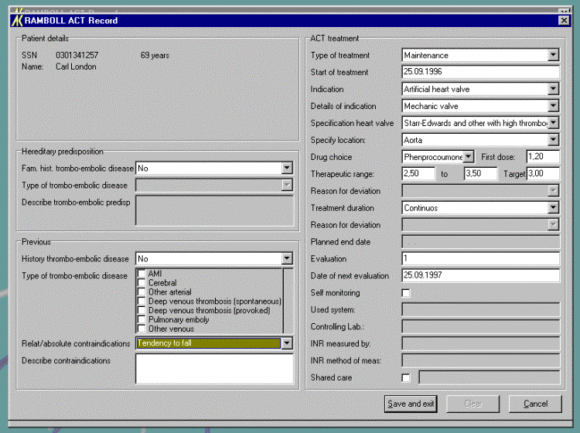

Slide 137
Maintenance Requirements
Version control requires updating information such as dates, release number, person who made the changes
From GEM:
Guideline
Document
Identity
Purpose
Method of
Development
Knowledge
Components
Revision
Plan
Developer
Intended
Audience
Target
Population
Testing

Slide 138
Maintenance Requirements: Version Control
Guideline
Document
Identity
Title
Citation
Release
Date
Availability
Status
Companion
Document
Adaptation
Length
Electronic
Print
Contact
Patient
Resource

Slide 139
Maintenance Requirements
Change Management
  Documenting the changes in a structural way
  Methods for documenting the differences between the versions

Slide 140
Analysis Requirements
Guidelines are aimed at improving treatment and reducing costs
  Do the physicians follow the guideline?
  Does it improve the patient’s outcomes?
  Are resources saved?

Slide 141
Analysis Requirements
Support analysis of user compliance with the guideline
  Available patient data
  Actions taken
  Decision options chosen
  Goals achieved
  Adverse conditions and contraindications encountered

Slide 142
Summary

Slide 143
Links and Contact Info
Mor Peleg
Stanford Medical Informatics
Stanford University School of Medicine
peleg@smi.stanford.edu
Aziz Boxwala
Decision Systems Group
Brigham and Women’s Hospital
Harvard School of Medicine
aziz@dsg.harvard.edu
GLIF page:
http://www.GLIF.org

