Slide 1
Work with the ACP
November 1-2, 2001
Mor Peleg and Vimla Patel

Slide 2
Outline
Goal
Research Methods
Results
How is GLIF’s level A different?
Next steps

Slide 3
Goal
Suggest methods to generate guideline documents that are easily encoded

Slide 4
Research Methods
Study the ACP process of algorithm development
  Look for errors and ambiguities
Demonstrate our encoding process
  Steps that we go through (CUIs…)
Suggest ways in which we can help
  Tools, methods

Slide 5
Results
The ACP process of algorithm creation
What changes are made from one iteration to another?
What do they miss?

Slide 6
Algorithm creation
Medical expert
creates algorithm
Medical expert +
Team leader
validate algorithm
Third person creates
The flowchart

Slide 7
Medical expert creates Algorithm
Algorithm is based on
  Recommendations (evidence)
  Detailed paragraph beneath Italicized rec
  Background paper
Goal is to provide guidance for the encounters
No tools are used
Only “boxes” are used (one step type)
detail

Slide 8
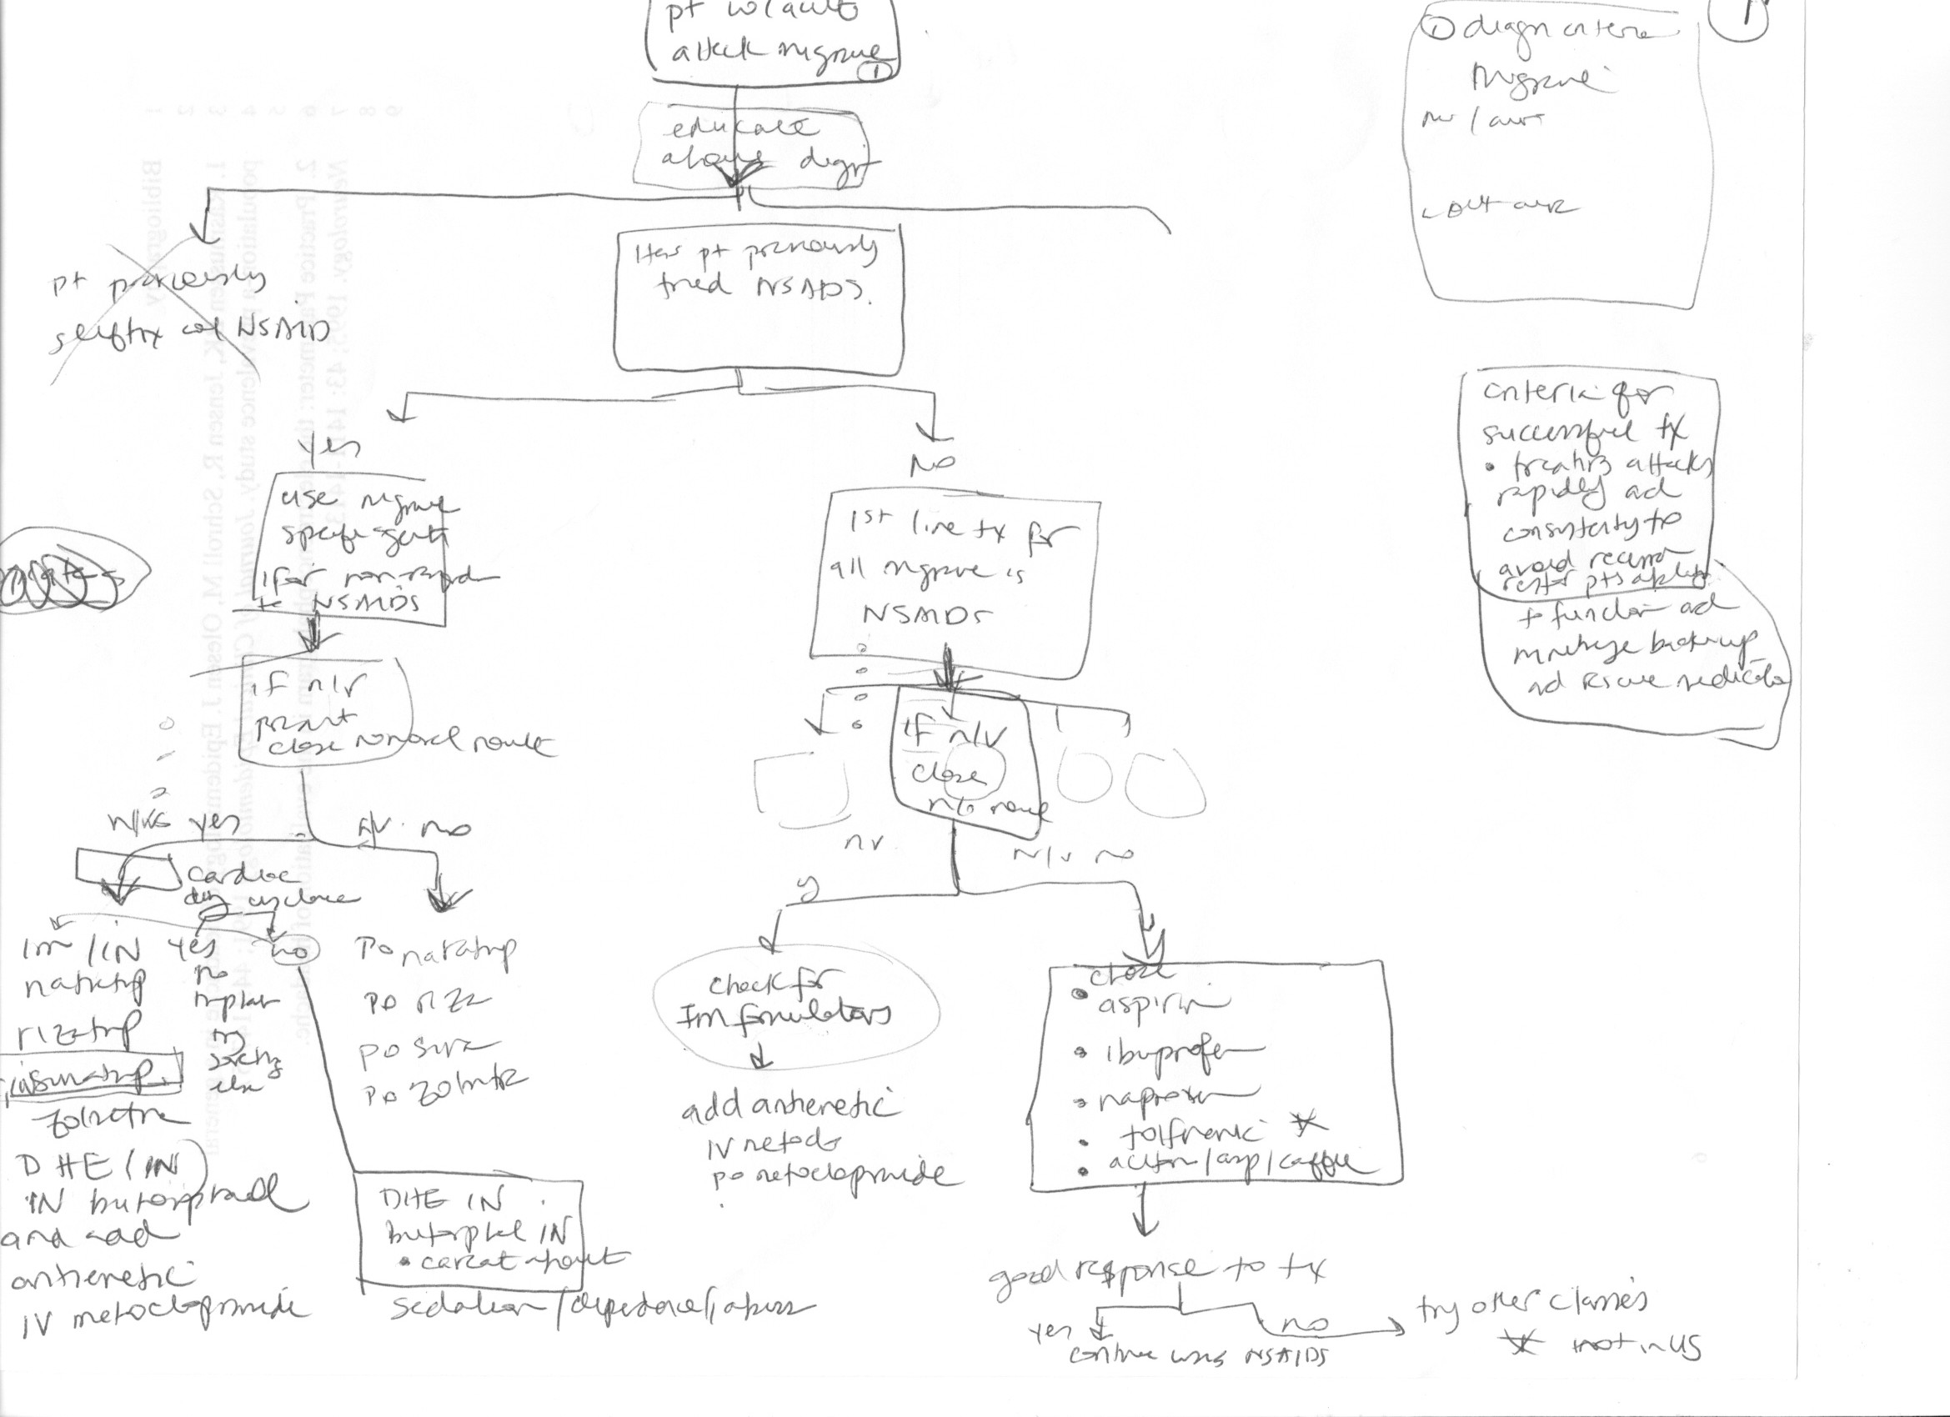
First Pass

Slide 9
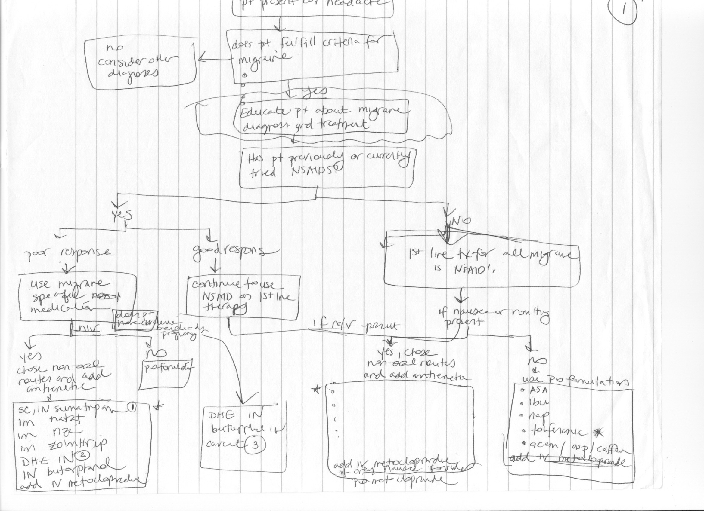
Second Pass
Eligibility: migraine → headache
Side-bar on rescue therapy
disappeared

Slide 10
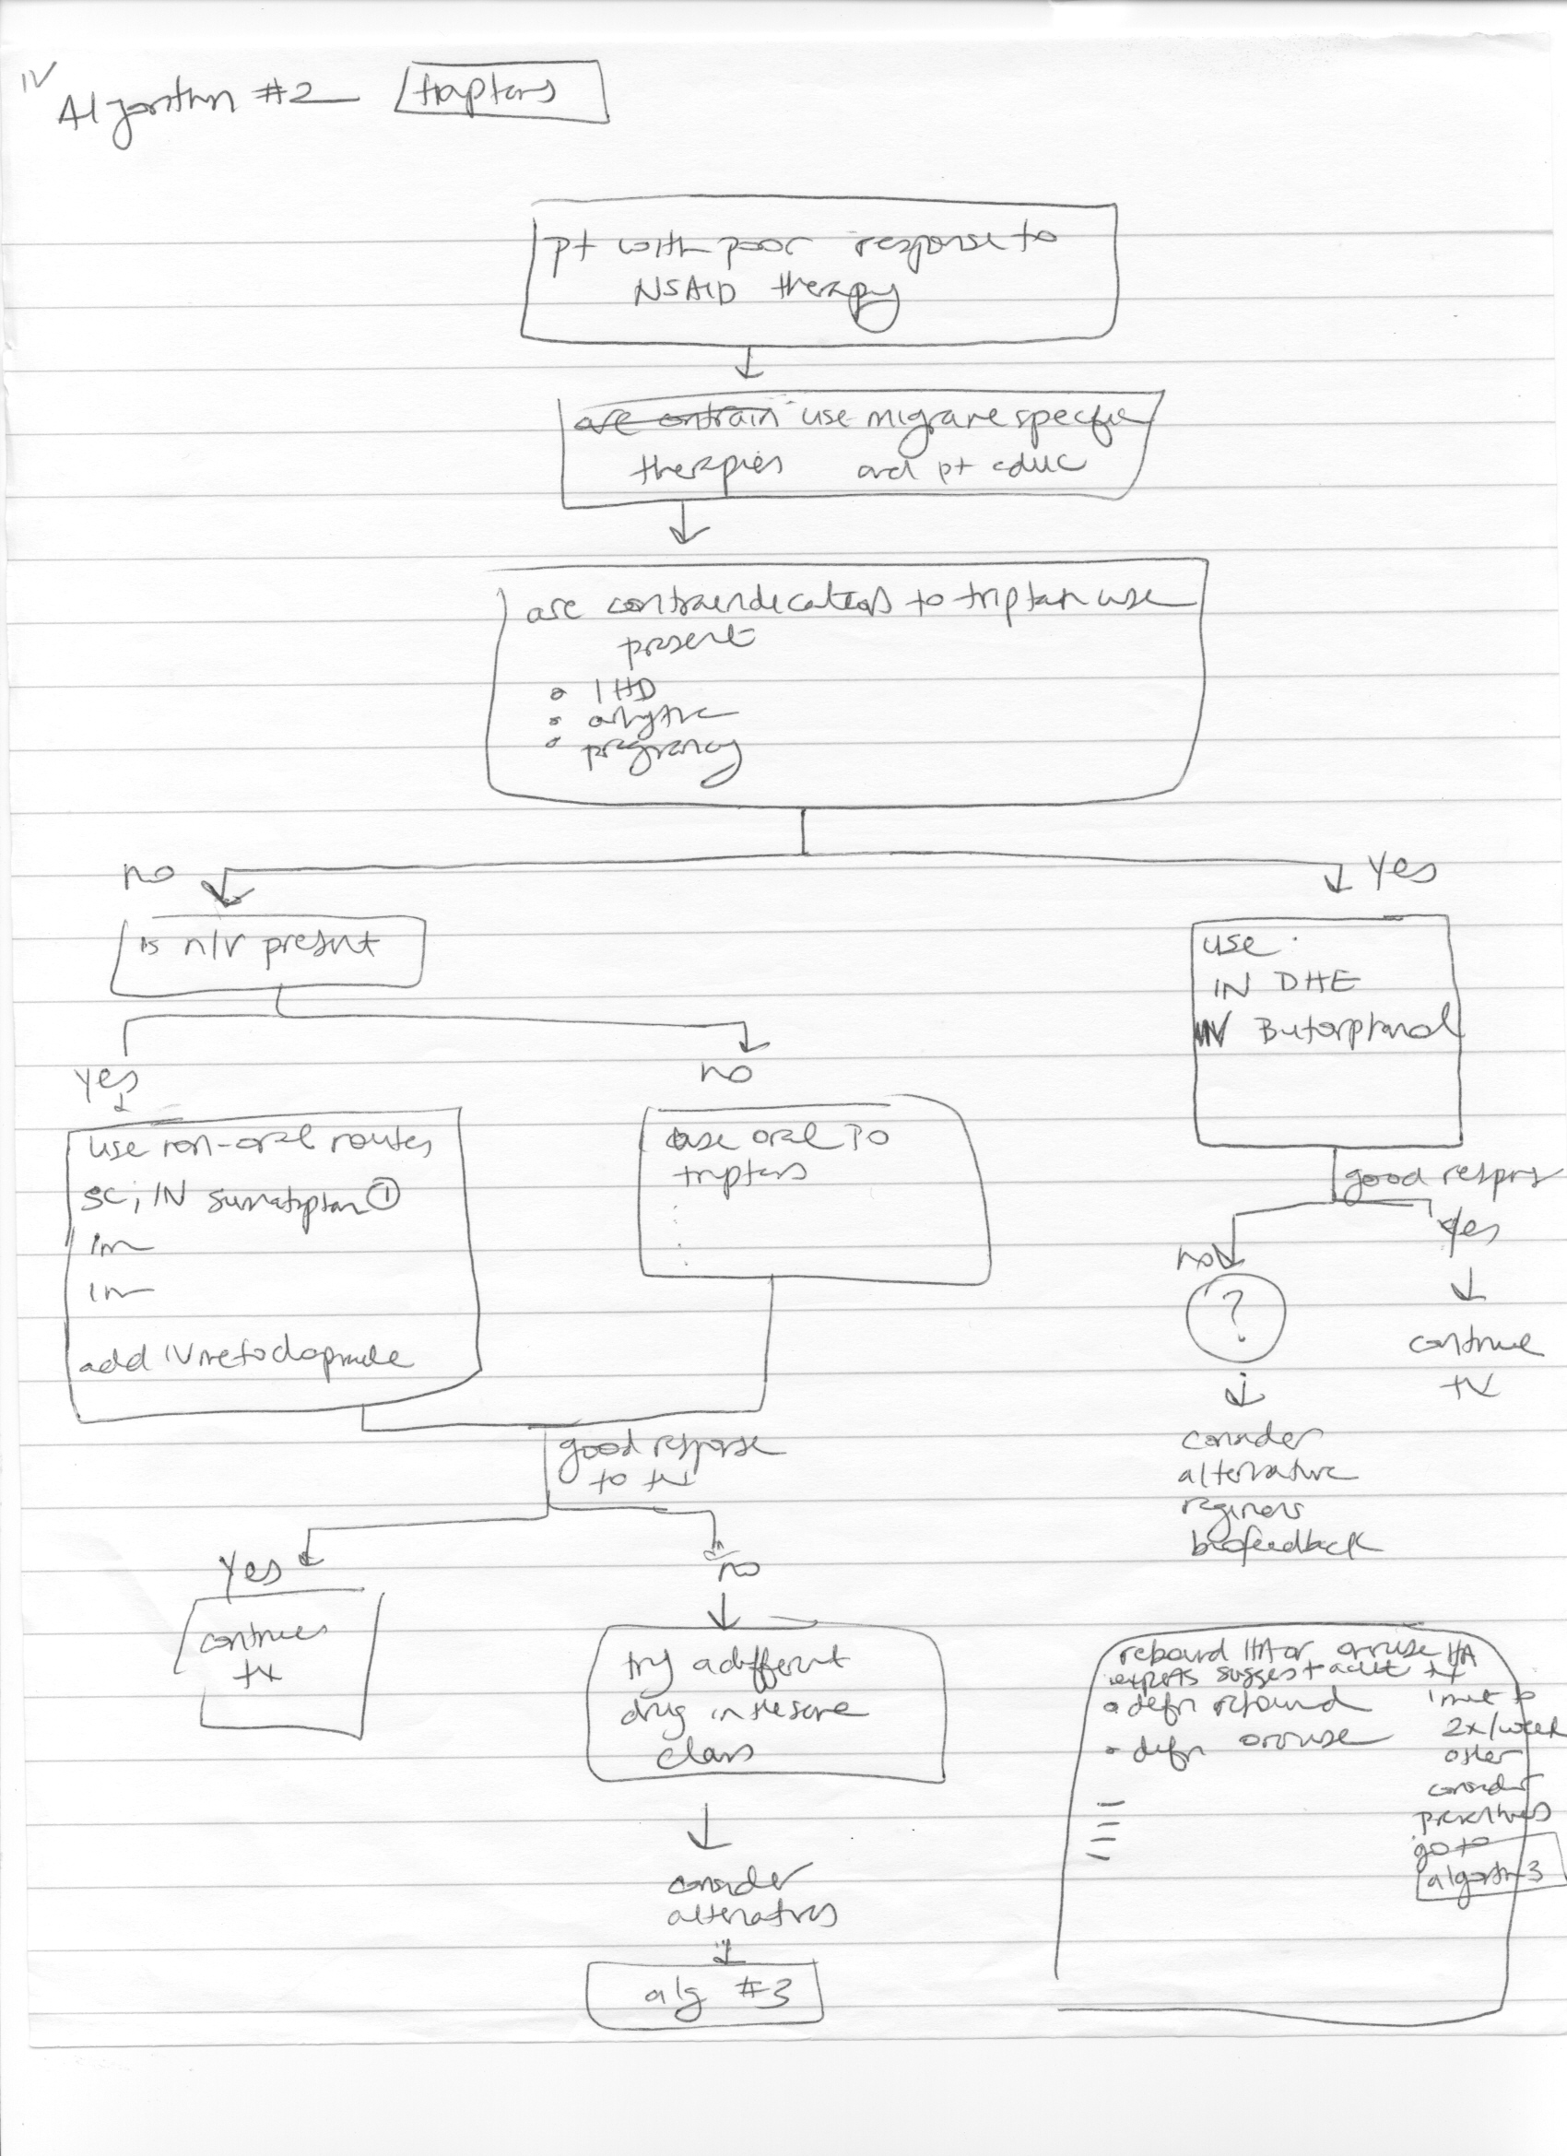
Introducing Nesting

Slide 11
Changes made by expert
Logic changes
  Switching order of steps
  Changing criteria
    generalizing (any contraindication, such as IHD)
    more specific (efficacious NSAIDs)
Adding detail (specifying kinds of Triptans)
Complexity management
  Link instead of repeating a box
  Nesting

Slide 12
Validation
Medical expert
creates algorithm
Medical expert +
Team leader
validate algorithm
Clarifying definitions
  “good response” and “period of stability” are assessments
Clarifying logic
  eligibility criteria are OR-ed
Clarifying actions vs. patient states
  “use migraine-specific medications” is a label
Third person creates
The flowchart

Slide 13
What did they miss?
Parts of the guideline
  rescue therapy
  ranking propranolol vs. amitptyrin
Logic changes
  if patient tried triptans with good response we should prescribe them again
  PO vs. ANY route (DHE and Butrophanol)
  Go to preventive therapy only after finding an agent that works

Slide 14
Creating the flowchart
Tools are used
Distinction among step types
Medical expert
creates algorithm
Medical expert +
Team leader
validate algorithm
Third person creates
The flowchart

Slide 15
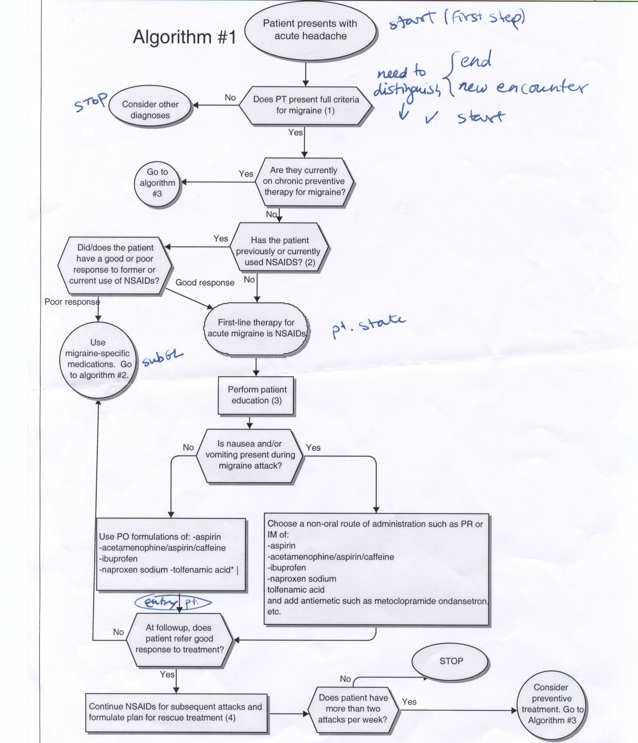
Entry point
Exit point
Decision
Subguideline
Patient-state (label)
Action
This would be a
decision step in GLIF
Entry
point

Slide 16
…creating the flowchart
Distinction among step types
  usually not a problem
  adding missing decisions
  splitting a box into two constructs
    “first line therapy for acute migraines is NSAIDs + patient education”

Slide 17
How is GLIF’s level A different?
Represents entire guideline
  not just algorithm
Includes GEM attributes
Links to support material
Can elaborate decision rules (rule-in)

Slide 18
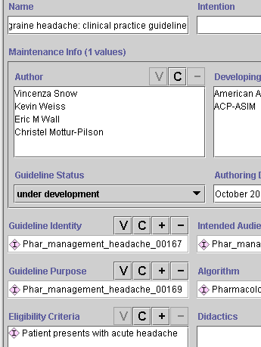
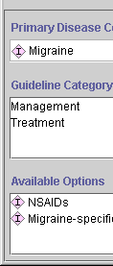

Slide 19
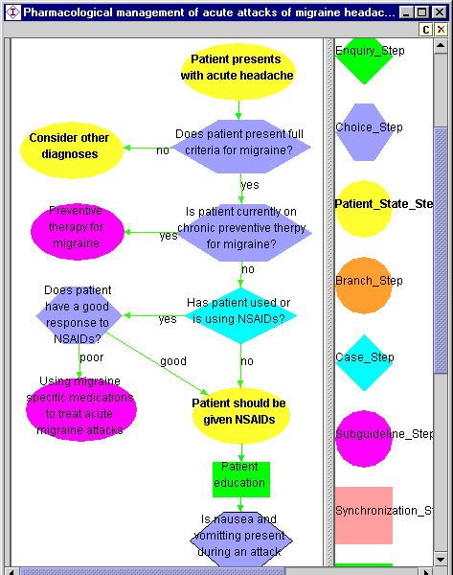
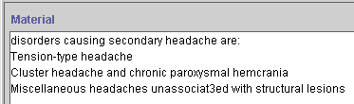
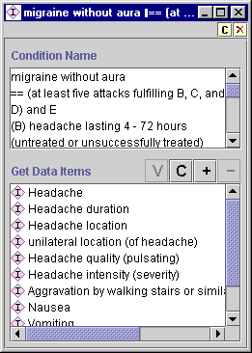

Slide 20
Next steps
Using GLIF authoring tools does not seem to be the solution
Procedures to solve main problems:
  remember “notes” from iteration to iteration
  make explicit that some criteria could not be further defined
  incorporate rules for ranking alternative treatment options

Slide 21
…next steps
Look at previously done algorithms
  I participated in flowchart creation
Classify errors (Batra, Knuth)
How does “thinking in terms of patient disease states” affect the algorithm?
Add
One
medication
Change
Two
medications
Remove

