Slide 1
HL7 v 3.0 Data Types
Mor Peleg

Slide 2
Outline
Overview of the DTDL
Should we make GLIF’s OO languages closer to the DTDL?
DT Spec
Basic Types
Generic Collections
Generic Type Extensions
  (probability and uncertainty)
Timing Spec

Slide 3
HL7 v3 Data Types Spec
Developed by Gunther Schadow and Mark Tucker and ~ 20 others over weekly conference calls and 24 meetings in 1998- 2000
Borrows significantly from IDL, the Object Constraint Language (OCL), JAVA, C++, and the parser generation tools LEX and YACC
The essence of data types is their semantics and not their abstract syntax
  The specification is independent from representational and operational concerns or specific implementation technologies

Slide 4
DTDL Characteristics
No primitive DTs
Declarative language
Defines many DTs that we can use and their operators
  We can adopt subsets of DTs and operators
User-defined literals (e.g., “4 weeks”) for all DTs
no special operator symbols (only operators)
But,
  Semantics of equality not formally defined
  Probably the same for restricts and extends

Slide 5
No Primitive Data Types
A very flexible mapping between HL7 abstract data types and those data types built into any specific implementation technology
Whether a data type is primitive of composite is irrelevant from a semantic perspective, and the answer may be different for different implementation technologies

Slide 6
DTDL Characteristics
No primitive DTs
Declarative language
Defines many DTs that we can use and their operators
  We can adopt subsets of DTs and operators
User-defined literals (e.g., “4 weeks”) for all DTs
no special operator symbols (only operators)
But,
  Semantics of equality not formally defined
  Probably the same for restricts and extends

Slide 7
Declarative Expressions
Declarative language
  No variable declarations outside of argument lists
  No assignments
  Can turn an Exists into a “return all”, so that results can be returned
    Sorting results can be done

Slide 8
DTDL Characteristics
No primitive DTs
Declarative language
Defines many DTs that we can use and their operators
  We can adopt subsets of DTs and operators
User-defined literals (e.g., “4 weeks”) for all DTs
no special operator symbols (only operators)
But,
  Semantics of equality not formally defined
  Probably the same for restricts and extends
  ……

Slide 9
Disadvantages of other languages
Java operators do not work at the abstraction level that we would like to apply them
  no operator over loading
  if(a.value < b.convertedTo(a.unit))
OCL doesn’t have termporary constructors for saying
  this.time.greaterThan(new PQ("4 wk"))
  Can’t say “4 weeks” in OCL
In SQL you can’t even define predicates for user defined types
    SELECT o.work, o.time, c.min
    FROM Observation o,
    Limit c
    WHERE GT(o.time, c.min) = 1;

Slide 10
…Disadvantages of other languages
Data type definition tables give the wrong impression of this specification being a specification of abstract syntax rather than semantics
IDL gives the wrong impression of this specification being an application programming interface (API) definition

Slide 11
How should we proceed?
Should we have one syntax for Expression in the
  procedural OO exp. Lang and
  Declarative OO query lang?
Should this syntax be declarative?
Use subset of HL7 DTs and subsets of their properties?
Extend them as necessary?
Use Java without primitives (operators and built-in DTs) ?

Slide 12
Why DTDL Did Not Adopt A Standard?
Don’t want to use primitive DTs
Others do not define data types that are important for HL7
  Physical quantities
  Precision
  Ranges
  Missing info
  Uncertainty
Others make distinctions that are not relevant to abstract semantics
  Fixed point vs. floating point real

Slide 13
Forms of DT Definitions
Textual description
UML diagrams
Tables
Formal definition

Slide 14
DT Definition Language
The formal DT definition language specifies:
  type name and short name
  named values of a fully enumerated extension
  semantic properties, unary, binary, and higher order properties
  invariants, i.e. constraints over the properties
  allowable type conversions
  syntax of character string value literals (if any)

Slide 15
Defining a Data Type
Declaration:
  DT name name
  list of names, types, and signatures of the new type’s semantic properties.
Definition
  logic statements about what is always true about this type’s values and their properties (invariant statements)

Slide 16
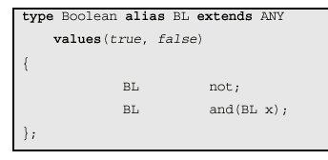
Example: Declaration
Or restricts
Only BL has a finite value set
Semantic properties that hold for every value of the DT
Abstract, protected
DT of the property’s value domain,
Property name
An optional argument list.

Slide 17
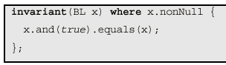
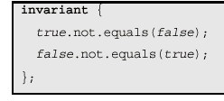
Example: Definition of invariant statements
Reads like natural language (?)
  “For all Boolean values x, where x is non-NULL it holds that x AND true equals x.”

Slide 18
Assertion Expressions
Assertion expressions must have a Boolean value (true or false)
No primitive data types, or operations, pre-exist the definition of any data type
The only preexisting features are:
  character strings representing utterances in the data type definition language;
  the notion of an assertion being successful (true) or failing (false);
  the invariant statement: invariant(...) where ... {...};

Slide 19
Assertion Expressions
  the universal quantifier expression form forall(...) where ... {...};
  the existence quantifier expression form exists(...) where ... {...};
  the implicit conjunction (logical AND) between the semicolon-separated assertions:
  assertion1;assertion2; ... ; assertionn;
  variables and declarations in the invariant argument list;
  the property reference using the period: x.property;
  implicit and explicit type conversion: (T)x;
  parentheses to override the priorities of the conversion and property resolution operators:
  (T)x.property versus((T)x).property

Slide 20
Type Conversion
Conversion types:
  Promotion
  Demotion
  Character string literals
Conversion can be implicit or explicit
invariant(ED x) where ((ST)x).nonNull { ... };
If you expect an Encoded Data value but actually has an ST value instead, one can turn the ST value into an ED

Slide 21
…Type Conversion
Demotion: a more complex type is converted into a simple type
  type Interval alias IVL {
  ...
  demotion QTY;
  ...
  };
Promotion

Slide 22
Literal Form
A literal is a character string representation of a data value
A literal is a type conversion from and to a specially formatted Character String (ST)
  “<5" means less than 5, which is much more readable than a fully structured form of the Interval
Literals can be declared as properties of a DT
  type IntegerNumber alias INT {
  ...
  literal ST;
  ...
  };

Slide 23
Defining Literals
type CardinalNumber alias CARD {
BL isZero;
BL equals(CARD x);
CARD successor;
CARD plus(CARD x);
CARD timesTen;
literal ST;
};
* Positive integer

Slide 24
..Defining Literals
Symbol: production {semantic rule} | production {rule} … ;
CARD.literal ST {
CARD
: CARD digit { $.equals($1.timesTen.plus($2); }
| digit { $.equals($1); };
CARD digit
: “0” { $.isZero; }
| “1” { $.equals(0.successor); }
| “2” { $.equals(1.successor); }
...
| “8” { $.equals(7.successor); }
| “9” { $.equals(8.successor); }
};
$ means “value of the currently defined symbol”. $n = nth symbol in the current def.

Slide 25
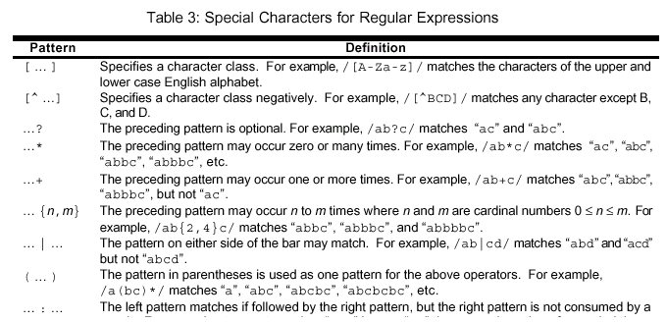
Terminal Symbols
Defined as regular expressions

Slide 26
Generic DT
Like class templates in C++
template<QTY T>
type Interval<T> alias IVL<T> {
T low;
T high;
};
Incomplete type definitions
Declaring parameters: components whose type is not yet defined
Late binding
  Interval has component T: OrderedType
  To use the interval you bind T to a base type such as Integer
type MyType alias MT {
IVL<CARD> multiplicity;
};

Slide 27
Generic Collections
Set <T>
List <T>
IVL <T>
  A continuous subset of an ordered type

Slide 28
Generic Type Extension
template<ANY T> type GenericTypeExtensionName extends T { ... };
These generic type extensions inherit properties of their base type and add some specific feature to it

Slide 29
Data Types Spec
Data types defined for:
  Strings and display data
  Codes and concept identifiers
  Quantities (units and time)
Important issues:
  Intervals
  Uncertain information
  Annotations that can enhance meaning
  Conversions between types

Slide 30
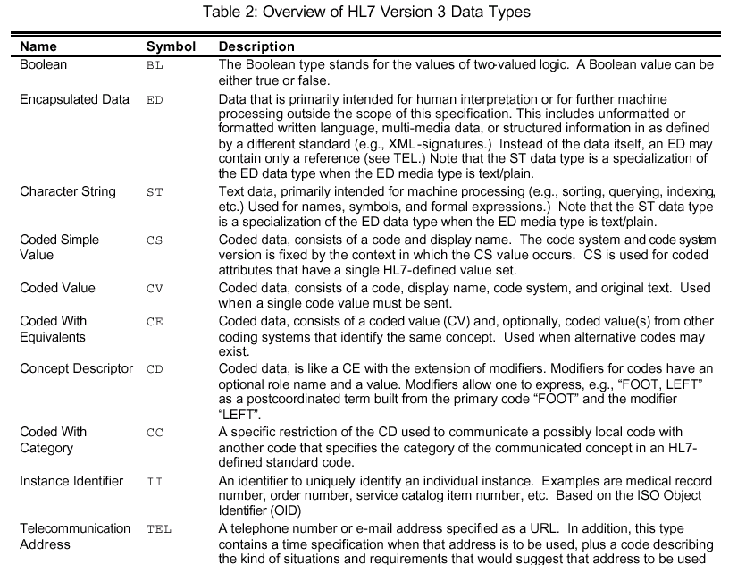

Slide 31
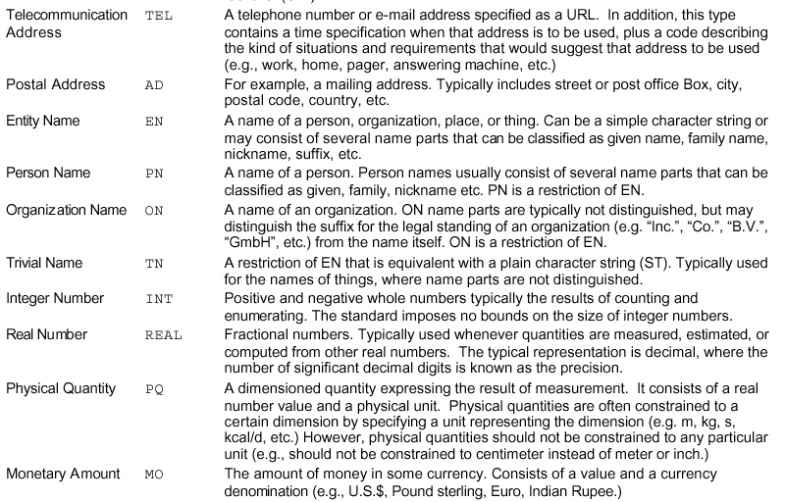

Slide 32
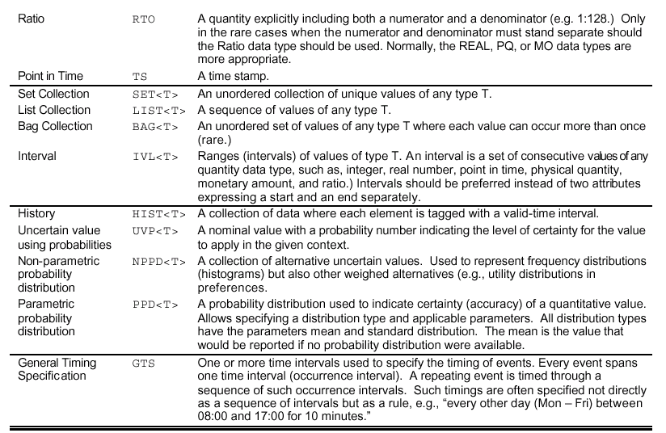

Slide 33
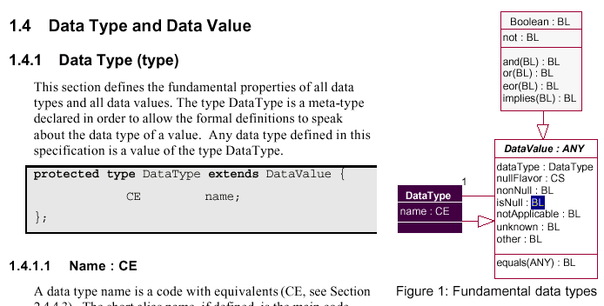
DT and Data Value
The data type “Coded with Equivalents” (CE) is a restriction of the concept descriptor (CD)
The CE suppresses the CD modifier property, which is not applicable

Slide 34
dataType : Data Type
Every data value is of a data type
Thus, given a data value in an HL7 message, one can inquire about its data type
invariant(ANY x) {
x.dataType.nonNull;
};

Slide 35
Null Values
Every data value is either a proper value or it is NULL
If the value is NULL, the nullFlavor property is non-NULL
If the value is not NULL, its nullFlavor property is NULL (not applicable)
invariant(ANY x) {
x.nonNull.equals(x.nullFlavor.isNull);
x.isNull.equals(x.nonNull.not);
};

Slide 36
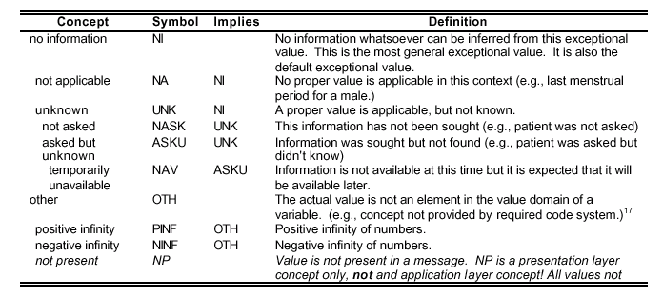
Flavors of Null
invariant(ANY x) {
x.notApplicable.equals(x.nullFlavor.implies(NA));
x.unknown.equals(x.nullFlavor.implies(UNK));
x.other.equals(x.nullFlavor.implies(OTH));
};

Slide 37
Equality
invariant(ANY x, y, z)
where x.nonNull.and(y.nonNull).and(z.nonNull)
{
x.equals(x); /* reflexivity */
x.equals(y).equals(y.equals(x)); /* symmetry */
x.equals(y).and(y.equals(z)).implies(x.equals(z)) /* transitivity */
x.equals(y).implies(x.dataType.equals(y.dataType);
}

Slide 38
No ACEI administration event in the last 4 weeks
(exists(MedAdminEvent m)
where m.patient.participant.equals(PATIENT) {
m.cd.implies(DrugClassAngiotensinConvertingEnzymeInhibitor);
effective_time.high.greaterThan(NOW.minus((PQ)4 wk));
}).not;
Role PATIENT;
TS NOW;
CD ACEI;
<<RIMClass>>
Entity
determiner_cd CS
class_cd CS
type_cd CE
desc ED
plays SET<Role>
scopes SET<Role>
Act
mood_cd CS
class_cd CS
id II
cd CD
effective_time GTS
participation SET<Participation>
Role
class_cd CS
cd CE
played_by Entity
scoped_by Entity
Substance_Administration
dose_qty PQ
route_cd CE
Participation
type_cd CS
tmr IVL<TS>
participant Role
act Act
Med_Admin_Event
effective_time IVL<TS>
patient Participation

Slide 39
Slight Modification
(exists(MedAdminEvent m)
where m.patient.participant.equals(PATIENT) {
m.cd.implies(DrugClassAngiotensinConvertingEnzymeInhibitor);
m.recent;
}).not;
type ClinicalAct extends Act {
Boolean recent(PQ timeFrame);
}
invariant(ClinicalAct a, PQ t)
where a.nonNull.and(t.compares(1 s)) {
a.recent(t).equals(NOW.minus(a.effective_time.high).lessThan(t));
}

Slide 40
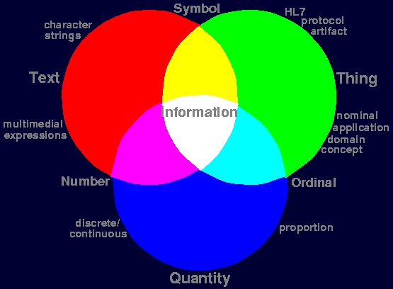
Phenomenology of Info
Notes:
When we talk about things we use symbols to label the things and concepts.
Quantities (Numbers) are represented through digits (text)
Assigning an ordinal number to each concept: UMLS code

Slide 41
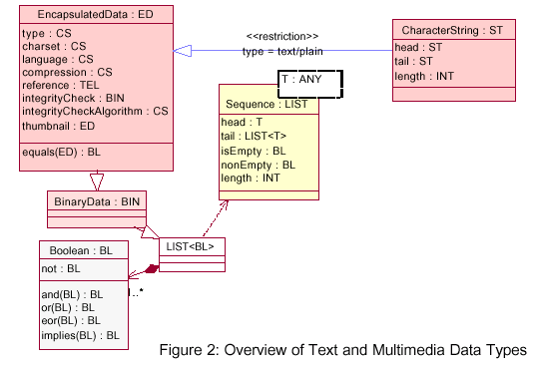
Text and Multimedia DT

Slide 42
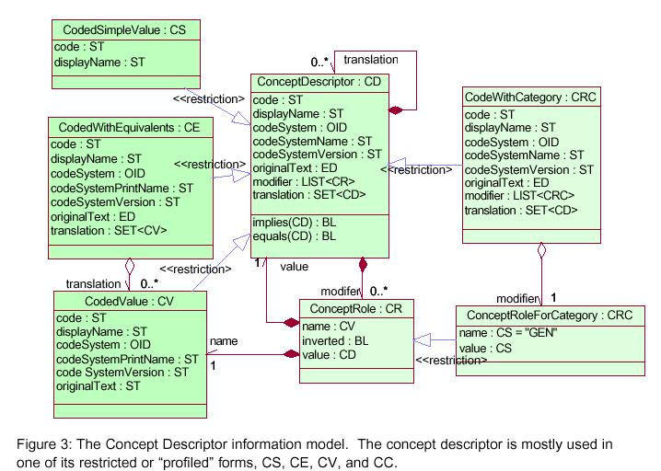
Concept Descriptor

Slide 43
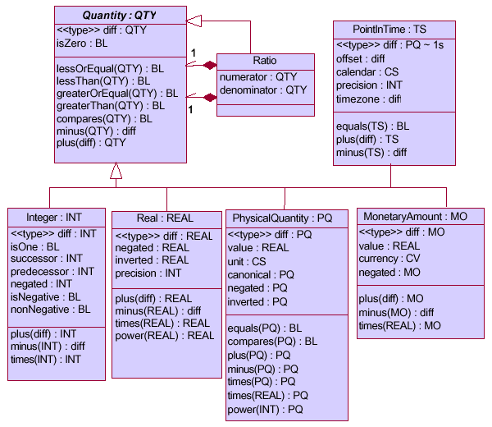
Quantity DTs
Notes:
The quantity data type is an abstract generalization for all data types (1) whose value set has an order
relation (less-or-equal, £) and (2) where difference is defined in all of the data type’s totally ordered
value subsets.

Slide 44
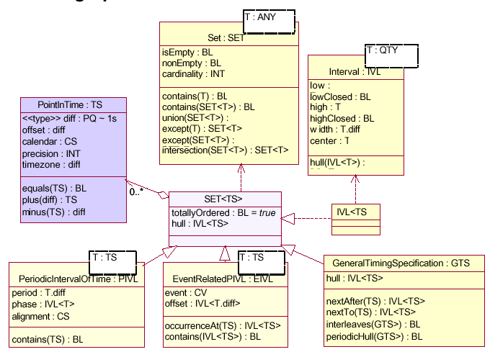
Timing Specification

Slide 45
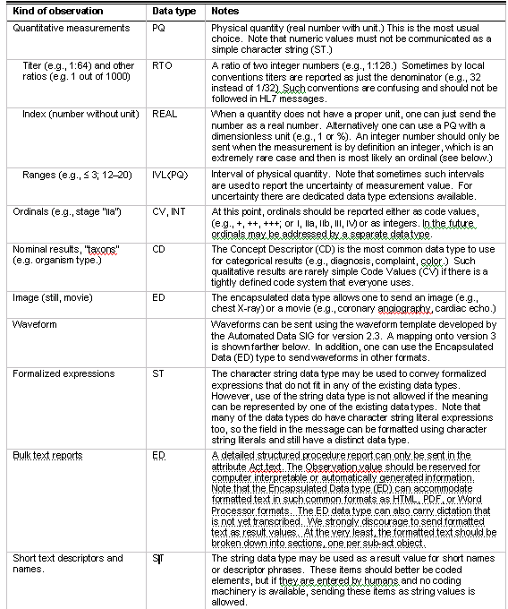
Reasonable DT for Obs.val

