Slide 1
CSCE 689: Special Topics on Algorithms for Big Data
September 29, 2023

Slide 2


Last Time: $(ε,k)$-Frequent Items Problem
Goal: Given a set $S$ of $m$ elements from $[n]$, an accuracy parameter $ε∈(0, 1)$, and a parameter $k$, output a list that includes:
The items from $[n]$ that have frequency at least $\frac{m}{k}$
No items with frequency less than $\left(1−ε\right)\frac{m}{k}$

Slide 3
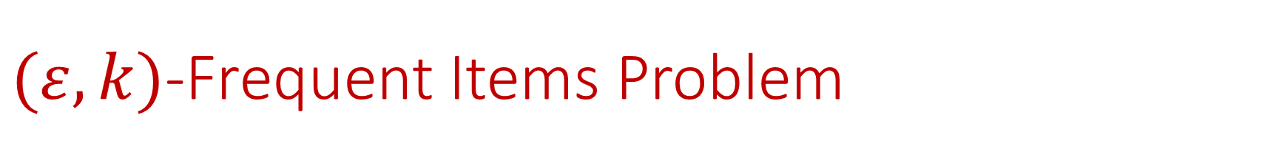
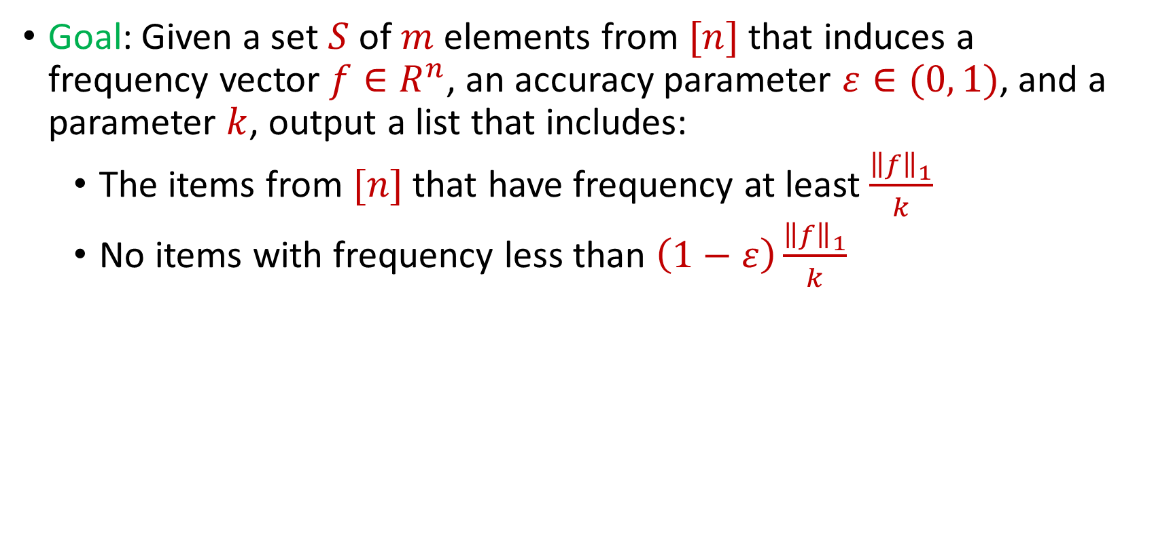
$(ε,k)$-Frequent Items Problem
Goal: Given a set $S$ of $m$ elements from $[n]$ that induces a frequency vector $f∈R^{n}$, an accuracy parameter $ε∈(0, 1)$, and a parameter $k$, output a list that includes:
The items from $[n]$ that have frequency at least $\frac{{\left\|f\right\|}_{1}}{k}$
No items with frequency less than $\left(1−ε\right)\frac{{\left\|f\right\|}_{1}}{k}$

Slide 4
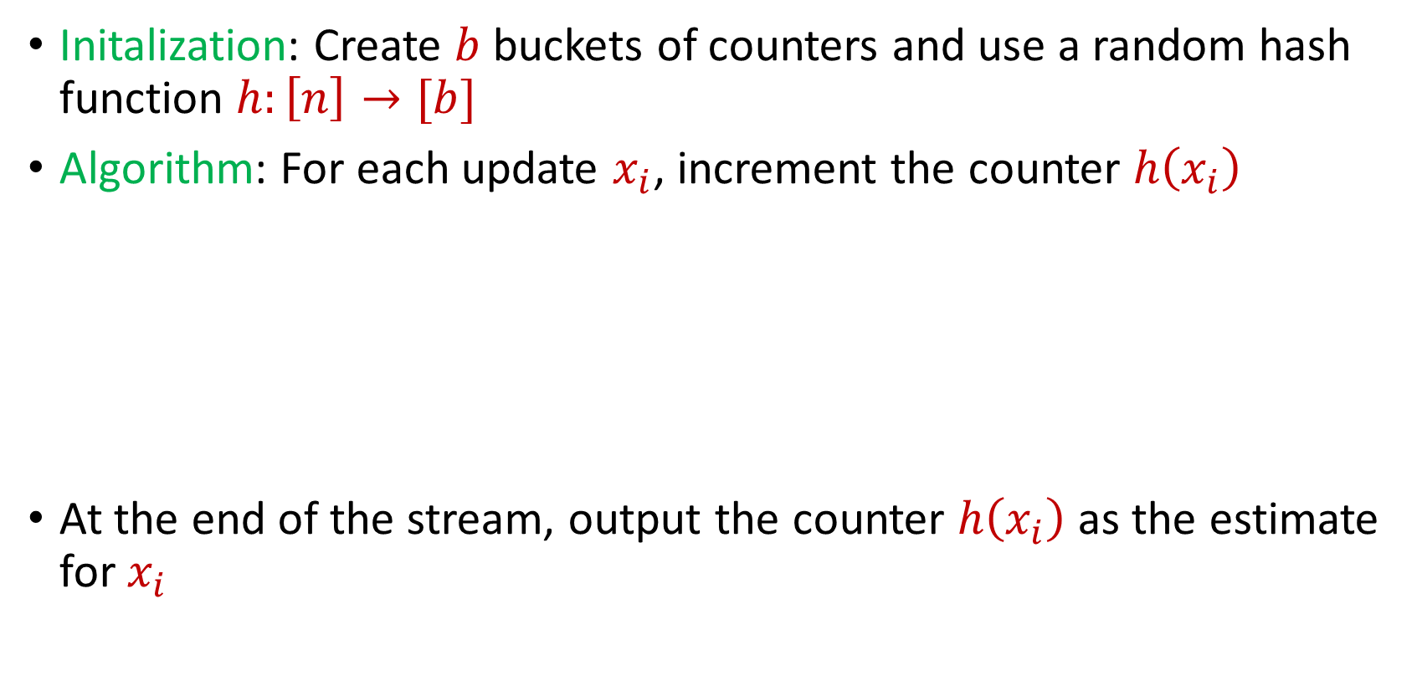
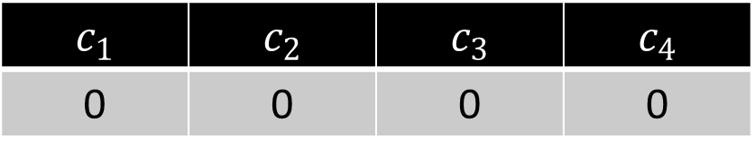
CountMin
Initalization: Create $b$ buckets of counters and use a random hash function $h:\left[n\right]→[b]$
Algorithm: For each update $x_{i}$, increment the counter $h\left(x_{i}\right)$
At the end of the stream, output the counter $h\left(x_{i}\right)$ as the estimate for $x_{i}$
$c_{1}$ | $c_{2}$ | $c_{3}$ | $c_{4}$
0 | 0 | 0 | 0

Slide 5


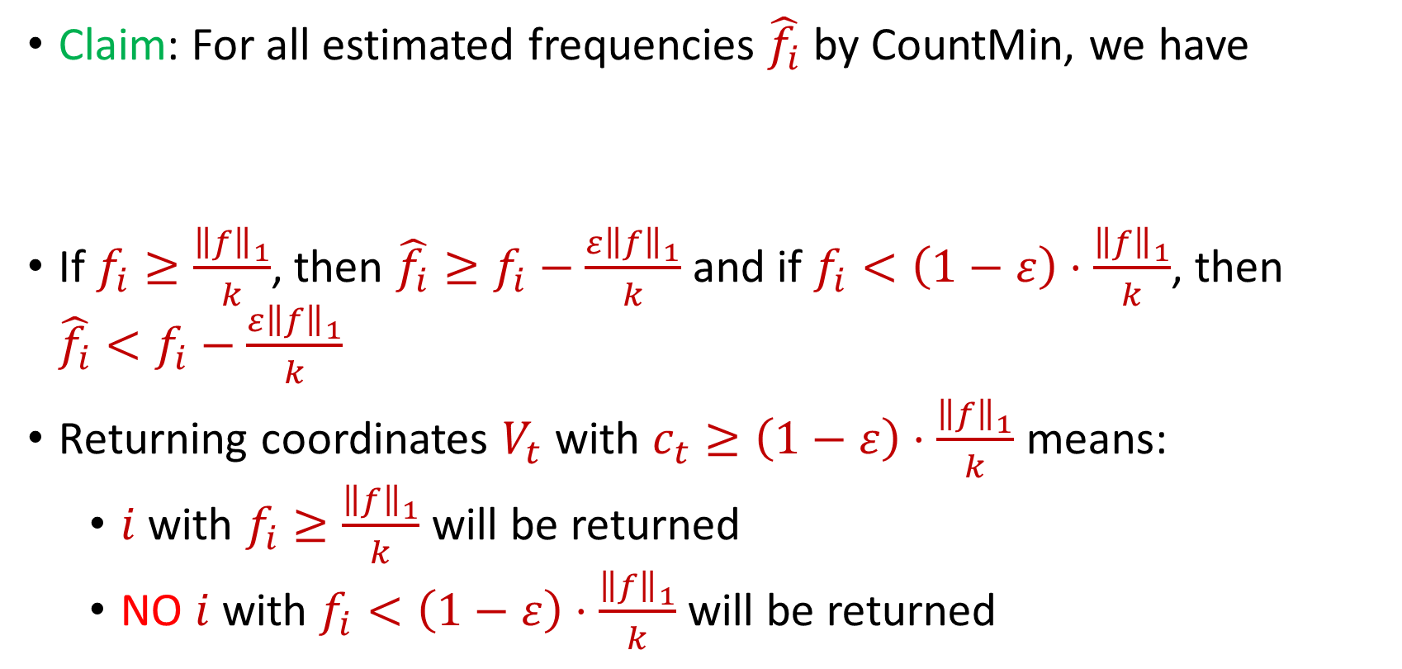
CountMin for $(ε,k)$-Frequent Items Problem
Claim: For all estimated frequencies $\hat{f_{i}}$ by CountMin, we have
If $f_{i}≥\frac{{\left\|f\right\|}_{1}}{k}$, then ${\hat{f_{i}}≥f}_{i}−\frac{ε{\left\|f\right\|}_{1}}{k}$ and if $f_{i}<\left(1−ε\right)⋅\frac{{\left\|f\right\|}_{1}}{k}$, then ${\hat{f_{i}}<f}_{i}−\frac{ε{\left\|f\right\|}_{1}}{k}$
Returning coordinates $V_{t}$ with $c_{t}≥\left(1−ε\right)⋅\frac{{\left\|f\right\|}_{1}}{k}$ means:
$i$ with $f_{i}≥\frac{{\left\|f\right\|}_{1}}{k}$ will be returned
NO $i$ with $f_{i}<\left(1−ε\right)⋅\frac{{\left\|f\right\|}_{1}}{k}$will be returned
$$f_{i}≤\hat{f_{i}}≤f_{i}+\frac{ε{\left\|f\right\|}_{1}}{k}$$

Slide 6
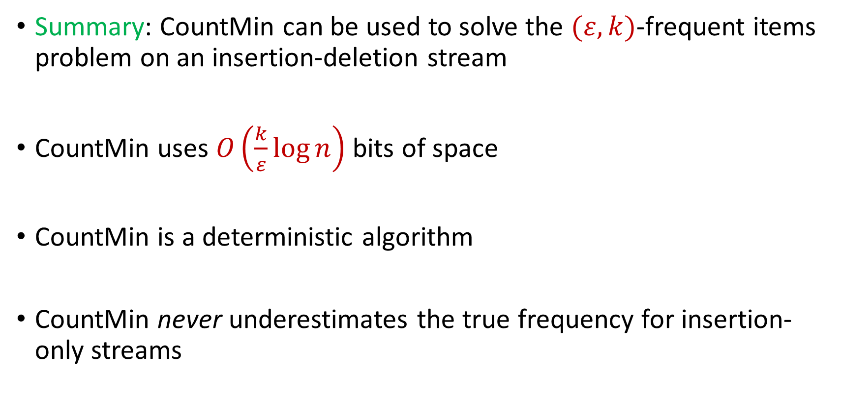
CountMin for $(ε,k)$-Frequent Items Problem
Summary: CountMin can be used to solve the $(ε,k)$-frequent items problem on an insertion-deletion stream
CountMin uses $O\left(\frac{k}{ε}\log{n}\right)$ bits of space
CountMin is a deterministic algorithm
CountMin never underestimates the true frequency for insertion-only streams

Slide 7
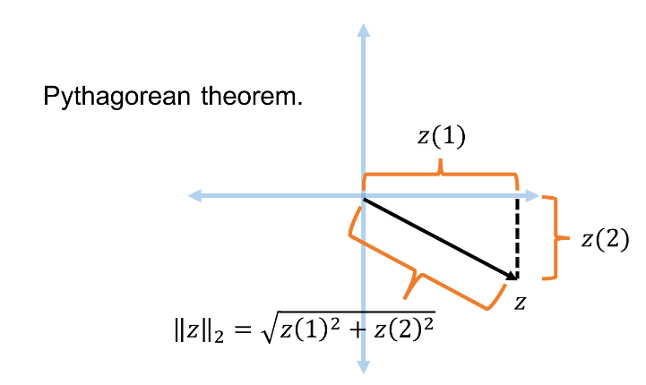




Recall: Euclidean Space and $L_{2}$ Norm
For $z$ $∈R^{n}$, the $L_{2}$ norm of $z$ is denoted by ${\left\|z\right\|}_{2}$ and defined as:
$${\left\|z\right\|}_{2}=\sqrt{z_{1}^{2}+z_{2}^{2}+…+z_{n}^{2}}$$
For $x,y$ $∈R^{n}$, the distance function $D$ is denoted by ${\left\|⋅\right\|}_{2}$ and defined as ${\left\|x−y\right\|}_{2}$

Slide 8
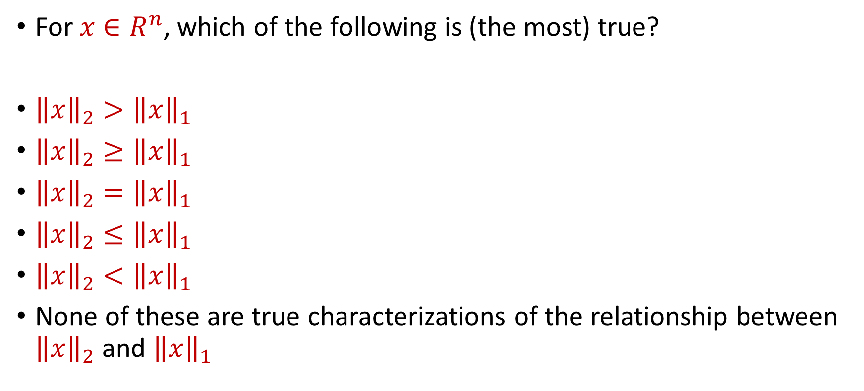
Trivia Question #7 (Norms)
For $x$ $∈R^{n}$, which of the following is (the most) true?
${\left\|x\right\|}_{2}>{\left\|x\right\|}_{1}$
${\left\|x\right\|}_{2}≥{\left\|x\right\|}_{1}$
${\left\|x\right\|}_{2}={\left\|x\right\|}_{1}$
${\left\|x\right\|}_{2}≤{\left\|x\right\|}_{1}$
${\left\|x\right\|}_{2}<{\left\|x\right\|}_{1}$
None of these are true characterizations of the relationship between ${\left\|x\right\|}_{2}$ and ${\left\|x\right\|}_{1}$

Slide 9

Trivia Question #8 (Norms)
For $x$ $∈R^{n}$, how much large can ${\left\|x\right\|}_{1}/{\left\|x\right\|}_{2}$ be?
$O\left(n\right)$
$O\left(\sqrt{n}\right)$
$O\left(\log{n}\right)$
$O\left(1\right)$

Slide 10
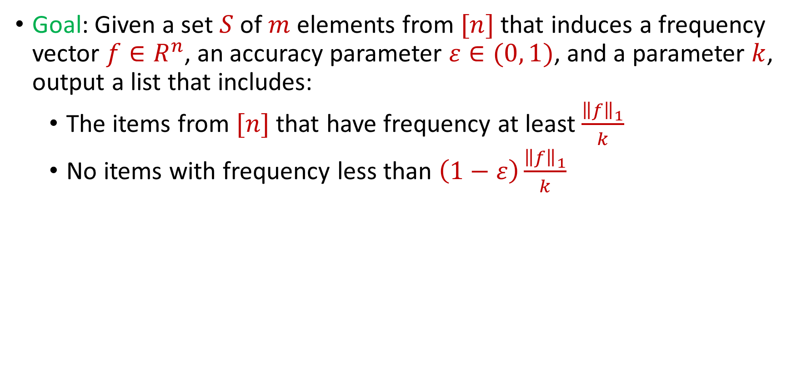
$(ε,k)$-Frequent Items Problem
Goal: Given a set $S$ of $m$ elements from $[n]$ that induces a frequency vector $f∈R^{n}$, an accuracy parameter $ε∈(0, 1)$, and a parameter $k$, output a list that includes:
The items from $[n]$ that have frequency at least $\frac{{\left\|f\right\|}_{1}}{k}$
No items with frequency less than $\left(1−ε\right)\frac{{\left\|f\right\|}_{1}}{k}$

Slide 11
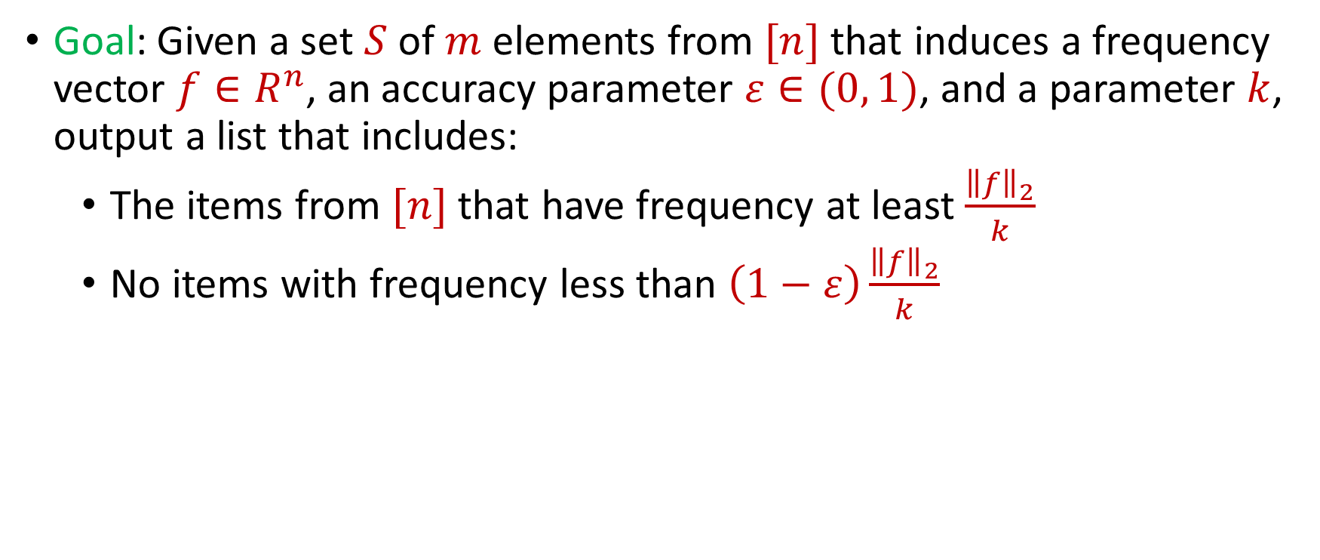
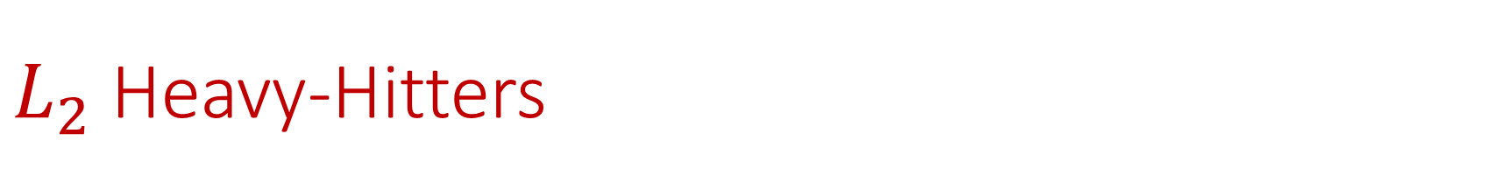
$L_{2}$ Heavy-Hitters
Goal: Given a set $S$ of $m$ elements from $[n]$ that induces a frequency vector $f∈R^{n}$, an accuracy parameter $ε∈(0, 1)$, and a parameter $k$, output a list that includes:
The items from $[n]$ that have frequency at least $\frac{{\left\|f\right\|}_{2}}{k}$
No items with frequency less than $\left(1−ε\right)\frac{{\left\|f\right\|}_{2}}{k}$

Slide 12
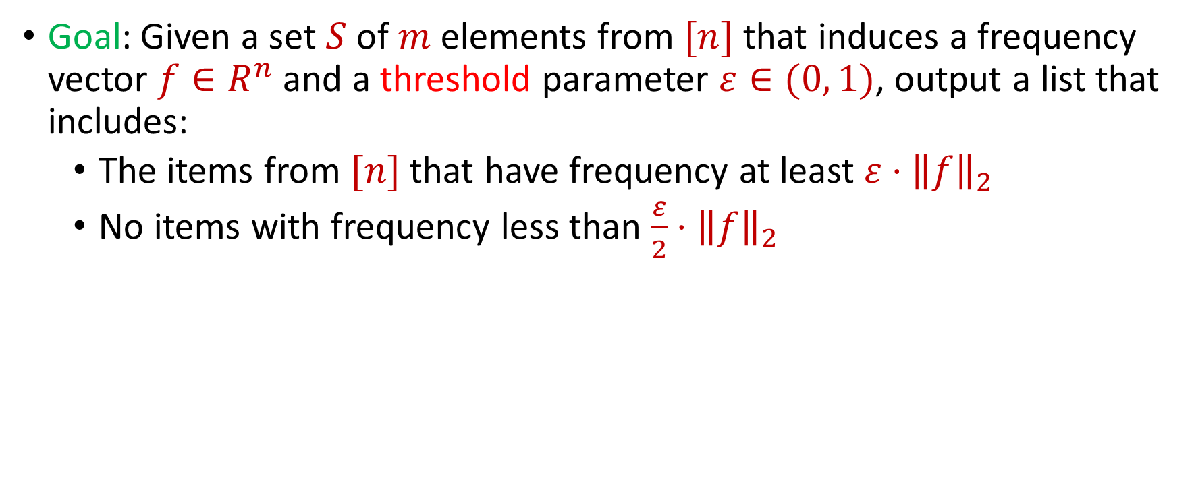
$L_{2}$ Heavy-Hitters
Goal: Given a set $S$ of $m$ elements from $[n]$ that induces a frequency vector $f∈R^{n}$ and a threshold parameter $ε∈(0, 1)$, output a list that includes:
The items from $[n]$ that have frequency at least $ε⋅{\left\|f\right\|}_{2}$
No items with frequency less than $\frac{ε}{2}⋅{\left\|f\right\|}_{2}$

Slide 13
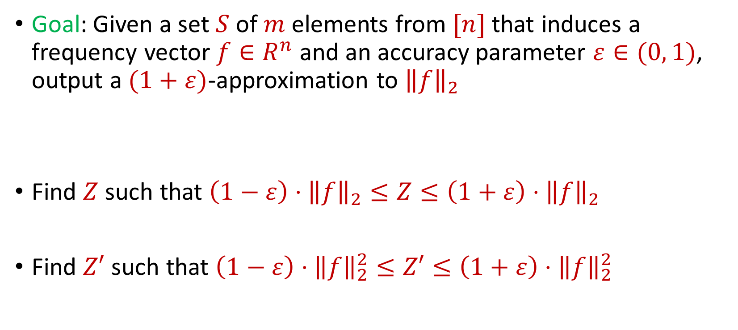
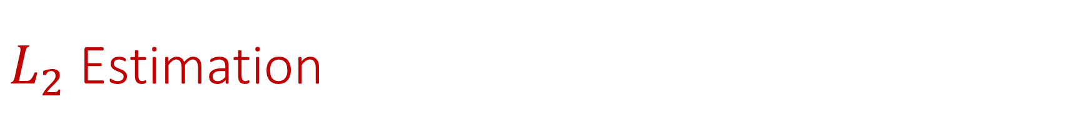
$L_{2}$ Estimation
Goal: Given a set $S$ of $m$ elements from $[n]$ that induces a frequency vector $f∈R^{n}$ and an accuracy parameter $ε∈(0, 1)$, output a $(1+ε)$-approximation to ${\left\|f\right\|}_{2}$
Find $Z$ such that ${\left(1−ε\right)⋅\left\|f\right\|}_{2}≤Z≤\left(1+ε\right)⋅{\left\|f\right\|}_{2}$
Find $Z′$ such that ${\left(1−ε\right)⋅\left\|f\right\|}_{2}^{2}≤Z′≤\left(1+ε\right)⋅{\left\|f\right\|}_{2}^{2}$

Slide 14
$L_{2}$ Estimation
How to do?

Slide 15

$L_{2}$ Estimation
How to do?
Sorry, won’t reveal until next lecture
Assume for now we are given ${\left\|f\right\|}_{2}$

Slide 16
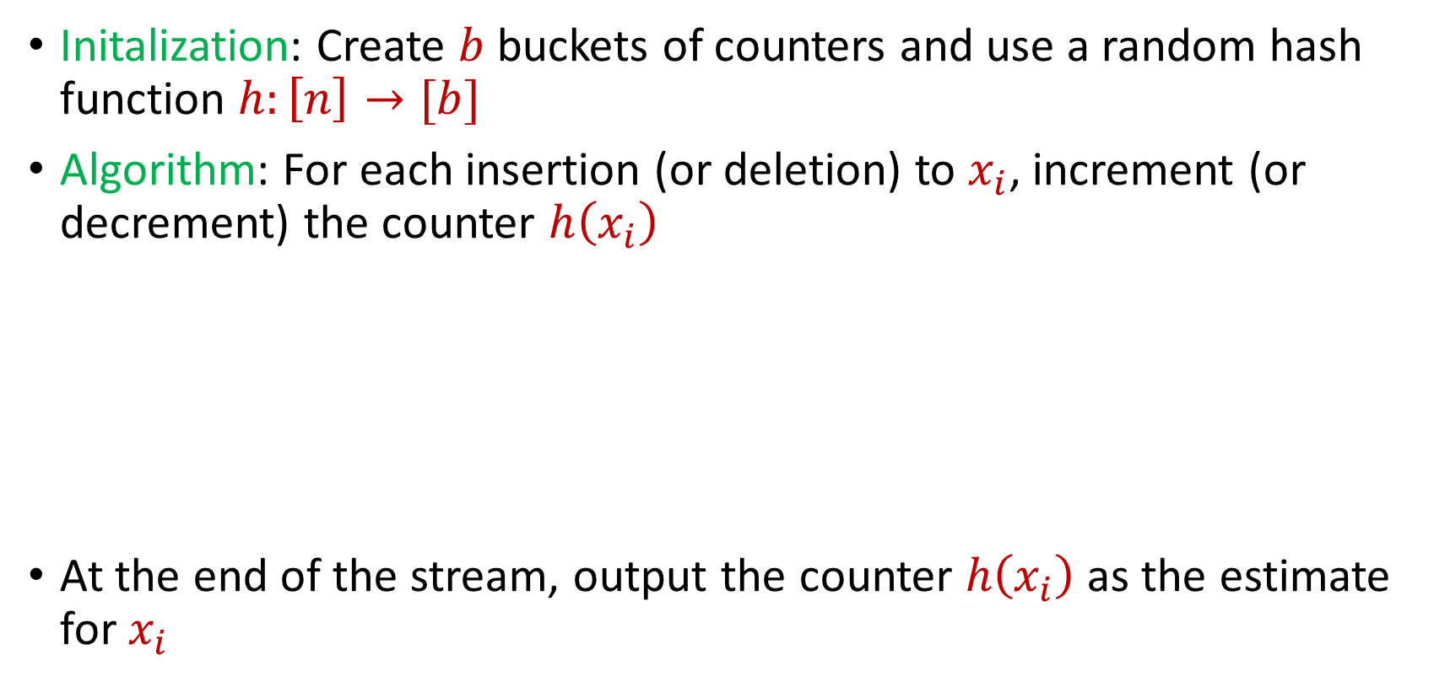
Revisiting CountMin
Initalization: Create $b$ buckets of counters and use a random hash function $h:\left[n\right]→[b]$
Algorithm: For each insertion (or deletion) to $x_{i}$, increment (or decrement) the counter $h\left(x_{i}\right)$
At the end of the stream, output the counter $h\left(x_{i}\right)$ as the estimate for $x_{i}$
$c_{1}$ | $c_{2}$ | $c_{3}$ | $c_{4}$
0 | 0 | 0 | 0

Slide 17
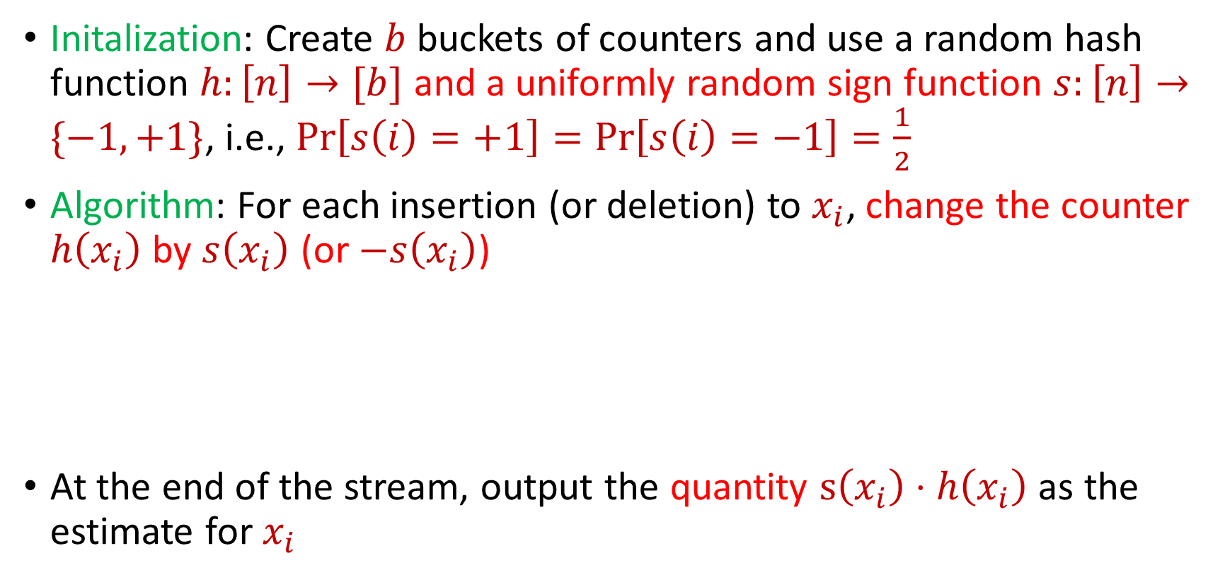
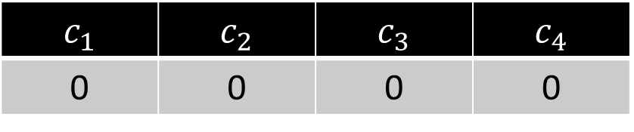
CountMin and the Power of Random Signs
Initalization: Create $b$ buckets of counters and use a random hash function $h:\left[n\right]→[b]$ and a uniformly random sign function $s:\left[n\right]→\{−1,+1\}$, i.e., $Pr\left[s\left(i\right)=+1\right]=Pr\left[s\left(i\right)=−1\right]=\frac{1}{2}$
Algorithm: For each insertion (or deletion) to $x_{i}$, change the counter $h\left(x_{i}\right)$ by $s\left(x_{i}\right)$ (or $−s\left(x_{i}\right)$)
At the end of the stream, output the quantity $s\left(x_{i}\right)⋅h\left(x_{i}\right)$ as the estimate for $x_{i}$
$c_{1}$ | $c_{2}$ | $c_{3}$ | $c_{4}$
0 | 0 | 0 | 0

Slide 18
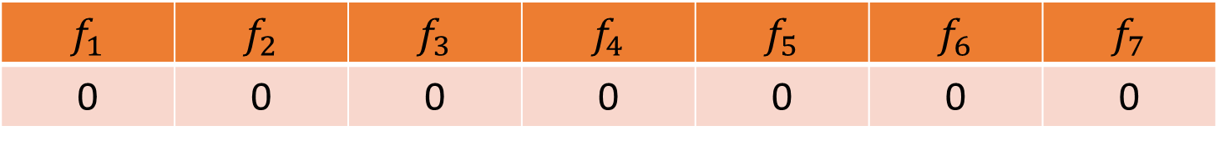


CountSketch
$f_{1}$ | $f_{2}$ | $f_{3}$ | $f_{4}$ | $f_{5}$ | $f_{6}$ | $f_{7}$
0 | 0 | 0 | 0 | 0 | 0 | 0
$$1$$
$c_{1}$ | $c_{2}$ | $c_{3}$ | $c_{4}$
0 | 0 | 0 | 0

Slide 19
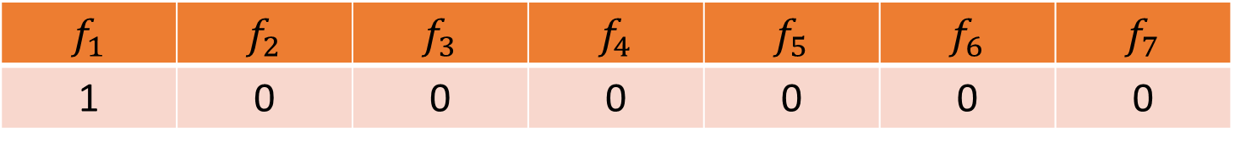
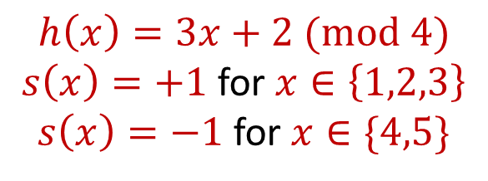
CountSketch
$f_{1}$ | $f_{2}$ | $f_{3}$ | $f_{4}$ | $f_{5}$ | $f_{6}$ | $f_{7}$
1 | 0 | 0 | 0 | 0 | 0 | 0
$$1$$
$$h\left(x\right)=3x+2 (mod 4)$$
$s\left(x\right)=+1$ for $x∈\left\{1,2,3\right\}$
$s\left(x\right)=−1$ for $x∈\{4,5\}$
$c_{1}$ | $c_{2}$ | $c_{3}$ | $c_{4}$
0 | 0 | 0 | 0

Slide 20
CountSketch
$f_{1}$ | $f_{2}$ | $f_{3}$ | $f_{4}$ | $f_{5}$ | $f_{6}$ | $f_{7}$
1 | 0 | 0 | 0 | 0 | 0 | 0
$$1$$
$$h\left(x\right)=3x+2 (mod 4)$$
$s\left(x\right)=+1$ for $x∈\left\{1,2,3\right\}$
$s\left(x\right)=−1$ for $x∈\{4,5\}$
$c_{1}$ | $c_{2}$ | $c_{3}$ | $c_{4}$
0 | 0 | 0 | 0

Slide 21
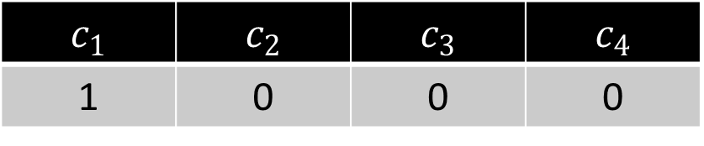
CountSketch
$f_{1}$ | $f_{2}$ | $f_{3}$ | $f_{4}$ | $f_{5}$ | $f_{6}$ | $f_{7}$
1 | 0 | 0 | 0 | 0 | 0 | 0
$$1$$
$$h\left(x\right)=3x+2 (mod 4)$$
$s\left(x\right)=+1$ for $x∈\left\{1,2,3\right\}$
$s\left(x\right)=−1$ for $x∈\{4,5\}$
$c_{1}$ | $c_{2}$ | $c_{3}$ | $c_{4}$
1 | 0 | 0 | 0

Slide 22
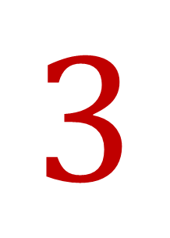
CountSketch
$f_{1}$ | $f_{2}$ | $f_{3}$ | $f_{4}$ | $f_{5}$ | $f_{6}$ | $f_{7}$
1 | 0 | 0 | 0 | 0 | 0 | 0
$$3$$
$$h\left(x\right)=3x+2 (mod 4)$$
$s\left(x\right)=+1$ for $x∈\left\{1,2,3\right\}$
$s\left(x\right)=−1$ for $x∈\{4,5\}$
$c_{1}$ | $c_{2}$ | $c_{3}$ | $c_{4}$
1 | 0 | 0 | 0

Slide 23
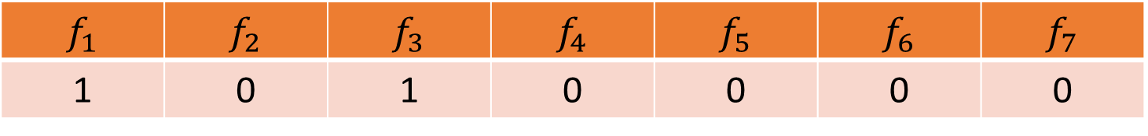
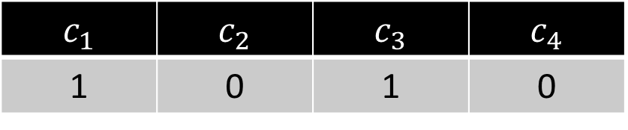
CountSketch
$f_{1}$ | $f_{2}$ | $f_{3}$ | $f_{4}$ | $f_{5}$ | $f_{6}$ | $f_{7}$
1 | 0 | 1 | 0 | 0 | 0 | 0
$$3$$
$$h\left(x\right)=3x+2 (mod 4)$$
$s\left(x\right)=+1$ for $x∈\left\{1,2,3\right\}$
$s\left(x\right)=−1$ for $x∈\{4,5\}$
$c_{1}$ | $c_{2}$ | $c_{3}$ | $c_{4}$
1 | 0 | 1 | 0

Slide 24

CountSketch
$f_{1}$ | $f_{2}$ | $f_{3}$ | $f_{4}$ | $f_{5}$ | $f_{6}$ | $f_{7}$
1 | 0 | 1 | 0 | 0 | 0 | 0
$$2$$
$$h\left(x\right)=3x+2 (mod 4)$$
$s\left(x\right)=+1$ for $x∈\left\{1,2,3\right\}$
$s\left(x\right)=−1$ for $x∈\{4,5\}$
$c_{1}$ | $c_{2}$ | $c_{3}$ | $c_{4}$
1 | 0 | 1 | 0

Slide 25
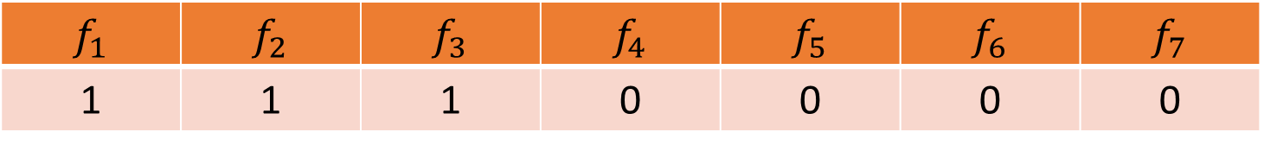
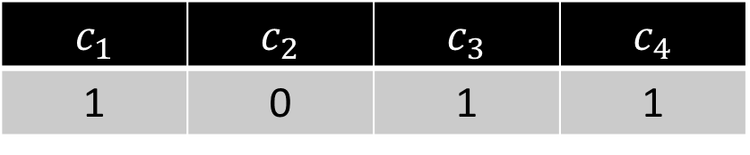
CountSketch
$f_{1}$ | $f_{2}$ | $f_{3}$ | $f_{4}$ | $f_{5}$ | $f_{6}$ | $f_{7}$
1 | 1 | 1 | 0 | 0 | 0 | 0
$$2$$
$$h\left(x\right)=3x+2 (mod 4)$$
$s\left(x\right)=+1$ for $x∈\left\{1,2,3\right\}$
$s\left(x\right)=−1$ for $x∈\{4,5\}$
$c_{1}$ | $c_{2}$ | $c_{3}$ | $c_{4}$
1 | 0 | 1 | 1

Slide 26
CountSketch
$f_{1}$ | $f_{2}$ | $f_{3}$ | $f_{4}$ | $f_{5}$ | $f_{6}$ | $f_{7}$
1 | 1 | 1 | 0 | 0 | 0 | 0
$$1$$
$$h\left(x\right)=3x+2 (mod 4)$$
$s\left(x\right)=+1$ for $x∈\left\{1,2,3\right\}$
$s\left(x\right)=−1$ for $x∈\{4,5\}$
$c_{1}$ | $c_{2}$ | $c_{3}$ | $c_{4}$
1 | 0 | 1 | 1

Slide 27
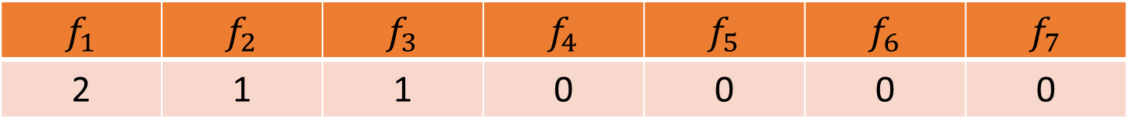
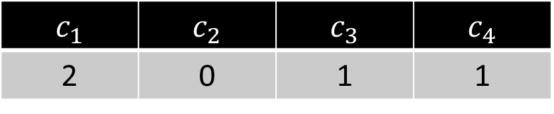
CountSketch
$f_{1}$ | $f_{2}$ | $f_{3}$ | $f_{4}$ | $f_{5}$ | $f_{6}$ | $f_{7}$
2 | 1 | 1 | 0 | 0 | 0 | 0
$$1$$
$$h\left(x\right)=3x+2 (mod 4)$$
$s\left(x\right)=+1$ for $x∈\left\{1,2,3\right\}$
$s\left(x\right)=−1$ for $x∈\{4,5\}$
$c_{1}$ | $c_{2}$ | $c_{3}$ | $c_{4}$
2 | 0 | 1 | 1

Slide 28

CountSketch
$f_{1}$ | $f_{2}$ | $f_{3}$ | $f_{4}$ | $f_{5}$ | $f_{6}$ | $f_{7}$
2 | 1 | 1 | 0 | 0 | 0 | 0
$$5$$
$$h\left(x\right)=3x+2 (mod 4)$$
$s\left(x\right)=+1$ for $x∈\left\{1,2,3\right\}$
$s\left(x\right)=−1$ for $x∈\{4,5\}$
$c_{1}$ | $c_{2}$ | $c_{3}$ | $c_{4}$
2 | 0 | 1 | 1

Slide 29
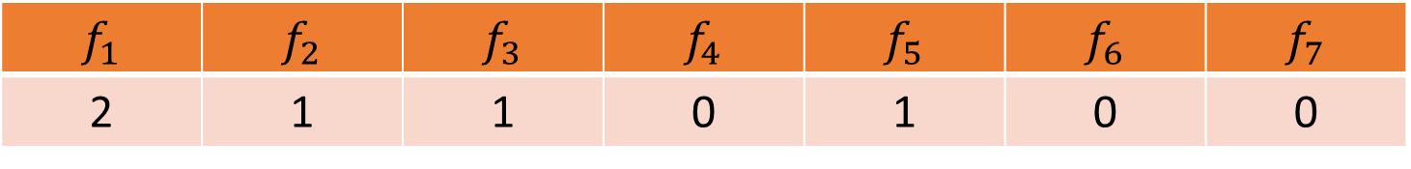
CountSketch
$f_{1}$ | $f_{2}$ | $f_{3}$ | $f_{4}$ | $f_{5}$ | $f_{6}$ | $f_{7}$
2 | 1 | 1 | 0 | 1 | 0 | 0
$$5$$
$$h\left(x\right)=3x+2 (mod 4)$$
$s\left(x\right)=+1$ for $x∈\left\{1,2,3\right\}$
$s\left(x\right)=−1$ for $x∈\{4,5\}$
$c_{1}$ | $c_{2}$ | $c_{3}$ | $c_{4}$
1 | 0 | 1 | 1

Slide 30
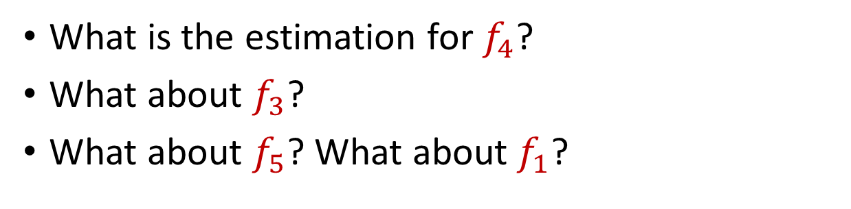
CountSketch
$f_{1}$ | $f_{2}$ | $f_{3}$ | $f_{4}$ | $f_{5}$ | $f_{6}$ | $f_{7}$
2 | 1 | 1 | 0 | 1 | 0 | 0
What is the estimation for $f_{4}$?
What about $f_{3}$?
What about $f_{5}$? What about $f_{1}$?
$$h\left(x\right)=3x+2 (mod 4)$$
$s\left(x\right)=+1$ for $x∈\left\{1,2,3\right\}$
$s\left(x\right)=−1$ for $x∈\{4,5\}$
$c_{1}$ | $c_{2}$ | $c_{3}$ | $c_{4}$
1 | 0 | 1 | 1

Slide 31
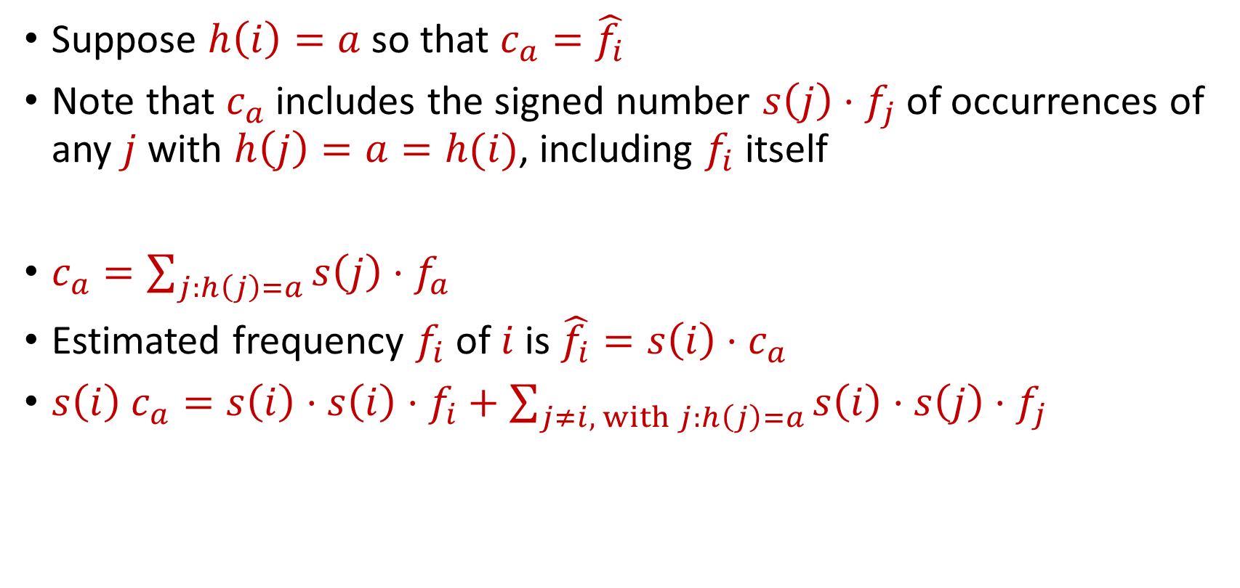
CountSketch
Suppose $h\left(i\right)=a$ so that $c_{a}=\hat{f_{i}}$
Note that $c_{a}$ includes the signed number $s\left(j\right)⋅f_{j}$of occurrences of any $j$ with $h\left(j\right)=a=h(i)$, including $f_{i}$ itself
$c_{a}=\sum_{j:h\left(j\right)=a}{s\left(j\right)⋅f_{a}}$
Estimated frequency $f_{i}$ of $i$ is $\hat{f_{i}}=s\left(i\right)⋅c_{a}$
$s\left(i\right) c_{a}=s\left(i\right)⋅s\left(i\right)⋅f_{i}+\sum_{j≠i, with j:h\left(j\right)=a}{s\left(i\right)⋅s\left(j\right)⋅f_{j}}$

Slide 32

CountSketch Error Analysis
$c_{a}=s\left(i\right)⋅s\left(i\right)⋅f_{i}+\sum_{j≠i, with j:h\left(j\right)=a}{s\left(i\right)⋅s\left(j\right)⋅f_{j}}$
Since $s\left(i\right)∈\{−1,+1\}$, we have $s\left(i\right)⋅s\left(i\right)=1$
What is the expected error for $f_{i}$?

Slide 33

CountSketch Error Analysis
$c_{a}=s\left(i\right)⋅s\left(i\right)⋅f_{i}+\sum_{j≠i, with j:h\left(j\right)=a}{s\left(i\right)⋅s\left(j\right)⋅f_{j}}$
What is the expectation of the error term for $f_{i}$?
$E\left[\sum_{j≠i, with j:h\left(j\right)=a}{{s\left(i\right)⋅s\left(j\right)⋅f}_{j}}\right]=Σ_{j≠i}E\left[{s\left(i\right)⋅s\left(j\right)⋅f}_{j}⋅I_{h\left(j\right)=h(i)}\right]$

Slide 34

CountSketch Error Analysis
$c_{a}=s\left(i\right)⋅s\left(i\right)⋅f_{i}+\sum_{j≠i, with j:h\left(j\right)=a}{s\left(i\right)⋅s\left(j\right)⋅f_{j}}$
What is the expectation of the error term for $f_{i}$?
$E\left[\sum_{j≠i, with j:h\left(j\right)=a}{{s\left(i\right)⋅s\left(j\right)⋅f}_{j}}\right]=0$

Slide 35

CountSketch Error Analysis
$c_{a}=s\left(i\right)⋅s\left(i\right)⋅f_{i}+\sum_{j≠i, with j:h\left(j\right)=a}{s\left(i\right)⋅s\left(j\right)⋅f_{j}}$
What is the expectation of the error term for $f_{i}$?
$E\left[\sum_{j≠i, with j:h\left(j\right)=a}{{s\left(i\right)⋅s\left(j\right)⋅f}_{j}}\right]=0$
What is the variance of the error term for $f_{i}$?

Slide 36

CountSketch Error Analysis
Variance is at most the 2nd moment of the error term
$E\left[{\left(\sum_{j≠i, with j:h\left(j\right)=a}{{s\left(i\right)⋅s\left(j\right)⋅f}_{j}}\right)}^{2}\right]$

Slide 37

CountSketch Error Analysis
Variance is at most the 2nd moment of the error term
$E\left[{\left(\sum_{j≠i, with j:h\left(j\right)=a}{{s\left(i\right)⋅s\left(j\right)⋅f}_{j}}\right)}^{2}\right]=Σ_{j≠i}E\left[{\left|f_{j}\right|}^{2}⋅I_{h\left(j\right)=h(i)}\right]$

Slide 38

CountSketch Error Analysis
Variance is at most the 2nd moment of the error term
$E\left[{\left(\sum_{j≠i, with j:h\left(j\right)=a}{{s\left(i\right)⋅s\left(j\right)⋅f}_{j}}\right)}^{2}\right]=Σ_{j≠i}E\left[{\left|f_{j}\right|}^{2}⋅I_{h\left(j\right)=h(i)}\right]$
$$=Σ_{j≠i}E\left[I_{h\left(j\right)=h(i)}\right]⋅{\left|f_{j}\right|}^{2}$$

Slide 39

CountSketch Error Analysis
Variance is at most the 2nd moment of the error term
$E\left[{\left(\sum_{j≠i, with j:h\left(j\right)=a}{{s\left(i\right)⋅s\left(j\right)⋅f}_{j}}\right)}^{2}\right]=Σ_{j≠i}E\left[{\left|f_{j}\right|}^{2}⋅I_{h\left(j\right)=h(i)}\right]$
$$=Σ_{j≠i}E\left[I_{h\left(j\right)=h(i)}\right]⋅{\left|f_{j}\right|}^{2}$$
$$=Σ_{j≠i}Pr\left[h\left(j\right)=h(i)\right]⋅{\left|f_{j}\right|}^{2}$$

Slide 40

CountSketch Error Analysis
Variance is at most the 2nd moment of the error term
$E\left[{\left(\sum_{j≠i, with j:h\left(j\right)=a}{{s\left(i\right)⋅s\left(j\right)⋅f}_{j}}\right)}^{2}\right]=Σ_{j≠i}E\left[{\left|f_{j}\right|}^{2}⋅I_{h\left(j\right)=h(i)}\right]$
$$=Σ_{j≠i}E\left[I_{h\left(j\right)=h(i)}\right]⋅{\left|f_{j}\right|}^{2}$$
$$=Σ_{j≠i}Pr\left[h\left(j\right)=h(i)\right]⋅{\left|f_{j}\right|}^{2}$$
$$=Σ_{j≠i}\frac{1}{b}⋅{\left|f_{j}\right|}^{2}≤\frac{{\left\|f\right\|}_{2}^{2}}{b}$$

Slide 41
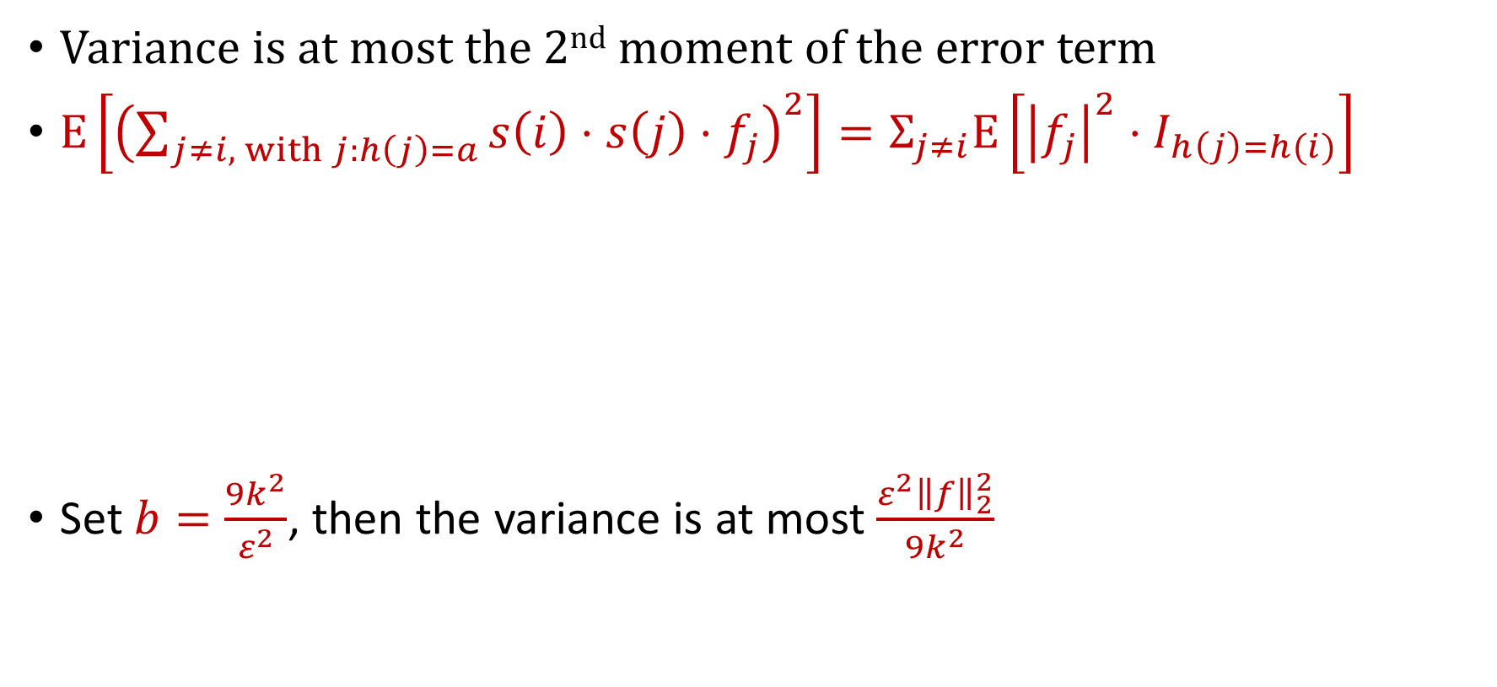
CountSketch Error Analysis
Variance is at most the 2nd moment of the error term
$E\left[{\left(\sum_{j≠i, with j:h\left(j\right)=a}{{s\left(i\right)⋅s\left(j\right)⋅f}_{j}}\right)}^{2}\right]=Σ_{j≠i}E\left[{\left|f_{j}\right|}^{2}⋅I_{h\left(j\right)=h(i)}\right]$
Set $b=\frac{9k^{2}}{ε^{2}}$, then the variance is at most $\frac{ε^{2}{\left\|f\right\|}_{2}^{2}}{9k^{2}}$
$$=Σ_{j≠i}E\left[I_{h\left(j\right)=h(i)}\right]⋅{\left|f_{j}\right|}^{2}$$
$$=Σ_{j≠i}Pr\left[h\left(j\right)=h(i)\right]⋅{\left|f_{j}\right|}^{2}$$
$$=Σ_{j≠i}\frac{1}{b}⋅{\left|f_{j}\right|}^{2}≤\frac{{\left\|f\right\|}_{2}^{2}}{b}$$

Slide 42
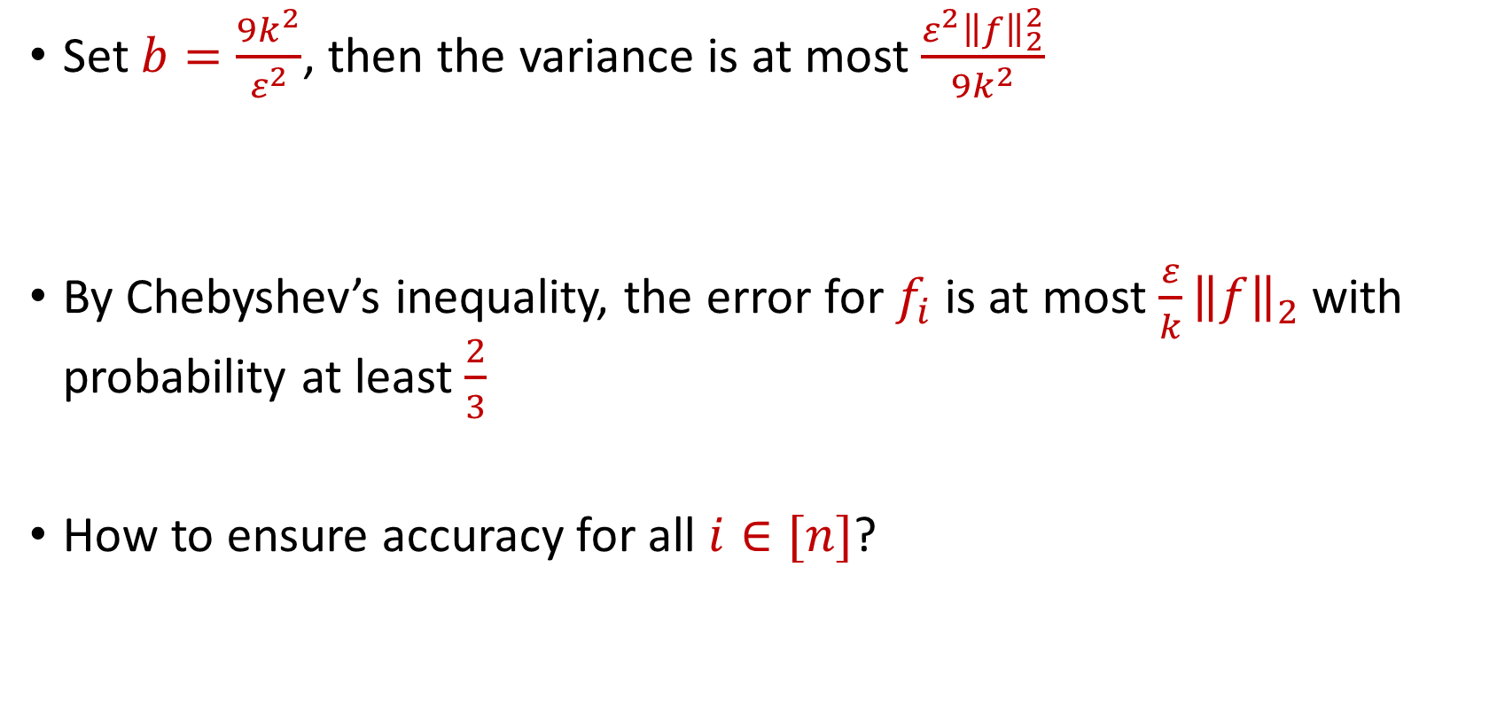
CountSketch Error Analysis
Set $b=\frac{9k^{2}}{ε^{2}}$, then the variance is at most $\frac{ε^{2}{\left\|f\right\|}_{2}^{2}}{9k^{2}}$
By Chebyshev’s inequality, the error for $f_{i}$ is at most $\frac{ε}{k}{\left\|f\right\|}_{2}$with probability at least $\frac{2}{3}$
How to ensure accuracy for all $i∈[n]$?

Slide 43
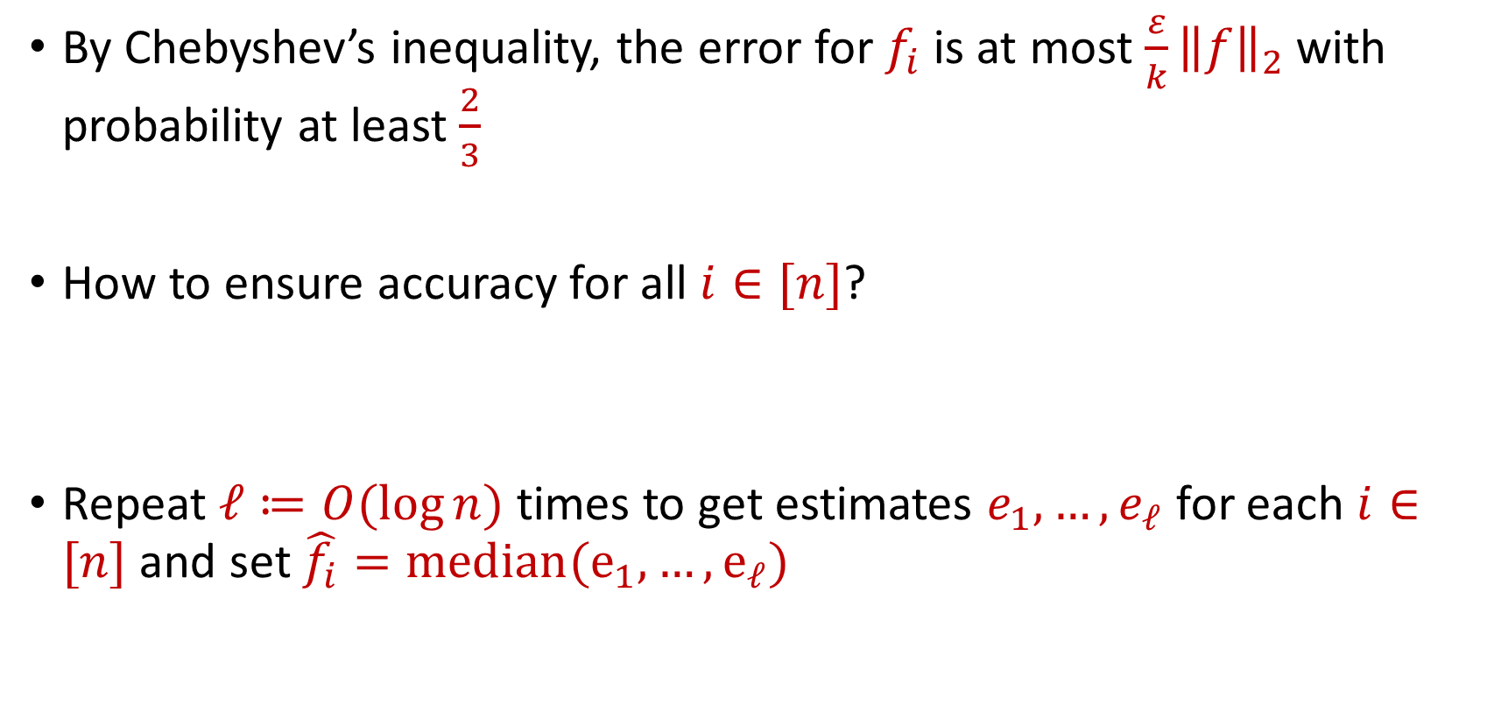
CountSketch Error Analysis
By Chebyshev’s inequality, the error for $f_{i}$ is at most $\frac{ε}{k}{\left\|f\right\|}_{2}$with probability at least $\frac{2}{3}$
How to ensure accuracy for all $i∈[n]$?
Repeat $ℓ≔O(\log{n)}$ times to get estimates $e_{1},…,e_{ℓ}$ for each $i∈[n]$ and set $\hat{f_{i}}=median(e_{1},…, e_{ℓ})$

Slide 44


CountSketch Error Analysis
Claim: For all estimated frequencies $\hat{f_{i}}$ by CountSketch, we have
$$f_{i}−\frac{ε{\left\|f\right\|}_{2}}{k}≤\hat{f_{i}}≤f_{i}+\frac{ε{\left\|f\right\|}_{2}}{k}$$

Slide 45
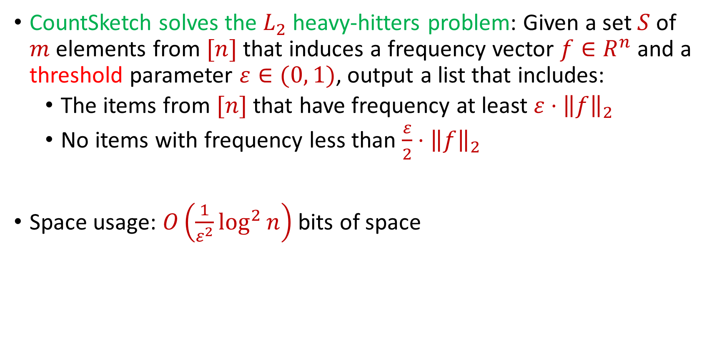
CountSketch Summary
CountSketch solves the $L_{2}$ heavy-hitters problem: Given a set $S$ of $m$ elements from $[n]$ that induces a frequency vector $f∈R^{n}$ and a threshold parameter $ε∈(0, 1)$, output a list that includes:
The items from $[n]$ that have frequency at least $ε⋅{\left\|f\right\|}_{2}$
No items with frequency less than $\frac{ε}{2}⋅{\left\|f\right\|}_{2}$
Space usage: $O\left(\frac{1}{ε^{2}}\log^{2}{n}\right)$ bits of space

