Slide 1
CSCE 658: Randomized Algorithms
Lecture 2
Samson Zhou

Slide 2
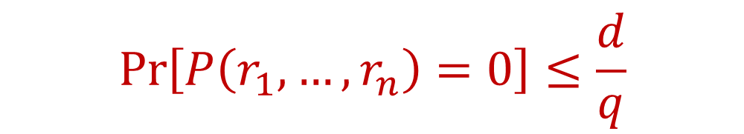
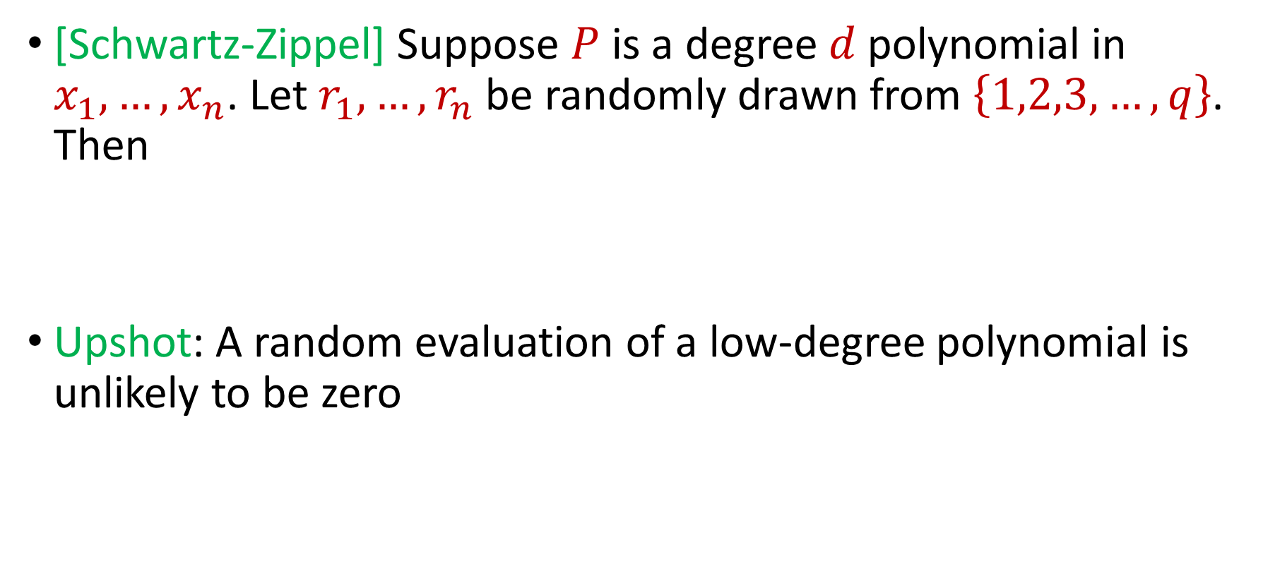
Last Time: Schwartz-Zippel Lemma
[Schwartz-Zippel] Suppose $P$ is a degree $d$polynomial in $x_{1},…,x_{n}$. Let $r_{1},…,r_{n}$ be randomly drawn from $\left\{1,2,3,…,q\right\}$. Then
Upshot: A random evaluation of a low-degree polynomial is unlikely to be zero
$$\operatorname{Pr}\left[P\left(r_{1},…,r_{n}\right)=0\right]≤\frac{d}{q}$$

Slide 3
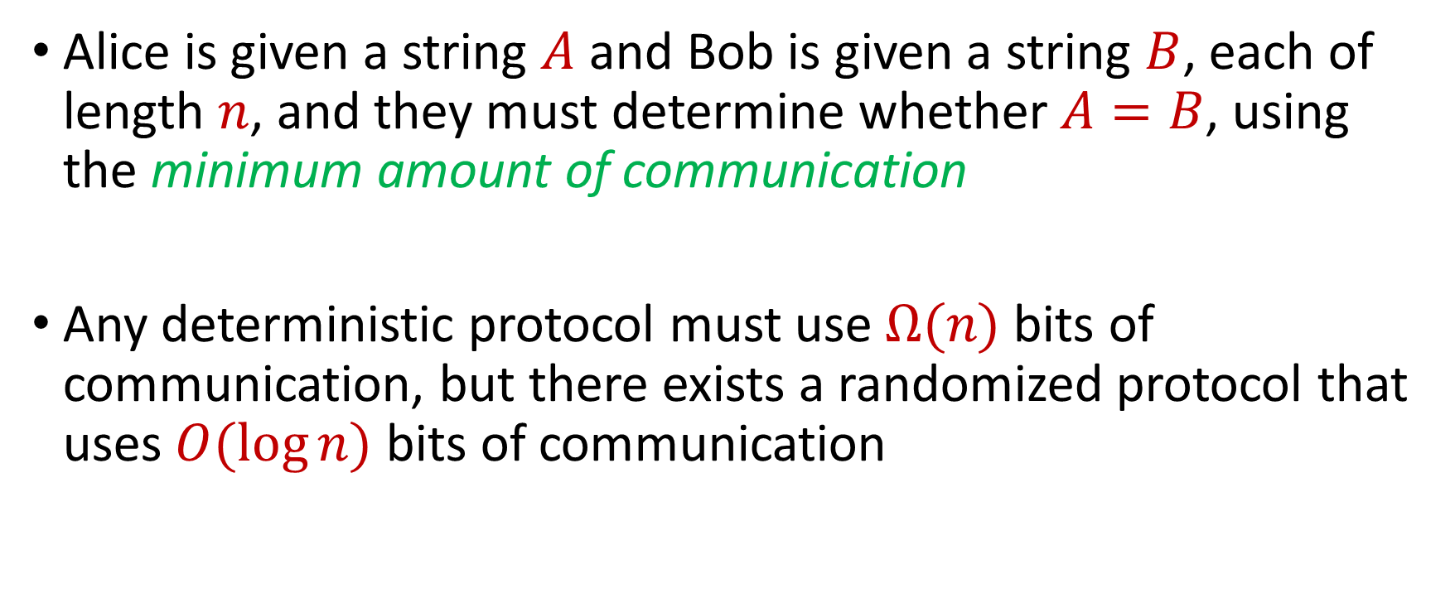
Last Time: Equality Problem
Alice is given a string $A$ and Bob is given a string $B$, each of length $n$, and they must determine whether $A=B$, using the minimum amount of communication
Any deterministic protocol must use $Ω(n)$ bits of communication, but there exists a randomized protocol that uses $O(\log{n})$ bits of communication

Slide 4
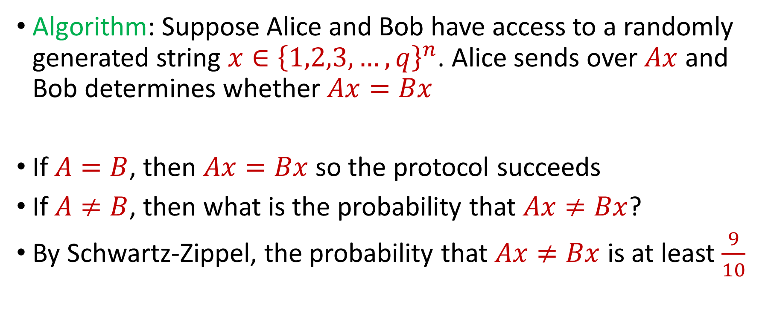
Last Time: Equality Problem
Algorithm: Suppose Alice and Bob have access to a randomly generated string $x∈{\left\{1,2,3,…,q\right\}}^{n}$. Alice sends over $Ax$ and Bob determines whether $Ax=Bx$
If $A=B$, then $Ax=Bx$ so the protocol succeeds
If $A≠B$, then what is the probability that $Ax≠Bx$?
By Schwartz-Zippel, the probability that $Ax≠Bx$ is at least $\frac{9}{10}$

Slide 5

Polynomial Identity Testing
$f\left(x,y\right)=x^{2}−y^{2}$
$g\left(x,y\right)=\left(x+y\right)(x−y)$
Do we have $f\left(x,y\right)≡g\left(x,y\right)$?

Slide 6

Polynomial Identity Testing
$f\left(x,y\right)=x^{3}+3xy+y^{3}−1$
$g\left(x,y\right)=\frac{1}{2}\left(x+y−1\right)\left({\left(x+1\right)}^{2}+{\left(y+1\right)}^{2}+{\left(x−y\right)}^{2}\right)$
Do we have $f\left(x,y\right)≡g\left(x,y\right)$?

Slide 7
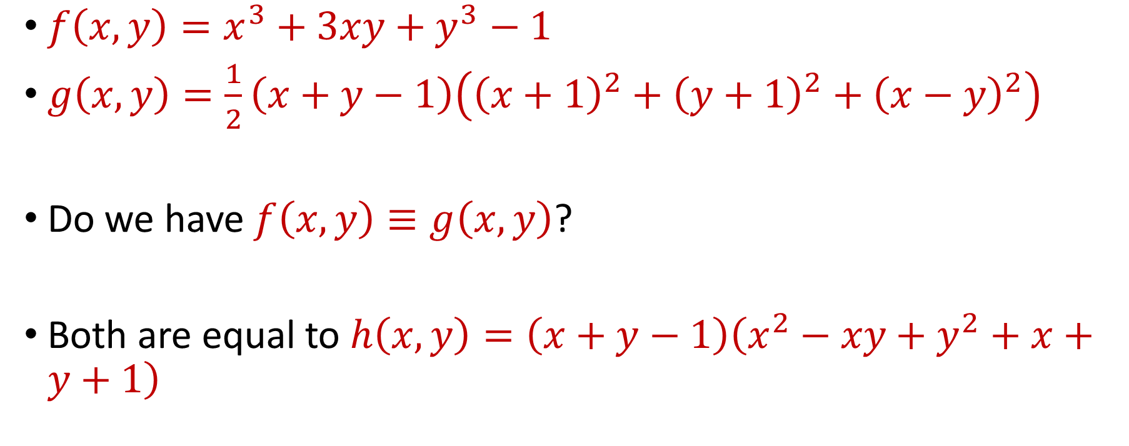
Polynomial Identity Testing
$f\left(x,y\right)=x^{3}+3xy+y^{3}−1$
$g\left(x,y\right)=\frac{1}{2}\left(x+y−1\right)\left({\left(x+1\right)}^{2}+{\left(y+1\right)}^{2}+{\left(x−y\right)}^{2}\right)$
Do we have $f\left(x,y\right)≡g\left(x,y\right)$?
Both are equal to $h\left(x,y\right)=\left(x+y−1\right)\left(x^{2}−xy+y^{2}+x+y+1\right)$

Slide 8
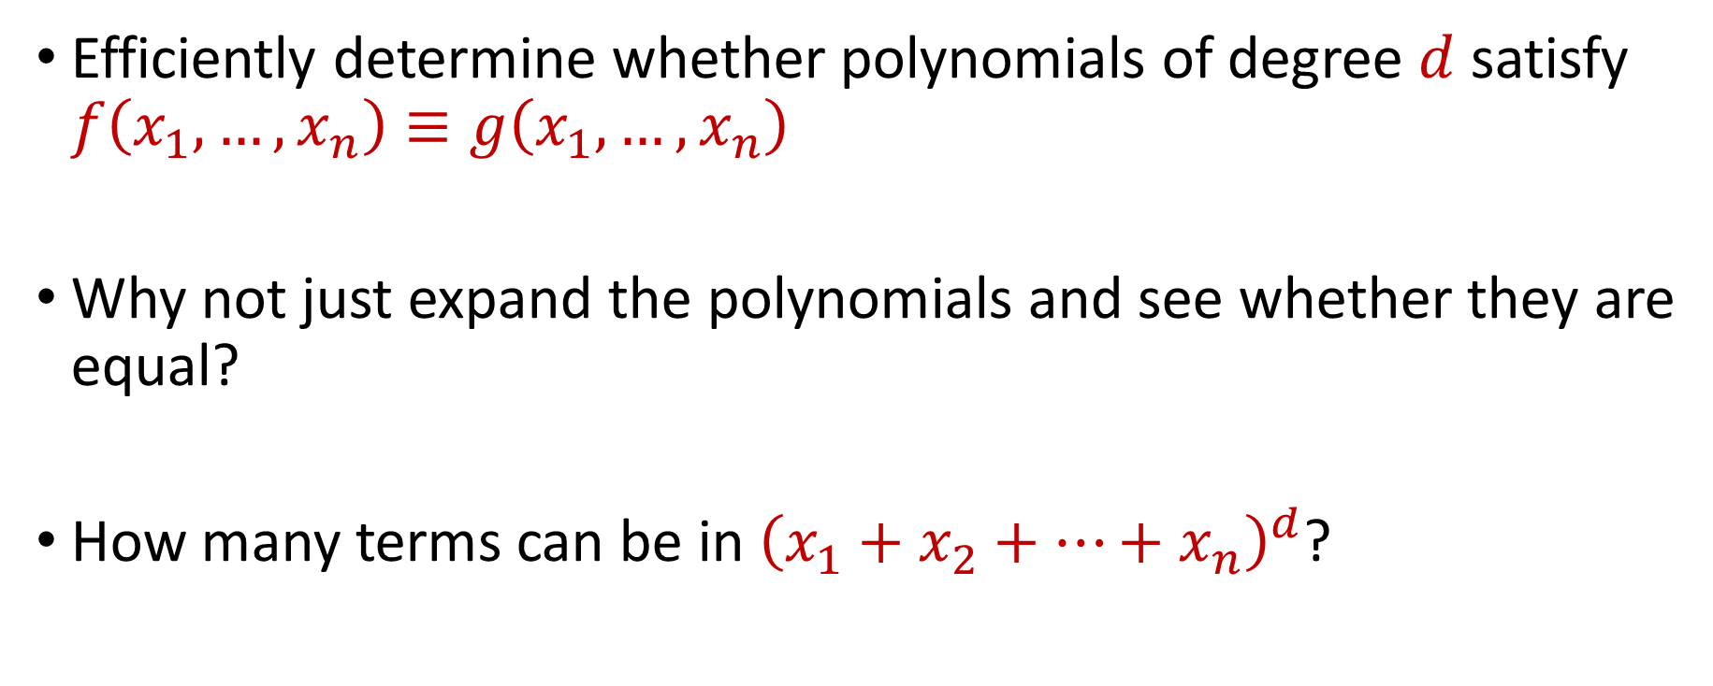
Polynomial Identity Testing
Efficiently determine whether polynomials of degree $d$ satisfy $f\left(x_{1},…,x_{n}\right)≡g\left(x_{1},…, x_{n}\right)$
Why not just expand the polynomials and see whether they are equal?
How many terms can be in ${\left(x_{1}+x_{2}+…+x_{n}\right)}^{d}$?

Slide 9
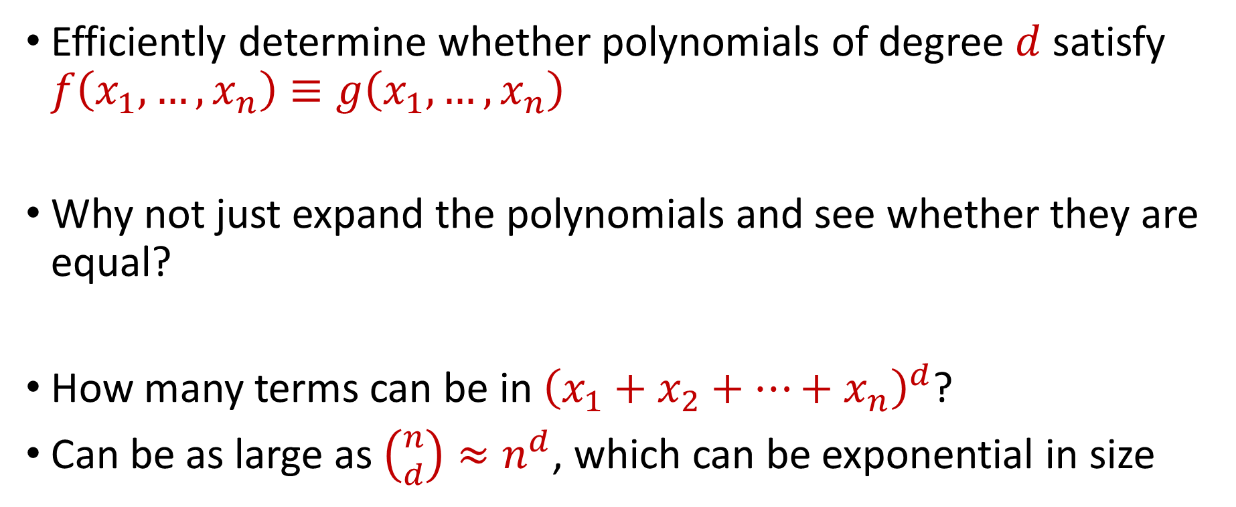
Polynomial Identity Testing
Efficiently determine whether polynomials of degree $d$ satisfy $f\left(x_{1},…,x_{n}\right)≡g\left(x_{1},…, x_{n}\right)$
Why not just expand the polynomials and see whether they are equal?
How many terms can be in ${\left(x_{1}+x_{2}+…+x_{n}\right)}^{d}$?
Can be as large as $\left({n \atop d}\right)≈n^{d}$, which can be exponential in size

Slide 10
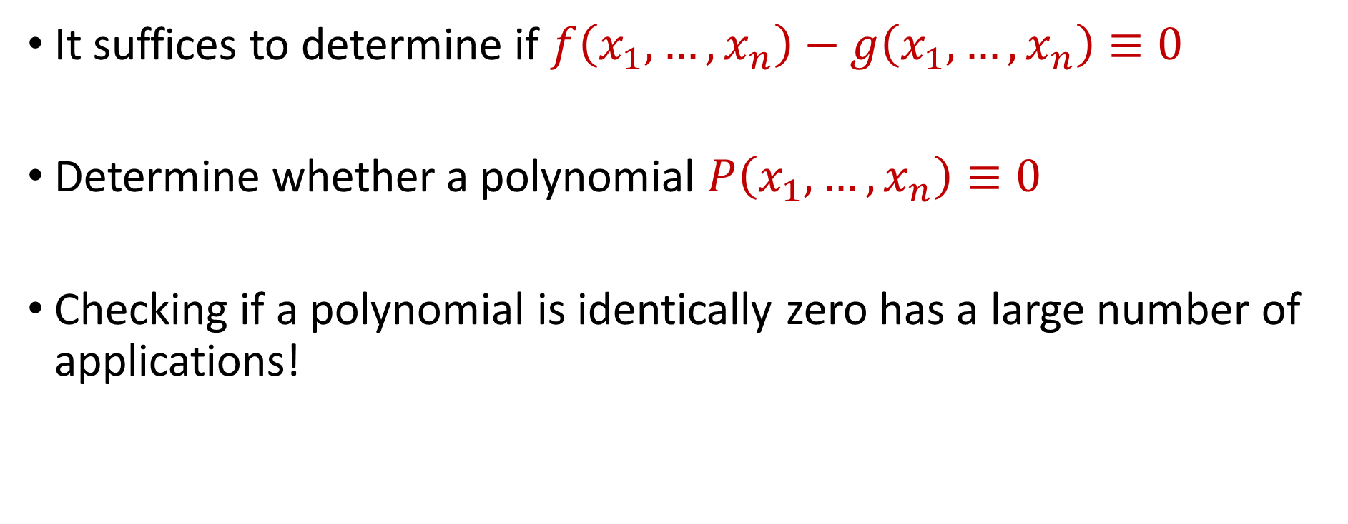
Polynomial Identity Testing
It suffices to determine if $f\left(x_{1},…,x_{n}\right)−g\left(x_{1},…, x_{n}\right)≡0$
Determine whether a polynomial $P\left(x_{1},…,x_{n}\right)≡0$
Checking if a polynomial is identically zero has a large number of applications!

Slide 11
Graph Analysis
Graphs can be represented via adjacency matrices
The determinants of adjacency matrices (and other matrices) reveal information about the structural of the graph, e.g., whether the determinant is non-zero if and only if a bipartite graph has a perfect matching
Determinants are polynomials!

Slide 12

Primality Checking
The polynomial $P\left(z\right)≔{\left(1+z\right)}^{n}−1−z^{n} (mod n)$ is identically zero if and only if $n$ is prime

Slide 13
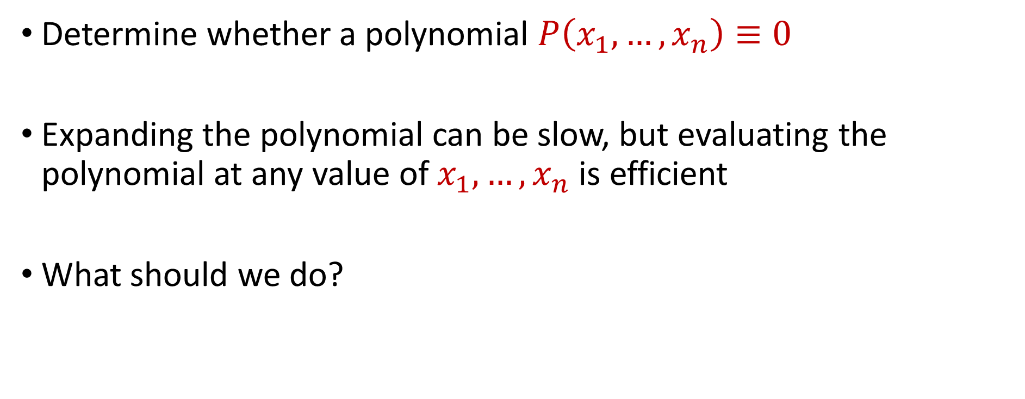
Polynomial Identity Testing
Determine whether a polynomial $P\left(x_{1},…,x_{n}\right)≡0$
Expanding the polynomial can be slow, but evaluating the polynomial at any value of $x_{1},…,x_{n}$ is efficient
What should we do?

Slide 14

Polynomial Identity Testing
Algorithm: Randomly pick values $x_{1}=r_{1},…,x_{n}=r_{n}$ and evaluate $P(r_{1},…,r_{n})$.
If $P\left(r_{1},…,r_{n}\right)=0$, return $P\left(x_{1},…,x_{n}\right)=0$
If $P\left(r_{1},…,r_{n}\right)≠0$, return $P\left(x_{1},…,x_{n}\right)≠0$

Slide 15
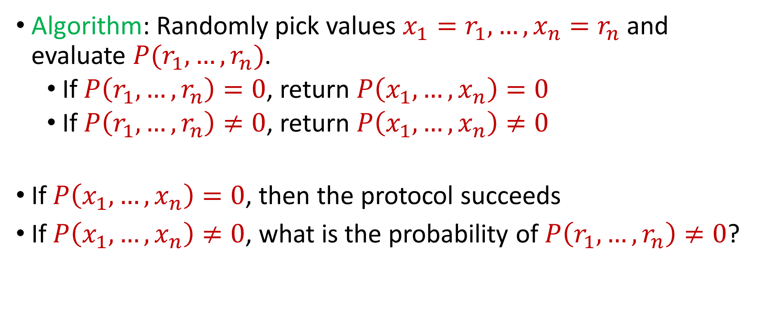
Polynomial Identity Testing
Algorithm: Randomly pick values $x_{1}=r_{1},…,x_{n}=r_{n}$ and evaluate $P(r_{1},…,r_{n})$.
If $P\left(r_{1},…,r_{n}\right)=0$, return $P\left(x_{1},…,x_{n}\right)=0$
If $P\left(r_{1},…,r_{n}\right)≠0$, return $P\left(x_{1},…,x_{n}\right)≠0$
If $P\left(x_{1},…,x_{n}\right)=0$, then the protocol succeeds
If $P\left(x_{1},…,x_{n}\right)≠0$, what is the probability of $P\left(r_{1},…,r_{n}\right)≠0$?

Slide 16
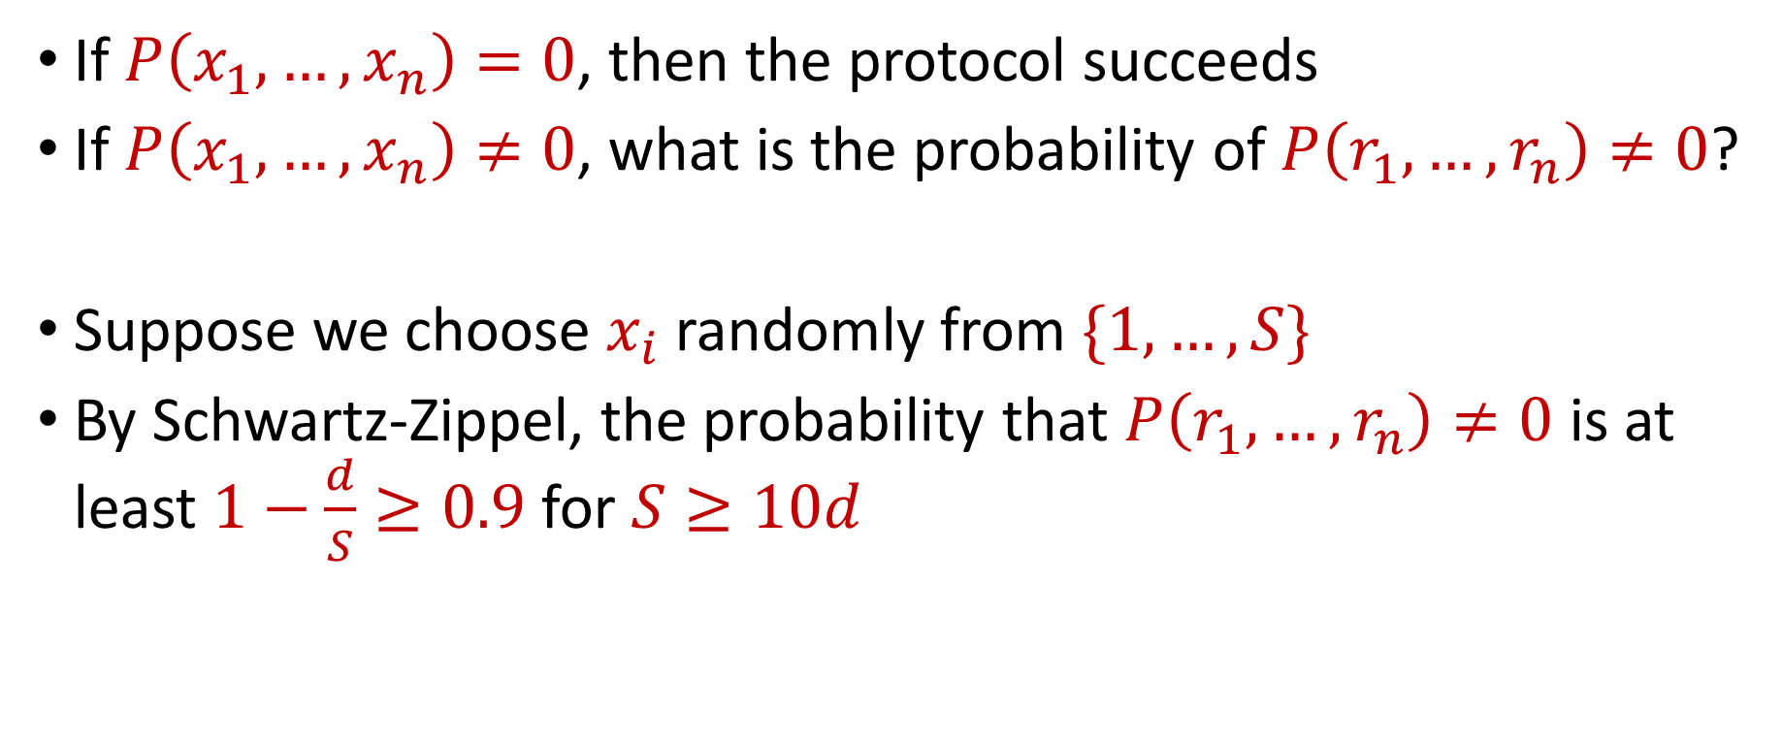
Polynomial Identity Testing
If $P\left(x_{1},…,x_{n}\right)=0$, then the protocol succeeds
If $P\left(x_{1},…,x_{n}\right)≠0$, what is the probability of $P\left(r_{1},…,r_{n}\right)≠0$?
Suppose we choose $x_{i}$ randomly from $\{1,…,S\}$
By Schwartz-Zippel, the probability that $P\left(r_{1},…,r_{n}\right)≠0$ is at least $1−\frac{d}{S}≥0.9$ for $S≥10d$

Slide 17

Questions?

Slide 18
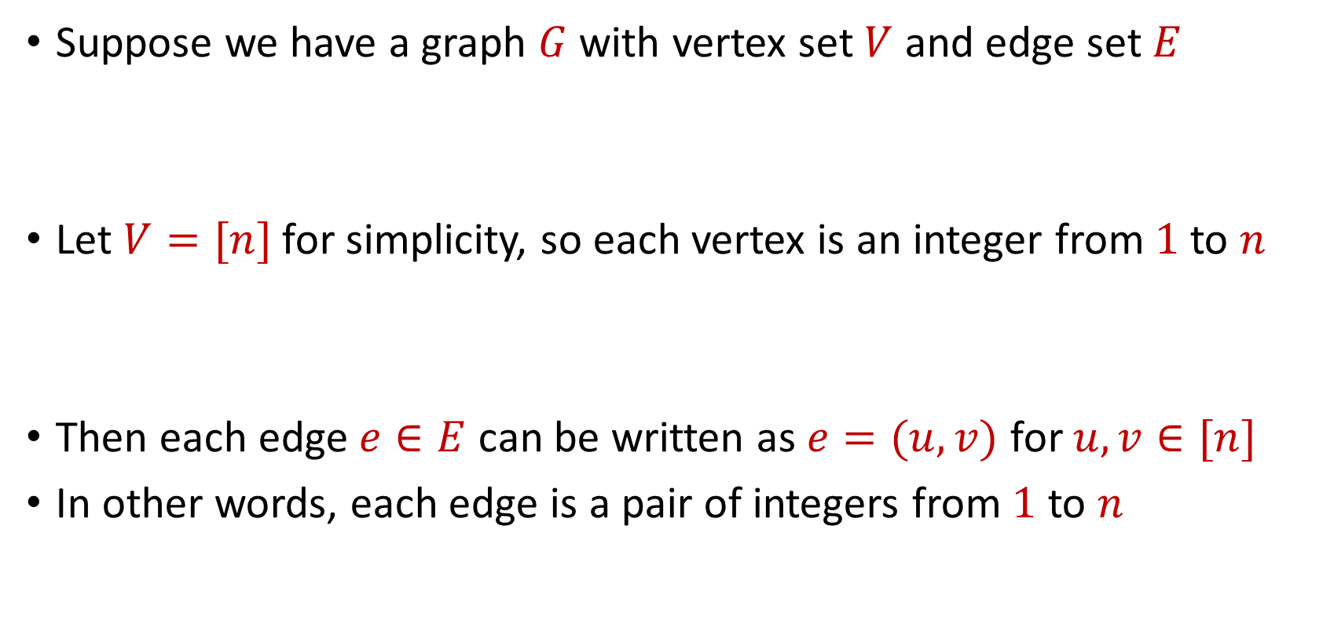
Graph Theory
Suppose we have a graph $G$ with vertex set $V$ and edge set $E$
Let $V=[n]$ for simplicity, so each vertex is an integer from $1$ to $n$
Then each edge $e∈E$ can be written as $e=(u,v)$ for $u,v∈[n]$
In other words, each edge is a pair of integers from $1$ to $n$

Slide 19






$$1$$
$$2$$
$$5$$
$$6$$
$$4$$
$$3$$

Slide 20
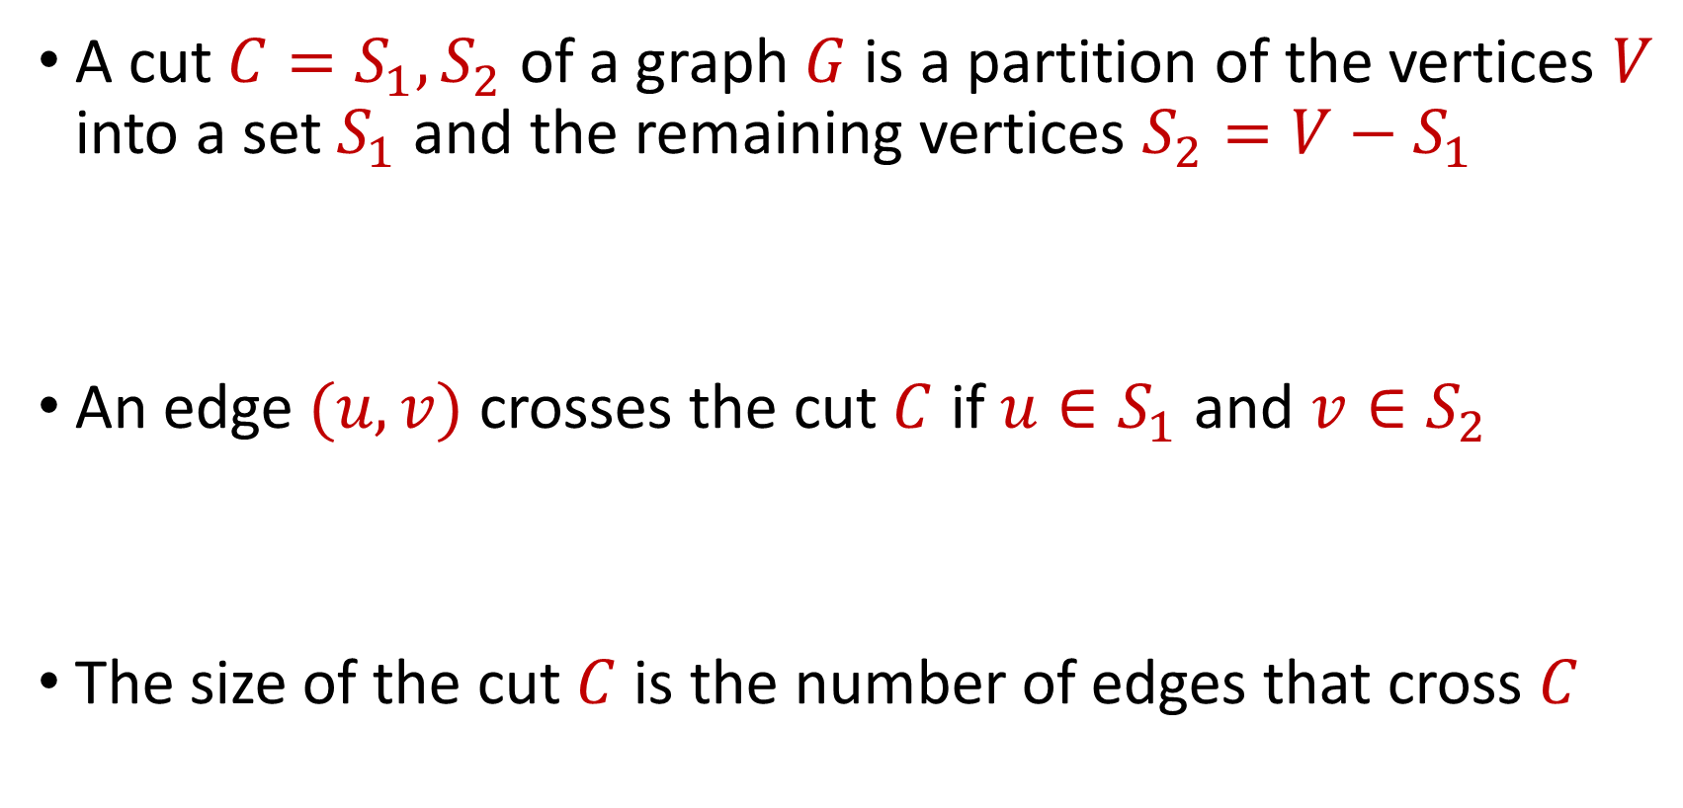
Cuts
A cut $C=S_{1},S_{2}$ of a graph $G$ is a partition of the vertices $V$ into a set $S_{1}$ and the remaining vertices $S_{2}=V−S_{1}$
An edge $(u,v)$ crosses the cut $C$ if $u∈S_{1}$ and $v∈S_{2}$
The size of the cut $C$ is the number of edges that cross $C$

Slide 21
$$1$$
$$2$$
$$5$$
$$6$$
$$4$$
$$3$$

Slide 22






What is the size of the cut $C=S_{1},S_{2}$?
$$1$$
$$2$$
$$S_{1}=\{1,4,5\}$$
$$S_{2}=\{2,3,6\}$$
$$5$$
$$6$$
$$4$$
$$3$$

Slide 23
What is the size of the cut $C=S_{1},S_{2}$?
$$1$$
$$2$$
$$S_{1}=\{1,4,5\}$$
$$S_{2}=\{2,3,6\}$$
$$5$$
$$6$$
$$4$$
$$3$$

Slide 24
What is the size of the cut $C=S_{1},S_{2}$?
$$1$$
$$2$$
$$S_{1}=\{1,4,5\}$$
$$S_{2}=\{2,3,6\}$$
$$5$$
$$6$$
$$4$$
$$3$$
The cut size is five

Slide 25
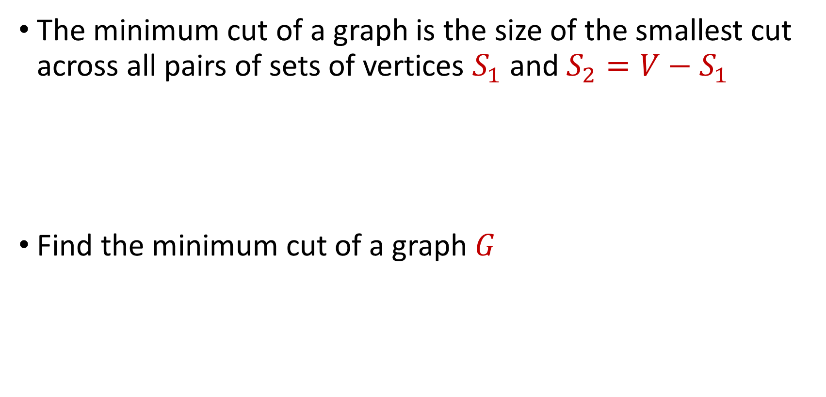
Minimum Cut
The minimum cut of a graph is the size of the smallest cut across all pairs of sets of vertices $S_{1}$ and $S_{2}=V−S_{1}$
Find the minimum cut of a graph $G$

Slide 26
What is the minimum cut of the graph?
$$1$$
$$2$$
$$5$$
$$6$$
$$4$$
$$3$$

Slide 27


What is the minimum cut of the graph?
$$1$$
$$2$$
$$5$$
$$6$$
$$4$$
$$3$$

Slide 28
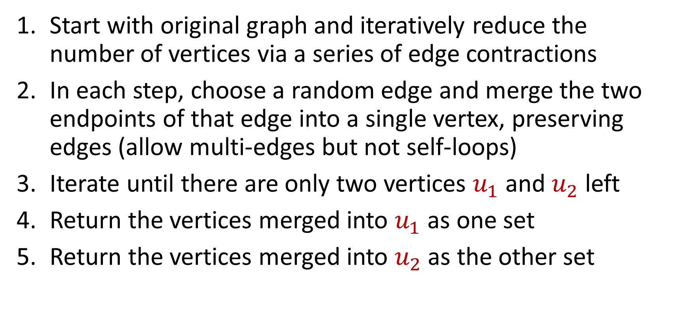
Karger’s Minimum Cut Algorithm
Start with original graph and iteratively reduce the number of vertices via a series of edge contractions
In each step, choose a random edge and merge the two endpoints of that edge into a single vertex, preserving edges (allow multi-edges but not self-loops)
Iterate until there are only two vertices $u_{1}$ and $u_{2}$ left
Return the vertices merged into $u_{1}$ as one set
Return the vertices merged into $u_{2}$ as the other set

Slide 29
$$1$$
$$2$$
$$5$$
$$6$$
$$4$$
$$3$$

Slide 30
$$1$$
$$2$$
$$5$$
$$6$$
$$4$$
$$3$$

Slide 31


$$1$$
$$2$$
$$5$$
$$6$$
$$4$$
$$3$$

Slide 32
$$1$$
$$2$$
$$5$$
$$6$$
$$4$$
$$3$$

Slide 33

$$1$$
$$2$$
$$5$$
$$6$$
$$3$$
$$4$$

Slide 34
$$1$$
$$2$$
$$5$$
$$6$$
$$3$$
$$4$$

Slide 35

$$5$$
$$1$$
$$2$$
$$6$$
$$3$$
$$4$$

Slide 36
$$5$$
$$1$$
$$2$$
$$6$$
$$3$$
$$4$$

Slide 37





$$1$$
$$2$$
$$5$$
$$3$$
$$4$$
$$6$$

Slide 38


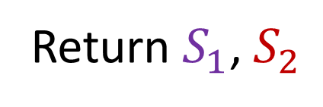
$$S_{1}=\{1,2,3,4,5\}$$
$$1$$
$$2$$
$$5$$
$$3$$
$$S_{2}=\{6\}$$
$$4$$
$$6$$
Return $S_{1}$, $S_{2}$

Slide 39
Karger’s Minimum Cut Algorithm
Intuition: Suppose the graph is disconnected. Then we will ALWAYS return the correct min-cut
Now suppose the graph consists of two components connected by a single. Algorithm is successful as long as it avoids selecting the single edge that crosses the two components
Why? As long as it avoids the single edge, each edge contraction will just shrink one of the two components
There is a good chance we never contract the single edge

Slide 40
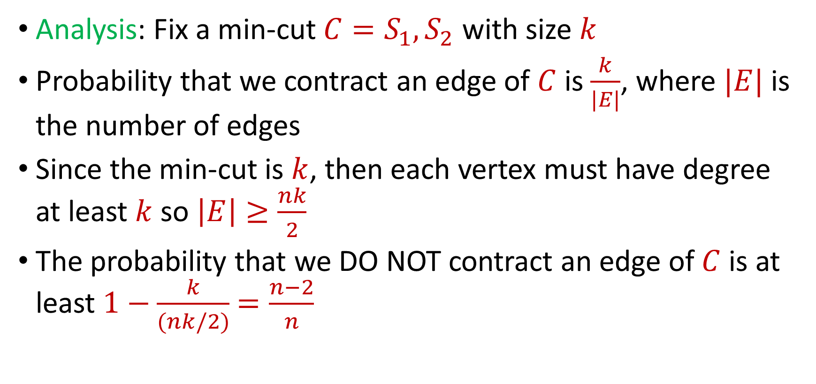
Karger’s Minimum Cut Algorithm
Analysis: Fix a min-cut $C=S_{1},S_{2}$ with size $k$
Probability that we contract an edge of $C$ is $\frac{k}{|E|}$, where $|E|$ is the number of edges
Since the min-cut is $k$, then each vertex must have degree at least $k$ so $\left|E\right|≥\frac{nk}{2}$
The probability that we DO NOT contract an edge of $C$ is at least $1−\frac{k}{(nk/2)}$ $=\frac{n−2}{n}$

Slide 41
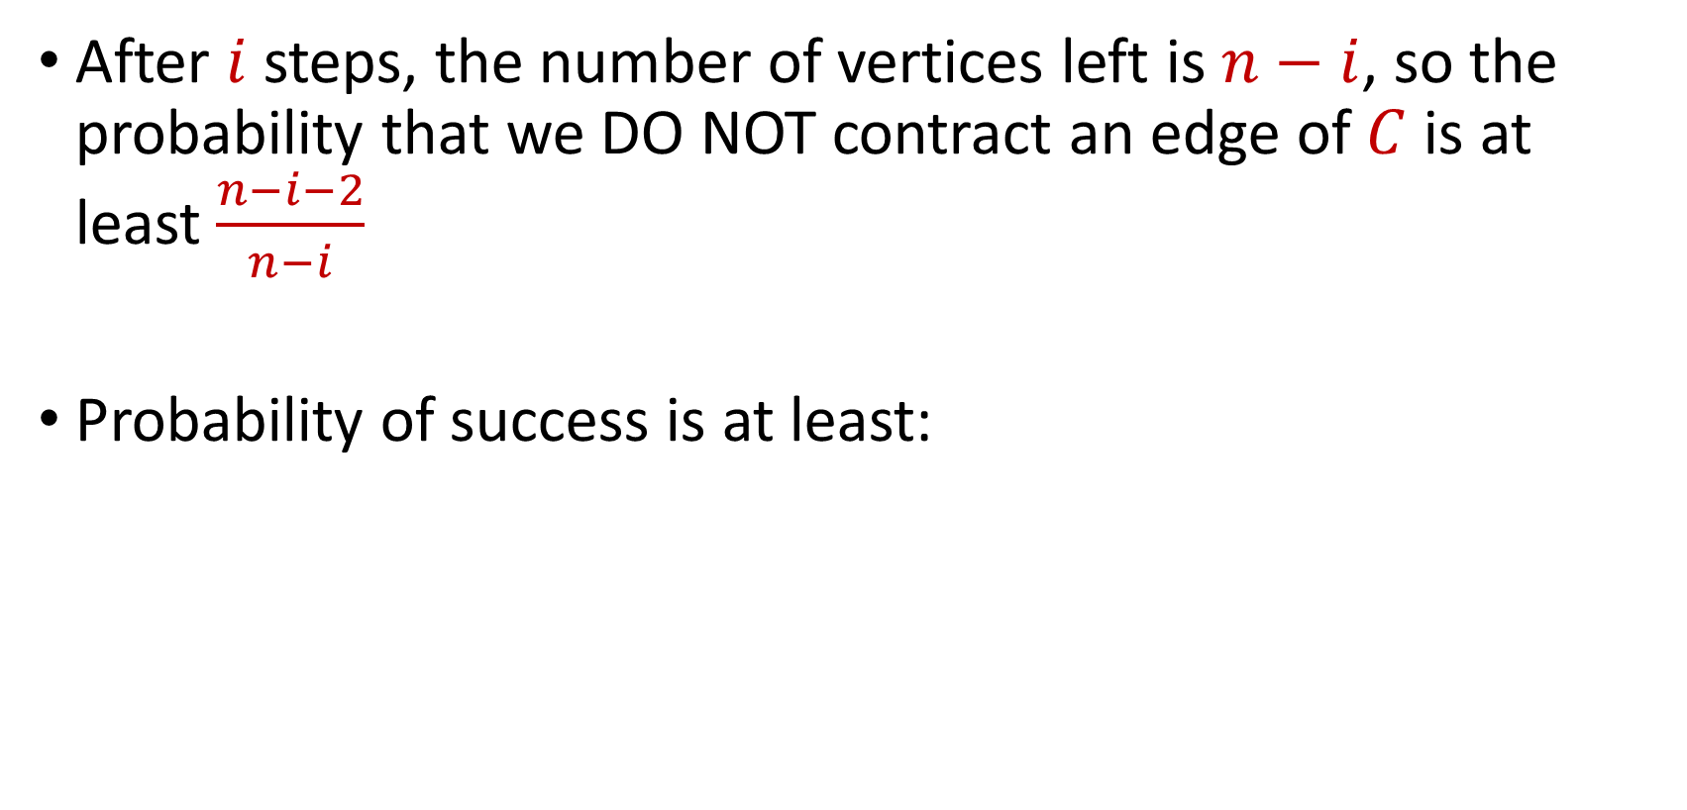
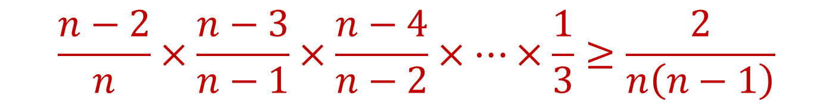
Karger’s Minimum Cut Algorithm
After $i$ steps, the number of vertices left is $n−i$, so the probability that we DO NOT contract an edge of $C$ is at least $\frac{n−i−2}{n−i}$
Probability of success is at least:
$$\frac{n−2}{n}×\frac{n−3}{n−1}×\frac{n−4}{n−2}×…×\frac{1}{3}≥\frac{2}{n\left(n−1\right)}$$

Slide 42

Karger’s Minimum Cut Algorithm
Probability of success is at least $\frac{2}{n^{2}}$
Will succeed with probability $0.99$ if we repeat $O\left(n^{2}\right)$ times

