Slide 1
CSCE 658: Randomized Algorithms
Lecture 11
Samson Zhou

Slide 2
Class Logistics
March 5: Lecture canceled, i.e., do NOT show up to HRBB 126 (unless you want to see an empty classroom)

Slide 3
Previously in the Streaming Model
Reservoir sampling
Heavy-hitters
Misra-Gries
CountMin
CountSketch
Moment estimation
AMS algorithm
Sparse recovery
Distinct elements estimation

Slide 4
Reservoir Sampling
Suppose we see a stream of elements from $[n]$. How do we uniformly sample one of the positions of the stream?
47 72 81 10 14 33 51 29 54 9 36 46 10

Slide 5
Heavy-Hitters (Frequent Items)
Given a set $S$ of $m$ elements from $[n]$, let $f_{i}$ be the frequency of element $i$. (How often it appears)
Let $L_{p}$ be the norm of the frequency vector:
Goal: Given a set $S$ of $m$ elements from $[n]$ and a threshold $ε$, output the elements $i$ such that $f_{i}>$ $ε L_{p}$...and no elements $j$ such that $f_{j}<$ $\frac{ε}{2} L_{p}$ (we saw algorithms for $p=1$ and $p=2$)
Motivation: DDoS prevention, iceberg queries
$$L_{p}={\left(f_{1}^{p}+f_{2}^{p}+…+f_{n}^{p}\right)}^{1/p}$$

Slide 6
Frequency Moments ($L_{p}$ Norm)
Given a set $S$ of $m$ elements from $[n]$, let $f_{i}$ be the frequency of element $i$. (How often it appears)
Let $F_{p}$ be the frequency moment of the vector:
Goal: Given a set $S$ of $m$ elements from $[n]$ and an accuracy parameter $ε$, output a $(1+ε)$-approximation to $F_{p}$
Motivation: Entropy estimation, linear regression
$F_{p}=$ $f_{1}^{p}+f_{2}^{p}+…+f_{n}^{p}$

Slide 7
The Streaming Model
So far, all questions have been statistical
What other questions can be asked? (Think in general, outside of the streaming model)

Slide 8
The Streaming Model
So far, all questions have been statistical
What other questions can be asked? (Think in general, outside of the streaming model)
Algebraic, geometric

Slide 9
The Streaming Model
So far, all questions have been statistical
What other questions can be asked? (Think in general, outside of the streaming model)
Algebraic, geometric
TODAY

Slide 10
Graph Theory
Suppose we have a graph $G$ with vertex set $V$ and edge set $E$
Let $V=[n]$ for simplicity, so each vertex is an integer from $1$ to $n$
Then each edge $e∈E$ can be written as $e=(u,v)$ for $u,v∈[n]$
In other words, each edge is a pair of integers from $1$ to $n$

Slide 11
Graph Theory
For today, we will assume a simple, undirected, unweighted graph
Graph has no self-loops, no multi-edges
Edges are undirected
Each edge has weight $1$

Slide 12
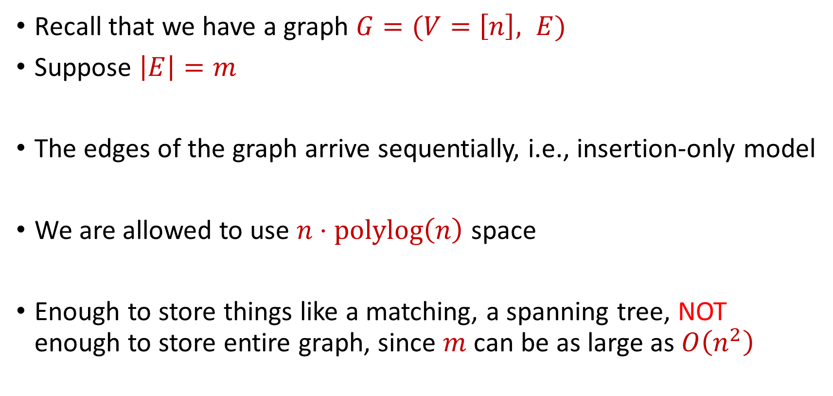
Semi-streaming Model
Recall that we have a graph $G=(V=\left[n\right], E)$
Suppose $\left|E\right|=m$
The edges of the graph arrive sequentially, i.e., insertion-only model
We are allowed to use $n⋅polylog\left(n\right)$ space
Enough to store things like a matching, a spanning tree, NOT enough to store entire graph, since $m$ can be as large as $O\left(n^{2}\right)$

Slide 13
$$1$$
$$2$$
$$5$$
$$6$$
$$4$$
$$3$$

Slide 14
Bipartiteness
Bipartite graph: Graph can be partitioned into two disjoint sets $L$ and $R$ so that every edge is between a vertex in $L$ and a vertex in $R$
Goal: Given a graph $G$, determine whether $G$ is a bipartite graph

Slide 15
$$1$$
$$2$$
$$5$$
$$6$$
$$4$$
$$3$$

Slide 16
$$2$$
$$1$$
$$6$$
$$4$$
$$5$$
$$3$$

Slide 17
$$1$$
$$2$$
$$5$$
$$6$$
$$4$$
$$3$$

Slide 18
$$1$$
$$2$$
$$5$$
$$6$$
$$4$$
$$3$$

Slide 19
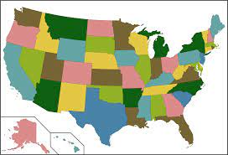
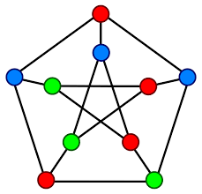
Applications for Bipartiteness Testing
Graph coloring: You want to color a graph such that no neighboring items share the same color

Slide 20

Applications for Bipartiteness Testing
Circuit design: In electrical engineering and VLSI (Very Large Scale Integration) design, you may want to know if a circuit can be optimally partitioned into two complementary parts, which can be achieved by testing the bipartiteness of the circuit's dependency graph

Slide 21
Bipartiteness
What is a necessary and sufficient condition for bipartiteness?

Slide 22
Bipartiteness
What is a necessary and sufficient condition for bipartiteness?
A graph is bipartite if and only if it can be colored using two colors (a coloring of a graph is an assignment of colors to vertices such that no two vertices share the same color)
A graph is bipartite if and only if it has no odd cycles

Slide 23
Bipartiteness
How to perform bipartiteness testing in the central setting?

Slide 24
Bipartiteness
How to perform bipartiteness testing in the central setting?
Start at arbitrary vertex, run BFS, and assign alternating levels to different side until there is a contradiction

Slide 25
$$1$$
$$2$$
$$5$$
$$6$$
$$4$$
$$3$$

Slide 26
$$1$$
$$2$$
$$5$$
$$6$$
$$4$$
$$3$$

Slide 27
$$1$$
$$2$$
$$5$$
$$6$$
$$3$$
$$4$$

Slide 28
$$1$$
$$2$$
$$5$$
$$6$$
$$3$$
$$4$$

Slide 29
Bipartiteness in the Streaming Model
Bipartiteness is a monotone property, i.e., additional edges to a graph that is not bipartite will result in a graph that is not bipartite

Slide 30
Bipartiteness in the Streaming Model
Intuition: Greedily add edges to minimum spanning forest
Algorithm:
Initialize $F=∅$.
For each edge $e=(u,v)$:
If $F∪(u,v)$ does not contain a cycle, add $(u,v)$ to $F$: $F←F∪\left(u,v\right)$
If $F∪(u,v)$ contains an odd cycle, return GRAPH IS NOT BIPARTITE
Return GRAPH IS BIPARTITE

Slide 31
Bipartiteness in the Streaming Model
Algorithm maintains a tree (because it does not add any edges that would create cycles)
How many edges does the algorithm keep?

Slide 32
Bipartiteness in the Streaming Model
Algorithm maintains a tree (because it does not add any edges that would create cycles)
Algorithm can keep at most $n$ edges, so the total space usage is $O(n)$ words of space.

Slide 34
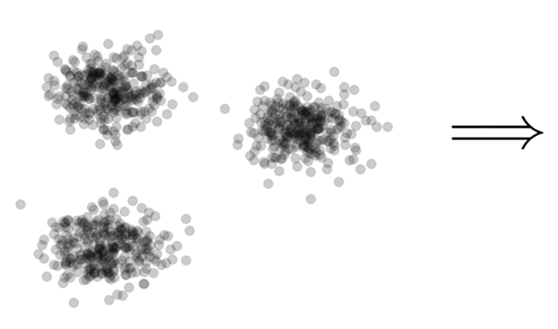
Clustering
Goal: Given input dataset $X$, partition $X$ so that “similar” points are in the same cluster and “different” points are in different clusters

Slide 35
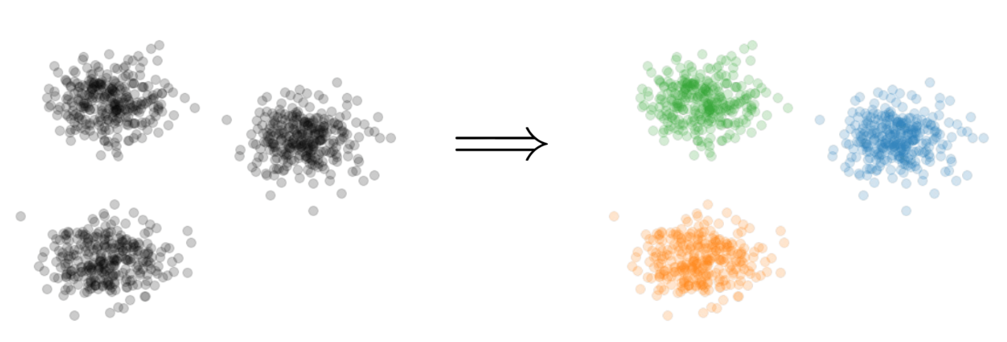
$k$-Clustering
Goal: Given input dataset $X$, partition $X$ so that “similar” points are in the same cluster and “different” points are in different clusters
There can be at most $k$ different clusters
$$k=3$$

Slide 36
$k$-Clustering
Question: How do we measure the “quality” of each clustering?
$$k=3$$

Slide 37
$k$-Clustering
Question: How do we measure the “quality” of each clustering?
Assign a “center” $c_{i}$ to each cluster
Have a cost function induced by $c_{i}$ for all of the points $P_{i}$ assigned to cluster $i$

Slide 38
$k$-Clustering
Question: How do we measure the “quality” of each clustering?
Assign a “center” $c_{i}$ to each cluster
Have a cost function induced by $c_{i}$ for all of the points $P_{i}$ assigned to cluster $i$
Assume points are in metric space with distance function $dist(⋅,⋅)$
Define $Cost\left(P_{i},c_{i}\right)$ to be a function of ${\left\{dist\left(x,c_{i}\right)\right\}}_{x∈P_{i}}$

Slide 39
$k$-Clustering
Question: How do we measure the “quality” of each clustering?
Have a cost function induced by $c_{i}$ for all of the points $P_{i}$ assigned to cluster $i$
Define $Cost\left(P_{i},c_{i}\right)$ to be a function of ${\left\{dist\left(x,c_{i}\right)\right\}}_{x∈P_{i}}$
Suppose the set of centers is $C=\left\{c_{1},…, c_{k}\right\}$
Define clustering cost $Cost\left(X,C\right)$ to be a function of ${\left\{dist\left(x,C\right)\right\}}_{x∈C}$

Slide 40
$k$-Clustering
Define clustering cost $Cost\left(X,C\right)$ to be a function of ${\left\{dist\left(x,C\right)\right\}}_{x∈C}$

Slide 41
$k$-Clustering
Define clustering cost $Cost\left(X,C\right)$ to be a function of ${\left\{dist\left(x,C\right)\right\}}_{x∈C}$
$k$-center: $Cost\left(X,C\right)=\max_{x∈X}{dist(x,C)}$

Slide 42
$k$-Clustering
Define clustering cost $Cost\left(X,C\right)$ to be a function of ${\left\{dist\left(x,C\right)\right\}}_{x∈C}$
$k$-center: $Cost\left(X,C\right)=\max_{x∈X}{dist(x,C)}$
$k$-median: $Cost\left(X,C\right)=\sum_{x∈X}{dist\left(x,C\right)}$

Slide 43
$k$-Clustering
Define clustering cost $Cost\left(X,C\right)$ to be a function of ${\left\{dist\left(x,C\right)\right\}}_{x∈C}$
$k$-center: $Cost\left(X,C\right)=\max_{x∈X}{dist(x,C)}$
$k$-median: $Cost\left(X,C\right)=\sum_{x∈X}{dist\left(x,C\right)}$
$k$-means: $Cost\left(X,C\right)=\sum_{x∈X}{{\left(dist\left(x,C\right)\right)}^{2}}$
$${\left(⋅\right)}^{2}$$
$${\left(⋅\right)}^{2}$$
$${\left(⋅\right)}^{2}$$
$${\left(⋅\right)}^{2}$$
$${\left(⋅\right)}^{2}$$
$${\left(⋅\right)}^{2}$$
$${\left(⋅\right)}^{2}$$

Slide 44
$k$-Clustering
Define clustering cost $Cost\left(X,C\right)$ to be a function of ${\left\{dist\left(x,C\right)\right\}}_{x∈C}$
$k$-center: $Cost\left(X,C\right)=\max_{x∈X}{dist(x,C)}$
$k$-median: $Cost\left(X,C\right)=\sum_{x∈X}{dist\left(x,C\right)}$
$k$-means: $Cost\left(X,C\right)=\sum_{x∈X}{{\left(dist\left(x,C\right)\right)}^{2}}$
$(k,z)$-clustering: $Cost\left(X,C\right)=\sum_{x∈X}{{\left(dist\left(x,C\right)\right)}^{z}}$
$${\left(⋅\right)}^{z}$$
$${\left(⋅\right)}^{z}$$
$${\left(⋅\right)}^{z}$$
$${\left(⋅\right)}^{z}$$
$${\left(⋅\right)}^{z}$$
$${\left(⋅\right)}^{z}$$
$${\left(⋅\right)}^{z}$$

Slide 45
Euclidean $k$-Clustering
For Euclidean $k$-clustering, input points $X=x_{1},…,x_{n}$ are in $ℝ^{d}$ (for us, they will be in ${[Δ]}^{d}≔{\left\{1,2,…,Δ\right\}}^{d}$)
$dist\left(x,y\right)=\sqrt{{\left(x_{1}−y_{1}\right)}^{2}+…+{\left(x_{d}−y_{d}\right)}^{2}}$ is the Euclidean distance
$(k,z)$-clustering problem:
$$\min_{C:\left|C\right|≤k} Cost\left(X,C\right)=\min_{C:\left|C\right|≤k}{Σ_{x∈X}\left(dist\left(x,C\right)\right)}^{z}$$

Slide 46
$$(−8, 4)$$
$$(−4, 3)$$
$$(4, 3)$$
$$(−3, 0)$$
$$(−11, −4)$$
$$(0, −4)$$

Slide 47
$$(−8, 4)$$
$$(−4, 3)$$
$$(4, 3)$$
$$(−8, 0)$$
$$(−3, 0)$$
$$(0, 0)$$
$$(−11, −4)$$
$$(0, −4)$$

Slide 48
$$(−8, 4)$$
$$(−4, 3)$$
$$(4, 3)$$
$$4$$
$$5$$
$$5$$
$$3$$
$$(−8, 0)$$
$$(−3, 0)$$
$$(0, 0)$$
$$5$$
$$4$$
$$(−11, −4)$$
$$(0, −4)$$

Slide 49
$k$-center: $Cost\left(X,C\right)=\max_{x∈X}{dist\left(x,C\right)=5}$
$$(−8, 4)$$
$$(−4, 3)$$
$$(4, 3)$$
$$4$$
$$5$$
$$5$$
$$3$$
$$(−8, 0)$$
$$(−3, 0)$$
$$(0, 0)$$
$$5$$
$$4$$
$$(−11, −4)$$
$$(0, −4)$$

Slide 50
$k$-median: $Cost\left(X,C\right)=\sum_{x∈X}{dist\left(x,C\right)}=4+5+5+3+4+5=26$
$$(−8, 4)$$
$$(−4, 3)$$
$$(4, 3)$$
$$4$$
$$5$$
$$5$$
$$3$$
$$(−8, 0)$$
$$(−3, 0)$$
$$(0, 0)$$
$$5$$
$$4$$
$$(−11, −4)$$
$$(0, −4)$$

Slide 51
$k$-means: $Cost\left(X,C\right)=\sum_{x∈X}{{\left(dist\left(x,C\right)\right)}^{2}} =16+25+25+9+16+25$
$$(−8, 4)$$
$$=116$$
$$(−4, 3)$$
$$(4, 3)$$
$$4$$
$$5$$
$$5$$
$$3$$
$$(−8, 0)$$
$$(−3, 0)$$
$$(0, 0)$$
$$5$$
$$4$$
$$(−11, −4)$$
$$(0, −4)$$

Slide 52
Coreset
Subset $X′$ of representative points of $X$ for a specific clustering objective
$Cost\left(X,C\right)≈Cost(X^{′},C)$ for all sets $C$ with $\left|C\right|=k$

Slide 53
Coreset
Subset $X′$ of representative points of $X$ for a specific clustering objective
$Cost\left(X,C\right)≈Cost(X^{′},C)$ for all sets $C$ with $\left|C\right|=k$

Slide 54
Coreset
Subset $X′$ of representative points of $X$ for a specific clustering objective
$Cost\left(X,C\right)≈Cost(X^{′},C)$ for all sets $C$ with $\left|C\right|=k$

Slide 55
Coreset (Formal Definition)
Given a set $X$ and an accuracy parameter $ε>0$, we say a set $X′$ with weight function $w$is an $(1+ε)$-multiplicative coreset for a cost function $Cost$, if for all queries $C$ with $\left|C\right|≤k$, we have
$$\left(1−ε\right)Cost(X,C)≤Cost(X′,C,w)≤\left(1+ε\right)Cost(X,C)$$
$(k,z)$-clustering: $Cost\left(X^{′},C,w\right)=\sum_{x∈X′}{{w\left(x\right)⋅\left(dist\left(x,C\right)\right)}^{z}}$

Slide 56
$(k,z)$-Clustering in the Streaming Model
Merge-and-reduce framework
Suppose there exists a $(1+ε)$-coreset construction for $(k,z)$-clustering that uses $f\left(k,\frac{1}{ε}\right)$ weighted input points
Partition the stream into blocks containing $f\left(k,\frac{\log{n}}{ε}\right)$ points
$$\tilde{O}\left(\frac{k^{2}}{ε^{2}}\right)$$

Slide 57
$(k,z)$-Clustering in the Streaming Model
Partition the stream into blocks containing $f\left(k,\frac{\log{n}}{ε}\right)$ points
Create a $\left(1+\frac{ε}{\log{n}}\right)$-coreset for each block
Create a $\left(1+\frac{ε}{\log{n}}\right)$-coreset for the set of points formed by the union of two coresets for each block
Reduce
Merge

Slide 58
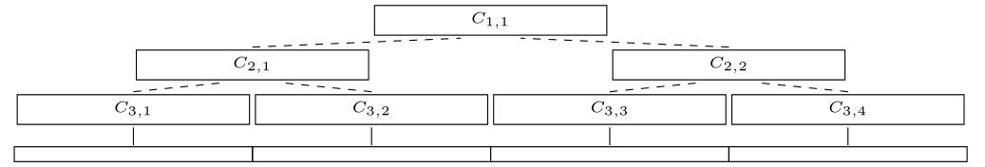
$(k,z)$-Clustering in the Streaming Model
Partition the stream into blocks containing $f\left(k,\frac{\log{n}}{ε}\right)$ points
Create a $\left(1+\frac{ε}{\log{n}}\right)$-coreset for each block
Create a $\left(1+\frac{ε}{\log{n}}\right)$-coreset for the set of points formed by the union of two coresets for each block

Slide 59
$(k,z)$-Clustering in the Streaming Model
There are $O\left(log n\right)$ levels
Each coreset is a $\left(1+\frac{ε}{\log{n}}\right)$-coreset of two coresets
Total approximation is ${\left(1+\frac{ε}{\log{n}}\right)}^{\log{n}}=(1+O\left(ε\right))$

Slide 60
$(k,z)$-Clustering in the Streaming Model
Suppose there exists a $(1+ε)$-coreset construction for $(k,z)$-clustering that uses $f\left(k,\frac{1}{ε}\right)$ weighted input points
Partition the stream into blocks containing $f\left(k,\frac{\log{n}}{ε}\right)$ points
Total space is $f\left(k,\frac{\log{n}}{ε}\right)⋅O(log{n)}$ points
For $k$-means clustering, this is $\tilde{O}\left(\frac{k^{2}}{ε^{2}}⋅\log^{3}{n}\right)$ points

Slide 61
Previously: Bernstein’s Inequality
Bernstein’s inequality: Let $X_{1},…,X_{n}∈[−M,M]$ be independent random variables and let ${X=X}_{1}+…+X_{n}$ have mean $μ$ and variance $σ^{2}$. Then for any $t≥0$:
Example: Suppose $M=1$ and let $t=kσ$. Then
$$Pr\left[\left|X−μ\right|≥t\right]≤2e^{−\frac{t^{2}}{2σ^{2}+\frac{4}{3}Mt}}$$
$$Pr\left[\left|X−μ\right|≥kσ\right]≤2exp\left(−\frac{k^{2}}{4}\right)$$

Slide 62
Sampling for Sum Estimation
Consider a fixed set $X=\{x_{1},…,x_{n}\}$ of $n$ numbers
Suppose we sample each point $x_{i}$ with some probability $p_{i}$ and rescale by $\frac{1}{p_{i}}$
What is the expected sum?

Slide 63
Sampling for Sum Estimation
Let $y_{i}$ be the contribution of the sample corresponding to $x_{i}$
$y_{i}=0$ with probability $1−p_{i}$
$y_{i}=\frac{1}{p_{i}}⋅x_{i}$ with probability $p_{i}$
$E\left[y_{i}\right]=x_{i}$
$E\left[y_{1}+…+y_{n}\right]=x_{1}+ …+x_{n}$

Slide 64
Sampling for Sum Estimation
Consider a fixed set $X=\{x_{1},…,x_{n}\}$ of $n$ numbers
Suppose we sample each point $x_{i}$ with some probability $p_{i}$ and rescale by $\frac{1}{p_{i}}$
What is the expected sum? $E\left[y_{1}+…+y_{n}\right]=x_{1}+ …+x_{n}$

Slide 65
Sampling for Sum Estimation
Consider a fixed set $X=\{x_{1},…,x_{n}\}$ of $n$ numbers
Suppose we sample each point $x_{i}$ with some probability $p_{i}$ and rescale by $\frac{1}{p_{i}}$
What is the expected sum? $E\left[y_{1}+…+y_{n}\right]=x_{1}+ …+x_{n}$
What can we say about concentration?

Slide 66
Uniform Sampling for Sum Estimation
Consider a fixed set $X=\{x_{1},…,x_{n}\}$ of $n$ numbers
Suppose we sample each point $x_{i}$ with some probability $p_{i}$ and rescale by $\frac{1}{p_{i}}$
Suppose $p_{i}=p$ for all $i∈[n]$
What can we say about concentration?

Slide 67
Uniform Sampling for Sum Estimation
Suppose $x_{1}=…=x_{n}=1$
Suppose $p_{i}=p$ for all $i∈[n]$
What can we say about concentration?
Can we get a $2$-approximation with high probability?

Slide 68
Uniform Sampling for Sum Estimation
Bernstein’s inequality: Let $y_{1},…,y_{n}∈[−M,M]$ be independent random variables and let ${y=y}_{1}+…+y_{n}$ have mean $μ$ and variance $σ^{2}$. Then for any $t≥0$:
$$Pr\left[\left|y−μ\right|≥t\right]≤2e^{−\frac{t^{2}}{2σ^{2}+\frac{4}{3}Mt}}$$

Slide 69
Uniform Sampling for Sum Estimation
Bernstein’s inequality: Let $y_{1},…,y_{n}∈[−M,M]$ be independent random variables and let ${y=y}_{1}+…+y_{n}$ have mean $μ$ and variance $σ^{2}$. Then for any $t≥0$:
Set $M=\frac{1}{p}$ , $t=\frac{n}{2}$, and $σ^{2}=\frac{n}{p}$. Then
$$Pr\left[\left|y−μ\right|≥t\right]≤2e^{−\frac{t^{2}}{2σ^{2}+\frac{4}{3}Mt}}$$
$$Pr\left[\left|y−μ\right|≥\frac{n}{2}\right]≤2exp\left(−\frac{{\left(n/2\right)}^{2}}{2\left(n/p\right)+(4/3)(n/2p)}\right)$$

Slide 70
Uniform Sampling for Sum Estimation
Suppose $x_{1}=…=x_{n}=1$
Suppose $p_{i}=p$ for all $i∈[n]$
What can we say about concentration?
Can get a $2$-approximation even for $p=Θ\left(\frac{1}{n}\right)$

Slide 71
Uniform Sampling for Sum Estimation
Suppose $x_{1}=…=x_{n}=1$
Suppose $p_{i}=p$ for all $i∈[n]$
What can we say about concentration?
Can get a $2$-approximation even for $p=Θ\left(\frac{1}{n}\right)$
How many samples do we expect?

Slide 72
Uniform Sampling for Sum Estimation
Suppose $x_{1}=…=x_{n}=1$
Suppose $p_{i}=p$ for all $i∈[n]$
What can we say about concentration?
Can get a $2$-approximation even for $p=Θ\left(\frac{1}{n}\right)$
How many samples do we expect? $np=Θ\left(1\right)$

Slide 73
Uniform Sampling for Sum Estimation
Suppose $x_{1},…,x_{n}∈[1,2]$
Suppose $p_{i}=p$ for all $i∈[n]$
Can we get a $2$-approximation with high probability?

Slide 74
Uniform Sampling for Sum Estimation
Bernstein’s inequality: Let $y_{1},…,y_{n}∈[−M,M]$ be independent random variables and let ${y=y}_{1}+…+y_{n}$ have mean $μ$ and variance $σ^{2}$. Then for any $t≥0$:
Set $M=\frac{2}{p}$ , $t=\frac{x}{2}$, and $σ^{2}≈\frac{4n}{p}$. Then
$$Pr\left[\left|y−μ\right|≥t\right]≤2e^{−\frac{t^{2}}{2σ^{2}+\frac{4}{3}Mt}}$$
$$Pr\left[\left|y−μ\right|≥\frac{x}{2}\right]≤2exp\left(−\frac{{\left(x/2\right)}^{2}}{2\left(4n/p\right)+(4/3)(x/p)}\right)$$

Slide 75
Uniform Sampling for Sum Estimation
Suppose $x_{1},…,x_{n}∈[1,2]$
Suppose $p_{i}=p$ for all $i∈[n]$
For $Pr\left[\left|y−μ\right|≥\frac{x}{2}\right]≤2exp\left(−\frac{{\left(x/2\right)}^{2}}{2\left(4n/p\right)+(4/3)(x/p)}\right)$, we require $\frac{8n}{p}≈{\left(\frac{x}{2}\right)}^{2}$ and $x$ can be as small as $n$, so $p≈\frac{2}{n}$

Slide 76
Uniform Sampling for Sum Estimation
Suppose $x_{1},…,x_{n}∈[1,2]$
Suppose $p_{i}=p$ for all $i∈[n]$
What can we say about concentration?
Can get a $2$-approximation for $p≈\frac{2}{n}$
How many samples do we expect? $np$ is now slightly larger

Slide 77
Uniform Sampling for Sum Estimation
Suppose $x_{1},…,x_{n}∈[1,100]$
Suppose $p_{i}=p$ for all $i∈[n]$
Can we get a $2$-approximation with high probability?

Slide 78
Uniform Sampling for Sum Estimation
Bernstein’s inequality: Let $y_{1},…,y_{n}∈[−M,M]$ be independent random variables and let ${y=y}_{1}+…+y_{n}$ have mean $μ$ and variance $σ^{2}$. Then for any $t≥0$:
Set $M=\frac{100}{p}$ , $t=\frac{x}{2}$, and $σ^{2}≈\frac{10000n}{p}$. Then
$$Pr\left[\left|y−μ\right|≥t\right]≤2e^{−\frac{t^{2}}{2σ^{2}+\frac{4}{3}Mt}}$$
$$Pr\left[\left|y−μ\right|≥\frac{x}{2}\right]≤2exp\left(−\frac{{\left(x/2\right)}^{2}}{2\left(10000n/p\right)+(4/3)(100x/p)}\right)$$

Slide 79
Uniform Sampling for Sum Estimation
Suppose $x_{1},…,x_{n}∈[1,100]$
Suppose $p_{i}=p$ for all $i∈[n]$
For $Pr\left[\left|y−μ\right|≥\frac{x}{2}\right]≤2exp\left(−\frac{{\left(x/2\right)}^{2}}{2\left(10000n/p\right)+(4/3)(100x/p)}\right)$, we require $\frac{20000n}{p}≈{\left(\frac{x}{2}\right)}^{2}$ and $x$ can be as small as $n$, so we need $p≈\frac{80000}{n}$

Slide 80
Uniform Sampling for Sum Estimation
Suppose $x_{1},…,x_{n}∈[1,100]$
Suppose $p_{i}=p$ for all $i∈[n]$
What can we say about concentration?
Can get a $2$-approximation even for $p≈\frac{80000}{n}$
How many samples do we expect? $np$ is now WAY larger

Slide 81
Uniform Sampling for Sum Estimation
Suppose $x_{1},…,x_{n}∈[1,n]$
Suppose $p_{i}=p$ for all $i∈[n]$
Can we get a $2$-approximation with high probability?

Slide 82
Uniform Sampling for Sum Estimation
Bernstein’s inequality: Let $y_{1},…,y_{n}∈[−M,M]$ be independent random variables and let ${y=y}_{1}+…+y_{n}$ have mean $μ$ and variance $σ^{2}$. Then for any $t≥0$:
Set $M=\frac{n}{p}$ , $t=\frac{x}{2}$, and $σ^{2}≈\frac{n^{2}}{p}$. Then
$$Pr\left[\left|y−μ\right|≥t\right]≤2e^{−\frac{t^{2}}{2σ^{2}+\frac{4}{3}Mt}}$$
$$Pr\left[\left|y−μ\right|≥\frac{x}{2}\right]≤2exp\left(−\frac{{\left(x/2\right)}^{2}}{2\left(n^{2}/p\right)+(4/3)(nx/2p)}\right)$$

Slide 83
Uniform Sampling for Sum Estimation
Suppose $x_{1},…,x_{n}∈[1,n]$
Suppose $p_{i}=p$ for all $i∈[n]$
For $Pr\left[\left|y−μ\right|≥\frac{x}{2}\right]≤2exp\left(−\frac{{\left(x/2\right)}^{2}}{2\left(n^{2}/p\right)+(4/3)(nx/2p)}\right)$, we require $\frac{2n^{2}}{p}≈{\left(\frac{x}{2}\right)}^{2}$ and $x$ can be as small as $n$, so we need $p≈1$

Slide 84
Uniform Sampling for Sum Estimation
Suppose $x_{1},…,x_{n}∈[1,n]$
Suppose $p_{i}=p$ for all $i∈[n]$
What can we say about concentration?
Can get a $2$-approximation for $p≈1$
How many samples do we expect? $np$ is now $n$

Slide 85
Uniform Sampling for Sum Estimation
Suppose $x_{1},…,x_{n}∈[1,n]$
Suppose $p_{i}=p$ for all $i∈[n]$
Do we really need $p$ to be a constant?

Slide 86
Uniform Sampling for Sum Estimation
Suppose $x_{1},…,x_{n}∈[1,n]$
Suppose $p_{i}=p$ for all $i∈[n]$
Do we really need $p$ to be a constant? YES!
1 1 1 1 1 1 1 1 1 1 1 1 1 1 1 1 1 1 1 1 $n$ $n$

Slide 87
Sampling for Sum Estimation
Consider a fixed set $X=\{x_{1},…,x_{n}\}$ of $n$ numbers
Suppose we sample each point $x_{i}$ with some probability $p_{i}$ and rescale by $\frac{1}{p_{i}}$
What is the expected sum? $E\left[y_{1}+…+y_{n}\right]=x_{1}+ …+x_{n}$
What can we say about concentration?

Slide 88
Sampling for Sum Estimation
Consider a fixed set $X=\{x_{1},…,x_{n}\}$ of $n$ numbers
What if we choose the probability $p_{i}$ different for each $x_{i}$?

Slide 89
Sampling for Sum Estimation
Consider a fixed set $X=\{x_{1},…,x_{n}\}$ of $n$ numbers
What if we choose the probability $p_{i}$ different for each $x_{i}$?
Choose $p_{i}$ proportional to $x_{i}$

Slide 90
Importance Sampling for Sum Estimation
Consider a fixed set $X=\{x_{1},…,x_{n}\}$ of $n$ numbers
What if we choose the probability $p_{i}$ different for each $x_{i}$?
Choose $p_{i}$ proportional to $x_{i}$
Let $x=x_{1}+…+x_{n}$, set $p_{i}=\frac{x_{i}}{x}$

Slide 91
Importance Sampling for Sum Estimation
Bernstein’s inequality: Let $y_{1},…,y_{n}∈[−M,M]$ be independent random variables and let ${y=y}_{1}+…+y_{n}$ have mean $μ$ and variance $σ^{2}$. Then for any $t≥0$:
Set $t=\frac{x}{2}$. What about $M$and $σ^{2}$?
$$Pr\left[\left|y−μ\right|≥t\right]≤2e^{−\frac{t^{2}}{2σ^{2}+\frac{4}{3}Mt}}$$

Slide 92
Importance Sampling for Sum Estimation
$y_{i}≤\frac{1}{p}⋅x_{i}=\frac{x}{x_{i}}⋅x_{i}=x$
Can set $M=x$ in Bernstein’s inequality

Slide 93
Importance Sampling for Sum Estimation
What is the variance for each $y_{i}$?
$Var\left[y_{i}\right]≤\frac{1}{p_{i}}⋅x_{i}^{2}≤x_{i}⋅x$
$Var\left[y\right]=Var\left[y_{1}\right]+…+Var\left[y_{n}\right]≤x⋅\left(x_{1}+…+x_{n}\right)=x^{2}$
What is the variance for $y$under uniform sampling? $\frac{{nx}_{i}^{2}}{p}$
What is the variance for each $y_{i}$ under uniform sampling? $\frac{x_{i}^{2}}{p}$

Slide 94
Importance Sampling for Sum Estimation
Bernstein’s inequality: Let $y_{1},…,y_{n}∈[−M,M]$ be independent random variables and let ${y=y}_{1}+…+y_{n}$ have mean $μ$ and variance $σ^{2}$. Then for any $t≥0$:
Set $M=x$, $t=\frac{x}{2}$, and $σ^{2}≈x^{2}$. Then
$$Pr\left[\left|y−μ\right|≥t\right]≤2e^{−\frac{t^{2}}{2σ^{2}+\frac{4}{3}Mt}}$$
$$Pr\left[\left|y−μ\right|≥\frac{x}{2}\right]≤2exp\left(−\frac{{\left(x/2\right)}^{2}}{2x^{2}+(4/3)(x^{2}/2)}\right)$$

Slide 95
Importance Sampling for Sum Estimation
Suppose $x_{1},…,x_{n}∈[1,n]$
Suppose $p_{i}=\frac{x_{i}}{x}$ for all $i∈[n]$
Can get a $2$-approximation for importance sampling
How many samples do we expect? $\frac{x_{1}}{x}+…+\frac{x_{n}}{x}=1$, so just a constant number of samples!

