Slide 1
CSCE 689: Special Topics in Modern Algorithms for Data Science
Lecture 16
Samson Zhou

Slide 2

Last Time: Sparse Recovery
Suppose we have an insertion-deletion stream of length $m=Θ\left(n\right)$ and at the end we are promised there are at most $k$ nonzero coordinates
Goal: Recover the $k$ nonzero coordinates and their frequencies

Slide 3
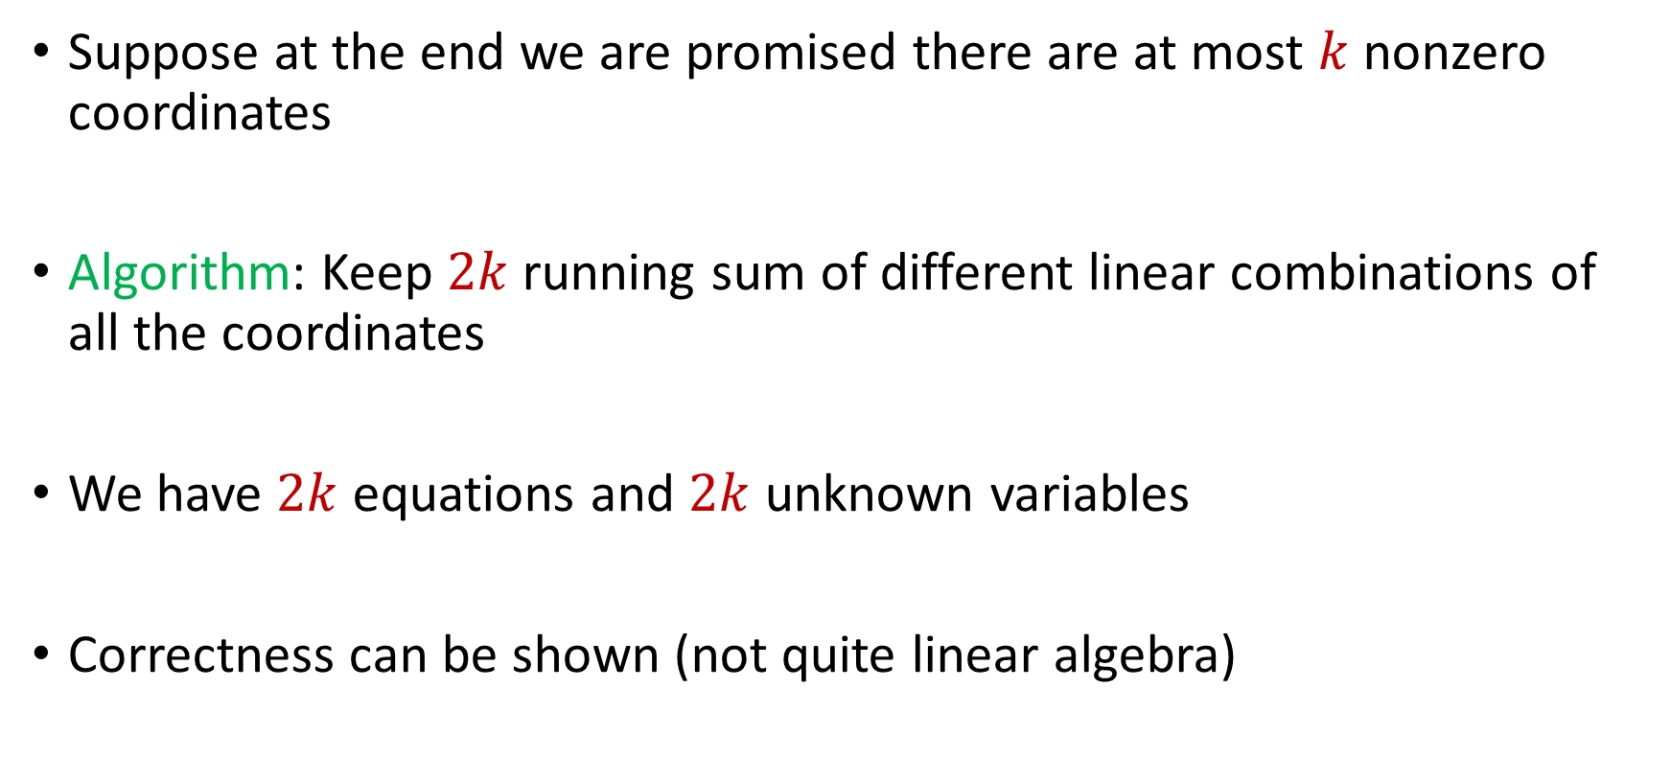
Last Time: Sparse Recovery
Suppose at the end we are promised there are at most $k$ nonzero coordinates
Algorithm: Keep $2k$running sum of different linear combinations of all the coordinates
We have $2k$ equations and $2k$ unknown variables
Correctness can be shown (not quite linear algebra)

Slide 4
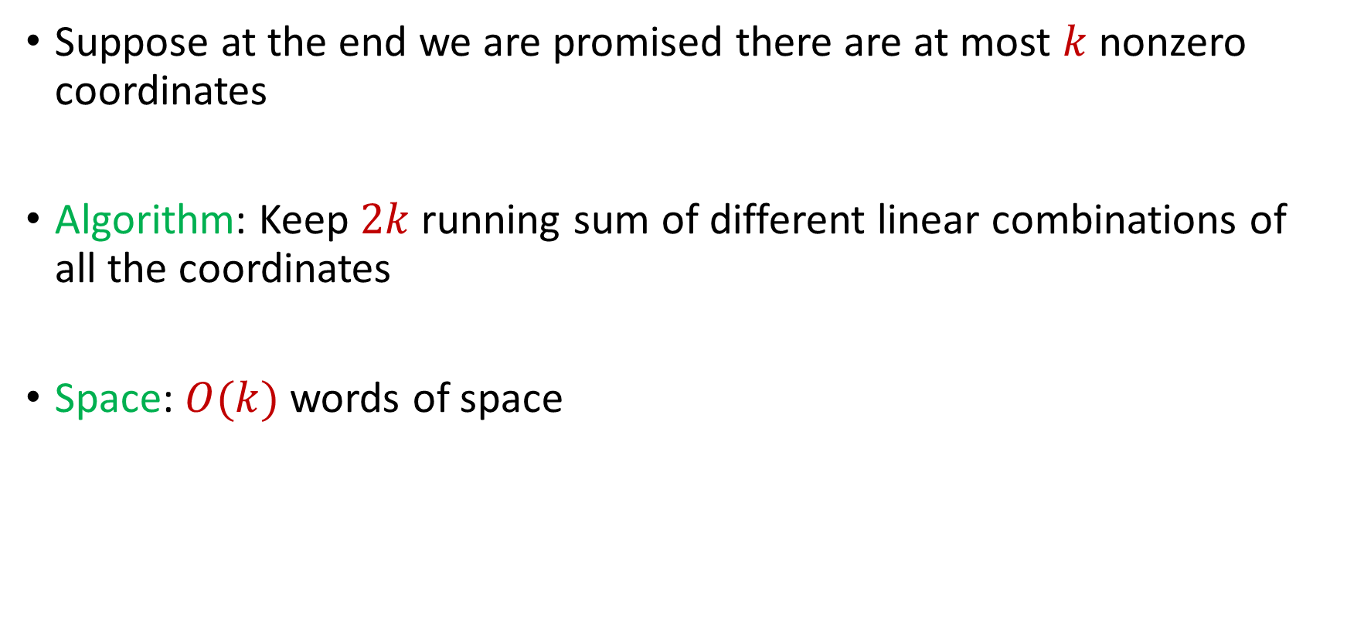
Last Time: Sparse Recovery
Suppose at the end we are promised there are at most $k$ nonzero coordinates
Algorithm: Keep $2k$running sum of different linear combinations of all the coordinates
Space: $O(k)$ words of space

Slide 5

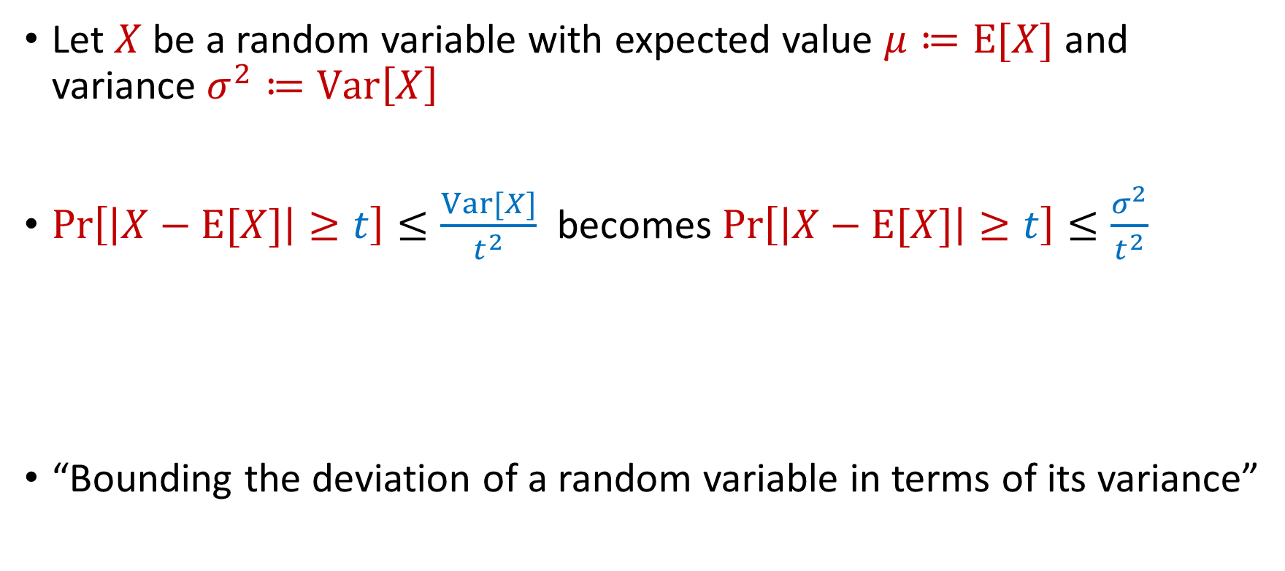
Previously: Chebyshev’s Inequality
Let $X$ be a random variable with expected value $μ≔E[X]$ and variance $σ^{2}≔Var\left[X\right]$
$Pr\left[\left|X−E[X]\right|≥t\right]≤\frac{Var[X]}{t^{2}}$ becomes $Pr\left[\left|X−E[X]\right|≥t\right]≤\frac{σ^{2}}{t^{2}}$
“Bounding the deviation of a random variable in terms of its variance”
$$Pr\left[\left|X−μ\right|≥kσ\right]≤\frac{1}{k^{2}}$$

Slide 6
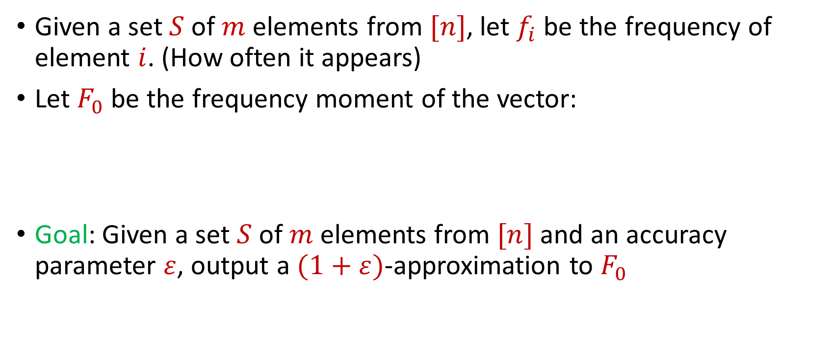

Distinct Elements ($F_{0}$ Estimation)
Given a set $S$ of $m$ elements from $[n]$, let $f_{i}$ be the frequency of element $i$. (How often it appears)
Let $F_{0}$ be the frequency moment of the vector:
Goal: Given a set $S$ of $m$ elements from $[n]$ and an accuracy parameter $ε$, output a $(1+ε)$-approximation to $F_{0}$
$F_{0}=$ $|\{i :f_{i}≠0\}|$

Slide 7



Slide 8


Slide 9


Slide 10


Slide 11


Slide 12


Slide 13


Slide 17


Slide 26


Slide 27
Distinct Elements ($F_{0}$ Estimation)
How many different fruits left in fruit basket?

Slide 28
Distinct Elements ($F_{0}$ Estimation)
How many different fruits left in fruit basket? 8

Slide 29

Distinct Elements ($F_{0}$ Estimation)
Ad allocation: Distinct IP addresses clicking an ad

Slide 30

Distinct Elements ($F_{0}$ Estimation)
Traffic monitoring: Distinct IP addresses visiting a site or number of unique search engine queries
3 billion monthly active users

Slide 31
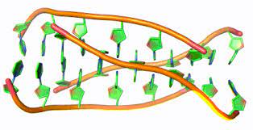
Distinct Elements ($F_{0}$ Estimation)
Computational biology: Counting number of distinct motifs in DNA sequencing
Sequence motifs are short, recurring patterns in DNA that are presumed to have a biological function

Slide 32

Distinct Elements ($F_{0}$ Estimation)
Let $S$ be a set of $N$ numbers
Suppose we form set $S′$ by sampling each item of $S$ with probability $\frac{1}{2}$
How many numbers are in $S′$?

Slide 33
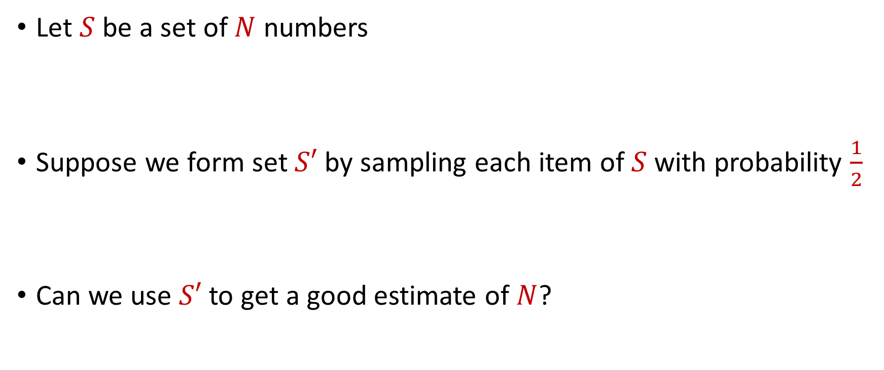
Distinct Elements ($F_{0}$ Estimation)
Let $S$ be a set of $N$ numbers
Suppose we form set $S′$ by sampling each item of $S$ with probability $\frac{1}{2}$
Can we use $S′$ to get a good estimate of $N$?

Slide 34
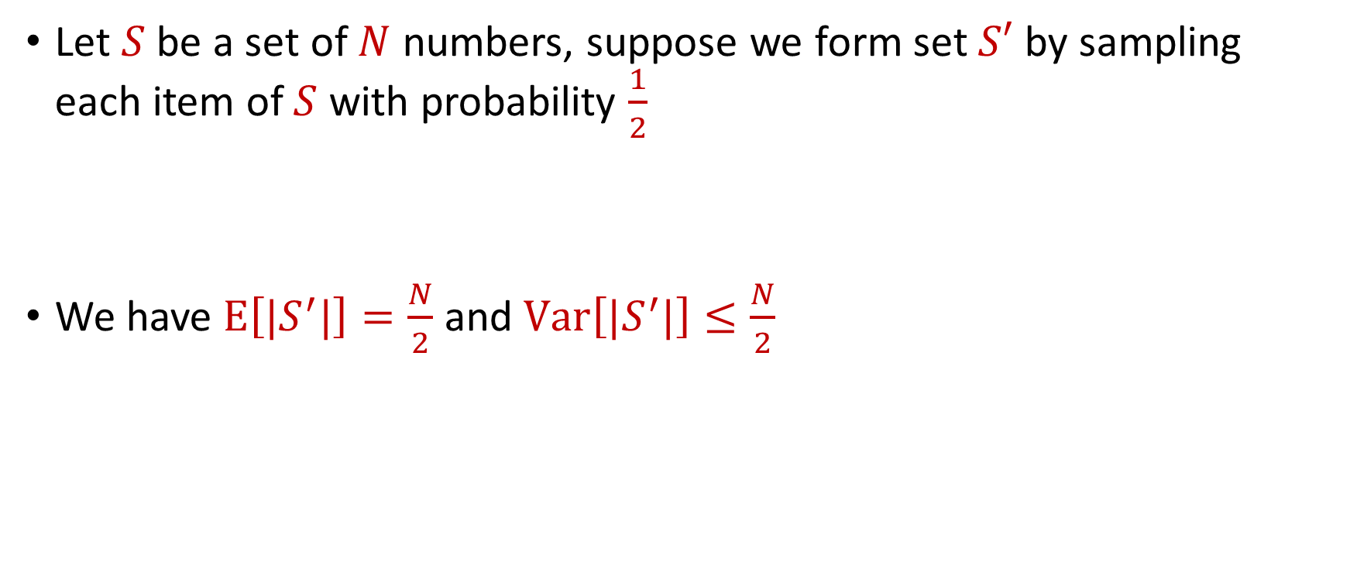
Distinct Elements ($F_{0}$ Estimation)
Let $S$ be a set of $N$ numbers, suppose we form set $S′$ by sampling each item of $S$ with probability $\frac{1}{2}$
We have $E\left[|S^{′}|\right]=\frac{N}{2}$ and $Var\left[|S^{′}|\right]≤\frac{N}{2}$

Slide 35

Distinct Elements ($F_{0}$ Estimation)
What can we say about $Pr\left[\left|\left|S^{′}\right|−\frac{N}{2}\right|≥t\right]$?
By Chebyshev’s inequality, we have $Pr\left[\left|\left|S^{′}\right|−\frac{N}{2}\right|≥100\sqrt{N}\right]≤\frac{1}{10}$

Slide 36
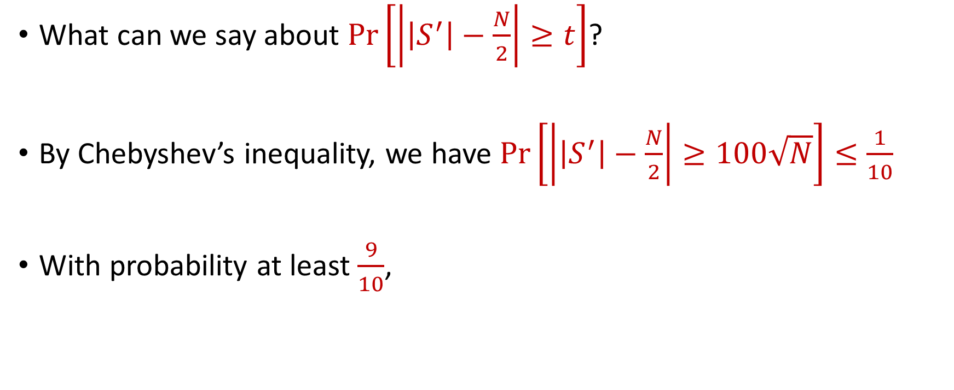
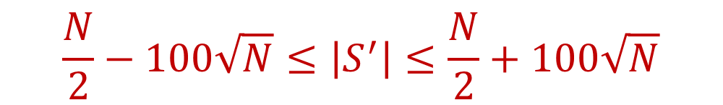
Distinct Elements ($F_{0}$ Estimation)
What can we say about $Pr\left[\left|\left|S^{′}\right|−\frac{N}{2}\right|≥t\right]$?
By Chebyshev’s inequality, we have $Pr\left[\left|\left|S^{′}\right|−\frac{N}{2}\right|≥100\sqrt{N}\right]≤\frac{1}{10}$
With probability at least $\frac{9}{10}$,
$$\frac{N}{2}−100\sqrt{N}≤\left|S^{′}\right|≤\frac{N}{2}+100\sqrt{N}$$

Slide 37

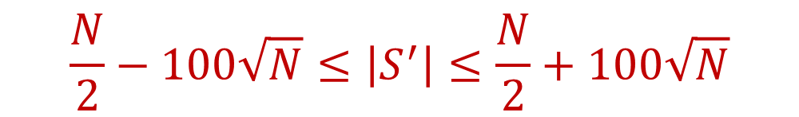
Distinct Elements ($F_{0}$ Estimation)
With probability at least $\frac{9}{10}$,
Thus with probability at least $\frac{9}{10}$,
$$\frac{N}{2}−100\sqrt{N}≤\left|S^{′}\right|≤\frac{N}{2}+100\sqrt{N}$$
$$N−200\sqrt{N}≤2\left|S^{′}\right|≤N+200\sqrt{N}$$

