Slide 1
CSCE 689: Special Topics in Modern Algorithms for Data Science
Lecture 9
Samson Zhou

Slide 2
Presentation Schedule
September 25: Team DAP, Team Bokun, Team Jason
September 27: Galaxy AI, Team STMI
September 29: Team JAC

Slide 3

Previous Lecture

Slide 4
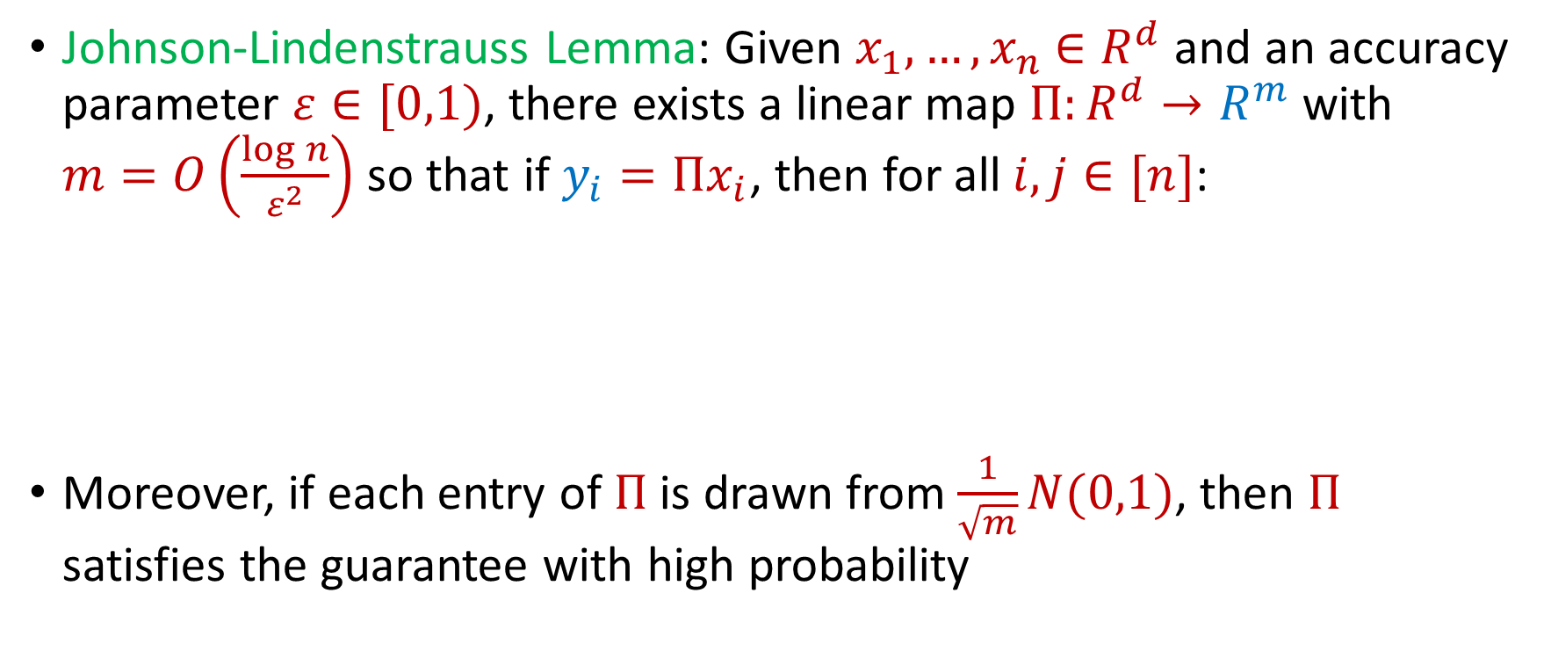
Last Time: Johnson-Lindenstrauss Lemma
Johnson-Lindenstrauss Lemma: Given $x_{1},…,x_{n}$ $∈R^{d}$ and an accuracy parameter $ε∈[0,1)$, there exists a linear map $Π:R^{d}→R^{m}$ with $m=O\left(\frac{\log{n}}{ε^{2}}\right)$ so that if $y_{i}=Πx_{i}$, then for all $i,j∈[n]$:
Moreover, if each entry of $Π$ is drawn from $\frac{1}{\sqrt{m}}N(0,1)$, then $Π$ satisfies the guarantee with high probability
$$\left(1−ε\right){\left\|x_{i}−x_{j}\right\|}_{2}≤{\left\|y_{i}−y_{j}\right\|}_{2}≤\left(1+ε\right){\left\|x_{i}−x_{j}\right\|}_{2}$$

Slide 5
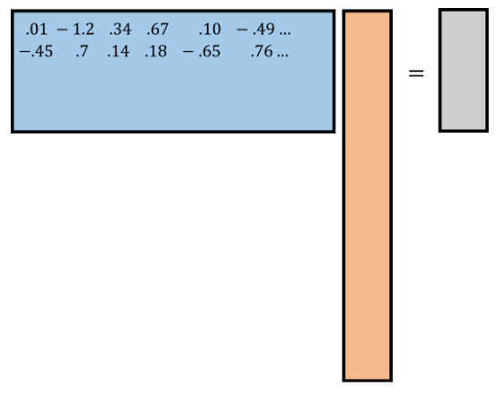
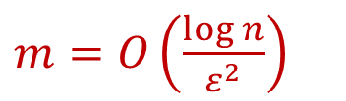
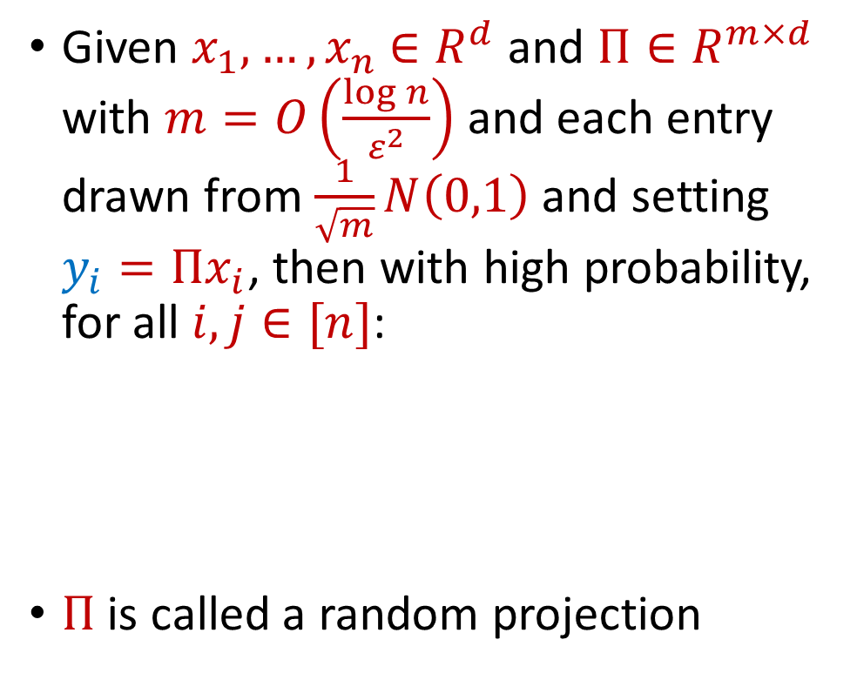






Last Time: Johnson-Lindenstrauss Lemma
$$R^{m×d}$$
$$R^{d}$$
$$R^{m}$$
Given $x_{1},…,x_{n}$ $∈R^{d}$ and $Π∈R^{m×d}$ with $m=O\left(\frac{\log{n}}{ε^{2}}\right)$ and each entry drawn from $\frac{1}{\sqrt{m}}N\left(0,1\right)$ and setting $y_{i}=Πx_{i}$, then with high probability, for all $i,j∈[n]$:
$Π$ is called a random projection
$$y_{i}$$
$$Π$$
$m=O\left(\frac{\log{n}}{ε^{2}}\right)$
$$x_{i}$$
$$\left(1−ε\right){\left\|x_{i}−x_{j}\right\|}_{2}≤{\left\|y_{i}−y_{j}\right\|}_{2}≤\left(1+ε\right){\left\|x_{i}−x_{j}\right\|}_{2}$$

Slide 6
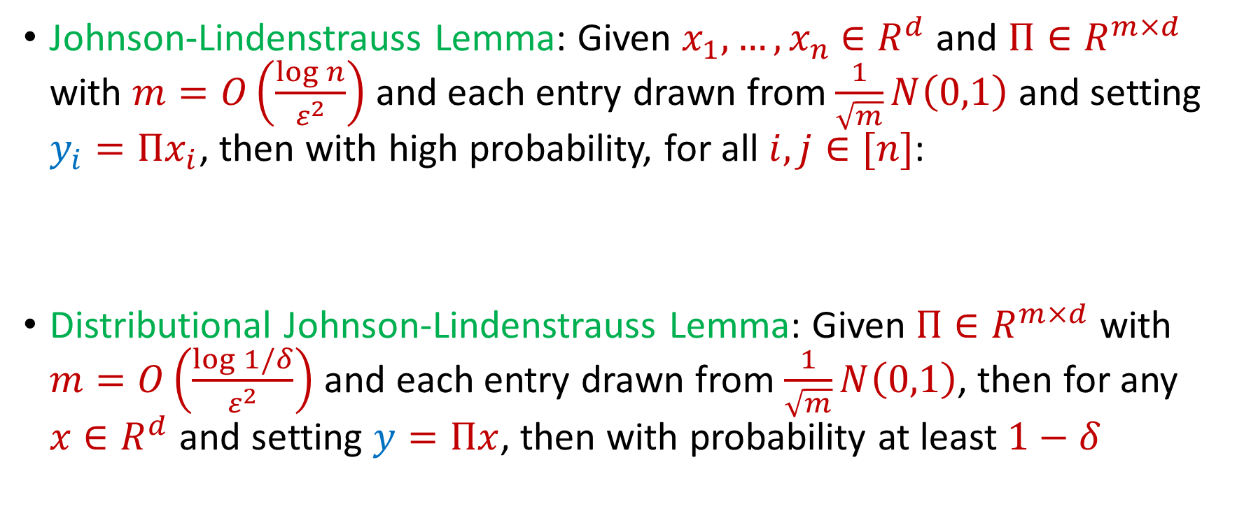
Last Time: Johnson-Lindenstrauss Lemma
Johnson-Lindenstrauss Lemma: Given $x_{1},…,x_{n}$ $∈R^{d}$ and $Π∈R^{m×d}$ with $m=O\left(\frac{\log{n}}{ε^{2}}\right)$ and each entry drawn from $\frac{1}{\sqrt{m}}N\left(0,1\right)$ and setting $y_{i}=Πx_{i}$, then with high probability, for all $i,j∈[n]$:
Distributional Johnson-Lindenstrauss Lemma: Given $Π∈R^{m×d}$ with $m=O\left(\frac{\log{1/δ}}{ε^{2}}\right)$ and each entry drawn from $\frac{1}{\sqrt{m}}N\left(0,1\right)$, then for any $x∈R^{d}$ and setting $y=Πx$, then with probability at least $1−δ$
$$\left(1−ε\right){\left\|x_{i}−x_{j}\right\|}_{2}≤{\left\|y_{i}−y_{j}\right\|}_{2}≤\left(1+ε\right){\left\|x_{i}−x_{j}\right\|}_{2}$$
$$\left(1−ε\right){\left\|x\right\|}_{2}≤{\left\|y\right\|}_{2}≤\left(1+ε\right){\left\|x\right\|}_{2}$$

Slide 7
The Streaming Model
Scenario: We are given a massive dataset that arrives in a continuous stream, which we would like to analyze – but we do not have enough space to store all the items

Slide 8
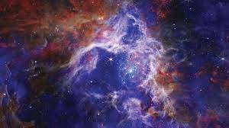
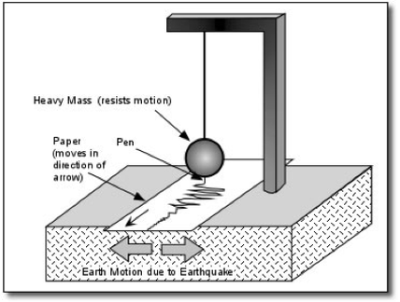
The Streaming Model
Scientific observations: images from telescopes (Event Horizon Telescope collected 1 petabyte, i.e., 1024 terabytes, of data from a five-day observing campaign), readings from seismometer arrays monitoring and predicting earthquake activity

Slide 9

The Streaming Model
Internet of Things (IoT): home automation (security cameras, smart devices), medical care (health monitoring devices, pacemakers), traffic cameras and travel time sensors (smart cities), electrical grid monitoring

Slide 10
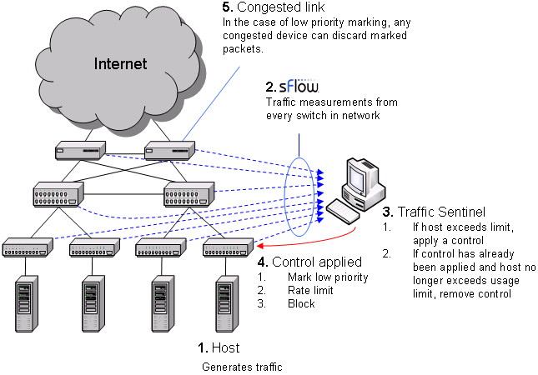

The Streaming Model
Financial markets
Traffic network monitoring

Slide 11
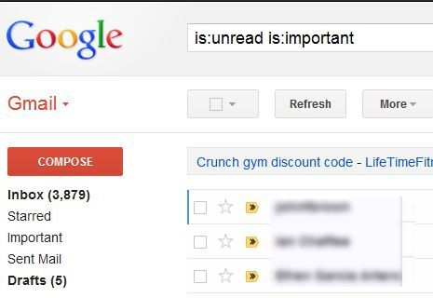
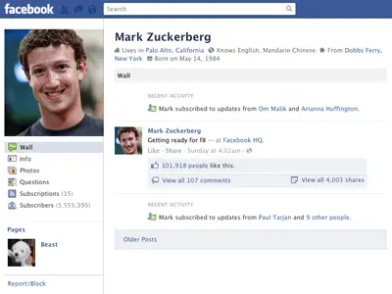

330 billion daily e-mails
3 billion monthly active users
8.5 billion daily Google searches

Slide 12
The Streaming Model
Scenario: We are given a massive dataset that arrives in a continuous stream, which we would like to analyze – but we do not have enough space to store all the items
Typically the data must be compressed on-the-fly
Store a data structure from which we can still learn useful information

Slide 13

The Streaming Model
Input: Elements of an underlying data set $S$, which arrive sequentially
Output: Evaluation (or approximation) of a given function
Goal: Use space sublinear in the size $m$of the input $S$
1 0 1 1 1 0 0 1

Slide 14
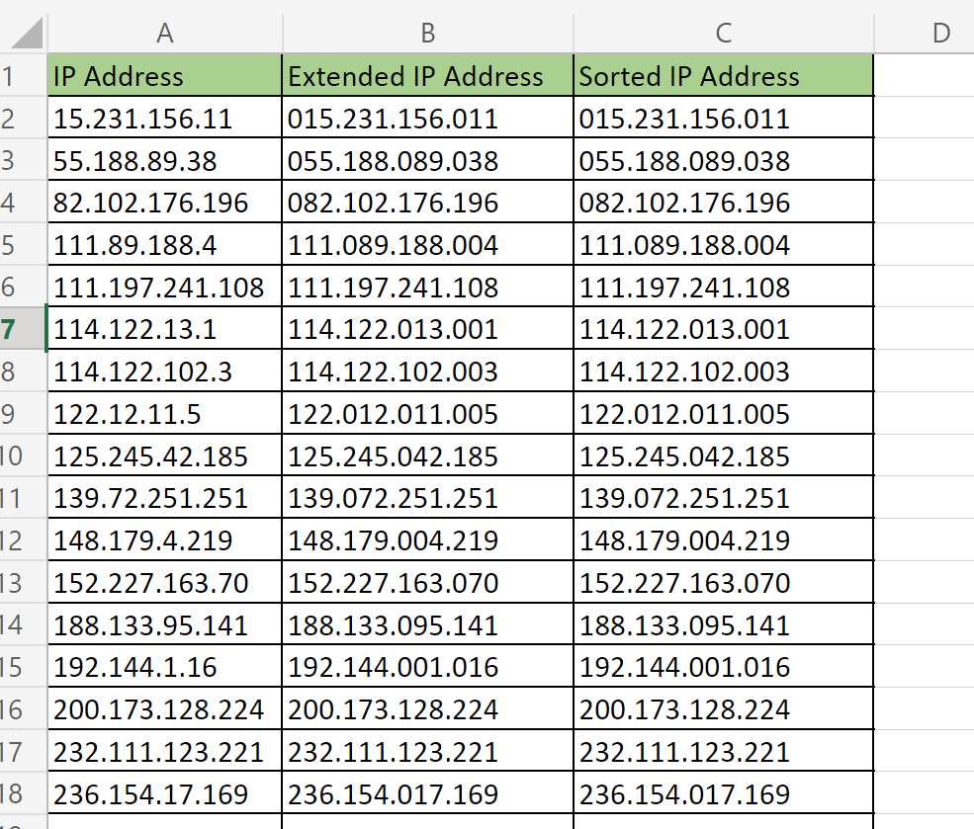

Slide 15
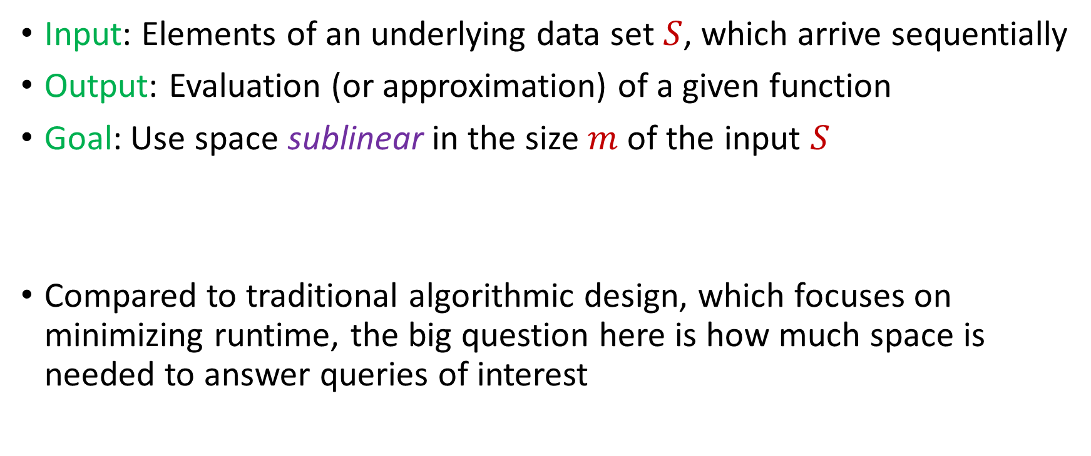
The Streaming Model
Input: Elements of an underlying data set $S$, which arrive sequentially
Output: Evaluation (or approximation) of a given function
Goal: Use space sublinear in the size $m$of the input $S$
Compared to traditional algorithmic design, which focuses on minimizing runtime, the big question here is how much space is needed to answer queries of interest

Slide 16

Sampling
Suppose we see a stream of elements from $[n]$. How do we uniformly sample one of the positions of the stream?
47 72 81 10 14 33 51 29 54 9 36 46 10

Slide 17
Sampling
Suppose we see a stream of elements from $[n]$. How do we uniformly sample one of the positions of the stream?
47 72 81 10 14 33 51 29 54 9 36 46 10

Slide 18

Reservoir Sampling
Suppose we see a stream of elements from $[n]$. How do we uniformly sample one of the positions of the stream?
[Vitter 1985]: Initialize $s=⊥$
On the arrival of element $i$, replace $s$ with $x_{i}$ with probability $\frac{1}{i}$
47 72 81 10 14 33 51 29 54 9 36 46 10

Slide 19

Reservoir Sampling
Suppose the stream has length $m$. What is the probability that $s=x_{t}$ for fixed $t∈[m]$?
47 72 81 10 14 33 51 29 54 9 36 46 10

Slide 20

Reservoir Sampling
Suppose the stream has length $m$. What is the probability that $s=x_{t}$ for fixed $t∈[m]$?
Must have chosen $s=x_{t}$ at time $t$ AND must have never updated $s$ afterwards
47 72 81 10 14 33 51 29 54 9 36 46 10

Slide 21
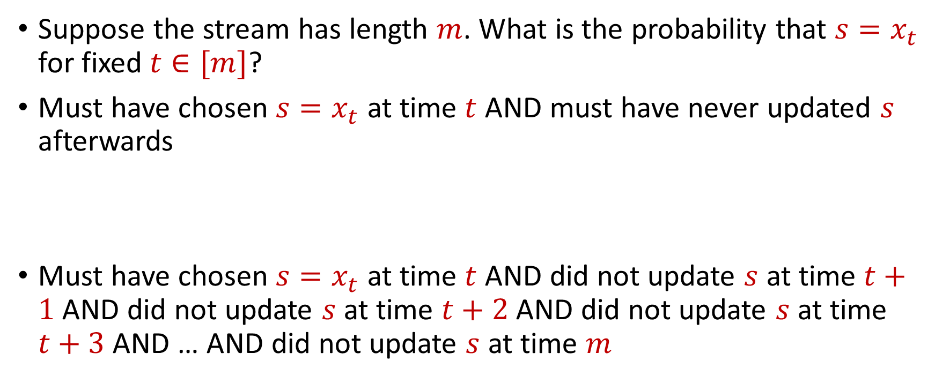
Reservoir Sampling
Suppose the stream has length $m$. What is the probability that $s=x_{t}$ for fixed $t∈[m]$?
Must have chosen $s=x_{t}$ at time $t$ AND must have never updated $s$ afterwards
Must have chosen $s=x_{t}$ at time $t$ AND did not update $s$ at time $t+1$ AND did not update $s$ at time $t+2$ AND did not update $s$ at time $t+3$ AND … AND did not update $s$ at time $m$

Slide 22
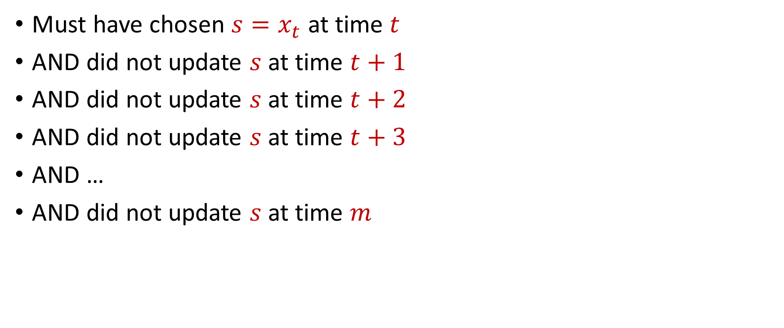
Reservoir Sampling
Must have chosen $s=x_{t}$ at time $t$
AND did not update $s$ at time $t+1$
AND did not update $s$ at time $t+2$
AND did not update $s$ at time $t+3$
AND …
AND did not update $s$ at time $m$

Slide 23

Reservoir Sampling
Happens with probability $\frac{1}{t}$
Must have chosen $s=x_{t}$ at time $t$
AND did not update $s$ at time $t+1$
AND did not update $s$ at time $t+2$
AND did not update $s$ at time $t+3$
AND …
AND did not update $s$ at time $m$

Slide 24

Reservoir Sampling
Happens with probability $\frac{1}{t}$
Must have chosen $s=x_{t}$ at time $t$
AND did not update $s$ at time $t+1$
AND did not update $s$ at time $t+2$
AND did not update $s$ at time $t+3$
AND …
AND did not update $s$ at time $m$
Happens with probability $1−\frac{1}{t+1}$

Slide 25

Reservoir Sampling
Happens with probability $\frac{1}{t}$
Must have chosen $s=x_{t}$ at time $t$
AND did not update $s$ at time $t+1$
AND did not update $s$ at time $t+2$
AND did not update $s$ at time $t+3$
AND …
AND did not update $s$ at time $m$
Happens with probability $1−\frac{1}{t+1}$
Happens with probability $1−\frac{1}{t+2}$

Slide 26

Reservoir Sampling
Happens with probability $\frac{1}{t}$
Must have chosen $s=x_{t}$ at time $t$
AND did not update $s$ at time $t+1$
AND did not update $s$ at time $t+2$
AND did not update $s$ at time $t+3$
AND …
AND did not update $s$ at time $m$
Happens with probability $1−\frac{1}{t+1}$
Happens with probability $1−\frac{1}{t+2}$
Happens with probability $1−\frac{1}{m}$

Slide 27
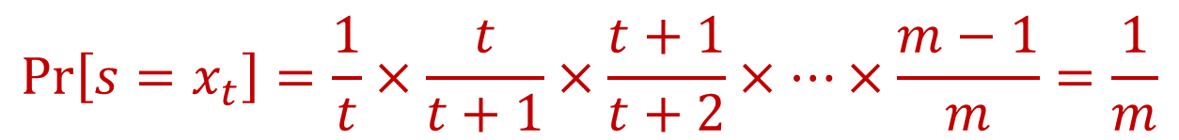
Reservoir Sampling
Happens with probability $\frac{1}{t}$
Must have chosen $s=x_{t}$ at time $t$
AND did not update $s$ at time $t+1$
AND did not update $s$ at time $t+2$
AND did not update $s$ at time $t+3$
AND …
AND did not update $s$ at time $m$
Happens with probability $1−\frac{1}{t+1}$
Happens with probability $1−\frac{1}{t+2}$
Happens with probability $1−\frac{1}{m}$
$$\operatorname{Pr}\left[s=x_{t}\right]=\frac{1}{t}×\frac{t}{t+1}×\frac{t+1}{t+2}×…×\frac{m−1}{m}=\frac{1}{m}$$

Slide 28
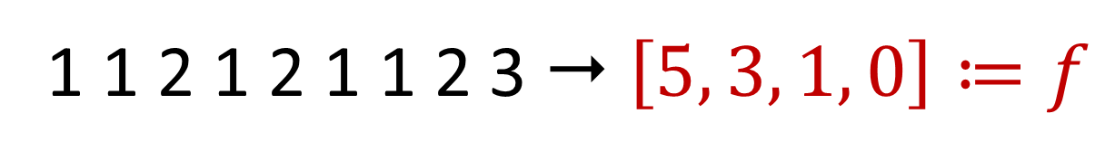

Frequency Vector
Given a set $S$ of $m$ elements from $[n]$, let $f_{i}$ be the frequency of element $i$. (How often it appears)
1 1 2 1 2 1 1 2 3  $\left[5, 3, 1, 0\right]≔f$

Slide 29
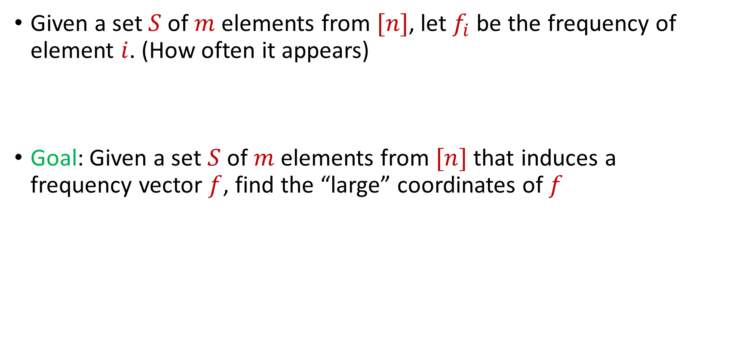
Frequent Items
Given a set $S$ of $m$ elements from $[n]$, let $f_{i}$ be the frequency of element $i$. (How often it appears)
Goal: Given a set $S$ of $m$ elements from $[n]$ that induces a frequency vector $f$, find the “large” coordinates of $f$
$f_{1}$ | $f_{2}$ | $f_{3}$ | $f_{4}$ | $f_{5}$ | $f_{6}$ | $f_{7}$
10 | 0 | 1 | 1 | 2 | 0 | 9

Slide 30
Frequent Items
Data mining: Finding top products/viral objects, e.g., Google searches, Amazon products, YouTube videos, etc.
Traffic network monitoring: Finding IP addresses with high volume traffic, e.g., detecting distributed denial of service (DDoS) attacks, network anomalies)
Database design: Finding iceberg queries, i.e., items in a database with high volume of queries
Want fast response and running list of frequent items, i.e., cannot process entire database for each query/update

Slide 31
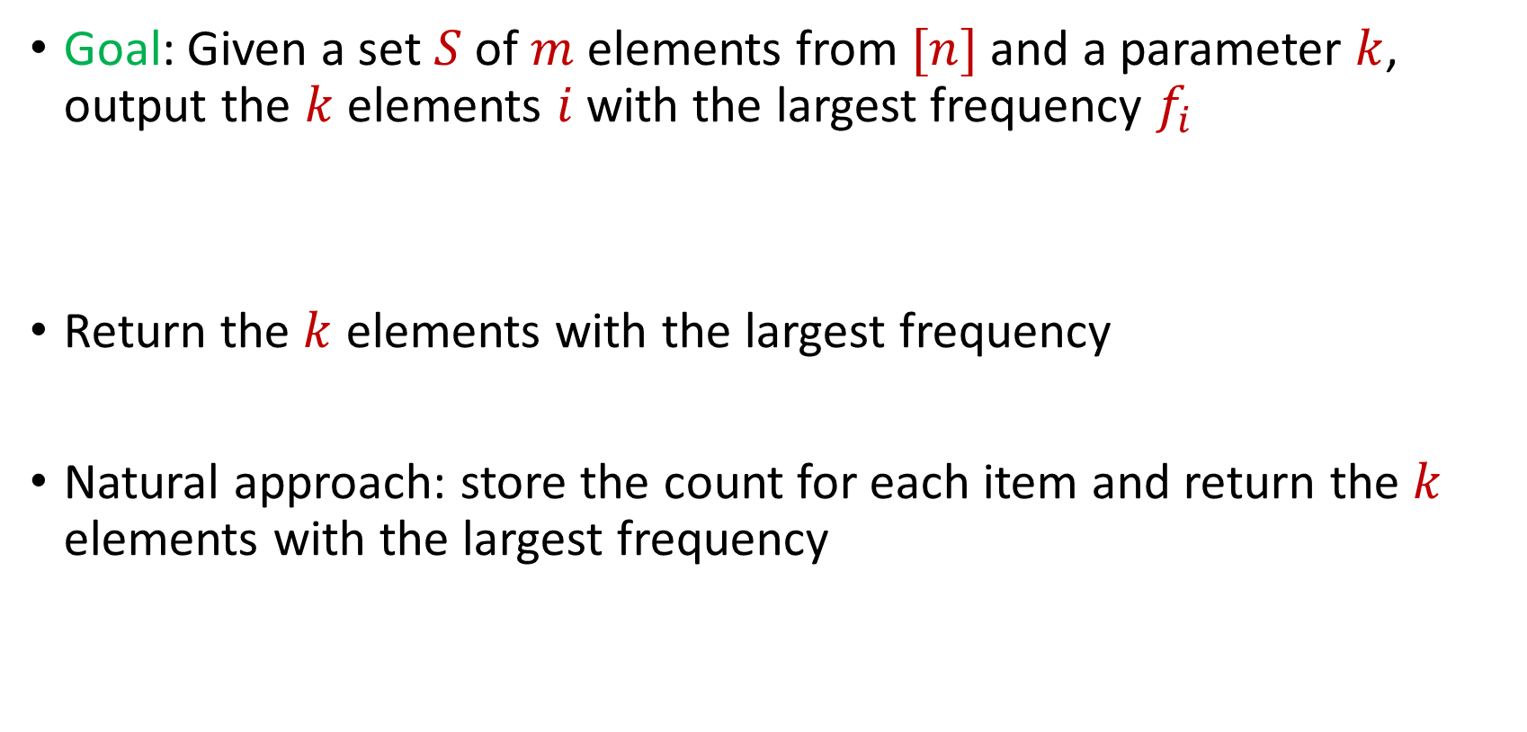
Frequent Items
Goal: Given a set $S$ of $m$ elements from $[n]$ and a parameter $k$, output the $k$ elements $i$ with the largest frequency $f_{i}$
Return the $k$ elements with the largest frequency
Natural approach: store the count for each item and return the $k$ elements with the largest frequency
$f_{1}$ | $f_{2}$ | $f_{3}$ | $f_{4}$ | $f_{5}$ | $f_{6}$ | $f_{7}$
10 | 0 | 1 | 1 | 2 | 0 | 9

Slide 32
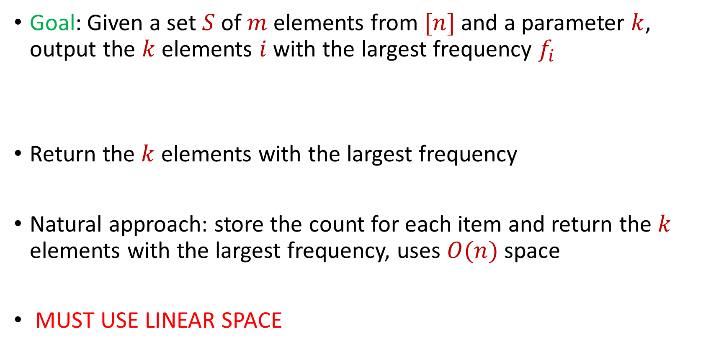
Frequent Items
Goal: Given a set $S$ of $m$ elements from $[n]$ and a parameter $k$, output the $k$ elements $i$ with the largest frequency $f_{i}$
Return the $k$ elements with the largest frequency
Natural approach: store the count for each item and return the $k$ elements with the largest frequency, uses $O(n)$ space
MUST USE LINEAR SPACE
$f_{1}$ | $f_{2}$ | $f_{3}$ | $f_{4}$ | $f_{5}$ | $f_{6}$ | $f_{7}$
10 | 0 | 1 | 1 | 2 | 0 | 9

Slide 33
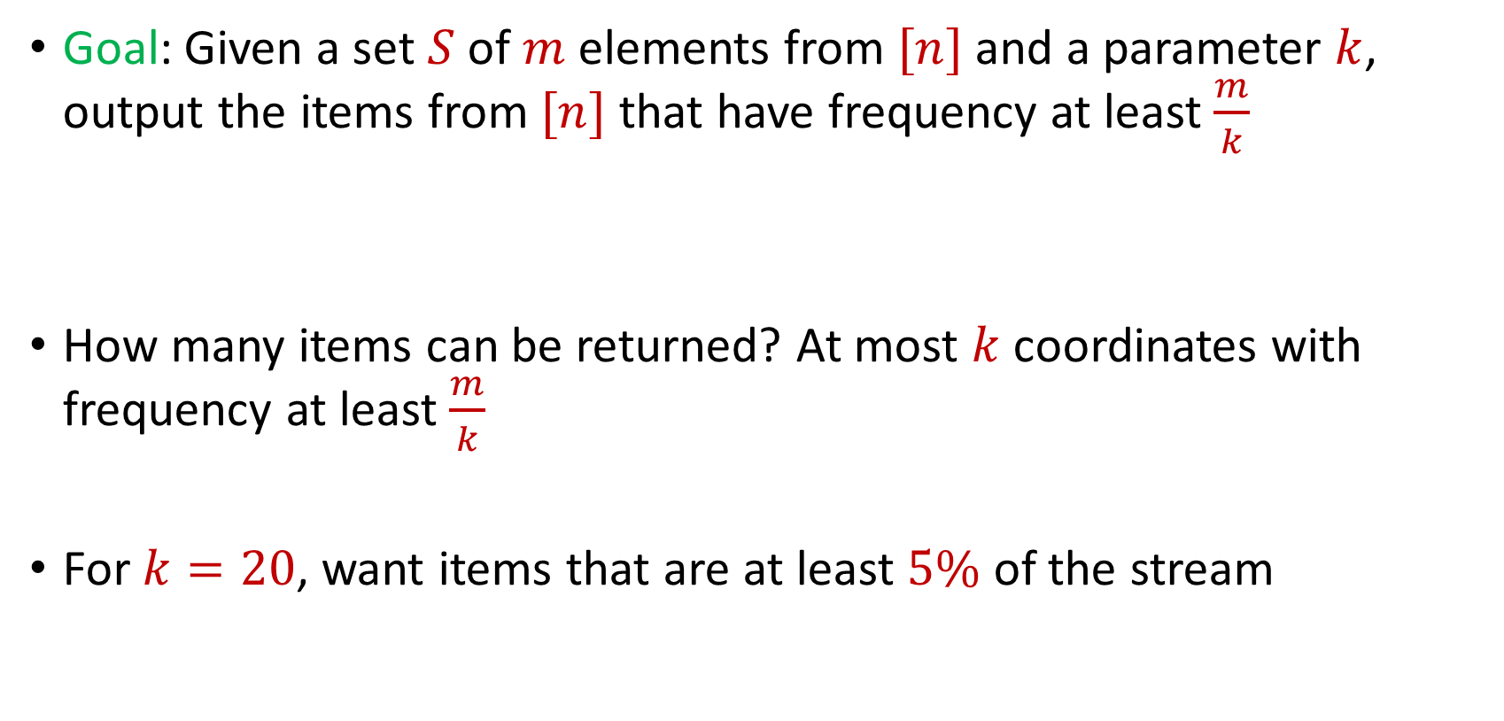
Frequent Items
Goal: Given a set $S$ of $m$ elements from $[n]$ and a parameter $k$, output the items from $[n]$ that have frequency at least $\frac{m}{k}$
How many items can be returned? At most $k$ coordinates with frequency at least $\frac{m}{k}$
For $k=20$, want items that are at least $5\%$ of the stream
$f_{1}$ | $f_{2}$ | $f_{3}$ | $f_{4}$ | $f_{5}$ | $f_{6}$ | $f_{7}$
10 | 0 | 1 | 1 | 2 | 0 | 9

Slide 34
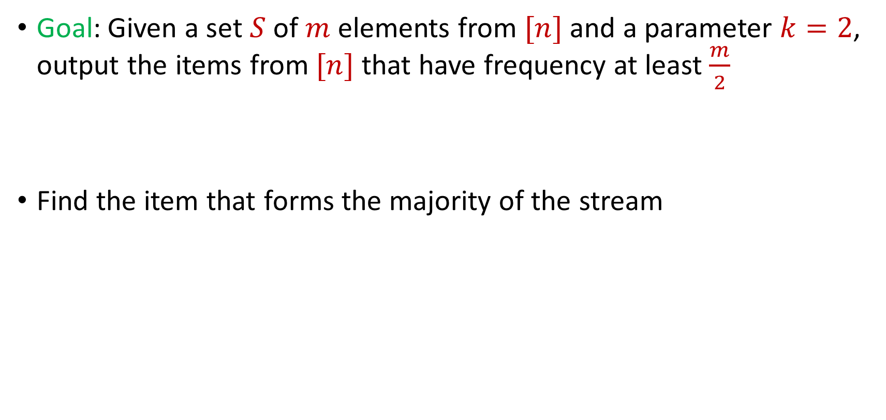
Frequent Items
Goal: Given a set $S$ of $m$ elements from $[n]$ and a parameter $k=2$, output the items from $[n]$ that have frequency at least $\frac{m}{2}$
Find the item that forms the majority of the stream

Slide 35

$$1$$

Slide 36
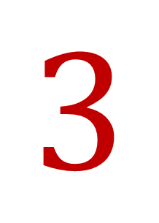
$$3$$

Slide 37
$$3$$

Slide 38
$$1$$

Slide 39
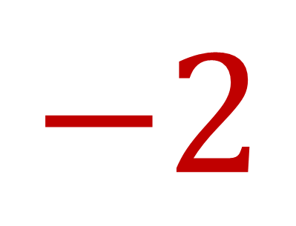
$$−2$$

Slide 40
$$1$$

Slide 41
$$1$$

Slide 42

$$7$$

Slide 43
$$1$$

Slide 44
$$1$$

Slide 45
$$3$$

Slide 46
$$3$$

Slide 47
$$1$$

Slide 48
$$1$$

Slide 49
$$3$$

Slide 50
$$3$$

Slide 51
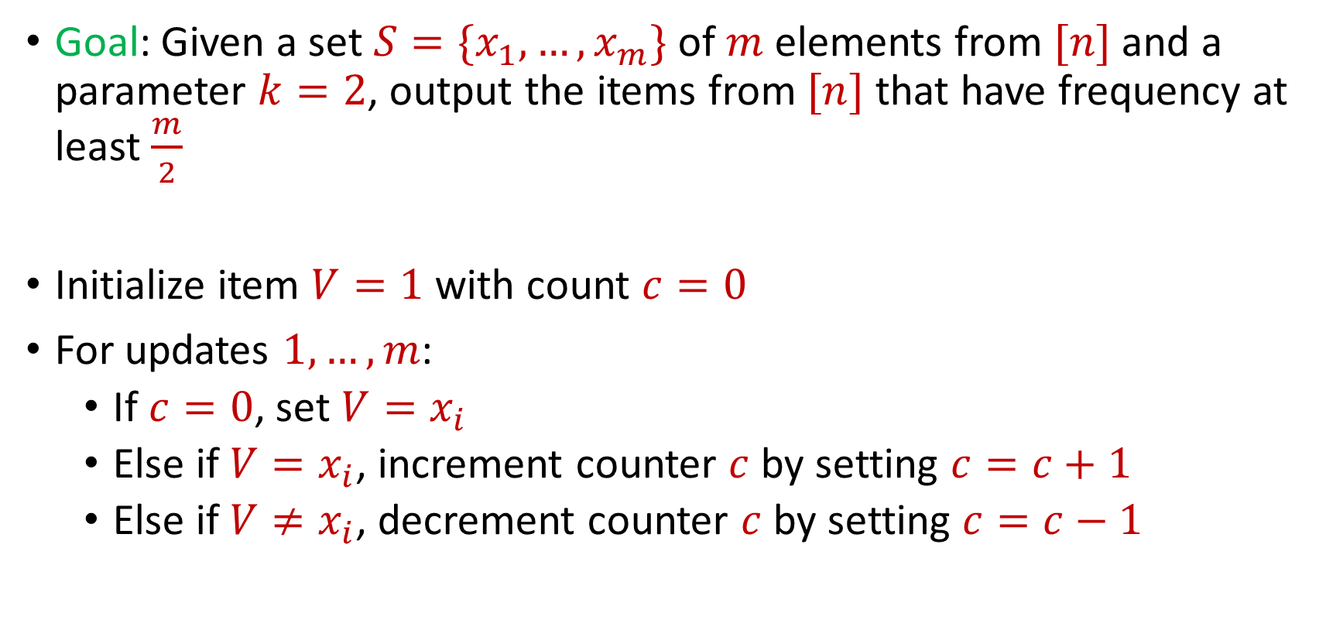
Majority
Goal: Given a set $S=\{x_{1},…, x_{m}\}$ of $m$ elements from $[n]$ and a parameter $k=2$, output the items from $[n]$ that have frequency at least $\frac{m}{2}$
Initialize item $V=1$ with count $c=0$
For updates $1,…,m$:
If $c=0$, set $V=x_{i}$
Else if $V=x_{i}$, increment counter $c$ by setting $c=c+1$
Else if $V≠x_{i}$, decrement counter $c$ by setting $c=c−1$

Slide 52
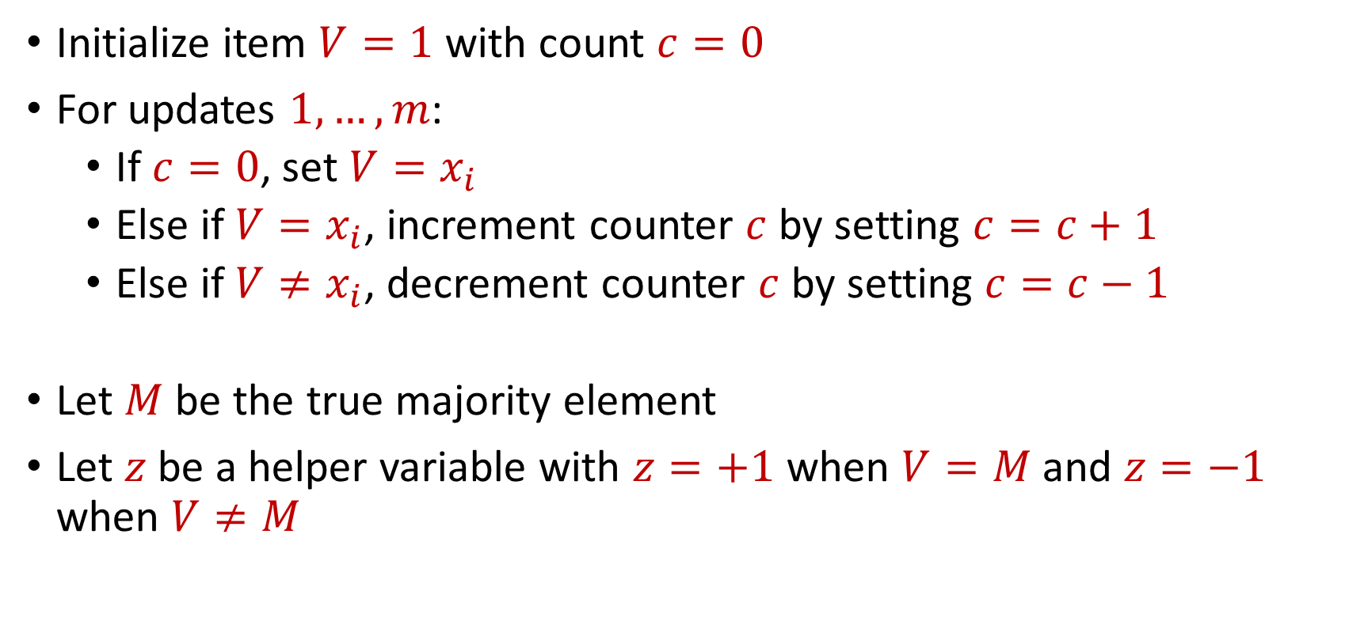
Majority
Initialize item $V=1$ with count $c=0$
For updates $1,…,m$:
If $c=0$, set $V=x_{i}$
Else if $V=x_{i}$, increment counter $c$ by setting $c=c+1$
Else if $V≠x_{i}$, decrement counter $c$ by setting $c=c−1$
Let $M$ be the true majority element
Let $z$be a helper variable with $z=+1$ when $V=M$ and $z=−1$ when $V≠M$

Slide 53
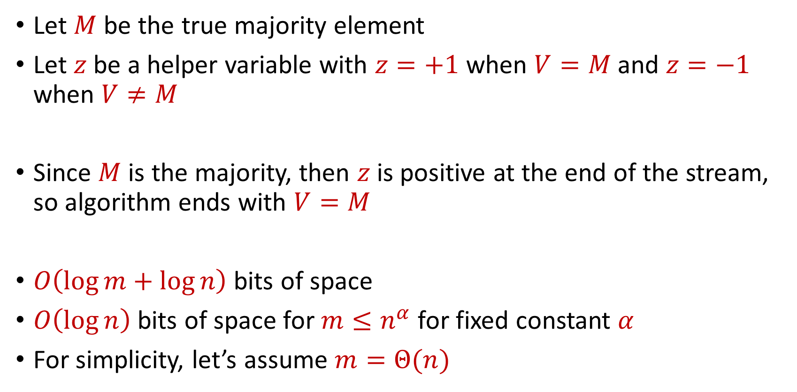
Majority
Let $M$ be the true majority element
Let $z$be a helper variable with $z=+1$ when $V=M$ and $z=−1$ when $V≠M$
Since $M$ is the majority, then $z$ is positive at the end of the stream, so algorithm ends with $V=M$
$O\left(\log{m}+\log{n}\right)$ bits of space
$O\left(\log{n}\right)$ bits of space for $m≤n^{α}$ for fixed constant $α$
For simplicity, let’s assume $m=Θ(n)$

Slide 54

Frequent Items
Goal: Given a set $S$ of $m$ elements from $[n]$ and a parameter $k$, output the items from $[n]$ that have frequency at least $\frac{m}{k}$

Slide 55
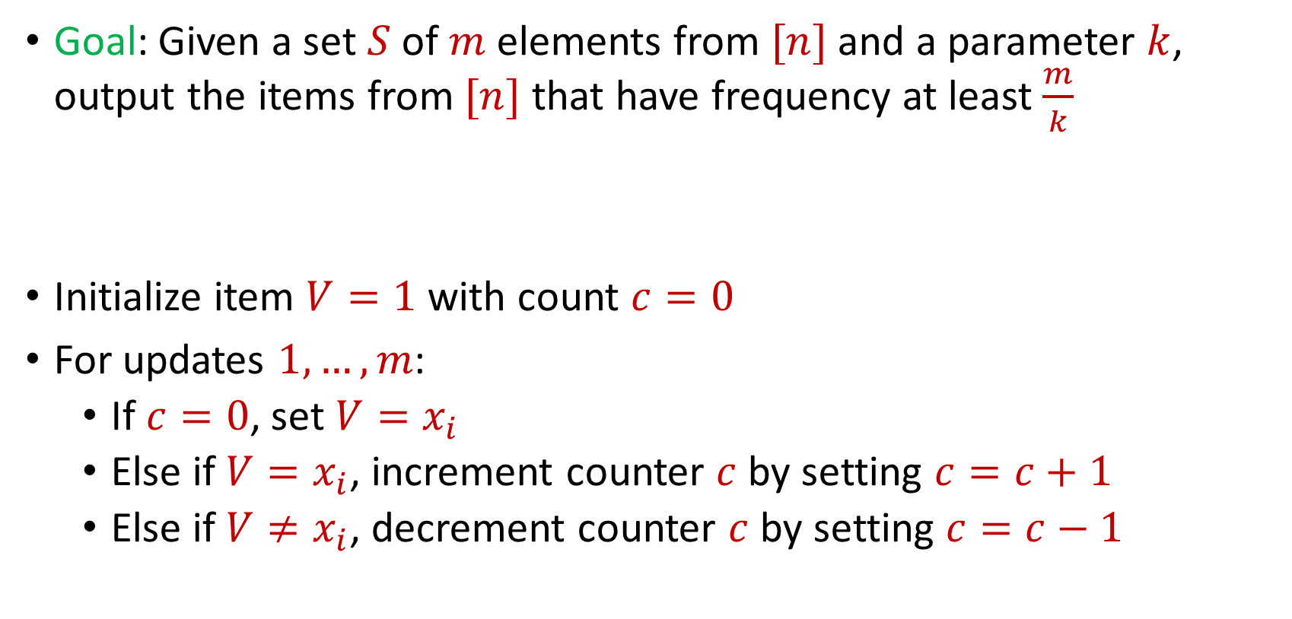
Frequent Items
Goal: Given a set $S$ of $m$ elements from $[n]$ and a parameter $k$, output the items from $[n]$ that have frequency at least $\frac{m}{k}$
Initialize item $V=1$ with count $c=0$
For updates $1,…,m$:
If $c=0$, set $V=x_{i}$
Else if $V=x_{i}$, increment counter $c$ by setting $c=c+1$
Else if $V≠x_{i}$, decrement counter $c$ by setting $c=c−1$

Slide 56
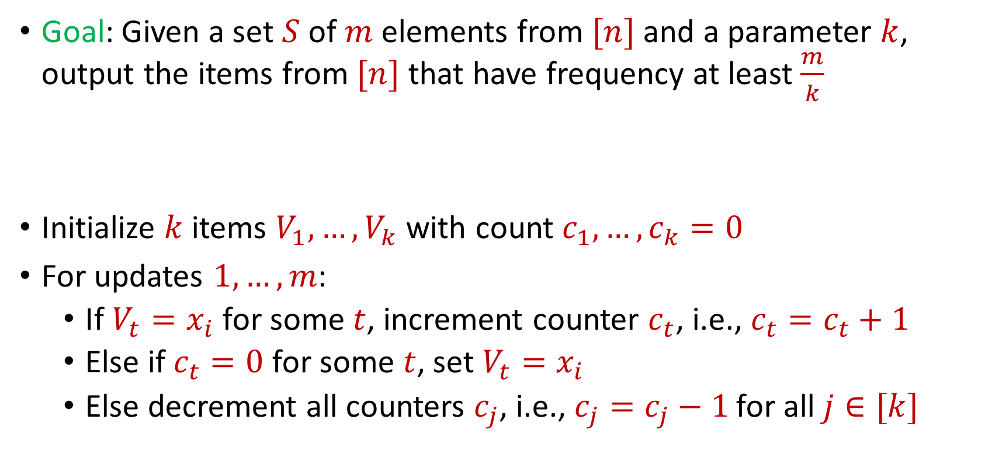
Misra Gries
Goal: Given a set $S$ of $m$ elements from $[n]$ and a parameter $k$, output the items from $[n]$ that have frequency at least $\frac{m}{k}$
Initialize $k$ items $V_{1},…,V_{k}$ with count $c_{1},…,c_{k}=0$
For updates $1,…,m$:
If $V_{t}=x_{i}$ for some $t$, increment counter $c_{t}$, i.e., $c_{t}=c_{t}+1$
Else if $c_{t}=0$ for some $t$, set $V_{t}=x_{i}$
Else decrement all counters $c_{j}$, i.e., $c_{j}=c_{j}−1$ for all $j∈[k]$

Slide 57

Misra Gries
$n=7$, $k=3$
$V_{1}= ⊥$, $c_{1}=0$
$V_{2}= ⊥$, $c_{2}=0$
$V_{3}= ⊥$, $c_{3}=0$
$f_{1}$ | $f_{2}$ | $f_{3}$ | $f_{4}$ | $f_{5}$ | $f_{6}$ | $f_{7}$
0 | 0 | 0 | 0 | 0 | 0 | 0

Slide 58


Misra Gries
$$3$$
$V_{1}= ⊥$, $c_{1}=0$
$V_{2}= ⊥$, $c_{2}=0$
$V_{3}= ⊥$, $c_{3}=0$
$f_{1}$ | $f_{2}$ | $f_{3}$ | $f_{4}$ | $f_{5}$ | $f_{6}$ | $f_{7}$
0 | 0 | 0 | 0 | 0 | 0 | 0

Slide 59

Misra Gries
$$3$$
$V_{1}=3$, $c_{1}=1$
$V_{2}= ⊥$, $c_{2}=0$
$V_{3}= ⊥$, $c_{3}=0$
$f_{1}$ | $f_{2}$ | $f_{3}$ | $f_{4}$ | $f_{5}$ | $f_{6}$ | $f_{7}$
0 | 0 | 1 | 0 | 0 | 0 | 0

Slide 60

Misra Gries
$$1$$
$V_{1}=3$, $c_{1}=1$
$V_{2}= ⊥$, $c_{2}=0$
$V_{3}= ⊥$, $c_{3}=0$
$f_{1}$ | $f_{2}$ | $f_{3}$ | $f_{4}$ | $f_{5}$ | $f_{6}$ | $f_{7}$
0 | 0 | 1 | 0 | 0 | 0 | 0

Slide 61

Misra Gries
$$1$$
$V_{1}=3$, $c_{1}=1$
$V_{2}=1$, $c_{2}=1$
$V_{3}= ⊥$, $c_{3}=0$
$f_{1}$ | $f_{2}$ | $f_{3}$ | $f_{4}$ | $f_{5}$ | $f_{6}$ | $f_{7}$
1 | 0 | 1 | 0 | 0 | 0 | 0

Slide 62

Misra Gries
$$2$$
$V_{1}=3$, $c_{1}=1$
$V_{2}=1$, $c_{2}=1$
$V_{3}= ⊥$, $c_{3}=0$
$f_{1}$ | $f_{2}$ | $f_{3}$ | $f_{4}$ | $f_{5}$ | $f_{6}$ | $f_{7}$
1 | 0 | 1 | 0 | 0 | 0 | 0

Slide 63

Misra Gries
$$2$$
$V_{1}=3$, $c_{1}=1$
$V_{2}=1$, $c_{2}=1$
$V_{3}=2$, $c_{3}=1$
$f_{1}$ | $f_{2}$ | $f_{3}$ | $f_{4}$ | $f_{5}$ | $f_{6}$ | $f_{7}$
1 | 1 | 1 | 0 | 0 | 0 | 0

Slide 64
Misra Gries
$$1$$
$V_{1}=3$, $c_{1}=1$
$V_{2}=1$, $c_{2}=1$
$V_{3}=2$, $c_{3}=1$
$f_{1}$ | $f_{2}$ | $f_{3}$ | $f_{4}$ | $f_{5}$ | $f_{6}$ | $f_{7}$
1 | 1 | 1 | 0 | 0 | 0 | 0

Slide 65

Misra Gries
$$1$$
$V_{1}=3$, $c_{1}=1$
$V_{2}=1$, $c_{2}=2$
$V_{3}=2$, $c_{3}=1$
$f_{1}$ | $f_{2}$ | $f_{3}$ | $f_{4}$ | $f_{5}$ | $f_{6}$ | $f_{7}$
2 | 1 | 1 | 0 | 0 | 0 | 0

Slide 66

Misra Gries
$$4$$
$V_{1}=3$, $c_{1}=1$
$V_{2}=1$, $c_{2}=2$
$V_{3}=2$, $c_{3}=1$
$f_{1}$ | $f_{2}$ | $f_{3}$ | $f_{4}$ | $f_{5}$ | $f_{6}$ | $f_{7}$
2 | 1 | 1 | 0 | 0 | 0 | 0

Slide 67

Misra Gries
$$4$$
$V_{1}=3$, $c_{1}=0$
$V_{2}=1$, $c_{2}=1$
$V_{3}=2$, $c_{3}=0$
$f_{1}$ | $f_{2}$ | $f_{3}$ | $f_{4}$ | $f_{5}$ | $f_{6}$ | $f_{7}$
2 | 1 | 1 | 1 | 0 | 0 | 0

Slide 68
Misra Gries
$$2$$
$V_{1}=3$, $c_{1}=0$
$V_{2}=1$, $c_{2}=1$
$V_{3}=2$, $c_{3}=0$
$f_{1}$ | $f_{2}$ | $f_{3}$ | $f_{4}$ | $f_{5}$ | $f_{6}$ | $f_{7}$
2 | 1 | 1 | 1 | 0 | 0 | 0

Slide 69

Misra Gries
$$2$$
$V_{1}=3$, $c_{1}=0$
$V_{2}=1$, $c_{2}=1$
$V_{3}=2$, $c_{3}=1$
$f_{1}$ | $f_{2}$ | $f_{3}$ | $f_{4}$ | $f_{5}$ | $f_{6}$ | $f_{7}$
2 | 2 | 1 | 1 | 0 | 0 | 0

Slide 70
Misra Gries
$$1$$
$V_{1}=3$, $c_{1}=0$
$V_{2}=1$, $c_{2}=1$
$V_{3}=2$, $c_{3}=1$
$f_{1}$ | $f_{2}$ | $f_{3}$ | $f_{4}$ | $f_{5}$ | $f_{6}$ | $f_{7}$
2 | 2 | 1 | 1 | 0 | 0 | 0

Slide 71

Misra Gries
$$1$$
$V_{1}=3$, $c_{1}=0$
$V_{2}=1$, $c_{2}=2$
$V_{3}=2$, $c_{3}=1$
$f_{1}$ | $f_{2}$ | $f_{3}$ | $f_{4}$ | $f_{5}$ | $f_{6}$ | $f_{7}$
3 | 2 | 1 | 1 | 0 | 0 | 0

Slide 72

Misra Gries
$$5$$
$V_{1}=3$, $c_{1}=0$
$V_{2}=1$, $c_{2}=2$
$V_{3}=2$, $c_{3}=1$
$f_{1}$ | $f_{2}$ | $f_{3}$ | $f_{4}$ | $f_{5}$ | $f_{6}$ | $f_{7}$
3 | 2 | 1 | 1 | 0 | 0 | 0

Slide 73

Misra Gries
$$5$$
$V_{1}=5$, $c_{1}=1$
$V_{2}=1$, $c_{2}=2$
$V_{3}=2$, $c_{3}=1$
$f_{1}$ | $f_{2}$ | $f_{3}$ | $f_{4}$ | $f_{5}$ | $f_{6}$ | $f_{7}$
3 | 2 | 1 | 1 | 1 | 0 | 0

Slide 74
Misra Gries
$$1$$
$V_{1}=5$, $c_{1}=1$
$V_{2}=1$, $c_{2}=2$
$V_{3}=2$, $c_{3}=1$
$f_{1}$ | $f_{2}$ | $f_{3}$ | $f_{4}$ | $f_{5}$ | $f_{6}$ | $f_{7}$
3 | 2 | 1 | 1 | 1 | 0 | 0

Slide 75

Misra Gries
$$1$$
$V_{1}=5$, $c_{1}=1$
$V_{2}=1$, $c_{2}=3$
$V_{3}=2$, $c_{3}=1$
$f_{1}$ | $f_{2}$ | $f_{3}$ | $f_{4}$ | $f_{5}$ | $f_{6}$ | $f_{7}$
4 | 2 | 1 | 1 | 1 | 0 | 0

Slide 76
Misra Gries
$$4$$
$V_{1}=5$, $c_{1}=1$
$V_{2}=1$, $c_{2}=3$
$V_{3}=2$, $c_{3}=1$
$f_{1}$ | $f_{2}$ | $f_{3}$ | $f_{4}$ | $f_{5}$ | $f_{6}$ | $f_{7}$
4 | 2 | 1 | 1 | 1 | 0 | 0

Slide 77

Misra Gries
$$4$$
$V_{1}=5$, $c_{1}=0$
$V_{2}=1$, $c_{2}=2$
$V_{3}=2$, $c_{3}=0$
$f_{1}$ | $f_{2}$ | $f_{3}$ | $f_{4}$ | $f_{5}$ | $f_{6}$ | $f_{7}$
4 | 2 | 1 | 2 | 1 | 0 | 0

Slide 78
Misra Gries
$$3$$
$V_{1}=5$, $c_{1}=0$
$V_{2}=1$, $c_{2}=2$
$V_{3}=2$, $c_{3}=0$
$f_{1}$ | $f_{2}$ | $f_{3}$ | $f_{4}$ | $f_{5}$ | $f_{6}$ | $f_{7}$
4 | 2 | 1 | 2 | 1 | 0 | 0

Slide 79

Misra Gries
$$3$$
$V_{1}=5$, $c_{1}=0$
$V_{2}=1$, $c_{2}=2$
$V_{3}=3$, $c_{3}=0$
$f_{1}$ | $f_{2}$ | $f_{3}$ | $f_{4}$ | $f_{5}$ | $f_{6}$ | $f_{7}$
4 | 2 | 2 | 2 | 1 | 0 | 0

Slide 80
Misra Gries
$$1$$
$V_{1}=5$, $c_{1}=0$
$V_{2}=1$, $c_{2}=2$
$V_{3}=3$, $c_{3}=0$
$f_{1}$ | $f_{2}$ | $f_{3}$ | $f_{4}$ | $f_{5}$ | $f_{6}$ | $f_{7}$
4 | 2 | 2 | 2 | 1 | 0 | 0

Slide 81

Misra Gries
$$1$$
$V_{1}=5$, $c_{1}=0$
$V_{2}=1$, $c_{2}=3$
$V_{3}=3$, $c_{3}=0$
$f_{1}$ | $f_{2}$ | $f_{3}$ | $f_{4}$ | $f_{5}$ | $f_{6}$ | $f_{7}$
5 | 2 | 2 | 2 | 1 | 0 | 0

Slide 82
Misra Gries
$$3$$
$V_{1}=5$, $c_{1}=0$
$V_{2}=1$, $c_{2}=3$
$V_{3}=3$, $c_{3}=0$
$f_{1}$ | $f_{2}$ | $f_{3}$ | $f_{4}$ | $f_{5}$ | $f_{6}$ | $f_{7}$
5 | 2 | 2 | 2 | 1 | 0 | 0

Slide 83

Misra Gries
$$3$$
$V_{1}=5$, $c_{1}=0$
$V_{2}=1$, $c_{2}=3$
$V_{3}=3$, $c_{3}=1$
$f_{1}$ | $f_{2}$ | $f_{3}$ | $f_{4}$ | $f_{5}$ | $f_{6}$ | $f_{7}$
5 | 2 | 3 | 2 | 1 | 0 | 0

Slide 84
Misra Gries
$$1$$
$V_{1}=5$, $c_{1}=0$
$V_{2}=1$, $c_{2}=3$
$V_{3}=3$, $c_{3}=1$
$f_{1}$ | $f_{2}$ | $f_{3}$ | $f_{4}$ | $f_{5}$ | $f_{6}$ | $f_{7}$
5 | 2 | 3 | 2 | 1 | 0 | 0

Slide 85

Misra Gries
$$1$$
$V_{1}=5$, $c_{1}=0$
$V_{2}=1$, $c_{2}=4$
$V_{3}=3$, $c_{3}=1$
$f_{1}$ | $f_{2}$ | $f_{3}$ | $f_{4}$ | $f_{5}$ | $f_{6}$ | $f_{7}$
6 | 2 | 3 | 2 | 1 | 0 | 0

Slide 86
Misra Gries
$$3$$
$V_{1}=5$, $c_{1}=0$
$V_{2}=1$, $c_{2}=4$
$V_{3}=3$, $c_{3}=1$
$f_{1}$ | $f_{2}$ | $f_{3}$ | $f_{4}$ | $f_{5}$ | $f_{6}$ | $f_{7}$
6 | 2 | 3 | 2 | 1 | 0 | 0

Slide 87

Misra Gries
$$3$$
$V_{1}=5$, $c_{1}=0$
$V_{2}=1$, $c_{2}=4$
$V_{3}=3$, $c_{3}=2$
$f_{1}$ | $f_{2}$ | $f_{3}$ | $f_{4}$ | $f_{5}$ | $f_{6}$ | $f_{7}$
6 | 2 | 4 | 2 | 1 | 0 | 0

Slide 88
Misra Gries
$$3$$
$V_{1}=5$, $c_{1}=0$
$V_{2}=1$, $c_{2}=4$
$V_{3}=3$, $c_{3}=2$
$f_{1}$ | $f_{2}$ | $f_{3}$ | $f_{4}$ | $f_{5}$ | $f_{6}$ | $f_{7}$
6 | 2 | 4 | 2 | 1 | 0 | 0

Slide 89

Misra Gries
$$3$$
$V_{1}=5$, $c_{1}=0$
$V_{2}=1$, $c_{2}=4$
$V_{3}=3$, $c_{3}=3$
$f_{1}$ | $f_{2}$ | $f_{3}$ | $f_{4}$ | $f_{5}$ | $f_{6}$ | $f_{7}$
6 | 2 | 5 | 2 | 1 | 0 | 0

Slide 90

Misra Gries
$$6$$
$V_{1}=5$, $c_{1}=0$
$V_{2}=1$, $c_{2}=4$
$V_{3}=3$, $c_{3}=3$
$f_{1}$ | $f_{2}$ | $f_{3}$ | $f_{4}$ | $f_{5}$ | $f_{6}$ | $f_{7}$
6 | 2 | 5 | 2 | 1 | 0 | 0

Slide 91

Misra Gries
$$6$$
$V_{1}=6$, $c_{1}=1$
$V_{2}=1$, $c_{2}=4$
$V_{3}=3$, $c_{3}=3$
$f_{1}$ | $f_{2}$ | $f_{3}$ | $f_{4}$ | $f_{5}$ | $f_{6}$ | $f_{7}$
6 | 2 | 5 | 2 | 1 | 1 | 0

Slide 92

Misra Gries
$$6$$
$V_{1}=6$, $c_{1}=1$
$V_{2}=1$, $c_{2}=4$
$V_{3}=3$, $c_{3}=3$
Report $1$, $3$, and $6$ as frequent items
$f_{1}$ | $f_{2}$ | $f_{3}$ | $f_{4}$ | $f_{5}$ | $f_{6}$ | $f_{7}$
6 | 2 | 5 | 2 | 1 | 1 | 0

Slide 93
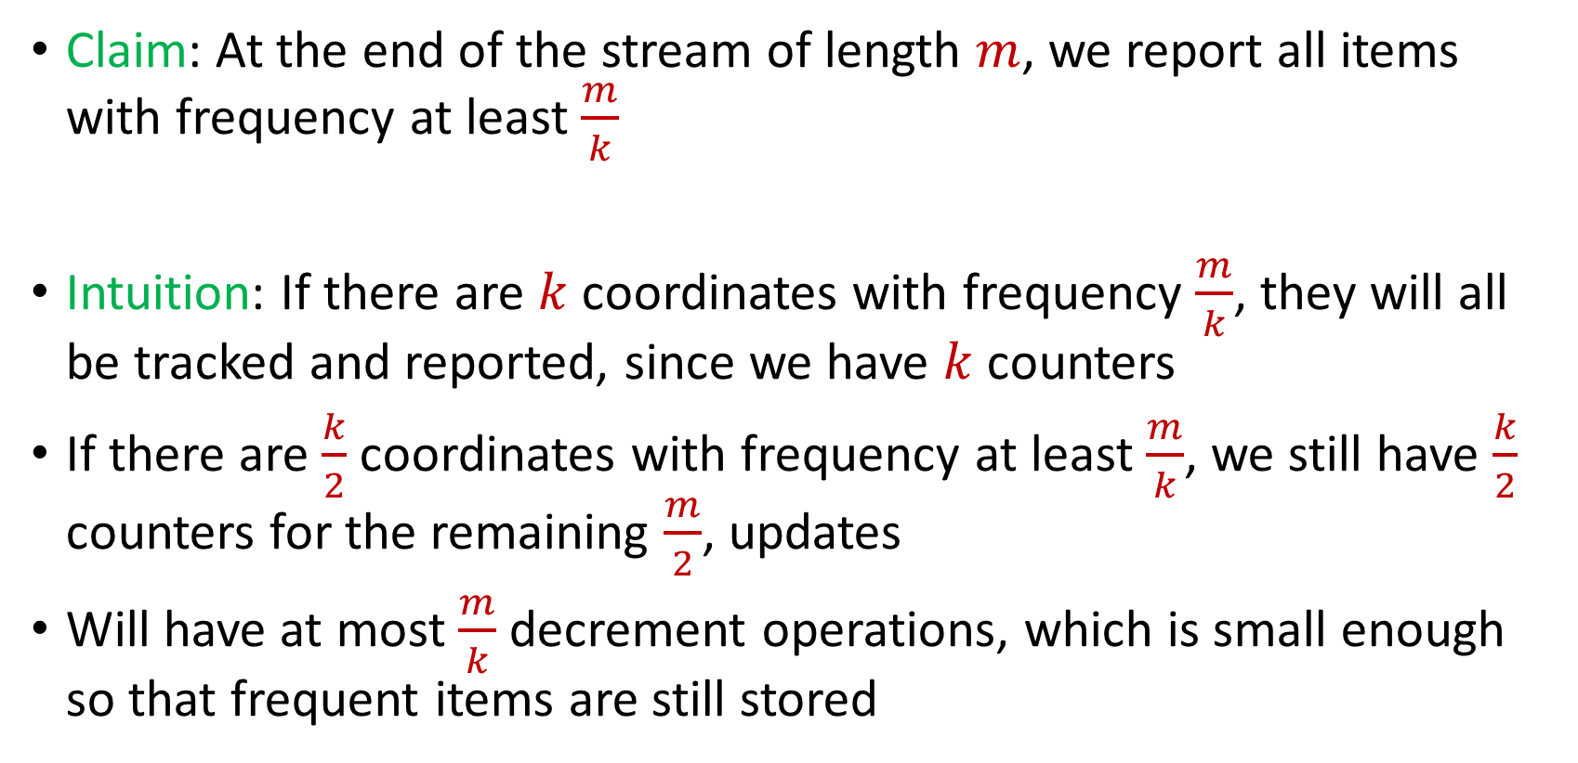
Misra Gries
Claim: At the end of the stream of length $m$, we report all items with frequency at least $\frac{m}{k}$
Intuition: If there are $k$ coordinates with frequency $\frac{m}{k}$, they will all be tracked and reported, since we have $k$counters
If there are $\frac{k}{2}$ coordinates with frequency at least $\frac{m}{k}$, we still have $\frac{k}{2}$ counters for the remaining $\frac{m}{2}$, updates
Will have at most $\frac{m}{k}$ decrement operations, which is small enough so that frequent items are still stored

Slide 94
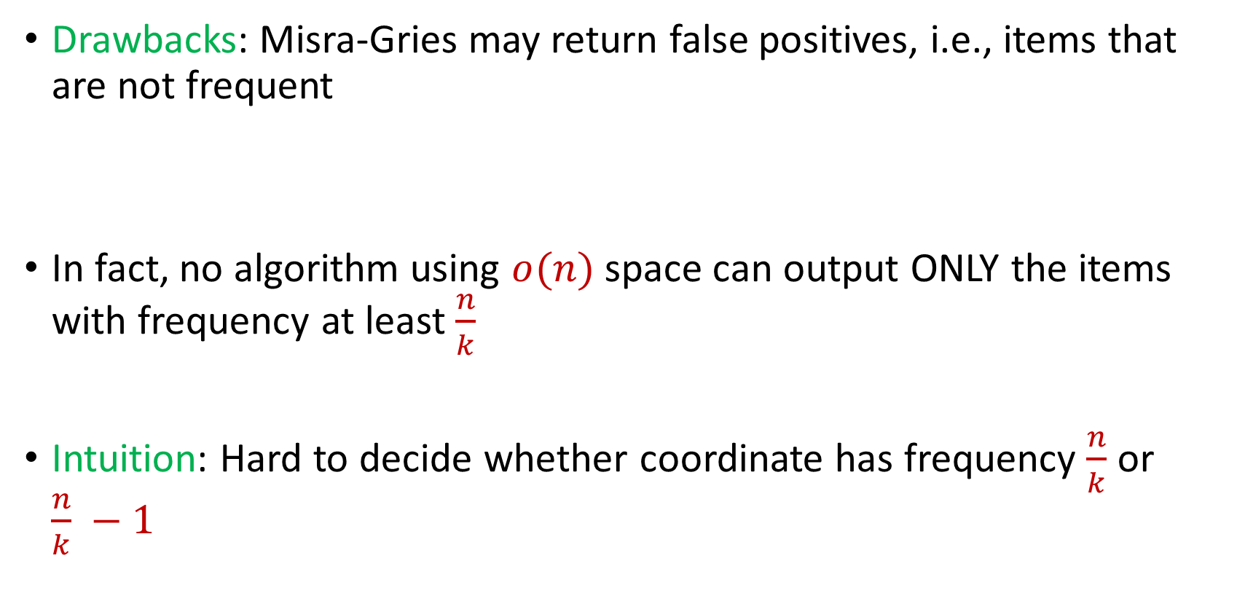
Misra Gries
Drawbacks: Misra-Gries may return false positives, i.e., items that are not frequent
In fact, no algorithm using $o(n)$ space can output ONLY the items with frequency at least $\frac{n}{k}$
Intuition: Hard to decide whether coordinate has frequency $\frac{n}{k}$ or $\frac{n}{k} −1$

Slide 95


Misra Gries
Intuition: Hard to decide whether coordinate has frequency $\frac{n}{k}$ or $\frac{n}{k} −1$
$x_{1}=2$, $x_{2}=5$, $x_{3}=4$, $x_{4}=7$, $x_{5}=1$, $x_{6}=9$, …
$x_{n−\frac{n}{k}+1}=α$, $x_{n−\frac{n}{k}+2}=α$,…, $x_{n}=α$
$\frac{n}{k}−1$ times

Slide 96


$(ε,k)$-Frequent Items Problem
Goal: Given a set $S$ of $m$ elements from $[n]$, an accuracy parameter $ε∈(0, 1)$, and a parameter $k$, output a list that includes:
The items from $[n]$ that have frequency at least $\frac{m}{k}$
No items with frequency less than $\left(1−ε\right)\frac{m}{k}$

Slide 97


Misra Gries for $(ε,k)$-Frequent Items Problem
Initialize $k$ items $V_{1},…,V_{k}$ with count $c_{1},…,c_{k}=0$
For updates $1,…,m$:
If $V_{t}=x_{i}$ for some $t$, increment counter $c_{t}$, i.e., $c_{t}=c_{t}+1$
Else if $c_{t}=0$ for some $t$, set $V_{t}=x_{i}$
Else decrement all counters $c_{j}$, i.e., $c_{j}=c_{j}−1$ for all $j∈[k]$

Slide 98

Misra Gries for $(ε,k)$-Frequent Items Problem
Set $r=\left\lceil \frac{k}{ε}\right\rceil$
Initialize $r$ items $V_{1},…,V_{r}$ with count $c_{1},…,c_{r}=0$
For updates $1,…,m$:
If $V_{t}=x_{i}$ for some $t$, increment counter $c_{t}$, i.e., $c_{t}=c_{t}+1$
Else if $c_{t}=0$ for some $t$, set $V_{t}=x_{i}$
Else decrement all counters $c_{j}$, i.e., $c_{j}=c_{j}−1$ for all $j∈[r]$

Slide 99


Misra Gries for $(ε,k)$-Frequent Items Problem
Claim: For all estimated frequencies $\hat{f_{i}}$ by Misra-Gries, we have
Intuition: Have a lot of counters, so relatively few decrements
$$f_{i}−\frac{εm}{k}≤\hat{f_{i}}≤f_{i}$$

Slide 100
$(ε,k)$-Frequent Items Problem
Goal: Given a set $S$ of $m$ elements from $[n]$, an accuracy parameter $ε∈(0, 1)$, and a parameter $k$, output a list that includes:
The items from $[n]$ that have frequency at least $\frac{m}{k}$
No items with frequency less than $\left(1−ε\right)\frac{m}{k}$

Slide 101

Misra Gries for $(ε,k)$-Frequent Items Problem
Set $r=\left\lceil \frac{k}{ε}\right\rceil$
Initialize $r$ items $V_{1},…,V_{r}$ with count $c_{1},…,c_{r}=0$
For updates $1,…,m$:
If $V_{t}=x_{i}$ for some $t$, increment counter $c_{t}$, i.e., $c_{t}=c_{t}+1$
Else if $c_{t}=0$ for some $t$, set $V_{t}=x_{i}$
Else decrement all counters $c_{j}$, i.e., $c_{j}=c_{j}−1$ for all $j∈[r]$
Output coordinates $V_{t}$ with $c_{t}≥\left(1−ε\right)⋅\frac{m}{k}$

Slide 102

Misra Gries for $(ε,k)$-Frequent Items Problem
Claim: For all estimated frequencies $\hat{f_{i}}$ by Misra-Gries, we have
If $f_{i}≥\frac{m}{k}$, then ${\hat{f_{i}}≥f}_{i}−\frac{εm}{k}$ and if $f_{i}<\left(1−ε\right)⋅\frac{m}{k}$, then ${\hat{f_{i}}<f}_{i}−\frac{εm}{k}$
Returning coordinates $V_{t}$ with $c_{t}≥\left(1−ε\right)⋅\frac{m}{k}$ means:
$i$ with $f_{i}≥\frac{m}{k}$ will be returned
NO $i$ with $f_{i}<\left(1−ε\right)⋅\frac{m}{k}$will be returned
$$f_{i}−\frac{εm}{k}≤\hat{f_{i}}≤f_{i}$$

Slide 103

Misra Gries for $(ε,k)$-Frequent Items Problem
Summary: Misra-Gries can be used to solve the $(ε,k)$-frequent items problem
Misra-Gries uses $O\left(\frac{k}{ε}\log{n}\right)$ bits of space
Misra-Gries is a deterministic algorithm
Misra-Gries always underestimates the true frequency

Slide 104

CountMin
Another algorithm for the $(ε,k)$-frequent items problem
Can be easily parallelized across multiple servers

Slide 105


CountMin
Initalization: Create $b$ buckets of counters and use a random hash function $h:\left[n\right]→[b]$
Algorithm: For each update $x_{i}$, increment the counter $h\left(x_{i}\right)$
At the end of the stream, output the counter $h\left(x_{i}\right)$ as the estimate for $x_{i}$
$c_{1}$ | $c_{2}$ | $c_{3}$ | $c_{4}$
0 | 0 | 0 | 0

Slide 106



CountMin
$f_{1}$ | $f_{2}$ | $f_{3}$ | $f_{4}$ | $f_{5}$ | $f_{6}$ | $f_{7}$
0 | 0 | 0 | 0 | 0 | 0 | 0
$$1$$
$c_{1}$ | $c_{2}$ | $c_{3}$ | $c_{4}$
0 | 0 | 0 | 0

Slide 107


CountMin
$f_{1}$ | $f_{2}$ | $f_{3}$ | $f_{4}$ | $f_{5}$ | $f_{6}$ | $f_{7}$
1 | 0 | 0 | 0 | 0 | 0 | 0
$$1$$
$$h\left(x\right)=3x+2 (mod 4)$$
$c_{1}$ | $c_{2}$ | $c_{3}$ | $c_{4}$
0 | 0 | 0 | 0

Slide 108
CountMin
$f_{1}$ | $f_{2}$ | $f_{3}$ | $f_{4}$ | $f_{5}$ | $f_{6}$ | $f_{7}$
1 | 0 | 0 | 0 | 0 | 0 | 0
$$1$$
$$h\left(x\right)=3x+2 (mod 4)$$
$c_{1}$ | $c_{2}$ | $c_{3}$ | $c_{4}$
0 | 0 | 0 | 0

Slide 109

CountMin
$f_{1}$ | $f_{2}$ | $f_{3}$ | $f_{4}$ | $f_{5}$ | $f_{6}$ | $f_{7}$
1 | 0 | 0 | 0 | 0 | 0 | 0
$$1$$
$$h\left(x\right)=3x+2 (mod 4)$$
$c_{1}$ | $c_{2}$ | $c_{3}$ | $c_{4}$
1 | 0 | 0 | 0

Slide 110

CountMin
$f_{1}$ | $f_{2}$ | $f_{3}$ | $f_{4}$ | $f_{5}$ | $f_{6}$ | $f_{7}$
1 | 0 | 0 | 0 | 0 | 0 | 0
$$3$$
$$h\left(x\right)=3x+2 (mod 4)$$
$c_{1}$ | $c_{2}$ | $c_{3}$ | $c_{4}$
1 | 0 | 0 | 0

Slide 111


CountMin
$f_{1}$ | $f_{2}$ | $f_{3}$ | $f_{4}$ | $f_{5}$ | $f_{6}$ | $f_{7}$
1 | 0 | 1 | 0 | 0 | 0 | 0
$$3$$
$$h\left(x\right)=3x+2 (mod 4)$$
$c_{1}$ | $c_{2}$ | $c_{3}$ | $c_{4}$
1 | 0 | 1 | 0

Slide 112

CountMin
$f_{1}$ | $f_{2}$ | $f_{3}$ | $f_{4}$ | $f_{5}$ | $f_{6}$ | $f_{7}$
1 | 0 | 1 | 0 | 0 | 0 | 0
$$2$$
$$h\left(x\right)=3x+2 (mod 4)$$
$c_{1}$ | $c_{2}$ | $c_{3}$ | $c_{4}$
1 | 0 | 1 | 0

Slide 113


CountMin
$f_{1}$ | $f_{2}$ | $f_{3}$ | $f_{4}$ | $f_{5}$ | $f_{6}$ | $f_{7}$
1 | 1 | 1 | 0 | 0 | 0 | 0
$$2$$
$$h\left(x\right)=3x+2 (mod 4)$$
$c_{1}$ | $c_{2}$ | $c_{3}$ | $c_{4}$
1 | 0 | 1 | 1

Slide 114
CountMin
$f_{1}$ | $f_{2}$ | $f_{3}$ | $f_{4}$ | $f_{5}$ | $f_{6}$ | $f_{7}$
1 | 1 | 1 | 0 | 0 | 0 | 0
$$1$$
$$h\left(x\right)=3x+2 (mod 4)$$
$c_{1}$ | $c_{2}$ | $c_{3}$ | $c_{4}$
1 | 0 | 1 | 1

Slide 115


CountMin
$f_{1}$ | $f_{2}$ | $f_{3}$ | $f_{4}$ | $f_{5}$ | $f_{6}$ | $f_{7}$
2 | 1 | 1 | 0 | 0 | 0 | 0
$$1$$
$$h\left(x\right)=3x+2 (mod 4)$$
$c_{1}$ | $c_{2}$ | $c_{3}$ | $c_{4}$
2 | 0 | 1 | 1

Slide 116

CountMin
$f_{1}$ | $f_{2}$ | $f_{3}$ | $f_{4}$ | $f_{5}$ | $f_{6}$ | $f_{7}$
2 | 1 | 1 | 0 | 0 | 0 | 0
$$5$$
$$h\left(x\right)=3x+2 (mod 4)$$
$c_{1}$ | $c_{2}$ | $c_{3}$ | $c_{4}$
1 | 0 | 1 | 1

Slide 117


CountMin
$f_{1}$ | $f_{2}$ | $f_{3}$ | $f_{4}$ | $f_{5}$ | $f_{6}$ | $f_{7}$
2 | 1 | 1 | 0 | 1 | 0 | 0
$$5$$
$$h\left(x\right)=3x+2 (mod 4)$$
$c_{1}$ | $c_{2}$ | $c_{3}$ | $c_{4}$
3 | 0 | 1 | 1

Slide 118

CountMin
$f_{1}$ | $f_{2}$ | $f_{3}$ | $f_{4}$ | $f_{5}$ | $f_{6}$ | $f_{7}$
2 | 1 | 1 | 0 | 1 | 0 | 0
What is the estimation for $f_{4}$?
What about $f_{3}$?
What about $f_{5}$? What about $f_{1}$?
$$h\left(x\right)=3x+2 (mod 4)$$
$c_{1}$ | $c_{2}$ | $c_{3}$ | $c_{4}$
3 | 0 | 1 | 1

Slide 119

CountMin
Given a set $S$ of $m$ elements from $[n]$, let $\hat{f_{i}}$ be the estimated frequency for $f_{i}$
Claim: We always have $\hat{f_{i}}≥f_{i}$
Suppose $h\left(i\right)=a$ so that $c_{a}=\hat{f_{i}}$
Note that $c_{a}$counts the number $f_{j}$of occurrences of any $j$ with $h\left(j\right)=a=h(i)$, including $f_{i}$ itself

Slide 120

CountMin
Suppose $h\left(i\right)=a$ so that $c_{a}=\hat{f_{i}}$
Note that $c_{a}$counts the number $f_{j}$of occurrences of any $j$ with $h\left(j\right)=a=h(i)$, including $f_{i}$ itself
$c_{a}=\sum_{j:h\left(j\right)=a}{f_{a}}≥f_{i}$ since $h\left(i\right)=a$
$c_{a}=f_{i}+\sum_{j≠i, with j:h\left(j\right)=a}{f_{j}}$

Slide 121

CountMin Error Analysis
$c_{a}=f_{i}+\sum_{j≠i, with j:h\left(j\right)=a}{f_{j}}$
$E\left[\sum_{j≠i, with j:h\left(j\right)=a}{f_{j}}\right]=\sum_{j≠i}{E\left[f_{j}⋅I_{h\left(j\right)=h(i)}\right]}$
$E\left[\sum_{j≠i, with j:h\left(j\right)=a}{f_{j}}\right]=\sum_{j≠i}{E\left[I_{h\left(j\right)=h(i)}\right]⋅f_{j}}$
$E\left[\sum_{j≠i, with j:h\left(j\right)=a}{f_{j}}\right]=\sum_{j≠i}{{Pr\left[h\left(j\right)=h(i)\right]⋅f}_{j}}$
$E\left[\sum_{j≠i, with j:h\left(j\right)=a}{f_{j}}\right]=\sum_{j≠i}{{\frac{1}{b}⋅f}_{j}=\frac{m}{b}}$
Set $b=\frac{3k}{ε}$, then the expected error is at most $\frac{εm}{3k}$

Slide 122


Heavy-Hitters (Frequent Items)
Given a set $S$ of $m$ elements from $[n]$, let $f_{i}$ be the frequency of element $i$. (How often it appears)
Let $L_{2}$ be the norm of the frequency vector:
Goal: Given a set $S$ of $m$ elements from $[n]$ and a threshold $ε$, output the elements $i$ such that $f_{i}>$ $ε L_{2}$...and no elements $j$ such that $f_{j}<$ $\frac{ε}{16} L_{2}$
Motivation: DDoS prevention, iceberg queries
$$L_{2}=\sqrt{f_{1}^{2}+f_{2}^{2}+…+f_{n}^{2}}$$

Slide 123



Frequency Moments ($L_{p}$ Norm)
Given a set $S$ of $m$ elements from $[n]$, let $f_{i}$ be the frequency of element $i$. (How often it appears)
Let $F_{p}$ be the frequency moment of the vector:
Goal: Given a set $S$ of $m$ elements from $[n]$ and an accuracy parameter $ε$, output a $(1+ε)$-approximation to $F_{p}$
Motivation: Entropy estimation, linear regression
$F_{p}=$ $f_{1}^{p}+f_{2}^{p}+…+f_{n}^{p}$

Slide 124


Distinct Elements ($F_{0}$ Estimation)
Given a set $S$ of $m$ elements from $[n]$, let $f_{i}$ be the frequency of element $i$. (How often it appears)
Let $F_{0}$ be the frequency moment of the vector:
Goal: Given a set $S$ of $m$ elements from $[n]$ and an accuracy parameter $ε$, output a $(1+ε)$-approximation to $F_{0}$
Motivation: Traffic monitoring
$F_{0}=$ $|\{i :f_{i}≠0\}|$

