Slide 1
CSCE 658: Randomized Algorithms
Lecture 5
Samson Zhou

Slide 2
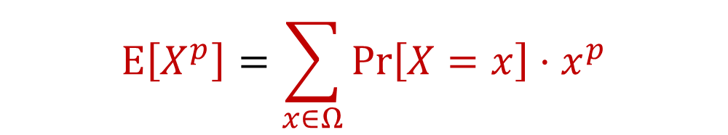

Recall: Moments
For $p>0$, the $p$-th moment of a random variable $X$ over $Ω$ is:
$$E\left[X^{p}\right]=\sum_{x∈Ω}{Pr\left[X=x\right]⋅x^{p}}$$

Slide 3

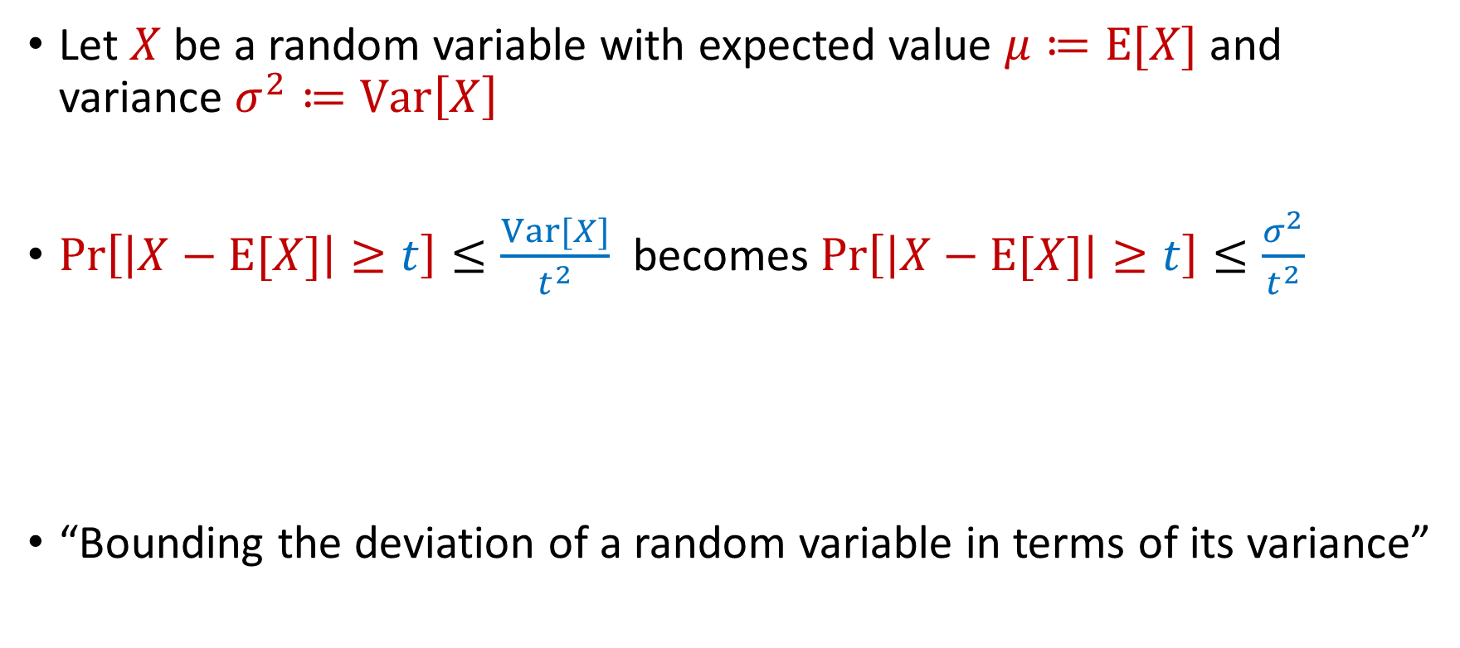
Last Time: Chebyshev’s Inequality
Let $X$ be a random variable with expected value $μ≔E[X]$ and variance $σ^{2}≔Var\left[X\right]$
$Pr\left[\left|X−E[X]\right|≥t\right]≤\frac{Var[X]}{t^{2}}$ becomes $Pr\left[\left|X−E[X]\right|≥t\right]≤\frac{σ^{2}}{t^{2}}$
“Bounding the deviation of a random variable in terms of its variance”
$$Pr\left[\left|X−μ\right|≥kσ\right]≤\frac{1}{k^{2}}$$

Slide 4
Last Time: Accuracy Boosting
Algorithmic consequence of Law of Large Numbers
To improve the accuracy of your algorithm, run it many times independently and take the average

Slide 5
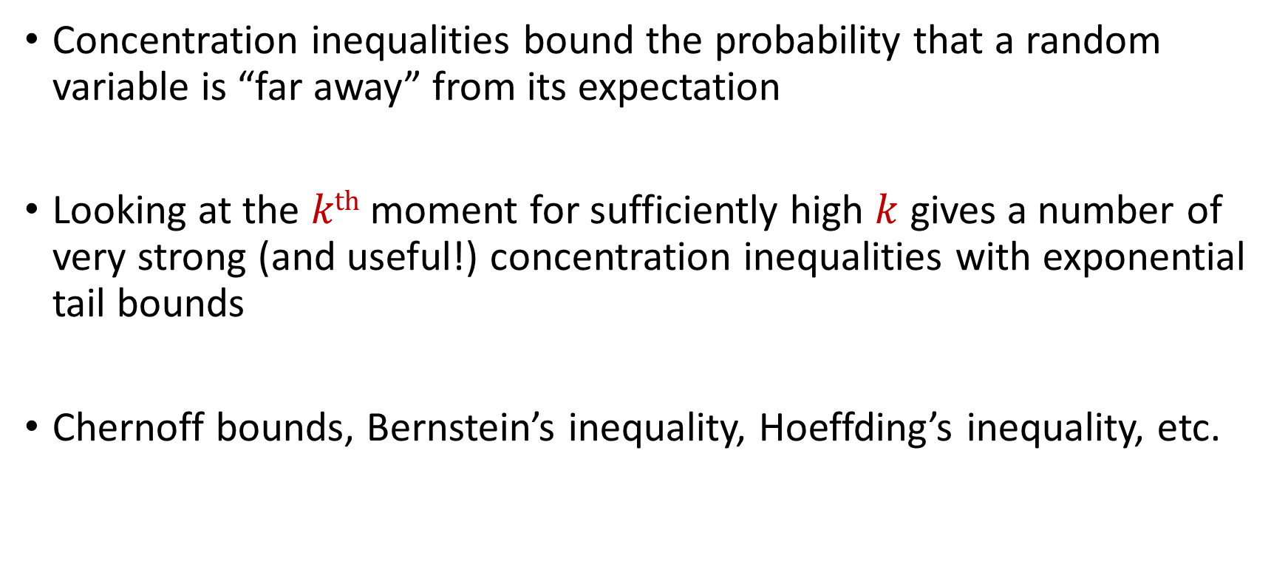
Recall: Concentration Inequalities
Concentration inequalities bound the probability that a random variable is “far away” from its expectation
Looking at the $kth$ moment for sufficiently high $k$ gives a number of very strong (and useful!) concentration inequalities with exponential tail bounds
Chernoff bounds, Bernstein’s inequality, Hoeffding’s inequality, etc.

Slide 6
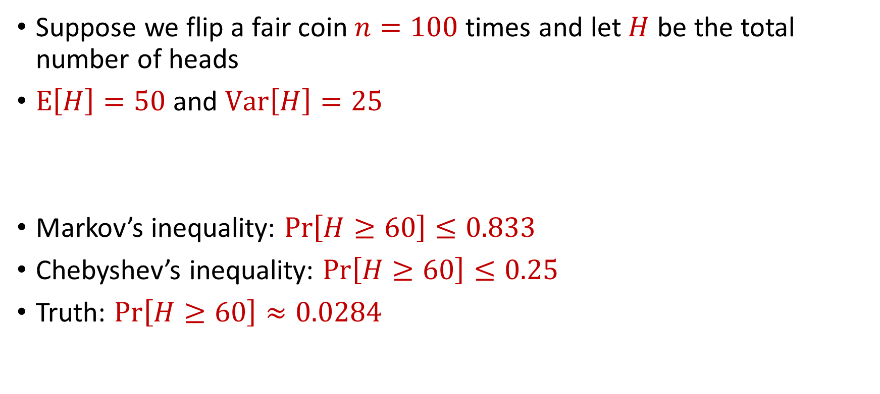
Limitations
Suppose we flip a fair coin $n=100$ times and let $H$ be the total number of heads
$E\left[H\right]=50$ and $Var\left[H\right]=25$
Markov’s inequality: $Pr\left[H≥60\right]≤0.833$
Chebyshev’s inequality: $Pr\left[H≥60\right]≤0.25$
Truth: $Pr\left[H≥60\right]≈0.0284$

Slide 7
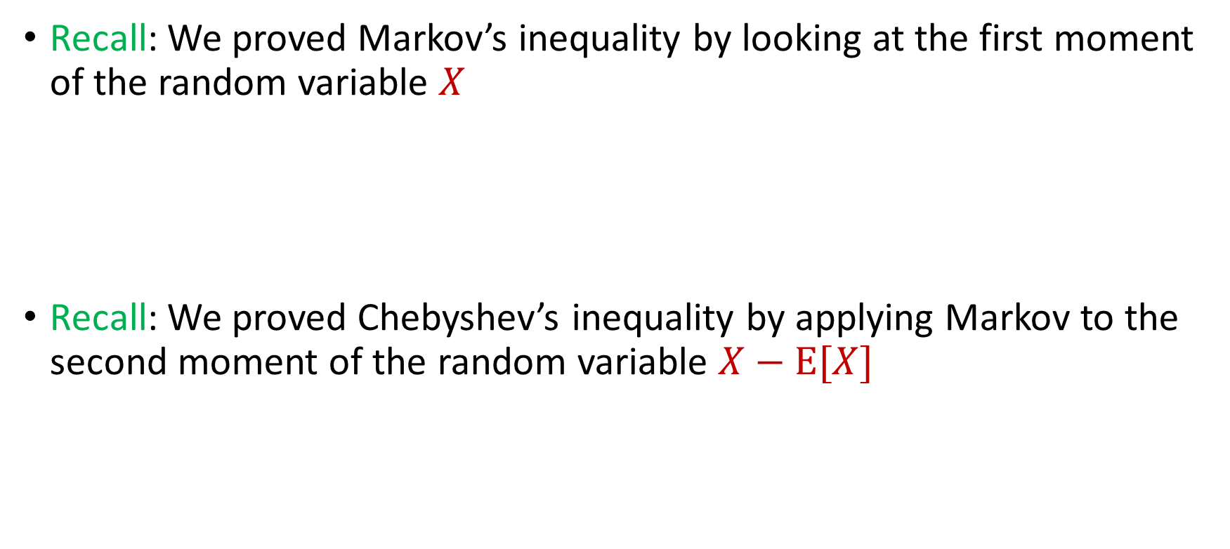

Intuition for Previous Inequalities
Recall: We proved Markov’s inequality by looking at the first moment of the random variable $X$
Recall: We proved Chebyshev’s inequality by applying Markov to the second moment of the random variable $X−E[X]$
$$Pr\left[X≥t⋅E[X]\right]≤\frac{1}{t}$$
$$Pr\left[\left|X−E[X]\right|≥t\right]=Pr\left[{\left|X−E\left[X\right]\right|}^{2}≥t^{2}\right]≤\frac{Var[X]}{t^{2}}$$

Slide 8
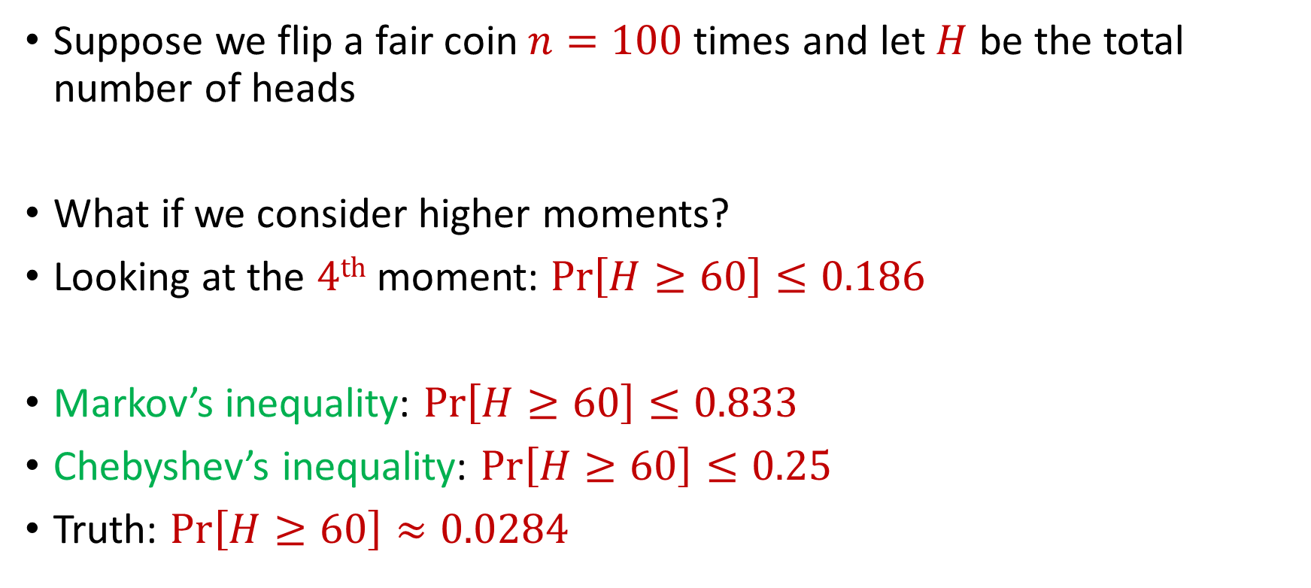
Generalizations
Suppose we flip a fair coin $n=100$ times and let $H$ be the total number of heads
What if we consider higher moments?
Looking at the $4th$ moment: $Pr\left[H≥60\right]≤0.186$
Markov’s inequality: $Pr\left[H≥60\right]≤0.833$
Chebyshev’s inequality: $Pr\left[H≥60\right]≤0.25$
Truth: $Pr\left[H≥60\right]≈0.0284$

Slide 9
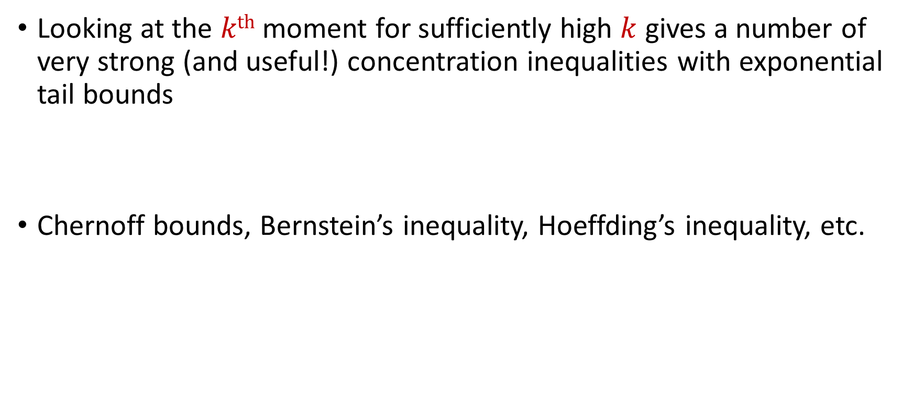
Concentration Inequalities
Looking at the $kth$ moment for sufficiently high $k$ gives a number of very strong (and useful!) concentration inequalities with exponential tail bounds
Chernoff bounds, Bernstein’s inequality, Hoeffding’s inequality, etc.

Slide 10
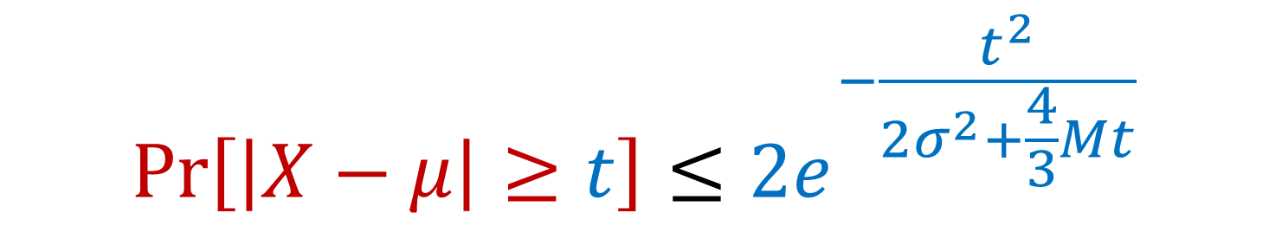

Bernstein’s Inequality
Bernstein’s inequality: Let $X_{1},…,X_{n}∈[−M,M]$ be independent random variables and let ${X=X}_{1}+…+X_{n}$ have mean $μ$ and variance $σ^{2}$. Then for any $t≥0$:
$$Pr\left[\left|X−μ\right|≥t\right]≤2e^{−\frac{t^{2}}{2σ^{2}+\frac{4}{3}Mt}}$$

Slide 11


Bernstein’s Inequality
Bernstein’s inequality: Let $X_{1},…,X_{n}∈[−M,M]$ be independent random variables and let ${X=X}_{1}+…+X_{n}$ have mean $μ$ and variance $σ^{2}$. Then for any $t≥0$:
Example: Suppose $M=1$ and let $t=kσ$. Then
$$Pr\left[\left|X−μ\right|≥t\right]≤2e^{−\frac{t^{2}}{2σ^{2}+\frac{4}{3}Mt}}$$
$$Pr\left[\left|X−μ\right|≥kσ\right]≤2exp\left(−\frac{k^{2}}{4}\right)$$

Slide 12



Bernstein’s Inequality
Suppose $M=1$ and let $t=kσ$. Then
Compare to Chebyshev’s inequality:
Exponential improvement!
$$Pr\left[\left|X−μ\right|≥kσ\right]≤2exp\left(−\frac{k^{2}}{4}\right)$$
$$Pr\left[\left|X−μ\right|≥kσ\right]≤\frac{1}{k^{2}}$$

Slide 13
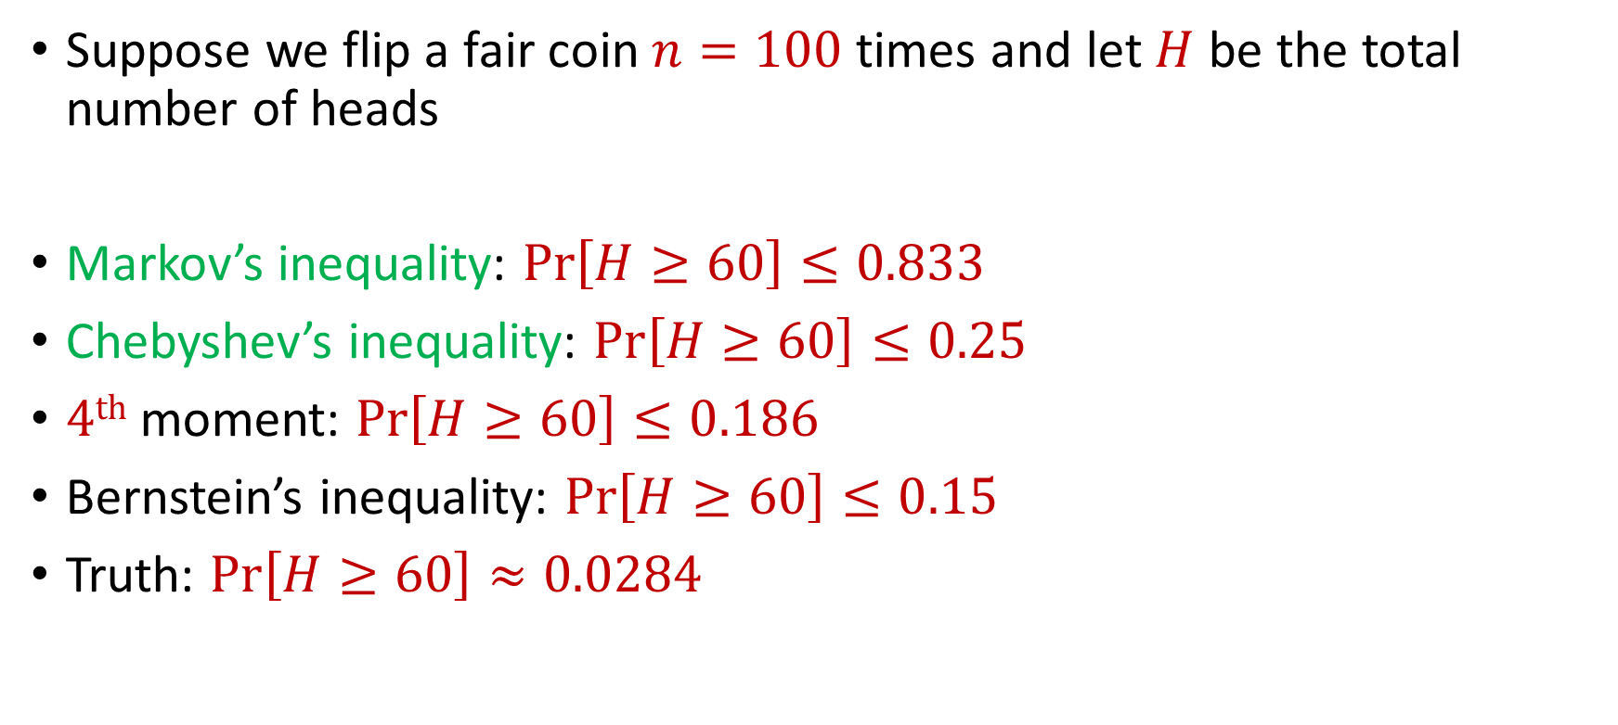
Bernstein’s Inequality
Suppose we flip a fair coin $n=100$ times and let $H$ be the total number of heads
Markov’s inequality: $Pr\left[H≥60\right]≤0.833$
Chebyshev’s inequality: $Pr\left[H≥60\right]≤0.25$
$4th$ moment: $Pr\left[H≥60\right]≤0.186$
Bernstein’s inequality: $Pr\left[H≥60\right]≤0.15$
Truth: $Pr\left[H≥60\right]≈0.0284$

Slide 14
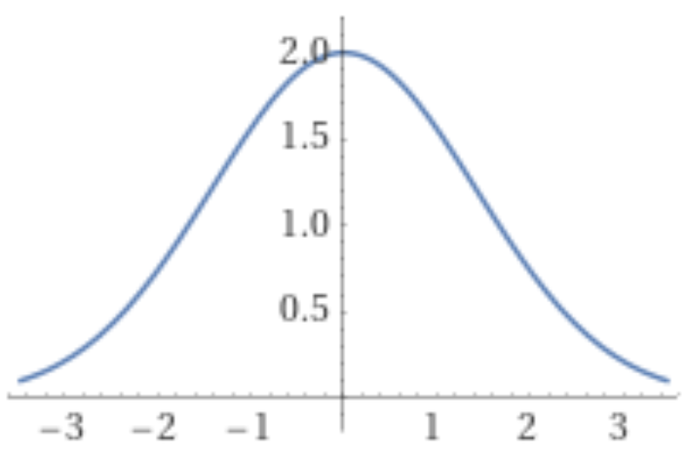
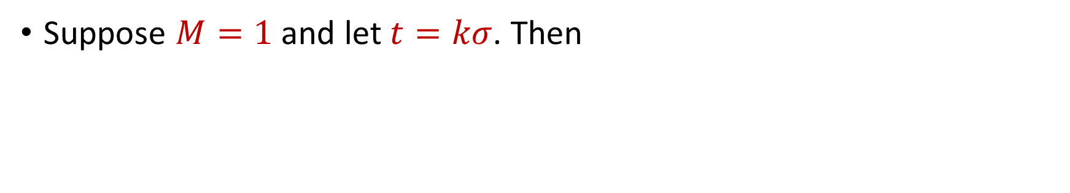
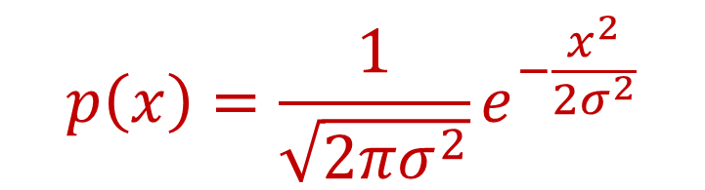
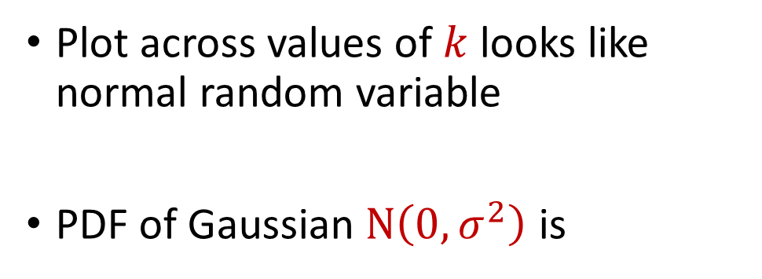
Bernstein’s Inequality
Suppose $M=1$ and let $t=kσ$. Then
$$Pr\left[\left|X−μ\right|≥kσ\right]≤2exp\left(−\frac{k^{2}}{4}\right)$$
Plot across values of $k$ looks like normal random variable
PDF of Gaussian $N\left(0,σ^{2}\right)$ is
$$p\left(x\right)=\frac{1}{\sqrt{2πσ^{2}}}e^{−\frac{x^{2}}{2σ^{2}}}$$

Slide 15
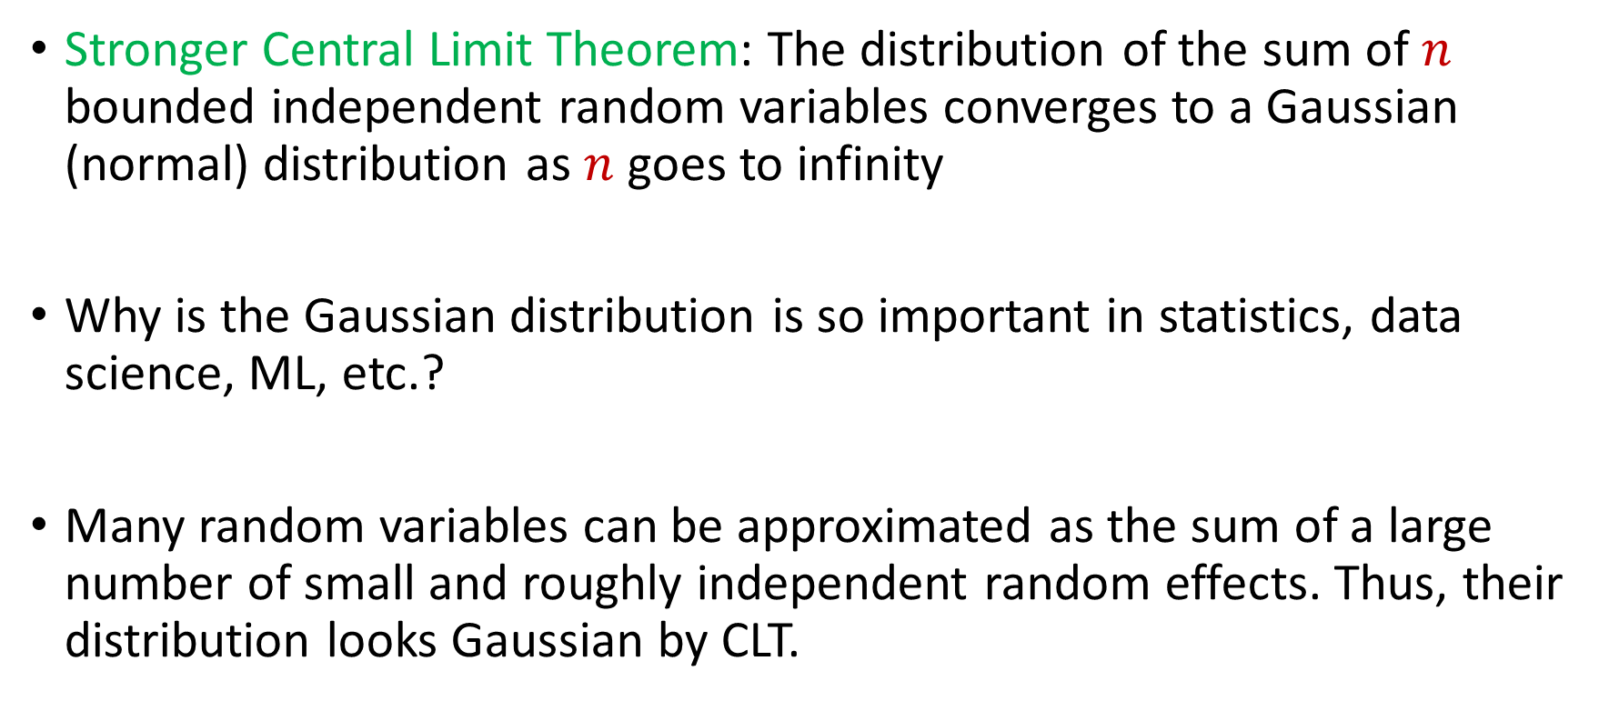
Central Limit Theorem
Stronger Central Limit Theorem: The distribution of the sum of $n$ bounded independent random variables converges to a Gaussian (normal) distribution as $n$ goes to infinity
Why is the Gaussian distribution is so important in statistics, data science, ML, etc.?
Many random variables can be approximated as the sum of a large number of small and roughly independent random effects. Thus, their distribution looks Gaussian by CLT.

Slide 16
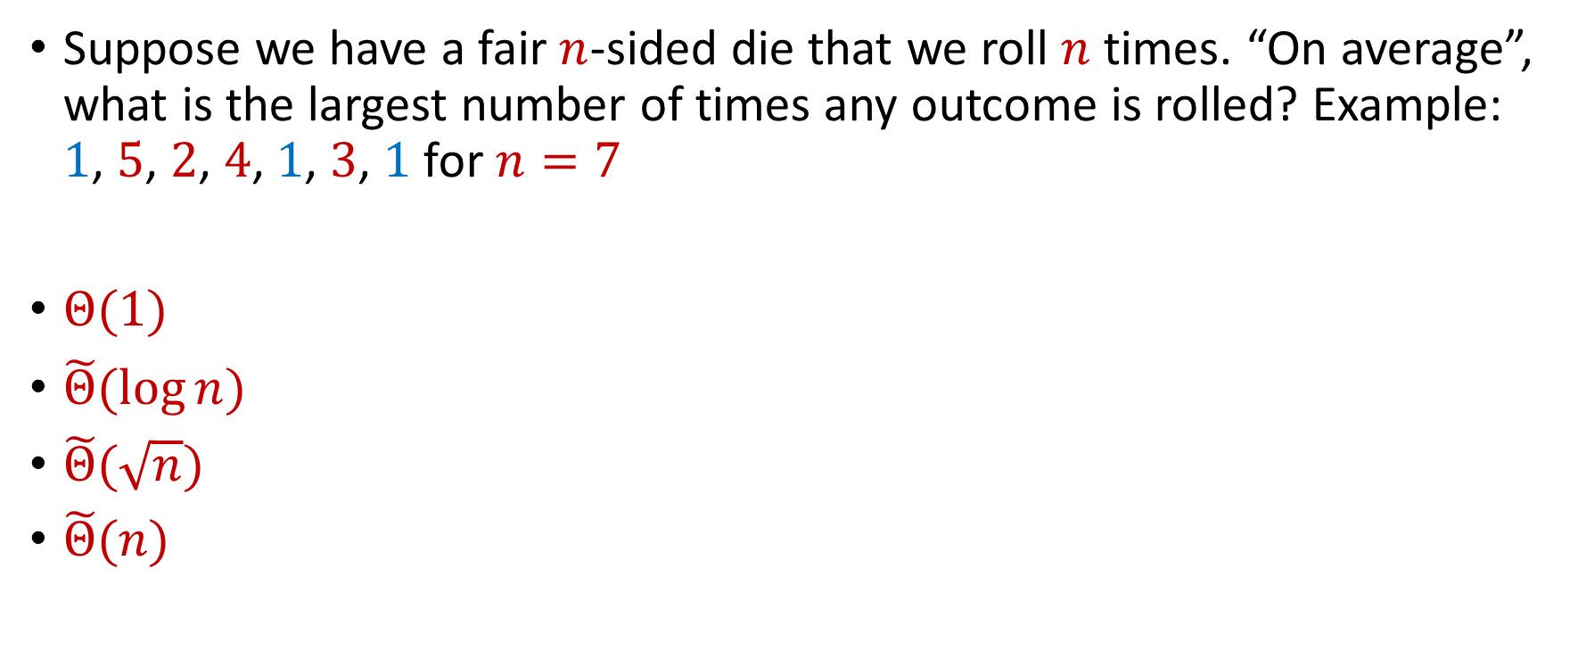
Trivia Question #3 (Max Load)
Suppose we have a fair $n$-sided die that we roll $n$ times. “On average”, what is the largest number of times any outcome is rolled? Example: $1$, $5$, $2$, $4$, $1$, $3$, $1$ for $n=7$
$Θ(1)$
$\tilde{Θ}(\log{n})$
$\tilde{Θ}(\sqrt{n})$
$\tilde{Θ}(n)$

Slide 17
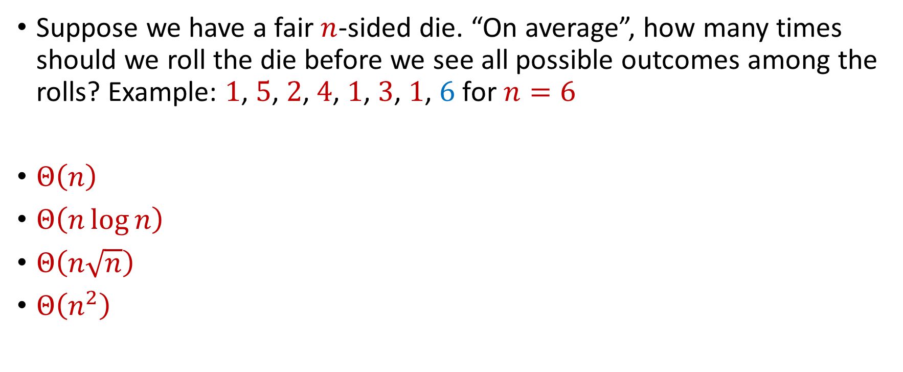
Trivia Question #4 (Coupon Collector)
Suppose we have a fair $n$-sided die. “On average”, how many times should we roll the die before we see all possible outcomes among the rolls? Example: $1$, $5$, $2$, $4$, $1$, $3$, $1$, $6$ for $n=6$
$Θ\left(n\right)$
$Θ\left(n\log{n}\right)$
$Θ\left(n\sqrt{n}\right)$
$Θ\left(n^{2}\right)$

Slide 18


Chernoff Bounds
Useful variant of Bernstein’s inequality when the random variables are binary
Chernoff bounds: Let $X_{1},…,X_{n}∈\{0, 1\}$ be independent random variables and let ${X=X}_{1}+…+X_{n}$ have mean $μ$. Then for any $δ≥0$:
$$Pr\left[\left|X−μ\right|≥δμ\right]≤2\exp\left(−\frac{δ^{2}μ}{2+δ}\right)$$

Slide 19




Multiplicative Error Chernoff Bounds
Chernoff bounds: Let $X_{1},…,X_{n}∈\{0, 1\}$ be independent random variables and let ${X=X}_{1}+…+X_{n}$ have mean $μ$. For $δ∈\left(0,1\right)$:
$$Pr\left[X≥\left(1+δ\right)μ\right]≤2\exp\left(−\frac{δ^{2}μ}{2+δ}\right)$$
$$Pr\left[X≤\left(1−δ\right)μ\right]≤\exp\left(−\frac{δ^{2}μ}{2}\right)$$
$$Pr\left[\left|X−μ\right|≥δμ\right]≤2\exp\left(−\frac{δ^{2}μ}{3}\right)$$

Slide 20
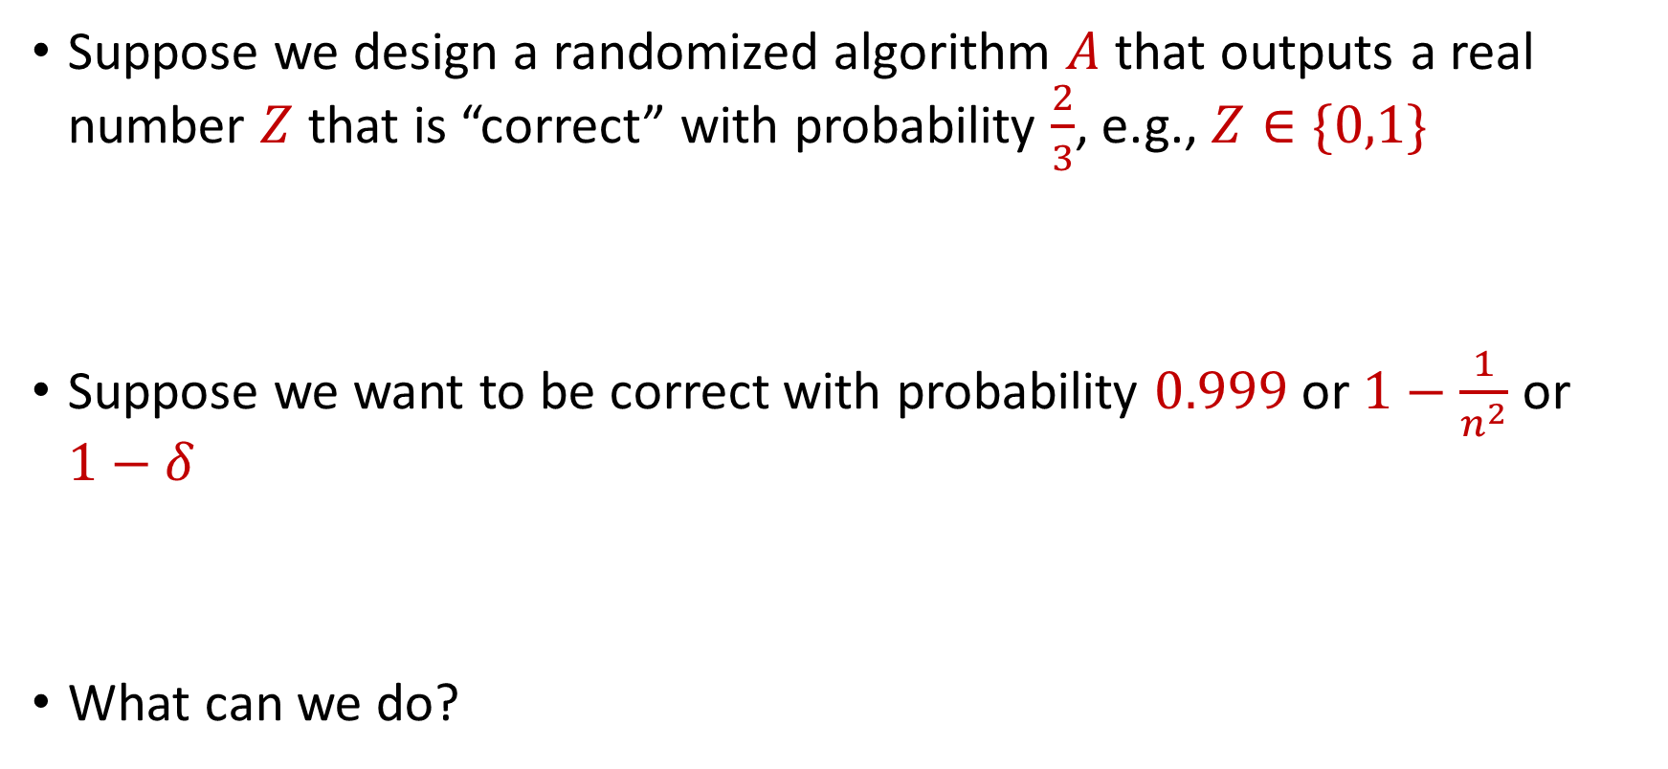
Use Case
Suppose we design a randomized algorithm $A$ that outputs a real number $Z$ that is “correct” with probability $\frac{2}{3}$, e.g., $Z∈\{0,1\}$
Suppose we want to be correct with probability $0.999$ or $1−\frac{1}{n^{2}}$ or $1−δ$
What can we do?

Slide 21

Success Boosting
Chernoff bounds: Run the algorithm $A$ a total of $O\left(\log{\frac{1}{δ}}\right)$ times and take the median. It will be correct with probability $1−δ$

Slide 22

Median-of-Means Framework
Suppose we design a randomized algorithm $A$ to estimate a hidden statistic $Θ$ of a dataset and we know $0<Θ≤1000$.
Suppose each time we use the algorithm $A$, it outputs a number $X$ such that $E\left[X\right]=Θ$ and $Var\left[X\right]=100Θ^{2}$
Suppose we want to estimate $Θ$ to accuracy $ε$, with probability $1−δ$

Slide 23
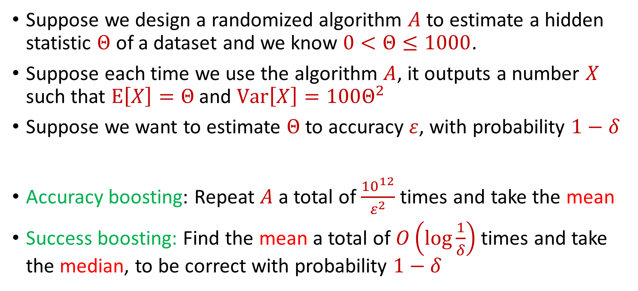
Median-of-Means Framework
Suppose we design a randomized algorithm $A$ to estimate a hidden statistic $Θ$ of a dataset and we know $0<Θ≤1000$.
Suppose each time we use the algorithm $A$, it outputs a number $X$ such that $E\left[X\right]=Θ$ and $Var\left[X\right]=100Θ^{2}$
Suppose we want to estimate $Θ$ to accuracy $ε$, with probability $1−δ$
Accuracy boosting: Repeat $A$ a total of $\frac{{10}^{12}}{ε^{2}}$ times and take the mean
Success boosting: Find the mean a total of $O\left(\log{\frac{1}{δ}}\right)$ times and take the median, to be correct with probability $1−δ$

Slide 24
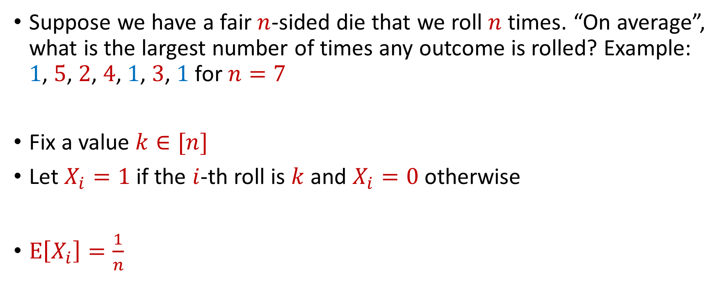
Max Load
Suppose we have a fair $n$-sided die that we roll $n$ times. “On average”, what is the largest number of times any outcome is rolled? Example: $1$, $5$, $2$, $4$, $1$, $3$, $1$ for $n=7$
Fix a value $k∈[n]$
Let $X_{i}=1$ if the $i$-th roll is $k$ and $X_{i}=0$ otherwise
$E\left[X_{i}\right]=\frac{1}{n}$

Slide 25


Max Load
The total number of rolls with value $k$ is $X=X_{1}+…+X_{n}$
$E\left[X\right]=1$
Recall Chernoff bounds:
$Pr\left[X≥3 log{n}\right]≤\frac{1}{n^{2}}$
$$Pr\left[X≥\left(1+δ\right)μ\right]≤2\exp\left(−\frac{δ^{2}μ}{2+δ}\right)$$

Slide 26
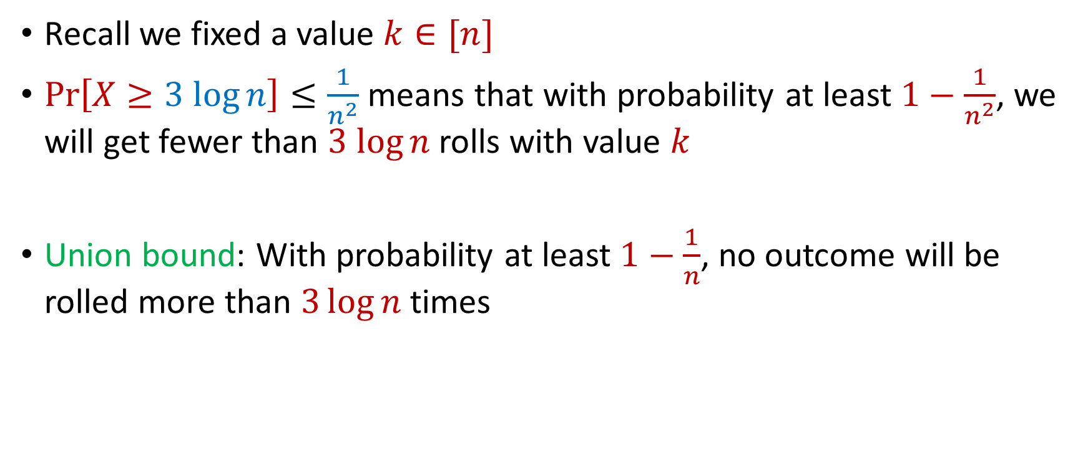
Max Load
Recall we fixed a value $k∈[n]$
$Pr\left[X≥3 log{n}\right]≤\frac{1}{n^{2}}$ means that with probability at least $1−\frac{1}{n^{2}}$, we will get fewer than $3 log{n}$ rolls with value $k$
Union bound: With probability at least $1−\frac{1}{n}$, no outcome will be rolled more than $3\log{n}$ times

Slide 27
Trivia Question #3 (Max Load)
Suppose we have a fair $n$-sided die that we roll $n$ times. “On average”, what is the largest number of times any outcome is rolled? Example: $1$, $5$, $2$, $4$, $1$, $3$, $1$ for $n=7$
$Θ(1)$
$\tilde{Θ}(\log{n})$
$\tilde{Θ}(\sqrt{n})$
$\tilde{Θ}(n)$

Slide 28
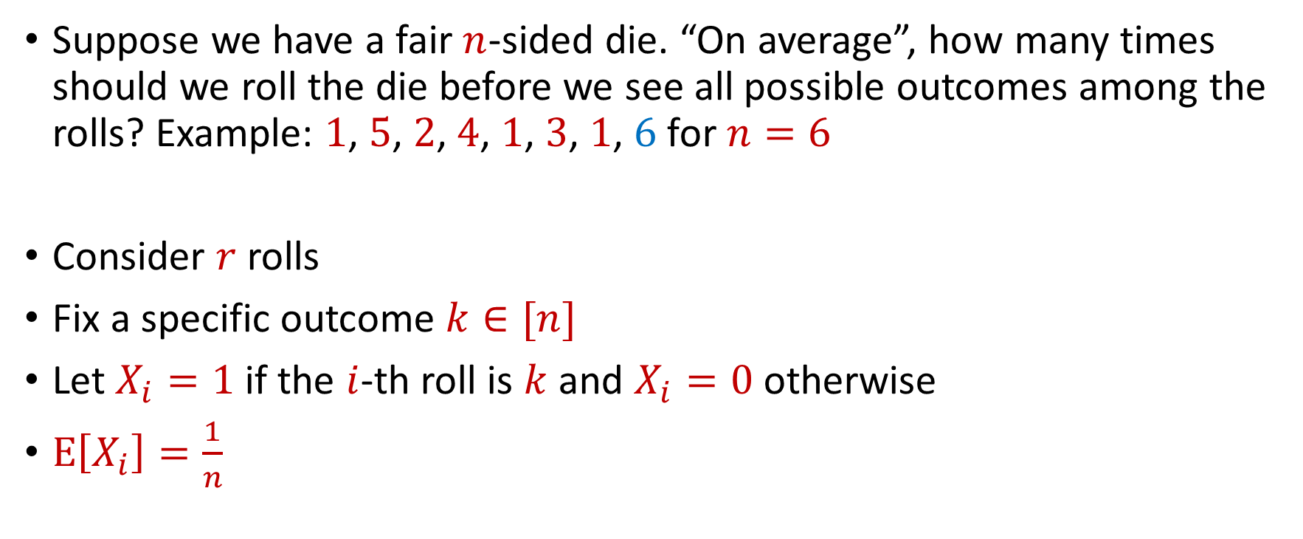
Coupon Collector
Suppose we have a fair $n$-sided die. “On average”, how many times should we roll the die before we see all possible outcomes among the rolls? Example: $1$, $5$, $2$, $4$, $1$, $3$, $1$, $6$ for $n=6$
Consider $r$ rolls
Fix a specific outcome $k∈[n]$
Let $X_{i}=1$ if the $i$-th roll is $k$ and $X_{i}=0$ otherwise
$E\left[X_{i}\right]=\frac{1}{n}$

Slide 29


Coupon Collector
The total number of rolls with value $k$ is $X=X_{1}+…+X_{r}$
$E\left[X\right]=\frac{r}{n}=6\log{n}$ for $r=6n\log{n}$
Recall Chernoff bounds:
$Pr\left[X≤\log{n}\right]≤\frac{1}{n^{2}}$
$$Pr\left[X≤\left(1−δ\right)μ\right]≤\exp\left(−\frac{δ^{2}μ}{2}\right)$$

Slide 30
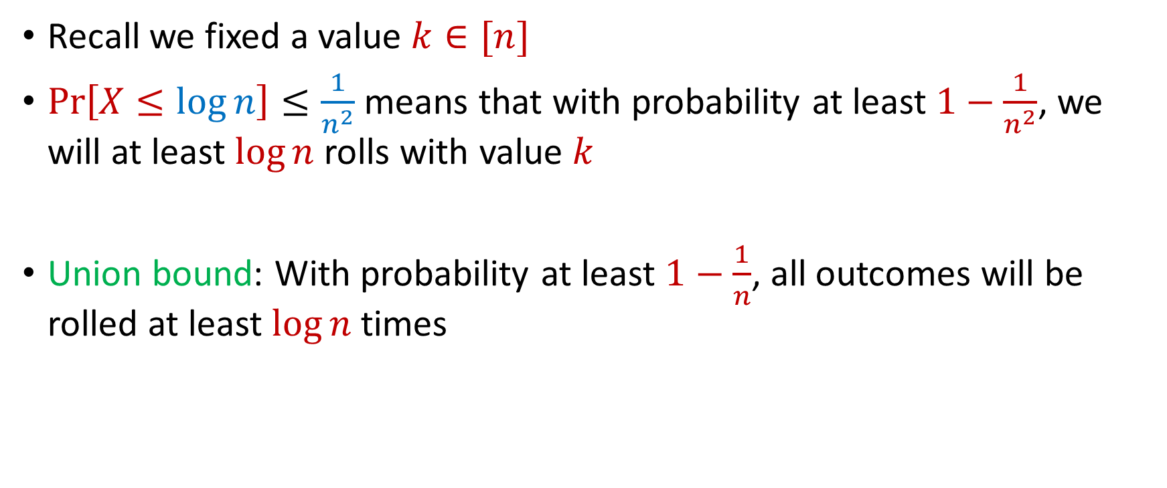
Coupon Collector
Recall we fixed a value $k∈[n]$
$Pr\left[X≤\log{n}\right]≤\frac{1}{n^{2}}$ means that with probability at least $1−\frac{1}{n^{2}}$, we will at least $\log{n}$ rolls with value $k$
Union bound: With probability at least $1−\frac{1}{n}$, all outcomes will be rolled at least $\log{n}$ times

Slide 31
Trivia Question #4 (Coupon Collector)
Suppose we have a fair $n$-sided die. “On average”, how many times should we roll the die before we see all possible outcomes among the rolls? Example: $1$, $5$, $2$, $4$, $1$, $3$, $1$, $6$ for $n=6$
$Θ\left(n\right)$
$Θ\left(n\log{n}\right)$
$Θ\left(n\sqrt{n}\right)$
$Θ\left(n^{2}\right)$

