Slide 1
CSCE 689: Special Topics in Modern Algorithms for Data Science
Lecture 2
Samson Zhou

Slide 2
Last Time: Class Logistics
Course materials: https://samsonzhou.github.io/csce689-2023
LaTeX summary of lectures 20%
Midterm presentation 35%
Final project 45%

Slide 3
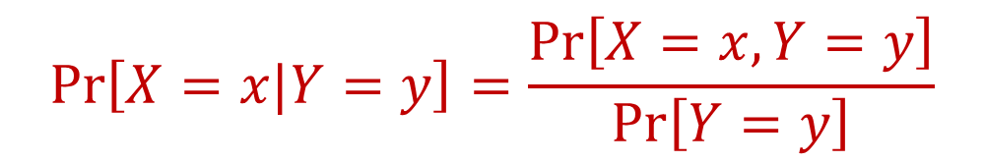
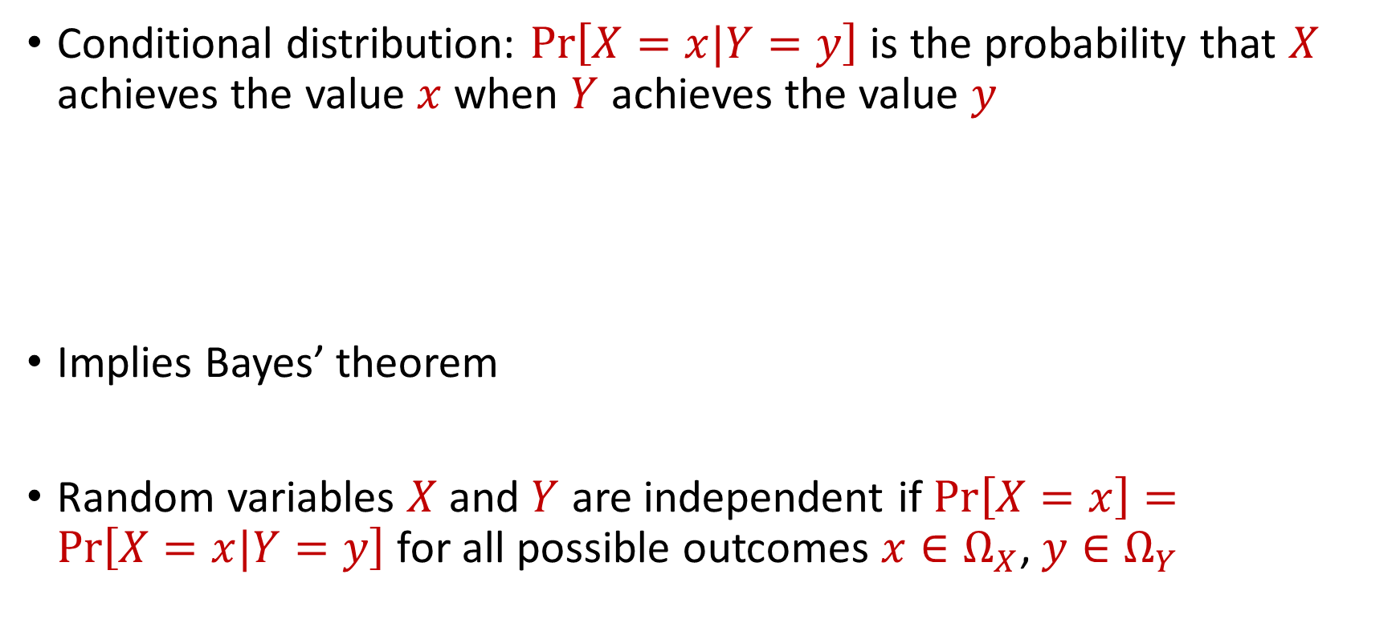
Last Time: Probability Basics
Conditional distribution: $Pr\left[X=x|Y=y\right]$ is the probability that $X$ achieves the value $x$when $Y$ achieves the value $y$
Implies Bayes’ theorem
Random variables $X$ and $Y$ are independent if $Pr\left[X=x\right]=Pr\left[X=x|Y=y\right]$ for all possible outcomes $x∈Ω_{X}$, $y∈Ω_{Y}$
$$Pr\left[X=x|Y=y\right]=\frac{Pr\left[X=x, Y=y\right]}{Pr\left[Y=y\right]}$$

Slide 4
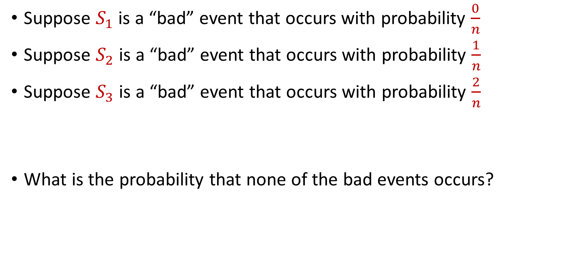
Warm-Up Question
Suppose $S_{1}$ is a “bad” event that occurs with probability $\frac{0}{n}$
Suppose $S_{2}$ is a “bad” event that occurs with probability $\frac{1}{n}$
Suppose $S_{3}$ is a “bad” event that occurs with probability $\frac{2}{n}$
What is the probability that none of the bad events occurs?

Slide 5
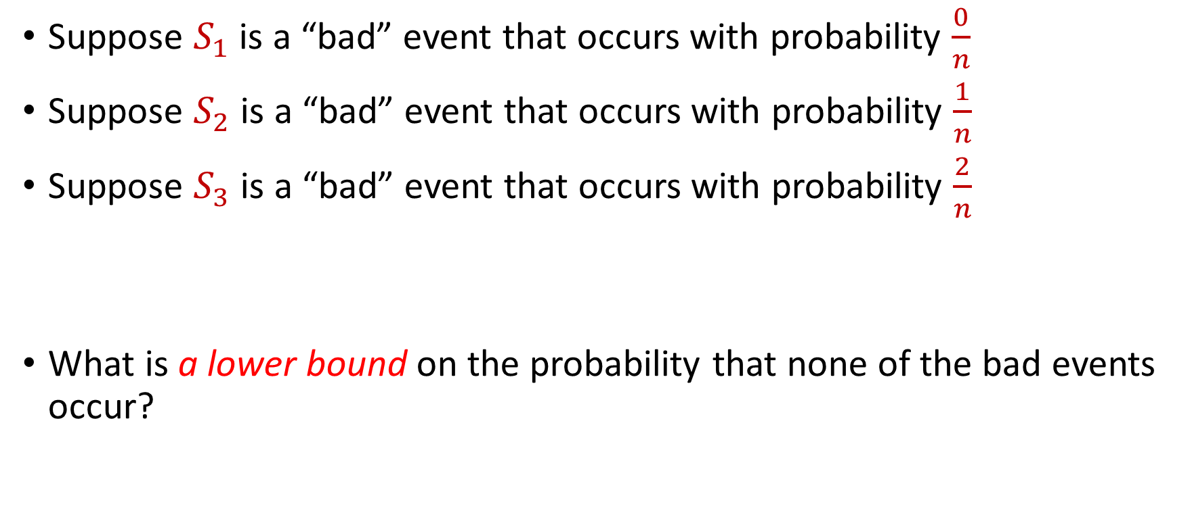
Warm-Up Question
Suppose $S_{1}$ is a “bad” event that occurs with probability $\frac{0}{n}$
Suppose $S_{2}$ is a “bad” event that occurs with probability $\frac{1}{n}$
Suppose $S_{3}$ is a “bad” event that occurs with probability $\frac{2}{n}$
What is a lower bound on the probability that none of the bad events occur?

Slide 6
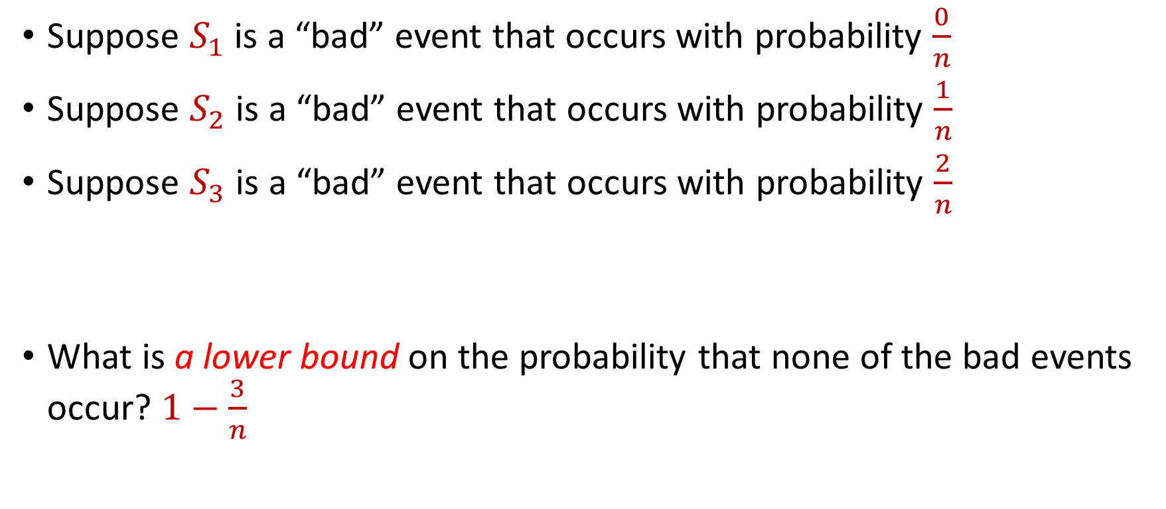
Warm-Up Question
Suppose $S_{1}$ is a “bad” event that occurs with probability $\frac{0}{n}$
Suppose $S_{2}$ is a “bad” event that occurs with probability $\frac{1}{n}$
Suppose $S_{3}$ is a “bad” event that occurs with probability $\frac{2}{n}$
What is a lower bound on the probability that none of the bad events occur? $1−\frac{3}{n}$

Slide 7
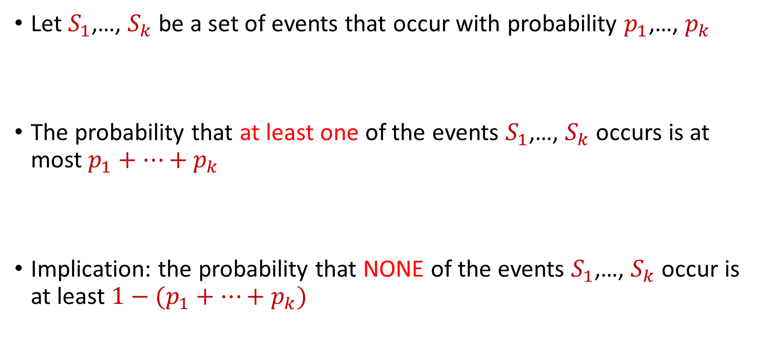
Last Time: Union Bound (Boole’s Inequality)
Let $S_{1}$,…, $S_{k}$ be a set of events that occur with probability $p_{1}$,…, $p_{k}$
The probability that at least one of the events $S_{1}$,…, $S_{k}$ occurs is at most $p_{1}+…+p_{k}$
Implication: the probability that NONE of the events $S_{1}$,…, $S_{k}$ occur is at least $1−(p_{1}+…+p_{k})$

Slide 8



Last Time: Union Bound
$Pr\left[A∪B\right]=Pr\left[A\right]+Pr\left[B\right]−Pr\left[A∩B\right]$
Proof by induction
$$A$$
$$B$$
$$A∩B$$

Slide 9
Today
Hashing
Abstraction: balls-in-bins
Birthday paradox

Slide 10
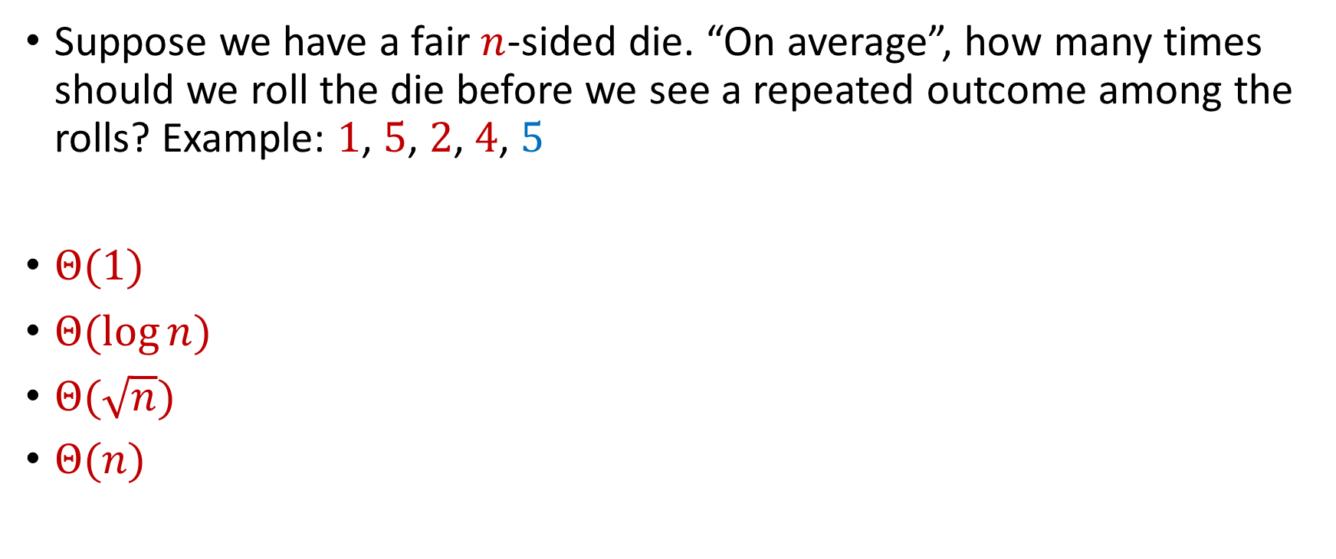
Trivia Question #1 (Birthday Paradox)
Suppose we have a fair $n$-sided die. “On average”, how many times should we roll the die before we see a repeated outcome among the rolls? Example: $1$, $5$, $2$, $4$, $5$
$Θ(1)$
$Θ(\log{n})$
$Θ(\sqrt{n})$
$Θ(n)$
Notes:
0, 1, 3, 6

Slide 11

Trivia Question #2 (Limits)
Let $c>0$ be a constant. What is $\lim_{n→∞}{\left(1−\frac{c}{n}\right)}^{n}$?
$0$
$\frac{1}{c}$
$\frac{1}{2c}$
$\frac{1}{e^{c}}$
$1$

Slide 12
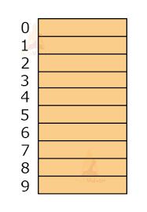
Hashing
Suppose we have a number of files, how do we consistently store them in memory?

Slide 13
Hashing
Suppose we have a number of files, how do we consistently store them in memory?
Anmol Anand
Zhitong Chen
Lipai Huang
Ryan King
Ayesha Qamar
Shima Salehi

Slide 14
Hashing
Suppose we have a number of files, how do we consistently store them in memory?
Anmol Anand
Zhitong Chen
Lipai Huang
Ryan King
Ayesha Qamar
Shima Salehi

Slide 15


Hashing
Suppose we have a number of files, how do we consistently store them in memory?
Anmol Anand
Zhitong Chen
Lipai Huang
Ryan King
Ayesha Qamar
Shima Salehi

Slide 16
Hashing
Suppose we have a number of files, how do we consistently store them in memory?
Goal: Fast query time

Slide 17

Hashing
Suppose we have a number of files, how do we consistently store them in memory?
$$h\left(x\right)$$
Anmol Anand
Zhitong Chen
Lipai Huang
Ryan King
Ayesha Qamar
Shima Salehi

Slide 18
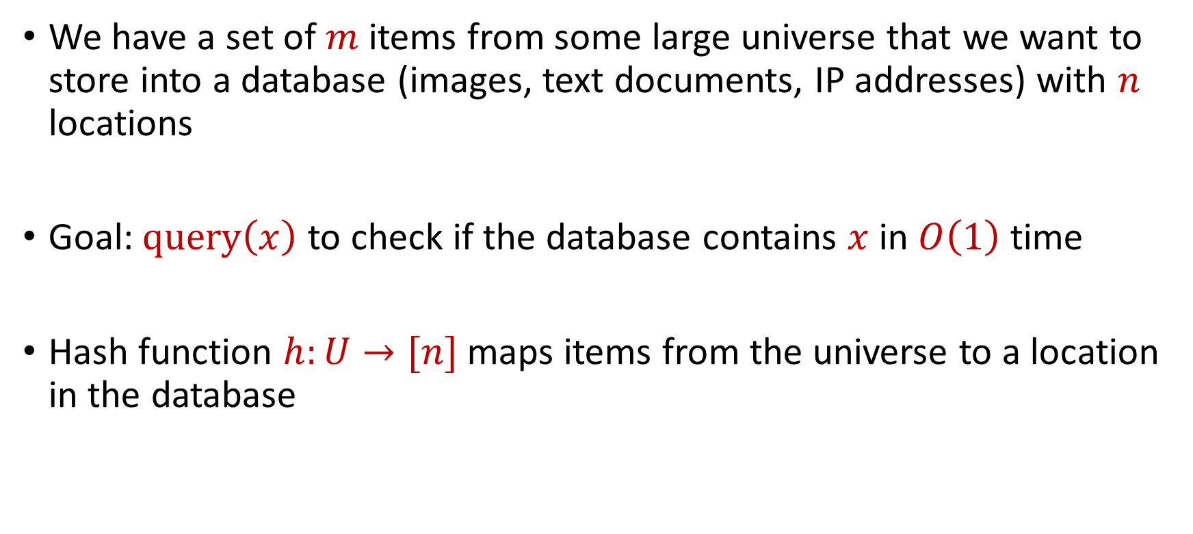
Hash Tables
We have a set of $m$ items from some large universe that we want to store into a database (images, text documents, IP addresses) with $n$ locations
Goal: $query\left(x\right)$ to check if the database contains $x$ in $O\left(1\right)$ time
Hash function $h:U→[n]$ maps items from the universe to a location in the database

Slide 19
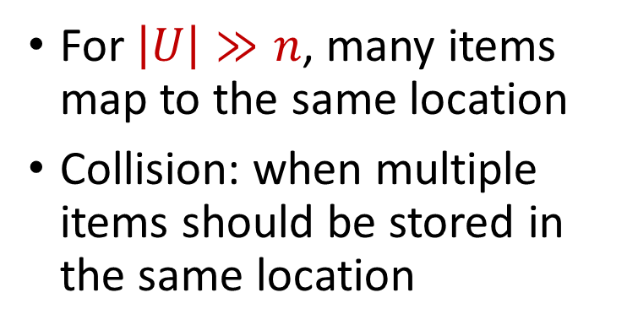


Collisions
Hash function $h:U→[n]$ maps items from the universe to a location in the database
$$h\left(x\right)$$
For $\left|U\right|≫n$, many items map to the same location
Collision: when multiple items should be stored in the same location
Anmol Anand
Zhitong Chen
Lipai Huang
Ryan King
Ayesha Qamar
Shima Salehi

Slide 20
Dealing with Collisions
Many ways of dealing with collisions
Store multiple items in the same location as a linked list
Bump item to the next available spot
Bump item to the next available spot using another hash function
Power-of-two-choices

Slide 21
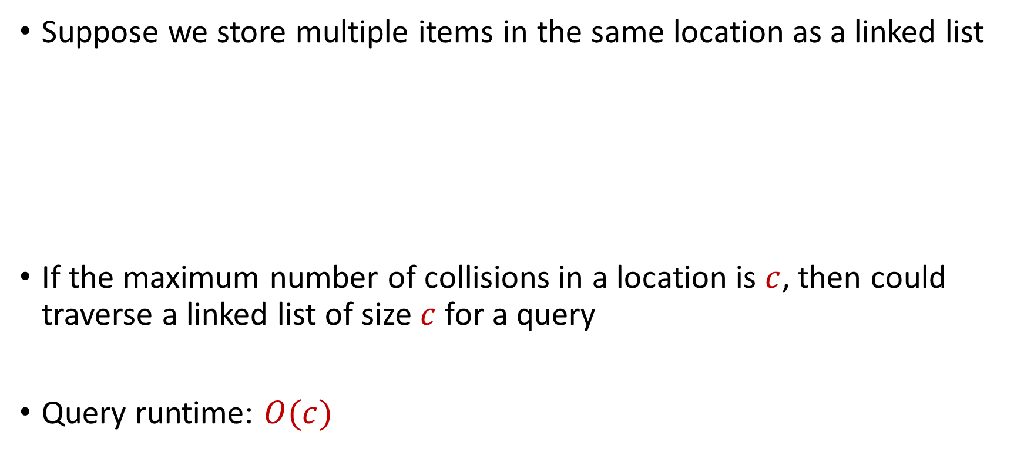

Dealing with Collisions
Suppose we store multiple items in the same location as a linked list
If the maximum number of collisions in a location is $c$, then could traverse a linked list of size $c$ for a query
Query runtime: $O(c)$
$$h(Ryan King)$$
$$Zhitong Chen$$
Ryan King

Slide 22
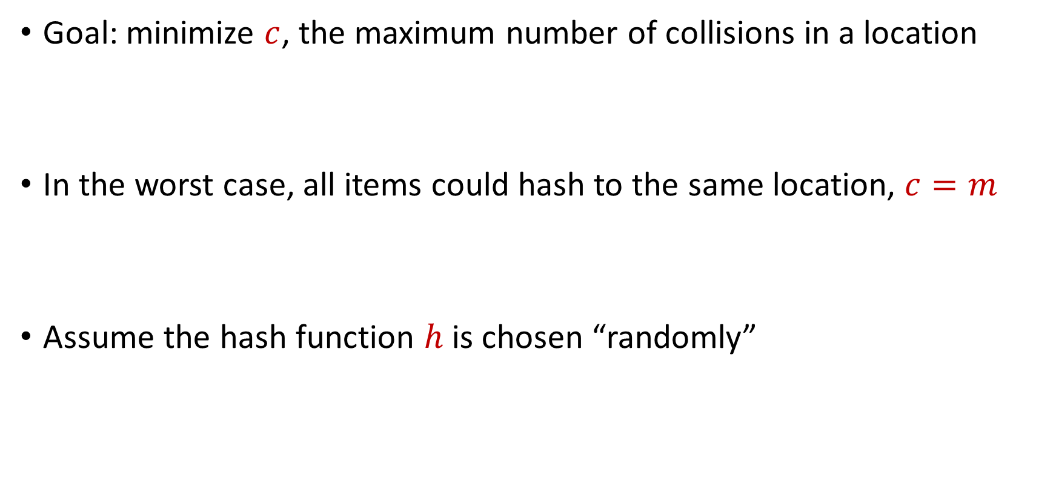
Dealing with Collisions
Goal: minimize $c$, the maximum number of collisions in a location
In the worst case, all items could hash to the same location, $c=m$
Assume the hash function $h$ is chosen “randomly”

Slide 23
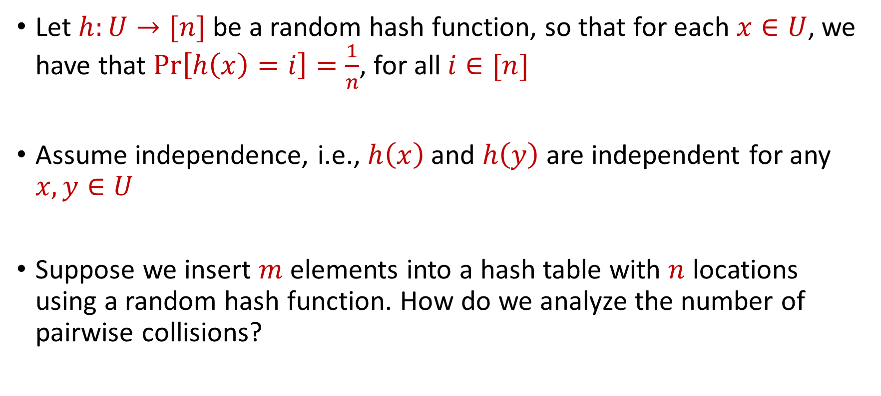
Random Hash Function
Let $h:U→[n]$ be a random hash function, so that for each $x∈U$, we have that $Pr\left[h\left(x\right)=i\right]=\frac{1}{n}$, for all $i∈[n]$
Assume independence, i.e., $h\left(x\right)$ and $h\left(y\right)$ are independent for any $x,y∈U$
Suppose we insert $m$ elements into a hash table with $n$ locations using a random hash function. How do we analyze the number of pairwise collisions?

Slide 24

Birthday Paradox
Suppose we have a room with $367$ people. What is the probability that two people share the same birthday?

Slide 25
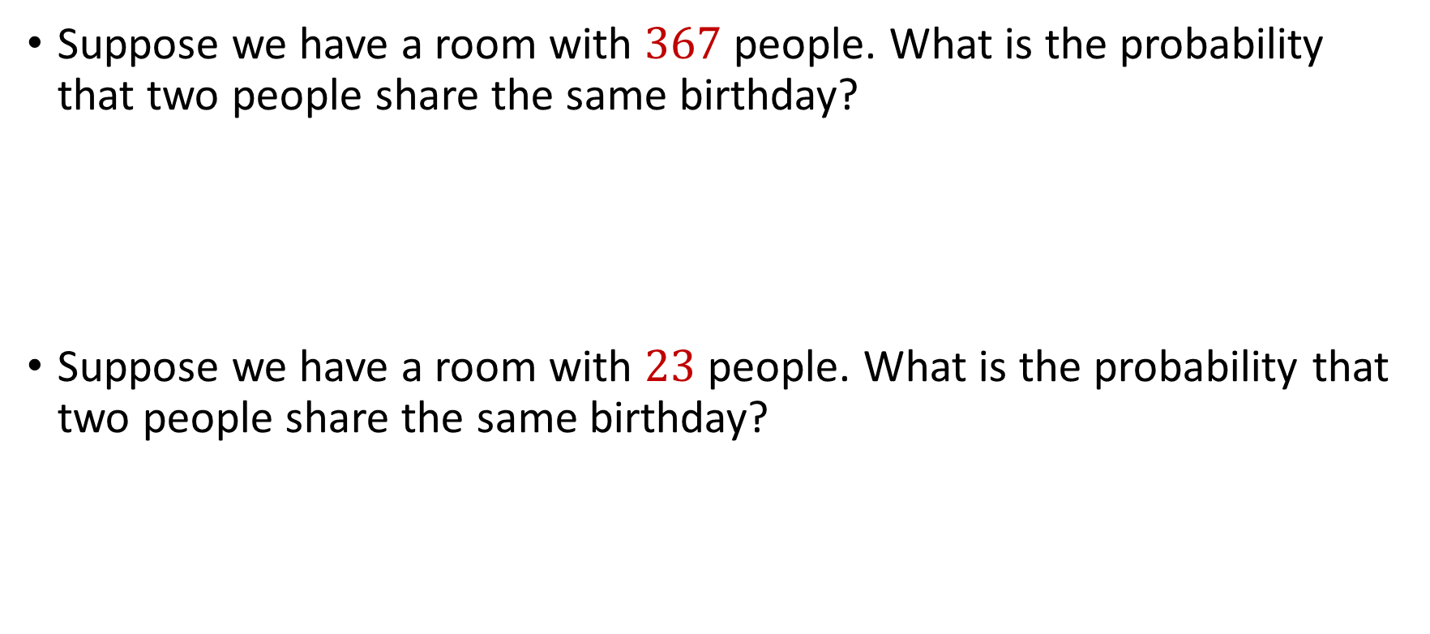
Birthday Paradox
Suppose we have a room with $367$ people. What is the probability that two people share the same birthday?
Suppose we have a room with $23$ people. What is the probability that two people share the same birthday?

Slide 26

Birthday Paradox
Suppose we have a fair $n$-sided die that we roll $k=1\text{,} 2\text{, }3\text{, }4\text{,}\text{...}$ times. What is the probability we see a repeated outcome among the rolls?

Slide 27

Birthday Paradox
Suppose we have a fair $n$-sided die that we roll $k=1\text{,} 2\text{, }3\text{, }4\text{,}\text{...}$ times. What is the probability we see a repeated outcome among the rolls?
$$\left(1−\frac{0}{n}\right)$$

Slide 28

Birthday Paradox
Suppose we have a fair $n$-sided die that we roll $k=1\text{,} 2\text{, }3\text{, }4\text{,}\text{...}$ times. What is the probability we see a repeated outcome among the rolls?
$$\left(1−\frac{0}{n}\right)\left(1−\frac{1}{n}\right)$$

Slide 29
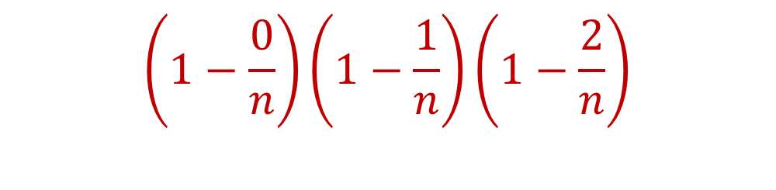
Birthday Paradox
Suppose we have a fair $n$-sided die that we roll $k=1\text{,} 2\text{, }3\text{, }4\text{,}\text{...}$ times. What is the probability we see a repeated outcome among the rolls?
$$\left(1−\frac{0}{n}\right)\left(1−\frac{1}{n}\right)\left(1−\frac{2}{n}\right)$$

Slide 30
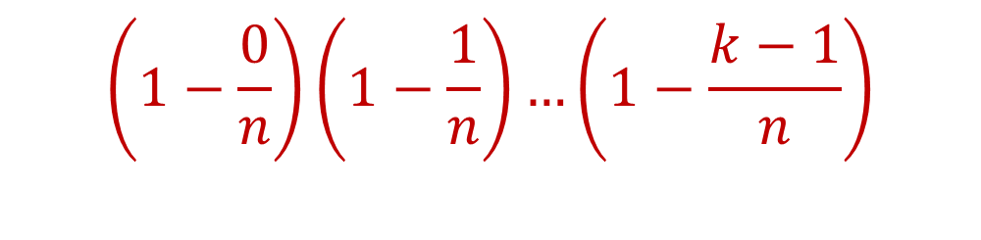
Birthday Paradox
Suppose we have a fair $n$-sided die that we roll $k=1\text{,} 2\text{, }3\text{, }4\text{,}\text{...}$ times. What is the probability we see a repeated outcome among the rolls?
$$\left(1−\frac{0}{n}\right)\left(1−\frac{1}{n}\right)…\left(1−\frac{k−1}{n}\right)$$

Slide 31
Birthday Paradox
Suppose we have a fair $n$-sided die that we roll $k=1\text{,} 2\text{, }3\text{, }4\text{,}\text{...}$ times. What is the probability we see a repeated outcome among the rolls?
$\left(1−\frac{0}{n}\right)\left(1−\frac{1}{n}\right)…\left(1−\frac{k−1}{n}\right)<\frac{1}{2}$ for $k=O(\sqrt{n})$

Slide 32
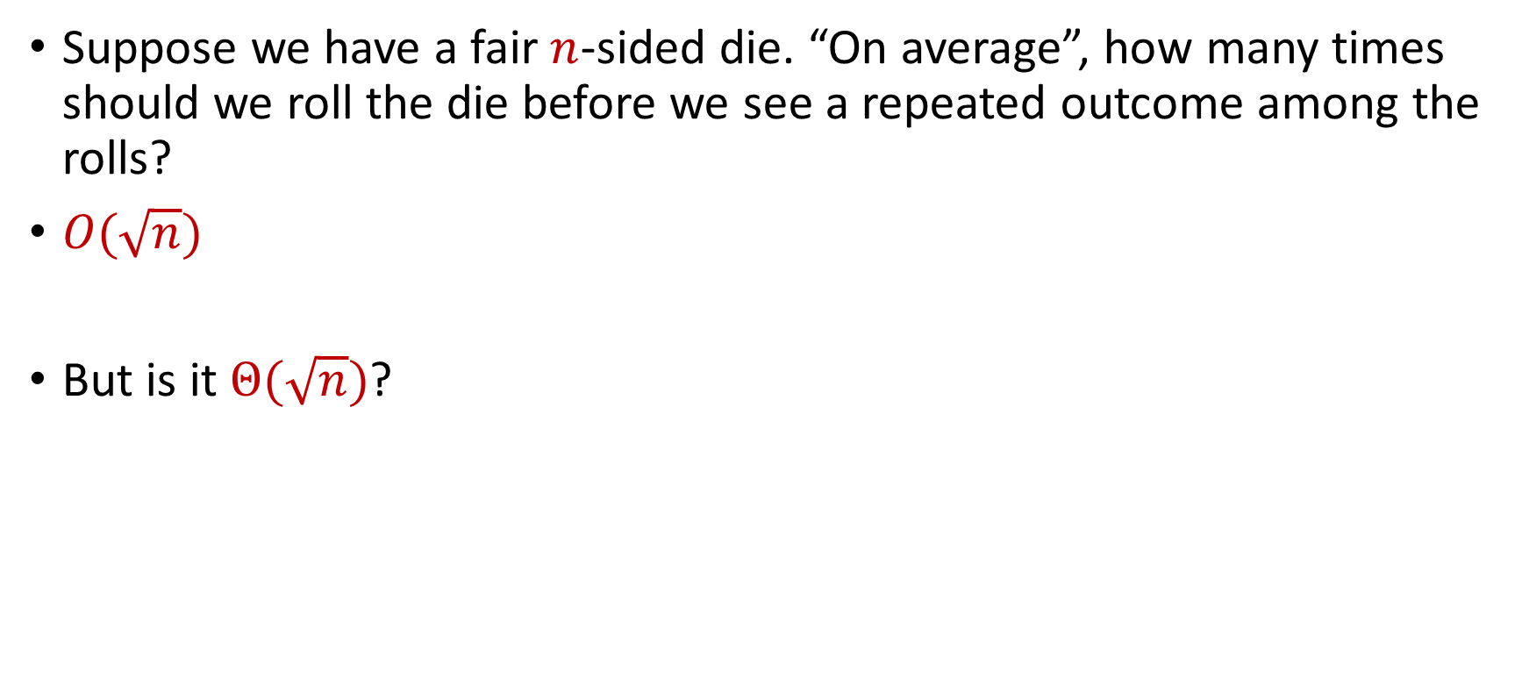
Birthday Paradox
Suppose we have a fair $n$-sided die. “On average”, how many times should we roll the die before we see a repeated outcome among the rolls?
$O(\sqrt{n})$
But is it $Θ(\sqrt{n})$?

Slide 33
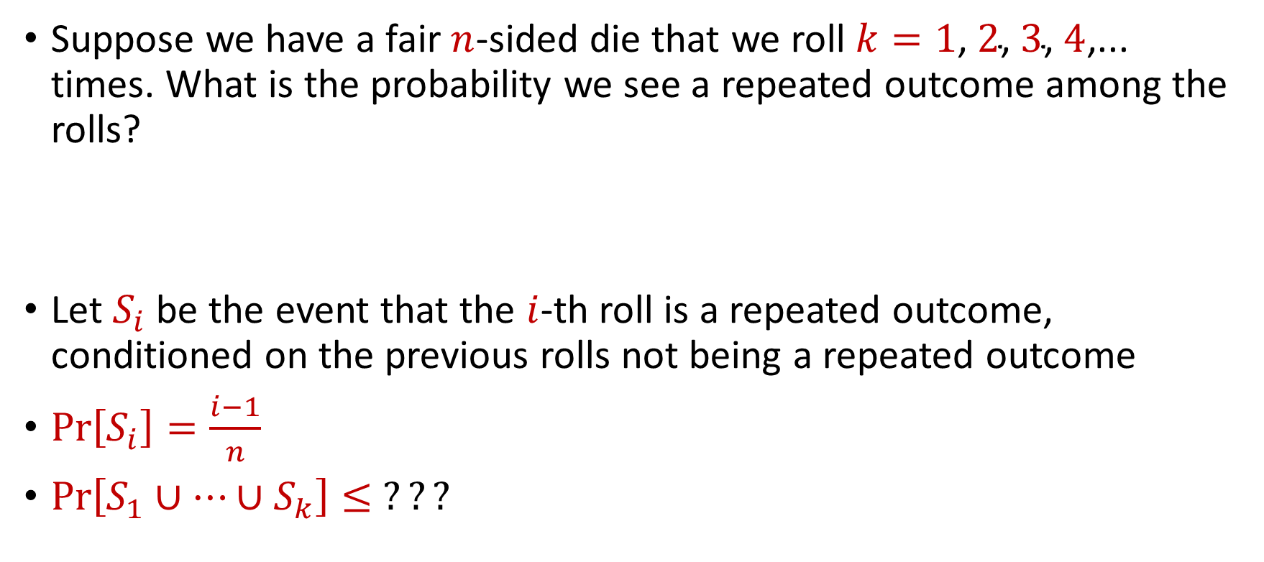
Birthday Paradox
Suppose we have a fair $n$-sided die that we roll $k=1\text{,} 2\text{, }3\text{, }4\text{,}\text{...}$ times. What is the probability we see a repeated outcome among the rolls?
Let $S_{i}$ be the event that the $i$-th roll is a repeated outcome, conditioned on the previous rolls not being a repeated outcome
$Pr\left[S_{i}\right]=\frac{i−1}{n}$
$Pr\left[S_{1}∪…∪S_{k}\right]≤$ $???$

Slide 34
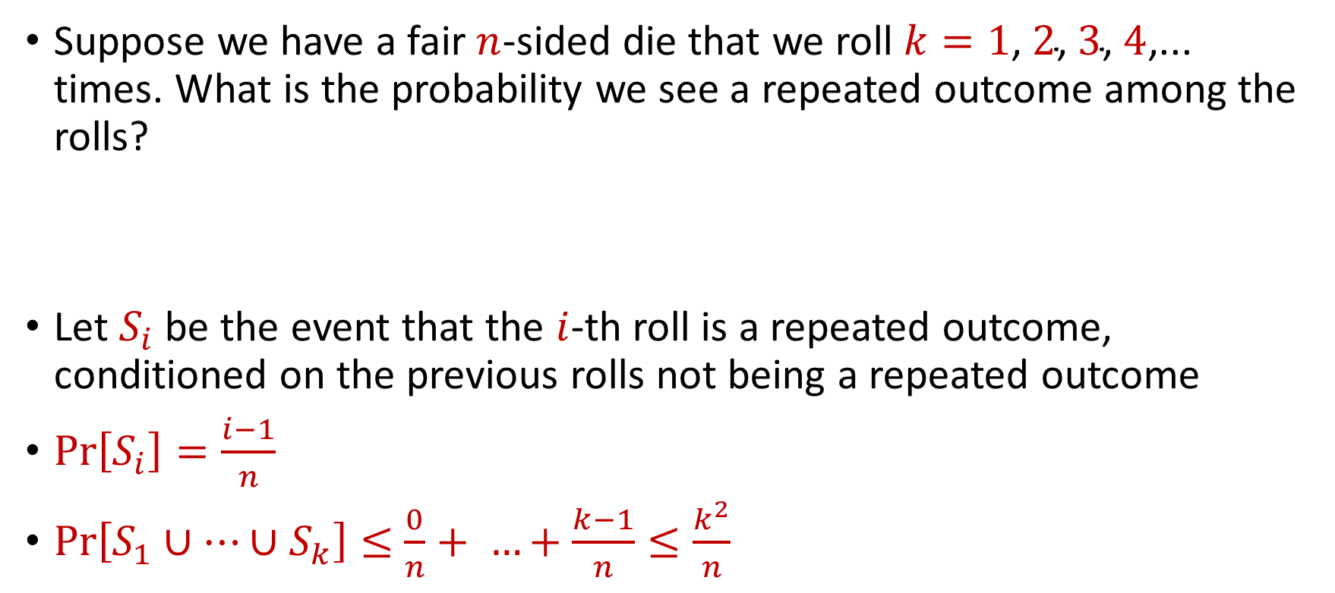
Birthday Paradox
Suppose we have a fair $n$-sided die that we roll $k=1\text{,} 2\text{, }3\text{, }4\text{,}\text{...}$ times. What is the probability we see a repeated outcome among the rolls?
Let $S_{i}$ be the event that the $i$-th roll is a repeated outcome, conditioned on the previous rolls not being a repeated outcome
$Pr\left[S_{i}\right]=\frac{i−1}{n}$
$Pr\left[S_{1}∪…∪S_{k}\right]≤$ $\frac{0}{n}+ …+\frac{k−1}{n}≤\frac{k^{2}}{n}$

Slide 35
Birthday Paradox
Suppose we have a fair $n$-sided die that we roll $k=1\text{,} 2\text{, }3\text{, }4\text{,}\text{...}$ times. What is the probability we see a repeated outcome among the rolls?
Let $S_{i}$ be the event that the $i$-th roll is a repeated outcome, conditioned on the previous rolls not being a repeated outcome
$Pr\left[S_{i}\right]=\frac{i−1}{n}$
$Pr\left[S_{1}∪…∪S_{k}\right]≤$ $\frac{0}{n}+ …+\frac{k−1}{n}≤\frac{k^{2}}{n}$
Union Bound

Slide 36

Birthday Paradox
Suppose we have a fair $n$-sided die. “On average”, how many times should we roll the die before we see a repeated outcome among the rolls?
$Θ(\sqrt{n})$

Slide 37
Trivia Question #1 (Birthday Paradox)
Suppose we have a fair $n$-sided die. “On average”, how many times should we roll the die before we see a repeated outcome among the rolls? Example: $1$, $5$, $2$, $4$, $5$
$Θ(1)$
$Θ(\log{n})$
$Θ(\sqrt{n})$
$Θ(n)$

Slide 38
Trivia Question #2 (Limits)
Let $c>0$ be a constant. What is $\lim_{n→∞}{\left(1−\frac{c}{n}\right)}^{n}$?
$0$
$\frac{1}{c}$
$\frac{1}{2c}$
$\frac{1}{e^{c}}$
$1$

Slide 39
CSCE 689: Special Topics in Modern Algorithms for Data Science
Lecture 3
Samson Zhou

Slide 40
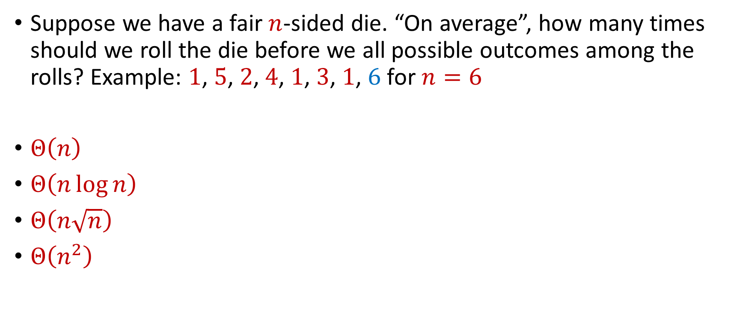
Trivia Question #3 (Coupon Collector)
Suppose we have a fair $n$-sided die. “On average”, how many times should we roll the die before we all possible outcomes among the rolls? Example: $1$, $5$, $2$, $4$, $1$, $3$, $1$, $6$ for $n=6$
$Θ\left(n\right)$
$Θ\left(n\log{n}\right)$
$Θ\left(n\sqrt{n}\right)$
$Θ\left(n^{2}\right)$

Slide 41
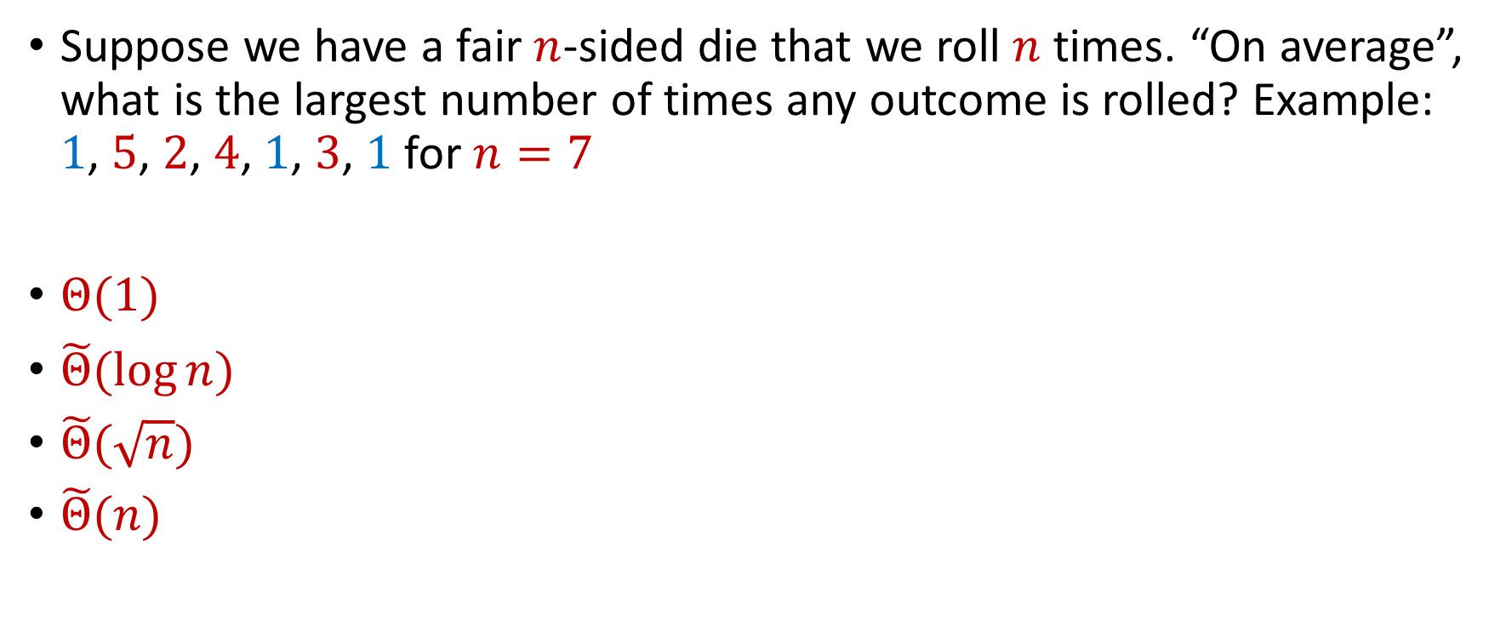
Trivia Question #4 (Max Load)
Suppose we have a fair $n$-sided die that we roll $n$ times. “On average”, what is the largest number of times any outcome is rolled? Example: $1$, $5$, $2$, $4$, $1$, $3$, $1$ for $n=7$
$Θ(1)$
$\tilde{Θ}(\log{n})$
$\tilde{Θ}(\sqrt{n})$
$\tilde{Θ}(n)$

Slide 42

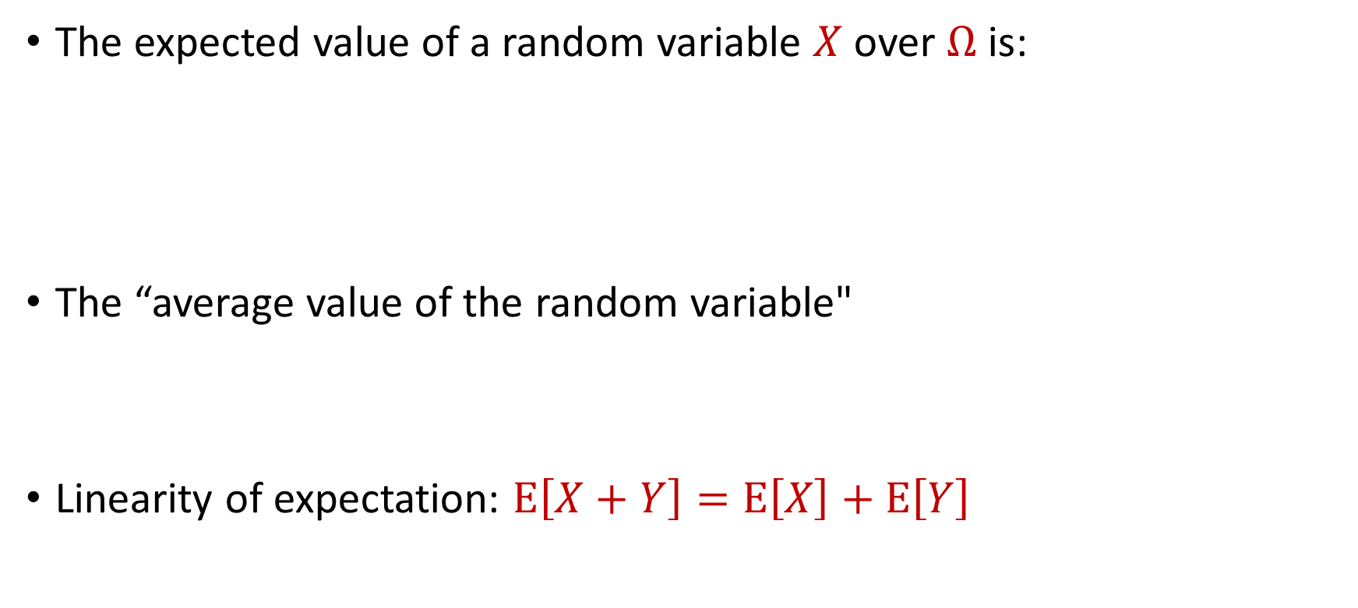
Expected Value
The expected value of a random variable $X$ over $Ω$ is:
The “average value of the random variable"
Linearity of expectation: $E\left[X+Y\right]=E\left[X\right]+E\left[Y\right]$
$$E\left[X\right]=\sum_{x∈Ω}{Pr\left[X=x\right]⋅x}$$

Slide 43

Expected Value
Suppose we roll a $6$-sided die
Let $X$ be the outcome of the roll
What is $E\left[X\right]$?

Slide 44


Moments
For $p>0$, the $p$-th moment of a random variable $X$ over $Ω$ is:
$$E\left[X^{p}\right]=\sum_{x∈Ω}{Pr\left[X=x\right]⋅x^{p}}$$

Slide 45
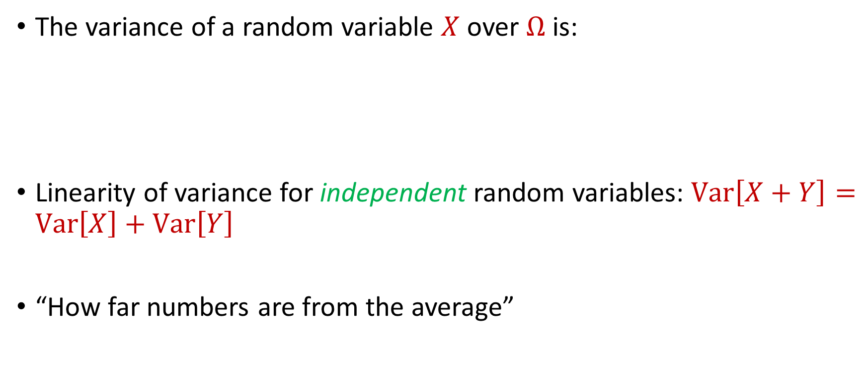
Variance
The variance of a random variable $X$ over $Ω$ is:
Linearity of variance for independent random variables: $Var\left[X+Y\right]=Var\left[X\right]+Var\left[Y\right]$
“How far numbers are from the average”
$$Var\left[X\right]=E\left[X^{2}\right]−{\left(E\left[X\right]\right)}^{2}$$

Slide 46

Variance
Suppose $X$ takes the value $1$ with probability $\frac{1}{2}$ and takes the value $−1$ with probability $\frac{1}{2}$
What is $E\left[X\right]$?
What is $Var\left[X\right]$?

Slide 47

Variance
Suppose $Y$ takes the value $100$ with probability $\frac{1}{2}$ and takes the value $−100$ with probability $\frac{1}{2}$
What is $E\left[Y\right]$?
What is $Var\left[Y\right]$?

Slide 48


Chebyshev’s Inequality
Let $X$ be a random variable with expected value $μ≔E[X]$ and variance $σ^{2}≔Var\left[X\right]$
“What is the probability a random variable is far away from its average?”
$$Pr\left[\left|X−μ\right|≥kσ\right]≤\frac{1}{k^{2}}$$

