Slide 1
CSCE 689: Special Topics in Modern Algorithms for Data Science
Lecture 3
Samson Zhou

Slide 2
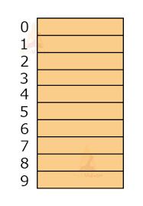

Last Time: Hashing
Hashing is a method to quickly map items from a universe to a location in a database
$$h\left(x\right)$$
Anmol Anand
Zhitong Chen
Lipai Huang
Ryan King
Ayesha Qamar
Shima Salehi

Slide 3
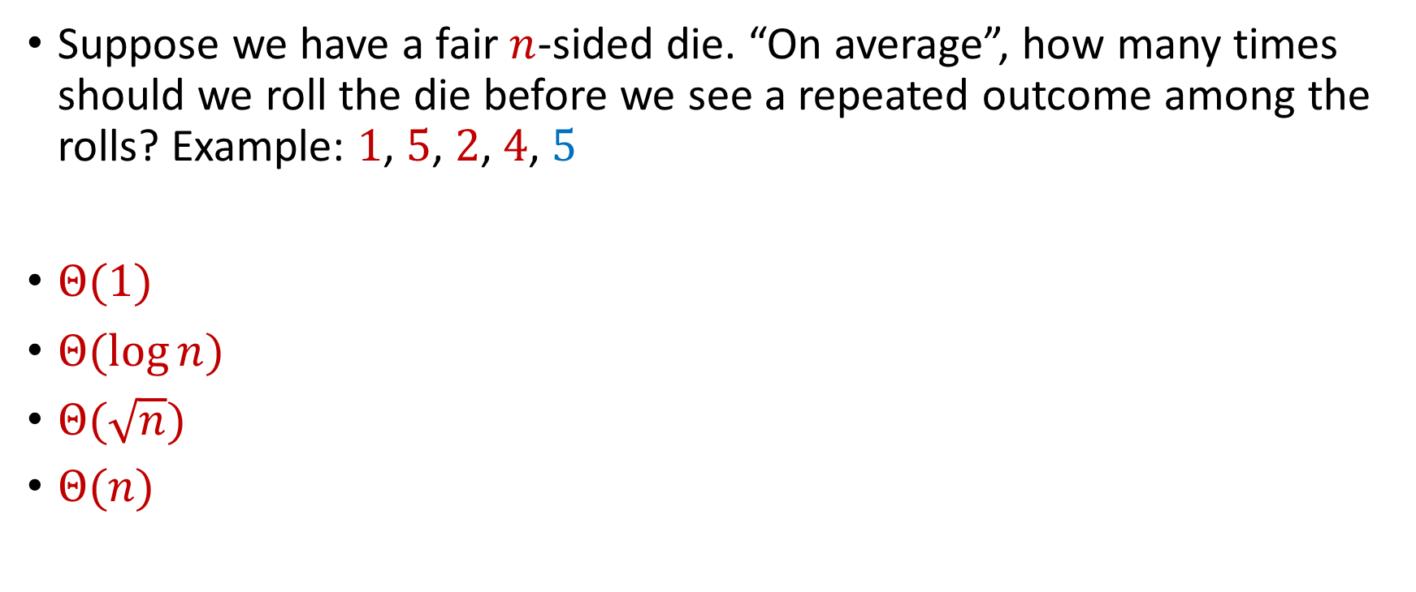
Last Time: Birthday Paradox
Suppose we have a fair $n$-sided die. “On average”, how many times should we roll the die before we see a repeated outcome among the rolls? Example: $1$, $5$, $2$, $4$, $5$
$Θ(1)$
$Θ(\log{n})$
$Θ(\sqrt{n})$
$Θ(n)$

Slide 4
Last Time: Birthday Paradox
Suppose we have a fair $n$-sided die. “On average”, how many times should we roll the die before we see a repeated outcome among the rolls? Example: $1$, $5$, $2$, $4$, $5$
$Θ(1)$
$Θ(\log{n})$
$Θ(\sqrt{n})$
$Θ(n)$

Slide 5
Future
Next Monday: Sign up for LaTeX scribe note slots
Today: Meet your classmates (1)
Next Monday: Meet your classmates (2), receive and consider list of potential projects/groups
Next Wednesday: Discuss potential project groups
Next Friday: Email me the members/group name

Slide 6


Case Study
We are trying to learn a new language on an app, which claims to have a database of 1 million words
Each time we ask the app, it gives us a random word in the database
We want to verify the claim

Slide 7
Case Study
We could use the app until we see 1 million unique words, but that would take at least 1 million checks
Instead, we use the app for 1000 times and count the number of pairwise duplicates
If there are many duplicates, the database is probably not very large

Slide 8
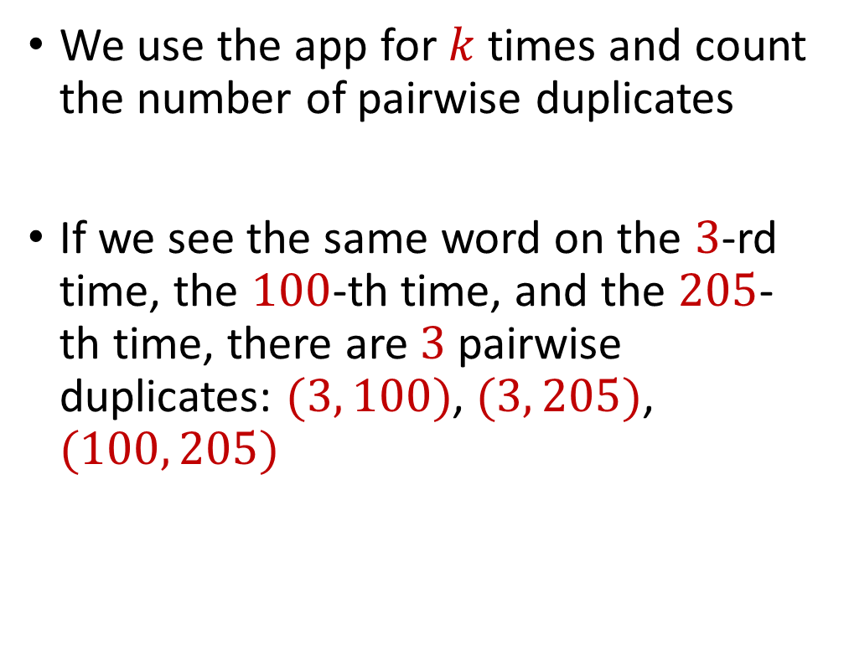
Case Study
We use the app for $k$ times and count the number of pairwise duplicates
If we see the same word on the $3$-rd time, the $100$-th time, and the $205$-th time, there are $3$pairwise duplicates: $(3, 100)$, $(3, 205)$, $(100, 205)$

Slide 9

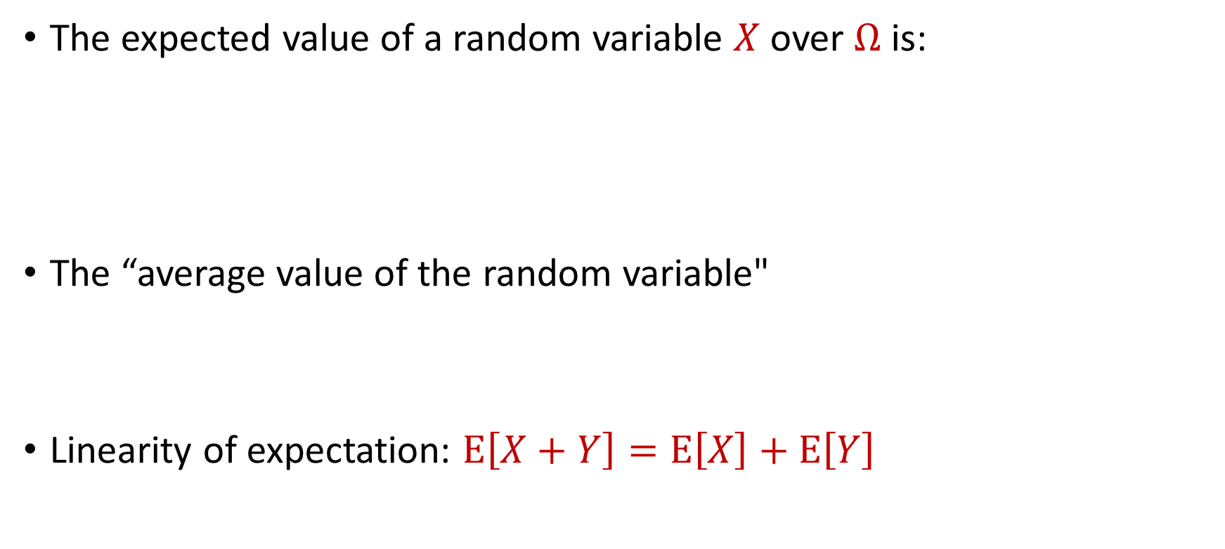
Expected Value
The expected value of a random variable $X$ over $Ω$ is:
The “average value of the random variable"
Linearity of expectation: $E\left[X+Y\right]=E\left[X\right]+E\left[Y\right]$
$$E\left[X\right]=\sum_{x∈Ω}{Pr\left[X=x\right]⋅x}$$

Slide 10

Linearity of Expectation
Linearity of expectation: $E\left[X+Y\right]=E\left[X\right]+E\left[Y\right]$
$$E\left[X+Y\right]=\sum_{x∈Ω_{X}}{\sum_{y∈Ω_{Y}}{Pr\left[X=x, Y=y\right]⋅(x+y)}}$$

Slide 11
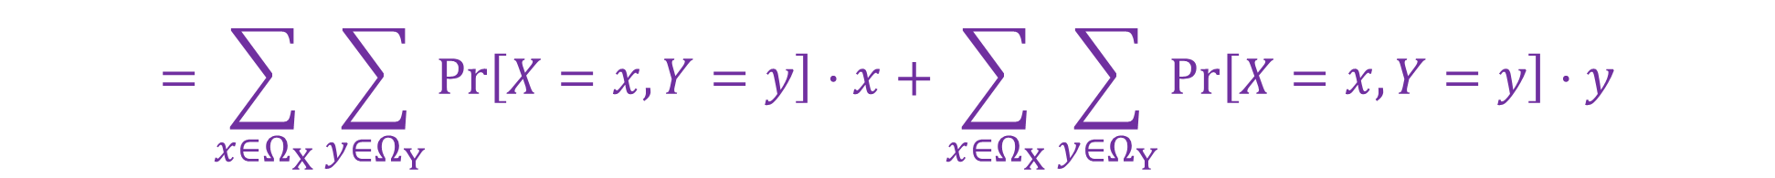
Linearity of Expectation
Linearity of expectation: $E\left[X+Y\right]=E\left[X\right]+E\left[Y\right]$
$$E\left[X+Y\right]=\sum_{x∈Ω_{X}}{\sum_{y∈Ω_{Y}}{Pr\left[X=x, Y=y\right]⋅(x+y)}}$$
$$=\sum_{x∈Ω_{X}}{\sum_{y∈Ω_{Y}}{Pr\left[X=x, Y=y\right]⋅x}}+\sum_{x∈Ω_{X}}{\sum_{y∈Ω_{Y}}{Pr\left[X=x, Y=y\right]⋅y}}$$

Slide 12

Linearity of Expectation
Linearity of expectation: $E\left[X+Y\right]=E\left[X\right]+E\left[Y\right]$
$$E\left[X+Y\right]=\sum_{x∈Ω_{X}}{\sum_{y∈Ω_{Y}}{Pr\left[X=x, Y=y\right]⋅(x+y)}}$$
$$=\sum_{x∈Ω_{X}}{\sum_{y∈Ω_{Y}}{Pr\left[X=x, Y=y\right]⋅x}}+\sum_{x∈Ω_{X}}{\sum_{y∈Ω_{Y}}{Pr\left[X=x, Y=y\right]⋅y}}$$
$$=\sum_{x∈Ω_{X}}{x\sum_{y∈Ω_{Y}}{Pr\left[X=x, Y=y\right]}}+\sum_{y∈Ω_{Y}}{y\sum_{x∈Ω_{X}}{Pr\left[X=x, Y=y\right]}}$$

Slide 13
Linearity of Expectation
Linearity of expectation: $E\left[X+Y\right]=E\left[X\right]+E\left[Y\right]$
$$E\left[X+Y\right]=\sum_{x∈Ω_{X}}{\sum_{y∈Ω_{Y}}{Pr\left[X=x, Y=y\right]⋅(x+y)}}$$
$$=\sum_{x∈Ω_{X}}{\sum_{y∈Ω_{Y}}{Pr\left[X=x, Y=y\right]⋅x}}+\sum_{x∈Ω_{X}}{\sum_{y∈Ω_{Y}}{Pr\left[X=x, Y=y\right]⋅y}}$$
$$=\sum_{x∈Ω_{X}}{x\sum_{y∈Ω_{Y}}{Pr\left[X=x, Y=y\right]}}+\sum_{y∈Ω_{Y}}{y\sum_{x∈Ω_{X}}{Pr\left[X=x, Y=y\right]}}$$
$$=\sum_{x∈Ω_{X}}{x⋅Pr\left[X=x\right]}+\sum_{y∈Ω_{Y}}{y⋅Pr\left[Y=y\right]}=E\left[X\right]+E\left[Y\right]$$

Slide 14

Expected Value
Suppose we roll a $6$-sided die
Let $X$ be the outcome of the roll
What is $E\left[X\right]$?

Slide 15
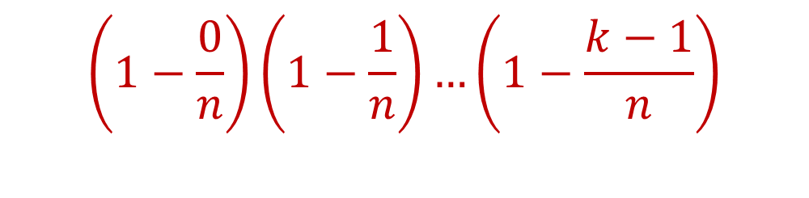

Birthday Paradox
Suppose we have a fair $n$-sided die that we roll $k=1\text{,} 2\text{, }3\text{, }4\text{,}\text{...}$ times. What is the probability we see a repeated outcome among the rolls?
$$\left(1−\frac{0}{n}\right)\left(1−\frac{1}{n}\right)…\left(1−\frac{k−1}{n}\right)$$

Slide 16
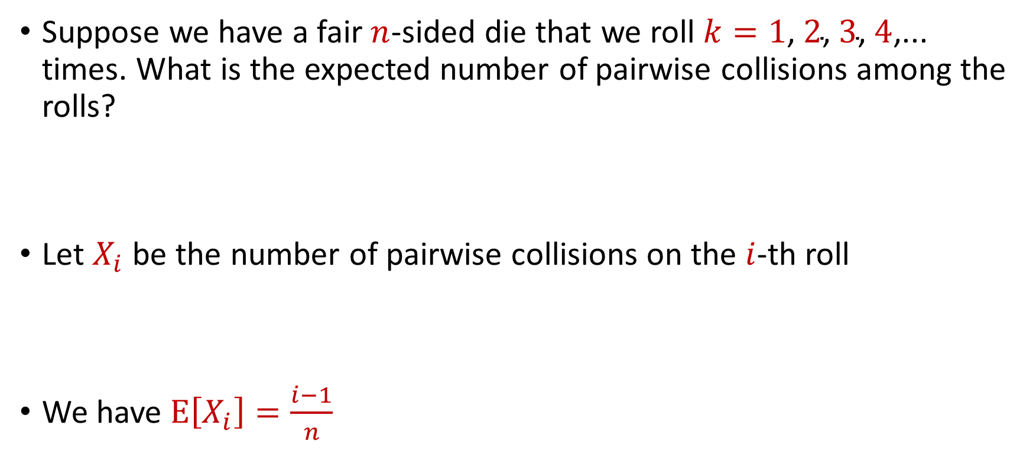
Birthday Paradox, Revisited
Suppose we have a fair $n$-sided die that we roll $k=1\text{,} 2\text{, }3\text{, }4\text{,}\text{...}$ times. What is the expected number of pairwise collisions among the rolls?
Let $X_{i}$ be the number of pairwise collisions on the $i$-th roll
We have $E\left[X_{i}\right]=\frac{i−1}{n}$

Slide 17

Birthday Paradox, Revisited
Let $X$ be the number of pairwise collisions after $k$ rolls
What is $E\left[X\right]$?

Slide 18



Birthday Paradox, Revisited
Let $X$ be the number of pairwise collisions after $k$ rolls
$$E\left[X\right]=E\left[X_{1}+…+X_{k}\right]$$
$$=E\left[X_{1}]+…+E[X_{k}\right]$$
$$=\frac{0}{n}+…+\frac{k−1}{n}$$
$$=\frac{k\left(k−1\right)}{n}$$

Slide 19

Birthday Paradox, Revisited
$E\left[X\right]=\frac{k\left(k−1\right)}{n}$
$\frac{{\left(k−1\right)}^{2}}{n}≤E\left[X\right]≤\frac{k^{2}}{n}$
$k=\sqrt{n}+1$ implies $E\left[X\right]≥1$
$k=\frac{\sqrt{n}}{2}$ implies $E\left[X\right]≤\frac{1}{4}$

Slide 20
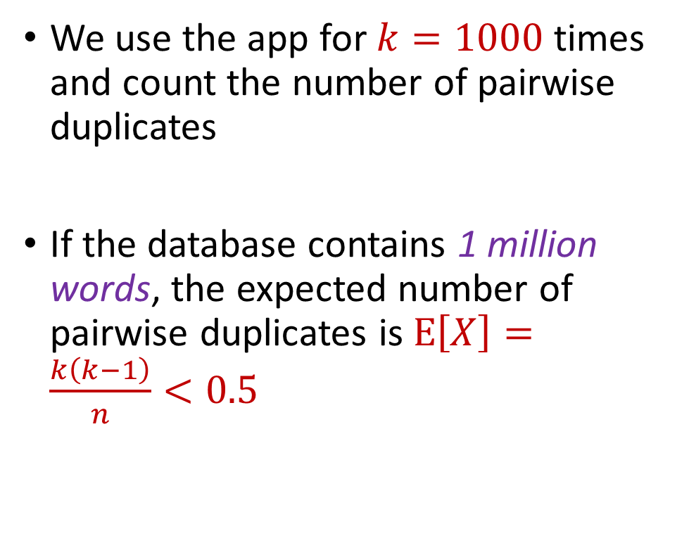
Case Study
We use the app for $k=1000$ times and count the number of pairwise duplicates
If the database contains 1 million words, the expected number of pairwise duplicates is $E\left[X\right]=\frac{k\left(k−1\right)}{n}<0.5$

Slide 21
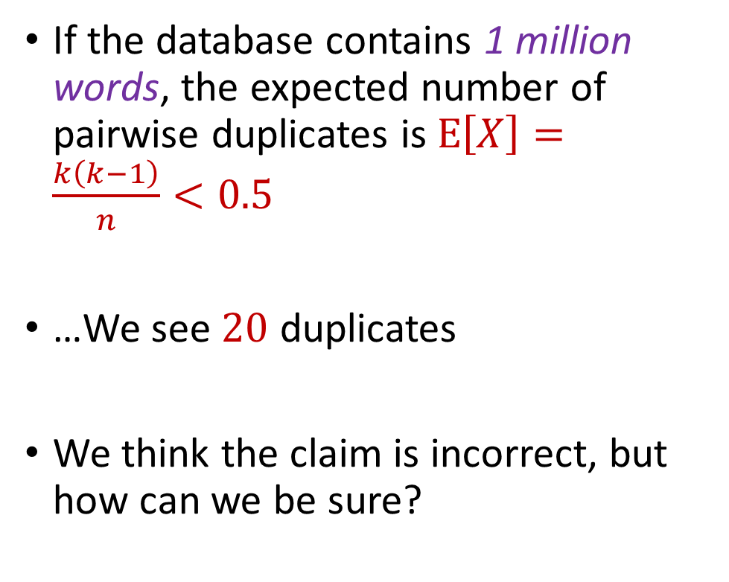
Case Study
If the database contains 1 million words, the expected number of pairwise duplicates is $E\left[X\right]=\frac{k\left(k−1\right)}{n}<0.5$
…We see $20$ duplicates
We think the claim is incorrect, but how can we be sure?

Slide 22
Concentration Inequalities
Concentration inequalities bound the probability that a random variable is “far away” from its expectation
Often used in understanding the performance of statistical tests, the behavior of data sampled from various distributions, and for our purposes, the guarantees of randomized algorithms

Slide 23


Markov’s Inequality
Let $X≥0$be a non-negative random variable. Then for any $t>0$:
$$Pr\left[X≥t⋅E[X]\right]≤\frac{1}{t}$$

Slide 24


Proof of Markov’s Inequality
Let $X≥0$be a non-negative random variable. Then for any $t>0$:
$E\left[X\right]=\sum_{x∈Ω}{Pr\left[X=x\right]⋅x}$
$=\sum_{x≥t⋅E\left[X\right]}{Pr\left[X=x\right]⋅x}+\sum_{x<t⋅E[X]}{Pr\left[X=x\right]⋅x}$
$≥\sum_{x≥t⋅E[X]}{Pr\left[X=x\right]⋅x}$
$≥t⋅E[X]\sum_{x≥t⋅E[X]}{Pr\left[X=x\right]}$
$$=t⋅E\left[X\right]⋅Pr\left[X≥t⋅E[X]\right]$$

Slide 25
Birthday Paradox
Suppose we have a fair $n$-sided die that we roll $k=1\text{,} 2\text{, }3\text{, }4\text{,}\text{...}$ times. What is the probability we see a repeated outcome among the rolls?
$$\left(1−\frac{0}{n}\right)\left(1−\frac{1}{n}\right)…\left(1−\frac{k−1}{n}\right)$$

Slide 26
Birthday Paradox, Revisited
Suppose we have a fair $n$-sided die that we roll $k=1\text{,} 2\text{, }3\text{, }4\text{,}\text{...}$ times. What is the expected number of pairwise collisions among the rolls?
Let $X_{i}$ be the number of pairwise collisions on the $i$-th roll
We have $E\left[X_{i}\right]=\frac{i−1}{n}$

Slide 27
Birthday Paradox, Revisited
$E\left[X\right]=\frac{k\left(k−1\right)}{n}$
$\frac{{\left(k−1\right)}^{2}}{n}≤E\left[X\right]≤\frac{k^{2}}{n}$
$k=\sqrt{n}+1$ implies $E\left[X\right]≥1$
$k=\frac{\sqrt{n}}{2}$ implies $E\left[X\right]≤\frac{1}{4}$

Slide 28

Birthday Paradox, Revisited
$E\left[X\right]=\frac{k\left(k−1\right)}{n}$
$\frac{{\left(k−1\right)}^{2}}{n}≤E\left[X\right]≤\frac{k^{2}}{n}$
$k=\sqrt{n}+1$ implies $E\left[X\right]≥1$
$k=\frac{\sqrt{n}}{2}$ implies $E\left[X\right]≤\frac{1}{4}$, $Pr\left[X≥1\right]≤\frac{1}{4}$,

Slide 29
Case Study
If the database contains 1 million words, the expected number of pairwise duplicates is $E\left[X\right]=\frac{k\left(k−1\right)}{n}<0.5$
…We see $20$ duplicates
We think the claim is incorrect, but how can we be sure?

Slide 30
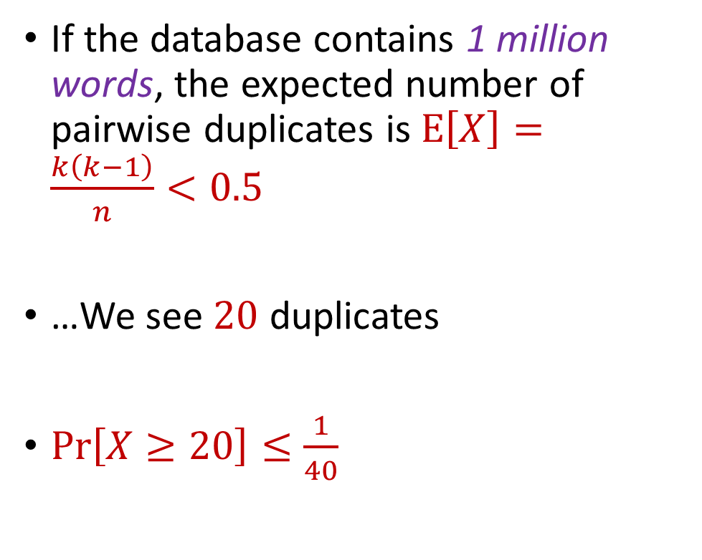
Case Study
If the database contains 1 million words, the expected number of pairwise duplicates is $E\left[X\right]=\frac{k\left(k−1\right)}{n}<0.5$
…We see $20$ duplicates
$Pr\left[X≥20\right]≤\frac{1}{40}$

Slide 31
CSCE 689: Special Topics in Modern Algorithms for Data Science
Lecture 4
Samson Zhou

Slide 32
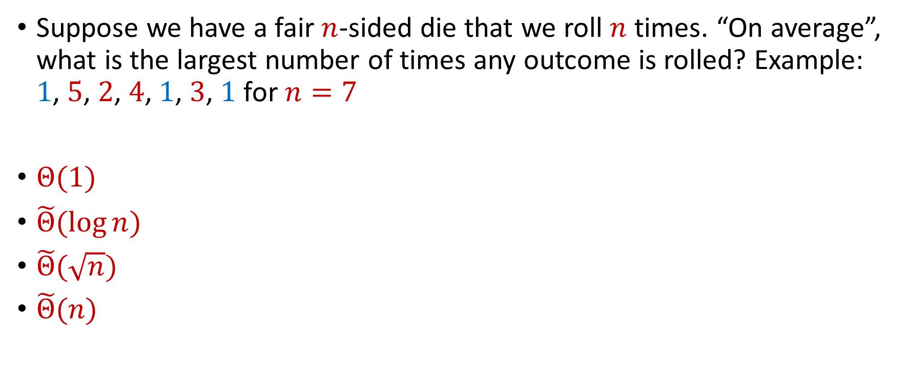
Trivia Question #3 (Max Load)
Suppose we have a fair $n$-sided die that we roll $n$ times. “On average”, what is the largest number of times any outcome is rolled? Example: $1$, $5$, $2$, $4$, $1$, $3$, $1$ for $n=7$
$Θ(1)$
$\tilde{Θ}(\log{n})$
$\tilde{Θ}(\sqrt{n})$
$\tilde{Θ}(n)$

Slide 33
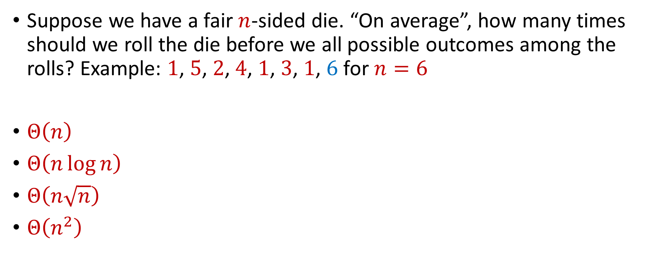
Trivia Question #4 (Coupon Collector)
Suppose we have a fair $n$-sided die. “On average”, how many times should we roll the die before we all possible outcomes among the rolls? Example: $1$, $5$, $2$, $4$, $1$, $3$, $1$, $6$ for $n=6$
$Θ\left(n\right)$
$Θ\left(n\log{n}\right)$
$Θ\left(n\sqrt{n}\right)$
$Θ\left(n^{2}\right)$

Slide 34


Moments
For $p>0$, the $p$-th moment of a random variable $X$ over $Ω$ is:
$$E\left[X^{p}\right]=\sum_{x∈Ω}{Pr\left[X=x\right]⋅x^{p}}$$

Slide 35
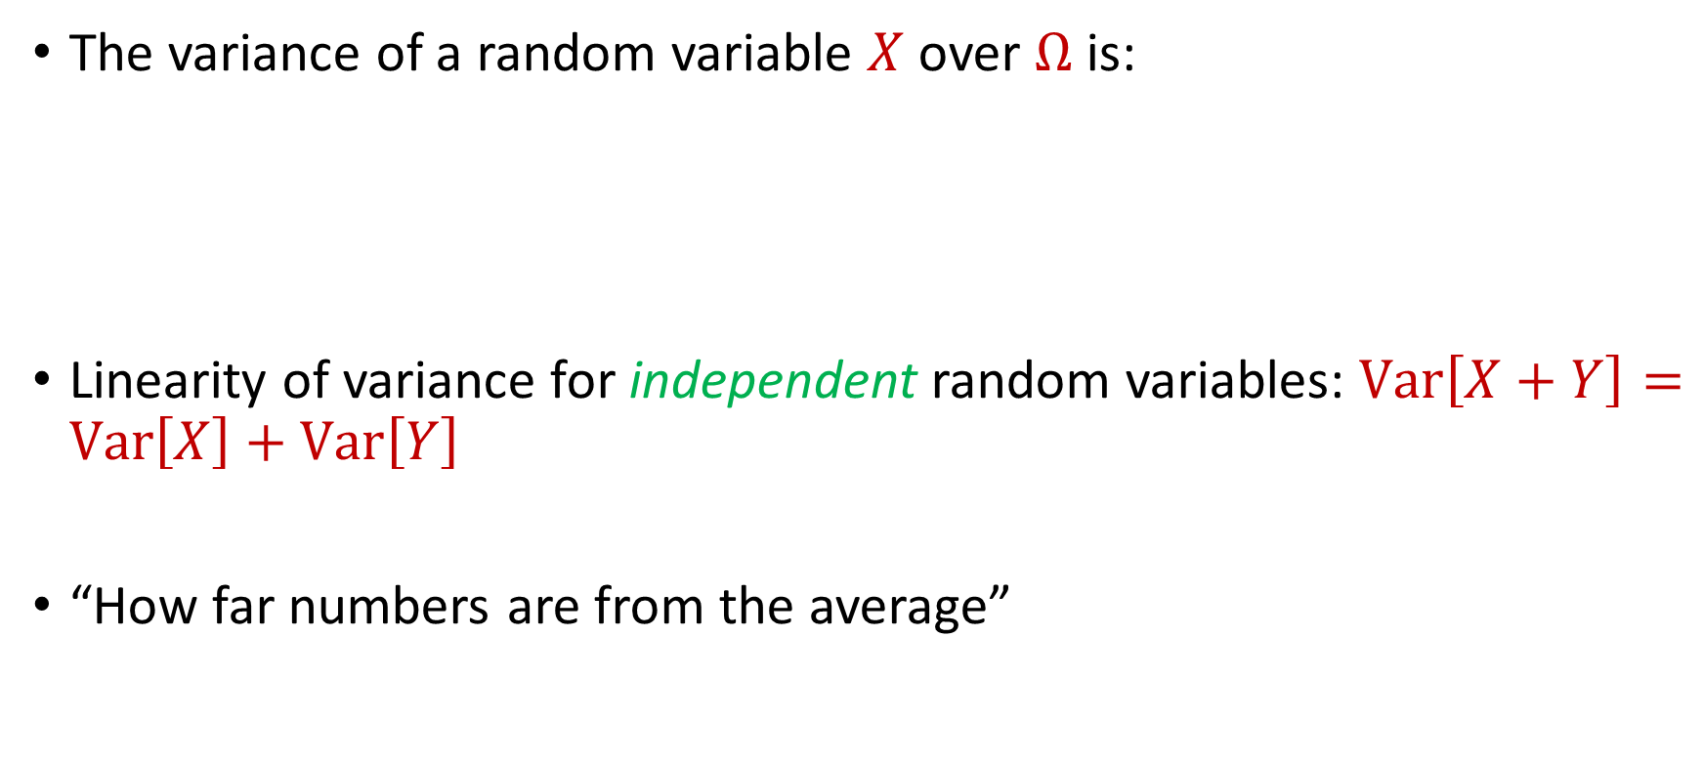
Variance
The variance of a random variable $X$ over $Ω$ is:
Linearity of variance for independent random variables: $Var\left[X+Y\right]=Var\left[X\right]+Var\left[Y\right]$
“How far numbers are from the average”
$$Var\left[X\right]=E\left[X^{2}\right]−{\left(E\left[X\right]\right)}^{2}$$

Slide 36

Variance
Suppose $X$ takes the value $1$ with probability $\frac{1}{2}$ and takes the value $−1$ with probability $\frac{1}{2}$
What is $E\left[X\right]$?
What is $Var\left[X\right]$?

Slide 37

Variance
Suppose $Y$ takes the value $100$ with probability $\frac{1}{2}$ and takes the value $−100$ with probability $\frac{1}{2}$
What is $E\left[Y\right]$?
What is $Var\left[Y\right]$?

Slide 38


Chebyshev’s Inequality
Let $X$ be a random variable with expected value $μ≔E[X]$ and variance $σ^{2}≔Var\left[X\right]$
“What is the probability a random variable is far away from its average?”
$$Pr\left[\left|X−μ\right|≥kσ\right]≤\frac{1}{k^{2}}$$

