Slide 1
CSCE 658: Randomized Algorithms
Lecture 20
Samson Zhou

Slide 2
Relevant Supplementary Material
Chapter 1-3 of “The Algorithmic Foundations of Differential Privacy”, by Cynthia Dwork and Aaron Roth (https://www.cis.upenn.edu/~aaroth/Papers/privacybook.pdf)

Slide 3




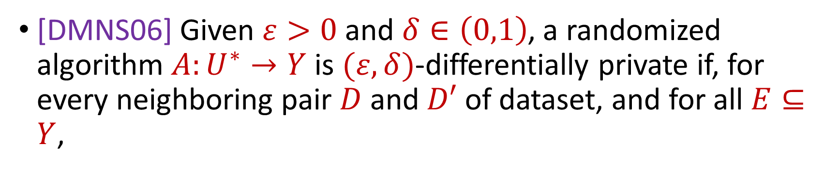

Last Time: Differential Privacy
[DMNS06] Given $ε>0$and $δ∈\left(0,1\right)$, a randomized algorithm $A:U^{∗}→Y$ is $(ε,δ)$-differentially private if, for every neighboring pair $D$ and $D′$ of dataset, and for all $E⊆Y$,
$$Pr\left[A\left(D\right)∈E\right]≤e^{ε}⋅Pr\left[A\left(D^{′}\right)∈E\right]+δ$$
$$A\left( \right)≈A\left( \right)$$
Notes:
[DworkMcSherryNissimSmith06]

Slide 4


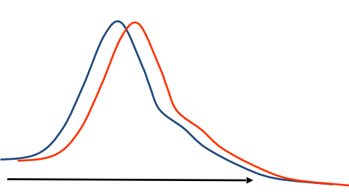
Last Time: Differential Privacy
[DMNS06] Given $ε>0$and $δ∈\left(0,1\right)$, a randomized algorithm $A:U^{∗}→Y$ is $(ε,δ)$-differentially private if, for every neighboring pair $D$ and $D′$ of dataset, and for all $E⊆Y$,
$$Pr\left[A\left(D\right)∈E\right]≤e^{ε}⋅Pr\left[A\left(D^{′}\right)∈E\right]+δ$$
Sensitive dataset
Algorithm
Output distribution
Notes:
[DworkMcSherryNissimSmith06]

Slide 5
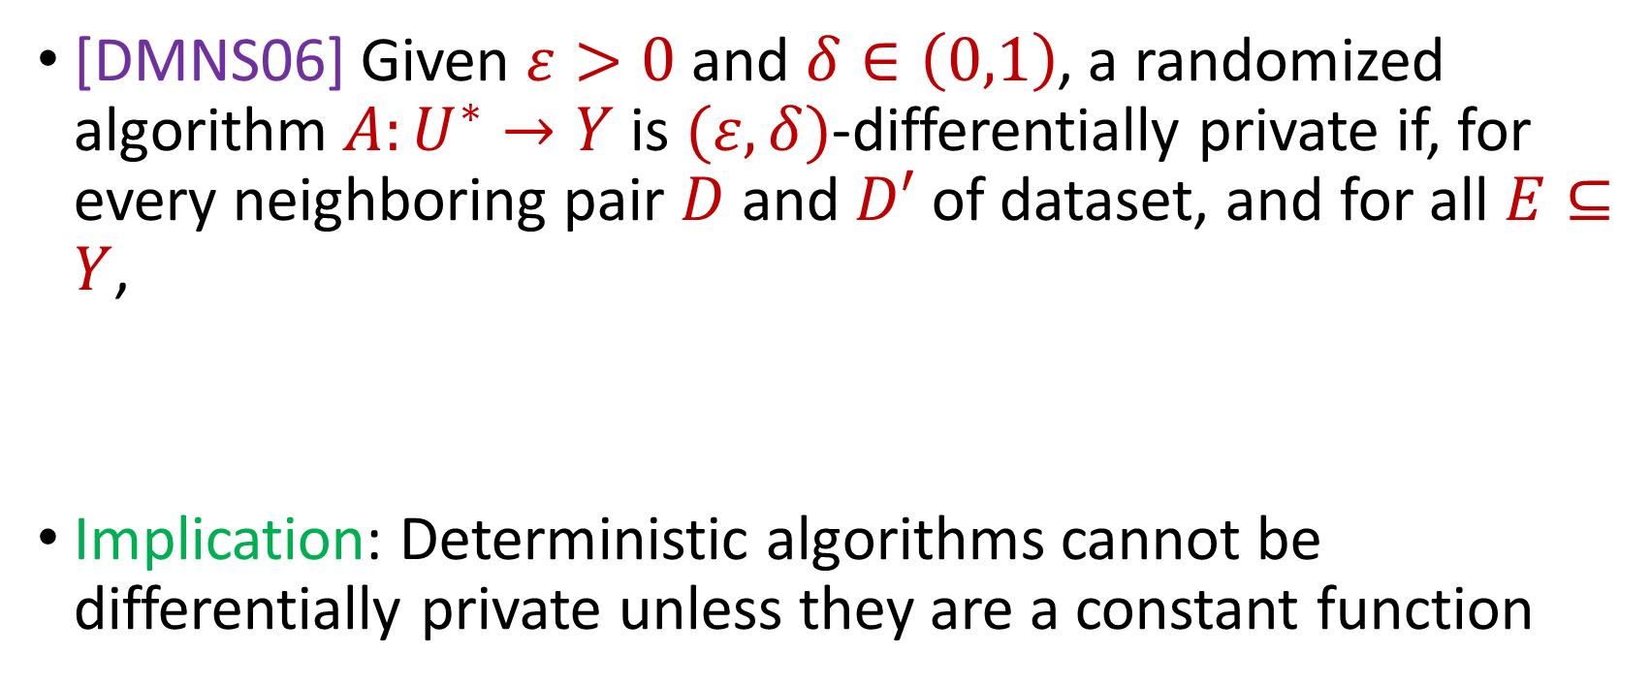
Last Time: Differential Privacy
[DMNS06] Given $ε>0$and $δ∈\left(0,1\right)$, a randomized algorithm $A:U^{∗}→Y$ is $(ε,δ)$-differentially private if, for every neighboring pair $D$ and $D′$ of dataset, and for all $E⊆Y$,
Implication: Deterministic algorithms cannot be differentially private unless they are a constant function
$$Pr\left[A\left(D\right)∈E\right]≤e^{ε}⋅Pr\left[A\left(D^{′}\right)∈E\right]+δ$$
Notes:
[DworkMcSherryNissimSmith06]

Slide 6






Privacy and Noise
$$Z$$
Random noise
$$x=x_{1},…,x_{n}$$
$$A(x)$$
$$A\left(x\right)=f\left(x\right)+Z$$
$$f(x)$$
Input
Algorithm
Output distribution
Notes:
[DworkMcSherryNissimSmith06]

Slide 7
Differential Privacy Properties
What properties would we like from a rigorous definition of privacy?
Notes:
[DworkMcSherryNissimSmith06]

Slide 8

Post-processing of Differential Privacy
Ability to handle post-processing
If mechanism $A$ has privacy loss $ε$ and we release $g\left(A(D)\right)$, then we have privacy loss $ε$
Notes:
[DworkMcSherryNissimSmith06]

Slide 9
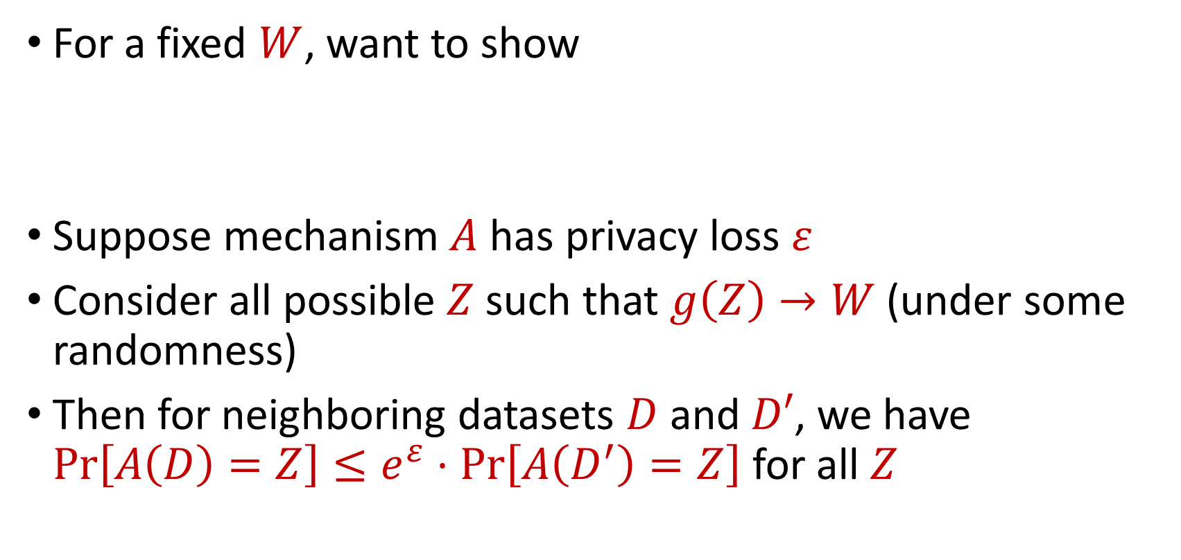
Post-processing of Differential Privacy
For a fixed $W$, want to show
Suppose mechanism $A$ has privacy loss $ε$
Consider all possible $Z$ such that $g\left(Z\right)→W$ (under some randomness)
Then for neighboring datasets $D$ and $D′$, we have $Pr\left[A\left(D\right)=Z\right]≤e^{ε}⋅Pr\left[A\left(D^{′}\right)=Z\right]$ for all $Z$
$$Pr\left[g\left(A\left(D\right)\right)=W\right]≤e^{ε}⋅Pr\left[g\left(A\left(D^{′}\right)\right)=W\right]$$
Notes:
[DworkMcSherryNissimSmith06]

Slide 10
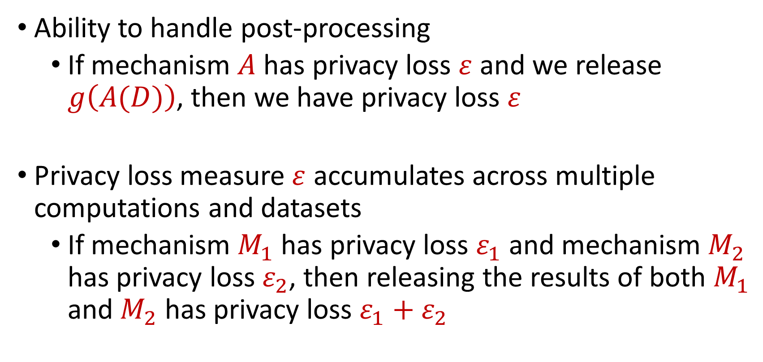
Differential Privacy Properties
Ability to handle post-processing
If mechanism $A$ has privacy loss $ε$ and we release $g\left(A(D)\right)$, then we have privacy loss $ε$
Privacy loss measure $ε$ accumulates across multiple computations and datasets
If mechanism $M_{1}$ has privacy loss $ε_{1}$ and mechanism $M_{2}$ has privacy loss $ε_{2}$, then releasing the results of both $M_{1}$ and $M_{2}$ has privacy loss $ε_{1}+ε_{2}$
Notes:
[DworkMcSherryNissimSmith06]

Slide 11
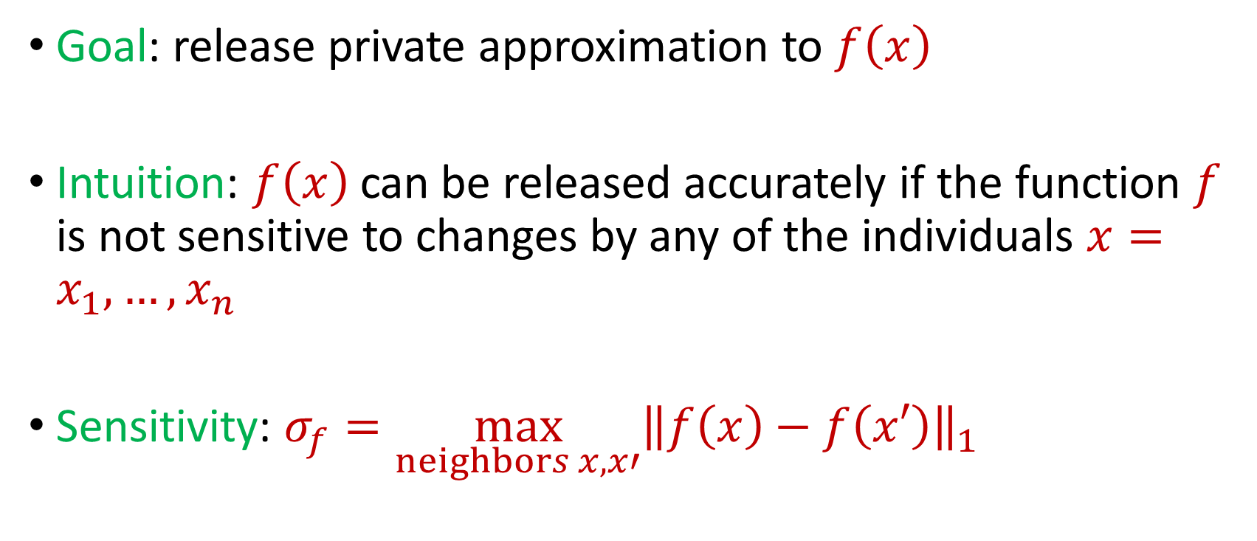
Privacy and Noise
Goal: release private approximation to $f\left(x\right)$
Intuition: $f\left(x\right)$ can be released accurately if the function $f$ is not sensitive to changes by any of the individuals $x=x_{1},…,x_{n}$
Sensitivity: $σ_{f}=\max_{neighbors x,x′}{\left\|f\left(x\right)−f\left(x′\right)\right\|}_{1}$
Notes:
[DworkMcSherryNissimSmith06]

Slide 12
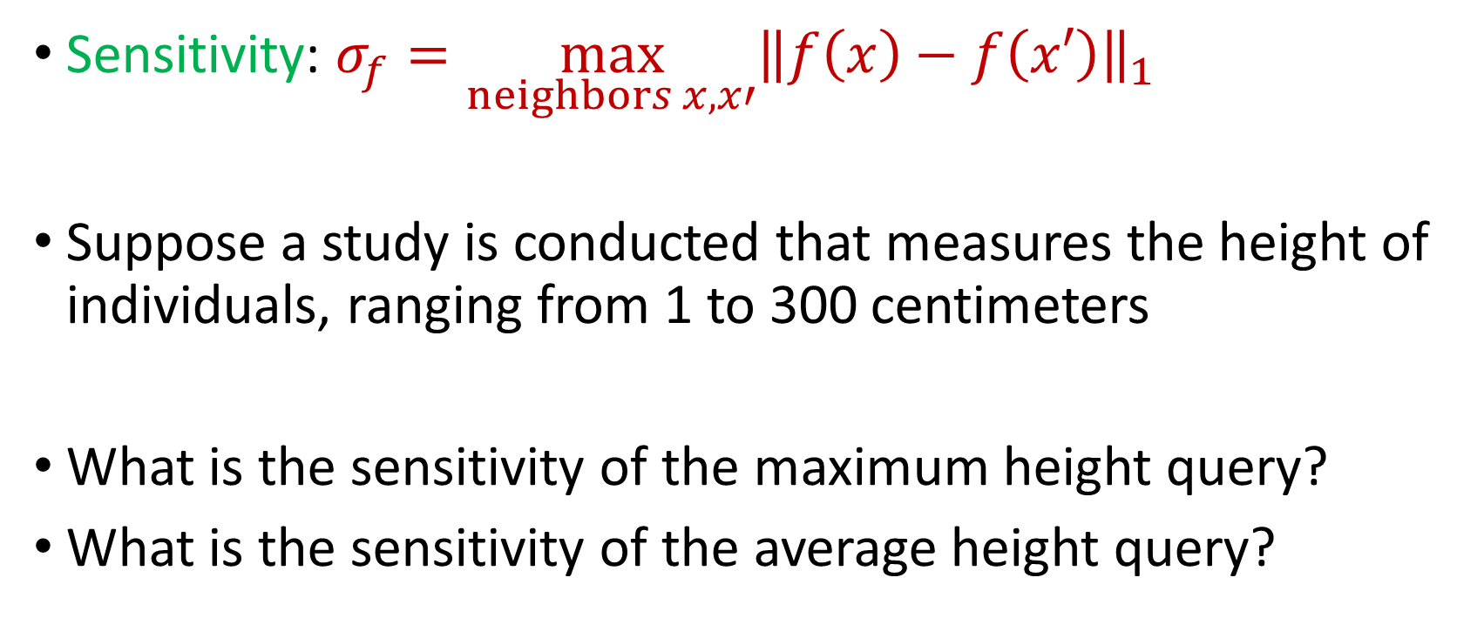
Sensitivity
Sensitivity: $σ_{f}=\max_{neighbors x,x′}{\left\|f\left(x\right)−f\left(x′\right)\right\|}_{1}$
Suppose a study is conducted that measures the height of individuals, ranging from 1 to 300 centimeters
What is the sensitivity of the maximum height query?
What is the sensitivity of the average height query?
Notes:
[DworkMcSherryNissimSmith06]

Slide 13
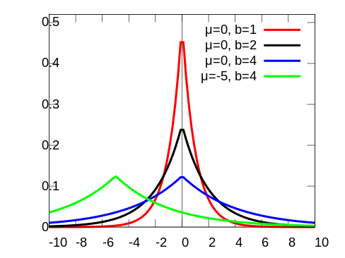
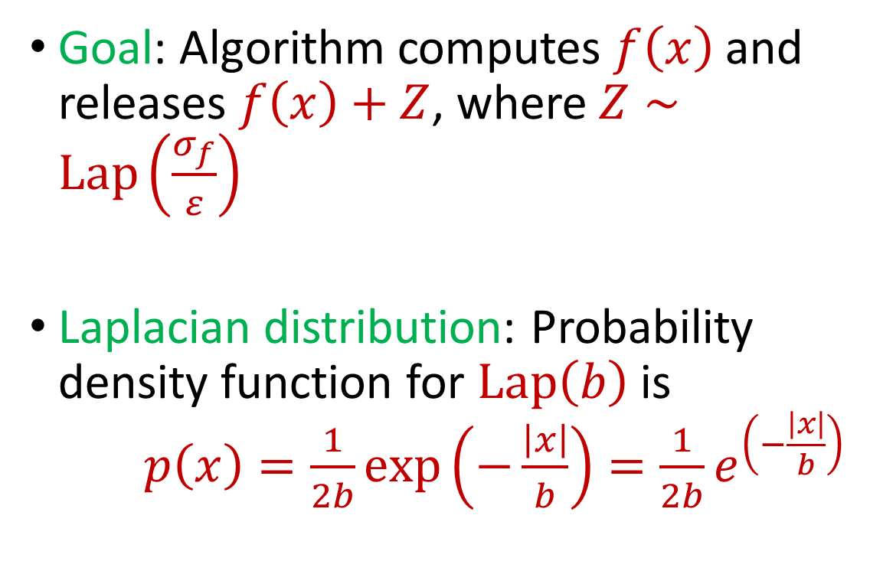
Laplace Mechanism
Goal: Algorithm computes $f\left(x\right)$ and releases $f\left(x\right)+Z$, where $Z∼Lap\left(\frac{σ_{f}}{ε}\right)$
Laplacian distribution: Probability density function for $Lap\left(b\right)$ is $p\left(x\right)=\frac{1}{2b}exp\left(−\frac{\left|x\right|}{b}\right)=\frac{1}{2b}e^{\left(−\frac{\left|x\right|}{b}\right)}$
Notes:
[DworkMcSherryNissimSmith06]

Slide 14
Laplace Mechanism
What does the Laplace mechanism do in the following cases?
Suppose a study is conducted that measures the height of individuals, ranging from 1 to 300 centimeters
What is the sensitivity of the maximum height query?
What is the sensitivity of the average height query?
Notes:
[DworkMcSherryNissimSmith06]

Slide 15

Laplace Mechanism
Theorem: Laplace mechanism is $ε$-differentially private (pure DP)
Notes:
[DworkMcSherryNissimSmith06]

Slide 16

Beyond Laplace Mechanism
What if the output is not a scalar, e.g., a vector?
Suppose the outputs lie in some space $Y$
Notes:
[DworkMcSherryNissimSmith06]

Slide 17
Beyond Laplace Mechanism
Suppose a study is conducted that finds the current location of individuals, in the two-dimensional plane
Who is the closest individual to a query location?
Notes:
[DworkMcSherryNissimSmith06]

Slide 18
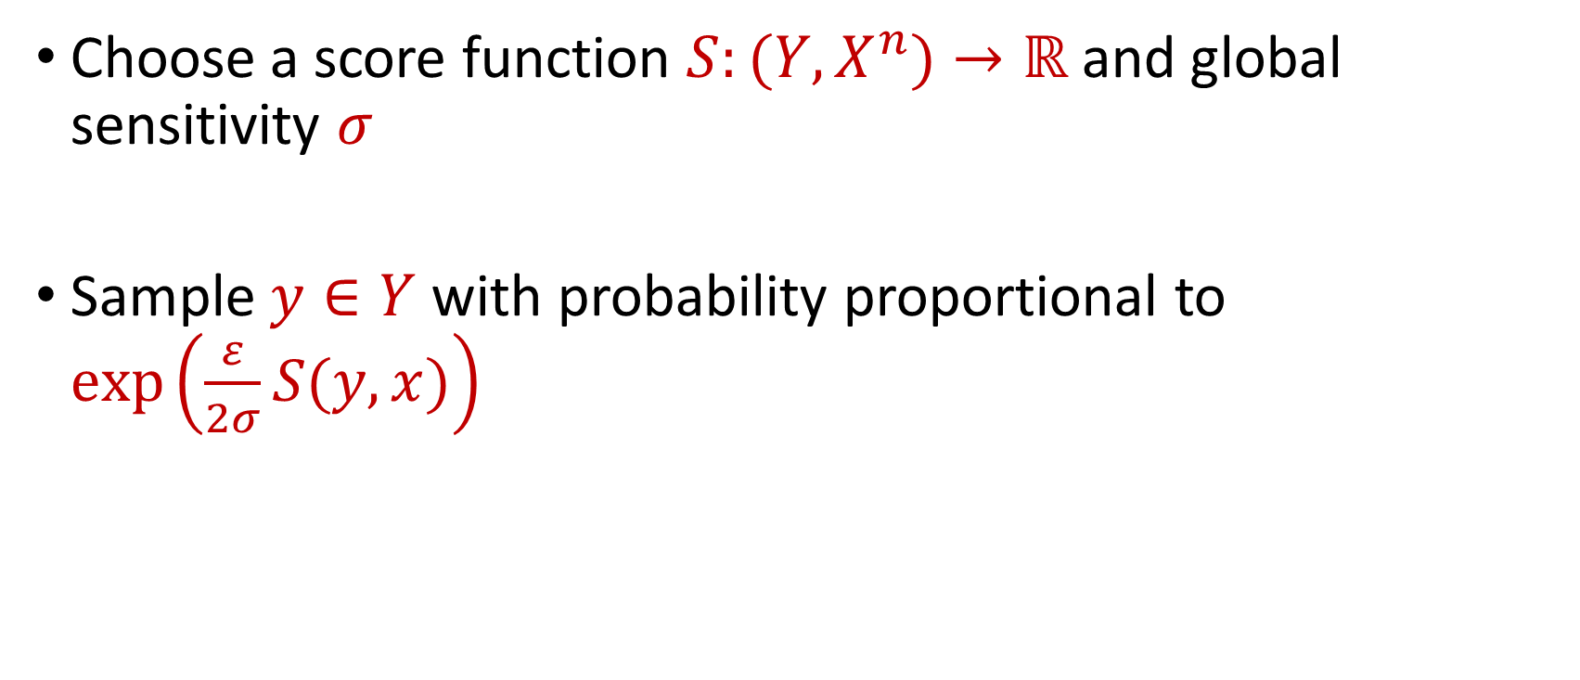
Exponential Mechanism
Choose a score function $S:(Y,X^{n})→ℝ$ and global sensitivity $σ$
Sample $y∈Y$ with probability proportional to $\exp\left(\frac{ε}{2σ}S(y,x)\right)$
Notes:
[DworkMcSherryNissimSmith06]

Slide 19
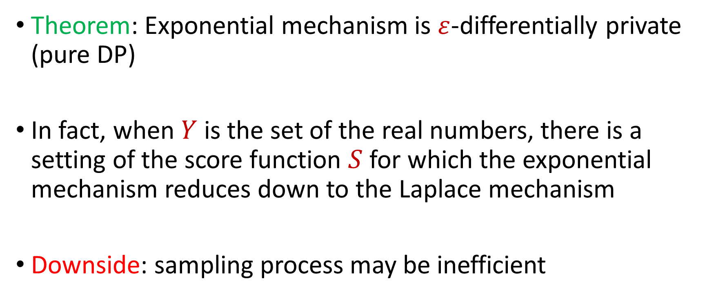
Exponential Mechanism
Theorem: Exponential mechanism is $ε$-differentially private (pure DP)
In fact, when $Y$ is the set of the real numbers, there is a setting of the score function $S$ for which the exponential mechanism reduces down to the Laplace mechanism
Downside: sampling process may be inefficient
Notes:
[DworkMcSherryNissimSmith06]

